Slide 1
The Covenants
What Noah, Abraham, and the Israelites had in Common

Slide 2
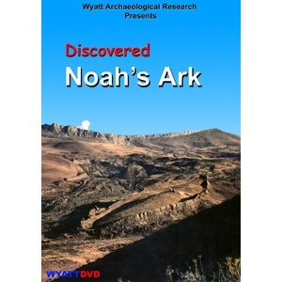
Noah
“And I, behold, I establish my covenant with you, and with your seed after you; And with every living creature that is with you, of the fowl, of the cattle, and of every beast of the earth with you; from all that go out of the ark, to every beast of the earth. And I will establish my covenant with you; neither shall all flesh be cut off any more by the waters of a flood; neither shall there any more be a flood to destroy the earth. And God said, This is the token of the covenant which I make between me and you and every living creature that is with you, for perpetual generations: I do set my bow in the cloud, and it shall be for a token of a covenant between me and the earth.” Genesis 9:10-13

Slide 3
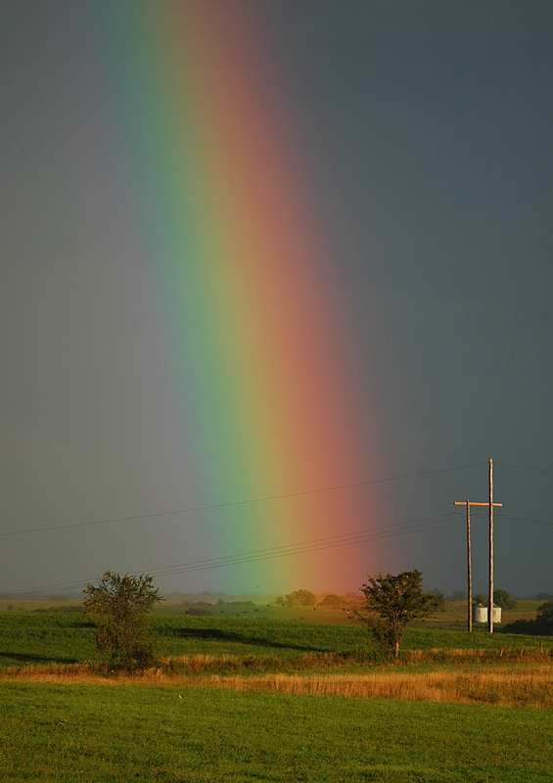
The Outward Sign
“I do set my bow in the cloud, and it shall be for a token of a covenant between me and the earth. And it shall come to pass, when I bring a cloud over the earth, that the bow shall be seen in the cloud: And I will remember my covenant, which is between me and you and every living creature of all flesh; and the waters shall no more become a flood to destroy all flesh. And the bow shall be in the cloud; and I will look upon it, that I may remember the everlasting covenant between God and every living creature of all flesh that is upon the earth.’ Genesis 9:13-16

Slide 4
What were the Terms?
“By faith Noah, being warned of God of things not seen as yet, moved with fear, prepared an ark to the saving of his house; by the which he condemned the world, and became heir of the righteousness which is by faith.” Hebrews 11:7
“It was through Noah's consistent faith and works combined that condemned the world. He not only preached the present truth appropriate for that time, but he acted every sermon. Had he never lifted his voice in warning, his works, his holy character among the corrupt and ungodly would have been condemning sermons to the unbelieving and dissolute of that age. He bore himself with a Christ like patience and meekness under the provoking insults, taunts, and mockery. His voice was often heard in prayer to God for His power and help that he might do all the commandments of God. This was a condemning power to the unbelieving. “ This Day with God, pg. 235

Slide 5
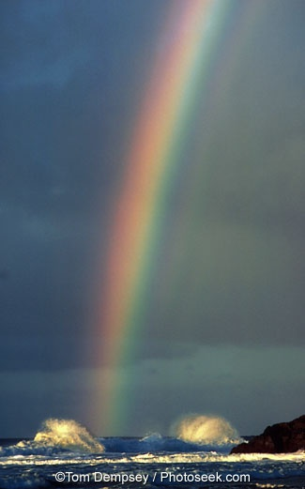
My Covenant
Noah was saved through faith in Jesus Christ. The terms of the covenant were to exalt the ten commandments through faith. Righteousness, in the Bible, is found in the commandments. “My tongue shall speak of thy word: for all thy commandments are righteousness.” Psalm 119:172 The ten commandments can only be obeyed through faith in Jesus Christ. Noah trusted God’s promise to do exactly what it said; namely, to enable Noah to follow God’s commands ,which in himself, he could never do.

Slide 6
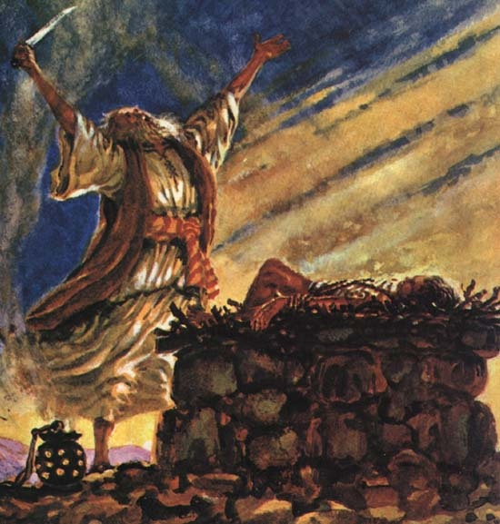
The Covenant with Abraham
“As for me, behold, my covenant is with thee, and thou shalt be a father of many nations. Neither shall thy name any more be called Abram, but thy name shall be Abraham; for a father of many nations have I made thee. And I will make thee exceeding fruitful, and I will make nations of thee, and kings shall come out of thee. And I will establish my covenant between me and thee and thy seed after thee in their generations for an everlasting covenant, to be a God unto thee, and to thy seed after thee. And I will give unto thee, and to thy seed after thee, the land wherein thou art a stranger, all the land of Canaan, for an everlasting possession; and I will be their God. And God said unto Abraham, Thou shalt keep my covenant therefore, thou, and thy seed after thee in their generations.” Genesis 17:4-9

Slide 7
The Outward Sign
“This is my covenant, which ye shall keep, between me and you and thy seed after thee; Every man child among you shall be circumcised.
And ye shall circumcise the flesh of your foreskin; and it shall be a token of the covenant betwixt me and you.” Genesis 17:10,11
“Cometh this blessedness then upon the circumcision only, or upon the uncircumcision also? for we say that faith was reckoned to Abraham for righteousness. How was it then reckoned? when he was in circumcision, or in uncircumcision? Not in circumcision, but in uncircumcision. And he received the sign of circumcision, a seal of the righteousness of the faith which he had yet being uncircumcised: that he might be the father of all them that believe, though they be not circumcised; that righteousness might be imputed unto them also:” Romans 4:9-11

Slide 8
Circumcision
“And the LORD thy God will circumcise thine heart, and the heart of thy seed, to love the LORD thy God with all thine heart, and with all thy soul, that thou mayest live.” Deuteronomy 30:6
Circumcision, like the rainbow, were both outward signs that God would fulfill His promise and give His children victory and deliverance. They showed the impotence of man to do anything, but that God would do exactly what He said to aid His helpless children.

Slide 9
Righteousness Comes by Faith
“For circumcision verily profiteth, if thou keep the law: but if thou be a breaker of the law, thy circumcision is made uncircumcision.
Therefore if the uncircumcision keep the righteousness of the law, shall not his uncircumcision be counted for circumcision? And shall not uncircumcision which is by nature, if it fulfill the law, judge thee, who by the letter and circumcision dost transgress the law? For he is not a Jew, which is one outwardly; neither is that circumcision, which is outward in the flesh: But he is a Jew, which is one inwardly; and circumcision is that of the heart, in the spirit, and not in the letter; whose praise is not of men, but of God.” Romans 2:25-29
Both the covenant to Noah and that to Abraham maintained the perpetuity and eternal nature of the 10 Commandments. Both covenants made with them were called ‘My Covenant’. Both covenants revealed man’s utter inability to do anything in their own flesh, but that God would enable man to do that which he could not. Both covenants declared that obedience to God comes through faith in Jesus Christ alone. Amazingly, the covenant that God made at Mt. Sinai was just like the first two. However, the covenant made at Mt Sinai is called the old covenant and the one made to Abraham the new covenant. What is the difference between the two? What are the similarities?

Slide 10
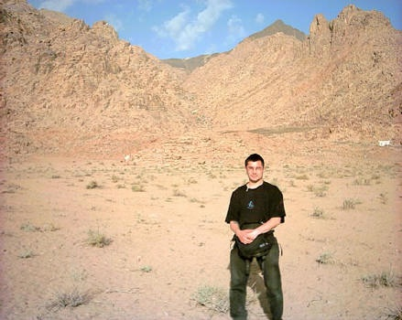
The Covenant at Mt. Sinai
“Ye have seen what I did unto the Egyptians, and how I bare you on eagles' wings, and brought you unto myself. Now therefore, if ye will obey my voice indeed, and keep my covenant, then ye shall be a peculiar treasure unto me above all people: for all the earth is mine: And ye shall be unto me a kingdom of priests, and an holy nation. These are the words which thou shalt speak unto the children of Israel.” Exodus 19:4-6

Slide 11
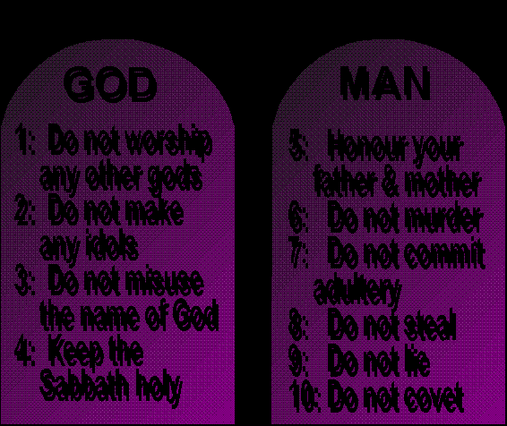
All the Same
The covenant that God made with Noah, Abraham, and the children of Israel was the same. It was called ‘My Covenant’ in every instance. In every case, the covenant was built on the agreement that obedience comes by faith in Jesus Christ. In every case, the basis for the agreement was the ten commandments.

Slide 12
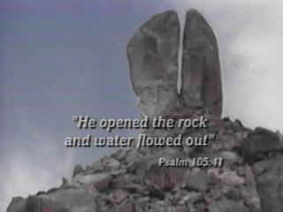
My Covenant at Sinai
God revealed to His children their weakness that they might find strength in Him to follow His commandments. He revealed His incredible power to keep them and provide for them, but they failed to grasp the lessons.

Slide 13
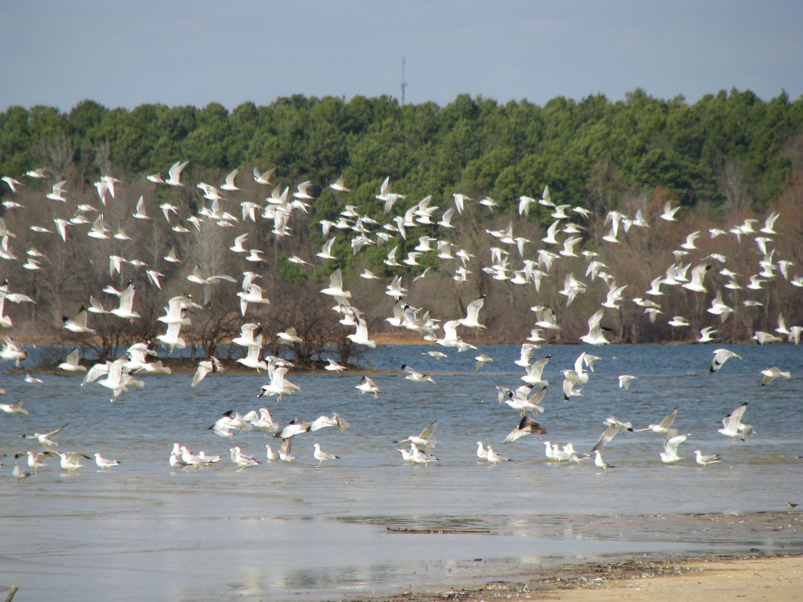
The Outward Sign
“And the LORD spake unto Moses, saying, Speak thou also unto the children of Israel, saying, Verily my sabbaths ye shall keep: for it is a sign between me and you throughout your generations; that ye may know that I am the LORD that doth sanctify you. Ye shall keep the sabbath therefore; for it is holy unto you: every one that defileth it shall surely be put to death: for whosoever doeth any work therein, that soul shall be cut off from among his people. Six days may work be done; but in the seventh is the sabbath of rest, holy to the LORD: whosoever doeth any work in the sabbath day, he shall surely be put to death.” Exodus 31:12-15

Slide 14
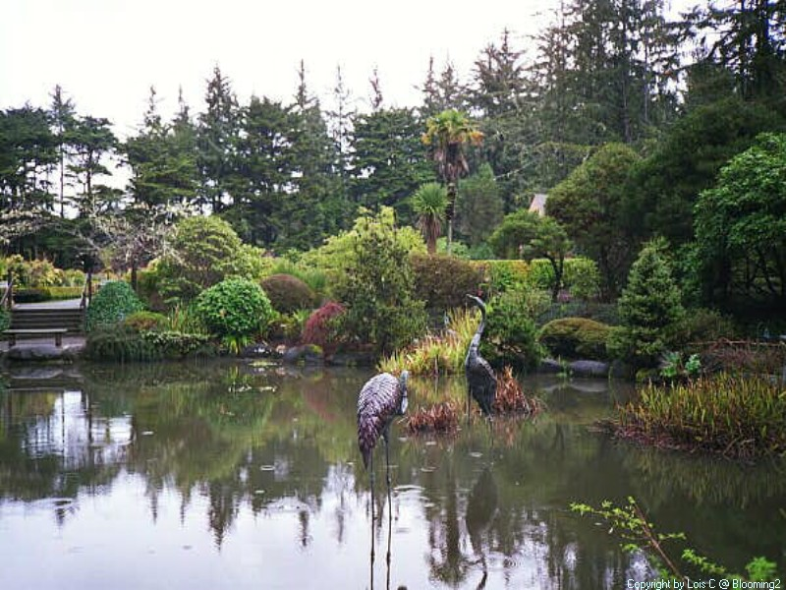
The Sabbath
The Sabbath, like the rainbow and circumcision before it, was the sign of the covenant. It was representative of the truth that righteousness comes by faith. It has been misunderstood as circumcision was by the Jews. It is the absolute antithesis of works righteousness.

Slide 15
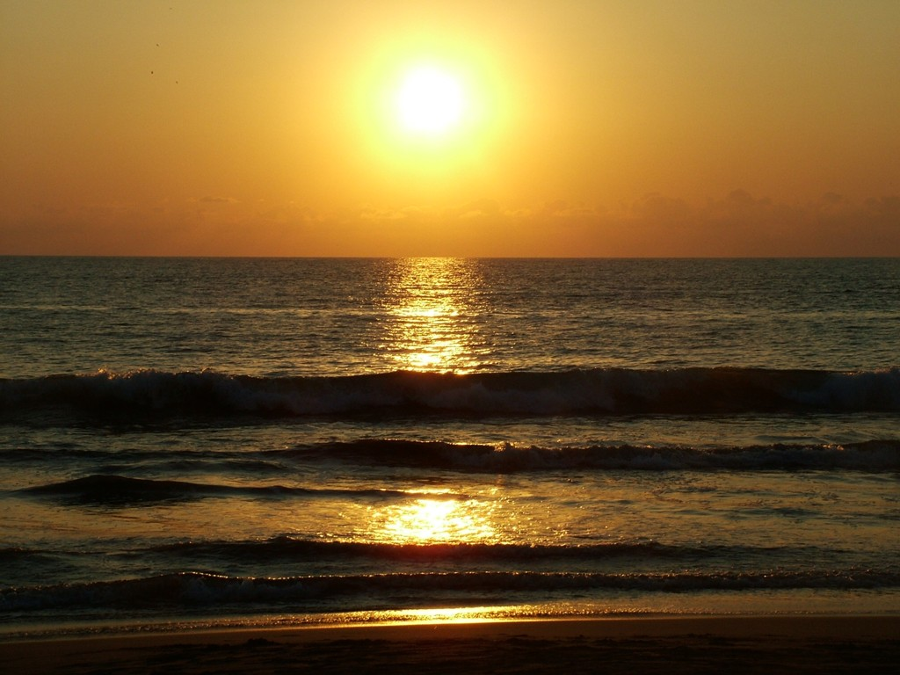
Creative Power
“As the Jews departed from God, and failed to make the righteousness of Christ their own by faith, the Sabbath lost its significance to them. Satan was seeking to exalt himself and to draw men away from Christ, and he worked to pervert the Sabbath, because it is the sign of the power of Christ.” DA, 283,284

Slide 16
Sabbath in Creation-Redemption
“Since He made all things, He made the Sabbath. By Him it was set apart as a memorial of the work of creation. It points to Him as both the Creator and the Sanctifier. It declares that He who created all things in heaven and in earth, and by whom all things hold together, is the head of the church, and that by His power we are reconciled to God. For, speaking of Israel, He said, "I gave them My Sabbaths, to be a sign between Me and them, that they might know that I am the Lord that sanctify them,"--make them holy. Ezek. 20:12. Then the Sabbath is a sign of Christ's power to make us holy. And it is given to all whom Christ makes holy. As a sign of His sanctifying power, the Sabbath is given to all who through Christ become a part of the Israel of God.
And the Lord says, "If thou turn away thy foot from the Sabbath, from doing thy pleasure on My holy day; and call the Sabbath a delight, the holy of the Lord, honorable; . . . then shalt thou delight thyself in the Lord." Isa. 58:13, 14. To all who receive the Sabbath as a sign of Christ's creative and redeeming power, it will be a delight. Seeing Christ in it, they delight themselves in Him. The Sabbath points them to the works of creation as an evidence of His mighty power in redemption. While it calls to mind the lost peace of Eden, it tells of peace restored through the Saviour. And every object in nature repeats His invitation, "Come unto Me, all ye that labor and are heavy-laden, and I will give you rest." Matt 11:28. DA , 288,289

Slide 17
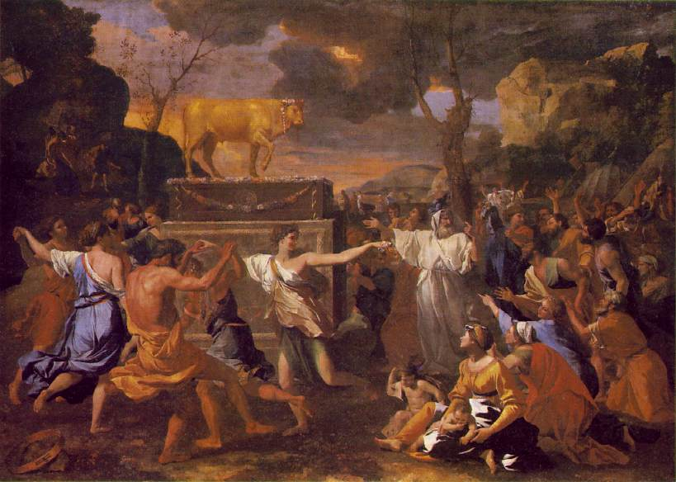
The people respond
“And all the people answered together, and said, All that the LORD hath spoken we will do. And Moses returned the words of the people unto the LORD.” Exodus 19:8
“And Moses came and told the people all the words of the LORD, and all the judgments: and all the people answered with one voice, and said, All the words which the LORD hath said will we do.” Exodus 24:3
The Israelites declared an impossibility; they could never keep God’s commands by themselves.

Slide 18
Trying Again
With the many similarities in the covenants comes something very different. While Noah and Abraham understood that the covenant was built on faith in Christ’s righteousness, the children of Israel failed to grasp this idea. They established a covenant of works in their own strength. This was completely contrary to God’s plan.
“Brethren, my heart's desire and prayer to God for Israel is, that they might be saved. For I bear them record that they have a zeal of God, but not according to knowledge. For they being ignorant of God's righteousness, and going about to establish their own righteousness, have not submitted themselves unto the righteousness of God. For Christ is the end of the law for righteousness to every one that believeth. “ Romans 10:1-4

Slide 19
What Made Mt. Sinai wrong?
“Behold, the days come, saith the LORD, that I will make a new covenant with the house of Israel, and with the house of Judah: Not according to the covenant that I made with their fathers in the day that I took them by the hand to bring them out of the land of Egypt; which my covenant they brake, although I was an husband unto them, saith the LORD: But this shall be the covenant that I will make with the house of Israel; After those days, saith the LORD, I will put my law in their inward parts, and write it in their hearts; and will be their God, and they shall be my people.” Jeremiah 31:31-34
“For if that first covenant had been faultless, then should no place have been sought for the second. For finding fault with them, he saith, Behold, the days come, saith the Lord, when I will make a new covenant with the house of Israel and with the house of Judah:
Not according to the covenant that I made with their fathers in the day when I took them by the hand to lead them out of the land of Egypt; because they continued not in my covenant, and I regarded them not, saith the Lord. For this is the covenant that I will make with the house of Israel after those days, saith the Lord; I will put my laws into their mind, and write them in their hearts: and I will be to them a God, and they shall be to me a people” Hebrews 8:7-10

Slide 20
Sarah and Hagar
“Tell me, ye that desire to be under the law, do ye not hear the law? For it is written, that Abraham had two sons, the one by a bondmaid, the other by a freewoman. But he who was of the bondwoman was born after the flesh; but he of the freewoman was by promise. Which things are an allegory: for these are the two covenants; the one from the mount Sinai, which gendereth to bondage, which is Agar. For this Agar is mount Sinai in Arabia, and answereth to Jerusalem which now is, and is in bondage with her children. But Jerusalem which is above is free, which is the mother of us all.” Galatians 4:21-26

Slide 21
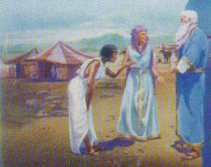
Righteousness by faith/works
Sarah and her son, Isaac represented the experience that only through faith in Jesus Christ can God’s law be kept. Hagar represented Israel’s pitiful attempt to keep God’s law by their own works which was impossible. These are the two covenants. Which one are we under today?

Slide 22
Why did the Law have to be spelled out in stone?
“And this I say, that the covenant, that was confirmed before of God in Christ, the law, which was four hundred and thirty years after, cannot disannul, that it should make the promise of none effect.
For if the inheritance be of the law, it is no more of promise: but God gave it to Abraham by promise. Wherefore then serveth the law? It was added because of transgressions, till the seed should come to whom the promise was made;” Galatians 3:17-19
“If man had kept the law of God, as given to Adam after his fall, preserved by Noah, and observed by Abraham, there would have been no necessity for the ordinance of circumcision. And if the descendants of Abraham had kept the covenant, of which circumcision was a sign, they would never have been seduced into idolatry, nor would it have been necessary for them to suffer a life of bondage in Egypt; they would have kept God's law in mind, and there would have been no necessity for it to be proclaimed from Sinai or engraved upon the tables of stone. And had the people practiced the principles of the Ten Commandments, there would have been no need of the additional directions given to Moses.
The sacrificial system, committed to Adam, was also perverted by his descendants. Superstition, idolatry, cruelty, and licentiousness corrupted the simple and significant service that God had appointed. Through long intercourse with idolaters the people of Israel had mingled many heathen customs with their worship; therefore the Lord gave them at Sinai definite instruction concerning the sacrificial service.” PP,

Slide 23
All Things Through Christ
“But if the Abrahamic covenant contained the promise of redemption, why was another covenant formed at Sinai? In their bondage the people had to a great extent lost the knowledge of God and of the principles of the Abrahamic covenant. In delivering them from Egypt, God sought to reveal to them His power and His mercy, that they might be led to love and trust Him. He brought them down to the Red Sea--where, pursued by the Egyptians, escape seemed impossible--that they might realize their utter helplessness, their need of divine aid; and then He wrought deliverance for them. Thus they were filled with love and gratitude to God and with confidence in His power to help them. He had bound them to Himself as their deliverer from temporal bondage. But there was a still greater truth to be impressed upon their minds. Living in the midst of idolatry and corruption, they had no true conception of the holiness of God, of the exceeding sinfulness of their own hearts, their utter inability, in themselves, to render obedience to God's law, and their need of a Saviour. All this they must be taught. God brought them to Sinai; He manifested His glory; He gave them His law, with the promise of great blessings on condition of obedience: "If ye will obey My voice indeed, and keep My covenant, then . . . ye shall be unto Me a kingdom of priests, and an holy nation." Exodus 19:5, 6. The people did not realize the sinfulness of their own hearts, and that without Christ it was impossible for them to keep God's law; and they readily entered into covenant with God. Feeling that they were able to establish their own righteousness, they declared, "All that the Lord hath said will we do, and be obedient." Exodus 24:7. They had witnessed the proclamation of the law in awful majesty, and had trembled with terror before the mount; and yet only a few weeks passed before they broke their covenant with God, and bowed down to worship a graven image. They could not hope for the favor of God through a covenant which they had broken; and now, seeing their sinfulness and their need of pardon, they were brought to feel their need of the Saviour revealed in the Abrahamic covenant and shadowed forth in the sacrificial offerings. Now by faith and love they were bound to God as their deliverer from the bondage of sin. Now they were prepared to appreciate the blessings of the new covenant.” PP, 371,372

Slide 24
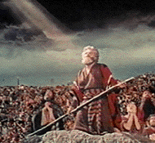
Moses and the Vail
Moses’ face shown with brightness that reflected the glory of Christ in the law. The Israelites could not see Christ, so Moses had to cover his face. “But their minds were blinded: for until this day remaineth the same vail untaken away in the reading of the old testament; which vail is done away in Christ.” 2 Corinthians 3:14

Slide 25
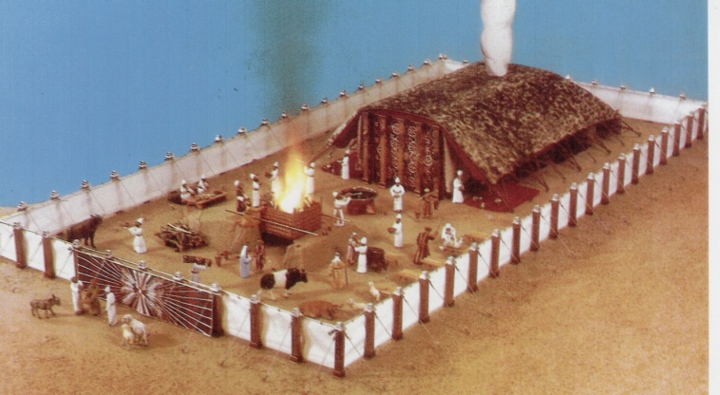
The Rest of the Story
“Then verily the first covenant had also ordinances of divine service, and a worldly sanctuary. For there was a tabernacle made; the first, wherein was the candlestick, and the table, and the shewbread; which is called the sanctuary. And after the second veil, the tabernacle which is called the Holiest of all; Which had the golden censer, and the ark of the covenant overlaid round about with gold, wherein was the golden pot that had manna, and Aaron's rod that budded, and the tables of the covenant; And over it the cherubims of glory shadowing the mercy seat; of which we cannot now speak particularly. Now when these things were thus ordained, the priests went always into the first tabernacle, accomplishing the service of God.” Hebrews 9:1-6

Slide 26
Temple, Priests, and Sacrifices
The covenant at Sinai was faulty because of the people’s attempts to keep the law by themselves. The glorious system of ceremonies that were laid out at Sinai were beautiful in their illustration of the story of redemption. Christ was the sacrificial offering, the priest, and everything in the temple revealed the glories of His redeeming power. When Christ died for our sins, this system of ceremonies was no longer necessary because the substance/antitype had come. Because the Jews rejected Christ, they failed to understand the end of these ceremonies and the glorious works of Christ in the heavenly sanctuary. Throughout the New Testament, Paul tried to show this to them.

