Slide 1
Jesus Life, pt. 14 ‘Jesus ‘Broke’ the Sabbath’

Slide 2
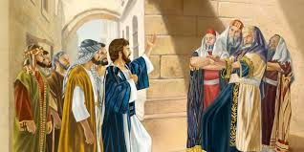
The Creator Broke the Sabbath!?!
In the creation, Jesus made the Sabbath. He was the creator of this day of rest. And yet, He was accused of breaking the Sabbath day. There is something very skewed about this. That is impossible! Clearly, the people that accused Him were so far off their rocker! How the mighty had fallen!

Slide 3
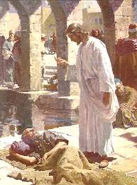
“And a certain man was there, which had an infirmity thirty and eight years. When Jesus saw him lie, and knew that he had been now a long time in that case, he saith unto him, Wilt thou be made whole? The impotent man answered him, Sir, I have no man, when the water is troubled, to put me into the pool: but while I am coming, another steppeth down before me. Jesus saith unto him, Rise, take up thy bed, and walk. And immediately the man was made whole, and took up his bed, and walked: and on the same day was the sabbath.” John 5:5-9

Slide 4
Tenderness and Compassion
“But the Savior saw one case of supreme wretchedness. It was that of a man who had been a helpless cripple for thirty-eight years. His disease was in a great degree the result of his own sin, and was looked upon as a judgment from God. Alone and friendless, feeling that he was shut out from God's mercy, the sufferer had passed long years of misery. At the time when it was expected that the waters would be troubled, those who pitied his helplessness would bear him to the porches. But at the favored moment he had no one to help him in. He had seen the rippling of the water, but had never been able to get farther than the edge of the pool. Others stronger than he would plunge in before him. He could not contend successfully with the selfish, scrambling crowd. His persistent efforts toward the one object, and his anxiety and continual disappointment, were fast wearing away the remnant of his strength.
The sick man was lying on his mat, and occasionally lifting his head to gaze at the pool, when a tender, compassionate face bent over him, and the words, “Wilt thou be made whole?” arrested his attention. Hope came to his heart.” DA, pg. 202

Slide 5
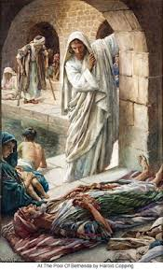
“Jesus does not ask this sufferer to exercise faith in Him. He simply says, “Rise, take up thy bed, and walk.” But the man's faith takes hold upon that word. Every nerve and muscle thrills with new life, and healthful action comes to his crippled limbs. Without question he sets his will to obey the command of Christ, and all his muscles respond to his will. Springing to his feet, he finds himself an active man. Jesus had given him no assurance of divine help. The man might have stopped to doubt, and lost his one chance of healing. But he believed Christ's word, and in acting upon it he received strength.” DA, pg. 203

Slide 6
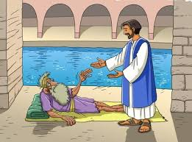
Praise the Lord!
“Through the same faith we may receive spiritual healing. By sin we have been severed from the life of God. Our souls are palsied. Of ourselves we are no more capable of living a holy life than was the impotent man capable of walking. There are many who realize their helplessness, and who long for that spiritual life which will bring them into harmony with God; they are vainly striving to obtain it. In despair they cry, “O wretched man that I am! who shall deliver me from this body of death?” Romans 7:24, margin. Let these desponding, struggling ones look up. The Savior is bending over the purchase of His blood, saying with inexpressible tenderness and pity, “Wilt thou be made whole?” He bids you arise in health and peace.” DA, pg. 203

Slide 7
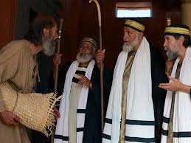
“The Jews therefore said unto him that was cured, It is the sabbath day: it is not lawful for thee to carry thy bed. He answered them, He that made me whole, the same said unto me, Take up thy bed, and walk. Then asked they him, What man is that which said unto thee, Take up thy bed, and walk? And he that was healed wist not who it was: for Jesus had conveyed himself away, a multitude being in that place. Afterward Jesus findeth him in the temple, and said unto him, Behold, thou art made whole: sin no more, lest a worse thing come unto thee. The man departed, and told the Jews that it was Jesus, which had made him whole. And therefore did the Jews persecute Jesus, and sought to slay him, because he had done these things on the sabbath day.” John 5:10-16

Slide 8
Healing and Sabbath Go Together
“He had come to free the Sabbath from those burdensome requirements that had made it a curse instead of a blessing. For this reason He had chosen the Sabbath upon which to perform the act of healing at Bethesda. He could have healed the sick man as well on any other day of the week; or He might simply have cured him, without bidding him bear away his bed. But this would not have given Him the opportunity He desired. A wise purpose underlay every act of Christ's life on earth. Everything He did was important in itself and in its teaching. Among the afflicted ones at the pool He selected the worst case upon whom to exercise His healing power, and bade the man carry his bed through the city in order to publish the great work that had been wrought upon him. This would raise the question of what it was lawful to do on the Sabbath, and would open the way for Him to denounce the restrictions of the Jews in regard to the Lord's day, and to declare their traditions void. Jesus stated to them that the work of relieving the afflicted was in harmony with the Sabbath law. It was in harmony with the work of God's angels, who are ever descending and ascending between heaven and earth to minister to suffering humanity.” DA, pg. 206

Slide 9
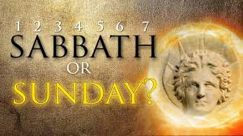
There is a Reason!
Everything Jesus did served a purpose. He could have healed the paralytic on any other day, but chose the Sabbath because He wanted to provoke controversy in regard to what was good and what was not good to do on the Sabbath. And Jesus, is about to do it again!

Slide 10
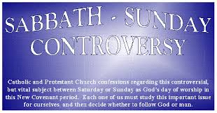
“Saying with a loud voice, Fear God, and give glory to him; for the hour of his judgment is come: and worship him that made heaven, and earth, and the sea, and the fountains of waters. And there followed another angel, saying, Babylon is fallen, is fallen, that great city, because she made all nations drink of the wine of the wrath of her fornication. And the third angel followed them, saying with a loud voice, If any man worship the beast and his image, and receive his mark in his forehead, or in his hand,” Rev. 14:7-9

Slide 11
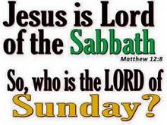
True and False Worship
“But in vain they do worship me, teaching for doctrines the commandments of men.” Matthew 15:9
False worship is honoring a man made tradition and true worship is honoring the commandments of God. The Sabbath is a sign of trusting in Jesus to save us from our sins. (Ezekiel 20:12)
Sunday is a sign that I am going to save myself in my sins.
It will be a simple choice with eternal consequences!

Slide 12
Jewish/Adventist Leaders Doing Devil’s Bidding!
“But the plans which these rabbis were working so zealously to fulfill originated in another council than that of the Sanhedrin. After Satan had failed to overcome Christ in the wilderness, he combined his forces to oppose Him in His ministry, and if possible to thwart His work. What he could not accomplish by direct, personal effort, he determined to effect by strategy. No sooner had he withdrawn from the conflict in the wilderness than in council with his confederate angels he matured his plans for still further blinding the minds of the Jewish people, that they might not recognize their Redeemer. He planned to work through his human agencies in the religious world, by imbuing them with his own enmity against the champion of truth. He would lead them to reject Christ and to make His life as bitter as possible, hoping to discourage Him in His mission. And the leaders in Israel became instruments of Satan in warring against the Saviour.” DA, pg. 205

Slide 13
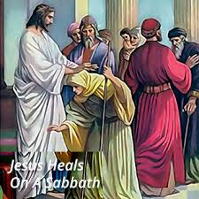
“But Jesus answered them, My Father worketh hitherto, and I work. Therefore the Jews sought the more to kill him, because he not only had broken the sabbath, but said also that God was his Father, making himself equal with God. Then answered Jesus and said unto them, Verily, verily, I say unto you, The Son can do nothing of himself, but what he seeth the Father do: for what things soever he doeth, these also doeth the Son likewise.” John 5:17-19

Slide 14

The Early Adventists had so encumbered the seventh day Sabbath with their own traditions that Jesus felt compelled to explain what was right to do on the Sabbath and what was not. Clearly, doing acts of mercy was well within the boundaries of the Sabbath! The Adventists were ready to kill Him for giving life on the Sabbath. Jesus said that His Father did the same thing. If God didn’t preserve life on the Sabbath, then everything would die away!

Slide 15

Doing Deeds of Mercy
Sharing the truth with others, placing truth within the reach of humanity is well within the Sabbath! Doing deeds of mercy, helping the sick are also well within the Sabbath and what it means. The idea that the Sabbath is a day to sleep or to do nothing is outside of how Jesus kept it.

Slide 16
Perverts!
“The Jews had so perverted the law that they made it a yoke of bondage. Their meaningless requirements had become a byword among other nations. Especially was the Sabbath hedged in by all manner of senseless restrictions. It was not to them a delight, the holy of the Lord, and honorable. The scribes and Pharisees had made its observance an intolerable burden. A Jew was not allowed to kindle a fire nor even to light a candle on the Sabbath. As a consequence the people were dependent upon the Gentiles for many services which their rules forbade them to do for themselves. They did not reflect that if these acts were sinful, those who employed others to perform them were as guilty as if they had done the work themselves. They thought that salvation was restricted to the Jews, and that the condition of all others, being already hopeless, could be made no worse. But God has given no commandments which cannot be obeyed by all. His laws sanction no unreasonable or selfish restrictions.” DA, pg. 204

Slide 17
The Father and the Son are at fault??????
“Jesus stated to them that the work of relieving the afflicted was in harmony with the Sabbath law. It was in harmony with the work of God's angels, who are ever descending and ascending between heaven and earth to minister to suffering humanity. Jesus declared, “My Father worketh hitherto, and I work.” All days are God's, in which to carry out His plans for the human race. If the Jews’ interpretation of the law was correct, then Jehovah was at fault, whose work has quickened and upheld every living thing since first He laid the foundations of the earth; then He who pronounced His work good, and instituted the Sabbath to commemorate its completion, must put a period to His labor, and stop the never-ending routine of the universe.” DA, pg. 206

