Slide 1
Romans, pt. 16
No Fear

Slide 2
Review of Romans 8:1-14
1. Christ took upon Himself our sinful flesh, lived a life of perfect obedience, so that He could do the same for us in our sinful flesh.
2. When we walk after our flesh, we are apart from Christ.
3. Naturally, we are at war with God.
4. The Holy Spirit can help us overcome the flesh.
5. The same Spirit that overcomes sin in our flesh will raise us from the dead.

Slide 3
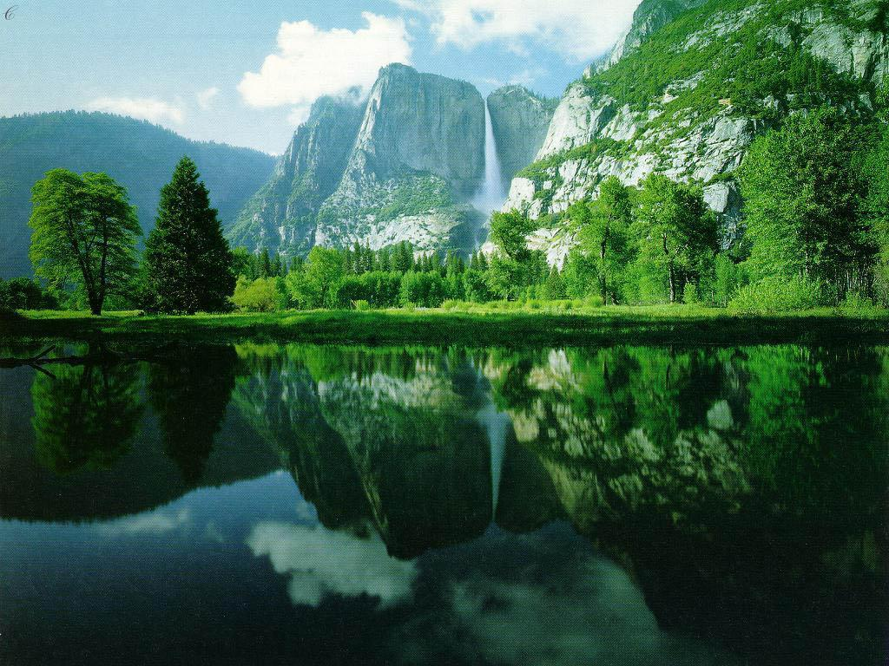
No Fear
“For ye have not received the spirit of bondage again to fear; but ye have received the Spirit of adoption, whereby we cry, Abba, Father. The Spirit itself beareth witness with our spirit, that we are the children of God: And if children, then heirs; heirs of God, and joint-heirs with Christ; if so be that we suffer with him, that we may be also glorified together. For I reckon that the sufferings of this present time are not worthy to be compared with the glory which shall be revealed in us. For the earnest expectation of the creature waiteth for the manifestation of the sons of God.” Romans 8:15-19

Slide 4
Children of God
Since the Holy Spirit is at work in our lives, and He overcomes all, then, we too, overcome all as well. Since nothing binds Him, including death, then nothing binds us, even death.
We not only are free from fear of anything, we are sure of our inheritance. This includes heaven and God Himself. The purpose for our creation is restored; we are one with God!
“For God hath not given us the spirit of fear; but of power, and of love, and of a sound mind.” 2 Timothy 1:7
“And he laid his right hand upon me, saying unto me, Fear not; I am the first and the last: I am he that liveth, and was dead; and, behold, I am alive for evermore, Amen; and have the keys of hell and of death.” Revelation 1:18,19

Slide 5
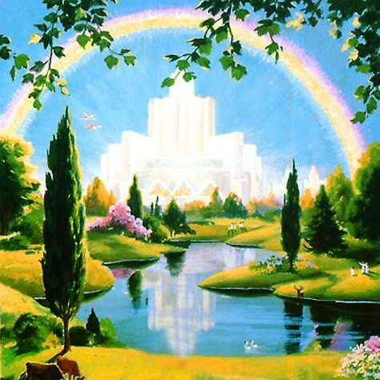
Heirs to the Kingdom
The sufferings in the now can’t compare with the treasures that are ours as we learn of God and all He is to us!
“He came unto his own, and his own received him not. But as many as received him, to them gave he power to become the sons of God, even to them that believe on his name: Which were born, not of blood, nor of the will of the flesh, nor of the will of man, but of God.” John 1:11-13
Heaven begins with Christ NOW!

Slide 6
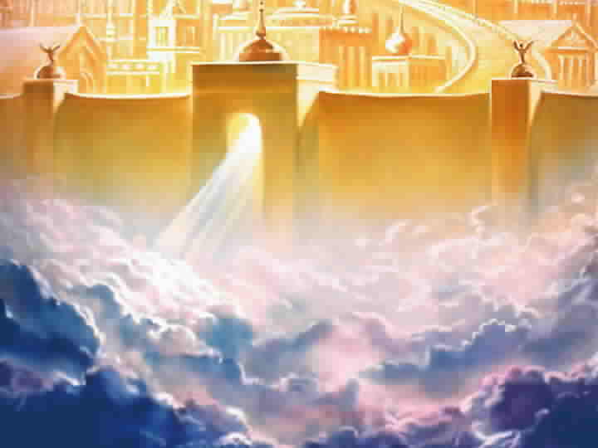
Deliverance from Bondage
“For the creature was made subject to vanity, not willingly, but by reason of him who hath subjected the same in hope, Because the creature itself also shall be delivered from the bondage of corruption into the glorious liberty of the children of God. For we know that the whole creation groaneth and travaileth in pain together until now. And not only they, but ourselves also, which have the firstfruits of the Spirit, even we ourselves groan within ourselves, waiting for the adoption, to wit, the redemption of our body. For we are saved by hope: but hope that is seen is not hope: for what a man seeth, why doth he yet hope for?” Romans 8:20-24

Slide 7
Absent from the Body
The fact that the Holy Spirit can bring deliverance from evil is awesome. While this can be a reality, we still grieve because we remain in this mortal, carnal body. However, we wait patiently for the giving of an immortal body at the return of Christ.
“For we that are in this tabernacle do groan, being burdened: not for that we would be unclothed, but clothed upon, that mortality might be swallowed up of life. Now he that hath wrought us for the selfsame thing is God, who also hath given unto us the earnest of the Spirit. Therefore we are always confident, knowing that, whilst we are at home in the body, we are absent from the Lord: (For we walk by faith, not by sight:) We are confident, I say, and willing rather to be absent from the body, and to be present with the Lord. Wherefore we labour, that, whether present or absent, we may be accepted of him.” 2Corinthians 5:4-9

Slide 8

Spirit and power
“The Spirit was to be given as a regenerating agent, and without this the sacrifice of Christ would have been of no avail. The power of evil had been strengthening for centuries, and the submission of men to this satanic captivity was amazing. Sin could be resisted and overcome only through the mighty agency of the Third Person of the Godhead, who would come with no modified energy, but in the fullness of divine power. It is the Spirit that makes effectual what has been wrought out by the world's Redeemer. It is by the Spirit that the heart is made pure. Through the Spirit the believer becomes a partaker of the divine nature. Christ has given His Spirit as a divine power to overcome all hereditary and cultivated tendencies to evil, and to impress His own character upon His church.” DA, pg. 671

Slide 9
Hope Today
“By His perfect obedience He has made it possible for every human being to obey God's commandments. When we submit ourselves to Christ, the heart is united with His heart, the will is merged in His will, the mind becomes one with His mind, the thoughts are brought into captivity to Him; we live His life. This is what it means to be clothed with the garment of His righteousness. Then as the Lord looks upon us He sees, not the fig-leaf garment, not the nakedness and deformity of sin, but His own robe of righteousness, which is perfect obedience to the law of Jehovah.” COL, pg. 312
One day very soon hope too will be swallowed up. Hope is the assurance of something we do not have, but know that we will one day possess it.
“Now faith is the substance of things hoped for, the evidence of things not seen.” Hebrews 11:1
The Holy Spirit assures us of future glory and eternity by His presence with us now to fight against sin.

Slide 10
Our Intercessor
“By so much was Jesus made a surety of a better testament.
And they truly were many priests, because they were not suffered to continue by reason of death: But this man, because he continueth ever, hath an unchangeable priesthood. Wherefore he is able also to save them to the uttermost that come unto God by him, seeing he ever liveth to make intercession for them. For such an high priest became us, who is holy, harmless, undefiled, separate from sinners, and made higher than the heavens;” Hebrews 7:22-26
“Likewise the Spirit also helpeth our infirmities: for we know not what we should pray for as we ought: but the Spirit itself maketh intercession for us with groanings which cannot be uttered. And he that searcheth the hearts knoweth what is the mind of the Spirit, because he maketh intercession for the saints according to the will of God. And we know that all things work together for good to them that love God, to them who are the called according to his purpose.” Romans 8:26-28

Slide 11
All Things
All things work together for good for everyone no matter who they are. The verse doesn’t say that, does it? Everything works together for good for those who are trusting Christ. If we aren’t trusting Christ and following our own perverse will, then the devil is allowed to bring havoc, tragedy and destruction.
If we are trusting Christ, then no matter what comes our way, we know that, even if it looks terrible, if we continue to trust, then everything will work out for our best.
‘Our best’ doesn’t mean it will work out for our best as far as worldly advancement is concerned, but it does mean that in the midst of difficulty, we will have the sweetest peace and confidence that Heaven is taking care of us.

Slide 12

Perfect in Time
“He hath made every thing beautiful in his time:” Eccl. 3:11
“But like the stars in the vast circuit of their appointed path, God's purposes know no haste and no delay. Through the symbols of the great darkness and the smoking furnace, God had revealed to Abraham the bondage of Israel in Egypt, and had declared that the time of their sojourning should be four hundred years. "Afterward," He said, "shall they come out with great substance." Gen. 15:14. Against that word, all the power of Pharaoh's proud empire battled in vain. On "the self-same day" appointed in the divine promise, "it came to pass, that all the hosts of the Lord went out from the land of Egypt." Ex. 12:41. So in heaven's council the hour for the coming of Christ had been determined. When the great clock of time pointed to that hour, Jesus was born in Bethlehem.” DA, pg. 32

Slide 13
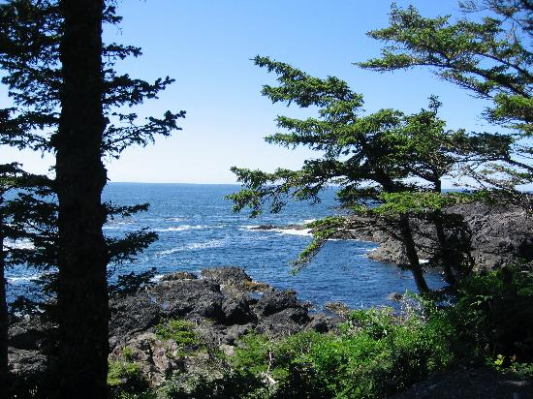
Predestination
“For whom he did foreknow, he also did predestinate to be conformed to the image of his Son, that he might be the firstborn among many brethren. Moreover whom he did predestinate, them he also called: and whom he called, them he also justified: and whom he justified, them he also glorified.” Romans 8:29,30

Slide 14
Foreknowledge, but not force
“For whom he did foreknow, he also did predestinate to be conformed to the image of his Son…” How many people does God foreknow exactly what they will and will not do? All of us does He foreknow. Since He knows all of us, then if He had it His way, then He would save us all. However, the greatest of all gifts can never be violated. That gift is free choice. God knows who will use the gift and choose to follow Him and He also knows those who will not. Even though He knows, He forces no one's decisions. It is God’s will that all mankind would be saved, but God can force no one! Predestination is based on God’s foreknowledge.

Slide 15
He Forces no Man, but Knows Everyone
The teachings of John Calvin declare that some are pre- determined to be saved and others are pre-determined to be lost. We all have no choice in the matter. Because God knows everything and doesn’t stop evil, then God is responsible for everything, including evil. Hence, God knows what a person will do; since He doesn’t stop what a person does, God is accountable, not man. God can’t justly keep anyone out of heaven because He ultimately is responsible for evil. Even the devil, Judas, Hitler, and the popes of wickedness will be saved. Insanity!!!
“Grace be to you, and peace, from God our Father, and from the Lord Jesus Christ. Blessed be the God and Father of our Lord Jesus Christ, who hath blessed us with all spiritual blessings in heavenly places in Christ: According as he hath chosen us in him before the foundation of the world, that we should be holy and without blame before him in love: Having predestinated us unto the adoption of children by Jesus Christ to himself, according to the good pleasure of his will, To the praise of the glory of his grace, wherein he hath made us accepted in the beloved.” Ephesians 1:2-6

Slide 16

God takes care
“What shall we then say to these things? If God be for us, who can be against us? He that spared not his own Son, but delivered him up for us all, how shall he not with him also freely give us all things? Who shall lay any thing to the charge of God's elect? It is God that justifieth. Who is he that condemneth? It is Christ that died, yea rather, that is risen again, who is even at the right hand of God, who also maketh intercession for us.” Romans 8:31-34

Slide 17
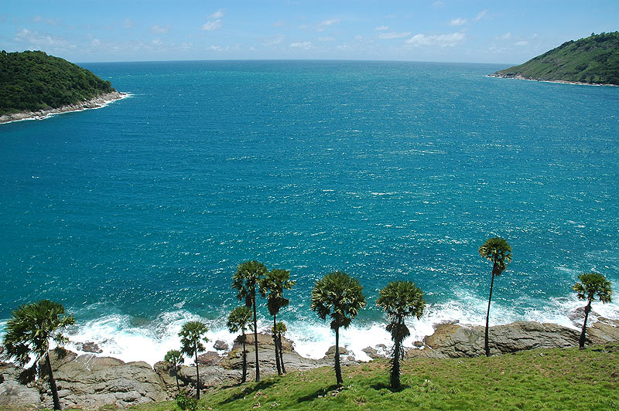
God’s Tenderness
“In these words Christ is speaking to every human being. Whether they know it or not, all are weary and heavy-laden. All are weighed down with burdens that only Christ can remove. The heaviest burden that we bear is the burden of sin. If we were left to bear this burden, it would crush us. But the Sinless One has taken our place. "The Lord hath laid on Him the iniquity of us all." Isa. 53:6. He has borne the burden of our guilt. He will take the load from our weary shoulders. He will give us rest. The burden of care and sorrow also He will bear. He invites us to cast all our care upon Him; for He carries us upon His heart.” DA, pg. 328,329

Slide 18
Precious
“The Elder Brother of our race is by the eternal throne. He looks upon every soul who is turning his face toward Him as the Saviour. He knows by experience what are the weaknesses of humanity, what are our wants, and where lies the strength of our temptations; for He was in all points tempted like as we are, yet without sin. He is watching over you, trembling child of God. Are you tempted? He will deliver. Are you weak? He will strengthen. Are you ignorant? He will enlighten. Are you wounded? He will heal. The Lord "telleth the number of the stars;" and yet "He healeth the broken in heart, and bindeth up their wounds." Ps. 147:4, 3. "Come unto Me," is His invitation. Whatever your anxieties and trials, spread out your case before the Lord. Your spirit will be braced for endurance. The way will be opened for you to disentangle yourself from embarrassment and difficulty. The weaker and more helpless you know yourself to be, the stronger will you become in His strength. The heavier your burdens, the more blessed the rest in casting them upon the Burden Bearer.” DA, pg. 329

Slide 19

Nothing Can Separate Us
“Who shall separate us from the love of Christ? shall tribulation, or distress, or persecution, or famine, or nakedness, or peril, or sword? As it is written, For thy sake we are killed all the day long; we are accounted as sheep for the slaughter. Nay, in all these things we are more than conquerors through him that loved us. For I am persuaded, that neither death, nor life, nor angels, nor principalities, nor powers, nor things present, nor things to come, Nor height, nor depth, nor any other creature, shall be able to separate us from the love of God, which is in Christ Jesus our Lord.” Romans 8:35-39

Slide 20

One Thing Can
No pain in the universe or any human being can separate us from the love of Christ. Death doesn’t keep us away, nothing that any demon can manufacture can take us from the hands of Christ. Locked into the heart of every human being is the gift of free choice whereby we can choose to separate from Jesus Christ . He forces no man; He desires our worship only as the willing response coming from our conscious free choice.

