Slide 1
Omega Octopus

Slide 2
Alpha Backdrop!
On February 18, 1902 the Battle Creek Sanitarium burned to the ground. To finance the new sanitarium, Dr. John Harvey Kellogg was asked to write a book, the royalties of which were to be used for the new sanitarium . The book Kellogg wrote was entitled "The Living Temple." The finished manuscript was full of his erroneous ideas that had their origin in spiritualistic, pantheistic philosophy. Ellen White wrote about this book. "In the book 'Living Temple' there is presented the alpha of deadly heresies. The omega will follow, and will be received by those who are not willing to heed the warning God has given." Selected Messages, vol. 1, 200.

Slide 3
Pantheism
“Soon after Kellogg's return to Battle Creek, Spicer was invited by the doctor to come to his home for a discussion of the book Living Temple. The men spent an entire Sabbath afternoon together, and soon they were in rather bitter controversy, as the doctor explained that the teachings of the book presented his views in a very modest fashion, and it was his intent to teach that God was in the things of nature. Later Spicer wrote of the exchange: "Where is God?" I was asked. I would naturally say, He is in heaven; there the Bible pictures the throne of God, all the heavenly beings at His command as messengers between heaven and earth. But I was told that God was in the grass and plants and in the trees... "Where is heaven?" I was asked. I had my idea of the center of the universe, with heaven and the throne of God in the midst, but disclaimed any attempt to fix the center of the universe astronomically. But I was urged to understand that heaven is where God is, and God is everywhere—in the grass, in the trees, in all creation.” The Early Elmshaven Years, pg. 289

Slide 4
Like Dominoes
By claiming that God was in everything, Kellogg was rejecting the basic tenets of Christianity/Adventism. Let us see………..
1. If God is in everything, what need is there for a heavenly sanctuary and God’s throne?
2. What need is there for a great high priest?
3. What need is there for angels going to and forth from heaven to earth?
4. What need is there for 1844 and the law?
5. If God is everywhere ,including in man, then what need is there for a Saviour?
Everything in Adventism tumbles and collapses!!

Slide 5
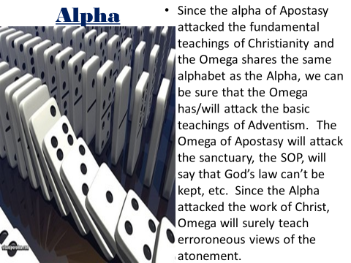

Slide 6
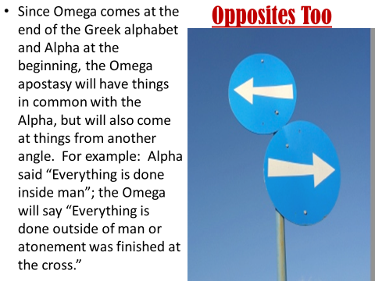

Slide 7
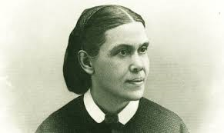
Omega’s Greatest Attack
She is the target of the Omega’s greatest attacks. Why? Any army man knows if you can cut the communication lines between headquarters and the men in the field, then the victory is won. One of the keys to American victory in WW11 was the breaking of the Japanese code. Victories won at Midway, Guadalcanal, and ultimately Iwo Jima were because the Japanese secret code had been broken. Cut communication lines between Heaven and God’s people and they are dead in the water!

Slide 8
How Do You Argue That?
"The sentiments in Living Temple regarding the personality of God have been received even by men who have had a long experience in the truth. . . .That those whom we thought sound in the faith should have failed to discern the specious, deadly influence of this science of evil, should alarm us as nothing else has alarmed us. . . . Those doctrines, followed to their logical conclusion, sweep away the whole Christian economy. . . . They make of no effect the truth of heavenly origin, and rob the people of God of their past experiences, giving them instead a false science." (Special Testimonies, Series B No. 7, p. 37.)
"In the book Living Temple there is presented the alpha of deadly heresies. The omega will follow, and will be received by those who are not willing to heed the warning God has given. . . .Living Temple contains the alpha of these theories. I knew that the omega would follow in a little while; and I trembled for our people." (Special Testimonies, No. 2, pp. 50,53.)

Slide 9

Watch
Kellogg retorted that Ellen White was not inspired to write such criticisms of his book. Kellogg claimed that she had gotten faulty information from ‘weeping’ Willie, her son, or from GC President A.G. Daniels. Kellogg claimed to believe in the inspiration of Ellen White, but was not willing to heed a word she said! Commencing with this subtle assault on EGW, Kellogg proceeded to go after the youth in the church.

Slide 10

Wow
Ellen White was not inspired when she wrote her comments on Kellogg’s book. She got the information from Willie White or from A.G. Daniels. The analysis came from someone else and not from the Lord! Wow! Have you ever heard that?

Slide 11

Could We Let it Happen again?
The Alpha of Apostasy had that element in it. Taking something that Ellen white said that was so clear and simple and saying, “What Ellen White said on that subject was not inspired. That came from someone else. Either Willie White or A.G. Daniels told her that!”

Slide 12
We Have Done Worse in the Omega of Apostasy!
How many have I heard a well meaning Adventist say those words? Just recently, a gentleman brought up the idea that the issue of the Godhead was something promoted by Leroy Froom. He is the one to blame for this idea. I said, “No, it was something very clearly stated by Ellen White. I mentioned Evangelism, pgs. 615-617 where it says, “The Father is all the fullness of the Godhead bodily, and is invisible to mortal sight. The Son is all the fullness of the Godhead manifested. The Word of God declares Him to be "the express image of His person." "God so loved the world, that He gave His only-begotten Son, that whosoever believeth in Him should not perish, but have everlasting life." Here is shown the personality of the Father. The Comforter that Christ promised to send after He ascended to heaven, is the Spirit in all the fullness of the Godhead, making manifest the power of divine grace to all who receive and believe in Christ as a personal Savior.”

Slide 13

His Response
His response, “Evangelism is a compilation of EGW and the compiler was Leroy Froom. Froom finagled that book. Clearly, Ellen White did not say that!” Wow! The man who said that was guilty of plagiarism; he took that comment straight from Kellogg. The spirit of the Alpha of apostasy lives today in the Omega and one of the Omega’s tentacles is making of none effect the Spirit of Prophecy.
“Satan is . . . constantly pressing in the spurious--to lead away from the truth. The very last deception of Satan will be to make of none effect the testimony of the Spirit of God. "Where there is no vision, the people perish" (Prov. 29:18). Satan will work ingeniously, in different ways and through different agencies, to unsettle the confidence of God's remnant people in the true testimony.-- Letter 12, 1890.

Slide 14

That Mentality
If you do not like what the SOP has to say about:
1. the harm of eating flesh food.
2. the bad effects of competition.
3. the false teaching over the Holy Spirit being just an influence.
4. Sin can be overcome thru the power of Christ.
5. the 2520 is wrong.
6. the feast days are NOT binding.
7. the papacy is still the antichrist.
SOP did not write that, someone else did!

Slide 15
Church is Babylon
Several years ago, I was having meetings in the northwest. In a Q and A, a gentleman wanted to discuss the SDA Church being Babylon. In several ways, I tried to share with him that the SOP is very clear that the SDA Church IS NOT BABYLON! I quoted Testimonies to Ministers, pg. 49,50 “There is but one church in the world who are at the present time standing in the breach, and making up the hedge, building up the old waste places; and for any man to call the attention of the world and other churches to this church, denouncing her as Babylon, is to do a work in harmony with him who is the accuser of the brethren. Is it possible that men will arise from among us, who speak perverse things, and give voice to the very sentiments that Satan would have disseminated in the world in regard to those who keep the commandments of God, and have the faith of Jesus? Is there not work enough to satisfy your zeal in presenting the truth to those who are in the darkness of error? As those who have been made stewards of means and ability, you have been misapplying your Lord’s goods in disseminating error.”

Slide 16
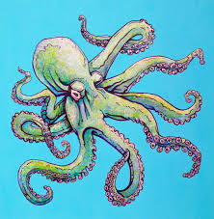
The response back was, “Testimonies to Ministers was not written by Ellen White. That book was done by Uriah Smith and Ellen White had nothing to do with it.” I can justify throwing out anything and everything that Ellen White said on any subject I want and say, ‘She didn’t write that.’ This is plagiarism, stolen from John Harvey Kellogg, and this is one of the major tentacles of Omega!

Slide 17
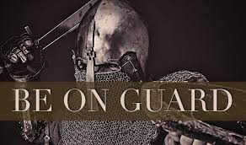
Satan’s Banner
Giving Up Faith in the Testimonies.--One thing is certain: Those Seventh-day Adventists who take their stand under Satan's banner will first give up their faith in the warnings and reproofs contained in the Testimonies of God's Spirit. The call to great consecration and holier service is being made, and will continue to be made.--Letter 156, 1903. 3 SM, pg. 84

Slide 18
Jehoachin’s Burning
“Then said the princes unto Baruch, Go, hide thee, thou and Jeremiah; and let no man know where ye be. And they went in to the king into the court, but they laid up the roll in the chamber of Elishama the scribe, and told all the words in the ears of the king. So the king sent Jehudi to fetch the roll: and he took it out of Elishama the scribe's chamber. And Jehudi read it in the ears of the king, and in the ears of all the princes which stood beside the king. Now the king sat in the winter house in the ninth month: and there was a fire on the hearth burning before him. And it came to pass, that when Jehudi had read three or four leaves, he cut it with the penknife, and cast it into the fire that was on the hearth, until all the roll was consumed in the fire that was on the hearth. Yet they were not afraid, nor rent their garments, neither the king, nor any of his servants that heard all these words. Nevertheless Elnathan and Delaiah and Gemariah had made intercession to the king that he would not burn the roll: but he would not hear them.” Jeremiah 36:19-25

Slide 19
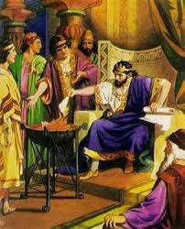
No Repentance Here!
Joachim was more honest that so many of God’s professed people today; certainly more honest than John Harvey Kellogg and people I’ve met. At least, he was honest, cutting to shreds the SOP and throwing it into the fire. Why do not Adventists be as honest when they say, “Oh, Ellen White did not write this or that.” Of course, she did!

