Slide 1
Jesus Life, pt. 23
Apology, Rebuke, and a Centurion

Slide 2
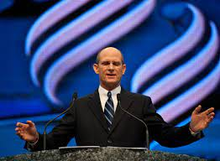
I Missed One!
Ted Wilson gave a sermon at the ASI meeting in Orlando, August 7, in which he did say that the papacy was the beast of Revelation 14:9. I erroneously stated in the sermon of Oct. 30 that he did not identify the papacy as the beast. Ted Wilson, I publicly apologize to you. I miss spoke.

Slide 3
Recent Camp meeting
An SDA evangelist recently approached me at a camp meeting and said, “I agree with almost all that you say (I was waiting for the proverbial ‘but’), except you are wrong to say T. Wilson doesn’t preach the 2nd or 3rd Angel’s message. Of course he does and I’ll send it to you.” I responded, “He hasn’t for 11 years. Send it to me.” Well, Ted Wilson FINALLY gave a talk where he did mention apostate Protestantism and the papacy in his sermon. It was given at the autumn council about 1 month ago.

Slide 4
My Response
“Finally!!! He did say something about apostate Protestantism and the papacy. That sermon was given last month!! What about the previous 11 years???? What about the FACT that he didn't give messages about the 2nd and 3rd angel's messages for the previous 11 years? What about the FACT that he continually said to preach the 3 angel's messages and HE didn't? What about that? What about the FACT that for 7 years he said that the mark of the beast was any day of the week other than the Sabbath? What about the FACT that right under his nose Diop marches to the ecumenical tune around the globe and NOTHING is said??”
It is interesting to me that after 11 years, and after we have said it a number of times that T. Wilson refuses to preach the 2nd and 3rd angel’s messages, he has finally discussed them???????????????????

Slide 5
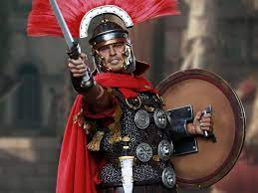
The centurion was a position in the Roman army during classical antiquity, nominally the commander of a century (Latin: centuria), a military unit of around 80 legionaries. In a Roman legion, centuries were grouped into cohorts commanded by their senior-most centurion. The prestigious first cohort was led by the primus pilus, the most senior centurion in the legion and its third-in-command.

Slide 6
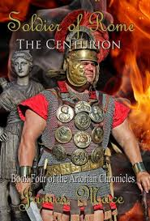
Killer for Rome
The centurion was a professional assassin. He killed people for a living. “Centurions were held personally responsible for the training and discipline of the legionaries under their command, and they had a reputation for dealing out harsh punishment.”

Slide 7
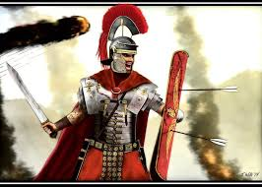
Human Life Meant Nothing
They had to be on guard constantly, good warriors/soldiers or it could mean their life and the lives of the men under them. Human life meant little to them; it was about the glory of Rome!
They were schooled in heathenism, taught to do whatever it took for the glory of Rome. Human life meant little to them. Blood and battle was their life!

Slide 8
Almost Impossible!
“But the centurion, born in heathenism, educated in the idolatry of imperial Rome, trained as a soldier, seemingly cut off from spiritual life by his education and surroundings, and still further shut out by the bigotry of the Jews, and by the contempt of his own countrymen for the people of Israel,—this man perceived the truth to which the children of Abraham were blinded. He did not wait to see whether the Jews themselves would receive the One who claimed to be their Messiah. As the “light, which lighteth every man that cometh into the world” (John 1:9) had shone upon him, he had, though afar off, discerned the glory of the Son of God.” DA, pg. 317

Slide 9
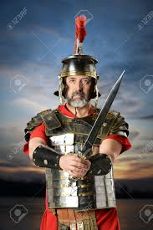
Such was the Man………..
“Now when he had ended all his sayings in the audience of the people, he entered into Capernaum. And a certain centurion's servant, who was dear unto him, was sick, and ready to die. And when he heard of Jesus, he sent unto him the elders of the Jews, beseeching him that he would come and heal his servant.” Luke 7:1-3

Slide 10
The Power of the Holy Spirit
“The centurion's servant had been stricken with palsy, and lay at the point of death. Among the Romans the servants were slaves, bought and sold in the market places, and treated with abuse and cruelty; but the centurion was tenderly attached to his servant, and greatly desired his recovery. He believed that Jesus could heal him. He had not seen the Saviour, but the reports he heard had inspired him with faith. Notwithstanding the formalism of the Jews, this Roman was convinced that their religion was superior to his own. Already he had broken through the barriers of national prejudice and hatred that separated the conquerors from the conquered people. He had manifested respect for the service of God, and had shown kindness to the Jews as His worshipers. In the teaching of Christ, as it had been reported to him, he found that which met the need of the soul. All that was spiritual within him responded to the Saviour's words.” DA, pg. 315

Slide 11
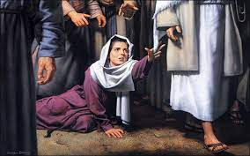
Heard the Stories
He heard:
About the leader of the synagogue whose daughter was sick.
About the tax collector to whom Jesus called ‘Follow Me’.
About the woman who had an issue of blood.
About the demon possessed man whom Jesus had healed.
About Jesus who turned NOONE away who asked for His help!!!

Slide 12
The centurion did not feel worthy to have Christ come to his home. He sent some Jewish leaders who showed their lack of the Spirit. They said Christ should heal the servant because the centurion had built them a synagogue. The only basis on which Christ will do anything is our great need of His mercy. This grand mercy He freely bestows because of who He is and not because of something we have done!

Slide 13
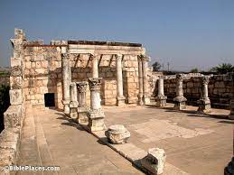
No Clue!
“And when he heard of Jesus, he sent unto him the elders of the Jews, beseeching him that he would come and heal his servant. And when they came to Jesus, they besought him instantly, saying, That he was worthy for whom he should do this: For he loveth our nation, and he hath built us a synagogue.” Luke 7:3-5

Slide 14
No self-Dependence
“The Jewish elders who recommended the centurion to Christ had shown how far they were from possessing the spirit of the gospel. They did not recognize that our great need is our only claim on God's mercy. In their self-righteousness they commended the centurion because of the favor he had shown to “our nation.” But the centurion said of himself, “I am not worthy.” His heart had been touched by the grace of Christ. He saw his own unworthiness; yet he feared not to ask help. He trusted not to his own goodness; his argument was his great need. His faith took hold upon Christ in His true character. He did not believe in Him merely as a worker of miracles, but as the friend and Saviour of mankind. It is thus that every sinner may come to Christ. “Not by works of righteousness which we have done, but according to His mercy He saved us.” Titus 3:5. When Satan tells you that you are a sinner, and cannot hope to receive blessing from God, tell him that Christ came into the world to save sinners. We have nothing to recommend us to God; but the plea that we may urge now and ever is our utterly helpless condition that makes His redeeming power a necessity. Renouncing all self-dependence, we may look to the cross of Calvary and say,—
“In my hand no price I bring;
Simply to Thy cross I cling.” DA, pgs. 316,317

Slide 15
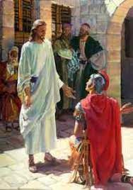
“The centurion answered and said, Lord, I am not worthy that thou shouldest come under my roof: but speak the word only, and my servant shall be healed. For I am a man under authority, having soldiers under me: and I say to this man, Go, and he goeth; and to another, Come, and he cometh; and to my servant, Do this, and he doeth it. When Jesus heard it, he marveled, and said to them that followed, Verily I say unto you, I have not found so great faith, no, not in Israel. And I say unto you, That many shall come from the east and west, and shall sit down with Abraham, and Isaac, and Jacob, in the kingdom of heaven.” Matthew 8:8-11

Slide 16
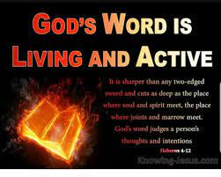
“As I represent the power of Rome, and my soldiers recognize my authority as supreme, so dost Thou represent the power of the Infinite God, and all created things obey Thy word. Thou canst command the disease to depart, and it shall obey Thee. Thou canst summon Thy heavenly messengers, and they shall impart healing virtue. Speak but the word, and my servant shall be healed.” DA, pg. 316

