Slide 1
Revelation, chapter 3
‘Sardis, Philadelphia, and Laodicea’

Slide 3
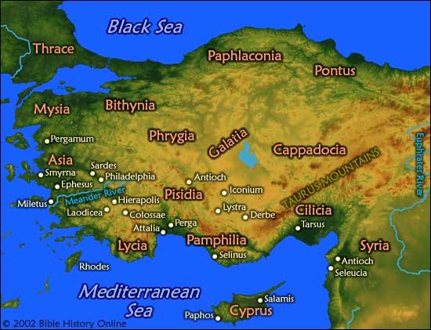

Slide 4
Review thus Far
Ephesus 100-313 AD ‘the desirable’
Smyrna 100-313 ‘the persecuted’
Pergamos 313-538 ‘compromise’
Thyatira 538-1517 ‘papal assault’
The last three churches cover the time from the beginning of the Reformation down to the end of time. These three periods are referred to as Sardis, Philadelphia, and Laodicea.

Slide 5
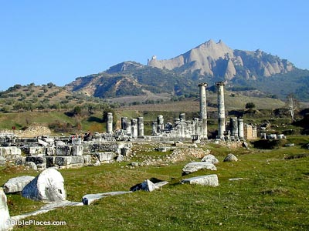
Sardis-Reformation Times
The metallurgists of Sardis discovered the secret of separating gold from silver, thereby producing both metals of a purity never known before.^{[2]} This was an economic revolution, for while gold nuggets panned or mined were used as currency, their purity was always suspect and a hindrance to trade. Such nuggets or coinage were naturally occurring alloys of gold and silver known as electrum and one could never know how much of it was gold and how much was silver. Sardis now could mint nearly pure silver and gold coins, the value of which could be—and was—trusted throughout the known world.

Slide 6
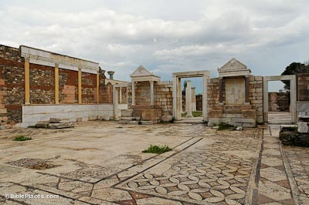
Sardis was a wealthy and dynamic place, but what is left of it today is anything but auspices. Its wealthy and extravagant buildings have all but crumbled. This is very similar to the church time period it represents; the Reformation. It started so well, but is only a shell of what it once was!!

Slide 7
Rev. 3:1-6
“And unto the angel of the church in Sardis write; These things saith he that hath the seven Spirits of God, and the seven stars; I know thy works, that thou hast a name that thou livest, and art dead. Be watchful, and strengthen the things which remain, that are ready to die: for I have not found thy works perfect before God. Remember therefore how thou hast received and heard, and hold fast, and repent. If therefore thou shalt not watch, I will come on thee as a thief, and thou shalt not know what hour I will come upon thee. Thou hast a few names even in Sardis which have not defiled their garments; and they shall walk with me in white: for they are worthy. He that overcometh, the same shall be clothed in white raiment; and I will not blot out his name out of the book of life, but I will confess his name before my Father, and before his angels. He that hath an ear, let him hear what the Spirit saith unto the churches.”

Slide 8
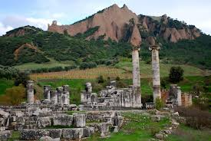
From Sardis to Philadelphia
The time period for Sardis was from Luther’s nailing the 95 thesis on the door of the chapel in Wittenberg, Germany in 1517 down to the fires that ignited the church of Philadelphia with evangelistic fervor around 1798. It was this missionary gusto that compelled Philadelphia to not receive a rebuke from God!

Slide 9
Philadelphia-from 1798-1844
Sardis, the Reformation church, ended in, roughly, 1798. In the 1790’s, the missionary William Carey, the cobbler of England, went to India and the missionary zeal never waned for the next 50 years, culminating in the Millerite movement. Philadelphia means the city of brotherly love and love for souls was the essence of this church time period. The other key feature of this time period was the studying and proclaiming of the opening book of Daniel. Prophecy became a great focus during this time. “But thou, O Daniel, shut up the words, and seal the book, even to the time of the end: many shall run to and fro, and knowledge shall be increased.” Daniel 12:4

Slide 10
The Letter
“ And to the angel of the church in Philadelphia write; These things saith he that is holy, he that is true, he that hath the key of David, he that openeth, and no man shutteth; and shutteth, and no man openeth; I know thy works: behold, I have set before thee an open door, and no man can shut it: for thou hast a little strength, and hast kept my word, and hast not denied my name. Behold, I will make them of the synagogue of Satan, which say they are Jews, and are not, but do lie; behold, I will make them to come and worship before thy feet, and to know that I have loved thee. Because thou hast kept the word of my patience, I also will keep thee from the hour of temptation, which shall come upon all the world, to try them that dwell upon the earth. Behold, I come quickly: hold that fast which thou hast, that no man take thy crown. Him that overcometh will I make a pillar in the temple of my God, and he shall go no more out: and I will write upon him the name of my God, and the name of the city of my God, which is new Jerusalem, which cometh down out of heaven from my God: and I will write upon him my new name.” Rev. 3:7-12

Slide 11
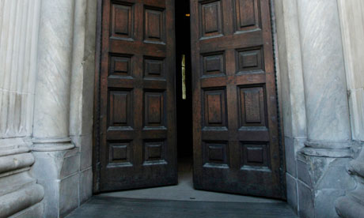
Opening and Closing Doors
“ They now saw that they were correct in believing that the end of the 2300 days in 1844 marked an important crisis. But while it was true that that door of hope and mercy by which men had for eighteen hundred years found access to God, was closed, another door was opened, and forgiveness of sins was offered to men through the intercession of Christ in the most holy. One part of His ministration had closed, only to give place to another. There was still an "open door" to the heavenly sanctuary, where Christ was ministering in the sinner's behalf. Now was seen the application of those words of Christ in the Revelation, addressed to the church at this very time: "These things saith He that is holy, He that is true, He that hath the key of David, He that openeth, and no man shutteth; and shutteth, and no man openeth; I know thy works: behold, I have set before thee an open door, and no man can shut it." Revelation 3:7, 8.

Slide 12
Missionaries!!
Philadelphia, the church from 1798-1844, was consumed by three things:
1. missionary fervor
2. proclamation of prophecy.
3. focus on Christ in the sanctuary above.
For this, Philadelphia, like Smyrna, never received rebuke from God!!!

Slide 13
Laodicea
The very word, Laodicea, is the combination of two Greek Words, Lao=people and dicea=righteousness and judgment. The word means a righteous people in a time of judgment. This immediately pinpoints the time frame for this church. 1844! This church goes from 1844-the close of probation. There are no other churches after this!! Laodicea does not get good marks in the eyes of heaven!

Slide 14
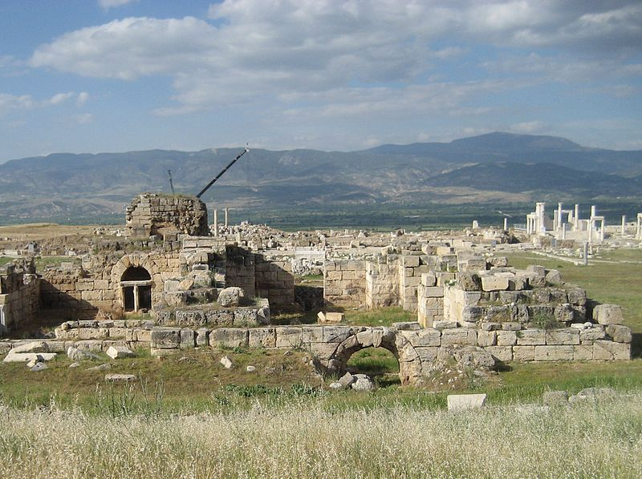
In Ancient Times
Laodicea, benefiting from its advantageous position on a trade route, became one of the most important and flourishing commercial cities of Asia Minor, in which large money transactions and an extensive trade in black wool were carried on..a great and wealthy center of industry, famous specially for the fine black wool of its sheep and for the Phrygian powder for the eyes, which was manufactured there.

Slide 15
Rich and Needs Nothing
”And unto the angel of the church of the Laodiceans write; These things saith the Amen, the faithful and true witness, the beginning of the creation of God; I know thy works, that thou art neither cold nor hot: I would thou wert cold or hot. So then because thou art lukewarm, and neither cold nor hot, I will spue thee out of my mouth. Because thou sayest, I am rich, and increased with goods, and have need of nothing; and knowest not that thou art wretched, and miserable, and poor, and blind, and naked: I counsel thee to buy of me gold tried in the fire, that thou mayest be rich; and white raiment, that thou mayest be clothed, and that the shame of thy nakedness do not appear; and anoint thine eyes with eye salve, that thou mayest see. As many as I love, I rebuke and chasten: be zealous therefore, and repent. Behold, I stand at the door, and knock: if any man hear my voice, and open the door, I will come in to him, and will sup with him, and he with me. To him that overcometh will I grant to sit with me in my throne, even as I also overcame, and am set down with my Father in his throne. He that hath an ear, let him hear what the Spirit saith unto the churches.” Rev. 3:14-21

Slide 16
Doesn’t See Their Need
“Two men went up into the temple to pray; the one a Pharisee, and the other a publican. The Pharisee stood and prayed thus with himself, God, I thank thee, that I am not as other men are, extortioners, unjust, adulterers, or even as this publican. I fast twice in the week, I give tithes of all that I possess. And the publican, standing afar off, would not lift up so much as his eyes unto heaven, but smote upon his breast, saying, God be merciful to me a sinner. I tell you, this man went down to his house justified rather than the other: for every one that exalteth himself shall be abased; and he that humbleth himself shall be exalted.” Luke 18:10-14

Slide 17
A Must!
“In order to attain to this high calling of God in Christ Jesus, you must begin the day with your Saviour. The very first out-breathing of the soul in the morning should be for the presence of Jesus. “Without me,” he says, “ye can do nothing.” It is Jesus that we need; his light, his life, his spirit, must be ours continually. We need him every hour. And we should pray in the morning that as the sun illuminates the landscape, and fills the world with light, so the Sun of righteousness may shine into the chambers of mind and heart, and make us all light in the Lord. We cannot do without his presence one moment. The enemy knows when we undertake to do without our Lord, and he is there, ready to fill our minds with his evil suggestions that we may fall from our steadfastness; but it is the desire of the Lord that from moment to moment we should abide in him, and thus be complete in him, accepted in the Beloved. God designs that every one of us shall be perfect in him, so that we may represent to the world the perfection of his character.” Bible Echo 1-15-1892

Slide 18
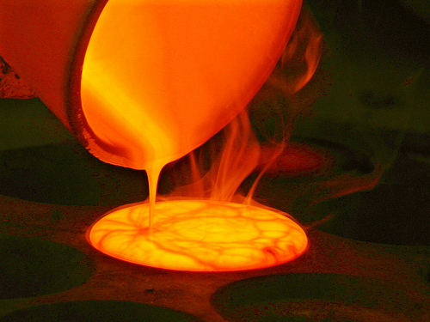
3 Gifts
1. Gold tried in the Fire
a. 1 Peter 1:5-7
2. White raiment
b. Rev. 19-7,8; Rev. 3:5
3. Anointing of our eyes.
c. Ps. 119:18

Slide 19
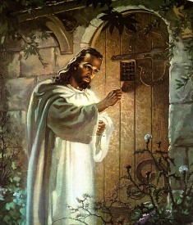
Mankind’s Hope
Laodicea has Christ at arms link. Laodicea’s only hope is to acknowledge her need and covet the presence of the abiding Christ!
“Behold, I stand at the door, and knock: if any man hear my voice, and open the door, I will come in to him, and will sup with him, and he with me.” Rev. 3:20

