Slide 1
Blood of All
Does all mean All?

Slide 2
Spreading the Truth
“In every generation God has sent His servants to rebuke sin, both in the world and in the church. But the people desire smooth things spoken to them, and the pure, unvarnished truth is not acceptable. Many reformers, in entering upon their work, determined to exercise great prudence in attacking the sins of the church and the nation. They hoped, by the example of a pure Christian life, to lead the people back to the doctrines of the Bible. But the Spirit of God came upon them as it came upon Elijah, moving him to rebuke the sins of a wicked king and an apostate people; they could not refrain from preaching the plain utterances of the Bible-- doctrines which they had been reluctant to present. They were impelled to zealously declare the truth and the danger which threatened souls. The words which the Lord gave them they uttered, fearless of consequences, and the people were compelled to hear the warning.” GC, pg. 606

Slide 3
Sins will be Disclosed
“Thus the message of the third angel will be proclaimed. As the time comes for it to be given with greatest power, the Lord will work through humble instruments, leading the minds of those who consecrate themselves to His service. The laborers will be qualified rather by the unction of His Spirit than by the training of literary institutions. Men of faith and prayer will be constrained to go forth with holy zeal, declaring the words which God gives them. The sins of Babylon will be laid open. The fearful results of enforcing the observances of the church by civil authority, the inroads of spiritualism, the stealthy but rapid progress of the papal power--all will be unmasked. By these solemn warnings the people will be stirred. Thousands upon thousands will listen who have never heard words like these. In amazement they hear the testimony that Babylon is the church, fallen because of her errors and sins, because of her rejection of the truth sent to her from heaven.” GC., pgs. 606,607

Slide 4
How much is All?
“And in her was found the blood of prophets, and of saints, and of all that were slain upon the earth.” Revelation 18:24
What is included in this statement? This passage of Scripture declares that Babylon the Great, the papacy, is responsible for the blood shed in this world. Obviously, this verse isn’t talking about the hit and run victims, or people dying by accident on their jobs. However, when there are large, or great amounts of people dying, like say, in wars or terror attacks, in these the blood shed can be pointed back to the doors of the Vatican!

Slide 5
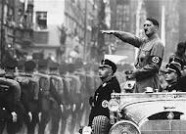
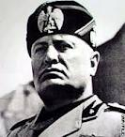
World War 2

Slide 6
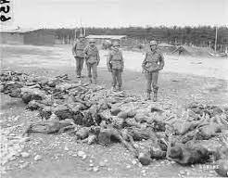
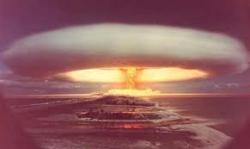
Cont.

Slide 7
At the Vatican’s Doorstep?
“The Pope was just as much in the Second World War as was Hitler and Catholic Mussolini and therefore just as guilty of the murder of six million Jews. In fact, Popes have been in or instigated most, if not all, the European wars down through the centuries.” F. Paul Peterson, Peter’s Tomb Recently Discovered in Jerusalem, p. 63. (Quoted in: Is Alberto for Real, Sidney Hunter, Chick Publications, page 41). “One may say quite specifically that in 1914, the Roman Church started the series of hellish wars. It was then that the tribute of blood which she has always taken from the peoples began to swell into a veritable torrent.” Edmond Paris, The Vatican Against Europe, The Wickliffe Press, p. 48.

Slide 8
Pius 12
“Eugenio Pacelli, Pope Pius XII, has long been the subject of controversy over his failure to speak out against Hitler's Final Solution. In Hitler's Pope, award-winning journalist and Roman Catholic John Cornwell shows that, even well before the Holocaust, Pope Pius XII was instrumental in negotiating an accord that helped the Nazis rise to unhindered power--and sealed the fate of the Jews in Europe. Drawing upon secret Vatican and Jesuit archives to which he had exclusive access, Cornwell tells the full, tragic story of how narcissism, longstanding personal antipathy for the Jews, and political and spiritual ambition combined to make Pius the most dangerous churchman in history. A firm and final indictment of Pius XII's papacy, Hitler's Pope is also a searing exploration of its lingering consequences for the Catholic church today. From Amazon.com

Slide 9
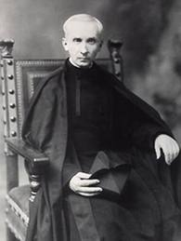
Author of Mein Kampf
According to the late Jesuit priest, Fr. Alberto Rivera, a fellow Jesuit named Fr. Staempfle wrote Mein Kampf, as the stage was being set for Germany's new Roman Catholic star, Adolf Hitler.

Slide 10
Confirmed
“The Fuhrer had come to power, thanks to the votes of the Catholic Zentrum, only five years before, but most of the objectives cynically revealed in 'Mein Kampf were already realized; this book, an insolent challenge to the western democracies, was written by the Jesuit Father Staempfle and signed by Hitler. For—as so many ignore the fact—it was the Society of Jesus which perfected the famous Pan-German programme as laid out in this book, and the Fuhrer endorsed it.” The Secret History of the Jesuits Page 138

Slide 11
Main Leaders of Nazi’s
"Hitler, Goebbels, Himmler and most members of the party's "old guard" were Catholics", wrote M. Frederic Hoffet. "It was not by accident that, because of its chiefs' religion, the National-socialist government was the most Catholic Germany ever had... This kinship between National-socialism and Catholicism is most striking if we study closely the propaganda methods and the interior organisation of the party. On that subject, nothing is more instructive than Joseph Goebbel's works. He had been brought up in a Jesuit college and was a seminarist before devoting himself to literature and politics... Every page, every line of his writings recall the teaching of his masters; so he stresses obedience... the contempt for truth... "Some lies are as useful as bread!" he proclaimed by virtue of a moral relativism extracted from Ignatius of Loyola's writings..." Frederic Hoffet: "L'lmperialisme protestant" (Flammarion, Paris 1948, pp.172 ss).

Slide 12
Hitler’s Rise to Power
“In Germany, the Papal Nuncio in Berlin, Mgr. Pacelli and Franz von Papen, privy Chamberlain to the Pope, advocated a ‘union with Rome’ and concentrated on the overthrow of the Weimar Republic. The German Catholics were hostile to Nazism, but were informed that the Pope himself was ‘favourably disposed towards Hitler.’ Consequently the Catholic Zentrum, axis of all parliamentary majorities, voted full rights to Hitler on January 30, 1933.
This operation was promptly followed, as in Italy, by the concluding of a Concordat which was most advantageous to the Roman church. The German Episcopate swore allegiance to the Fuhrer and Catholic Youth organizations combined with those of the Nazis.” Edmond Paris, The Vatican Against Europe, The Wickliffe Press, page 15.

Slide 13
Again!
“The Vatican helped Hitler to gain power and then helped him consolidate his grip on Germany. This was done in party by ‘advising’ the Catholic Party of Germany to vote for Nazi candidates.
The Catholic vote gave Hitler the majority he needed to legally form a government in 1933. Further to this, the Vatican ordered Catholic members of the Reichstag Parliament to support legislation giving Hitler the power to rule by decree. This measure gave Hitler the dictatorial power he needed to destroy the German Communists.
The whole Vatican-Hitler bargain had been conducted in secret before Hitler became Chancellor of Germany in January 1933. In June of the same year, Hitler and the Vatican signed a Concordat, under terms of which the church swore allegiance to the Nazi regime....
Soon afterward, Catholic Franz von Papen, the second in command to Hitler, put the essence of the Hitler-Vatican alliance very succinctly in these words: “The Third Reich,” he said, “is the first power which not only recognizes, but puts into practice, the high principles of the Papacy.” Avro Manhattan, The Vatican Moscow Washington Alliance, Ozark Books, (quoted in Sydney Hunter, Is Alberto for Real, Chick Publications, pp. 42, 43)

Slide 14
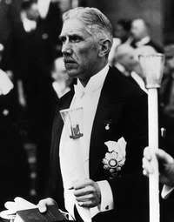
Franz von Papen
“Another well informed person, the mainspring of the pact between the Holy See and Berlin and the pope's secret chamberlain, Franz von Papen, was even more explicit: "The Third Reich is the first world power which not only acknowledges but also puts into practice the high principles of the papacy". (Robert d'Harcourt of the French Academy: "Franz von Papen, l'homme a tout faire" L'Aube, 3rd of October 1946).

Slide 15
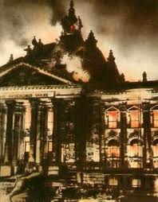
Reichstag Fire
“On the day following the fire, February 28, [Hitler] prevailed on President Hindenburg to sign a decree “for the Protection of the People and the State” suspending seven sections of the constitution which guaranteed individual and civil liberties. Described as a “defensive measure against Communist acts of violence endangering the state, the decree laid down that: Restrictions on personal liberty, on the right of free expression of opinion, including freedom of the press, on the rights of assembly and association; and violations of the privacy of postal, telegraphic and phone communications; and warrants for house searchers, orders for confiscations, as well as restrictions on property, are also permissible beyond the legal limits otherwise prescribed. ‘

Slide 16
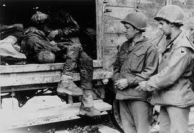
Jewish Solution
"Hitler was also ready to discuss with the Bishop his views on the Jewish question: "As for the Jews, I am just carrying on with the same policy which the Catholic church has adopted for fifteen hundred years, when it has regarded the Jews as dangerous and pushed them into ghettos etc., because it knew what the Jews were like. I don't put race above religion, but I do see the danger in the representatives of this race for Church and State, and perhaps I am doing Christianity a great service." -"The Nazi Persecution of the Churches" by J.S. Conway, Pgs. 25, 26 & 162.

Slide 17
Jewish Elimination
“The Vatican believes that if hatred for the Jews can be fomented as took place in
Hitler’s Germany. Then Jews will be ruthlessly eliminated. The Vatican believes
that if all Jews are killed, Christ will not come, and the Vatican’s aim to rule the
world would remain intact. Avro Manhattan says it this way:
It is important, although it may be difficult for some to recognize the religious
nature of the Communist/Zionist/Catholic political configuration. Although
deliberately muted in public pronouncements, behind the Zionist banner there
was to be found the ancient Messianic hope for the coming a global theocracy,
as predicted by all the seers and prophets of Zion. It was to be a theocracy in
which Jehovah, not Christ, was to be King.
The spectre of the creation of such a theocracy has haunted the inner chambers
of the Catholic church from her earliest inception, and still is a dominant fear.
In Vatican eyes, therefore, the millenarian yearning for a global Hebrew
theocracy, represents a deadly threat to the eschatological teachings of the
Catholic church. When translated into concrete political terms, such a view spells
not only rivalry, but implacable enmity. “ Avro Manhattan, The Vatican Moscow
Washington Alliance, chick Publications, pp. 169, 170

Slide 18
Hitler’s Admission
"I learned much from the Order of the Jesuits", said Hitler... "Until now, there has never been anything more grandiose, on the earth, than the hierarchical organization of the Catholic Church. I transferred much of this organization into my own party... I am going to let you in on a secret... I am founding an Order... In my "Burgs" of the Order, we will raise up a youth which will make the world tremble... Hitler then stopped, saying that he couldn't say any more.."Hermann Rauschning, former national-socialist chief of the government of Dantzig: "Hitler m'a dit", (Ed. Co-operation, Paris 1939, pp.266, 267, 273 ss).

Slide 19
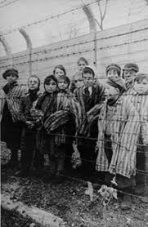
Blood of All
“And in her was found the blood of prophets, and of saints, and of all that were slain upon the earth.” Rev. 18:24
This applies to Vietnam, Korea, WW 1, Middle East, Civil War, 9-11, Oklahoma City, etc.

