Slide 1
El Shaddai
The Answer

Slide 2
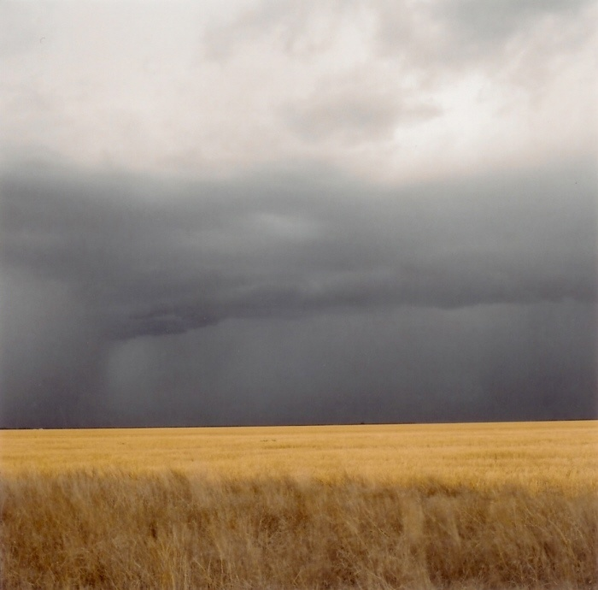
El Shaddai Enters Salvation History
The first time that the name El Shaddai is found in the Bible is during the story of Abraham. He is now 99 years old and Sarah 90. They have waited some 24 years for a promised child, but he has yet to arrive. They have given up all hope of a child by Sarah; it is impossible for her to have a child. El Shaddai makes His appearance.

Slide 3

Genesis 17:1
“And when Abram was ninety years old and nine, the LORD appeared to Abram, and said unto him, I am the Almighty God; walk before me, and be thou perfect.” Throughout the King James, Almighty is translated as El Shaddai. It identifies God’s overwhelming goodness toward His children.

Slide 4
Its Surprising Etymology
El Shaddai has as its base the Hebrew word shad. Shad denotes a mother’s breast! From Leslie Hardinge’s book, “His Name is Wonderful”, “This idea of almightiness, illustrated by a mother’s breasts, is colored by her unique relationship to her infant… The mother loves her newborn because he is totally helpless, completely dependant and utterly vulnerable, and so she continues to give him everything she has and seeks to anticipate all his needs... She is able to provide his mental, physical, psychological, emotional, and social needs at her breasts.” Pg.56&57

Slide 5
The Maternal Side of God.
From Hardinge’s book again “As a mother nurses her baby at her warm and comforting breasts, God promises to nurture his children. El Shaddai displays the feminine or maternal aspect of deity. Jesus revealed himself to the beloved John on the isle of Patmos ‘girt about the paps with a golden girdle’. The word the apostle used describes, not a man’s chest (matzos) but a mother’s breast (mastos)… Christ here pictured himself as the all sufficient Priest.” pg. 56

Slide 6
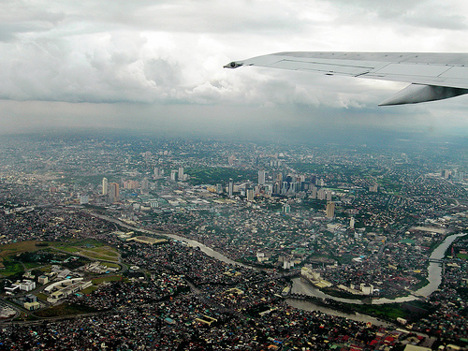
Puzzled No More
Thinking of God with maternal qualities was surprising and puzzling at first. Then, as I was taking off out of Hong Kong Airport and I heard a baby cry, the baby showed me El Shaddai very clearly.

Slide 7
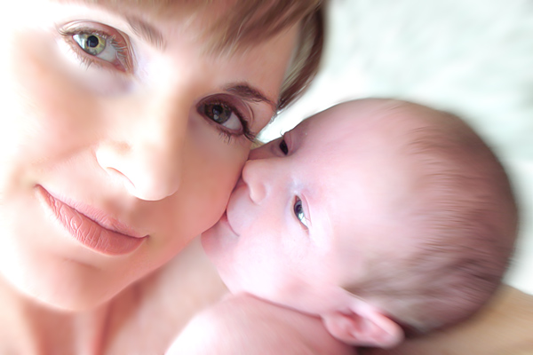
Deeper Than a Mother’s Love
“But Zion said, The LORD hath forsaken me, and my Lord hath forgotten me. Can a woman forget her sucking child, that she should not have compassion on the son of her womb? yea, they may forget, yet will I not forget thee. Behold, I have graven thee upon the palms of my hands; thy walls are continually before me.” Isaiah 49:14-16

Slide 8
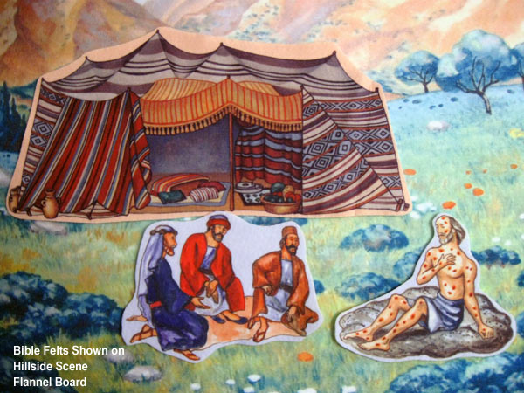
He Needed El Shaddai More Than Any Other!
The name El Shaddai is mentioned some 46 times in the Bible. Of those 46, 31 times the name is repeated in one particular book of the Bible. Can you guess which one?

Slide 9
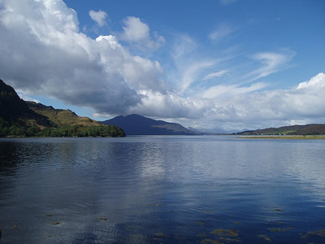
El Shaddai Went with Him
“And Isaac called Jacob, and blessed him, and charged him, and said unto him, Thou shalt not take a wife of the daughters of Canaan. Arise, go to Padan-aram, to the house of Bethuel thy mother's father; and take thee a wife from thence of the daughters of Laban thy mother's brother. And God Almighty bless thee, and make thee fruitful, and multiply thee, that thou mayest be a multitude of people;” Genesis 28:3

Slide 10
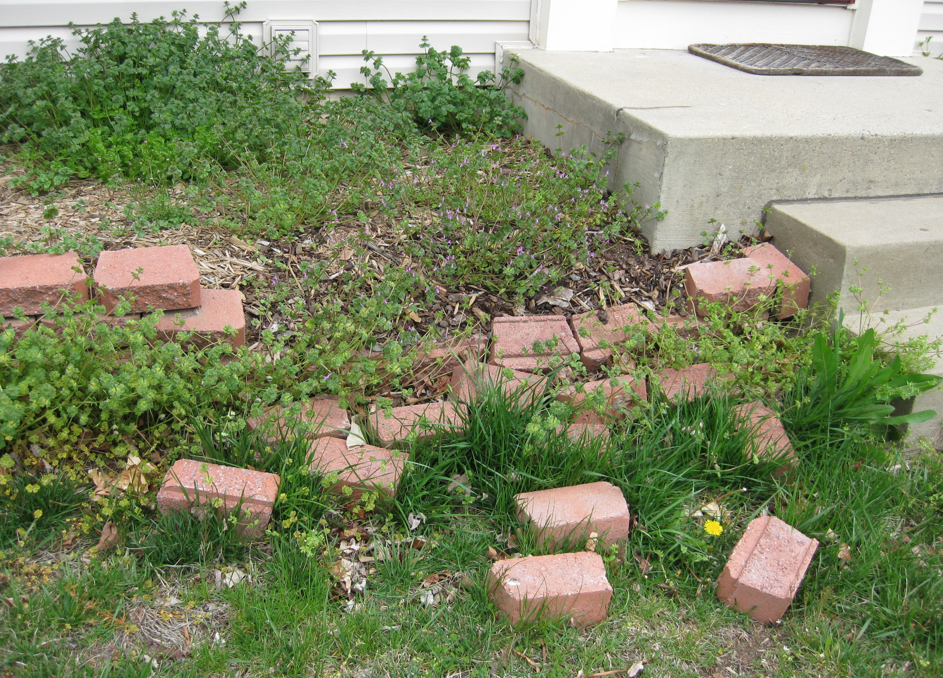
Jacob’s Travel’s
He never saw his mother again whom he loved deeply. He deals with Laban whom he wished he would never see again. His home life is full of contention and jealousy. His sons have just committed mass murder. He fears for his life in Canaan.

Slide 11

El Shaddai Speaks
“And God said unto him, I am God Almighty: be fruitful and multiply; a nation and a company of nations shall be of thee, and kings shall come out of thy loins; And the land which I gave Abraham and Isaac, to thee I will give it, and to thy seed after thee will I give the land. And God went up from him in the place where he talked with him.” Genesis 35:11-13

Slide 12
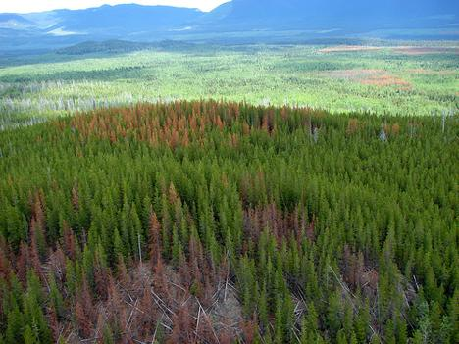
Trouble Stalks Jacob
Tension spills out in the disappearance and apparent death of Joseph. Jacob is as good as dead. Famine strikes. Simeon is tossed in an Egyptian dungeon and the governor is cruel. He wants to see Benjamin. Jacob is ripping in half. Where could Jacob find help? Who could nurture and encourage him in this utter extremity in his life? Who would listen to his heart felt cries? What could he do to find comfort? Rachel was dead; would anyone listen?

Slide 13
He is still There!
“ And their father Israel said unto them, If it must be so now, do this; take of the best fruits in the land in your vessels, and carry down the man a present, a little balm, and a little honey, spices, and myrrh, nuts, and almonds: And take double money in your hand; and the money that was brought again in the mouth of your sacks, carry it again in your hand; peradventure it was an oversight: Take also your brother, and arise, go again unto the man: And God Almighty give you mercy before the man, that he may send away your other brother, and Benjamin. If I be bereaved [of my children], I am bereaved.” Genesis 43:11-14

Slide 14
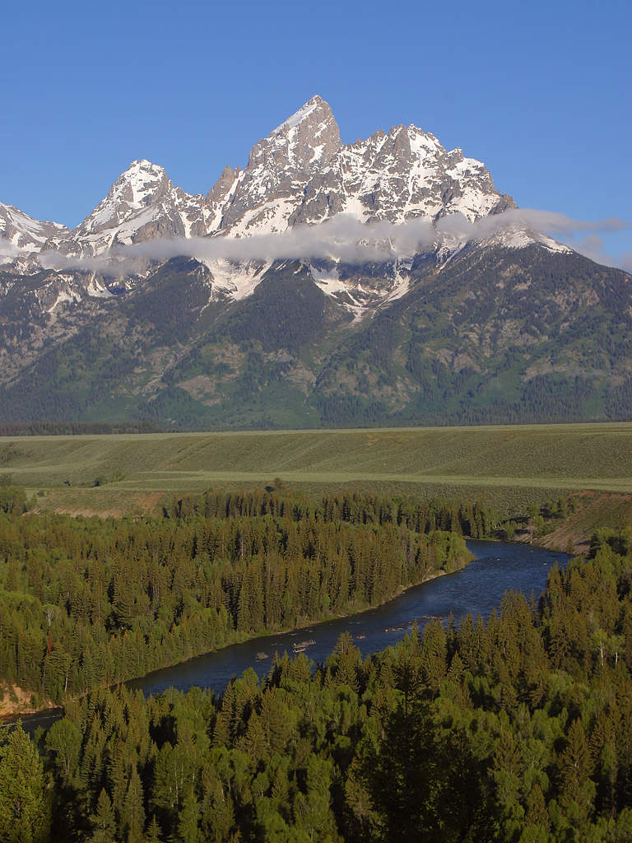
Always there
Throughout Jacob’s troublesome life; through the troubles with his brother, his uncle, his wives, his sons, and lastly, with the governor of Egypt, one constant had nurtured, strengthened, comforted, and remained at his side all the way through-El Shaddai!!!

Slide 15
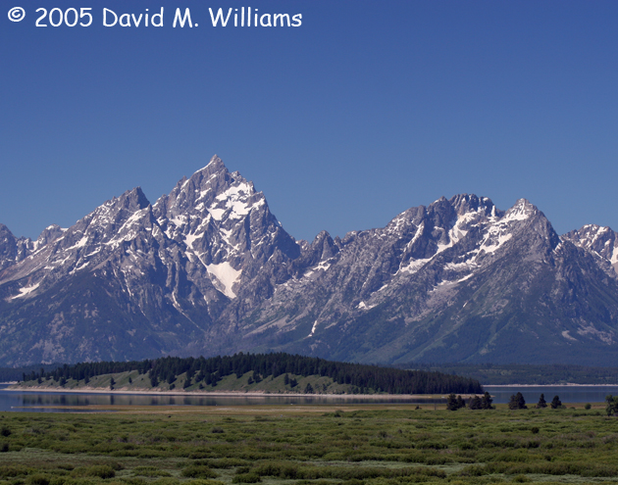
The Last Hurrah
“As they came nearer, the patriarch embraced and kissed them, solemnly laying his hands upon their heads in benediction. Then he uttered the prayer, "God, before whom my fathers Abraham and Isaac did walk, the God which fed me all my life long unto this day, the Angel which redeemed me from all evil, bless the lads." There was no spirit of self-dependence, no reliance upon human power or cunning now. God had been his preserver and support. There was no complaint of the evil days in the past. Its trials and sorrows were no longer regarded as things that were
"against" him. Memory recalled only His mercy and loving-kindness who had been with him throughout his pilgrimage.” PP, pgs. 234,235

Slide 16

What name?
“And Jacob said unto Joseph, God Almighty appeared unto me at Luz in the land of Canaan, and blessed me, And said unto me, Behold, I will make thee fruitful, and multiply thee, and I will make of thee a multitude of people; and will give this land to thy seed after thee for an everlasting possession.” Genesis 48:3,4

Slide 17
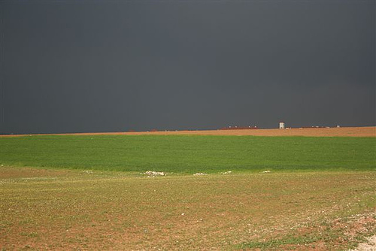
El Shaddai Not Just For Jacob
  The descendants of Jacob were in sight of the Promised Land. It was time for them to go home. ”Ye have compassed this mountain long enough: turn you northward,” Deut. 2:3 was the cry of their Invisible Leader. Unbeknownst to Israel, there was evil lurking nearby.

Slide 18
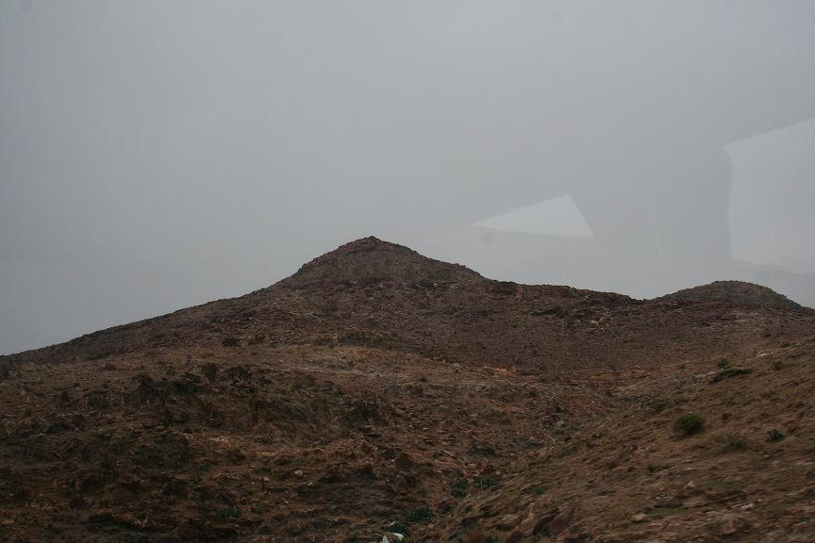
A Selfish Monster
Balaam knew that rich booty was soon to be his. All he had to do was curse Israel and he would be a wealthy man. He prepared his weapons of hell at the very heart of God’s people. Would he be able to curse God’s people?

Slide 19
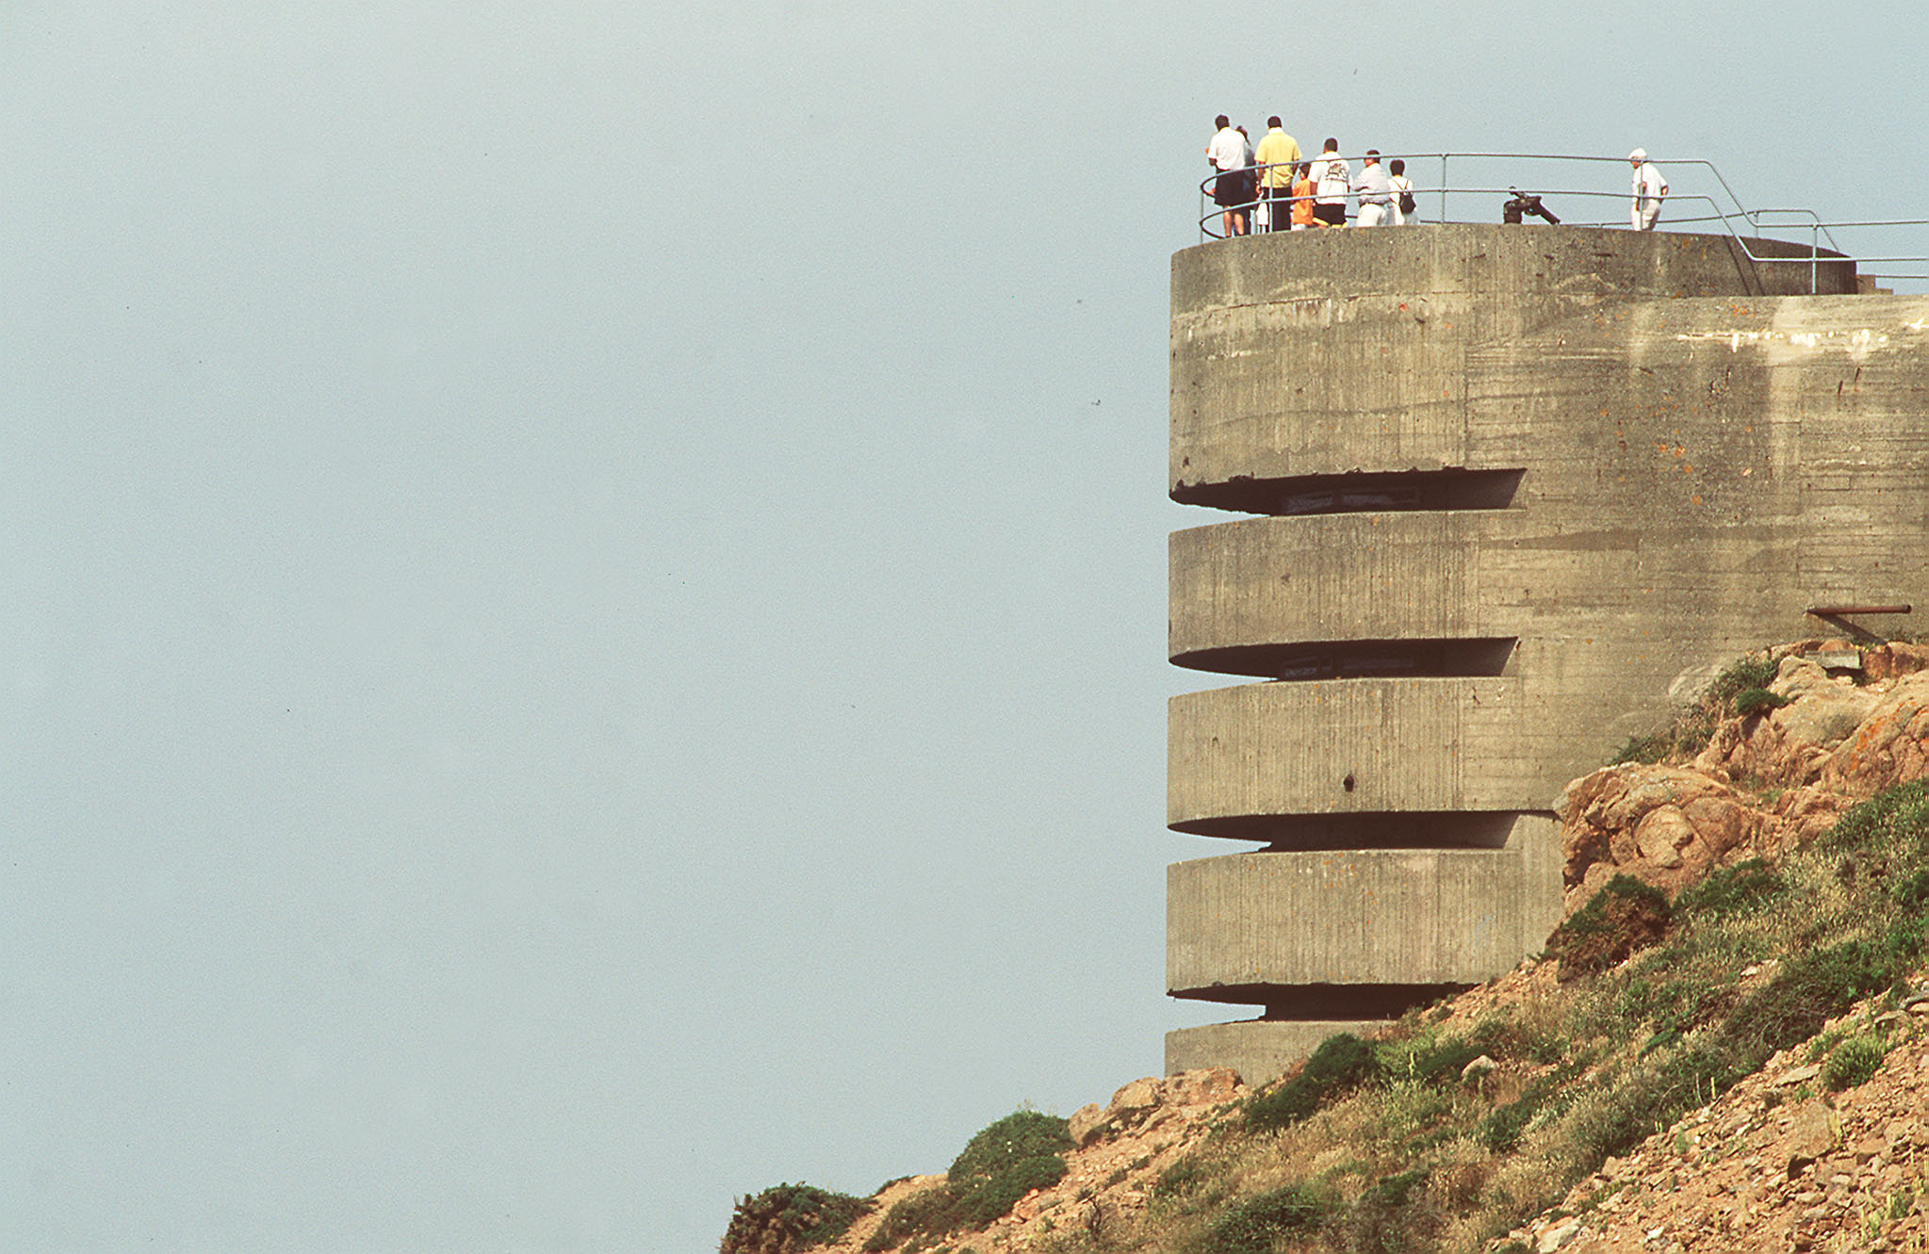
Someone was Watching
Someone was watching over His wayward children with a heart of tenderest pity. As long as His children walked before Him in humility and faith, no weapon in earth or hell could touch them. El Shaddai wouldn’t allow it!

Slide 20
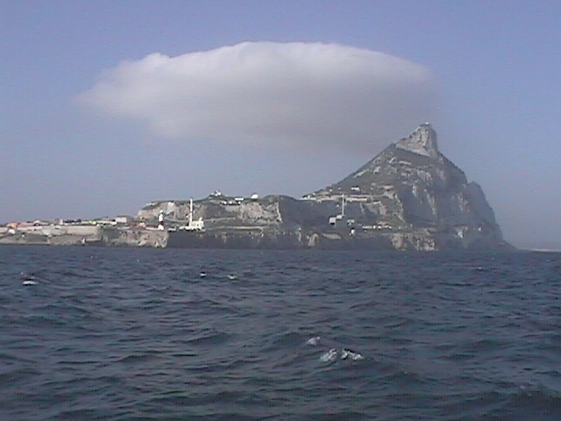
Balaam Invoked the Mighty Protector
“And he took up his parable, and said, Balaam the son of Beor hath said, and the man whose eyes are open hath said: He hath said, which heard the words of God, and knew the knowledge of the most High, which saw the vision of the Almighty, falling into a trance, but having his eyes open: I shall see him, but not now: I shall behold him, but not nigh: there shall come a Star out of Jacob, and a Sceptre shall rise out of Israel, and shall smite the corners of Moab, and destroy all the children of Sheth.” Numbers 24:15-17

Slide 21
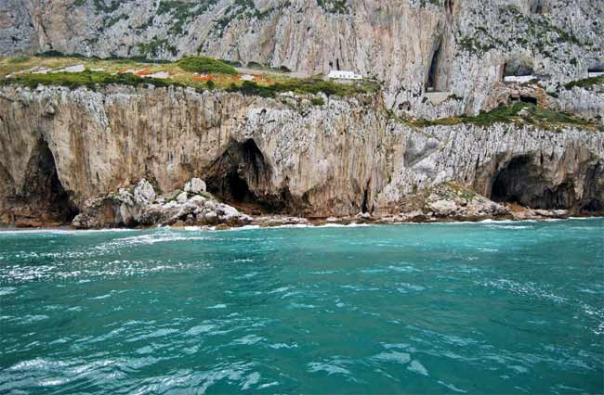
El Shaddai Today
As God’s people look to a future of trial and trouble; as the little and great times of trouble loom on the horizon, we can know that El Shaddai will be ever near His people. “He that dwelleth in the secret place of the most High shall abide under the shadow of the Almighty.” Ps. 91:1

Slide 22
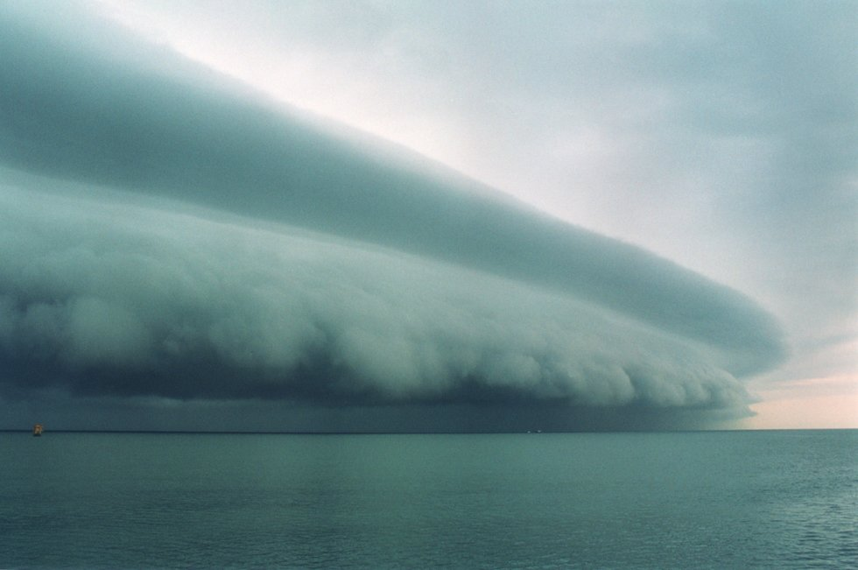
Possessed by the Spirit of Elijah
Filled by the Spirit of Elijah, God’s people will triumphant gloriously under the guiding hand of El Shaddai. As the papal Jezebel’s harangue God’s people, One will be near.. “While under the inspiration of the Almighty, he had stood the severest trial of faith.” RH, 10-16-1913

Slide 23
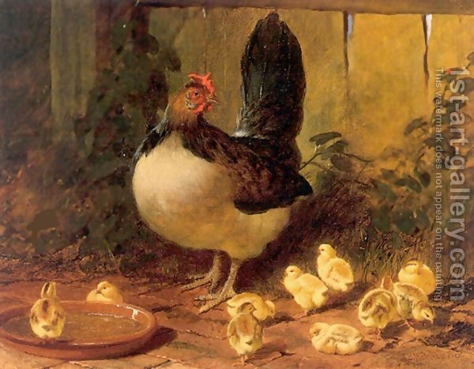
The Mother Hen
There was a fire…………

