Slide 1
Al-Qaeda, ISIS, CIA, and Papacy!
Do They Connect?

Slide 3
Both Sides Controlled!
Rev. 17:2,18 “With whom the kings of the earth have committed fornication, and the inhabitants of the earth have been made drunk with the wine of her fornication.… And the woman which thou sawest is that great city, which reigneth over the kings of the earth.”
The Papacy controlled both Roosevelt and Stalin and had them fighting against one another in the Cold War. Why?????????????????

Slide 4
Remember Malachi Martin?
3 powers vying for dominion of the world. Make your opponents look bad and yourself good and take over. How are America and the Russians looked at today?

Slide 5
Right Where You Want Them!

Slide 6
The Cold War!
Russia went everywhere with Communism; Korea, Vietnam, into Eastern Europe, Africa, South America, and even to Cuba!! How would America stop this? Who would be used to so such a task?

Slide 8
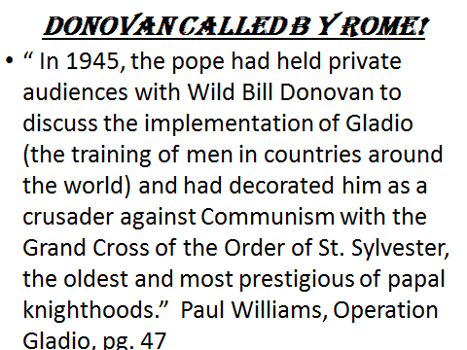

Slide 9
Gladio/CIA/ Papal Consortium
The Gladio units in the countries were set up by the Office of Strategic Services and this was the forerunner of the CIA! The CIA was run by Wild Bill Donovan, James Jesus Angleton, and other devout Catholics. Pope Pius X12 commissioned Donovan to use his office to stop Communism! The CIA- Catholic Intelligence Agency!

Slide 10
Funding Such a Program?
How do you:
1. find the money to train men and women throughout the world?
2. find the money to feed, house, and arm armies through out the world with modern weaponry?
3. find the money to pay people to do all this?
This is an enormous task!

Slide 11
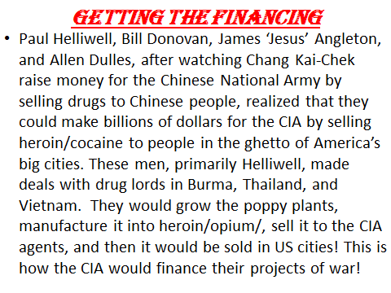
The Plan?

Slide 12
The Shan Plateau
The Shan Plateau of Burma became the heroin growing capital of the world! Billions and billions of dollars of heroin flowed from this region to the ghettos of the big cities of America and the Catholic Intelligence Agency was fighting Communism around the world!

Slide 13
Where does one Launder such Money?
“The money had to be channeled through a financial firm that would not be subjected to scrutiny by US Treasury agents,… or international fiscal monitors. Only one such institution possessed such immunity, and it was located in the heart of …………………………………………………………………………………………………………………………………………………VATICAN CITY! “The bank remains a sovereign financial agency within a sovereign state…it cannot be compelled to redress wrongs, not even the worst violations of international law. Nor can it be forced to release the source of any deposit. The bank resides under the jurisdiction of the pope. He owns it; he controls it!” Williams, pg. 45

Slide 14
What Does the Bible Say?
“The merchandise of gold, and silver, and precious stones, and of pearls, and fine linen, and purple, and silk, and scarlet, and all thyine wood, and all manner vessels of ivory, and all manner vessels of most precious wood, and of brass, and iron, and marble, And cinnamon, and odours, and ointments, and frankincense, and wine, and oil, and fine flour, and wheat, and beasts, and sheep, and horses, and chariots, and slaves, and souls of men. And the fruits that thy soul lusted after are departed from thee, and all things which were dainty and goodly are departed from thee, and thou shalt find them no more at all. The merchants of these things, which were made rich by her, shall stand afar off for the fear of her torment, weeping and wailing,” Rev. 18:12-15
“And the light of a candle shall shine no more at all in thee; and the voice of the bridegroom and of the bride shall be heard no more at all in thee: for thy merchants were the great men of the earth; for by thy sorceries were all nations deceived.” Rev. 18:23

Slide 15
Dirty, Drug Money Flowed thru the Vatican Bank!

Slide 16
Al-Qaeda/ISIS Connection?
Good information, but none of this speaks of Al-Qaeda! From where did they come? How do they fit into the CIA and the Papacy? Remember, the Catholic Intelligence Agency used drug money to finance armies to oppose the advances of Russia. Did this ever happen in the Middle East?

Slide 17
Helmand Valley of Afghanistan
In the mid 70’s, the Shan Plateau of Burma had a severe drought. The Catholic Intelligence Agency needed another place to grow poppies for heroin. The Helmand Valley in Southwestern Afghanistan was a perfect place! There were a few problems. The leader of Afghanistan, Nur Mohammed Taraki, did not want any poppies grown in the region, and he wanted to modify the strict Moslems in the area that wanted to follow the Koran strictly!

Slide 18
Taraki Had to Go
A group was formed in Afghanistan called Hezb-e-Islami; a group dedicated to creating a pure Islamic state. Does that sound familiar? (ISIS) Backed by the Papacy/CIA, the militant Moslems clashed with Taraki’s government. During this time in 1978, the production of heroin rose to 1,200 tons. Taraki was assassinated in September of 1979 and a pro-west, papacy, and CIA man, Hafizullah Amin, was put into power. In Dec. 1979, Russia invaded Afghanistan. They didn’t want a western Moslem at their backdoor!!

Slide 19
Who Would fight the Soviet Union in Afghanistan?
The Soviet Union sent in over 100,000 well equipped soldiers to subdue the pro western government of Amin. Afghanistan needed able men to fight the Soviets. They needed arms, missiles, everything possible, to fund a war against the Soviet superpower! Any idea what the groups were called that were trained by the Catholic Intelligence Agency in Afghanistan?

Slide 20
Well, well, well
The stage was now set for a clash between the Soviet Union and the CIA led forces that could be trained in Afghanistan. One of the groups of men trained by the Catholic Intelligence Agency in Afghanistan was called Al-Qaeda and an offshoot of Al-Qaeda that was later formed by the CIA was called ISIS. One of the major leaders of the CIA led forces in Afghanistan was Osama bin Laden. The conflict with the Soviets began in early 1980. Many of the Muslim fighters were trained in the Middle East. Many were trained in America and because the need for fighters became paramount, many black Americans were recruited by the CIA!

Slide 22
Al-Qaeda Funding!
In order to support this jihad against the Soviets, the Papacy/CIA needed huge supplies of heroin. The heroin flowing thru this region in the early 1980’s would be about 3 million dollars of heroin per hour!
“And the light of a candle shall shine no more at all in thee; and the voice of the bridegroom and of the bride shall be heard no more at all in thee: for thy merchants were the great men of the earth; for by thy sorceries were all nations deceived.” Rev. 18:23

Slide 27
Al-Qaeda/ISIS
1. Creation of the Catholic Intelligence Agency to fight the spread of communism.
2. Today, being used by the Catholic Intelligence Agency to create terror all over the world.
3. Today, Catholic Intelligence agency, is using them as smoke screen to further her own ends—EVEN IN AMERICA!

