Slide 1
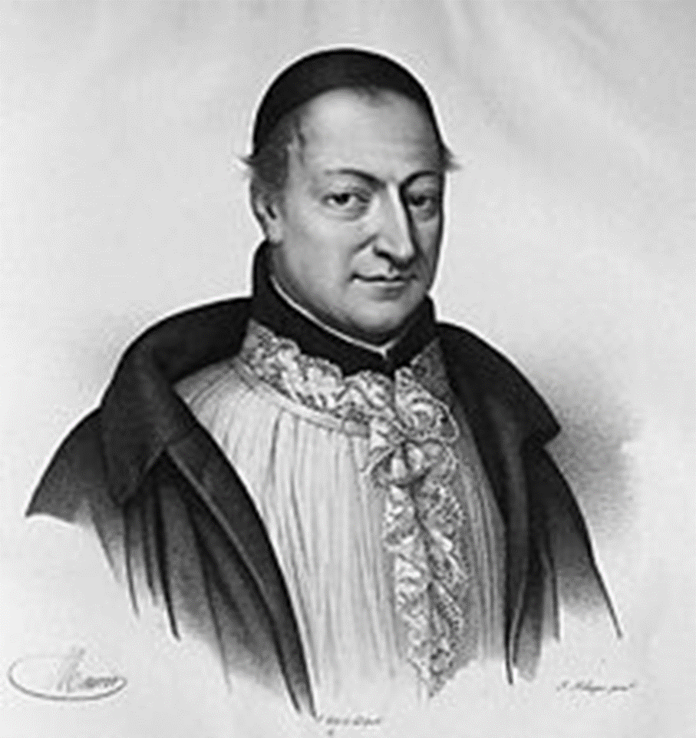
King Louis XIV’s Confessor La Chaise

Slide 2
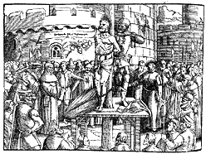

Slide 3
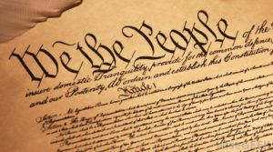

Slide 5
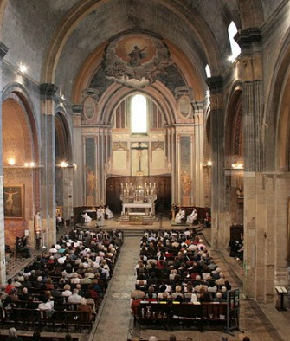

Slide 6
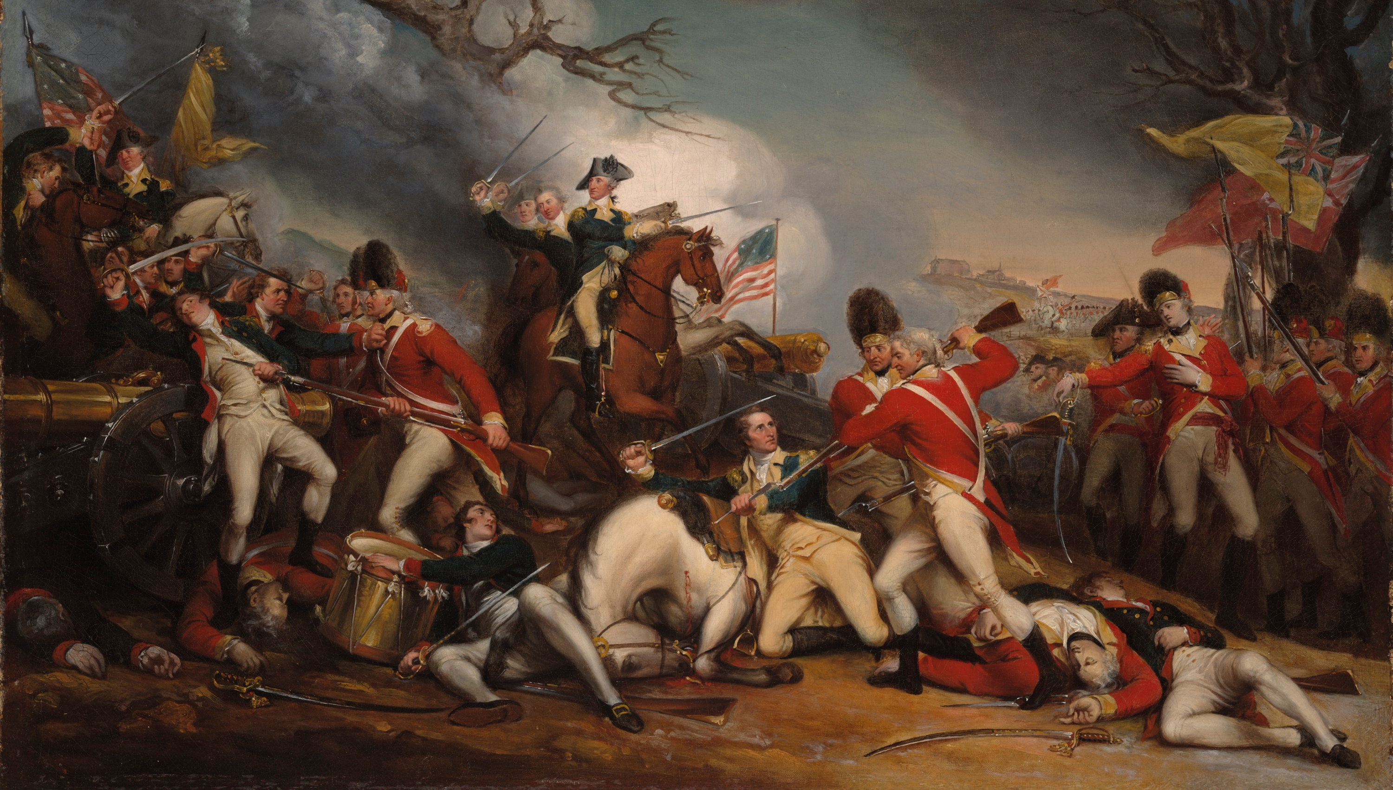
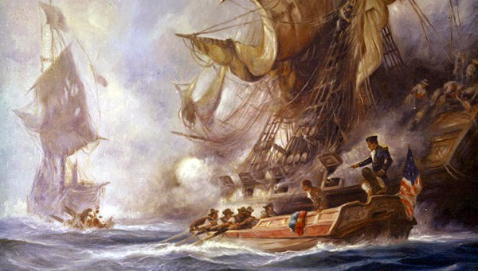
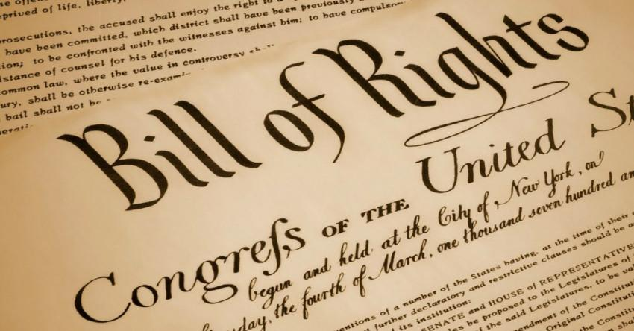
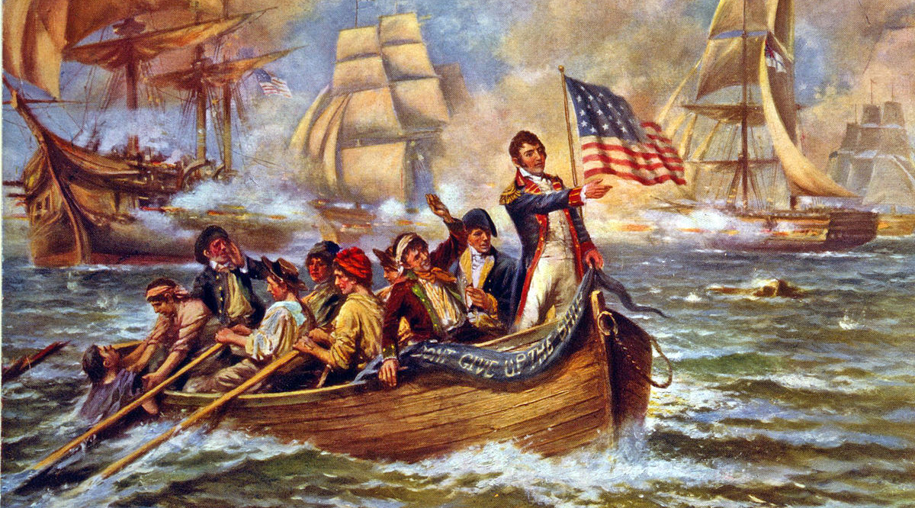
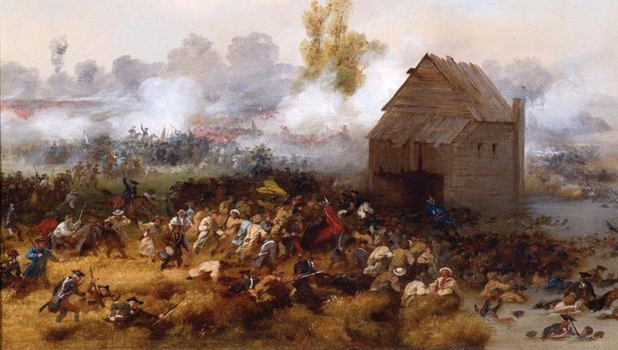

Slide 7
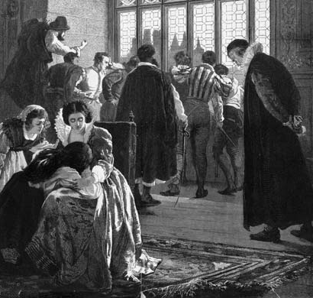
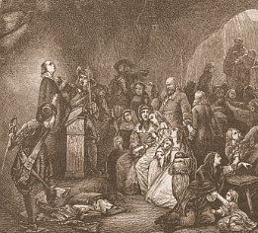

Slide 8
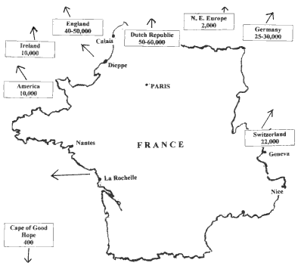
Routes Used by Huguenots to flee religious persecution
Rev. 12:6 “ And the woman fled into the wilderness, where she hath a place prepared of God, that they should feed her there a thousand two hundred and threescore days.”

Slide 9
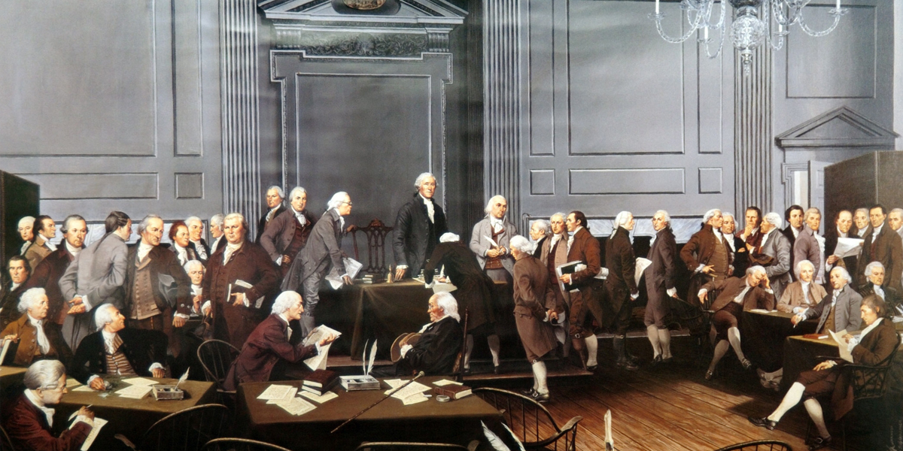

Slide 10
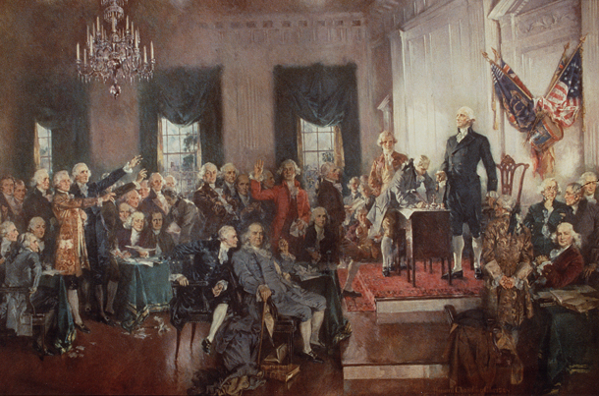

Slide 12
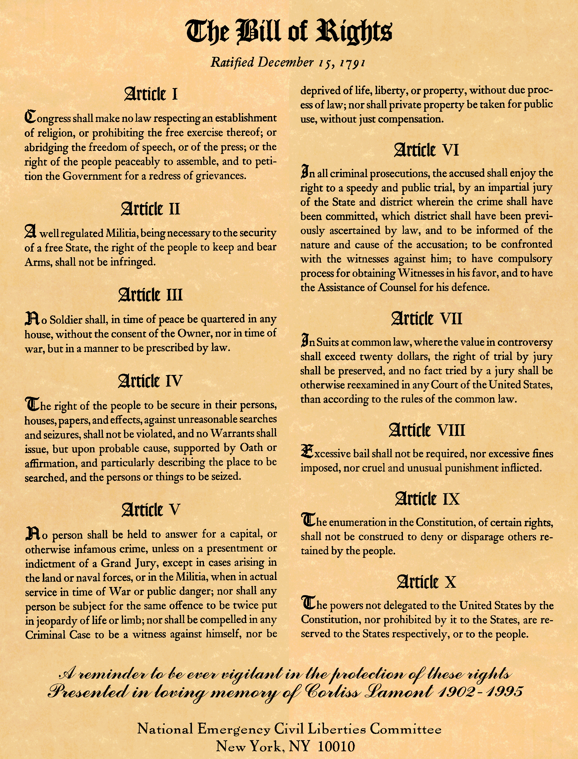
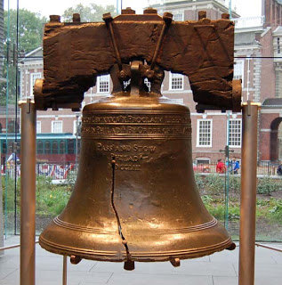

Slide 13
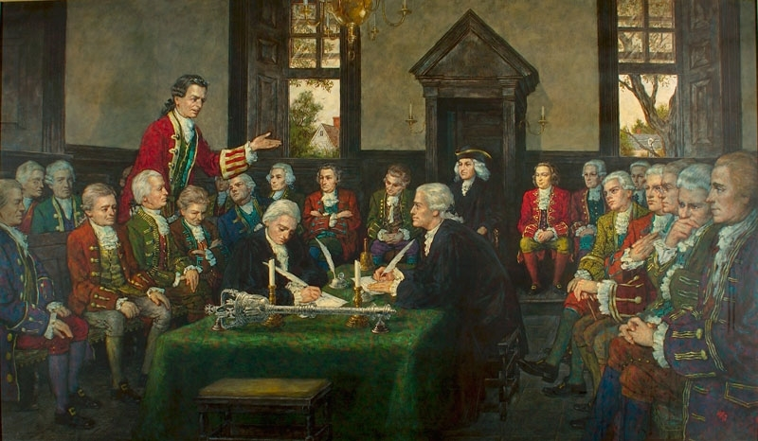

Slide 14
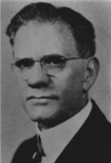
Benjamin G. Wilkinson (1872-1968)

Slide 15
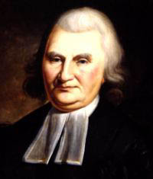
John Witherspoon (1723-1794)

Slide 16
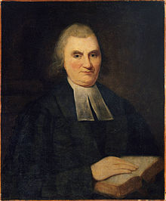
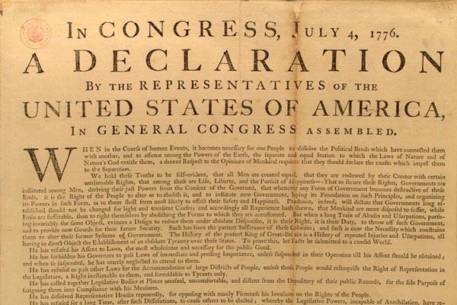
John Witherspoon:
Signer of the Declaration of Independence

Slide 17
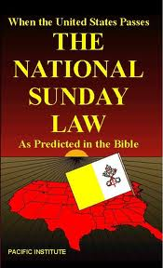

Slide 18
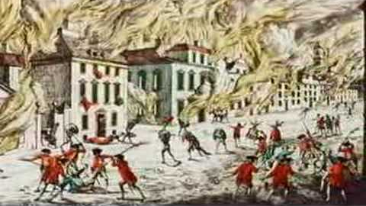
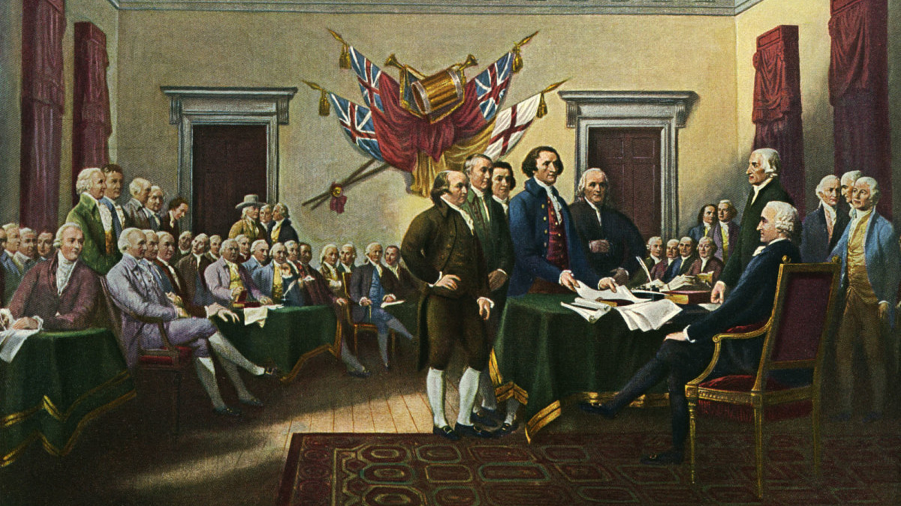
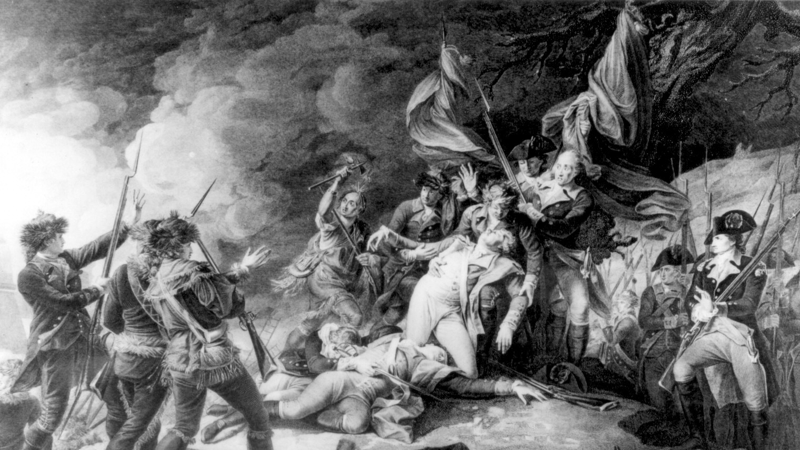
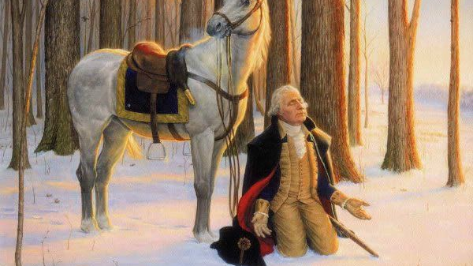

Slide 19
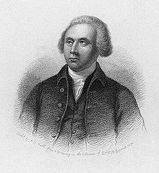
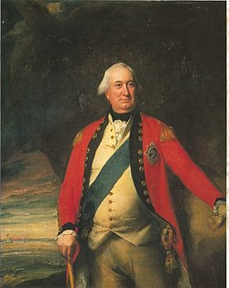
Thomas Nelson (1738-1789)
General Charles Cornwallis (1738-1805)

Slide 20
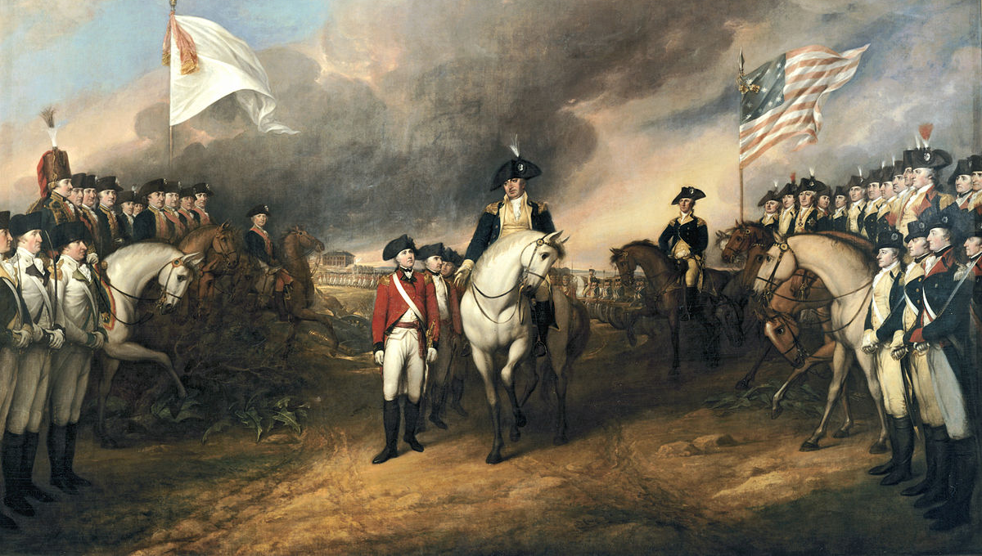

Slide 21
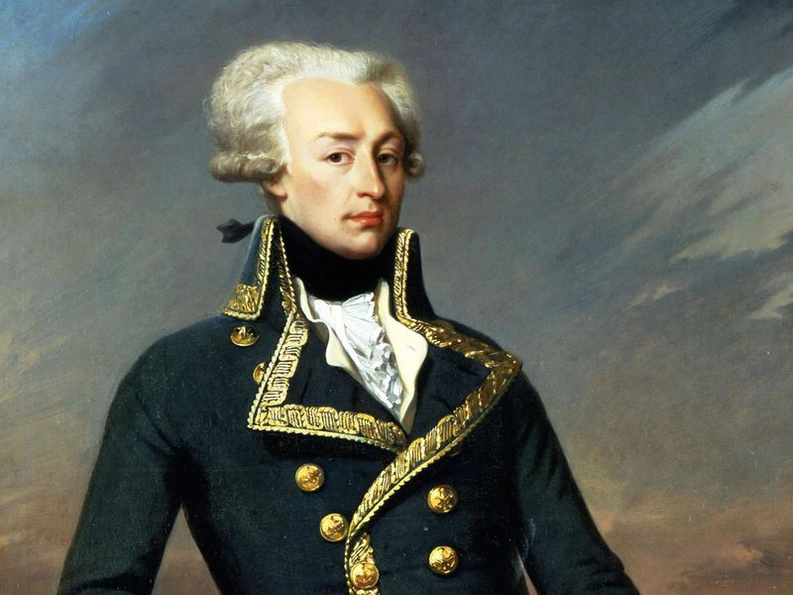
Marquis de Lafayette

Slide 22
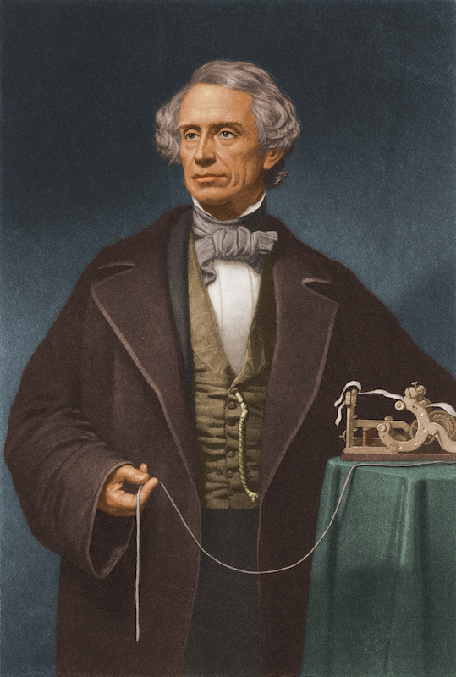
Samuel Morse: Scholar, Artist, and Inventor of the Telegraph

Slide 23
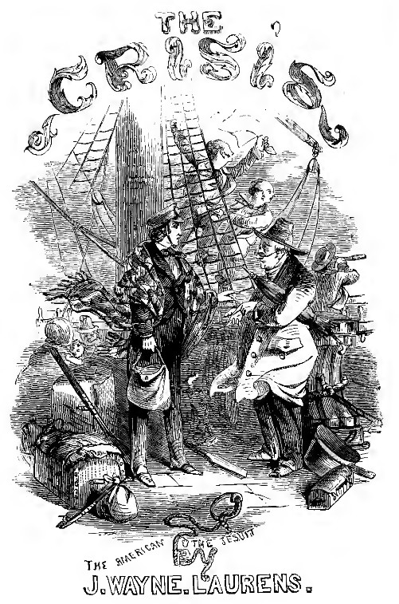

Slide 24
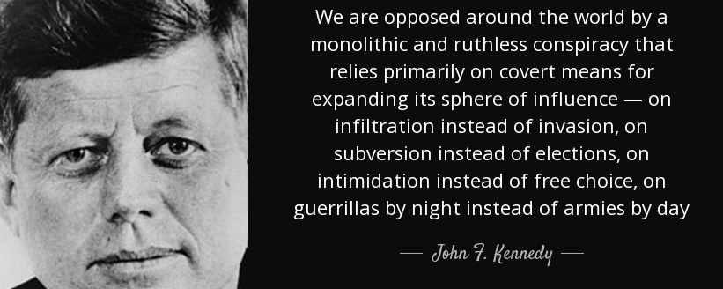

Slide 25
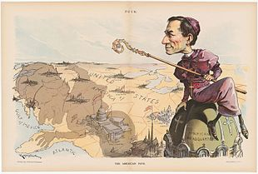

Slide 26
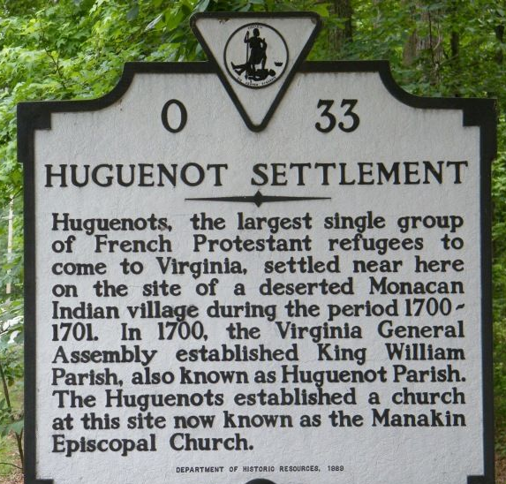
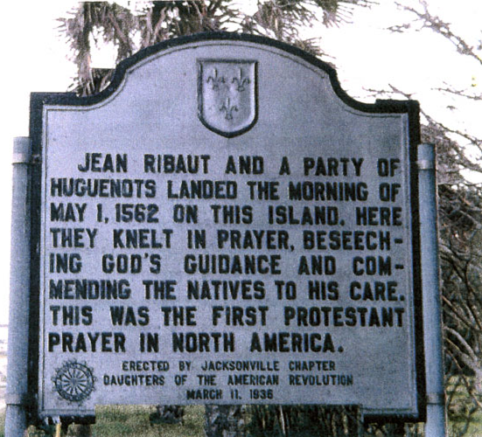

Slide 27
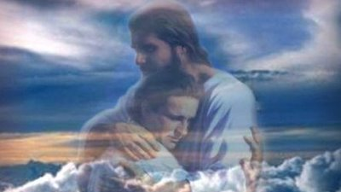

Slide 29
Fearful is the issue to which the world is to be brought. The powers of earth, uniting to war against the commandments of God, will decree that "all, both small and great, rich and poor, free and bond" (Revelation 13:16), shall conform to the customs of the church by the observance of the false sabbath. All who refuse compliance will be visited with civil penalties, and it will finally be declared that they are deserving of death. On the other hand, the law of God enjoining the Creator's rest day demands obedience and threatens wrath against all who transgress its precepts.
With the issue thus clearly brought before him, whoever shall trample upon God's law to obey a human enactment receives the mark of the beast; he accepts the sign of allegiance to the power which he chooses to obey instead of God.—Ellen White, Great Controversy, p. 604

Slide 30
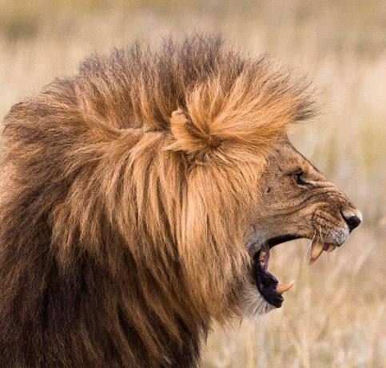
With the issue thus clearly brought before him, whoever shall trample upon God's law to obey a human enactment receives the mark of the beast; he accepts the sign of allegiance to the power which he chooses to obey instead of God. The warning from heaven is: "If any man worship the beast
and his image, and receive his mark in his forehead, or in his hand, the same shall drink of the wine of the wrath of God, which is poured out without mixture into the cup of His indignation." Revelation 14:9, 10. –Ellen White, Great Controversy, p. 604-605

Slide 31
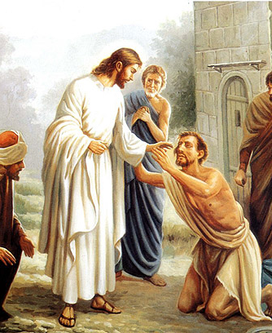
Christ
Satan
We Must Choose…
Peace, Joy, Eternal Life with a God that loves you
Misery, Chaos, Depression, Temporal Wealth, Temporal Fame, Corrupt Fortune, Destroyed in the Lake of Fire

