Slide 1
Ezekiel, pt. 24
‘Flowing River’

Slide 2
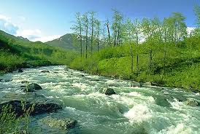
Amazing in its Simplicity
The first part of Ezekiel 47 is amazing in its simplicity, but profound in what it is communicating to us. This will be our study today.
“Afterward he brought me again unto the door of the house; and, behold, waters issued out from under the threshold of the house eastward: for the forefront of the house stood toward the east, and the waters came down from under from the right side of the house, at the south side of the altar. Then brought he me out of the way of the gate northward, and led me about the way without unto the utter gate by the way that looketh eastward; and, behold, there ran out waters on the right side.” Ezek. 47:1,2

Slide 3
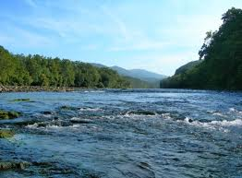
Water Flowing out of the sanctuary
“Christ's words were the water of life. There in the presence of the assembled multitude He set Himself apart to be smitten, that the water of life might flow to the world Satan thought to destroy the Prince of life; but from the smitten rock there flowed living water. As Jesus thus spoke to the people, their hearts thrilled with a strange awe, and many were ready to exclaim, with the woman of Samaria, "Give me this water, that I thirst not." John 4:15…

Slide 4
Water=Christ’s Words
…Many of those who heard Jesus were mourners over disappointed hopes, many were nourishing a secret grief, many were seeking to satisfy their restless longing with the things of the world and the praise of men; but when all was gained, they found that they had toiled only to reach a broken cistern, from which they could not quench their thirst. Amid the glitter of the joyous scene they stood, dissatisfied and sad. That sudden cry, "If any man thirst," startled them from their sorrowful meditation, and as they listened to the words that followed, their minds kindled with a new hope. The Holy Spirit presented the symbol before them until they saw in it the offer of the priceless gift of salvation. “ DA, pg. 454

Slide 5
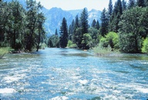
Flowing Truth
We have been called to share the truth of the 3 Angel’s Messages with every nation, kindred, tongue, and people. Those messages of life include:
1. the righteousness of Christ.
2. the 10 commandments.
3. the health message.
4. apostates Protestant churches are fallen.
5. The papacy is the antichrist.
Is it flowing?

Slide 6
Watch it Grow
“And when the man that had the line in his hand went forth eastward, he measured a thousand cubits, and he brought me through the waters; the waters were to the ankles. Again he measured a thousand, and brought me through the waters; the waters were to the knees. Again he measured a thousand, and brought me through; the waters were to the loins. Afterward he measured a thousand; and it was a river that I could not pass over: for the waters were risen, waters to swim in, a river that could not be passed over. And he said unto me, Son of man, hast thou seen this? Then he brought me, and caused me to return to the brink of the river.” Ezekiel 47:3-6

Slide 7
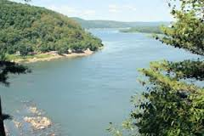
Ankles, Knees, Loins, Too High
The messages of heaven continue to go forward, offering life and power to those who hear the messages. They continue to increase and expand all the time.

Slide 8
The Work
“Wonderful is the work which the Lord designs to accomplish through His church, that His name may be glorified. A picture of this work is given in Ezekiel's vision of the river of healing: "These waters issue out toward the east country, and go down into the desert, and go into the sea: which being brought forth into the sea, the waters shall be healed. And it shall come to pass, that everything that liveth, which moveth, whithersoever the rivers shall come, shall live: . . . and by the river upon the bank thereof, on this side and on that side, shall grow all trees for meat, whose leaf shall not fade, neither shall the fruit thereof be consumed: it shall bring forth new fruit according to his months, because their waters they issued out of the sanctuary: and the fruit thereof shall be for meat, and the leaf thereof for medicine." Ezekiel 47:8-12.

Slide 9
The Plan
“From the beginning God has wrought through His people to bring blessing to the world. To the ancient Egyptian nation God made Joseph a fountain of life. Through the integrity of Joseph the life of that whole people was preserved. Through Daniel God saved the life of all the wise men of Babylon. And these deliverances are as object lessons; they illustrate the spiritual blessings offered to the world through connection with the God whom Joseph and Daniel worshiped. Everyone in whose heart Christ abides, everyone who will show forth His love to the world, is a worker together with God for the blessing of humanity. As he receives from the Saviour grace to impart to others, from his whole being flows forth the tide of spiritual life. “ AA, pg. 13

Slide 10
Flowing River? Or Miry Marsh?
“But the miry places thereof and the marshes thereof shall not be healed; they shall be given to salt. And by the river upon the bank thereof, on this side and on that side, shall grow all trees for meat, whose leaf shall not fade, neither shall the fruit thereof be consumed: it shall bring forth new fruit according to his months,” Ezek. 47:11,12

Slide 11
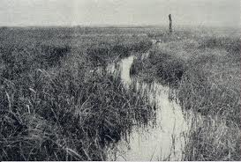
Miry Marsh?
Deuteronomy 29:23 “The whole land will be a burning waste of salt and sulfur--nothing planted, nothing sprouting, no vegetation growing on it. It will be like the destruction of Sodom and Gomorrah, Admah and Zeboim, which the LORD overthrew in fierce anger.”

Slide 12
Which Will it Be?
1. Spiritual Formation?
2. Rock Music?
3. Celebration?
4. New International Perversion?
5. Anything Goes?
6. Salvation in Sin?
7. Pope our Friend?
Miry Marsh?
1. 3 Angel’s Messages?
2. Rock of Ages?
3. Solemnity in Christ?
4. King James?
5. 10 Commandments Still Binding?
6. Victory thru Christ?
7. Pope the Antichrist?
Flowing River?

Slide 13
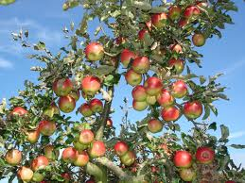
Decision Time!
The messages we proclaim are either a blessing or a curse. We are either a source of life to the world or a source of death! We are either sharing a counterfeit of the true or we are sharing the truth of God for this time. Heaven will not be held captive by our decision!

Slide 14
God Held Captive?
“For if thou altogether holdest thy peace at this time, then shall there enlargement and deliverance arise to the Jews from another place; but thou and thy father's house shall be destroyed: and who knoweth whether thou art come to the kingdom for such a time as this?” Esther 4:14

Slide 15
“But the people of Israel lost sight of their high privileges as God's representatives. They forgot God and failed to fulfill their holy mission. The blessings they received brought no blessing to the world. All their advantages they appropriated for their own glorification. They shut themselves away from the world in order to escape temptation. The restrictions that God had placed upon their association with idolaters as a means of preventing them from conforming to the practices of the heathen, they used to build up a wall of separation between themselves and all other nations. They robbed God of the service He required of them, and they robbed their fellow men of religious guidance and a holy example.” AA, pgs. 14,15

Slide 16
“The Jewish leaders thought themselves too wise to need instruction, too righteous to need salvation, too highly honored to need the honor that comes from Christ. The Saviour turned from them to entrust to others the privileges they had abused and the work they had slighted. God's glory must be revealed, His word established. Christ's kingdom must be set up in the world. The salvation of God must be made known in the cities of the wilderness; and the disciples were called to do the work that the Jewish leaders had failed to do.” AA, pg. 16

Slide 17
The Choice is Ours!
“The message of salvation is communicated to men through human agencies. But the Jews had sought to make a monopoly of the truth which is eternal life. They had hoarded the living manna, and it had turned to corruption. The religion which they tried to shut up to themselves became an offense. They robbed God of His glory, and defrauded the world by a counterfeit of the gospel. They had refused to surrender themselves to God for the salvation of the world, and they became agents of Satan for its destruction.
The people whom God had called to be the pillar and ground of the truth had become representatives of Satan. They were doing the work that he desired them to do, taking a course to misrepresent the character of God, and cause the world to look upon Him as a tyrant. The very priests who ministered in the temple had lost sight of the significance of the service they performed. They had ceased to look beyond the symbol to the thing signified. In presenting the sacrificial offerings they were as actors in a play. The ordinances which God Himself had appointed were made the means of blinding the mind and hardening the heart. God could do no more for man through these channels. The whole system must be swept away.” DA, pg. 36

Slide 18
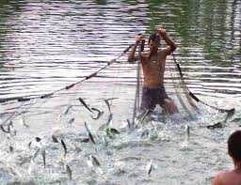
Fishers of Men
Are we reaching out to fellow Adventists or reaching the world? Is our focus on sharing the truth with those who have had the SOP for 40 years or are we reaching out to those in darkness? Is our work to reach Adventists or the world?

