Slide 1
Japanese Invasion
Something Similar

Slide 2
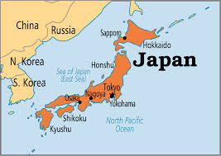
When/Why it Began!
Beginning in the 1500’s, during the military dictatorship of Daimyo Nobunaga, Jesuit missionaries were welcomed into Japan. This was with the hope of exchanging ideas. Along with the missionaries came Spanish/Portuguese traders with commodities that pleased the Japanese eye!

Slide 3
Economic Expansion
“In the history of Japan we have an even more striking instance of Vatican aggressiveness with profound repercussions in the world. As in China and Siam, the basic policy was to see that Catholic merchants and Catholic priests worked together so that both, by extending their own interests, should ultimately extend those of the Catholic Church.
Contrary to popular belief, when Japan first came into contact with the West she was eager for the interchange of ideas and commercial commodities. From the first chance landing of the Portuguese in Japan, foreign merchants were encouraged to call at Japanese ports. Local potentates vied with one another in opening their provinces to Western merchants. Catholic missionaries were as welcome as the traders, and set about spreading the Catholic faith in the new land.” Manhattan, ‘Vietnam: Why did we go?’, pg. 145

Slide 4
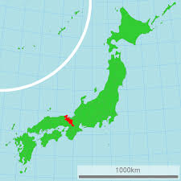
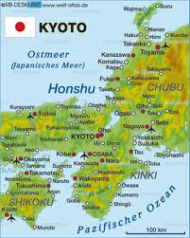
Kyoto- the Center of Catholic Missions

Slide 5
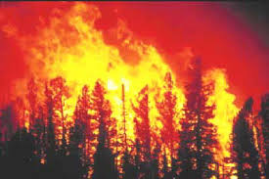
Spread Like Wildfire!
Emperor Nobunga, from 1573-1582, donated to the Catholic/Jesuit missionaries land in Kyoto, promised them a yearly allowance, and granted them the right to promote their religion throughout the empire. With these freedoms, converts to Roman Catholicism were made in the thousands!

Slide 6
Too Late!!
What all nations have failed to understand, as well as Japan, is that the Japanese were now subject to a foreign ruler, the pope and when obedience to the pope required it, the Japanese subject must disobey their sovereign and obey the pope. Commercial interests and political support would now go to Catholic commercial/political interests and not to those of Japan! Japan would be brought to her knees!

Slide 7
Trouble!!!
“The Roman Catholic Church, with all its ramifications throughout the world, forms one vast organization under the control, and designed to serve the interests, of the papal see. Its millions of communicants, in every country on the globe, are instructed to hold themselves as bound in allegiance to the pope. Whatever their nationality or their government, they are to regard the authority of the church as above all other. Though they may take the oath pledging their loyalty to the state, yet back of this lies the vow of obedience to Rome, absolving them from every pledge inimical to her interests.
History testifies of her artful and persistent efforts to insinuate herself into the affairs of nations; and having gained a foothold, to further her own aims, even at the ruin of princes and people. In the year 1204, Pope Innocent III extracted from Peter II, king of Aragon, the following extraordinary oath: "I, Peter, king of Arragonians, profess and promise to be ever faithful and obedient to my lord, Pope Innocent, to his Catholic successors, and the Roman Church, and faithfully to preserve my kingdom in his obedience, defending the Catholic faith, and persecuting heretical pravity." --John Dowling, The History of Romanism, b. 5, ch. 6, sec.” GC, pg. 580

Slide 8
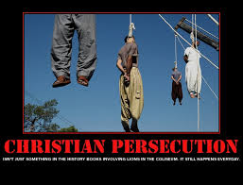
Intolerance Breeds Persecution!
The Catholic religion is the epitome of intolerance. They are right, everyone else is wrong, and if you do not join them, you will be persecuted. Your business will be boycotted, your church destroyed, until you either ‘convert’, or be destroyed!! This came to Japan in the late 1500’s!

Slide 9
Confrontation!!
The steps to domination were simple:
1. bring in a healthy commercial trade with the Japanese.
2. bring in new ideas in science, literature, and religion.
3. begin converting people to Catholicism.
4. the new converts begin to have financial, political, and economic success and advances.
5. Those who do not comply are finished!
6. Final step; take over the country religiously, economically, and politically.
When a ruler sees the danger, he attacks!

Slide 10
Hideyoshi Comes to Help!
“Hideyoshi, the new master of Japan, had become keenly conscious of the political implications of Catholicism and its allegiance to a distant Western religio-political potentate like the Pope. He decided to unite with Buddhism, which owed no political allegiance to any prince outside Japan.
In 1587 Hideyoshi visited Kyushu and to his astonishment found that the Catholic community had carried out the most appalling religious persecution. Everywhere he saw the ruins of Buddhist temples and broken Buddhist idols. The Catholics, in fact, had forcibly attempted to make the whole island of Kyushu totally Catholic. In indignation Hideyoshi condemned the attacks on the Buddhists, the Catholic religious intolerance, their political allegiance to a foreign power, and other real misdemeanors and gave all foreign Catholics an ultimatum.” Manhattan, Vietnam: Why did we Go?”, pg. 149

Slide 11
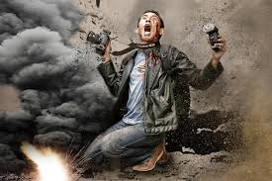
“…They had just twenty days to leave Japan. Churches and monasteries were pulled down in Kyoto and Osaka in retaliation for the attacks upon the Buddhists, and troops were sent to Kyushu.
Such measures were only partially successful since the society had been so deeply penetrated. In 1614 all Catholic foreign priests were ordered to be deported once more.” ibid, pg. 150

Slide 12
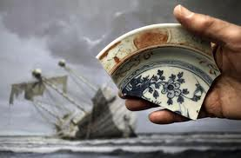
The Catalyst!!
The incident that brought everything to a head was the shipwrecking of a Spanish ship, the San Felipe, in 1596. The Spanish captain of the ship showed the Japanese authorities maps of Spanish dominions. He told them, “These conquests were made possible by the Catholic missionaries.’ Hideyoshi knew that Japan would be next. He had to take measures to stop Catholic takeover of Japan!!

Slide 13
Martyrs for Whom??????
“On February 5, 1597, twenty-six Christians—six European Franciscan missionaries, three Japanese Jesuits and seventeen Japanese laymen including three young boys—were executed by crucifixion in Nagasaki. These individuals were raised on crosses and then pierced through with spears.
Persecution continued sporadically, breaking out again in 1613 and 1630. On September 10, 1632, 55 Christians were martyred in Nagasaki in what became known as the Great Genna Martyrdom. At this time Roman Catholicism was officially outlawed. The Church remained without clergy and theological teaching disintegrated until the arrival of Western missionaries in the nineteenth century.
While there were many more martyrs, the first martyrs came to be especially revered, the most celebrated of whom was Paulo Miki. The Martyrs of Japan were canonized by the Roman Catholic Church on June 8, 1862 by Blessed Pius IX .” Wikipedia

Slide 14
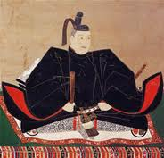
Ieyasu and Jemitsu
Both of these rulers, following the death of Hideyoshi, sought to drive the Jesuit/Catholic missionaries out of Japan. They knew that if the Catholics were not stopped, Japan would be overtaken. Edicts were passed, demanding that all Spanish and Portuguese Catholics leave Japan at once.

Slide 15
Go Home!!!
“In 1598 Hideyoshi died, and Catholic exertions were resumed with renewed vigor until Ieyasu became ruler of Japan in 1616 and enforced even more sternly his predecessor's expulsion edict.
Foreign priests were again ordered to leave Japan, and the death penalty was inflicted on Japanese "Christians" who did not renounce "Christianity." This persecution took a more violent turn in 1624 under Jemitsu (1623-51) when all Spanish merchants and missionaries were ordered to be deported immediately. Japanese "Christians" were warned not to follow the missionaries abroad and Japanese merchants not to trade any longer with Catholic powers. To make certain that these decrees were respected, all seaworthy ships which could carry more than 2,500 bushels of rice were to be destroyed. The government decided to stamp out Catholicism in Japan. Further edicts in 1633-4 and in 1637 completely prohibited all foreign religion in the Japanese islands.” Manhattan, pg. 152

Slide 16
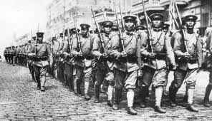
Civil War!
Civil War raged in Japan. Catholic Japanese were armed by their Jesuit priests to fight against their government. Bloody battles were fought for the sole purpose of taking over Japan for the papacy. The loyal governor of Shimbara was murdered!

Slide 17
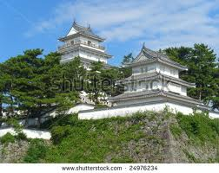
Barricaded Fortress
The Catholic army barricaded itself in the fortress in Shimbara. With the aid of the protestant Dutch, the Japanese were able to bombard the fortress and eventually destroy all the Catholics inside! The rebellion was stopped and the Edict of 1639 was the result.

Slide 18
Edict of 1639
EXCLUSION OF THE PORTUGUESE, 1639
1. The matter relating to the proscription of Christianity is known [to the Portuguese]. However, heretofore they have secretly transported those who are going to propagate that religion. 2. If those who believe in that religion band together in an attempt to do evil things, they must be subjected to punishment. 3. While those who believe in the preaching of the priests are in hiding, there are incidents in which chat country [Portugal] has sent gifts to them for their sustenance.
In view of the above, hereafter entry by the Portuguese galeota is forbidden. If they insist on coming [to Japan], the ships must be destroyed and anyone aboard those ships must be beheaded. We have received the above order and are thus transmitting it to you accordingly. The above concerns our disposition with regard to the galeota. With regard to those who believe in Christianity, you are aware that there is a proscription, and thus knowing, you are not permitted to let priests and chose who believe in their preaching to come aboard your ships. If there is any violation, all of you who are aboard will be considered culpable. If there is anyone who hides the fact that he is a Christian and boards your ship, you may report it to us. A substantial reward will be given to you for this information. This memorandum is to be given to those who come on Chinese ships. [A similar note to the Dutch ships.]

Slide 19
Closed for 0ver 2 centuries
Japan’s involvement with Western Christianity or papal Christianity was bloody, cunning, and cruel. Papists had revealed their desire for domination of Japan and its people. There was nothing in this of Christ, His love, and His goodness. It was all about greed, lust for power, and total control.
Japan would be shut to foreigners for over 200 years. However, Rome never forgets and payback would come!

