Slide 1
Church and State…Holding Pattern

Slide 2
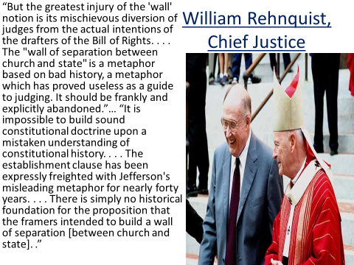

Slide 3
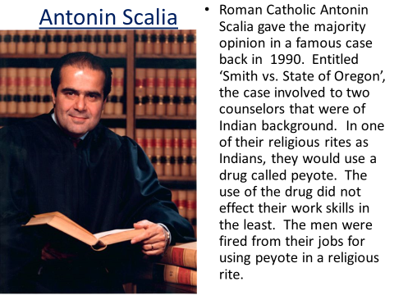

Slide 4
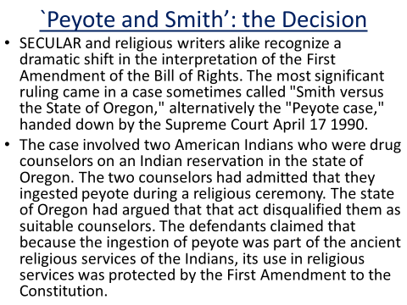

Slide 5
Amazing! Speaking like a Dragon!
David Savage, of the Los Angeles Times, wrote,
In what was called a "radical departure" from previous rulings protecting religion, the Supreme Court Tuesday forcibly declared that it would no longer shield believers whose practices violate general laws… Religions that are out of the mainstream are most likely to be affected, because their unconventional practices and lack of political clout have led them to depend upon the courts for protection…But in a sweeping opinion, Justice Antonin Scalia went far beyond the case and declared that when religious rights clash with the government’s need for uniform rules, the court will side with the government…Even for lay members of the community, this decision dramatically eroded the protection given to those citizens who were members of churches not part of the popular or mainstream churches of America… We cannot afford the luxury "of striking down laws simply because they limit someone’s religious practice." Scalia said. He advised religious adherents to look to the political system, not to the courts for protection.” Los Angeles Times, April 18 1990

Slide 6
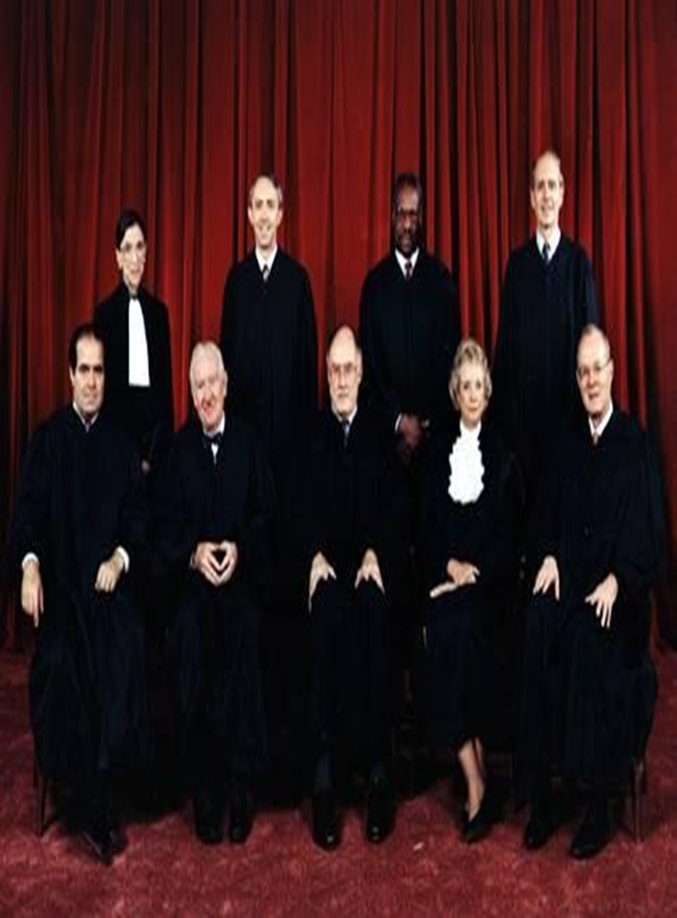
6 of 9 are…Roman Catholic!
“The architects of the Bill of Rights sought to safeguard the rights of minorities through the First Amendment. It would not be going too far to suggest that Scalia’s opinion was a direct violation of the Constitution of the United States. We question how justices who had sworn to uphold the Constitution of the United States could have rendered such an opinion. We are even more surprised that the majority of the citizens of the nation, or alternatively the members of Congress, did not rise up more decidedly against such a decision. It would seem that only a minority of Congressional members held deep concerns about this ruling.” Sunday Law. net

Slide 7
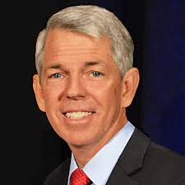
Powerful Conservative
Another incident that demonstrates the far reach of Barton's ideas occurred last year in Colorado during the state Republican Party convention. David S. Nelson, state director of the Colorado branch of the Christian Coalition distributed fliers asserting that "The Separation of Church and State is (1) Not a teaching of the founding fathers; (2) Not an historical teaching; (3) Not a teaching of law (except in recent years); (4) Not a biblical teaching." This language is lifted word for word.”

Slide 8
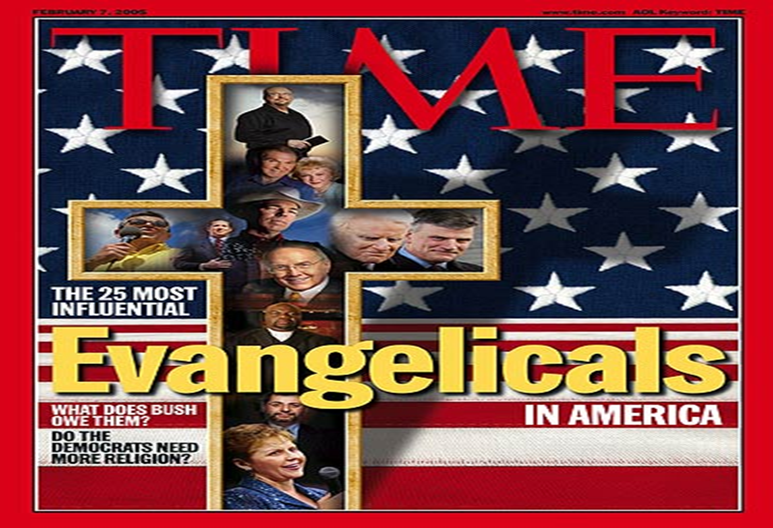

Slide 9
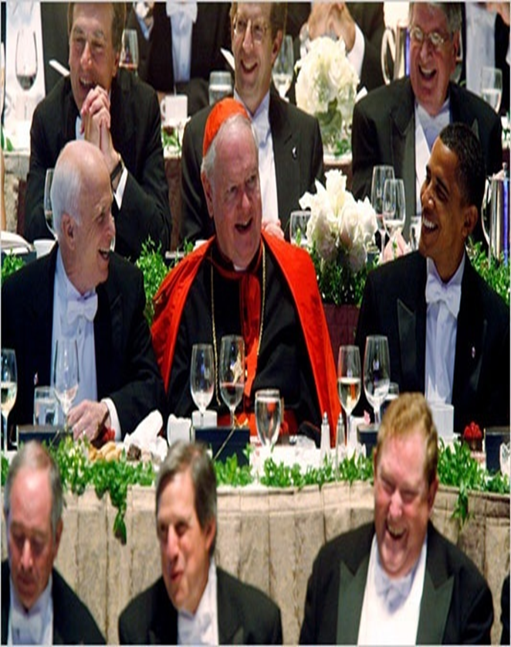
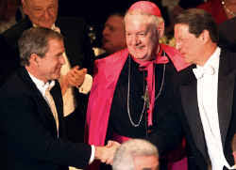
Buddies!

Slide 10
When Barack Obama arrived in Chicago in 1985 as a community organizer, he held meetings in what was then Holy Rosary Church and is now New Day Ministries. Taylor Glascock for The New York Times
By Jason Horowitz
March 22, 2014 CHICAGO — In a meeting room under Holy Name Cathedral, a rapt group of black Roman Catholics listened as Barack Obama, a 25-year-old community organizer, trained them to lobby their fellow delegates to a national congress in Washington on issues like empowering lay leaders and attracting more believers. “He so quickly got us,” said Andrew Lyke, a participant in the meeting who is now the director of the Chicago Archdiocese’s Office for Black Catholics. The group succeeded in inserting its priorities into the congress’s plan for churches, Mr. Lyke said, and “Barack Obama was key in helping us do that.” By the time of that session in the spring of 1987, Mr. Obama — himself not Catholic — was already well known in Chicago’s black Catholic circles. He had arrived two years earlier to fill an organizing position paid for by a church grant, and had spent his first months here surrounded by Catholic pastors and congregations. In this often overlooked period of the president’s life, he had a desk in a South Side parish and became steeped in the social justice wing of the church, which played a powerful role in his political formation.

Slide 11
What do you Know?
“Yes, President Barack Obama is absolutely right—change is coming! Especially when we consider that many of his appointees are Jesuit-trained. For example, Obama's Chief Speechwriter, Jon Favreau, was Jesuit-trained; Obama's Senior Military and Foreign Policy Advisor, Major General J. Scott Gration, was Jesuit-trained; Obama's Deputy Communications Director, Dan Pfeiffer, was Jesuit-trained; Obama’s Chicago mentor is Gregory Galluzzo, a “former” Jesuit priest and National Director and co-founder of the Gamaliel Foundation—a community organizing network representing more than a million multi-faith, church-going people who work on campaigns for social justice guided by an extreme, anti-American ideology; and former congressman Leon Panetta, who graduated from Santa Clara University—a comprehensive Jesuit, Catholic university, as head of the Central Intelligence Agency (CIA). Fasten your seatbelts!” D. Vierra’s, The Final Inquisition, pg. 27

Slide 12
Welcome to Mother!
“He had to do a power analysis of each Catholic church,” said one of his mentors at the time, Gregory Galluzzo, a former Jesuit priest and disciple of the organizer Saul Alinsky. Mr. Obama, Mr. Galluzzo said, soon understood the chain of command and who had influence in individual parishes.
Mr. Obama had a small office with two cloudy glass-block windows on the ground floor of Holy Rosary, a handsome red brick parish on the South Side, where he would pop down the hall to the office of the Rev. William Stenzel, raise a phantom cigarette to his lips and ask, “Want to go out for lunch?” Besides sneaking smoke breaks with the priest on the roof, Mr. Obama listened to him during Mass. “He was on an exposure curve to organized religion,” Father Stenzel said.
The future president’s education included evangelizing. Mr. Obama often plotted strategy with the recent Catholic convert who had hired him, Gerald Kellman, about how to bring people into the program and closer to the church.” Horowitz

Slide 13
O’bama and McCain
…This pernicious law poses one of the greatest threats to civil liberties in our nation’s history. Under Section 1021 of the NDAA, foreign nationals who are alleged to have committed or merely “suspected” of sympathizing with or providing any level of support to groups the U.S. designates as terrorist organization or an affiliate or associated force may be imprisoned without charge or trial “until the end of hostilities.” The law affirms the executive branch’s authority granted under the 2001 Authorization for Use of Military Force (AUMF) and broadens the definition and scope of “covered persons.” But because the “war on terror” is a war on a tactic, not on a state, it has no parameters or timetable. Consequently, this law can be used by authorities to detain (forever) anyone the government considers a threat to national security and stability – potentially even demonstrators and protesters exercising their First Amendment rights.” http://www.counterpunch.org/2012/01/18/why-the-ndaa-is-unconstitutional/
Proposed by McCain, passed by Obama. CFR members unite!

Slide 14
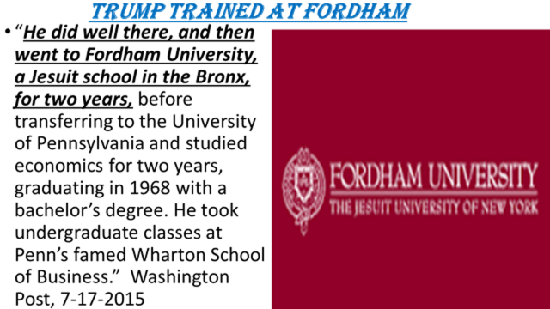

Slide 15
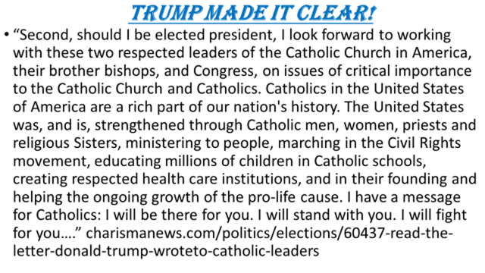

Slide 16

“With Donald Trump’s campaign losing ground among independent voters in recent weeks due to a series of well-publicized mistakes, the GOP presidential nominee has tripled down with the one base of political support that has steadfastly remained with him—white, evangelical voters—by promising to dismantle the laws that separate church and state in America…”
Time, Jeff Nesbit, August 15, 2016
Is he sounding like a dragon or is that my imagination?

Slide 17
“Trump told the pastors that evangelical voters would make the difference in key battleground states like Florida, Virginia, Ohio and Pennsylvania. And if white, evangelical Christians put him in the White House, he promised to return the favor.
“You have a chance to do something that will be earth shaking,” he said. “I literally mean it: earth shaking. You got to get your people out to vote.” ibid
Fl-29, Ohio-18, Penn-20, and Virginia-13

Slide 18
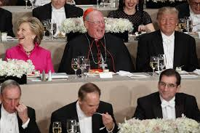

Slide 19

Trump Trained at Fordham
“He did well there, and then went to Fordham University, a Jesuit school in the Bronx, for two years, before transferring to the University of Pennsylvania and studied economics for two years, graduating in 1968 with a bachelor’s degree. He took undergraduate classes at Penn’s famed Wharton School of Business.” Washington Post, 7-17-2015

