Slide 1
World War……III!!!
Planning Ahead!!!

Slide 2
The Prophet Speaks
“But Romanism as a system is no more in harmony with the gospel of Christ now than at any former period in her history. The Protestant churches are in great darkness, or they would discern the signs of the times. The Roman Church is far-reaching in her plans and modes of operation. She is employing every device to extend her influence and increase her power in preparation for a fierce and determined conflict to regain control of the world, to re-establish persecution, and to undo all that Protestantism has done. Catholicism is gaining ground upon every side.” GC, pgs. 565,566

Slide 3
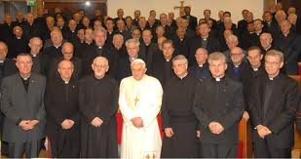
Think Tank
The Jesuit Order plans years, decades, centuries ahead in order to bring their plans to fruition. They want to ‘undo all that Protestantism has done. Catholicism is gaining ground upon every side.’ Is it happening??

Slide 4
Another century
“In the decades that followed it became apparent that, in order to achieve their goal of world domination, they would have to instigate of the old world order in preparation for the construction of the New World Order. This plan was outlined in graphic detail by Albert Pike, the Sovereign Grand Commander of the Ancient and Accepted Scottish Rite of Freemasonry and the top Illuminist in America, in a letter to Giusseppe Mazzini dated August 15, 1871. Pike stated that the First World War was to be fomented in order to destroy Czarist Russia- and to place that vast land under the direct control of Illuminati agents. Russia was then to be used as a ‘bogey man’ to further the aims of the Illuminati worldwide…

Slide 5
Cont.
…World War II was to be fomented through manipulation of the differences that existed between the German Nationalists and the Political Zionists. This was to result in an expansion of Russian influence and the establishment of a state of Israel in Palestine. The Third World War was planned to result from the differences stirred up by Illuminati agents between the Zionists and the Arabs. The conflict was planned to spread worldwide. The Illuminati planned to unleash the Nihilists and Atheists and provoke a formidable social cataclysm which in all its horror will show clearly to the nations the effect of absolute atheism, origin of savagery and of the most bloody turmoil. Then everywhere, the citizens, obliged to defend themselves
against the world minority of revolutionaries, will exterminate those destroyers of civilization, and… will receive the true light through the universal manifestation of the pure doctrine of Lucifer, brought finally out in the public view,…” - Des Griffin, Descent Into
Slavery, Emissary Publications, pp. 38, 39. .

Slide 6
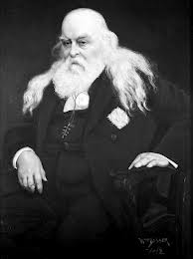
Farfetched!!!
‘Sovereign Grand Commander of the Ancient
and Accepted Scottish Rite of Freemasonry and the top Illuminist in America,’ Albert Pike was the top Free Mason and Illuminist in America in the 19th century. By the time of Pike, the Free Masons were completely taken over by the Jesuits and the Illuminati had always been a Jesuit front. Thus, Pike worked in the inner circles of the Jesuit Order and knew what was being planned!!

Slide 7
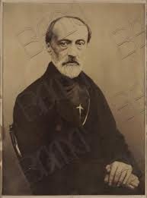
Penned in 1871
1. Grant was President.
2. The Civil War had just ended!
3. James White would die some 9 years later.
4. The early Adventist Church had yet to send out its foreign missionary. James Andrews would leave shortly!
5. The final spike had just been nailed down to complete the first transcontinental railroad!

Slide 8
Masterminds
When Pike speaks of three wars that have been planned; he is revealing the Jesuits plan for the world. As far back as 1871, the Jesuit Order had planned the wars of the 20th century and the current war on terror. How we have been lied to; it wasn’t the shooting of the Archduke of Austria that bought World War I; nor was it Adolf Hitler and Benito Mussolini that brought World War II; nor was it weapons of mass destructions of Saddam Hussein that brought this current war on terror. These wars have been on the Jesuit chalkboard for over 130 years; to them and them alone is the
responsibility for these horrors. The visible leaders that are paraded before the world are mere puppets whose strings are being pulled by their masters!!!

Slide 9
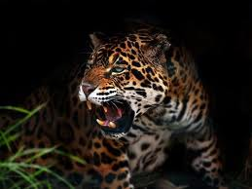
WWI
“Pike stated that the First World War was to be fomented in order to destroy Czarist Russia- and to place that vast land under the direct control of Illuminati agents. Russia was then to be used as a ‘bogey man’ to further the aims of the Illuminati worldwide…” The animal growls!!

Slide 10
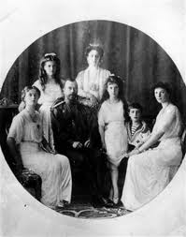
Czarist Russia Destroyed??
’Nicholas II, his wife, his son, his four daughters, the family's medical doctor, the Emperor's footman, the Empress' maidservant, and the family's cook were killed in the same room by the Bolsheviks on the night of 16/17 July 1918.’ This assassination brought an end to Czarist Russia. It took place toward the end of WWI!!!!

Slide 11
Why Destroy the Czar?
The Russian emperor, Alexander, was currently compelled to issue a royal decree in 1816, by which he expelled them [the Jesuits] from St. Petersburg and Moscow. This proving ineffectual, he issued another in 1820, excluding them entirely from the Russian dominions. -- R.W. Thompson, The Footprints of the Jesuits, Hunt and Eaton, pp. 245, 246.
Alexander II had progressed well with his great reforms and had attached his signature to a Constitution to be adopted by Russia…This same czar, who had the audacity to bring a constitution to the Russian people, also did something else for which the Jesuits would not forgive him. At the height of the Civil War, when the balance of the war could go either way, Alexander II came to the aid of Abraham Lincoln….

Slide 12
Far Reaching in her PLANS
By driving the Jesuits from Russia, refusing to establish a central bank, planning a constitution, and aiding the North during the Civil War, the czars of Russia had incurred the undying wrath of the Jesuit Order. Payback was imminent. The other no-no of the czars was their protection of the Russian Orthodox Church, the implacable enemy of Rome for over 1000 years.
“The overthrow of the Czarist system therefore, brought with it the inevitable overthrow of the established Orthodox Church. To the Vatican, which had waged war against the Orthodox Church since the eleventh century, the downfall of her millenarian rival was too good to be true. “-- Avro Manhattan, The Vatican Billions, Chick Publications, pp. 120, 121.

Slide 13
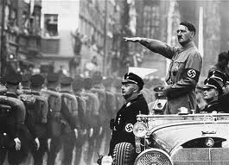
World War II
‘World War II was to be fomented through manipulation of the differences that existed between the German Nationalists and the Political Zionists. This was to result in an expansion of Russian influence and the establishment of a state of Israel in Palestine.’

Slide 14
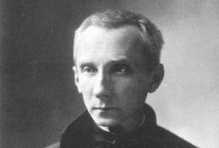
He Pulled the Strings!!!
Włodzimierz Ledóchowski Position Superior General (1915-1942)
Died December 13, 1942 (aged 76)
This man carried out Pike’s plans to restore the papacy to world dominance. He had Nicholas II killed. He was behind the holocaust. He triggered WWII/ He planned the deaths of millions!!!

Slide 15
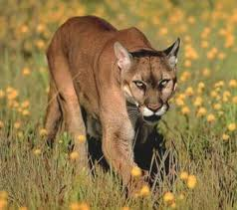
Animals on the Hunt
The plan for WWII was the expansion of Russia and establishing a state for Jews in Palestine. Did that happen?
Following WWII, we find Russia expanding into Eastern Europe, SE Asia, and even into the Caribbean. Albert Pike is batting 1,000!!

Slide 16
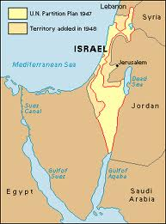
Israel Established???
‘On May 14, 1948, the Jewish People's Council declared the establishment of the State of Israel,^{[1]}following a prolonged campaign beginning in the late 19th century, when the Zionist movement began working towards creating a homeland for the Jewish people. About 42% of the world's Jews live in Israel today.’

Slide 17
WHY?
“The Vatican believes that if hatred for the Jews can be fomented as took place in Hitler’s Germany. Then Jews will be ruthlessly eliminated. The Vatican believes that if all Jews are killed, Christ will not come, and the Vatican’s aim to rule the world would remain intact. Avro Manhattan says it this way: It is important, although it may be difficult for some to recognize the religious nature of the Communist/Zionist/Catholic political configuration. Although deliberately muted in public pronouncements, behind the Zionist banner there was to be found the ancient Messianic hope for the coming a global theocracy, as predicted by all the seers and prophets of Zion. It was to be a theocracy in which Jehovah, not Christ, was to be King.

Slide 18
Kill or be Killed
…The spectre of the creation of such a theocracy has haunted the inner chambers of the Catholic church from her earliest inception, and still is a dominant fear. In Vatican eyes, therefore, the millenarian yearning for a global Hebrew theocracy, represents a deadly threat to the eschatological teachings of the Catholic church. When translated into concrete political terms, such a view spells
not only rivalry, but implacable enmity. -- Avro Manhattan, The Vatican Moscow Washington Alliance, chick Publications, pp. 169, 170.

Slide 19
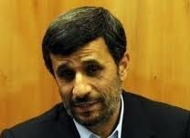
Pike Calls for ONE More
“The Third World War was planned to result from the differences stirred up by
Illuminati agents between the Zionists and the Arabs. The conflict was planned to
spread worldwide…the citizens will receive the true light through the universal manifestation of the pure doctrine of Lucifer, brought finally out in the public view…”

Slide 20
Man on a Mission
“Iran's president believes Allah has chosen him to prepare the world for the coming of an Islamic 'savior' called the Mahdi.
But before the Mahdi's return, Mahmoud Ahmadinejad believes there must be global chaos - even if he has to create it himself.
Whether it's his belief that Israel should be wiped off the map, denials of the Holocaust, obsession with going nuclear, or support for radical Islamic terrorist groups, Mahmoud Ahmadinejad is a man on a divine mission.” http://www.cbn.com/cbnnews/411301.aspx

Slide 21
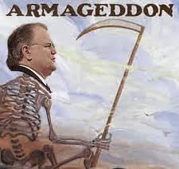
War Before Messiah/False Armageddon
Evangelicals have been preaching for years of a literal, physical battle called Armageddon. This would bring in the Messiah’s coming. All the world is looking for a messiah. Great Controversy tells us the devil will come, claiming to be Christ.

Slide 22
All Religions Looking for Messiah
Islam-Mahdi
Buddhism-Maitreya: Meaning either 'The World Unifier' or simply 'The Friend’
The Aztec/Mayan Messiah: The return of Quetzalcoatl -- an olive-skinned man with a white beard and followers in red.
The Hindu Messiah: Kalki or Javada: The ninth and last Avatar of this yuga cycle. His final incarnation will appear from the West.
The Messiah of Central Asian nomads: The White Burkhan. He will come when the people of the steppes have abandoned their ancient gods (Communist Russia was atheist). He will come to offer them and the entire human race a spiritual rebirth.
The Christian Tradition-Jesus will come.
All religions await a Messiah figure. All whose names aren’t written in the Lamb’s book of life will see in the devil’s personating of Christ their messiah.

Slide 23
The Crowning Act
“As the crowning act in the great drama of deception, Satan himself will personate Christ. The church has long professed to look to the Saviour's advent as the consummation of her hopes. Now the great deceiver will make it appear that Christ has come. In different parts of the earth, Satan will manifest himself among men as a majestic being of dazzling brightness, resembling the description of the Son of God given by John in the Revelation. Revelation 1:13-15. The glory that surrounds him is unsurpassed by anything that mortal eyes have yet beheld. The shout of triumph rings out upon the air: "Christ has come! Christ has come!" The people prostrate themselves in adoration before him, while he lifts up his hands and pronounces a blessing upon them, as Christ blessed His disciples when He was upon the earth.” GC, pg. 624

Slide 24
Pure Doctrine of Lucifer
From the fall of man, the devil has turned humanity from the Creator to the most powerful force in the visible universe. The worship of the sun will be the devil’s last hurrah. Sunday is its manifestation today.

Slide 25
Summary
1. Albert Pike, leading Jesuit in the 19th century, declared 3 Wars were planned.
2. In the final war, which is being agitated in the press right now between Jews and Arabs, Lucifer’s pure doctrine would be seen. I believe that is Sunday worship.
3. There will be a false Armageddon before the devil impersonates Christ. This 3rd war will be it.
4. In this 3rd war, we will see Sunday.
5. After the Loud Cry, the devil will appear, claiming to be Christ.
6. Hold on to the real Christ!!

