Slide 1
Hebrews, ch. 1
Christ, Greater Than All

Slide 2
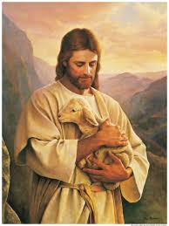
Confronted by Christ’s Greatness
“God, who at sundry times and in divers manners spake in time past unto the fathers by the prophets, Hath in these last days spoken unto us by his Son, whom he hath appointed heir of all things, by whom also he made the worlds; Who being the brightness of his glory, and the express image of his person, and upholding all things by the word of his power, when he had by himself purged our sins, sat down on the right hand of the Majesty on high;” Hebrews 1:1-3

Slide 3
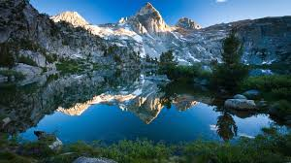
Creator/Savior
1. Creator.
2. the glory of His Father rested upon Him.
3. image of His Father.
“Let this mind be in you, which was also in Christ Jesus: Who, being in the form of God, thought it not robbery to be equal with God: But made himself of no reputation, and took upon him the form of a servant, and was made in the likeness of men: And being found in fashion as a man, he humbled himself, and became obedient unto death, even the death of the cross.” Phil. 2:5-8

Slide 4
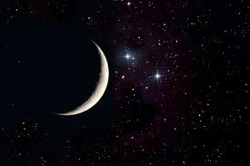
When I Consider Thy Heavens, the Moon and the stars…. Ps. 8:3,4

Slide 5
Amazing Sacrifice
“The cross of Christ will be the science and the song of the redeemed through all eternity. In Christ glorified they will behold Christ crucified. Never will it be forgotten that He whose power created and upheld the unnumbered worlds through the vast realms of space, the Beloved of God, the Majesty of heaven, He whom cherub and shining seraph delighted to adore--humbled Himself to uplift fallen man; that He bore the guilt and shame of sin, and the hiding of His Father's face, till the woes of a lost world broke His heart and crushed out His life on Calvary's cross. That the Maker of all worlds, the Arbiter of all destinies, should lay aside His glory and humiliate Himself from love to man will ever excite the wonder and adoration of the universe. As the nations of the saved look upon their Redeemer and behold the eternal glory of the Father shining in His countenance; as they behold His throne, which is from everlasting to everlasting, and know that His kingdom is to have no end, they break forth in rapturous song: "Worthy, worthy is the Lamb that was slain, and hath redeemed us to God by His own most precious blood!“ The mystery of the cross explains all other mysteries.” GC., pgs. 651, 652

Slide 6
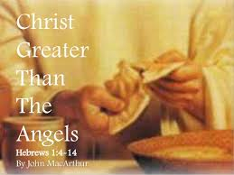
Greater Than the Angels
“Being made so much better than the angels, as he hath by inheritance obtained a more excellent name than they. For unto which of the angels said he at any time, Thou art my Son, this day have I begotten thee? And again, I will be to him a Father, and he shall be to me a Son? And again, when he bringeth in the first begotten into the world, he saith, And let all the angels of God worship him. And of the angels he saith, Who maketh his angels spirits, and his ministers a flame of fire. But unto the Son he saith, Thy throne, O God, is for ever and ever: a sceptre of righteousness is the sceptre of thy kingdom.” Hebrews 1:4-8

Slide 7
Christ’s Superiority
“The first chapter of Hebrews contrasts the position of the angels and the position of Christ. God has spoken words concerning Christ that are not to be applied to the angels. They are “sent forth to minister for them who shall be heirs of salvation,” but Christ, as Mediator, is the great Minister in the work of redemption. The Holy Spirit is His representative in our world, to execute the divine purpose of bringing to fallen man power from above, that he may be an overcomer. All who enter into a covenant with Jesus Christ become by adoption the children of God. They are cleansed by the regenerating power of the Word, and angels are commissioned to minister unto them (Manuscript 57, 1907).

Slide 8
Angels
Angels are in nature superior to men, for the psalmist says that man was made “a little lower than the angels.” Psalm 8:5.—The Great Controversy, 511.
From eternal ages it was God's purpose that every created being, from the bright and holy seraph to man, should be a temple for the indwelling of the Creator.—The Desire of Ages, 161. TA 26.1
All created beings live by the will and power of God. They are dependent recipients of the life of God. From the highest seraph to the humblest animate being, all are replenished from the Source of life.—The Desire of Ages, 785. TA 26.2
When the Lord created these [angelic] beings to stand before His throne, they were beautiful and glorious. Their loveliness and holiness were equal to their exalted station. They were enriched by the wisdom of God, and girded with the panoply of heaven.—The Signs of the Times, April 14, 1898. TA 26.3
God made him [Lucifer] good and beautiful, as near as possible like Himself.—The Review and Herald, September 24, 1901. TA 26.4
God had made him [Lucifer] noble, had given him rich endowments. He gave him a high, responsible position. He asked of him nothing that was unreasonable. TA 26.5

Slide 9
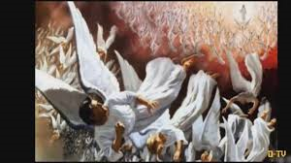
Christ the Chief of the Angels
“And there was war in heaven: Michael and his angels fought against the dragon; and the dragon fought and his angels, And prevailed not; neither was their place found any more in heaven. And the great dragon was cast out, that old serpent, called the Devil, and Satan, which deceiveth the whole world: he was cast out into the earth, and his angels were cast out with him.” Rev. 12:7-9

Slide 10
Supremacy of Christ!
“The angels joyfully acknowledged the supremacy of Christ, and prostrating themselves before Him, poured out their love and adoration. Lucifer bowed with them, but in his heart there was a strange, fierce conflict. Truth, justice, and loyalty were struggling against envy and jealousy. The influence of the holy angels seemed for a time to carry him with them. As songs of praise ascended in melodious strains, swelled by thousands of glad voices, the spirit of evil seemed vanquished; unutterable love thrilled his entire being; his soul went out, in harmony with the sinless worshippers, in love to the Father and the Son. But again he was filled with pride in his own glory. His desire for supremacy returned, and envy of Christ was once more indulged. The high honors conferred upon Lucifer were not appreciated as God's special gift, and therefore, called forth no gratitude to his Creator. He glorified in his brightness and exaltation and aspired to be equal with God. He was beloved and reverenced by the heavenly host, angels delighted to execute his commands, and he was clothed with wisdom and glory above them all. Yet the Son of God was exalted above him, as one in power and authority with the Father. He shared the Father's counsels, while Lucifer did not thus enter into the purposes of God. "Why," questioned this mighty angel, "should Christ have the supremacy? Why is He honored above Lucifer?“ PP, pgs. 36,37

Slide 11
“Thou hast loved righteousness, and hated iniquity; therefore God, even thy God, hath anointed thee with the oil of gladness above thy fellows. And, Thou, Lord, in the beginning hast laid the foundation of the earth; and the heavens are the works of thine hands: They shall perish; but thou remainest; and they all shall wax old as doth a garment; And as a vesture shalt thou fold them up, and they shall be changed: but thou art the same, and thy years shall not fail. But to which of the angels said he at any time, Sit on my right hand, until I make thine enemies thy footstool? Are they not all ministering spirits, sent forth to minister for them who shall be heirs of salvation?” Heb. 1:9-14

Slide 12
Saving Humanity from the Devil’s Attacks
”Divine ministration is needed to give power and efficiency to the church in this world. God's family on earth, subject to temptations and trials, is very near to His heart of love. He has ordained that communication be kept up between heavenly intelligences and His children on this earth. Angels from the courts above are sent forth to minister to those who shall be heirs of salvation (Manuscript 142, 1899).
“God has angels whose whole work is to draw those who shall be heirs of salvation. Whenever one takes a step toward Jesus, Jesus is taking steps toward him. The angels’ work is to keep back the powers of Satan (Manuscript 17, 1893).

Slide 13
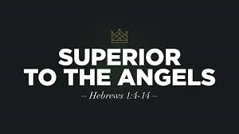
Angels in Subjection to Christ
“These stood ready to second Lucifer's demand for equal authority with the Son of God. But angels who were loyal and true maintained the wisdom and justice of the divine decree and endeavored to reconcile this disaffected being to the will of God. Christ was the Son of God; He had been one with Him before the angels were called into existence. He had ever stood at the right hand of the Father; His supremacy, so full of blessing to all who came under its benignant control, had not heretofore been questioned.” PP, pgs. 38,39

Slide 14
Hebrews 2:1-5
“Therefore we ought to give the more earnest heed to the things which we have heard, lest at any time we should let them slip. For if the word spoken by angels was stedfast, and every transgression and disobedience received a just recompence of reward; How shall we escape, if we neglect so great salvation; which at the first began to be spoken by the Lord, and was confirmed unto us by them that heard him; God also bearing them witness, both with signs and wonders, and with divers miracles, and gifts of the Holy Ghost, according to his own will? For unto the angels hath he not put in subjection the world to come, whereof we speak.” Hebrews 2:1-5

Slide 15
An Earnest Appeal
“Study to shew thyself approved unto God, a workman that needeth not to be ashamed, rightly dividing the word of truth. But shun profane and vain babblings: for they will increase unto more ungodliness.” 2 Tim. 2:15,16

Slide 16
Tasted the Suffering of Death for All!
“But one in a certain place testified, saying, What is man, that thou art mindful of him? or the son of man, that thou visitest him? Thou madest him a little lower than the angels; thou crownedst him with glory and honour, and didst set him over the works of thy hands: Thou hast put all things in subjection under his feet. For in that he put all in subjection under him, he left nothing that is not put under him. But now we see not yet all things put under him. But we see Jesus, who was made a little lower than the angels for the suffering of death, crowned with glory and honour; that he by the grace of God should taste death for every man.” Hebrews 2:6-9

Slide 17
Could not see thru the portals of the Tomb
“Upon Christ as our substitute and surety was laid the iniquity of us all. He was counted a transgressor, that He might redeem us from the condemnation of the law. The guilt of every descendant of Adam was pressing upon His heart. The wrath of God against sin, the terrible manifestation of His displeasure because of iniquity, filled the soul of His Son with consternation. All His life Christ had been publishing to a fallen world the good news of the Father's mercy and pardoning love. Salvation for the chief of sinners was His theme. But now with the terrible weight of guilt He bears, He cannot see the Father's reconciling face. The withdrawal of the divine countenance from the Saviour in this hour of supreme anguish pierced His heart with a sorrow that can never be fully understood by man. So great was this agony that His physical pain was hardly felt. Satan with his fierce temptations wrung the heart of Jesus. The Saviour could not see through the portals of the tomb. Hope did not present to Him His coming forth from the grave a conqueror, or tell Him of the Father's acceptance of the sacrifice. He feared that sin was so offensive to God that Their separation was to be eternal. Christ felt the anguish which the sinner will feel when mercy shall no longer plead for the guilty race. It was the sense of sin, bringing the Father's wrath upon Him as man's substitute, that made the cup He drank so bitter, and broke the heart of the Son of God.” DA, pg. 753

Slide 18
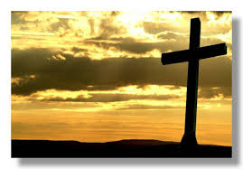
Jesus Died the 2nd Death For all Men!
When Jesus hung upon the cross, He could not see thru the tomb. He thought if He died, His separation from His Father would be eternal. The sins of mankind were placed upon Him and in our place, He died the second death for us! In love for us, Christ would have separated Himself from His Father forever.

