Slide 1
Feast Days, pt. 3
Pentecost

Slide 2
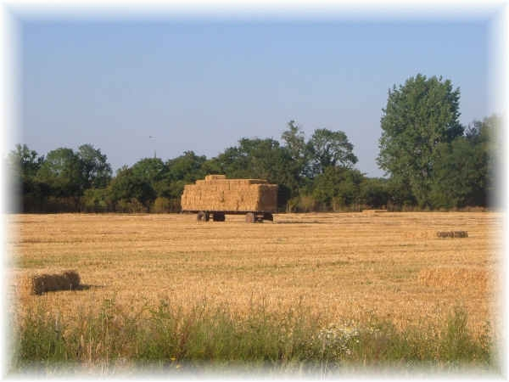
Feast of……
After the Feast of Passover/Unleavened Bread, the next feast was Pentecost. This feast had more names used to refer to it than any other. It was known as the Feast of Harvest, the Feast of Weeks and the day of firstfruits:
“... the Feast of Harvest, the firstfruits of your labors .“(Exodus 23:16).
“And you shall observe the Feast of Weeks, of the firstfruits .”(Exodus 34:22).
“Also on the day of the firstfruits, when you bring a new grain offering to the LORD at your Feast of Weeks, you shall have a holy convocation .”(Numbers 28:26).

Slide 3
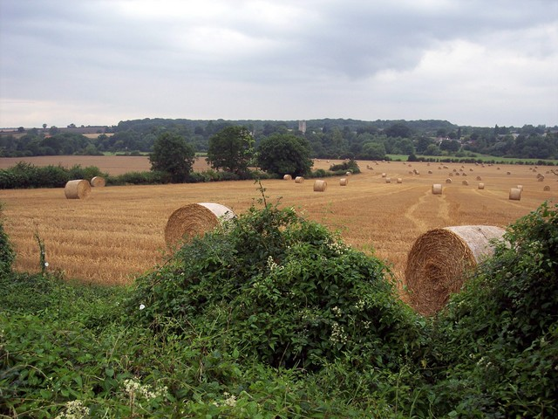
New Testament
In the New Testament, this feast was referred to as Pentecost, or translated, ‘the feast of fifty.’ It was referred to this way because it came 50 days after the waving of the grain at the feast of Passover/Unleavened Bread. Since this feast was directly tied to the first feast, it too, was tied to the new moon.

Slide 4
The Feast of Harvest
“And ye shall count unto you from the morrow after the sabbath, from the day that ye brought the sheaf of the wave offering; seven sabbaths shall be complete: Even unto the morrow after the seventh sabbath shall ye number fifty days; and ye shall offer a new meat offering unto the LORD. Ye shall bring out of your habitations two wave loaves of two tenth deals: they shall be of fine flour; they shall be baken with leaven; [they are] the firstfruits unto the LORD. And ye shall offer with the bread seven lambs without blemish of the first year, and one young bullock, and two rams: they shall be [for] a burnt offering unto the LORD, with their meat offering, and their drink offerings, [even] an offering made by fire, of sweet savour unto the LORD. Then ye shall sacrifice one kid of the goats for a sin offering, and two lambs of the first year for a sacrifice of peace offerings. And the priest shall wave them with the bread of the firstfruits [for] a wave offering before the LORD, with the two lambs: they shall be holy to the LORD for the priest. And ye shall proclaim on the selfsame day, [that] it may be an holy convocation unto you: ye shall do no servile work [therein: it shall be] a statute for ever in all your dwellings throughout your generations. And when ye reap the harvest of your land, thou shalt not make clean riddance of the corners of thy field when thou reapest, neither shalt thou gather any gleaning of thy harvest: thou shalt leave them unto the poor, and to the stranger: I [am] the LORD your God.” Leviticus 23:15-22

Slide 5
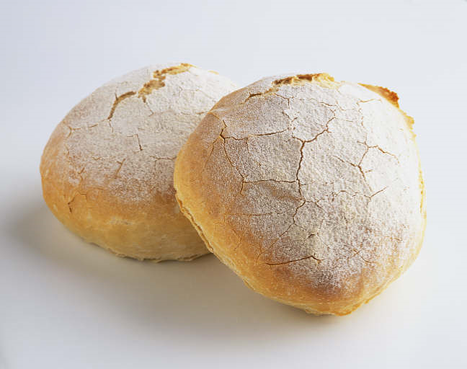
Two Loaves
It was the first of the two agrarian festivals of Israel and signified the completion of the barley-harvest (Lev 23:15,16;), which had begun at the time of the waving of the first ripe sheaf of the first-fruits (Lev 23:11). Pentecost, or the Feast of Weeks, therefore fell on the 50th day after this occurrence. The wheat was then also nearly everywhere harvested (Ex 23:16; 34:22; Nu 28:26), and the general character of the festival was that of a harvest-home celebration. The day was observed as a Sabbath day, all labor was suspended, and the people appeared before God to express their gratitude (Lev 23:21; Nu 28:26). The central feature of the day was the presentation of two loaves of leavened, salted bread unto the Lord (Lev 23:17,20; Ex 34:22; Nu 28:26).
This day was in thanksgiving for all that the Lord had done in blessing the grain crops for that year.

Slide 6
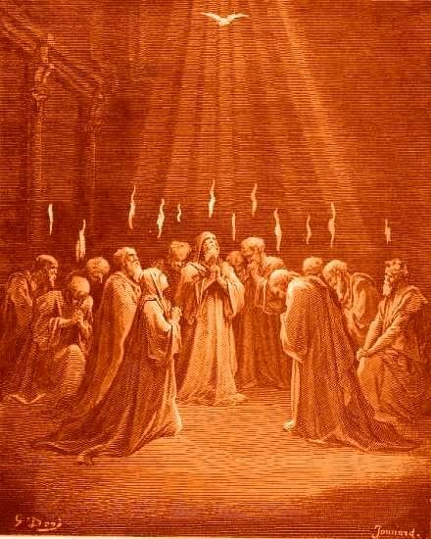
Deep Spiritual Significance
In the time of Christ, the Day of Pentecost occurred fifty days after His resurrection. Acts 2 records it for us. “And when the day of Pentecost was fully come, they were all with one accord in one place. And suddenly there came a sound from heaven as of a rushing mighty wind, and it filled all the house where they were sitting. And there appeared unto them cloven tongues like as of fire, and it sat upon each of them. And they were all filled with the Holy Ghost, and began to speak with other tongues, as the Spirit gave them utterance.”

Slide 7
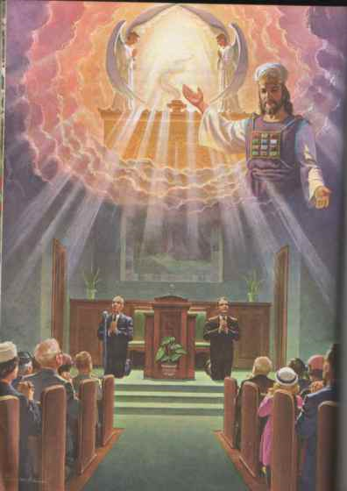
His First Act
After Christ’s resurrection, the next forty days were spent teaching and guiding the disciples. “To whom also he shewed himself alive after his passion by many infallible proofs, being seen of them forty days, and speaking of the things pertaining to the kingdom of God:” Acts 1:3
Then, with those who were resurrected with Him, they ascended to heaven. “Wherefore he saith, When he ascended up on high, he led captivity captive, and gave gifts unto men.” Eph. 4:8
Christ’s very first act as our High Priest, He poured the Early Rain upon the disciples!!

Slide 8
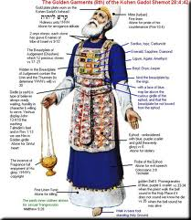
Our Great High Priest
Hebrews 4:14-16 “Seeing then that we have a great high priest, that is passed into the heavens, Jesus the Son of God, let us hold fast [our] profession. For we have not an high priest which cannot be touched with the feeling of our infirmities; but was in all points tempted like as [we are, yet] without sin. Let us therefore come boldly unto the throne of grace, that we may obtain mercy, and find grace to help in time of need.”
Revelation 1:12,13 “And I turned to see the voice that spake with me. And being turned, I saw seven golden candlesticks; And in the midst of the seven candlesticks [one] like unto the Son of man, clothed with a garment down to the foot, and girt about the paps with a golden girdle.”

Slide 9

Thousands Converted
As a result of Christ’s work as our Creator, the harvest was dedicated to Him by the wave sheaf. This was the first fruits. Then, the sickle went to the crop and, at the end of 50 days, the result was a huge harvest of grain. What was the result of the outpouring of the early rain?

Slide 10
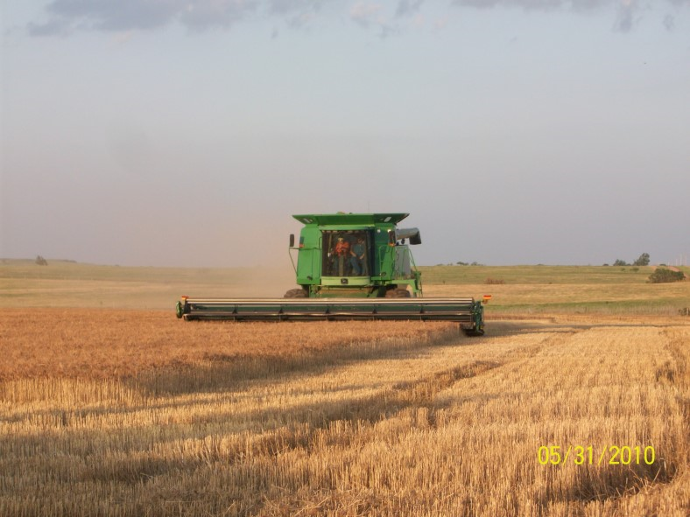
3,000 Baptized
“Then Peter said unto them, Repent, and be baptized every one of you in the name of Jesus Christ for the remission of sins, and ye shall receive the gift of the Holy Ghost. For the promise is unto you, and to your children, and to all that are afar off, [even] as many as the Lord our God shall call. And with many other words did he testify and exhort, saying, Save yourselves from this untoward generation. Then they that gladly received his word were baptized: and the same day there were added [unto them] about three thousand souls.” Acts 2:38-41

Slide 11
The Harvest
“The Jewish leaders had supposed that the work of Christ would end with His death; but, instead of this, they witnessed the marvelous scenes of the Day of Pentecost. They heard the disciples, endowed with a power and energy hitherto unknown, preaching Christ, their words confirmed by signs and wonders. In Jerusalem, the stronghold of Judaism, thousands openly declared their faith in Jesus of Nazareth as the Messiah.
The disciples were astonished and overjoyed at the greatness of the harvest of souls. They did not regard this wonderful ingathering as the result of their own efforts; they realized that they were entering into other men's labors. Ever since the fall of Adam, Christ had been committing to chosen servants the seed of His word, to be sown in human hearts. During His life on this earth He had sown the seed of truth and had watered it with His blood. The conversions that took place on the Day of Pentecost were the result of this sowing, the harvest of Christ's work, revealing the power of His teaching.” AA, pgs. 44,45

Slide 12
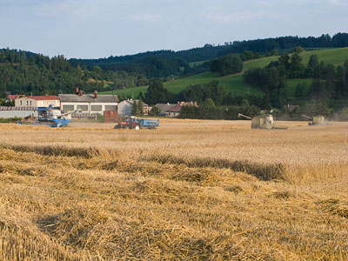
The Pentecostal Shadow
Like Passover/Unleavened Bread, Pentecost was another feast that pointed forward to Jesus Christ, the body.
Passover revealed Christ’s death and resurrection; Pentecost pointed forward to Christ’s work as our great High Priest in the sanctuary in heaven. Pentecost was the venue where Christ’s first great act as our high priest was performed!

Slide 13
Comparison/Contrast
Shadows of Christ
The Body
1. Passover- The lamb is slain and brings deliverance.
2. Unleavened Bread- the first fruits of the grain are waved the third day after the Passover sacrifice. Let the harvest begin.
3. Pentecost/feast of harvest- The harvest of the grain crop is complete, dedication/thanksgiving for the harvest.
1. Christ the Passover Lamb. 1 Cor. 5:8
2. Christ resurrected from the tomb on the third day, becoming the first fruits of them that sleep. 1 Corinthians 15:20-23
3. Christ, at Pentecost, in first act as our High Priest, pours out the Spirit, and an abundant harvest of souls results!

Slide 14
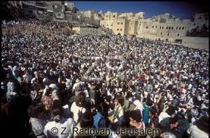
Pentecost-Required Attendance
Of the five feasts of the Jews, three of them had mandatory attendance for all males 12 years and older.
“Three times thou shalt keep a feast unto me in the year. Thou shalt keep the feast of unleavened bread: (thou shalt eat unleavened bread seven days, as I commanded thee, in the time appointed of the month Abib; for in it thou camest out from Egypt: and none shall appear before me empty:) And the feast of harvest, the firstfruits of thy labours, which thou hast sown in the field: and the feast of ingathering, [which is] in the end of the year, when thou hast gathered in thy labours out of the field. Three times in the year all thy males shall appear before the Lord GOD.” Ex.23:14-17

Slide 15
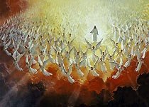
Christ-Sacrifice, Priest, and King
Two of the three required feasts were Passover and Pentecost. The third was the final feast called the Feast of Tabernacles. This one took place in the 7th month after the Day of Atonement was completed. Passover revealed Christ as our sacrifice and Pentecost revealed Christ as our great High Priest. As we will see, Tabernacles pointed forward to the Second Coming of Christ. By required attendance, the Lord hoped that the significance of Christ’s death, work as High Priest, and coming as King of Kings would be in the forefront of the people’s minds.

Slide 16
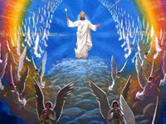
Daniel’s Pictures
The prophet Daniel saw Christ in three phases of His work for us. He saw Him as Coming King (Daniel 2:34,35), High Priest (Daniel 7:13,14), and as sacrifice (Daniel 9:27). These are the same three phases of Christ's work that corresponded with the feast which were required of the Hebrews. Daniel mentions them in reverse order!

Slide 17
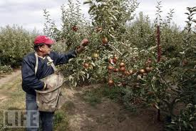
Springtime Feasts
As the springtime feasts took place in the beginning of the Jewish year, so the fulfillment of these feasts took place at the beginning of the gospel commission. The fulfillment of these feasts took place in the 1st century. As we turn toward the three fall festivals, let us realize that they take place at the end of the Jewish harvest cycle. We should expect to see their fulfillment somewhere down at the end of this earth’s history!

Slide 18
Fulfilled in Event and Time!
“These types were fulfilled, not only as to the event, but as to the time. On the fourteenth day of the first Jewish month, the very day and month on which for fifteen long centuries the Passover lamb had been slain, Christ, having eaten the Passover with His disciples, instituted that feast which was to commemorate His own death as "the Lamb of God, which taketh away the sin of the world." That same night He was taken by wicked hands to be crucified and slain. And as the antitype of the wave sheaf our Lord was raised from the dead on the third day, "the first fruits of them that slept," a sample of all the resurrected just, whose "vile body" shall be changed, and "fashioned like unto His glorious body." Verse 20; Philippians 3:21.
In like manner the types which relate to the second advent must be fulfilled at the time pointed out in the symbolic service.” GC, pgs. 399,400

