Slide 1
Jesus Life, pt. 25 ‘Touch of Faith’

Slide 2
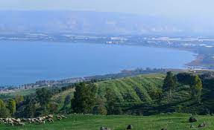
Sea of Galilee
“Returning from Gergesa to the western shore, Jesus found a multitude gathered to receive Him, and they greeted Him with joy. He remained by the seaside for a time, teaching and healing, and then repaired to the house of Levi-Matthew to meet the publicans at the feast. Here Jairus, the ruler of the synagogue, found Him.” DA, pg. 342

Slide 3
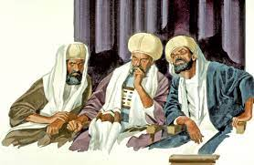
The Haughty Rabbi
“This elder of the Jews came to Jesus in great distress, and cast himself at His feet, exclaiming, “My little daughter lieth at the point of death: I pray Thee, come and lay Thy hands on her, that she may be healed; and she shall live.” Jesus set out at once with the ruler for his home. Though the disciples had seen so many of His works of mercy, they were surprised at His compliance with the entreaty of the haughty rabbi; yet they accompanied their Master, and the people followed, eager and expectant.” DA, pg. 342

Slide 4
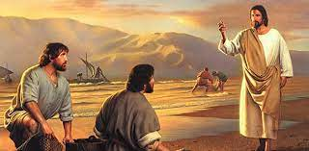
Jesus Would Help Jairus????
The disciples were shocked that Jesus would help this haughty, Jewish ruler. Why, he had a shady past, was arrogant and rude, and even spread rumors about the Son of God. JESUS WOULD HELP ANYONE WHO CAME TO HIM IN NEED!!!! Recent call concerning Advent Messenger!

Slide 5
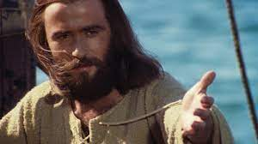
“The ruler's house was not far distant, but Jesus and His companions advanced slowly, for the crowd pressed Him on every side. The anxious father was impatient of delay; but Jesus, pitying the people, stopped now and then to relieve some suffering one, or to comfort a troubled heart. While they were still on the way, a messenger pressed through the crowd, bearing to Jairus the news that his daughter was dead, and it was useless to trouble the Master further. The word caught the ear of Jesus. “Fear not,” He said; “believe only, and she shall be made whole.” DA, pg. 342

Slide 6
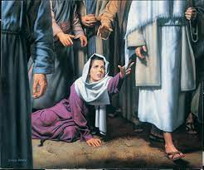
Touch of Faith
“And, behold, a woman, which was diseased with an issue of blood twelve years, came behind him, and touched the hem of his garment: For she said within herself, If I may but touch his garment, I shall be whole. But Jesus turned him about, and when he saw her, he said, Daughter, be of good comfort; thy faith hath made thee whole. And the woman was made whole from that hour.” Matthew 9:20-22

Slide 7
Someone in the Crowd with Need!
“On the way to the ruler's house, Jesus had met, in the crowd, a poor woman who for twelve years had suffered from a disease that made her life a burden. She had spent all her means upon physicians and remedies, only to be pronounced incurable. But her hopes revived when she heard of the cures that Christ performed. She felt assured that if she could only go to Him she would be healed. In weakness and suffering she came to the seaside where He was teaching, and tried to press through the crowd, but in vain. Again she followed Him from the house of Levi-Matthew, but was still unable to reach Him. She had begun to despair, when, in making His way through the multitude, He came near where she was. The golden opportunity had come. She was in the presence of the Great Physician! But amid the confusion she could not speak to Him, nor catch more than a passing glimpse of His figure. Fearful of losing her one chance of relief, she pressed forward, saying to herself, “If I may but touch His garment, I shall be whole.” As He was passing, she reached forward, and succeeded in barely touching the border of His garment. But in that moment she knew that she was healed. In that one touch was concentrated the faith of her life, and instantly her pain and feebleness gave place to the vigor of perfect health.” DA, pg. 343

Slide 8
Tried Everything
She had tried everything. She had tried doctors, every kind of medicine. She had gone to the local pastor, requesting his help in her matter. Every method devised by man had failed. She tried being especially punctilious concerning her diet and dress, thinking that those may bring healing. She even tried wearing a head covering. Nothing availed her in her need. Finally, she heard of Jesus!!

Slide 10
What Will We Spend Everything on?
Charles Wesley was once asked, “On what do you base your hope of eternal life?” He responded, “I base it on the good things I have done; the monies I have given to the poor, the fasting's and the giving of alms.”
“The Pharisee stood and prayed thus with himself, God, I thank thee, that I am not as other men are, extortioners, unjust, adulterers, or even as this publican. I fast twice in the week, I give tithes of all that I possess. And the publican, standing afar off, would not lift up so much as his eyes unto heaven, but smote upon his breast, saying, God be merciful to me a sinner. I tell you, this man went down to his house justified rather than the other: for every one that exalteth himself shall be abased; and he that humbleth himself shall be exalted.” Luke 18:11-14

Slide 11
Classic
“The rabbis counted their righteousness a passport to heaven; but Jesus declared it to be insufficient and unworthy. External ceremonies and a theoretical knowledge of truth constituted Pharisaical righteousness. The rabbis claimed to be holy through their own efforts in keeping the law; but their works had divorced righteousness from religion. While they were punctilious in ritual observances, their lives were immoral and debased. Their so-called righteousness could never enter the kingdom of heaven. The greatest deception of the human mind in Christ's day was that a mere assent to the truth constitutes righteousness. In all human experience a theoretical knowledge of the truth has been proved to be insufficient for the saving of the soul. It does not bring forth the fruits of righteousness. A jealous regard for what is termed theological truth often accompanies a hatred of genuine truth as made manifest in life. The darkest chapters of history are burdened with the record of crimes committed by bigoted religionists. The Pharisees claimed to be children of Abraham, and boasted of their possession of the oracles of God; yet these advantages did not preserve them from selfishness, malignity, greed for gain, and the basest hypocrisy. They thought themselves the greatest religionists of the world, but their so-called orthodoxy led them to crucify the Lord of glory.” DA. Pg. 309

Slide 12
Wow!!!
“The same danger still exists. Many take it for granted that they are Christians, simply because they subscribe to certain theological tenets. But they have not brought the truth into practical life. They have not believed and loved it, therefore they have not received the power and grace that come through sanctification of the truth. Men may profess faith in the truth; but if it does not make them sincere, kind, patient, forbearing, heavenly-minded, it is a curse to its possessors, and through their influence it is a curse to the world.
The righteousness which Christ taught is conformity of heart and life to the revealed will of God. Sinful men can become righteous only as they have faith in God and maintain a vital connection with Him. Then true godliness will elevate the thoughts and ennoble the life. Then the external forms of religion accord with the Christian's internal purity. Then the ceremonies required in the service of God are not meaningless rites, like those of the hypocritical Pharisees.” DA, pgs. 309,310

Slide 13
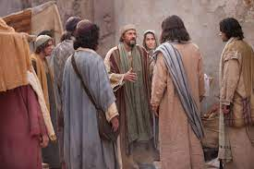
“While he yet spake, there cometh one from the ruler of the synagogue's house, saying to him, Thy daughter is dead; trouble not the Master. But when Jesus heard it, he answered him, saying, Fear not: believe only, and she shall be made whole. And when he came into the house, he suffered no man to go in, save Peter, and James, and John, and the father and the mother of the maiden. And all wept, and bewailed her: but he said, Weep not; she is not dead, but sleepeth.” Luke 8:49-52

Slide 14
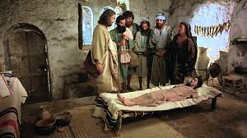
“Jairus pressed closer to the Saviour, and together they hurried to the ruler's home. Already the hired mourners and flute players were there, filling the air with their clamor. The presence of the crowd, and the tumult jarred upon the spirit of Jesus. He tried to silence them, saying, “Why make ye this ado, and weep? the damsel is not dead, but sleepeth.” They were indignant at the words of the Stranger. They had seen the child in the embrace of death, and they laughed Him to scorn. Requiring them all to leave the house, Jesus took with Him the father and mother of the maiden, and the three disciples, Peter, James, and John, and together they entered the chamber of death.” DA, pg. 343

Slide 15
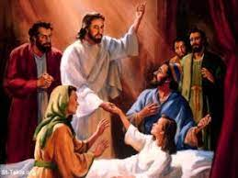
“Through the same faith we may receive spiritual healing. By sin we have been severed from the life of God. Our souls are palsied. Of ourselves we are no more capable of living a holy life than was the impotent man capable of walking. There are many who realize their helplessness, and who long for that spiritual life which will bring them into harmony with God; they are vainly striving to obtain it. In despair they cry, “O wretched man that I am! who shall deliver me from this body of death?” Romans 7:24, margin. Let these desponding, struggling ones look up. The Saviour is bending over the purchase of His blood, saying with inexpressible tenderness and pity, “Wilt thou be made whole?” He bids you arise in health and peace. Do not wait to feel that you are made whole. Believe His word, and it will be fulfilled.” DA, pg. 203

