Slide 1
Ezekiel, pt. 12
‘The Rebellious’

Slide 2
Fed Up
And it came to pass in the seventh year, in the fifth month, the tenth day of the month, that certain of the elders of Israel came to enquire of the LORD, and sat before me. Then came the word of the LORD unto me, saying, Son of man, speak unto the elders of Israel, and say unto them, Thus saith the Lord GOD; Are ye come to enquire of me? As I live, saith the Lord GOD, I will not be enquired of by you. Wilt thou judge them, son of man, wilt thou judge them? cause them to know the abominations of their fathers:” Ezekiel 20:1-4

Slide 3
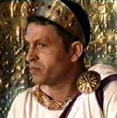
Herod
“Herod had rejected the truth spoken to him by the greatest of the prophets, and no other message was he to receive. Not a word had the Majesty of heaven for him. That ear that had ever been open to human woe, had no room for Herod's commands. Those eyes that had ever rested upon the penitent sinner in pitying, forgiving love had no look to bestow upon Herod. Those lips that had uttered the most impressive truth, that in tones of tenderest entreaty had pleaded with the most sinful and the most degraded, were closed to the haughty king who felt no need of a Saviour.” DA, pg. 730

Slide 4
Rebellion
“And say unto them, Thus saith the Lord GOD; In the day when I chose Israel, and lifted up mine hand unto the seed of the house of Jacob, and made myself known unto them in the land of Egypt, when I lifted up mine hand unto them, saying, I am the LORD your God; In the day that I lifted up mine hand unto them, to bring them forth of the land of Egypt into a land that I had espied for them, flowing with milk and honey, which is the glory of all lands: Then said I unto them, Cast ye away every man the abominations of his eyes, and defile not yourselves with the idols of Egypt: I am the LORD your God. But they rebelled against me, and would not hearken unto me: they did not every man cast away the abominations of their eyes, neither did they forsake the idols of Egypt: then I said, I will pour out my fury upon them, to accomplish my anger against them in the midst of the land of Egypt.” Ezekiel 20:5-8

Slide 5
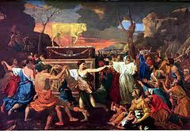
The Golden Calf
“ And he received them at their hand, and fashioned it with a graving tool, after he had made it a molten calf: and they said, These be thy gods, O Israel, which brought thee up out of the land of Egypt. And when Aaron saw it, he built an altar before it; and Aaron made proclamation, and said, To morrow is a feast to the LORD.” Ex. 32:5,6

Slide 6
Mercy/Deliverance
“But I wrought for my name's sake, that it should not be polluted before the heathen, among whom they were, in whose sight I made myself known unto them, in bringing them forth out of the land of Egypt. Wherefore I caused them to go forth out of the land of Egypt, and brought them into the wilderness. And I gave them my statutes, and shewed them my judgments, which if a man do, he shall even live in them. Moreover also I gave them my sabbaths, to be a sign between me and them, that they might know that I am the LORD that sanctify them.” Ezekiel 20:9-12

Slide 7
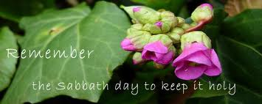
Sabbath and Idolatry
“No other institution which was committed to the Jews tended so fully to distinguish them from surrounding nations as did the Sabbath. God designed that its observance should designate them as His worshipers. It was to be a token of their separation from idolatry, and their connection with the true God. But in order to keep the Sabbath holy, men must themselves be holy. Through faith they must become partakers of the righteousness of Christ.” DA, pg. 283

Slide 8
Sanctification
“Since He made all things, He made the Sabbath. By Him it was set apart as a memorial of the work of creation. It points to Him as both the Creator and the Sanctifier. It declares that He who created all things in heaven and in earth, and by whom all things hold together, is the head of the church, and that by His power we are reconciled to God. For, speaking of Israel, He said, "I gave them My Sabbaths, to be a sign between Me and them, that they might know that I am the Lord that sanctify them,"--make them holy. Ezek. 20:12. Then the Sabbath is a sign of Christ's power to make us holy. And it is given to all whom Christ makes holy. As a sign of His sanctifying power, the Sabbath is given to all who through Christ become a part of the Israel of God.” DA, pg. 288

Slide 9
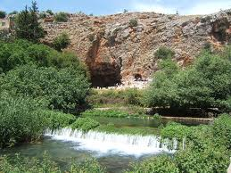
Land of Delights
“But the house of Israel rebelled against me in the wilderness: they walked not in my statutes, and they despised my judgments, which if a man do, he shall even live in them; and my sabbaths they greatly polluted: then I said, I would pour out my fury upon them in the wilderness, to consume them. But I wrought for my name's sake, that it should not be polluted before the heathen, in whose sight I brought them out. Yet also I lifted up my hand unto them in the wilderness, that I would not bring them into the land which I had given them, flowing with milk and honey, which is the glory of all lands;” Ezekiel 20:13-15

Slide 10
More Than 1,000 Years
“The history of more than a thousand years of God's special favor and guardian care, manifested to the chosen people, was open to the eye of Jesus....Jerusalem had been honored of God above all the earth. The Lord had "chosen Zion," He had "desired it for His habitation." Psalm 132:13. There, for ages, holy prophets had uttered their messages of warning. There priests had waved their censers, and the cloud of incense, with the prayers of the worshipers, had ascended before God. There daily the blood of slain lambs had been offered, pointing forward to the Lamb of God. There Jehovah had revealed His presence in the cloud of glory above the mercy seat. There rested the base of that mystic ladder connecting earth with heaven (Genesis 28:12; John 1:51)--that ladder upon which angels of God descended and ascended, and which opened to the world the way into the holiest of all. Had Israel as a nation preserved her allegiance to Heaven, Jerusalem would have stood forever, the elect of God. Jeremiah 17:21-25. But the history of that favored people was a record of backsliding and rebellion. They had resisted Heaven's grace, abused their privileges, and slighted their opportunities.” GC, pgs. 18,19

Slide 11
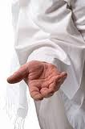
Continual Story
Ezekiel 20 is a history lesson of Ancient Adventism’s continual rebellion’s against God. God wrought marvelously for them, but they despised and rebelled against Him continually. This story is repeated continually throughout this chapter!

Slide 12
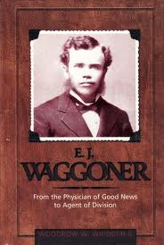
Modern Adventism
The history of Modern Adventism has been similar to ancient Adventism. Faithfulness in the beginning; then forgetfulness of God, and then the horrible rejection of the message of righteousness by faith that came in 1888.

Slide 13
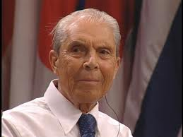
Evangelical Conferences and Desmond Ford
Through the war years, then came the evangelical conferences of the 1950’s in which Adventist leaders denied fundamental Adventist beliefs and adopted apostate Protestant teachings. The apostasy is waxing more and more bold!!!

Slide 14
Apostasy Has An End!
““The Lord has a controversy with his professed people in these last days. In this controversy men in responsible positions will take a course directly opposite to that pursued by Nehemiah. They will not only ignore and despise the Sabbath themselves, but they will try to keep it from others by burying it beneath the rubbish of custom and tradition. In churches and in large gatherings in the open air, ministers will urge upon the people the necessity of keeping the first day of the week. There are calamities on sea and land: and these calamities will increase, one disaster following close upon another; and the little band of conscientious Sabbath-keepers will be pointed out as the ones who are bringing the wrath of God upon the world by their disregard of Sunday.” RH, March 18,1884

Slide 15
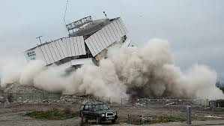
Goodbye!
“The fundamental principles that have sustained the work for the last fifty years would be accounted as error. A new organization would be established. Books of a new order would be written. A system of intellectual philosophy would be introduced. The founders of this system would go into the cities, and do a wonderful work. The Sabbath of course, would be lightly regarded, as also the God who created it. Nothing would be allowed to stand in the way of the new movement. The leaders would teach that virtue is better than vice, but God being removed, they would place their dependence on human power, which, without God, is worthless. Their foundation would be built on the sand, and storm and tempest would sweep away the structure.” 1 SM, pgs. 204, 205

Slide 16
How About Us?
It is so easy to point fingers at others , at Adventism, and at nominal churches, but what about us? Are we following the idols of today; rock stars, athletes, money hoarding; the idols of our age? Are we part of the world’s ill’s, clamoring after its sins, or are we part of the solution?

Slide 17
Who Has Our Heart?
“In giving ourselves to God, we must necessarily give up all that would separate us from Him. Hence the Saviour says, "Whosoever he be of you that forsaketh not all that he hath, he cannot be My disciple." Luke 14:33. Whatever shall draw away the heart from God must be given up. Mammon is the idol of many. The love of money, the desire for wealth, is the golden chain that binds them to Satan. Reputation and worldly honor are worshiped by another class. The life of selfish ease and freedom from responsibility is the idol of others. But these slavish bands must be broken. We cannot be half the Lord's and half the world's. We are not God's children unless we are such entirely.
There are those who profess to serve God, while they rely upon their own efforts to obey His law, to form a right character, and secure salvation. Their hearts are not moved by any deep sense of the love of Christ, but they seek to perform the duties of the Christian life as that which God requires of them in order to gain heaven.” Steps to Christ, pg. 44

