Slide 1
Hebrews 5 ‘An Eternal Priesthood’

Slide 2
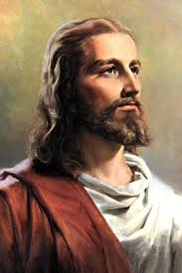
The Greatest of All
The book of Hebrews tells us of the greatness of Christ.
Notice:
Chapter 1- greater than the angels.
Chapter 2- bore sinful flesh in His greatness
Chapter 3- greater than Moses
Chapter 4- greater than the Sabbath
Now, chapter 5 begins with a discussion of the Levitical priesthood…………………………………………

Slide 3
Hebrews 5:1-4
“For every high priest taken from among men is ordained for men in things pertaining to God, that he may offer both gifts and sacrifices for sins: Who can have compassion on the ignorant, and on them that are out of the way; for that he himself also is compassed with infirmity. And by reason hereof he ought, as for the people, so also for himself, to offer for sins. And no man taketh this honour unto himself, but he that is called of God, as was Aaron.”

Slide 4
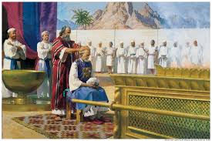
Earthly Priesthood
The priesthood of Aaron and the sons of Levi was an earthly priesthood. Men selected for this position were fallible, frail, sinful men; men whose priesthood would perish at their death. Like Paul has done in every other chapter in Hebrews so far, he is about to draw a contrast between the Aaronic priesthood and the priesthood of Christ! He is about to show the greatness of Christ's priesthood in comparison to the priesthood of Aaron!

Slide 5
Hebrews 5:5-6
“So also Christ glorified not himself to be made an high priest; but he that said unto him, Thou art my Son, to day have I begotten thee. As he saith also in another place, Thou art a priest for ever after the order of Melchisedec.”
In contrasting the earthly priesthood of Aaron, Paul uses Melchisedec to show the superiority of Christ’s priesthood. The implication is obvious: Aaron’s priesthood was earthly/temporal---Christ’s priesthood was heavenly/eternal and was represented by Melchisedec. How could Melchisedec represent an eternal priesthood unless he was an eternal being????

Slide 6
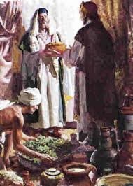
The greatness of Melchisedec can only be determined by the way in which he is described. His priesthood is clearly set a part from the Levitical priesthood of the Old Testament. Christ’s priesthood is likened to Melchisedec. In harmony with the book of Hebrews, Christ again is contrasted with something else. In this chapter, His priesthood is so much greater than the Levitical priesthood.

Slide 7
Hebrews 5:7-9
“Who in the days of his flesh, when he had offered up prayers and supplications with strong crying and tears unto him that was able to save him from death, and was heard in that he feared; Though he were a Son, yet learned he obedience by the things which he suffered; And being made perfect, he became the author of eternal salvation unto all them that obey him;”

Slide 8
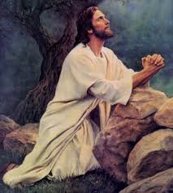
The Suffering, Obedient Priest
Hebrews 5 is similar to Hebrews 2 and 4. Christ could become our empathizing priest because He suffered in our flesh. Not a fake flesh or a perfect flesh of Adam before the fall, but a carnal flesh like ours that He could truly understand our trials and temptations.

Slide 9
The Seed of Abraham
“Forasmuch then as the children are partakers of flesh and blood, he also himself likewise took part of the same; that through death he might destroy him that had the power of death, that is, the devil; And deliver them who through fear of death were all their lifetime subject to bondage. For verily he took not on him the nature of angels; but he took on him the seed of Abraham. Wherefore in all things it behooved him to be made like unto his brethren, that he might be a merciful and faithful high priest in things pertaining to God, to make reconciliation for the sins of the people. For in that he himself hath suffered being tempted, he is able to succor them that are tempted.” Hebrews 2:14-18

Slide 10
Tempted Like Us!
“Seeing then that we have a great high priest, that is passed into the heavens, Jesus the Son of God, let us hold fast our profession. For we have not an high priest which cannot be touched with the feeling of our infirmities; but was in all points tempted like as we are, yet without sin. Let us therefore come boldly unto the throne of grace, that we may obtain mercy, and find grace to help in time of need.”

Slide 11
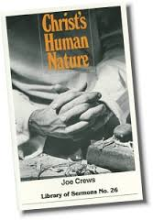
If Christ were not like us in that He himself suffered being tempted, then He could not be a merciful and faithful High Priest that could be touched with the feeling of our infirmities. He Can be our priest because He understands our plight because He experienced it in our flesh! His humanity touched earth and provides us power to obey!

Slide 12
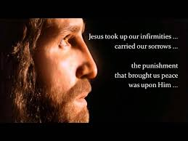
Very Important to Paul and to Us!
“Christ was treated as we deserve, that we might be treated as He deserves. He was condemned for our sins, in which He had no share, that we might be justified by His righteousness, in which we had no share. He suffered the death which was ours, that we might receive the life which was His. "With His stripes we are healed.“ DA, pg. 25

Slide 13
Hebrews 5:10 and other Places
“Called of God an high priest after the order of Melchisedec.”
“As he saith also in another place, Thou art a priest for ever after the order of Melchisedec.” verse 6
“Whither the forerunner is for us entered, even Jesus, made an high priest for ever after the order of Melchisedec.” Heb. 6:20
“For he testifieth, Thou art a priest for ever after the order of Melchisedec.” Heb. 7:17
“(For those priests were made without an oath; but this with an oath by him that said unto him, The Lord sware and will not repent, Thou art a priest for ever after the order of Melchisedec:)” Heb. 7:21

Slide 14
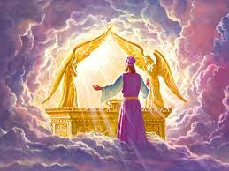
Melchisedec Priesthood Greater Than Levitical Priesthood
It is truly amazing to me that Paul connects the following ideas together.
1. The sinful nature of Christ.
2. The Sabbath
3. The eternal priesthood of Melchisedec and Christ!
This is the sum and substance of Adventism.

Slide 15
Hebrews 5:11
“Of whom we have many things to say, and hard to be uttered, seeing ye are dull of hearing.”
“I have yet many things to say unto you, but ye cannot bear them now. Howbeit when he, the Spirit of truth, is come, he will guide you into all truth: for he shall not speak of himself; but whatsoever he shall hear, that shall he speak: and he will shew you things to come.” John 16:12,13
What is entailed in this saying of Paul and Jesus before him?
Was the book of Hebrews part of Christ’s statement and Revelation?
In Paul’s statement, was the person of Melchisedec included in his discussion?

Slide 16
Not Now!
It was the Lord’s intention for His people to grasp the great truths that were unlocked in the books of Hebrews and Revelation, but the disciples could not bear it then. 30 years passed before Hebrews was written and 60 before the Revelation. Does the Lords have something for us today that we can not bear to hear?

Slide 17
Milk or Meat?
“For when for the time ye ought to be teachers, ye have need that one teach you again which be the first principles of the oracles of God; and are become such as have need of milk, and not of strong meat. For every one that useth milk is unskilful in the word of righteousness: for he is a babe. But strong meat belongeth to them that are of full age, even those who by reason of use have their senses exercised to discern both good and evil.” Hebrews 5:12-14

Slide 18
