Slide 1
Jesus Life, pt. 30 “Thou art Peter”

Slide 2
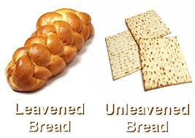
Christ’s Warning
“Then understood they how that he bade them not beware of the leaven of bread, but of the doctrine of the Pharisees and of the Sadducees.“ Matthew 16:12
Beware of Pharisees:
1. flat earth.
2. Holy Spirt not a Person.
3. church is Babylon.
Beware of Sadducees:
1. save the church.
2. support apostasy/ pay tithe in church.
3. refuses to call out apostates.

Slide 3
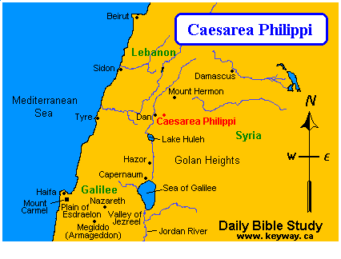
“When Jesus came into the coasts of Caesarea Philippi, he asked his disciples, saying, Whom do men say that I the Son of man am? And they said, Some say that thou art John the Baptist: some, Elias; and others, Jeremias, or one of the prophets. He saith unto them, But whom say ye that I am? And Simon Peter answered and said, Thou art the Christ, the Son of the living God. And Jesus answered and said unto him, Blessed art thou, Simon Barjona: for flesh and blood hath not revealed it unto thee, but my Father which is in heaven. And I say also unto thee, That thou art Peter, and upon this rock I will build my church; and the gates of hell shall not prevail against it.” Matt. 16:13-18

Slide 4
No goodness of himself!
“The truth which Peter had confessed is the foundation of the believer's faith. It is that which Christ Himself has declared to be eternal life. But the possession of this knowledge was no ground for self-glorification. Through no wisdom or goodness of his own had it been revealed to Peter. Never can humanity, of itself, attain to a knowledge of the divine. “It is as high as heaven; what canst thou do? deeper than hell; what canst thou know?” Job 11:8. Only the spirit of adoption can reveal to us the deep things of God, which “eye hath not seen, nor ear heard, neither have entered into the heart of man.” “God hath revealed them unto us by His Spirit: for the Spirit searcheth all things, yea, the deep things of God.” 1 Corinthians 2:9, 10.” pg. 412

Slide 5
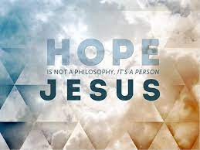
Mankind’s Only Hope!
“It is not enough to perceive the loving-kindness of God, to see the benevolence, the fatherly tenderness, of His character. It is not enough to discern the wisdom and justice of His law, to see that it is founded upon the eternal principle of love. Paul the apostle saw all this when he exclaimed, “I consent unto the law that it is good.” “The law is holy, and the commandment holy, and just, and good.” But he added, in the bitterness of his soul-anguish and despair, “I am carnal, sold under sin.” Romans 7:16, 12, 14. He longed for the purity, the righteousness, to which in himself he was powerless to attain, and cried out, “O wretched man that I am! who shall deliver me from this body of death?” Romans 7:24, margin. Such is the cry that has gone up from burdened hearts in all lands and in all ages. To all, there is but one answer, “Behold the Lamb of God, which taketh away the sin of the world.” John 1:29.” Steps to Christ, pg. 19

Slide 6
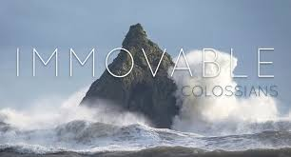
Thou art Peter
That thou art Peter, and upon this rock I will build my church;” Matthew 16:18 The word for Peter is Petros and it means a pebble that can be kicked around hither and yon. The rock on which Christ built the church was petra. Petra is a solid, immoveable rock.
Petros and petra are two distinct words in the Greek. Petros is a shifting, rolling, or insecure stone, while petra is a solid, immov­able rock.

Slide 7
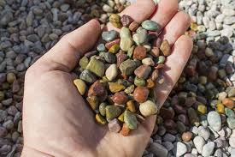
Pebbles!
Peter, the fickle pebble that could be kicked around, was truly booted around by the devil. Just as we are! He was many times overcome by the hosts of darkness. Even in this very passage, Jesus said to Peter, “Get thee behind me, Satan: thou art an offence unto me: for thou savourest not the things that be of God, but those that be of men.” The word Peter signifies a stone,—a rolling stone. Peter was not the rock upon which the church was founded. The gates of hell did prevail against him when he denied his Lord with cursing and swearing. The church was built upon One against whom the gates of hell could not prevail.” DA, pg. 412

Slide 8
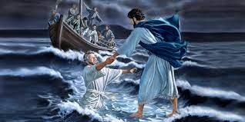
Jesus Didn’t Give Up!
“He desired to reveal to Peter his own weakness,—to show that his safety was in constant dependence upon divine power. Amid the storms of temptation he could walk safely only as in utter self-distrust he should rely upon the Saviour. It was on the point where he thought himself strong that Peter was weak; and not until he discerned his weakness could he realize his need of dependence upon Christ. Had he learned the lesson that Jesus sought to teach him in that experience on the sea, he would not have failed when the great test came upon him. Day by day God instructs His children. By the circumstances of the daily life He is preparing them to act their part upon that wider stage to which His providence has appointed them. It is the issue of the daily test that determines their victory or defeat in life's great crisis.” DA, pg. 382

Slide 9
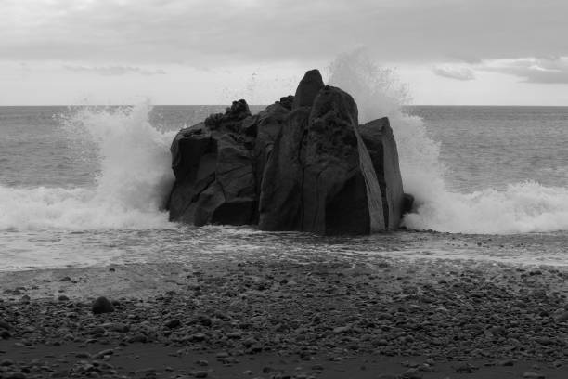
Only ONE Rock!
“Because I will publish the name of the LORD: ascribe ye greatness unto our God. He is the Rock, his work is perfect: for all his ways are judgment: a God of truth and without iniquity, just and right is he.” Deut. 32:3,4
“My soul, wait thou only upon God; for my expectation is from him. He only is my rock and my salvation: he is my defense; I shall not be moved. In God is my salvation and my glory: the rock of my strength, and my refuge, is in God.” Ps. 62:5-7

Slide 10
Christ the Unmovable!!
“Standing behind Pilate, in view of all in the court, Christ heard the abuse; but to all the false charges against Him He answered not a word. His whole bearing gave evidence of conscious innocence. He stood unmoved by the fury of the waves that beat about Him. It was as if the heavy surges of wrath, rising higher and higher, like the waves of the boisterous ocean, broke about Him, but did not touch Him. He stood silent, but His silence was eloquence. It was as a light shining from the inner to the outer man.” DA, pg. 726

Slide 11
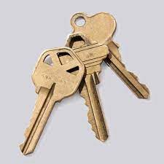
The Keys of the Kingdom
“And I will give unto thee the keys of the kingdom of heaven: and whatsoever thou shalt bind on earth shall be bound in heaven: and whatsoever thou shalt loose on earth shall be loosed in heaven.” Matthew 16:19
““The keys of the kingdom of heaven” are the words of Christ. All the words of Holy Scripture are His, and are here included. These words have power to open and to shut heaven. They declare the conditions upon which men are received or rejected. Thus the work of those who preach God's word is a savor of life unto life or of death unto death. Theirs is a mission weighted with eternal results.” DA, pg. 413

Slide 12
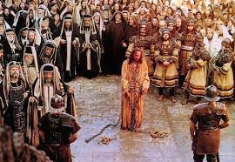
Slain by Adventists
“From that time forth began Jesus to shew unto his disciples, how that he must go unto Jerusalem, and suffer many things of the elders and chief priests and scribes, and be killed, and be raised again the third day.” Matthew 16:21

Slide 13
Same will Happen Again!
“As the storm approaches, a large class who have professed faith in the third angel's message, but have not been sanctified through obedience to the truth, abandon their position and join the ranks of the opposition. By uniting with the world and partaking of its spirit, they have come to view matters in nearly the same light; and when the test is brought, they are prepared to choose the easy, popular side. Men of talent and pleasing address, who once rejoiced in the truth, employ their powers to deceive and mislead souls. They become the most bitter enemies of their former brethren. When Sabbath keepers are brought before the courts to answer for their faith, these apostates are the most efficient agents of Satan to misrepresent and accuse them, and by false reports and insinuations to stir up the rulers against them.” GC, pg. 608

Slide 14
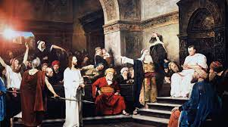
Christ was slain by those who wanted to save the church more than they wanted to save the truth! These were the Sadducees! “And one of them, named Caiaphas, being the high priest that same year, said unto them, Ye know nothing at all, Nor consider that it is expedient for us, that one man should die for the people, and that the whole nation perish not.” John 11:49,50
And by the Pharisees who loved their extreme views on church is Babylon, feast days, Holy Spirit not a Person, God doesn’t kill, etc.

Slide 15
For You and Me!
“The spotless Son of God hung upon the cross, His flesh lacerated with stripes; those hands so often reached out in blessing, nailed to the wooden bars; those feet so tireless on ministries of love, spiked to the tree; that royal head pierced by the crown of thorns; those quivering lips shaped to the cry of woe. And all that He endured—the blood drops that flowed from His head, His hands, His feet, the agony that racked His frame, and the unutterable anguish that filled His soul at the hiding of His Father's face—speaks to each child of humanity, declaring, It is for thee that the Son of God consents to bear this burden of guilt; for thee He spoils the domain of death, and opens the gates of Paradise. He who stilled the angry waves and walked the foam-capped billows, who made devils tremble and disease flee, who opened blind eyes and called forth the dead to life,—offers Himself upon the cross as a sacrifice, and this from love to thee.” DA, pg. 755

