Slide 1
Critiquing the Critique, pt. 2

Slide 2
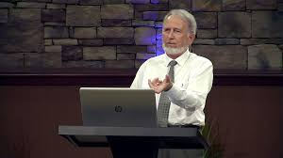
Scholar???!!!???
In pt. 1 of this series on the Judgment and the sanctuary teaching among SDA’s, we were told by ‘Scholar’ Laiu of Romania that:
1. the proof text method of Bible study, used by out pioneers and series Bible students is not a valid way to study the Bible.
2. Ellen white was WRONG in many of her assertions and interpretations.
3. The best source to trust is the scholars!
4. Wow! What is coming next???

Slide 3
Preterist Teaching
“After our scholars gradually abandoned or tend to ignore today the traditional solutions for the origin of the little horn, the implication of the phrase “out of one of the[m = four horns]” compels me to resort to the traditional Christian solution: Antiochus-Antichrist, in Daniel 8 and 11, but with the identity of Antichrist–Papacy taken from Daniel 7. Though we do not need to resort to the so called apotelesmatical principle, this solution has apologetic advantages: it is already acknowledged, and it does not contradict our application to Rome and Papacy. Most important, the little horn of Daniel 8 has its widely acknowledged parallel character in the prophecy of Daniel 11:21-35. The vile king of the North is best applied to Antiochus, as it is commonly agreed, usually outside the SDA circles.” Laiu, pg. 21

Slide 4
Take the Heat off of Rome!
“Desmond Ford’s proposal that Antiochus is a first, incomplete and typical fulfillment of this prophecy, which had to be better fulfilled by the pagan and Christian Rome, seems to me the best solution, even though I don’t like double prophecies. I would avoid it, if I could find a better solution. Anyway, it seems to me, hermeneutically and apologetically, more acceptable than any other historical or current Adventist explanations. Rome and Papacy better fulfill much better the most prophetic features of the little horn, but Antiochus fits best the origin of the little horn – at least. In Daniel 11, in the same manner, the king of the north is, in the last phase, the Papal Antichrist, but at the moment of his first appearance (11:21), and in a lot of dealings with the Jewish religion (v. 21-34), it is clearly the Hellenistic king. Antiochus is the spiritual root of Antichrist, and as a character he is even a “Roman” king, since he was educated in Rome and played so ominously his role as a persecuting god-king.” Laiu, pg.23

Slide 5
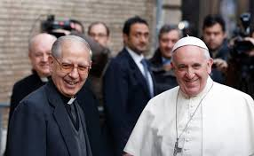
Following their Lead!
By following the lines of the ‘Scholars’, Adventism has adopted a teaching that places her in the arms of Francis. Only sorrow and great evil will result from this!!!!

Slide 6
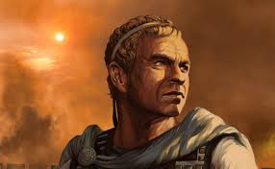
Antiochus Epiphanes???
“Therefore the he goat waxed very great: and when he was strong, the great horn was broken; and for it came up four notable ones toward the four winds of heaven. And out of one of them came forth a little horn, which waxed exceeding great, toward the south, and toward the east, and toward the pleasant land. And it waxed great, even to the host of heaven; and it cast down some of the host and of the stars to the ground, and stamped upon them. Yea, he magnified himself even to the prince of the host, and by him the daily sacrifice was taken away, and the place of his sanctuary was cast down. And an host was given him against the daily sacrifice by reason of transgression, and it cast down the truth to the ground; and it practised, and prospered.” Daniel 8:8-12

Slide 7
Let’s Decipher This.
1. The he goat (Greece) waxed very great. Antiochus was part of the Seleucid division of Alexander’s kingdom, ruling from 175-164 BC.
2. The little horn waxes exceedingly great. The little horn is greater than the Greek Empire. Laiu says the little horn is Antiochus. So, Antiochus was greater than the entire Greek kingdom??? Absurd! Ridiculous!!
3. This teaching of Antiochus being the little horn of Daniel 8 has its origins in the preterist view of Bible prophecy, espoused by Jesuit Luis de Alcazar who wanted to take the light off of the papacy as the antichrist. Desmond Ford taught this as well.
4, While Laiu says the little horn of Daniel 7 is the papacy, and Antiochus in chapter 8, this is a Jesuit ploy where you introduce two meanings for a symbol, leading eventually to the removal of one and the exaltation of the other!
5. Daniel 8 is so clear; Laiu uses his ‘scholarship’ to twist things!

Slide 8
Better Know about Antiochus!
Little Horn of Daniel 8
Old Position: Cannot be applied to Antiochus Epiphanes.
New Position: Can be applied to Antiochus, though he does not exhaust it. This is believed by S. Horn, R. Cottrell, D. Neufeld, Ford, etc. At the 1919 Bible Conference, Lacey, Wirth, M. Wilcox and others saw the prominence of Antiochus in Daniel.”
‘Daniel 8:14, The Day Of Atonement, And The Investigative Judgment By Desmond Ford

Slide 9
Now, it Really Gets Discombobulated!
“There is no reason to see the little horn as representative of the professed people of God, or of their sins, confessed or unconfessed, as some have proposed. The little horn of Daniel 7 and 8 are symbolic for the same class of hostile forces as the other horns, and as the beastly heads where they are rooted. No matter that the wicked horn represents first either Antiochus or pagan Rome, how can these professed pagans represent the professed people of God? If the little horn of Daniel 7 is the Roman (Papal) Antichrist, and it has a correspondent in the wicked horn of Daniel 8, how could a Pagan-Christian power represent the professed people of God or their sins? Such interpretation was an ingenious way to compensate the lack of contextual support for the historical view of cleansing the sanctuary from the confessed sins of God’s people in the eschatological Day of Atonement.” Laiu, pg. 21

Slide 10
Little Horn Professes
Laiu says the little horn, Antiochus or the papacy, have NOTHING to do with the cleansing of the sanctuary. Really? Antiochus HAS NOTHING to do with the day of atonement, but the papacy surely does!!! For over 1, 000 years, the papacy professed to be God’s people. They claimed to be the followers of God. And for whom is the investigative judgment? All who have ever professed to accept Christ and to follow Him have their names come in review before God. That includes papal worshippers! They are part of the cleansing of the sanctuary and the editing of the book of life! Antiochus never professed anything but his own worship!

Slide 11

Why Laiu would make such a statement is beyond me. SDA’s for decades have been saying that the Catholic Church of the Dark Ages was the Christian Church. Mervyn Maxwell in God Cares, pt. 1 and George Vandemann in ‘The Rise and Fall of Antichrist are two examples of this. All professed Christians will have their names come in review before God in the investigative judgment. Daniel 8 and judgment on the little horn fits perfectly with Daniel 8:14.

Slide 12
Puts on his Gloves Now!!
“And he said unto me, Unto two thousand and three hundred days; then shall the sanctuary be cleansed.” Daniel 8:14
“The crucial verb ק ִד ִצ ִנ ִו wǝ·ni·ṣdaq in Da 8:14 is a passive from √ צדק ṣdq
(“be right”, “make right”, “justify”). It does not really mean “cleansed (or purified)”, but “vindicated”, “put right” as it was already known, but not gladly acknowledged among us. Martin Pröbstle made an impressive analysis of this verb. He cites Jože Krašovec’s noticing that the Niphal draws attention to the Hiphil forms (Ex 23:7; 1K 8:32; Is 50:8), “where God in a legal context vindicates the righteous”. And Pröbstle concludes that “the verb points to a divine judgment which will justify the ש ׁדֹ ק ,“and he shows that in the intertestamental period צדק ṣdq functioned also “as an eschatological and apocalyptic term.” The verb ק ִד ִצ ִנ ִו wǝ·ni·ṣdaq of Da 8:14 is not directly connected (linguistically or literary) to Leviticus 16, as our historical theology insists for 166 years. The
Hebrew verb makes no allusion to, neither it echoes Leviticus 16. Actually, the relevant verbs used in Lev. 16 to express the idea of cleansing of sin are ר ִה ִט ṭahhēr “cleanse”, and ר ִפ ִכ kappēr “expiate”.1

Slide 13
Laiu, Hogwash!
Laiu argues that there is no connection between Daniel 8:14 and Leviticus 16. Daniel 8:14 talks about the cleansing of the sanctuary and Leviticus 16 talks about the cleansing of the sanctuary.
“And he said unto me, Unto two thousand and three hundred days; then shall the sanctuary be cleansed.” Daniel 8:14
Leviticus 16:19 “And he shall sprinkle of the blood upon it with his finger seven times, and cleanse it, and hallow it from the uncleanness of the children of Israel.”

Slide 14
Daniel 8:14 reads, “Unto 2300 evening mornings, then shall the sanctuary be nis√daq.” A glance at major modern English versions, lexicons, and commentaries indicates a wide range of different translations for the Hebrew nis√daq. The various renderings cluster around three basic ideas: First, there is the idea of the sanctuary being “restored to its rightful state.” Variations of the same idea include “have its rights restored,” “rights of the sanctuary be restored,” “declared right,” “put right,” “come into its right,” “reestablished within its rights,” “properly restored, or simply “restored.” A second idea conveyed by the translations of nis√daq is the traditional one, “cleansed,” indicated already by the Greek Septuagint and Theodotian katharistheœsetai and the Latin mundábitur, and the Syriac and Coptic. This translation of “shall be purified/cleansed” is followed in English by major modern versions in Protestant, Catholic, and Jewish traditions. The third idea represented by the English translations of nis√daq is that of vindication. Several translations read “shall be vindicated,” others, “shall be justified” or “its cause vindicated,” or the related “emerge victorious.” From this brief survey, it is clear that there is no consensus on the best English translation for nis√daq in Daniel 8:14!”

Slide 15
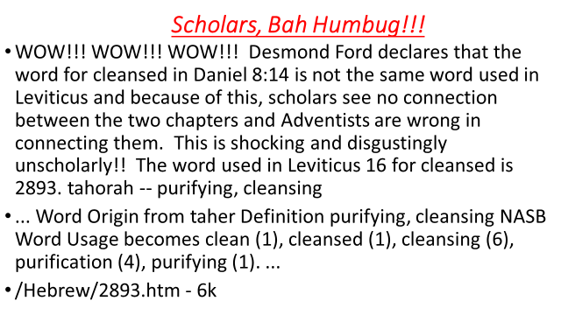

Slide 16
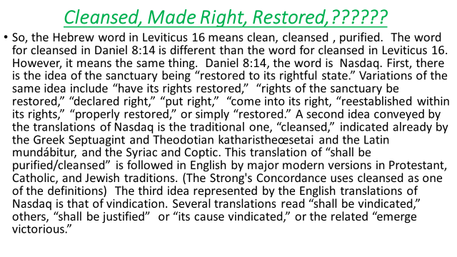

Slide 17


Slide 18

Scholars Make Me Gag!
It is clear that the words used in Daniel 8 and Leviticus 16 are different. However, the fact that their meaning is so similar leaves one to wonder: why does Laiu make an issue over this? Is he trying to drive a wedge between Daniel 8 and Lev. 16? Is he trying to trash 1844? He knows that Daniel 8 is the cornerstone of Adventism. Is he trying to destroy it in the name of scholarship? This appears to be the case!

