Slide 1
What is the Difference Between Mormons, Jehovah’s Witnesses, and Seventh-day Adventists? pt 6

Slide 2
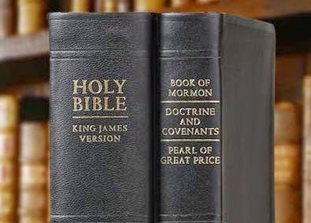
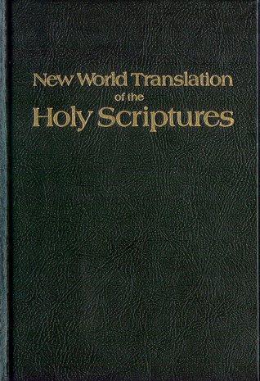
What We Will Study….
Origins of the Religion
Their Authorities and/or Authoritative Texts
Their Doctrinal Differences
Their Message to the World

Slide 3
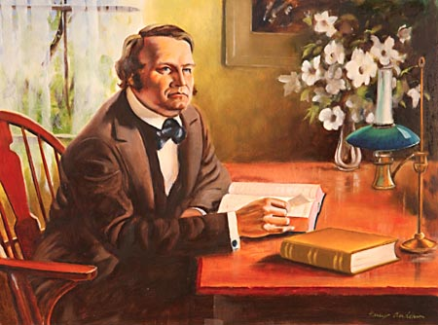
Origins of Seventh-day Adventism
The Seventh-day Adventist Church has its origin in the Millerites, similar to Charles Taze Russell—however, both took very distinct and separate paths. Many claim that Seventh-day Adventism is built on a failed prophecy by a deceptive preacher William Miller, for that reason, we must first examine the Millerite movement, which is the foundation of what would later become the Seventh-day Adventist Church.

Slide 4
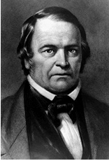
William Miller Backstory
“William Miller provided the impetus behind one of the most intense periods of millennial expectation in American history. Born in Pittsfield, Massachusetts, on 15 February 1782 and raised on the Vermont frontier, he grew up in the formative years of the new nation. His father was a veteran of the Revolutionary War, and though his mother was the daughter of a minister, Miller himself was moved early on by the rationalistic, enlightenment principles expounded by some of the most prominent revolutionaries. He proclaimed himself a Deist and rejected Christianity as superstition. When he returned home after service in the War of 1812, however, his attitude had changed. Observing that the United States had won the war despite the failings of many individuals who participated, he concluded that God had played a direct role in his nation’s victory. He began attending revival meetings and in 1815 had a dramatic conversion experience. As he described it, “God by his Holy Spirit opened my eyes. I saw Jesus as a friend, and my only help, and the Word of God as a perfect rule of duty.” He joined the Baptist Church and began to study the Bible in earnest.” Encyclopedia.com, William Miller, William Miller | Encyclopedia.com

Slide 5
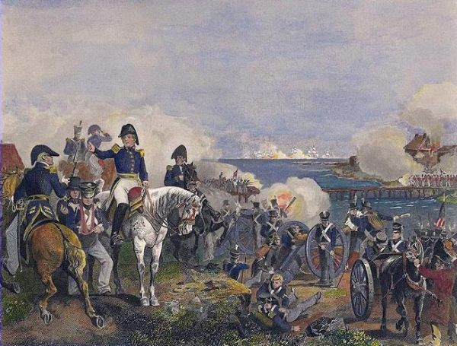
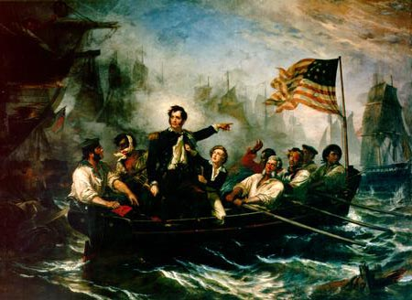
The Battle of Plattsburgh
“Miller spent most of the war working as a recruiter and on February 1, 1814, he was promoted to captain. He saw his first action at the Battle of Plattsburgh, where vastly outnumbered American forces overcame the British. ‘The fort I was in was exposed to every shot. Bombs, rockets, and shrapnel shells fell as thick as hailstones’, he said. One of these many shots had exploded two feet from him, wounding three of his men and killing another, but Miller survived without a scratch. Miller came to view the outcome of this battle as miraculous, and therefore at odds with his deistic view of a distant God far removed from human affairs. He later wrote, ‘It seemed to me that the Supreme Being must have watched over the interests of this country in an especial manner, and delivered us from the hands of our enemies... So surprising a result, against such odds, did seem to me like the work of a mightier power than man.’”—Wikipedia, William Miller (Sylvester Bliss, Memoirs of William Miller, 1853, p. 32-53)
Oliver Hazard Perry, .5 mile USS
Lawrence to USS Niagra

Slide 6
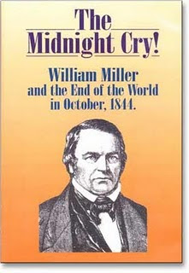
The 2300 Day Prophecy
“Within a few years of his conversion Miller had reached the conclusion that would raise great expectations in the hearts of thousands of believers: Christ would return to earth to usher in the thousand year period of peace and prosperity known as the millennium in 1843. While expectation of the millennium (or the Advent) was common in the early nineteenth century, prediction of such a precise date for its arrival was not. But Miller had approached the Bible with the same rational mind that had once made him a skeptic. In the course of two years of intense study he had scrutinized the Bible word by word, seeking to prove the truth of its contents by demonstrating its internal consistency. He devoted special attention to the parts of Scripture that dealt with the end of the world, or apocalypse. By seemingly logical manipulation of symbolic numbers in the Book of Daniel he was able to calculate a precise year when the millennium would come. “I was thus brought,” he later wrote, “at the close of my two-year study of the Scriptures, to the solemn conclusion that in about twenty-five years from that time [1818] all the affairs of our present state would be wound up.” Encyclopedia.com, William Miller, William Miller | Encyclopedia.com

Slide 7
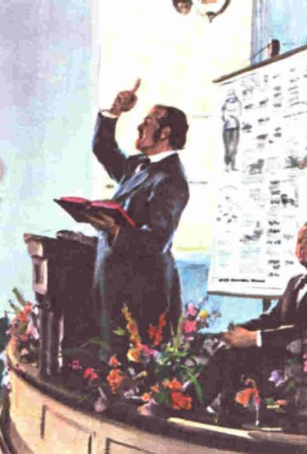
Into the ministry
“Though initially reluctant to air his prediction in public, by the early 1830s Miller felt a calling from God to go out and spread the word of Christ’s impending return. He became a successful lay preacher, sparking revivals as he traveled through New York, Vermont, and New Hampshire. In 1833 he was ordained as a Baptist minister. In 1835 he published a book [Evidences from Scripture and History of the Second Coming of Christ about the Year A.D. 1843] explaining his beliefs and how they had developed. While the book was relatively well received, Miller achieved national prominence only after 1839, when he and his cause were taken up by a Boston minister named Joshua V. Himes. Himes was a skilled publicist and organizer, and he arranged meetings across the country at which Miller would preach his Adventist message. In one six-month period Miller preached more than three hundred times. To reinforce Miller’s message Himes published two millennialist newspapers [Signs of the Times & The Midnight Cry], a book of millennial hymns, and numerous tracts urging people to prepare themselves for Christ’s return.” Ibid.

Slide 8
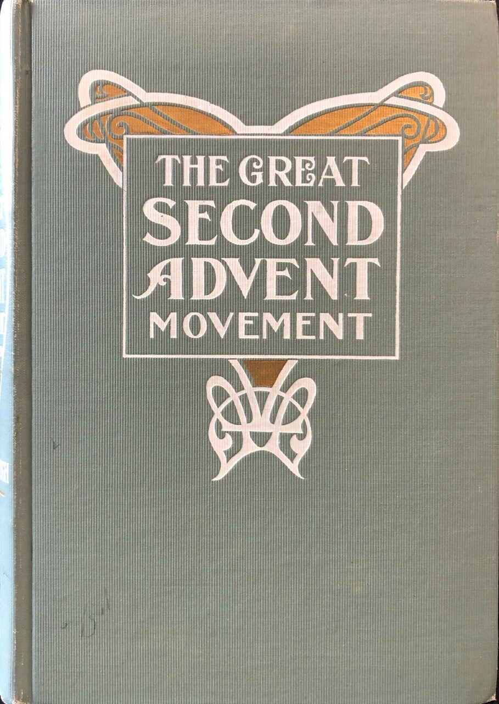
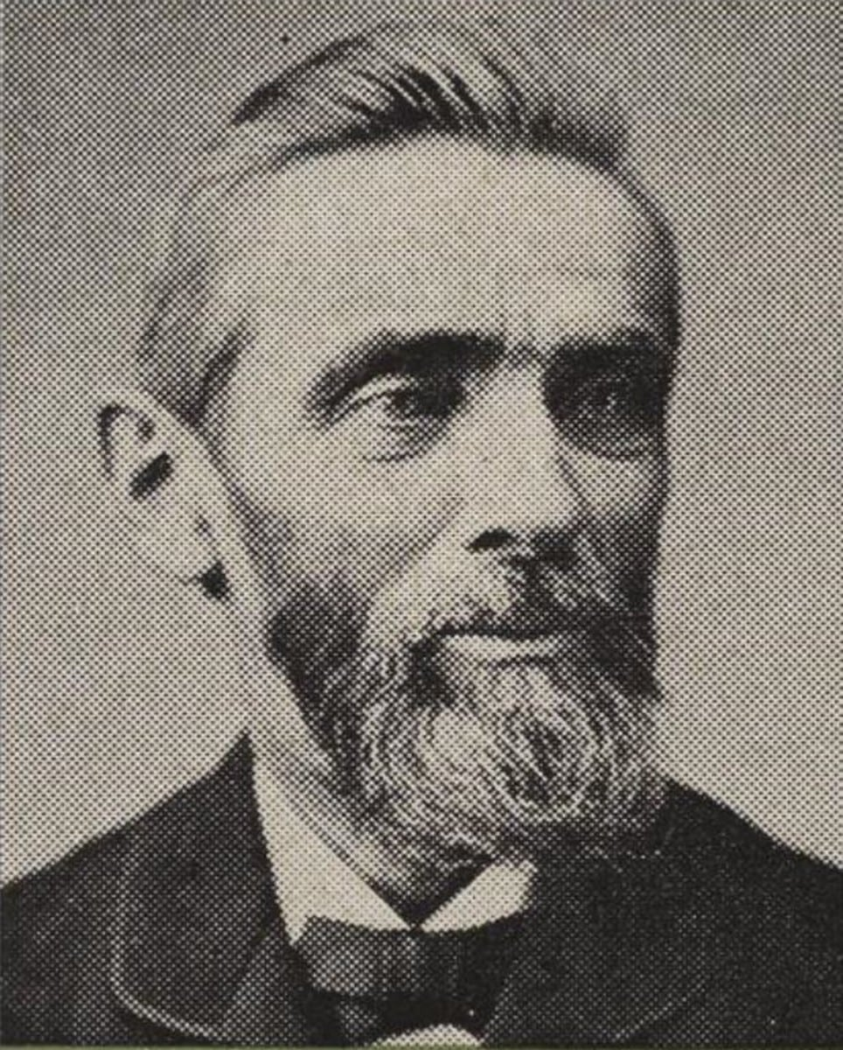
The Worldwide Message Proclaimed!
“To meet the growing interest, large tents were used, and grove meetings here held in summer season. Some of the largest church buildings and public halls were used in the winter, and all were packed to their utmost capacity with interested listeners. Instead of Elder Miller now standing, as had previous in 1840, ‘almost alone’ in declaring the message, about three hundred joined him in publicly proclaiming the termination of the twenty-three-hundred-day period, and in giving the cry ‘There shall be time no longer,’ and ‘The hour of his judgment is come.’ This we see how, when the Lord’s time came for the message to make its world-wide advancement, his word was fulfilled, and the millions were moved, with a desire to hear the call. What was true of the movement in America was true in other countries. From the year 1840, instead of a few individuals scattering their publications, scores sprang, as it were, to the front to proclaim the cry. In England there were seven hundred ministers of the Church of England alone proclaiming the message, to say nought of the scores of others engaged in the same work. In more than a score of the different leading nations of the earth a message going with that zeal which the looker-on to say, ‘This people are terribly in earnest.’”—Loughborough, The Great Second Advent Movement, p. 188

Slide 9
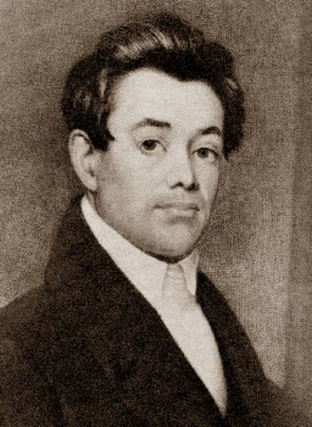
United in Doctrine
“In this prophetic description of the seven churches, we see the fall of the Sardis church is immediately followed by the Philadelphia, or (as the word signifies) brotherly love, church. Such, indeed, were the 50,000 believers who, by the second angel’s message, were brought out from all the varied churches, and united in one bond of brotherly love on the great cardinal truth of the immediate advent of Christ… The Midnight Cry of Sept. 12, 1844, contains a statement made by Elder J. V. Himes respecting the second angel’s message, and the circumstances which led to the proclamation of the same. His letter is dated, McConnelsville, Ohio, Aug. 29, 1844 and reads”– Loughborough, the Great Second Advent Movement, p. 177-178

Slide 10
“When we commenced the work with Brother Miller in 1840, he had been lecturing nine years. During that time he almost alone. But his labors had been incessant and effectual in awakening professors of religion to the true hope of God’s people, and the necessary preparation for the advent of the Lord; as also the awakening of all classes of the unconverted to a sense of their lost condition, and the duty of immediate repentance and conversion to God, as a preparation to the meet the Bridegroom in peace at his coming. . . . We told ministers and churches that it was no part of our business to break them up, or to divide and distract them. We had one distinct object, and that was to give the ‘cry,’ the warning of judgment ‘at the door,’ and persuade our fellow-men to get ready for the event. The ministry and membership who availed themselves of our labors, but had not sincerely embraced the doctrine, saw that they must either go with the doctrine, and preach and maintain it, or in the crisis which was right upon them, they would have difficulty with the decided and determined believers. They therefore decided against the doctrine, and determined, some by one policy or some by another, to suppress the subject. This placed our brethren and sisters among them in a most trying position. Most of them loved their churches, and could not think of leaving. But when they were ridiculed, oppressed, and in various ways cut off from their former privileges and enjoyments, and when the ‘meat in due season’ was withheld from them, the siren song of ‘peace and safety’ was sounded in their ears from Sabbath to Sabbath, they were soon weaned from their party predilections, and rose in the majesty of their strength, shook off the yoke, and raised the cry, ‘Come out of her, my people.’”—Ibid., 178-179

Slide 11
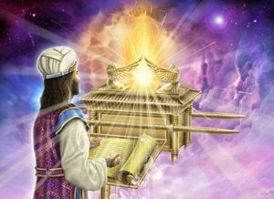
The Hour of His Judgment
Dan. 8:14 “And he said unto me, Unto two thousand and three hundred days (6153, 1242); then shall the sanctuary be cleansed.”---ended in 1844
Lev. 16:15-16 “Then shall he kill the goat of the sin offering, that is for the people, and bring his blood within the vail, and do with that blood as he did with the blood of the bullock, and sprinkle it upon the mercy seat, and before the mercy seat: And he shall make an atonement for the holy place, because of the uncleanness of the children of Israel, and because of their transgressions in all their sins: and so shall he do for the tabernacle of the congregation, that remaineth among them in the midst of their uncleanness.”

Slide 12
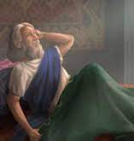
When Does it Start???
6153: ereb (eh’-reb)- even, evening, night, mingled, people, eventide, eveningtide 1) evening, night, sunset 1a) evening, sunset 1b) night
1242: boqer (bo’-ker)- morning, morrow, day, days, early 1) morning, break of day 1a) morning 1) end of night 2) of coming of daylight 3) of coming of sunrise 4) of beginning of day 5) of bright joy after night of distress (fig.) morrow, next day, next morning
Dan. 8:26-27 “And the vision of the evening and the morning (6153, 1242) which was told is true: wherefore shut thou up the vision; for it shall be for many days. And I Daniel fainted, and was sick certain days; afterward I rose up, and did the king's business; and I was astonished at the vision, but none understood it.”

Slide 13
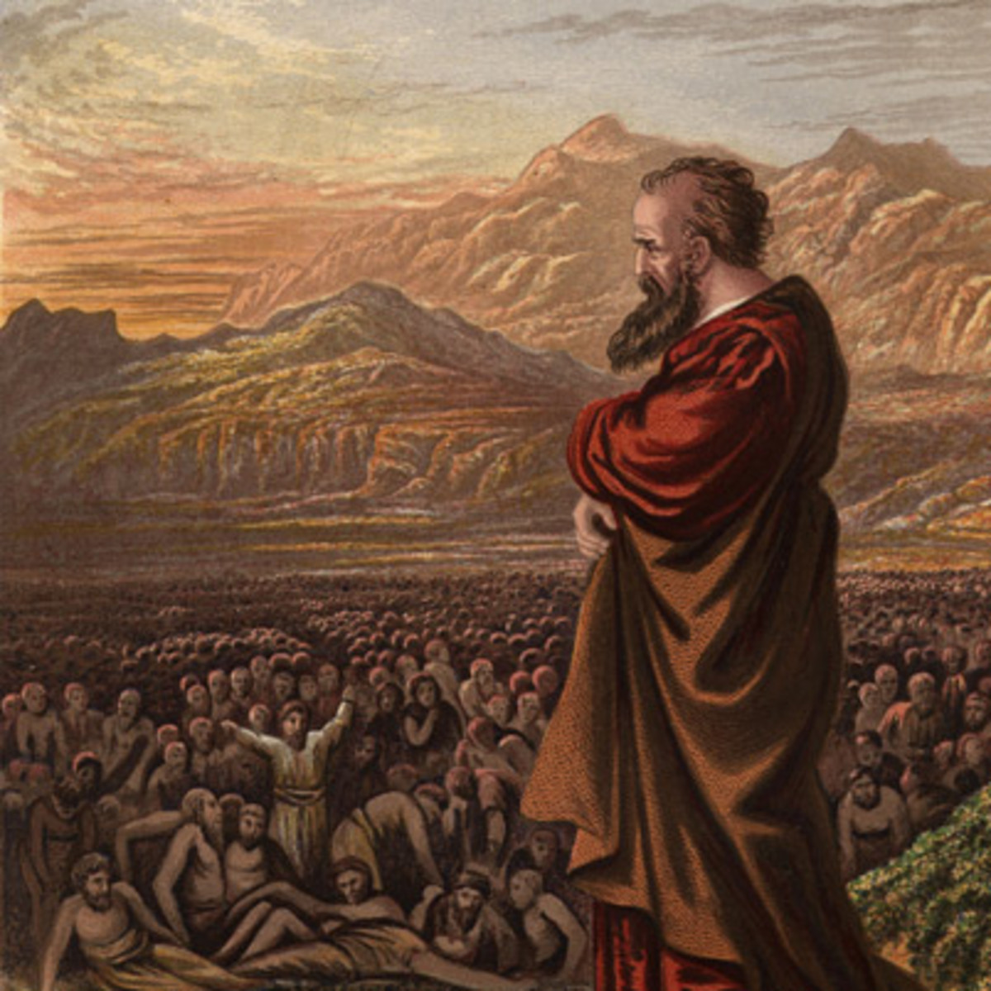
Day for a Year
Num. 14:34 “After the number of the days in which ye searched the land, even forty days, each day for a year, shall ye bear your iniquities, even forty years, and ye shall know my breach of promise.”
Ez. 4:6 “And when thou hast accomplished them, lie again on thy right side, and thou shalt bear the iniquity of the house of Judah forty days: I have appointed thee each day for a year.”

Slide 14
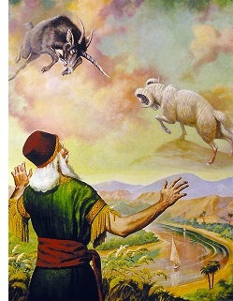
First Part of the Prophecy Starts in Dan. 9
Dan. 9:24-27 “Seventy weeks are determined upon thy people and upon thy holy city, to finish the transgression, and to make an end of sins, and to make reconciliation for iniquity, and to bring in everlasting righteousness, and to seal up the vision and prophecy, and to anoint the most Holy. Know therefore and understand, that from the going forth of the commandment to restore and to build Jerusalem unto the Messiah the Prince shall be seven weeks, and threescore and two weeks: the street shall be built again, and the wall, even in troublous times. And after threescore and two weeks shall Messiah be cut off, but not for himself: and the people of the prince that shall come shall destroy the city and the sanctuary; and the end thereof shall be with a flood, and unto the end of the war desolations are determined. And he shall confirm the covenant with many for one week: and in the midst of the week he shall cause the sacrifice and the oblation to cease, and for the overspreading of abominations he shall make it desolate, even until the consummation, and that determined shall be poured upon the desolate.”

Slide 15
Artaxerxes’ Decree in 457 BC-
Ezra 7:8,12-26 “And he came to Jerusalem in the fifth month, which was in the seventh year of the king. . . . Artaxerxes, king of kings, unto Ezra the priest, a scribe of the law of the God of heaven, perfect peace, and at such a time. I make a decree, that all they of the people of Israel, and of his priests and Levites, in my realm, which are minded of their own freewill to go up to Jerusalem, go with thee. Forasmuch as thou art sent of the king, and of his seven counsellors, to enquire concerning Judah and Jerusalem, according to the law of thy God which is in thine hand; And to carry the silver and gold, which the king and his counsellors have freely offered unto the God of Israel, whose habitation is in Jerusalem, And all the silver and gold that thou canst find in all the province of Babylon, with the freewill offering of the people, and of the priests, offering willingly for the house of their God which is in Jerusalem: That thou mayest buy speedily with this money bullocks, rams, lambs, with their meat offerings and their drink offerings, and offer them upon the altar of the house of your God which is in Jerusalem. And whatsoever shall seem good to thee, and to thy brethren, to do with the rest of the silver and the gold, that do after the will of your God. The vessels also that are given thee for the service of the house of thy God, those deliver thou before the God of Jerusalem. And whatsoever more shall be needful for the house of thy God, which thou shalt have occasion to bestow, bestow it out of the king's treasure house. And I, even I Artaxerxes the king, do make a decree to all the treasurers which are beyond the river, that whatsoever Ezra the priest, the scribe of the law of the God of heaven, shall require of you, it be done speedily, Unto an hundred talents of silver, and to an hundred measures of wheat, and to an hundred baths of wine, and to an hundred baths of oil, and salt without prescribing how much. Whatsoever is commanded by the God of heaven, let it be diligently done for the house of the God of heaven: for why should there be wrath against the realm of the king and his sons? Also we certify you, that touching any of the priests and Levites, singers, porters, Nethinims, or ministers of this house of God, it shall not be lawful to impose toll, tribute, or custom, upon them. And thou, Ezra, after the wisdom of thy God, that is in thine hand, set magistrates and judges, which may judge all the people that are beyond the river, all such as know the laws of thy God; and teach ye them that know them not. And whosoever will not do the law of thy God, and the law of the king, let judgment be executed speedily upon him, whether it be unto death, or to banishment, or to confiscation of goods, or to imprisonment.”

Slide 16
Does This Decree Restore and Rebuild Jerusalem?
Answer: Yes, Jerusalem is Rebuilt, Sanctuary reestablished with tax immunities to clergy, civil authority and autonomy granted, immunity to tribute.

Slide 17
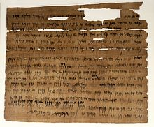
Other Ancient Texts Confirm
In the Ancient Dating Systems, we find that the 7th Year of Artaxerxes to be 457 BC to be confirmed by:
The Canon of Ptolemy—lists kings and astronomical observations
Greek Olympiad Dates
Babylonian Tablets (see Richard A. Parker and Waldo H. Dubberstein Babylonian Chronology: 626 B.C.-AD. 75)
Elephantine papyri from Egypt—contains the identification of the reign of Artaxerxes in 464 BC

Slide 18
Now Let’s Calculate….
457 BC + 2300 = 1843

Slide 19
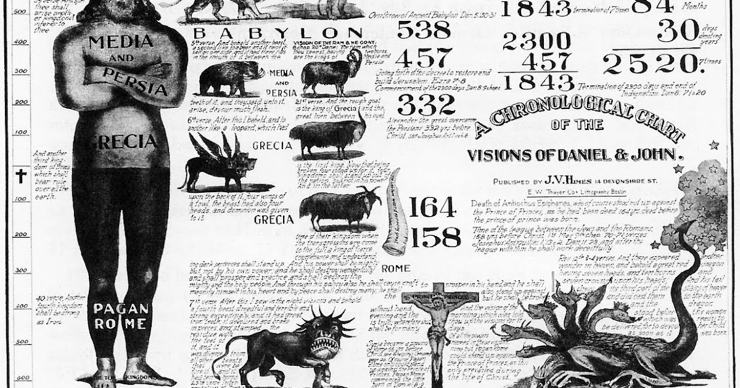
William Miller Gives the First Date
“My principles in brief, are, that Jesus Christ will come again to this earth, cleanse, purify, and take possession of the same, with all the saints, sometime between March 21, 1843, and March 21, 1844.” William Miller quoted in James White, Sketches of the Christian Life and Public Labors of William Miller, p. 182

Slide 21
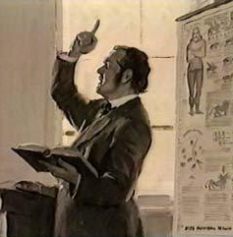
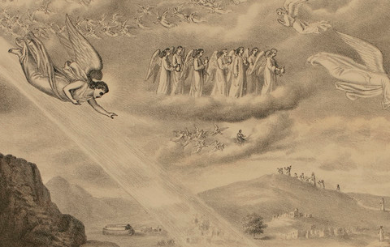
1843-Spring 1844 Pass…
After the time periods (March 21, 1843-March 21, 1844; then April 18/19, 1844) came and went with no return of Jesus Christ, the Millerites were still hopeful and eager for Christ’s Return. The Message of Habbakuk’s tarrying time was applied to the Millerite’s experience in awaiting the fulfillment of the 2300 days:
Hab. 2:2-4 “And the Lord answered me, and said, Write the vision, and make it plain upon tables, that he may run that readeth it. For the vision is yet for an appointed time, but at the end it shall speak, and not lie: though it tarry, wait for it; because it will surely come, it will not tarry. Behold, his soul which is lifted up is not upright in him: but the just shall live by his faith.”

Slide 22
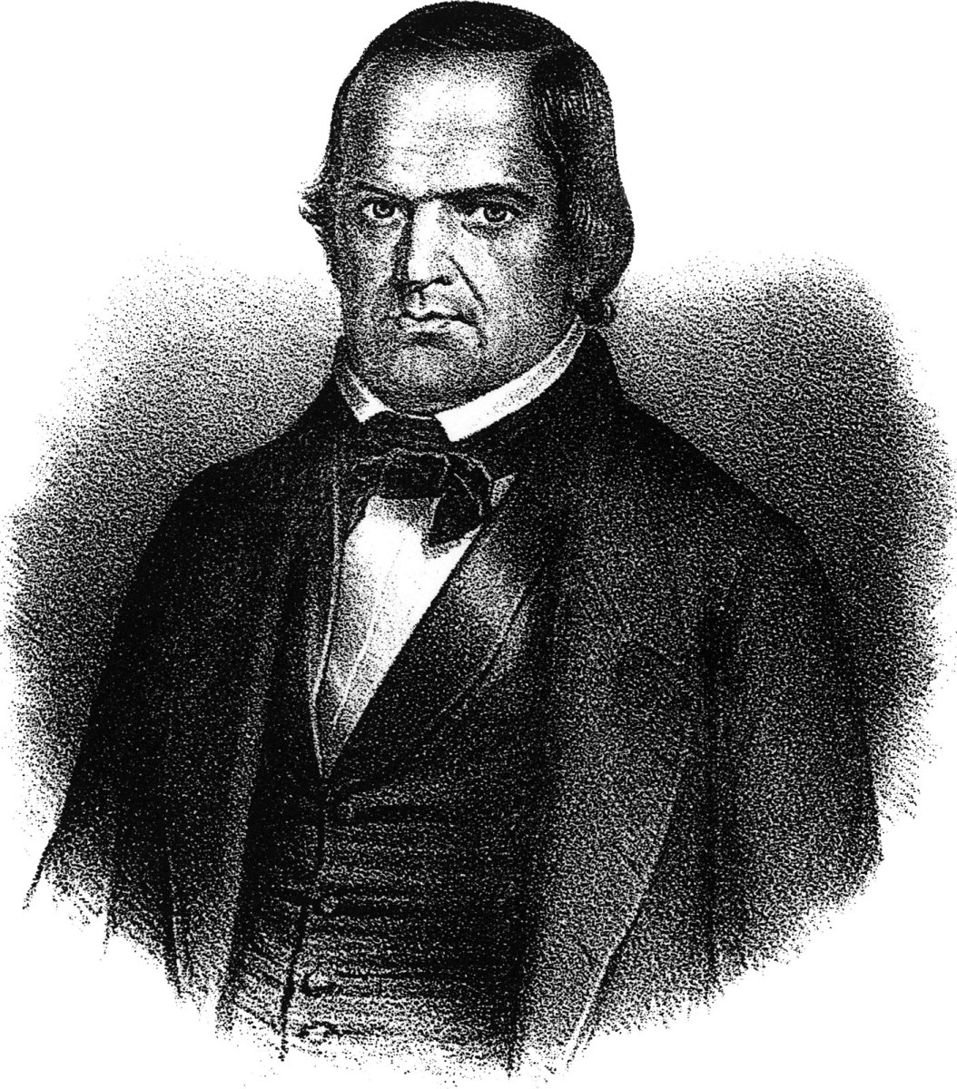
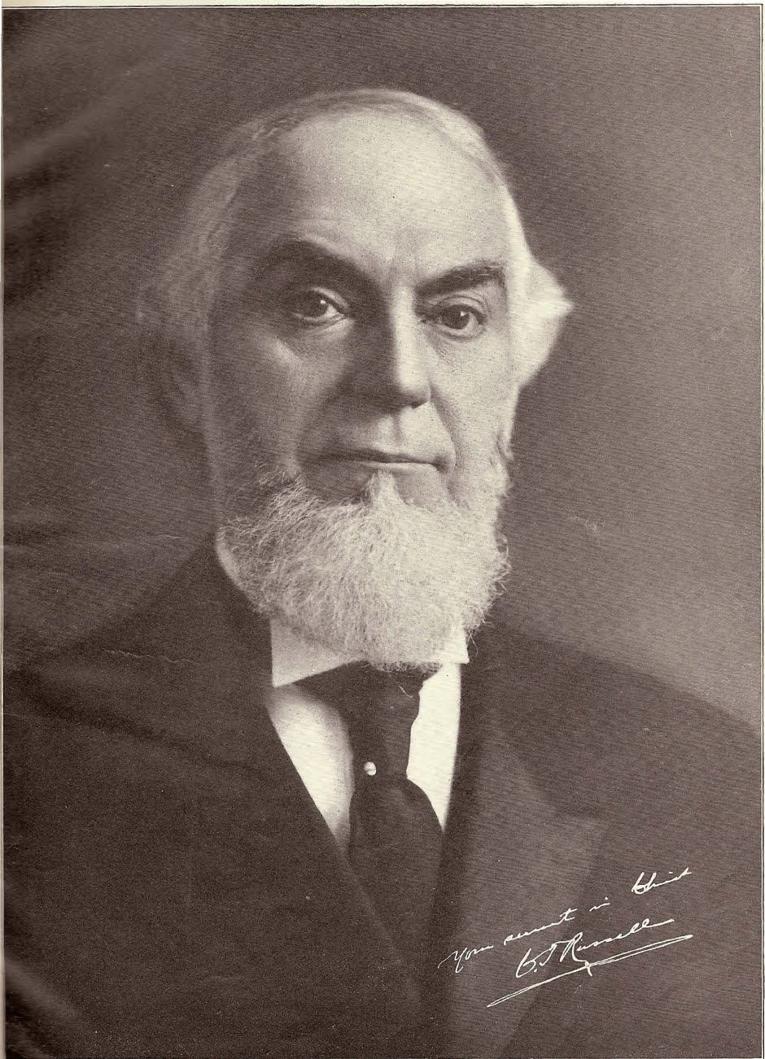
The Courage to Admit the Mistake!
“’I confess my error, and acknowledge my disappointment; yet I still believe that the day of the Lord is near, even at the door; and I exhort you, my brethren, to be watchful, and not let that day come upon you unawares. The wicked, the proud, and the bigot, will exult over us. I will try to be patient. God will deliver the godly out of temptation, and will reserve the unjust to be punished at Christ’s appearing.’”—William Miller quoted in Sylvester Bliss, Memoirs of William Miller, p. 256
VS

Slide 23
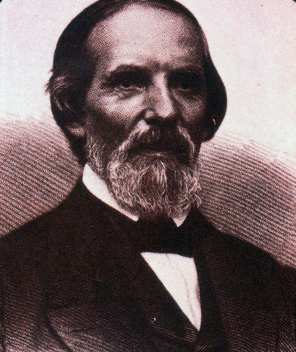
Samuel S. Snow’s 7 Month Message!
In August 1844, at a camp meeting in Exeter, New Hampshire Millerite Samuel S. Snow preached the correct timing of the end of the 2300 day (year) prophecy. Here is what Samuel Snow saw in the prophecy:
The command to restore and build Jerusalem by Artazerxes occurred in the “5th month” according to Ezra 7:8—putting the decree in the fall NOT spring, time for travel from Persia to Jerusalem pushes the date back further.
The cleansing of the sanctuary happened during the Day of Atonement which was on the 10th day of the 7th month, using the Karaite calendar—this would concur on October 22, 1844
--This Message was considered the 7 Month Message, of the truth “Midnight Cry”

Slide 24
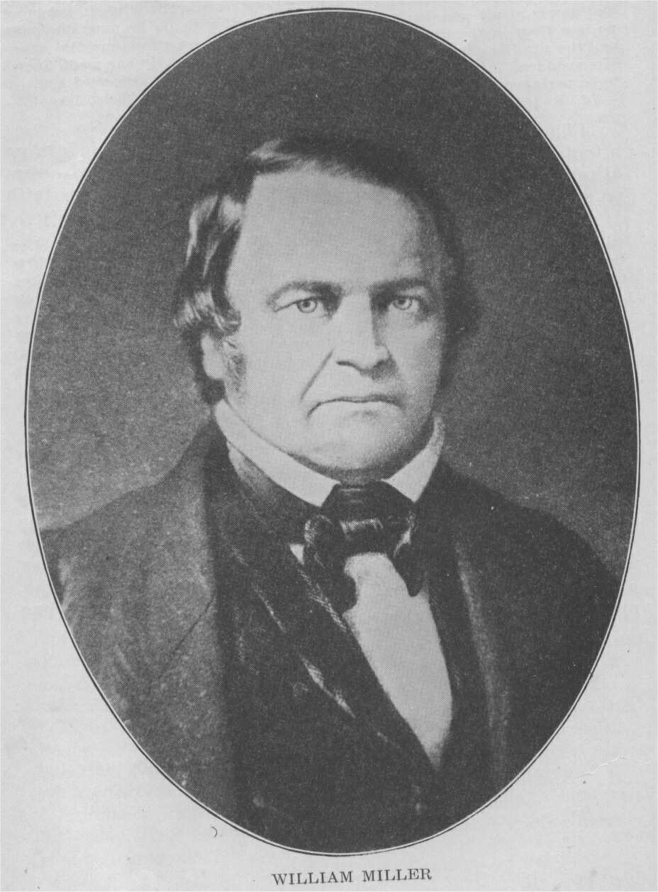
The Mistake Explained: Rabbinic vs Karaite Calendar
“As far back as April, and then in June and December of 1843, and in February of 1844 – months before Miller’s original date expired for the ending of the “Jewish year 1843” at the time of the vernal equinox in 1844- his associates (Sylvester Bliss, Josiah Litch, Joshua V. Himes, Nathaniel Southard, Apollos Hale, Nathan Whiting, and others) came to a definite conclusion. This was that the solution of Daniel’s prophecy is dependent upon the ancient or original Jewish form of luni-solar time, and not upon the altered modern rabbinical Jewish calendar . . . They therefore began to shift from Miller’s original date for the ending of the 2300 years (at the equinox in March), over to the new moon of April, 1844.”--(L. E. Froom, Prophetic Faith of Our Fathers, Review & Herald Publishing Assoc., 1982, Vol. IV, 796)

Slide 25
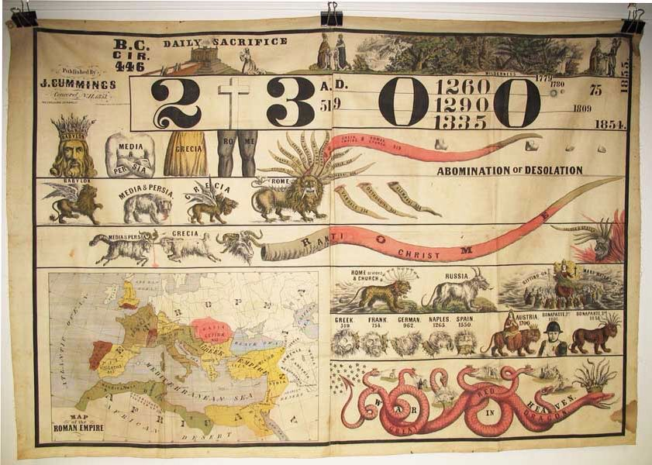
Millerites Get Back to Work!
“It swept over the land with the velocity of a tornado, and it reached hearts in different and distant places almost simultaneously”—Southard, N., Midnight Cry, Oct. 31, 1844.

Slide 26
The Great Disappointment
“Had the disciples realized that Christ was going to judgment and to death, they could not have fulfilled this prophecy. In like manner Miller and his associates fulfilled prophecy and gave a message which Inspiration had foretold should be given to the world, but which they could not have given had they fully understood the prophecies pointing out their disappointment, and presenting another message to be preached to all nations before the Lord should come. The first and second angels' messages were given at the right time and accomplished the work which God designed to accomplish by them. The world had been looking on, expecting that if the time passed and Christ did not appear, the whole system of Adventism would be given up. But while many, under strong temptation, yielded their faith, there were some who stood firm. The fruits of the advent movement, the spirit of humility and heart searching, of renouncing of the world and reformation of life, which had attended the work, testified that it was of God. They dared not deny that the power of the Holy Spirit had witnessed to the preaching of the second advent, and they could detect no error in their reckoning of the prophetic periods.”—GC, p. 405

Slide 27
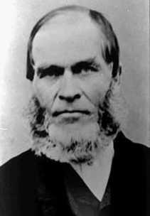
The Disappointment Cut Deep!
“Our fondest hopes and expectations were blasted, and such a spirit of weeping came over us as I never experienced before. It seemed that the loss of all earthly friends could have been no comparison. We wept, and wept, till the day dawn. I mused in my own heart, saying, My advent experience has been the richest and brightest of all my christian experience. If this had proved a failure, what was the rest of my christian experience worth? Has the Bible proved a failure? Is there no God—no heaven—no golden home city—no paradise? Is all this but a cunningly devised fable? Is there no reality to our fondest hopes and expectation of these things? And thus we had something to grieve and weep over, if all our fond hopes were lost. And as I said, we wept till the day dawn.”—Hiram Edson, undated manuscript of his life and experience, quoted in: George R. Knight, William Miller and the Rise of Adventism (Nampa, ID: Pacific Press, 2010), p. 184.

Slide 28
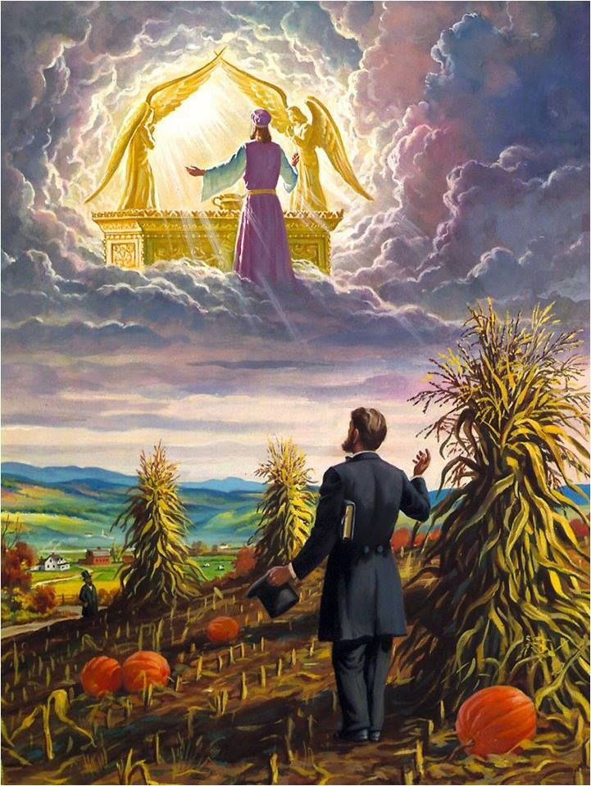
Hiram Edson’s “vision” of the Sanctuary
“When October 23, 1844, dawned and the little group of Millerites huddled in Edson’s farm had managed to check the first outpouring of grief, Edson led the way to his barn. Here they gathered and spent the morning in prayer. After this season of prayer, Edson, accompanied by his friend Owen Crosier, decided to make a trip across his cornfield. They wanted to visit some of their Millerite neighbors and encourage them. As they were making their way across the field Edson stopped short and seemed to stare straight ahead. Puzzled, Crosier pulled to an abrupt stop behind him calling out “Brother Edson, what are you stopping for?””—lineagejourney.com/read/hiram-Edson-the-farmer-in-the-cornfield/

Slide 29
“To which Edson replied, “God is answering our morning prayer, giving light regarding our disappointment”. Edson later explained that as he was walking he felt as if a hand was laid on his shoulder and he seemed to have a vision of the heavenly sanctuary where he saw that Jesus had that very day entered into the Most Holy Place of the Heavenly Sanctuary to begin the work of judgment. Crosier and Edson along with their friend and neighbor Franklin B. Hahn spent the next several weeks and months poring over their Bibles studying the themes of the sanctuary and judgment. In March of 1845, they published their findings in a small paper called “The Day Dawn”. Crosier, being a school teacher, wrote the article while Edson and his wife sold their best silverware to raise money to fund the publication and Hahn had the material published.”—Ibid.

Slide 30
The Remnant of the Remnant

Slide 31
The Awakening
“With earnest prayer they reviewed their position and studied the Scriptures to discover their mistake. As they could see no error in their reckoning of the prophetic periods, they were led to examine more closely the subject of the sanctuary. In their investigation they learned that there is no Scripture evidence sustaining the popular view that the earth is the sanctuary; but they found in the Bible a full explanation of the subject of the sanctuary, its nature, location, and services; the testimony of the sacred writers being so clear and ample as to place the matter beyond all question. The apostle Paul, in the Epistle to the Hebrews, says: "Then verily the first covenant had also ordinances of divine service, and a worldly sanctuary. For there was a tabernacle made; the first, wherein was the candlestick, and the table, and the shewbread; which is called the sanctuary. And after the second veil, the tabernacle which is called the holiest of all; which had the golden censer, and the ark of the covenant overlaid round about with gold, wherein was the golden pot that had manna, and Aaron's rod that budded, and the tables of the covenant; and over it the cherubims of glory shadowing the mercy seat." Hebrews 9:1-5.” GC, 411

Slide 32
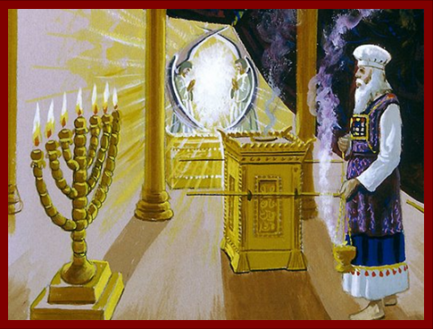
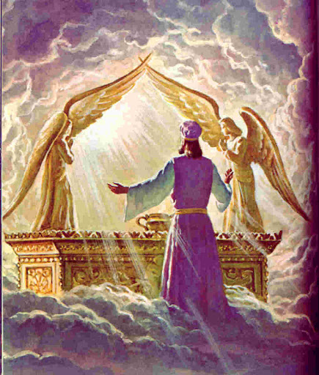
The Sanctuary on earth is a replica
Heb. 8:1-5 “Now of the things which we have spoken this is the sum: We have such an high priest, who is set on the right hand of the throne of the Majesty in the heavens; A minister of the sanctuary, and of the true tabernacle, which the Lord pitched, and not man. For every high priest is ordained to offer gifts and sacrifices: wherefore it is of necessity that this man have somewhat also to offer. For if he were on earth, he should not be a priest, seeing that there are priests that offer gifts according to the law: Who serve unto the example and shadow of heavenly things, as Moses was admonished of God when he was about to make the tabernacle: for, See, saith he, that thou make all things according to the pattern shewed to thee in the mount.”

Slide 33
Time-setting Again! 1975
"Choosing the Best Way of Life". The Watchtower. March 15, 1980. pp. 17–18. With the appearance of the book Life Everlasting—in Freedom of the Sons of God, ... considerable expectation was aroused regarding the year 1975. ... there were other statements published that implied that such realization of hopes by that year was more of a probability than a mere possibility. It is to be regretted that these latter statements apparently overshadowed the cautionary ones and contributed to a buildup of the expectation already initiated. ... persons having to do with the publication of the information ... contributed to the buildup of hopes centered on that date.
"What will the 1970's Bring?". Awake!. Watch Tower Society. October 8, 1968. p. 14. Does this mean that the above evidence positively points to 1975 as the complete end of this system of things? Since the Bible does not specifically state this, no man can say... If the 1970s should see intervention by Jehovah God to bring an end to a corrupt world drifting toward ultimate disintegration, that should surely not surprise us.
"How Are You Using Your Life?". Our Kingdom Ministry. May 1, 1974. p. 63. Reports are heard of brothers selling their homes and property and planning to finish out the rest of their days in this old system in the pioneer service. Certainly, this is a fine way to spend the short time remaining before the wicked world's end.

Slide 34
Decline of the Watch Tower After Death
Chicago Daily Tribune October 30, 1949 pg 18: "Pastor Russell died in 1916. In the 33 years since, the methods of this sect have deviated completely from those of Pastor Russell and his manner of teaching."

Slide 35
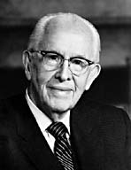
An Important Statement From an LDS Prophet
Prophet Ezra Taft: “the Book of Mormon is the keystone of our religion. This was the Prophet Joseph Smith’s statement. He testified that “the Book of Mormon was the most correct of any book on earth, and the keystone of our religion” (Introduction to the Book of Mormon). A keystone is the central stone in an arch. It holds all the other stones in place, and if removed, the arch crumbles.” (October 1986 General Conference)

