Slide 1
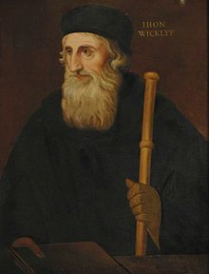
Historical Impact of Literature Evangelism
In the 1370s, he produced three significant works as countermeasures to the church’s corruption. The first one, On Divine Dominion (1373–1374), took aim at papal authority. Wycliffe was at a loss to find biblical warrant for the papacy. In fact, he argued that the papacy conflicts with and obscures the church’s true authority, Scripture. The second major work was On Civil Dominion (1375–1376). Here Wycliffe targeted the Roman Catholic Church’s assertion of authority over the English crown and English nobility. He saw no reason for England to be obliged to support a corrupt church. In his third major work, On the Truth of Sacred Scripture (1378), he further developed the doctrine of the authority of Scripture.—Stephen Nichols”The Morning Star of the Reformation”, desiringgod.org,

Slide 2
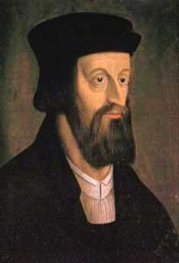
“The writings of John Hus, the Bohemian reformer, which got him condemned and burned at the stake, depended heavily on translations and adaptations of tracts, treatises, and sermons by John Wycliffe.”—Christianity Today, “John Wycliffe: Bible Translator” Issue 3, 1983

Slide 3
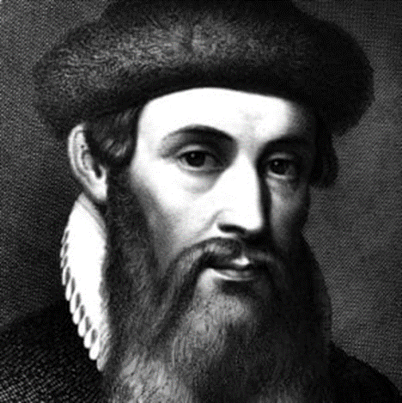
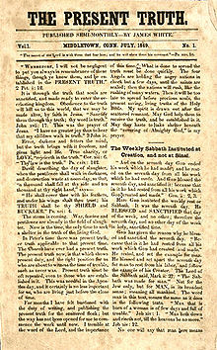
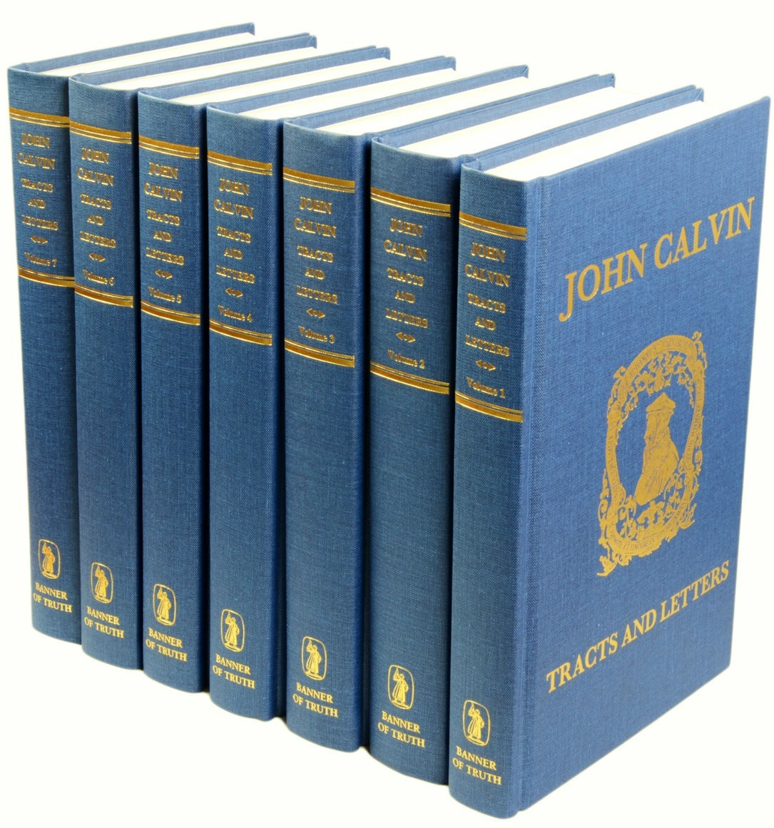
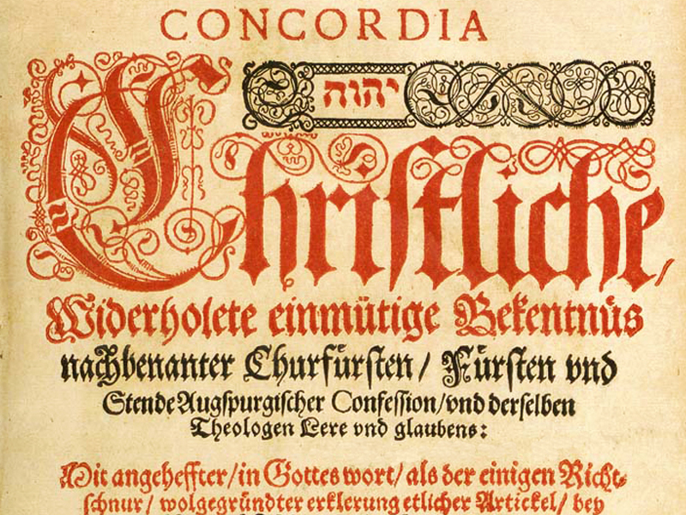
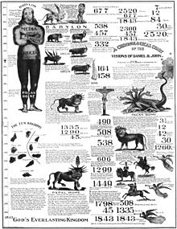
Turning the World Upside Down… Again!
In the 1440s, Johannes Gutenberg invented the “Gutenberg Press” which about 100 years later would be the sword of the Reformation. Books, Tracts, Pamphlets, lessons, Bible Studies, and most importantly Bibles were printed in mass in the language of the people and distributed, sometimes unlawfully to the mass of hungry souls

Slide 4
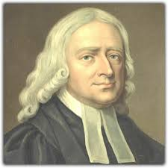
Pamphleteers for Jesus
“In 1798, Wesley’s evangelical faith was 10 years old. It had been broadcast to the nation not only through his sermons but also by a stream of very readable pamphlets. The Connexion that had built on it incorporated 80 societies, spreading from Bristol and London down to Cornwall, up through the Midlands to Newcastle and to Ireland.”—Stephen Tomkins, “John Wesley, A Biography”, p. 121
“At fairly sober estimates, he rode 250,000 miles”—Ibid., p. 199

Slide 5
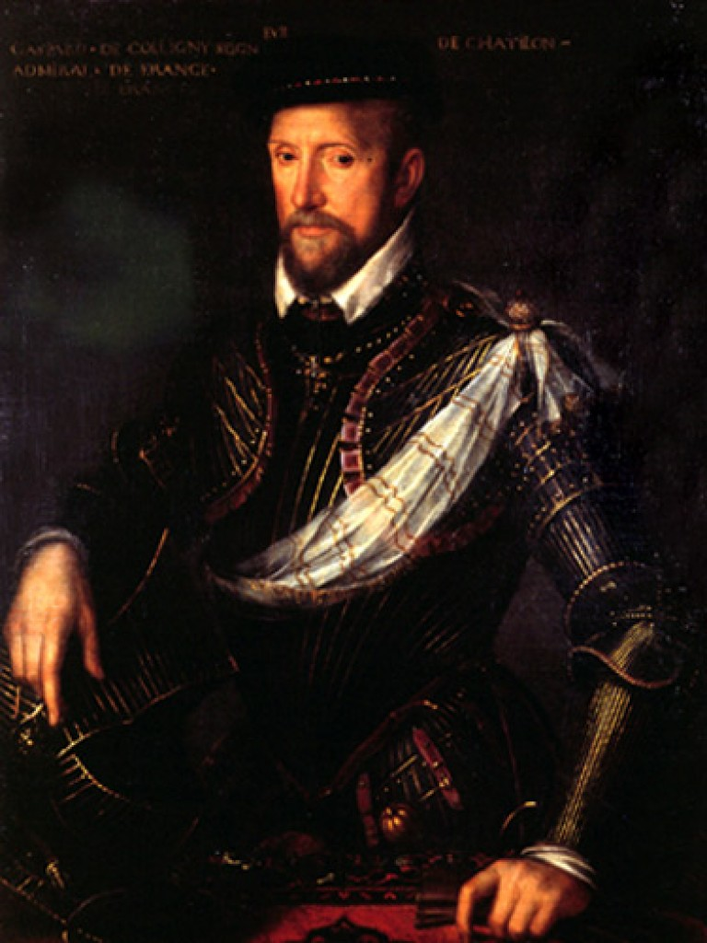
The Fruits of Literature Evangelism
In 1557, a young French officer, wounded in the battle of Saint Quentin, lay weak in bed in an enemy fortress where he was imprisoned. His brother, a covert Huguenot, visited him bringing a few evangelical books and tracts. The wounded officer read one of the tracts and trusted Christ as his Savior. When he was released from prison months later, the officer, Gaspard de Coligny, joined the Protestant movement embodied in the Huguenots in France, and he became one of the great spiritual leaders in the history of that country.—Perry C. Brown, “God Uses Gospel Tracts”, Journal of the Grace Evangelical Society, Autumn 1994 -- Volume 7:13

Slide 6
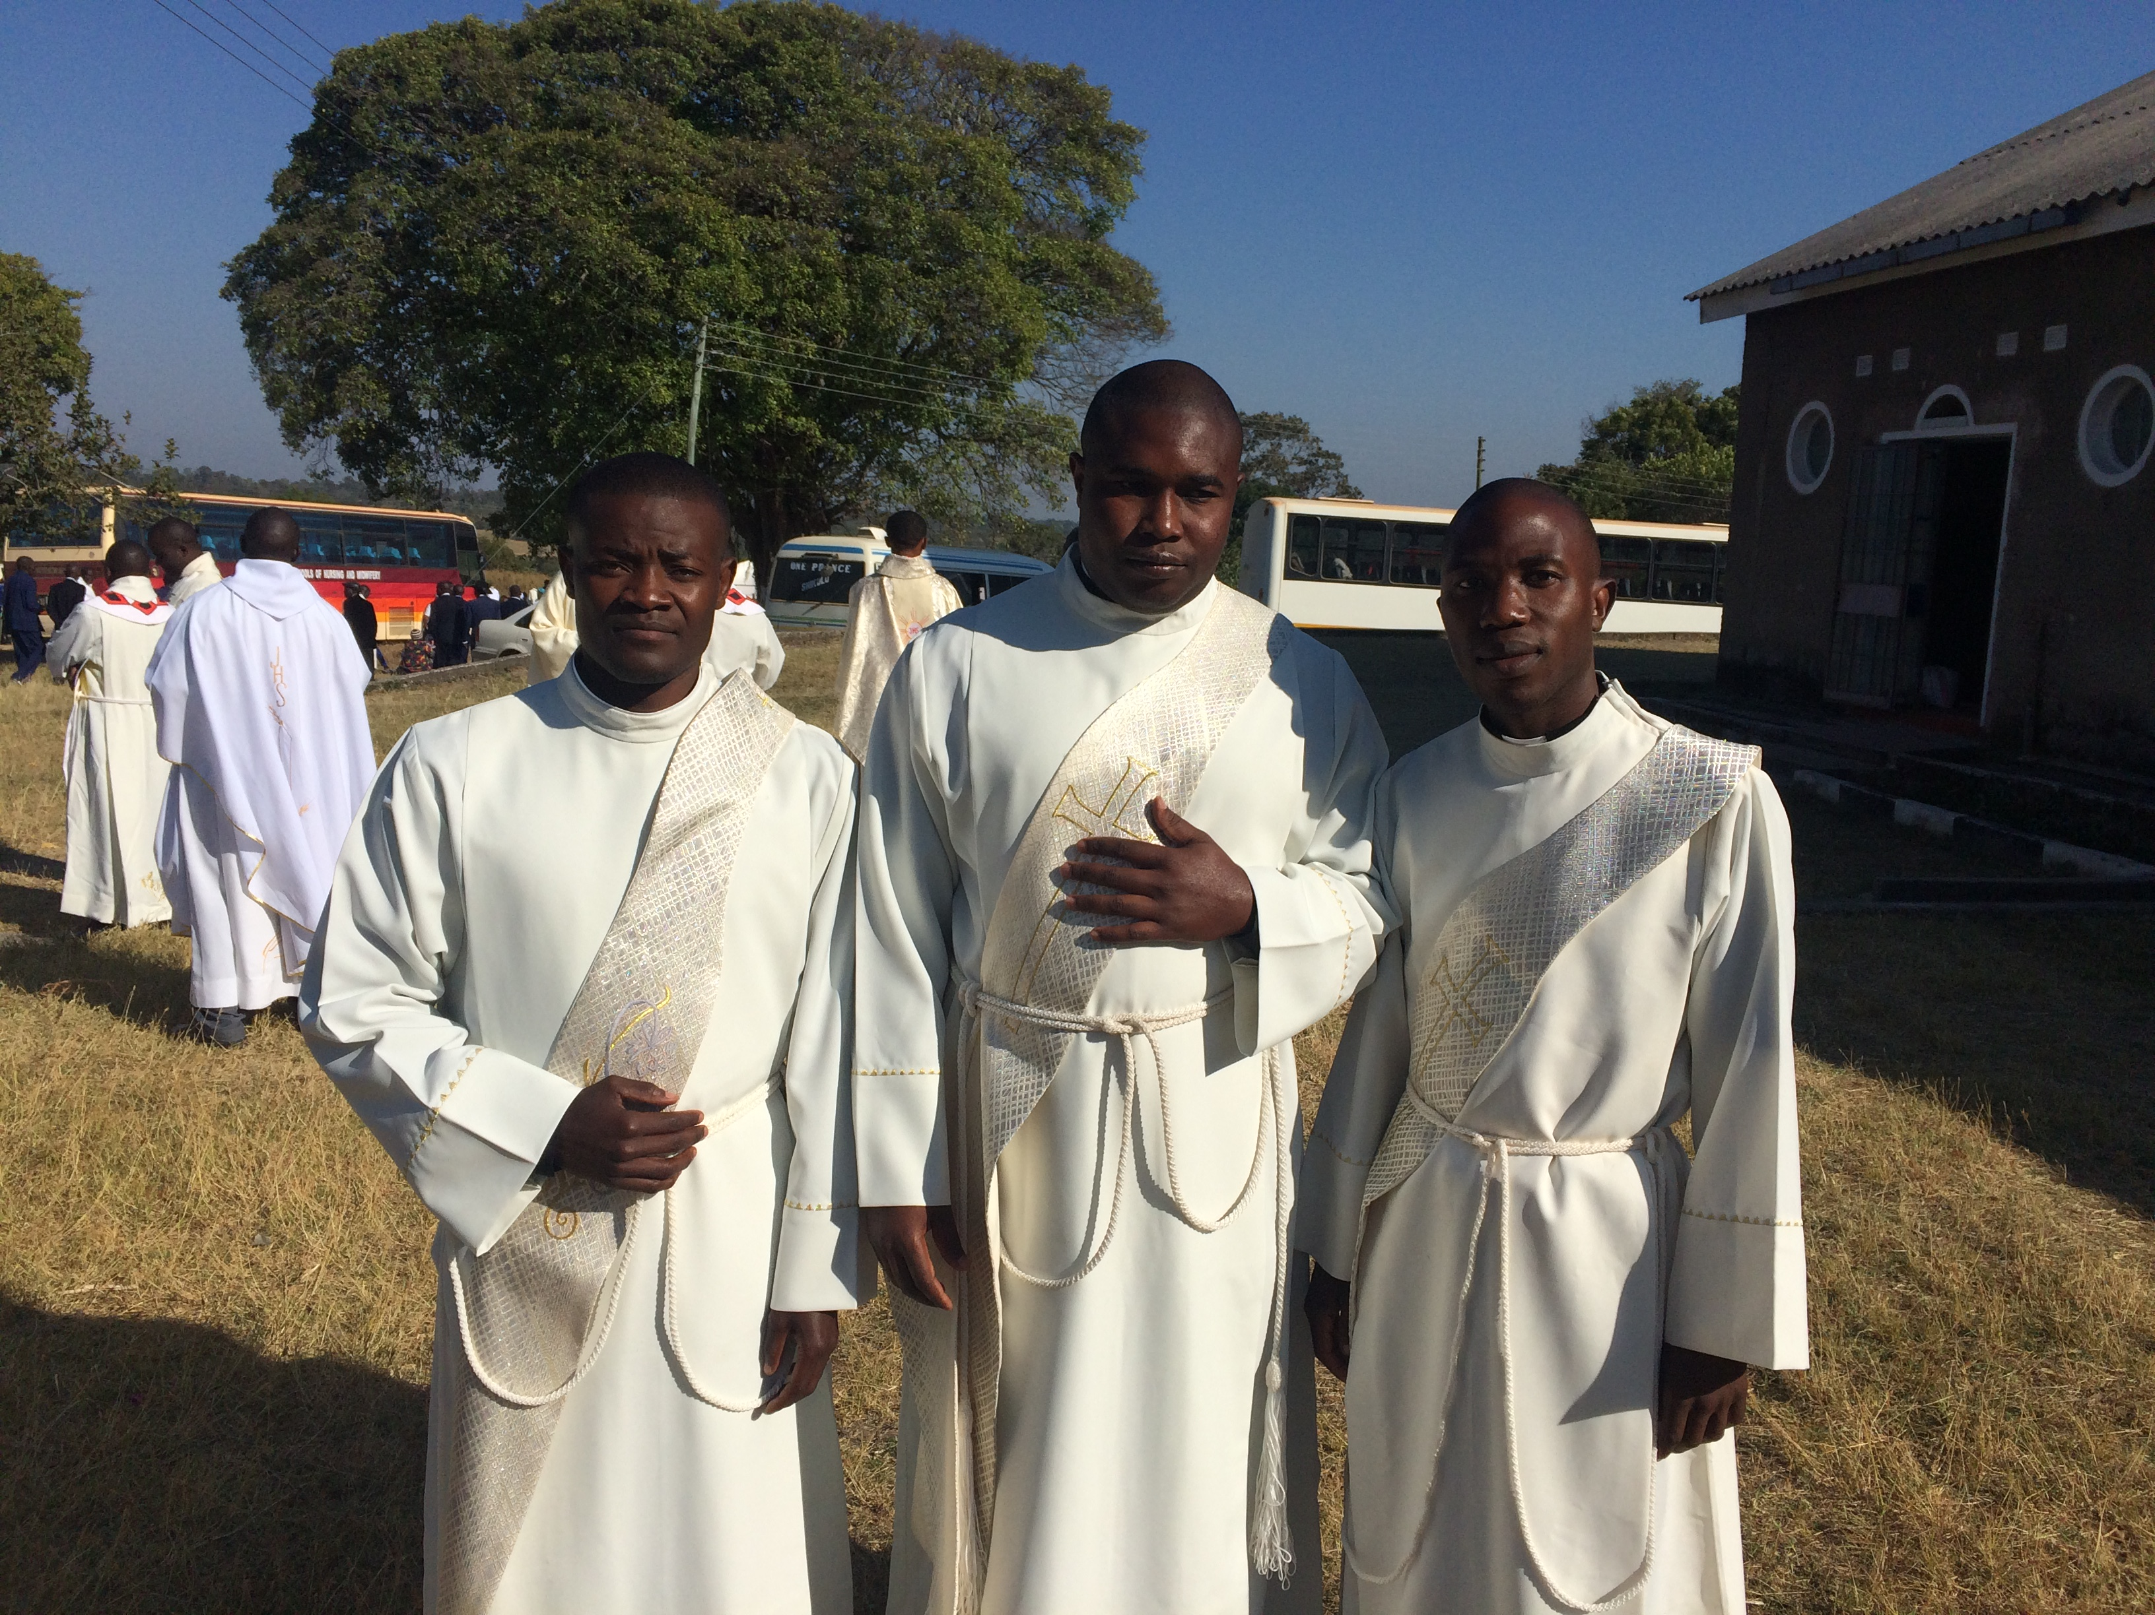
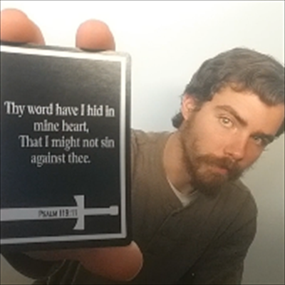
Faith of Giants inspired by pieces of Paper!
“One day, in March of 2013, there were some young men on of Monze who were passing out tracts and DVDs. One of was called Who Changed it? This tract discussed the little horn symbol in Daniel 7 and all of its characteristics. . . While handing out the tracts and DVDs, the young men came upon Priest Bwalya. As the priest looked over the tracts and saw thetitles of the DVDs, he became so happy because the tracts and DVDs sounded just like what he was hearing on the radio.”—Three Angel’s Over Africa, Bill Hughes, p. 14

Slide 7


A person may not be able to tell the exact time or place, or to trace all the circumstances in the process of conversion; but this does not prove him to be unconverted. By an agency as unseen as the wind, Christ is constantly working upon the heart. Little by little, perhaps unconsciously to the receiver, impressions are made that tend to draw the soul to Christ.... Suddenly, as the Spirit comes with more direct appeal, the soul gladly surrenders itself to Jesus. By many this is called sudden conversion; but it is the result of long wooing by the Spirit of God,—a patient, protracted process.—Maranatha, March 3

Slide 8

What can we do???
-Feed the poor with lunch bags with food and tracts/books/DVDs
-pass out on streets
-pass out to people you meet: cashiers, acquaintances, etc.
-make small packets/bags and leave them at peoples doors or mailboxes
-leave cards/tracts in random places
-give to waiters/waitresses (leave with tip)
-leave cards in the credit card slot at gas pumps
-leave in hotel drawers, or on beds with notes that they are for housekeepers
-plane seat pockets
-restrooms
-on cars under wiper blades
-anywhere and anyway the Holy Spirit leads you!

Slide 9

They Change Lives
The canvassing work, properly conducted, is missionary work of the highest order, and it is as good and successful a method as can be employed for placing before the people the important truths for this time. The importance of the work of the ministry is unmistakable; but many who are hungry for the bread of life have not the privilege of hearing the word from God’s delegated preachers. For this reason it is essential that our publications be widely circulated. Thus the message will go where the living preacher cannot go, and the attention of many will be called to the important events connected with the closing scenes of this world’s history.

Slide 10
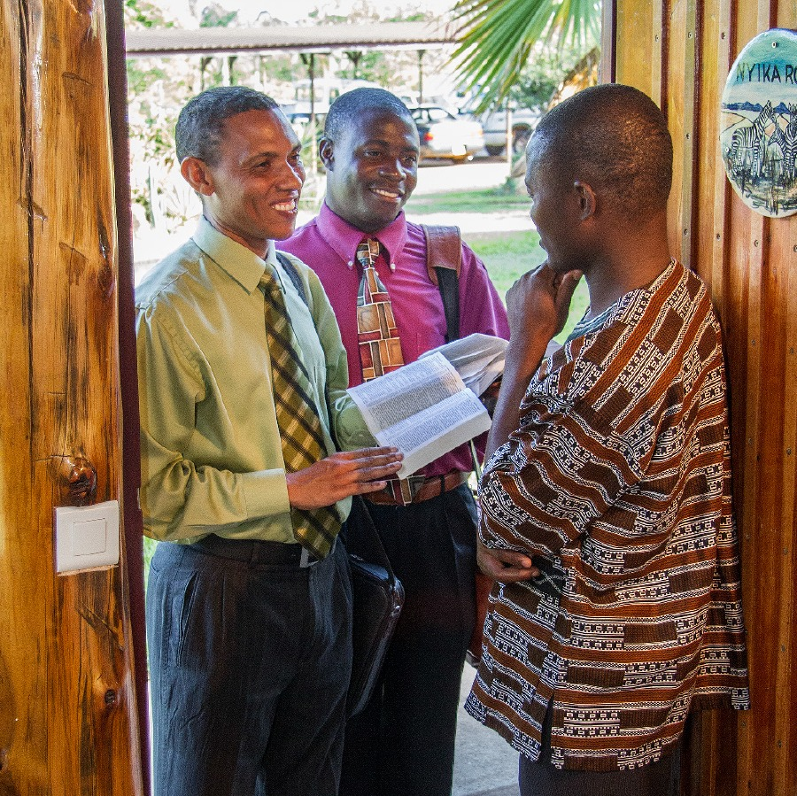

God has ordained the canvassing work as a means of presenting before the people the light contained in our books, and canvassers should be impressed with the importance of bringing before the world as fast as possible the books necessary for their spiritual education and enlightenment. This is the very work the Lord would have His people do at this time. All who consecrate themselves to God to work as canvassers are assisting to give the last message of warning to the world. We cannot too highly estimate this work; for were it not for the efforts of the canvasser, many would never hear the warning. It is true that some who buy the books will lay them on the shelf or place them on the parlor table and seldom look at them. Still God has a care for His truth, and the time will come when these books will be sought for and read. Sickness or misfortune may enter the home, and through the truth contained in the books God sends to troubled hearts peace and hope and rest. His love is revealed to them, and they understand the preciousness of the forgiveness of their sins. Thus the Lord co-operates with His self-denying workers

