Slide 1
Daniel 7
The Unit, pt.1
Pot of Gold or Poison Pill?

Slide 2
The Package
Daniel, chapters 7,8 and 9 are a unit and must be studied together. The three chapters build on each other and follow a chronological sequence. The three chapters look at the following topics:
1. the rise and fall of kingdoms.
2. the time of the judgment.
3. the work, death, and final victory of the Son of God.
Our study will begin with Daniel 7.

Slide 3
The Beasts
In setting the stage for the judgment and the work of the Messiah, Daniel is shown the rise and fall of nations. “And four great beasts came up from the sea, diverse one from another.” “These great beasts, which are four, are four kings, which shall arise out of the earth.” Daniel 7:3,17
Daniel watches the rise of four beasts. They are a lion, a bear, a leopard, and a beast without description. He is told that these beasts represent kingdoms or world powers. Each kingdom follows the other in succession, in chronological order, heading toward the judgment scene in verses 9 and 10.

Slide 4
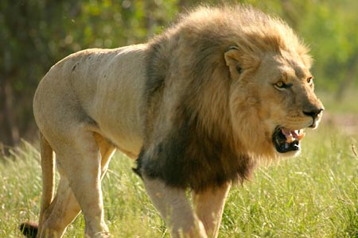
The lion beast
“The first was like a lion, and had eagle's wings: I beheld till the wings thereof were plucked, and it was lifted up from the earth, and made stand upon the feet as a man, and a man's heart was given to it.” verse 4
“Set up the standard toward Zion: retire, stay not: for I will bring evil from the north, and a great destruction. The lion is come up from his thicket, and the destroyer of the Gentiles is on his way;.” Jer. 4:6,7
These verses refer to Babylon as the lion kingdom.
Babylon ruled 605-539 B.C.

Slide 5
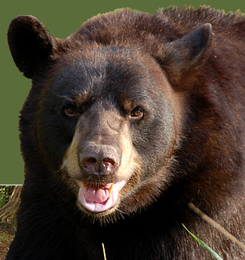
The Lopsided Bear
“And behold another beast, a second, like to a bear, and it raised up itself on one side, and it had three ribs in the mouth of it between the teeth of it: and they said thus unto it, Arise, devour much flesh.”
The kingdom that followed Babylon was Media Persia.
“PERES; Thy kingdom is divided, and given to the Medes and Persians.” Daniel 5:28
Media-Persia ruled from 539-331 B.C.

Slide 6
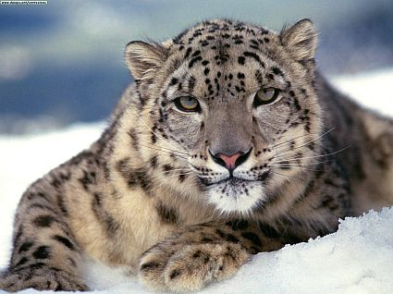
The Leopard Beast
“After this I beheld, and lo another, like a leopard, which had upon the back of it four wings of a fowl; the beast had also four heads; and dominion was given to it.” Daniel 7:6
The kingdom that followed Media-Persia was Greece. “The ram which thou sawest having two horns are the kings of Media and Persia. And the rough goat is the king of Grecia:” Dan. 8:20,21 Greece reigned from 331-168 B.C.

Slide 7
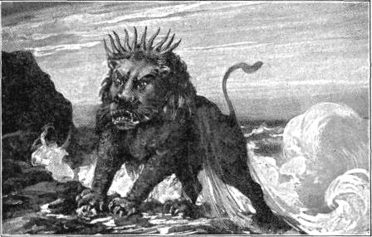
A Beast Without Description
“After this I saw in the night visions, and behold a fourth beast, dreadful and terrible, and strong exceedingly; and it had great iron teeth: it devoured and brake in pieces, and stamped the residue with the feet of it: and it was diverse from all the beasts that were before it; and it had ten horns.” Dan. 7:7
The kingdom that followed Greece was Pagan Rome. She ruled from 168 B.C. to 476 A.D.

Slide 8
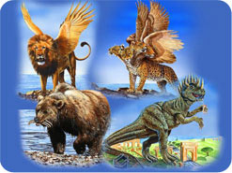
The Nations in Succession
Babylon 605-539 B.C.
Media-Persia 539-331 B.C.
Greece 331-168 B.C.
Pagan Rome 168 B.C.-476 A.D.
Because of the fact that this prophecy is based in history, it cannot be reapplied, or altered in any way, shape, or form. If any part is changed or moved, then it all falls apart.

Slide 9

The Little Horn
“I considered the horns, and, behold, there came up among them another little horn, before whom there were three of the first horns plucked up by the roots: and, behold, in this horn were eyes like the eyes of man, and a mouth speaking great things…And the ten horns out of this kingdom are ten kings that shall arise: and another shall rise after them; and he shall be diverse from the first, and he shall subdue three kings. And he shall speak great words against the most High, and shall wear out the saints of the most High, and think to change times and laws: and they shall be given into his hand until a time and times and the dividing of time.” Dan. 7:8,24,25

Slide 10
The little horn’s characteristics
1. It rose to prominence after the fall of Pagan Rome in 476 A.D.
2. It destroyed 3 Germanic tribes that came up after Pagan Rome’s demise.
3. He spoke great, boastful words and blasphemy.
4. He is not just a political power; he is different from the original ten. He is a religious/political power.

Slide 11
There are more
5. The three Germanic tribes included the Heruli- 493 A.D., Vandals- 534 A.D. and the Ostrogoths- 538 A.D.
6. He speaks boastful words against God.
7. He persecutes the people of God.
8. He has sought to change the ten commandments.
9. His time of control would be 1,260 years.

Slide 12
A Day for a Year
The 1260 day prophecy chart Scriptures: Daniel 7:25, Daniel 12:7, Revelation 11:2, Revelation 11:3, Revelation 12:6, Revelation 12:14, Revelation 13:5
This 1260 day time period is referred to 7 times in the Bible's prophecies; three times as a time, times, and half a time; twice as 42 months; and twice as 1,260 days.
Based on the 30-day calendar used by the Jews, these time periods are all the same amount of time: 3 1/2 years = 42 months = 1,260 days.
One prophetic day equals one literal year (Ezekiel 4:6; Numbers 14:34).
Thus a terrible persecution of God's people would exist for 1,260 prophetic days or 1,260 literal years.

Slide 13
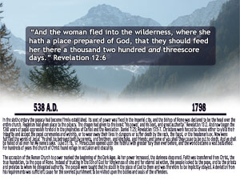
538-1798 A.D.

Slide 14
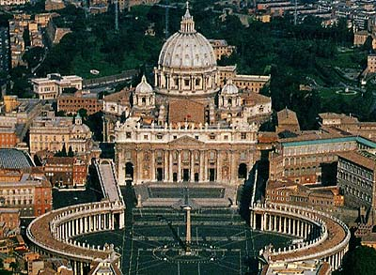
The Little Horn Revealed
Every specification of the little horn power represents the history and current activities of the Roman Catholic Church.

Slide 15
Summary of the powers in Daniel 7
Babylon 605-539 B.C.
Media/Persia 539-331 B.C..
Greece 331-168 B.C.
Pagan Rome 168 B.C.-476 A.D.
Struggle between the Arian tribes, the other Germanic tribes, and the papacy 476-538 A.D.
Papal Rome Rules 538-1798 A.D.

Slide 16
One Final Scene
Daniel 7:9,10 “I beheld till the thrones were cast down, and the Ancient of days did sit, whose garment was white as snow, and the hair of his head like the pure wool: his throne was like the fiery flame, and his wheels as burning fire. A fiery stream issued and came forth from before him: thousand thousands ministered unto him, and ten thousand times ten thousand stood before him: the judgment was set, and the books were opened.”
verse 26 “But the judgment shall sit, and they shall take away his dominion, to consume and to destroy it unto the end.”

Slide 17
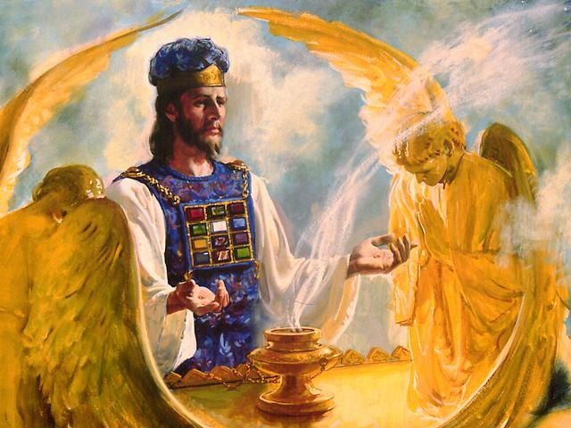
Judgment Begins!
Following the fall of the papacy at the end of the 1,260 years, the Bible says that judgment would begin. Since the Bible and history tell us of the temple in Jerusalem falling in 70 A.D., this judgment must take place in the sanctuary above. This Paul speaks of in Hebrews 8:1,2.

Slide 18
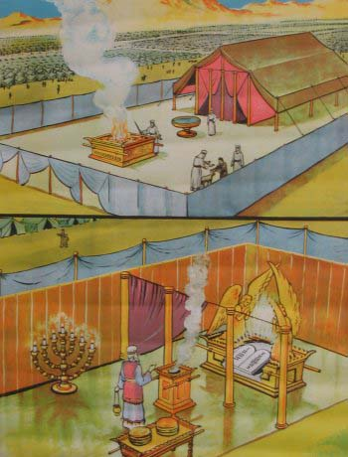
Hebrews 8:1,2
“Now of the things which we have spoken this is the sum: We have such an high priest, who is set on the right hand of the throne of the Majesty in the heavens; A minister of the sanctuary, and of the true tabernacle, which the Lord pitched, and not man.”

Slide 19
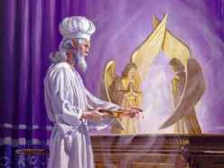
The End Time Day of Atonement
Since an investigative judgment is only found in the Bible on the Jewish feast day called the day of atonement, in Leviticus 23:26-32, then this heavenly judgment, as recorded in Daniel 7, must take place in the Most Holy Place up there. But when?

Slide 20
But When?
We have seen the rise and fall of nations. We have seen the chronological sequence of nations throughout history. The last one in the train is the papacy, from 538-1798 A.D. After that comes the judgment. From Daniel 7, all we know is that the heavenly judgment takes place after 1798. The jigsaw puzzle continues into Daniel 8. Let us keep our eyes open as to further clues that will discuss the time of the judgment, the day of atonement, and the cleansing of the sanctuary.
? ? ? ?

Slide 21
