Slide 1
Ted Wilson, GC President
Saint or Snake?

Slide 2
The First Apparent Look
Pastor Ted N.C. Wilson, was elected the 20th president of the General Conference on June 25, 2010. In his opening sermon at the General conference session, he highlighted so many things that faithful SDA’s could appreciate. He focused on many things:
1. the righteousness of Christ.
2. the foundation of the Bible/SOP
3. the sanctuary, the Sabbath, and the 10 commandments.
4. the final triumph of the great Advent message.

Slide 3
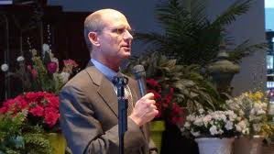
Another Josiah?
Many people were so thrilled with his message that many independent Adventists were openly questioning, “Should I go back to the denomination?” “Has God raised up this man that I need to support?” “Is this possibly another Josiah, raised up to curb widespread apostasy?”

Slide 4
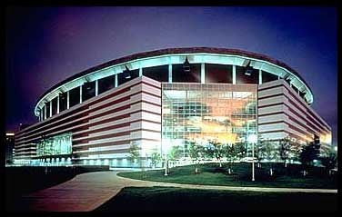
Opening Address
With all the good that was said in the first sermon given by Ted Wilson, there were three things of note to analyze here.
1. In his oft repeated mention of the Three Angels messages, he never once specified who Babylon is in Rev. 14:8.
2. In commenting on the third angel’s message, he never once specified who the beast and is image were in Rev. 14:9-12.
As we continue, this becomes very important!

Slide 5
Spiritual Formation
"Stay away from non-Biblical spiritual disciplines or methods of spiritual formation that are rooted in mysticism such as contemplating prayer, centering prayer, and the emerging church movement in which they are promoted. Look within the Seventh-day Adventist Church.” Sermon at General Conference July 2010

Slide 6
It is Here!
“Please prayerfully consider this quotation from a General Conference bulletin, informing the church at large of its plans to implement the teaching of spiritual formation around the world. ‘The Adventist world church created the International Board of Ministerial and Theological Education in September 2001, designed to provide overall guidance and standards to the professional training of pastors, evangelists, theologians, teachers, chaplains, and other denominational employees involved in ministerial and religious formation, or spiritual formation, in each of the church’s 13 regions around the world.’ (ANN News, 2-3-2004, www.Adventist.org. Feature: Church, Congregations Increase Focus on ‘Spiritual Formation’.)
) Quoted in Rick Howard’s book, The Omega Rebellion, pg. 136

Slide 7
Board that Approved Spiritual Formation
INTERNATIONAL BOARD OF MINISTERIAL AND THEOLOGICAL EDUCATION ROCK, CALVIN B, Chairman Advisor for Education* Hsu, Eugene, Vice-chairman Advisor for AIIAS Wilson, Ted N C, Vice-chairman Advisor for Ministerial Association* Rasi, Humberto M, Secretary Education Department Director* Cress, James A, Associate Secretary Ministerial Association Secretary* Paulsen, Jan President* Bediako, Matthew A Secretary* Rawson, Robert L Treasurer* Stenbakken, Richard O Adventist Chaplaincy Ministries Director* Reid, George W Biblical Research Institute Director* . Taken from the Adventist Review.

Slide 8
Fox in the Henhouse!
Why would Ted Wilson tell SDA’s to stay away from Spiritual Formation and then tell them to look within the denomination as though it is not there, when he was on a committee that brought into Adventism over 10 years ago? That is like telling the chickens to go into the henhouse, even though you know there are dozens of foxes in the henhouse!!!

Slide 9
Loyola’s Focus
“Loyola’s whole religious life centered around his meditation. He is said to have believed that he had revelations from God everyday…He authored a volume that is still in print, entitled ‘The spiritual Exercise of Ignatius Loyola, a series of meditations by which one is supposed to purge the soul and find oneness with God…He spends hours in mystical meditation, under the control of a director, and within a month his mind has begun to accept the concept of absolute submission.” Submission to whom? “Malachi Martin says that after going through the rigors of the Spiritual Exercises, ‘Each man emerged from that weeks long regimen as a spiritual fighter completely won over to warfare…an entirely obedient servant of the pope.’ “ quote form Omega II by Lewis Walton, pgs. 150,151

Slide 10
Where it All Ends
“The Lord has a controversy with his professed people in these last days. In this controversy men in responsible positions will take a course directly opposite to that pursued by Nehemiah. They will not only ignore and despise the Sabbath themselves, but they will try to keep it from others by burying it beneath the rubbish of custom and tradition. In churches and in large gatherings in the open air, ministers will urge upon the people the necessity of keeping the first day of the week. There are calamities on sea and land: and these calamities will increase, one disaster following close upon another; and the little band of conscientious Sabbath-keepers will be pointed out as the ones who are bringing the wrath of God upon the world by their disregard of Sunday.” RH, March 18,1884

Slide 11
Great Controversy Plan
The Great Controversy Project: An interview with Delbert W. Baker
Editor’s note: Delbert W. Baker, a general vice president for the world church of Seventh-day Adventists, who chairs The Great Controversy Project (GCP) Committee, discusses the world wide initiative to distribute Ellen G. White’s book The Great Controversy, disseminating its last-day message to a world in need of hope… “That’s what our General Conference president, Pastor Ted Wilson, was referring to when he preached his first message in Atlanta—do something big and bold for God! Under God, we need to do something bold and get our message out in a very powerful and distinct way. We must tell the world about the message God has given us. By sending millions of copies of The Great Controversy around the globe, we think that can be accomplished… President Wilson has challenged all the divisions of the world field, all the departments in the General Conference, all the entities, for example, hospitals, Adventist Health Systems, schools, Adventist-laymen’s Services and Industries, independent ministries, publishing houses, supporting organizations, and so forth, to help us in spreading The Great Controversy like the leaves of autumn……

Slide 12
Cont.
The third benefit of The Great Controversy is that it has a way of applying history in a very practical fashion to our lives. So when we read the story about Zwingli, Luther, Calvin, then the Reformation, lessons are not simply relegated to the distant past, but they can be applied to our lives today.
In the latter part of the book, Ellen G. White talks about end-time events. She had to have prophetic insight. People need to know what is in these pages. Today, people are very interested in the future. They want to know, what does the future hold? What can we expect? The Great Controversy answers those questions. Ellen G. White said she wanted to see this book distributed more than any of her other books. And so we are following through with her desire…. But now is the time for The Great Controversy. Many people are distributing it now and have been for some years. But it is the conviction of Pastor Wilson, the division presidents, the vice presidents here, and church leadership overall, that the message of The Great Controversy is what needs to be shared at this time!...

Slide 13
Not Quite!
Ellen White wrote many books, why did you send this book?
This is the book for which Ellen White urged the greatest circulation.
“The Great Controversy should be very widely circulated. It contains the story of the past, the present, and future… I am more anxious to see a wide circulation for this book than for any others I have written; for in The Great Controversy, the last message of warning to the world is given more distinctly than in any of my other books.” – Letter 281, 1905.

Slide 14
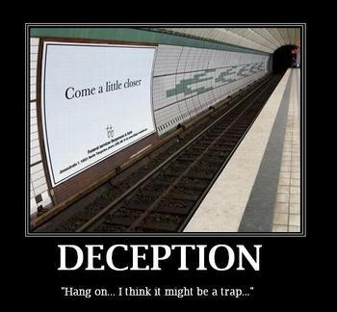
Watering it Down!
Tragically, the Great Hope guts the message of the true Great Controversy. It leaves out the chapters that deal with the early Christian era, the Dark Ages, Huss, Wycliffe, the Reformation, and the early rise of Adventism. It never discloses the working of the papal anti-Christian system. It is a boldface lie and deception for it isn’t the Great Controversy we know. It leaves out the distinctive truths that makes the Great Controversy the book that it is!

Slide 15
End of Independent Ministries
2010 Annual Council, Oct. 8-13, Silver Spring, Maryland—Members of
the General Conference Executive
Committee, the highest ruling body of
the Seventh-day Adventist Church,
gathered at the Adventist world headquarters in Silver Spring, Maryland, for the committee's Annual Council on October 8-13, 2010. The main purpose of the Annual Council is to hear institutional and departmental reports, vote changes in church policy, and approve the church's world budget. During the Sabbath, Ted Wilson gave t h e S a b- b a t h s e r m o n e n t i t l e d
“Remember Your Name” on Oct. 9,
2010. Ted Wilson listed 7 different groups that need to remember their name. 6 of those 7 are pretty clear. However, the 7th one leaves much to be desired.

Slide 16
Remember Your Name
7. To independent groups or ministries who have found themselves somewhat distant from official church connection and have accepted tithe for support. Contact your local church and local conference and return to a warm and appropriate relationship refusing to accept tithe and encouraging members to return their tithe through the storehouse of the local church. Remember your name!... it is possible that some groups and ministries who are “somewhat distant from the official church” have departed from the faith and have forgotten the meaning of the name Seventh-day Adventist. But where Ted Wilson fails to consider or at least acknowledge is that many lay groups, organizations, and ministries are deeply committed Seventh-day Adventists whose fundamental motivation is deeply rooted in a sincere zeal for the historic faith and a willingness to give all in the effort to save the “faith once delivered unto thesaints”Jude3

Slide 17
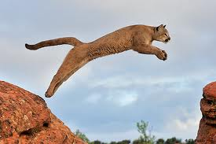
The AntiChrist?
“They have also launched The Great Controversy distribution campaign to reach over 127 million people with a copy of the book which Ellen White said should be at the top of the list of her books to be given to the people of the world ! Wonderful ! But, a major complication with this effort was embedded into the plans before it was even launched. It was decided to "delete" a few sentences from the text as it was no longer a teaching that the GC Leaders believed. Yes, they said they could not tell people that the pope was the Antichrist of Bible prophecy. They said that Seventh Day Adventists did not believe the pope was the Antichrist, so they deleted those statements that said he was Antichrist ! A friend had accessed The Great Controversy web site for the project and she read the following statement…

Slide 18
"Do you believe that the pope is the antichrist? No. The Adventist Church does not teach that any specific person on earth is the antichrist. We believe that the antichrist is Satan who opposed Christ and rebelled in Heaven. Prophecy does speak of a political-religious system (rather than a particular individual) which will embody the spirit and purpose of the antichrist in the last days. We also believe that any person or system that seeks to take Christ's rightful place or oppress His followers at any time acts in the spirit of the antichrist.“ But, when I went to The Great Controversy site the statement was missing ? I then wrote The Great Controversy site and received the following reply: From: star707@Uniserve.com [mailto:star707@Uniserve.com] Sent: Wednesday, November 16, 2011 3:06 PM To: Rasmussen, Lisa Subject: WHY DID YOU REMOVE THIS STATEMENT ? Do you believe that the pope is the antichrist? No. The Adventist Church does not teach that any specific person on earth is the antichrist. We believe that the antichrist is Satan who opposed Christ and rebelled in Heaven. Prophecy does speak of a political-religious system (rather than a particular individual) which will embody the spirit and purpose of the antichrist in the last days. We also believe that any person or system that seeks to take Christ’s rightful place or oppress His followers at any time acts in the spirit of the antichrist. -------Original Message-------

Slide 19
Conclusion
From: Rasmussen, Lisa
Date: 11/17/2011 5:52:45 AM
To: star707@Uniserve.com
Subject: RE: Statement Removed
Dear Richard, "In the time since that FAQ was originally posted, many divisions, including the North American Division, have decided to distribute an abbreviated version of The Great Controversy rather than the full text.
The FAQs were designed to address questions that would be raised in the minds of non-Adventist readers of the book. Since the abbreviated version approved for this project doesn't include the word antichrist we got to thinking that it would be better not to answer a question the reader would not be likely to ask after all. The question has therefore been pulled in order to avoid the confusion of bringing up a subject not mentioned in the text most of the non-Adventist readers will be receiving.“ Regards, Lisa Rasmussen Great Controversy Project Liaison

Slide 20
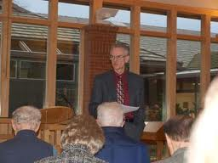
Going on for 40 Years!
On February 2, 2012 at the annual Seminary Scholarship Symposium at Andrews University, Dr. Michael Kinnamon gave a talk entitled, “The Ecumenical Movement and Why You Should Be Involved.” Then Dr. Nicholas Miller, professor of church history and director of the International Religious Liberty Institute, responded. (A brief summary of Dr. Kinnamon's first presentation at the seminary today is here.)
In his introduction of the speaker, seminary dean Dr. Denis Fortin shared how he came into contact with Dr. Kinnamon.

Slide 21
Uniting with the UN!
Seventh-day Adventist Church leaders yesterday called on members and local congregations to increase collaboration with local governments and health officials when conducting public health outreach. Adventist Church President Ted N. C. Wilson and Pan American Health Director Mirta Roses Periago sign a memorandum of understanding that will formalize collaboration as the two organizations continue public health initiatives. The signing ceremony took place Tuesday, July 26 in the executive conference room at the Adventist Church's world headquarters.
The request came during a ceremony in which top officials from the church and the Pan American Health Organization signed a memorandum of understanding that formalizes collaboration of implementing health projects throughout the Americas. The memorandum outlines shared goals of improving promotion of health, strengthening disease prevention and control strategies at the local level, and contributing to the achievement of the United Nations‘ Millennium Development Goals.

Slide 22
Cooperate with the Devil
The move follows several years of church leaders seeking to increase the global denomination's health outreach, as well as PAHO's goal of strengthening faith-based partnerships for more effective health awareness and education in local communities. The Adventist Church has historically emphasized healthful practices as part of living a life of Christian faith and service. "It will be a great privilege for us to cooperate in whatever way we can according to our abilities and our use of health applications that will truly help the quality of life improve for many thousands of people," said Ted Wilson, president of the Adventist world church.“ Br. Wilson I am going to emphasize the next part with some bold print because I do not have a [horn] to blow ! Christians know that the United Nations exists for one purpose alone ! It is a tool of the Jesuits to institute a Papal New World Order !

Slide 23
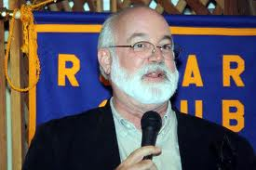
Jesuit Priest
“Jesuit priest teaches seventh-day Adventists about missions
The Alumni Association, School of Medicine of Loma Linda University is celebrating the 80th postgraduate convention March 1-5, 2012. One of the featured speakers is Greg Boyle, described as a “Jesuit priest”.
Mission Emphasis Vespers, Friday, March 2, 7:00 p.m., Loma Linda University Church Author of “Tattoos on the Heart” Jesuit priest

Slide 24
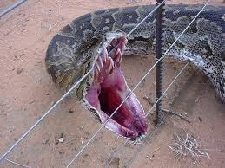
Saint or Snake?
1. Spiritual Formation
2. Abbreviated Great Controversy-leaves out Antichrist.
3. Antichrist is the Devil.
4. Jesuit speaks at Loma Linda.
5. Ecumenical speaker at Andrews.
6. Uniting health message with the UN.
“Ye shall know them by their fruits.” Matt. 7:15

