Slide 1
The 2nd Angels Message
Heaven Keeps Trying

Slide 2
God Pleads
“ And there followed another angel, saying, Babylon is fallen, is fallen, that great city, because she made all nations drink of the wine of the wrath of her fornication.” Revelation 14:8
Babylon rejects the first angel’s message. Since the first angel’s message is given in the time frame of 1844, this Babylon falls around 1844. Heaven sends another message to her. Babylon gives the world wine to drink and is committing fornication. Let us look at each of these symbols…………………………………….

Slide 3
Babylon-What is it?
“Come hither; I will shew unto thee the judgment of the great whore that sitteth upon many waters: With whom the kings of the earth have committed fornication, and the inhabitants of the earth have been made drunk with the wine of her fornication.”…………
“And upon her forehead was a name written, MYSTERY, BABYLON THE GREAT, THE MOTHER OF HARLOTS AND ABOMINATIONS OF THE EARTH.” Revelation 17:1,2,5

Slide 4
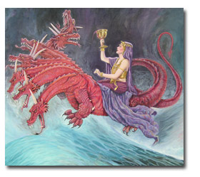
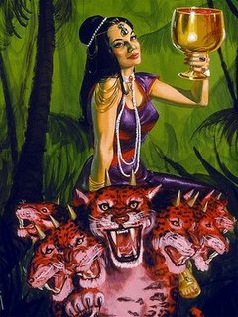
The Whore

Slide 5
The Bible is Clear
“The vision of Isaiah the son of Amoz, which he saw concerning Judah and Jerusalem in the days of Uzziah, Jotham, Ahaz, and Hezekiah, kings of Judah.” “How is the faithful city become an harlot! it was full of judgment; righteousness lodged in it; but now murderers.“ Isaiah 1:1,21
“Hast thou seen that which backsliding Israel hath done? she is gone up upon every high mountain and under every green tree, and there hath played the harlot…yet her treacherous sister Judah feared not, but went and played the harlot also.” Jeremiah 3:6-8

Slide 6
Confirmation
“In Revelation 14 the first angel is followed by a second proclaiming: "Babylon is fallen, is fallen, that great city, because she made all nations drink of the wine of the wrath of her fornication." Revelation 14:8. The term "Babylon" is derived from "Babel," and signifies confusion. It is employed in Scripture to designate the various forms of false or apostate religion. In Revelation 17 Babylon is represented as a woman --a figure which is used in the Bible as the symbol of a church, a virtuous woman representing a pure church, a vile woman an apostate church.” GC. Pg.381

Slide 7
An Apostate Church
Whenever the professed people of God went into apostasy, they were referred to as a harlot or a whore. Babylon, in the book of Revelation, that commits fornication, is obviously an apostate church. The one distinction between the apostate church of Revelation 17 and Revelation 14 is: the whore of Revelation 17 has been in apostasy for centuries while the apostate church of Revelation 14 has been in apostasy since around 1844.
The whore of Revelation 17, that is Babylon, has these characteristics.
1. commits blasphemy
a. claiming to be God.
b. claiming power to forgive sin.
2. unites with government leaders.
3. persecutes those who oppose her.
4.has as its geographical
foundation an area of 7 hills.
5. it is a very wealthy church.

Slide 8
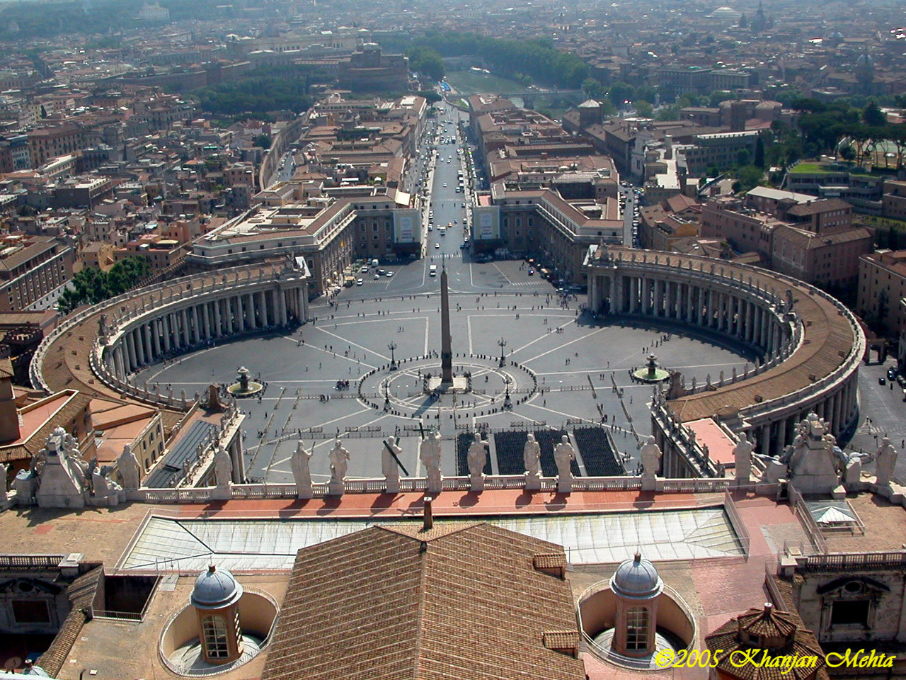
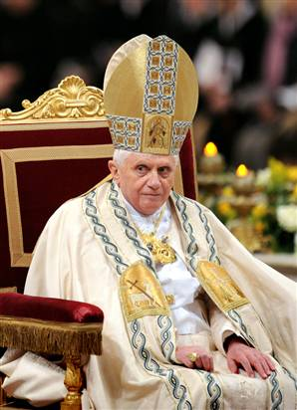
The Babylon/Whore of Revelation 17

Slide 9
Babylon Since 1844
The papacy is ‘Babylon the Great’ of Revelation 17 in a fallen condition for centuries. The Babylon of Revelation 14:8 has been in a fallen condition since around 1844. Who or what church/churches have been in this fallen condition since the middle of the 1800’s? Since the 2nd angels message follows the first, it would make sense that the churches who rejected the messages in the first angels message would be those churches who constitute ‘Babylon’ of Revelation 14:8

Slide 10
Babylon Rejects Message
Babylon rejects:
1. the commandments of God and the power of Christ to keep them.
2. the messages of health reform contained in the eight laws of health.
3. the judgment hour message of Christ in the most holy place since 1844.
4. the Sabbath truth of Christ’s creative and redeeming power.

Slide 11
The Application
“The second angel's message of Revelation 14 was first preached in the summer of 1844, and it then had a more direct application to the churches of the United States, where the warning of the judgment had been most widely proclaimed and most generally rejected, and where the declension in the churches had been most rapid. But the message of the second angel did not reach its complete fulfillment in 1844. The churches then experienced a moral fall, in consequence of their refusal of the light of the advent message; but that fall was not complete. As they have continued to reject the special truths for this time they have fallen lower and lower. Not yet, however, can it be said that "Babylon is fallen,... because she made all nations drink of the wine of the wrath of her fornication." She has not yet made all nations do this. {Mar 171.1}
God still has a people in Babylon; and before the visitation of His judgments these faithful ones must be called out, that they partake not of her sins and "receive not of her plagues." {Mar 171.2}

Slide 12
Confirmation
“The message of Revelation 14, announcing the fall of Babylon must apply to religious bodies that were once pure and have become corrupt. Since this message follows the warning of the judgment, it must be given in the last days; therefore it cannot refer to the Roman Church alone, for that church has been in a fallen condition for many centuries. Furthermore, in the eighteenth chapter of the Revelation the people of God are called upon to come out of Babylon. According to this scripture, many of God's people must still be in Babylon. And in what religious bodies are the greater part of the followers of Christ now to be found? Without doubt, in the various churches professing the Protestant faith. At the time of their rise these churches took a noble stand for God and the truth, and His blessing was with them. Even the unbelieving world was constrained to acknowledge the beneficent results that followed an acceptance of the principles of the gospel.’ GC, pg. 383

Slide 13
Continued
“ In the words of the prophet to Israel: "Thy renown went forth among the heathen for thy beauty: for it was perfect through My comeliness, which I had put upon thee, saith the Lord God." But they fell by the same desire which was the curse and ruin of Israel--the desire of imitating the practices and courting the friendship of the ungodly. "Thou didst trust in thine own beauty, and playedst the harlot because of thy renown." Ezekiel 16:14, 15. Many of the Protestant churches are following Rome's example of iniquitous connection with "the kings of the earth"--the state churches, by their relation to secular governments; and other denominations, by seeking the favor of the world. And the term "Babylon"--confusion--may be appropriately applied to these bodies, all professing to derive their doctrines from the Bible, yet divided into almost innumerable sects, with widely conflicting creeds and theories.”
GC., pg.383

Slide 14
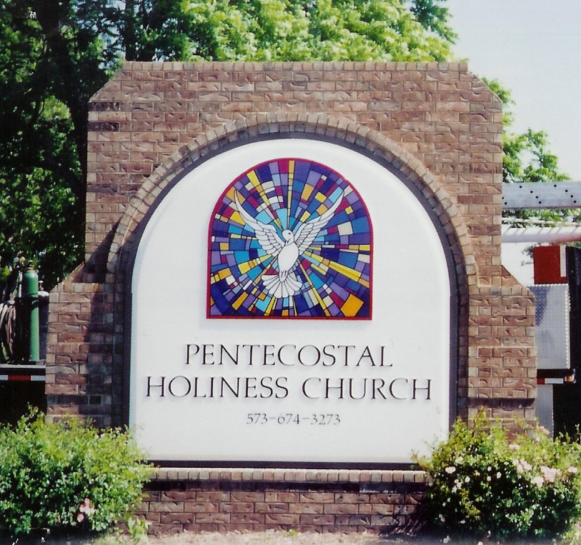
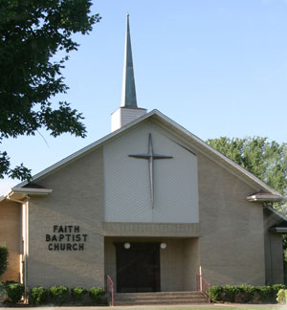
Babylon since 1844

Slide 15
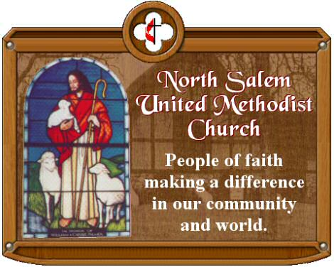

More

Slide 16

And…………………………………….
All of these churches constitute Babylon since 1844. All of these churches rejected the 1st angels message and, by so doing, became ‘Babylon fallen’ in 1844.
Because of God’s great compassion for the people in those churches, He sends another message to them.

Slide 17
A Final Warning
“And he cried mightily with a strong voice, saying, Babylon the great is fallen, is fallen, and is become the habitation of devils, and the hold of every foul spirit, and a cage of every unclean and hateful bird. For all nations have drunk of the wine of the wrath of her fornication, and the kings of the earth have committed fornication with her, and the merchants of the earth are waxed rich through the abundance of her delicacies. And I heard another voice from heaven, saying, Come out of her, my people, that ye be not partakers of her sins, and that ye receive not of her plagues. For her sins have reached unto heaven, and God hath remembered her iniquities.” Revelation 18:2-5

Slide 18
‘the wine of Babylon’
“Babylon is fallen, is fallen, that great city, because she made all nations drink of the wine of the wrath of her fornication.”...” For all nations have drunk of the wine of the wrath of her fornication, and the kings of the earth have committed fornication with her, and the merchants of the earth are waxed rich. Revelation 14:8, 18:2
“This is the same message that was given by the second angel. Babylon is fallen, "because she made all nations drink of the wine of the wrath of her fornication." What is that wine?--her false doctrines. She has given to the world a false sabbath instead of the Sabbath of the fourth commandment, and has repeated the falsehood that Satan first told to Eve in Eden--the natural immortality of the soul.” {Mar 171.3}

Slide 19
Wine- spiritually speaking
“But they also have erred through wine, and through strong drink are out of the way; the priest and the prophet have erred through strong drink, they are swallowed up of wine, they are out of the way through strong drink; they err in vision, they stumble in judgment. For all tables are full of vomit and filthiness, so that there is no place clean. Whom shall he teach knowledge? and whom shall he make to understand doctrine? them that are weaned from the milk, and drawn from the breasts.” Isaiah 28:7-9
“Neither do men put new wine into old bottles: else the bottles break, and the wine runneth out, and the bottles perish: but they put new wine into new bottles, and both are preserved.” Matthew 9:17

Slide 20
Christ and Wine
“The skin bottles which were used as vessels to contain the new wine, after a time became dry and brittle, and were then worthless to serve the same purpose again. In this familiar illustration Jesus presented the condition of the Jewish leaders. Priests and scribes and rulers were fixed in a rut of ceremonies and traditions. Their hearts had become contracted, like the dried-up wine skins to which He had compared them. …The faith that works by love and purifies the soul could find no place for union with the religion of the Pharisees, made up of ceremonies and the injunctions of men. The effort to unite the teachings of Jesus with the established religion would be vain. The vital truth of God, like fermenting wine, would burst the old, decaying bottles of the Pharisaical tradition….” DA pgs. 278,279

Slide 21
Continued
The teaching of Christ, though it was represented by the new wine, was not a new doctrine, but the revelation of that which had been taught from the beginning. But to the Pharisees the truth of God had lost its original significance and beauty. To them Christ's teaching was new in almost every respect, and it was unrecognized and unacknowledged.
Jesus pointed out the power of false teaching to destroy the appreciation and desire for truth. "No man," He said, "having drunk old wine straightway desireth new: for he saith, The old is better." All the truth that has been given to the world through patriarchs and prophets shone out in new beauty in the words of Christ. But the scribes and Pharisees had no desire for the precious new wine. Until emptied of the old traditions, customs, and practices, they had no place in mind or heart for the teachings of Christ. They clung to the dead forms, and turned away from the living truth and the power of God.” DA, pg. 279

Slide 22
Babylon’s False Teachings
1. Sunday Sacredness
2. Immortality of the Soul
3. Eternally Burning Hell
4. Universalism-Everyone will finally be saved-even the devil.
5. Israel/Judaism is still important in Bible prophecy.

Slide 23
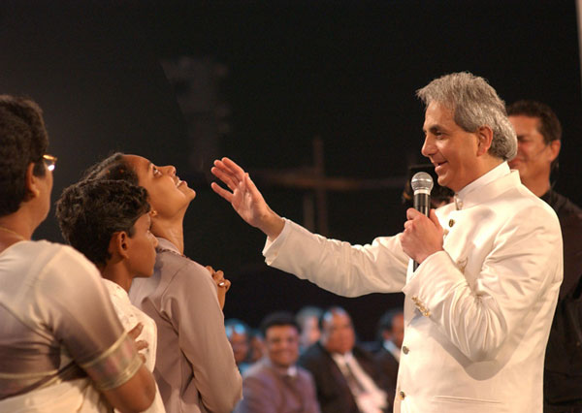

Babylon’s Major Proponents

Slide 24
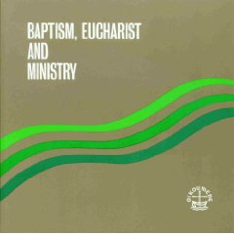

Is There a Similarity?

Slide 25
We Can’t unite with Babylon
“BEM is an ecumenical milestone. The result of more than 50 years of Faith and Order study, it is recognized as one of the most influential achievements of multilateral dialogue.
It presents the highest level of ecumenical convergence and, in some aspects, consensus on three basic themes over which Christians have been divided since the 16th century. It has been widely distributed, having been translated into more than 30 languages, with more than 500,000 copies in circulation.
Various Member Churches of the WCC, and also non-members including the Catholic Church, responded to it, giving BEM the widest formal response and reception of any Faith and Order text up till then, and since…..

Slide 26
There is a Reason We are Here Today!
“The back of the BEM document reveals a most startling statement:
“The statement published here marks a major advance in the ecumenical journey. The result of a fifty-year process of study and consultation, this text on Baptism, Eucharist, and Ministry represents a theological convergence that has been achieved thorough decades of dialogue, under the guidance of the Holy Spirit.
“Over 100 theologians met in Lima, Peru in January 1982, and recommended unanimously to transmit this agreed statement—the Lima Text—for the common study and official response of the churches. They represented virtually all the major church traditions: Eastern Orthodox, Oriental Orthodox, Roman Catholic, Old Catholic, Lutheran, Anglican, Reformed, Methodist, United, Disciples, Baptists, Adventists, and Pentecostal.
“The churches’ response to this agreed statement will be a vital step of the ecumenical process of “reception.” (Lima Test, emphasis ours).
Dr. Raoul Dederen, professor at the Seminary at Andrews University, was the Seventh-day Adventist representative at this meeting.”

