Slide 1
Jesus Life, pt. 21 ‘Another Church’

Slide 2
I Am a Disgruntled Adventist Minister
Bandon, OR recently was mass mailed with my new book ‘Remember Your Name’. The conference pastor there was livid. ‘Bill Hughes is a disgruntled Adventist minister’. Disgruntled Adventist Minister? Is that me? Mad at the Conference for firing me? I saw the man who fired me in a Spaghetti Factory in the Redlands area. My wife asked me, “Did you thank him?
No spiritual formation, no mark of the beast is any day of the week, no break down of standards, no ecumenical insanity and Guanone Diop! I would be constantly down at the conference office battling with the brethren.
Having the opportunity to send literature all over the world; sharing the 3 Angel’s messages on many continents; seeing thousands come to Christ and the 3 Angel’s messages; I COULD NOT BE HAPPIER!!

Slide 3
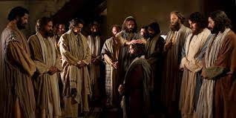
He Ordained 12
“And he goeth up into a mountain, and calleth unto him whom he would: and they came unto him. And he ordained twelve, that they should be with him, and that he might send them forth to preach, And to have power to heal sicknesses, and to cast out devils: And Simon he surnamed Peter; And James the son of Zebedee, and John the brother of James; and he surnamed them Boanerges, which is, The sons of thunder: And Andrew, and Philip, and Bartholomew, and Matthew, and Thomas, and James the son of Alphaeus, and Thaddaeus, and Simon the Canaanite, And Judas Iscariot, which also betrayed him: and they went into an house.” Mark 3: 13-19

Slide 4
Starting another Church????
“The first step was now to be taken in the organization of the church that after Christ's departure was to be His representative on earth. No costly sanctuary was at their command, but the Saviour led His disciples to the retreat He loved, and in their minds the sacred experiences of that day were forever linked with the beauty of mountain and vale and sea.
Jesus had called His disciples that He might send them forth as His witnesses, to declare to the world what they had seen and heard of Him. Their office was the most important to which human beings had ever been called, and was second only to that of Christ Himself. They were to be workers together with God for the saving of the world. As in the Old Testament the twelve patriarchs stand as representatives of Israel, so the twelve apostles were to stand as representatives of the gospel church.” DA, pg. 291

Slide 5
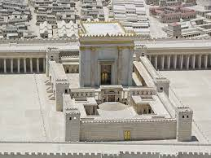
But Why?
“If the leaders in Israel had received Christ, He would have honored them as His messengers to carry the gospel to the world. To them first was given the opportunity to become heralds of the kingdom and grace of God. But Israel knew not the time of her visitation. The jealousy and distrust of the Jewish leaders had ripened into open hatred, and the hearts of the people were turned away from Jesus. The Sanhedrin had rejected Christ's message and was bent upon His death; therefore Jesus departed from Jerusalem, from the priests, the temple, the religious leaders, the people who had been instructed in the law, and turned to another class to proclaim His message, and to gather out those who should carry the gospel to all nations.” DA, pgs. 231,232

Slide 6
Gave to Others to Proclaim
“As the light and life of men was rejected by the ecclesiastical authorities in the days of Christ, so it has been rejected in every succeeding generation. Again and again the history of Christ's withdrawal from Judea has been repeated. When the Reformers preached the word of God, they had no thought of separating themselves from the established church; but the religious leaders would not tolerate the light, and those that bore it were forced to seek another class, who were longing for the truth. In our day few of the professed followers of the Reformers are actuated by their spirit. Few are listening for the voice of God, and ready to accept truth in whatever guise it may be presented. Often those who follow in the steps of the Reformers are forced to turn away from the churches they love, in order to declare the plain teaching of the word of God. And many times those who are seeking for light are by the same teaching obliged to leave the church of their fathers, that they may render obedience.” DA, pg. 232

Slide 7
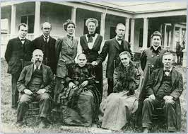
Nothing Has Changed
Due to the utter failure of the Adventist educational system, Ellen White told Sutherland and Megan to begin their own school and to follow the blueprint. For a time, they did and God abundantly blessed their humble efforts! Ellen White was a member of the Madison board. One of the very few boards to which Ellen White ever belonged; in fact, so far as I know, the only board.

Slide 8
Independent Groups!!
Ellen White also made another promise. She told Sutherland and Megan that, if they would incorporate the new institution as an independent organization, she would serve on the board. At this juncture, the reader needs to understand that a momentous change in Spirit of Prophecy guidance was about to take place. Prior to this time, Ellen White’s life had been wrapped up in denominational work. But, time after time, she had seen Heaven-sent opportunities and projects damaged or ruined by stubborn leaders or committees. It was now the summer of 1904. God revealed to her that the time had come for her to begin urging the formation of independent organizations, faithful to the historic beliefs, which would help fulfill..” BB, pg. 64

Slide 9
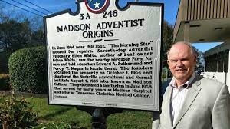
It was thus a follow-through part of the overall plan that, in 1904, Ellen White was directed to initiate independent ministries which would train more independent workers, ministries, and training schools. Laymen were to set to work and, alone or in little groups, carry on missionary work. (7 Testimonies, pp. 18-28, is an example of this.)” Broken Blueprint, pg. 68

Slide 10
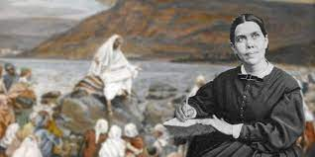
No Better Company
There was a church organization in Jerusalem. This was equivalent to the organization of SDAdventism today. Both Jesus and Ellen White stepped aside from their respective denominations in their times and created self supporting ministries.

Slide 11
The Leaders
“The Saviour knew the character of the men whom He had chosen; all their weaknesses and errors were open before Him; He knew the perils through which they must pass, the responsibility that would rest upon them; and His heart yearned over these chosen ones. Alone upon a mountain near the Sea of Galilee He spent the entire night in prayer for them, while they were sleeping at the foot of the mountain. With the first light of dawn He summoned them to meet Him; for He had something of importance to communicate to them. These disciples had been for some time associated with Jesus in active labor. John and James, Andrew and Peter, with Philip, Nathanael, and Matthew, had been more closely connected with Him than the others, and had witnessed more of His miracles. Peter, James, and John stood in still nearer relationship to Him. They were almost constantly with Him, witnessing His miracles, and hearing His words. John pressed into still closer intimacy with Jesus, so that he is distinguished as the one whom Jesus loved. The Saviour loved them all, but John's was the most receptive spirit. He was younger than the others, and with more of the child's confiding trust he opened his heart to Jesus. Thus he came more into sympathy with Christ, and through him the Saviour's deepest spiritual teaching was communicated to His people.” DA, pgs. 291,292

Slide 12
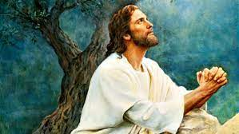
Never Stopped Praying
“And the Lord said, Simon, Simon, behold, Satan hath desired to have you, that he may sift you as wheat: But I have prayed for thee, that thy faith fail not: and when thou art converted, strengthen thy brethren. And he said unto him, Lord, I am ready to go with thee, both into prison, and to death. And he said, I tell thee, Peter, the cock shall not crow this day, before that thou shalt thrice deny that thou knowest me.” Luke 22:31-34

Slide 13
Christ Foretold the War on the Church!
“In the presence of God, and all the heavenly intelligences, in the presence of the unseen army of hell, Christ founded His church upon the living Rock. That Rock is Himself,—His own body, for us broken and bruised. Against the church built upon this foundation, the gates of hell shall not prevail.
How feeble the church appeared when Christ spoke these words! There was only a handful of believers, against whom all the power of demons and evil men would be directed; yet the followers of Christ were not to fear. Built upon the Rock of their strength, they could not be overthrown.
For six thousand years, faith has builded upon Christ. For six thousand years the floods and tempests of satanic wrath have beaten upon the Rock of our salvation; but it stands unmoved.” DA, pg. 413

Slide 14
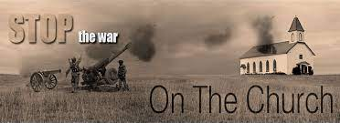
“He saith unto them, But whom say ye that I am? And Simon Peter answered and said, Thou art the Christ, the Son of the living God. And Jesus answered and said unto him, Blessed art thou, Simon Barjona: for flesh and blood hath not revealed it unto thee, but my Father which is in heaven. And I say also unto thee, That thou art Peter, and upon this rock I will build my church; and the gates of hell shall not prevail against it.” Matthew 16:15-18

Slide 15
Defective Disciples; Amazing Savior
“The apostles differed widely in habits and disposition. There were the publican, Levi-Matthew, and the fiery zealot Simon, the uncompromising hater of the authority of Rome; the generous, impulsive Peter, and the mean-spirited Judas; Thomas, truehearted, yet timid and fearful, Philip, slow of heart, and inclined to doubt, and the ambitious, outspoken sons of Zebedee, with their brethren. These were brought together, with their different faults, all with inherited and cultivated tendencies to evil; but in and through Christ they were to dwell in the family of God, learning to become one in faith, in doctrine, in spirit. They would have their tests, their grievances, their differences of opinion; but while Christ was abiding in the heart, there could be no dissension. His love would lead to love for one another; the lessons of the Master would lead to the harmonizing of all differences, bringing the disciples into unity, till they would be of one mind and one judgment. Christ is the great center, and they would approach one another just in proportion as they approached the center.” DA, pg. 296

