Slide 1
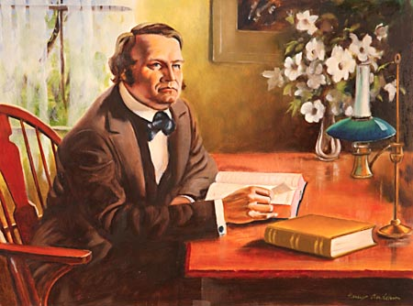
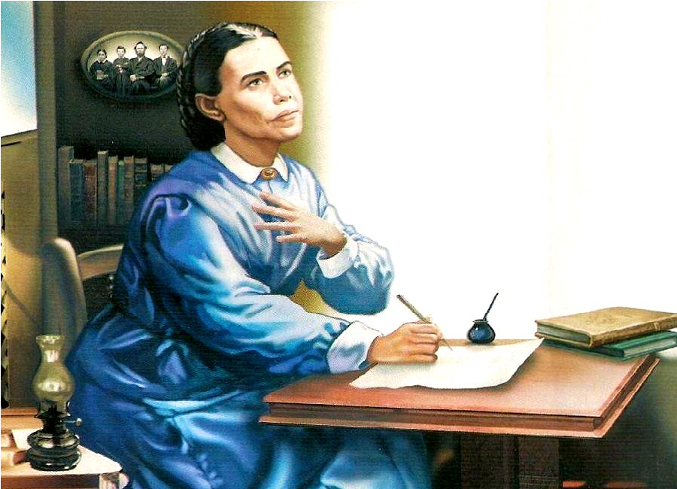
The Sanctuary pt 51: The Antitypical Trumpet Call

Slide 2
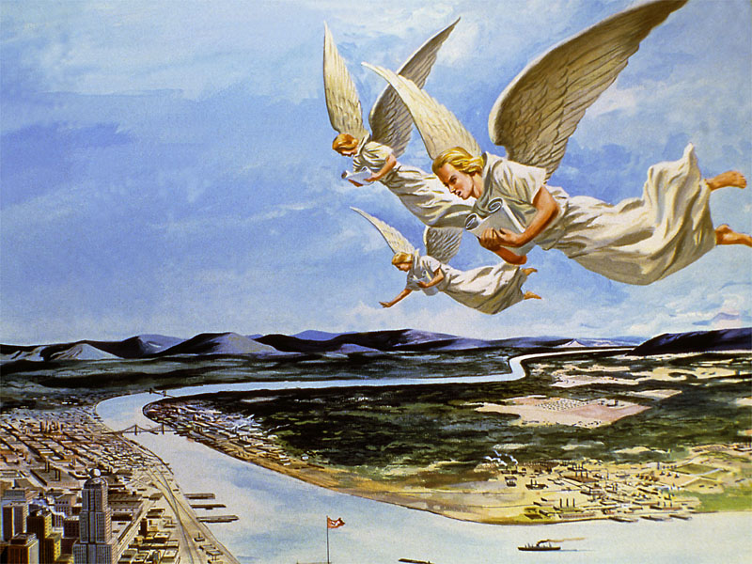
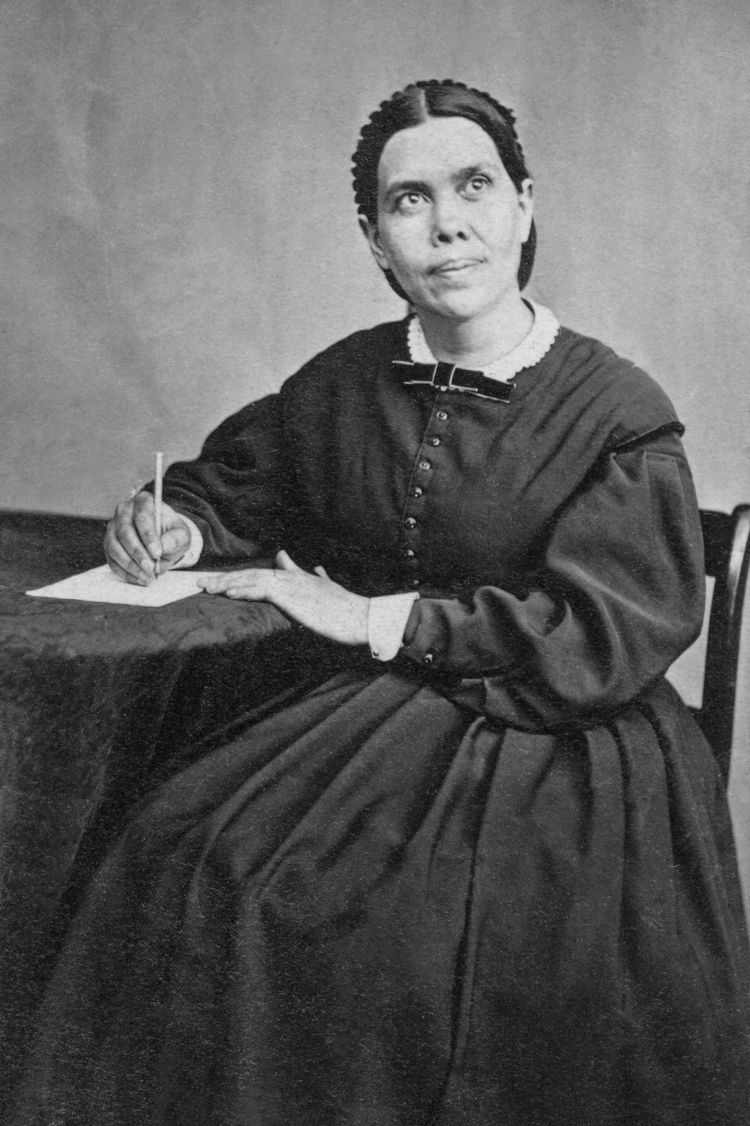
What A Work Has Been Entrusted to Us!
“In a special sense Seventh-day Adventists have been set in the world as watchmen and light bearers. To them has been entrusted the last warning for a perishing world. On them is shining wonderful light from the word of God. They have been given a work of the most solemn import--the proclamation of the first, second, and third angels' messages. There is no other work of so great importance. They are to allow nothing else to absorb their attention. The most solemn truths ever entrusted to mortals have been given us to proclaim to the world. The proclamation of these truths is to be our work. The world is to be warned, and God's people are to be true to the trust committed to them. They are not to engage in speculation, neither are they to enter into business enterprises with unbelievers; for this would hinder them in their God-given work.”—9T, p. 19

Slide 3
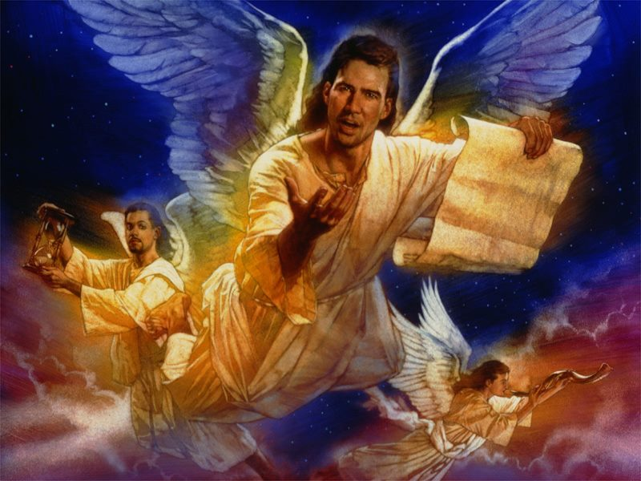
The First Angel’s Message
Rev. 14:6-7 “And I saw another angel fly in the midst of heaven, having the everlasting gospel to preach unto them that dwell on the earth, and to every nation, and kindred, and tongue, and people, Saying with a loud voice, Fear God, and give glory to him; for the hour of his judgment is come: and worship him that made heaven, and earth, and the sea, and the fountains of waters.”

Slide 4
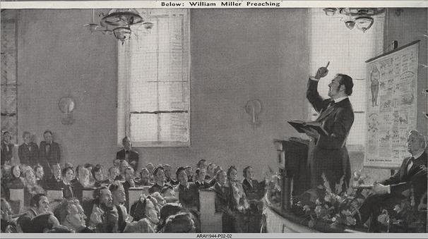
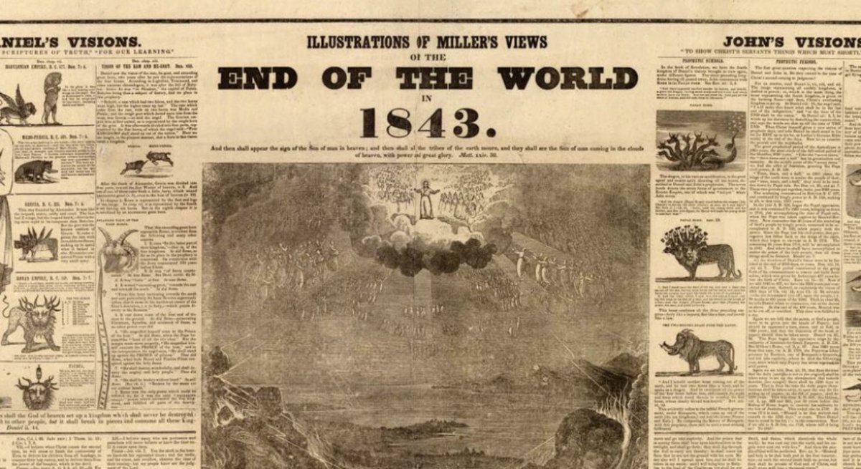
What is an “Angel” Symbolically?
Strong’s Concordance: Angel, “Aggelos” (ang’-el-os) — a messenger, envoy, one who is sent, an angel, a messenger from God
“This message is declared to be a part of ‘the everlasting gospel.’ The work of preaching the gospel has not been committed to angels, but has been committed to men. Holy angels have been employed in directing this work, that have been in charge of the great movements of salvation of men; but the actual proclamation of the gospel is performed by the servants of Christ upon the earth.” GC, p. 312

Slide 5
The Everlasting Gospel?
“The power of Christ, the crucified Saviour, to give eternal life, should be presented to the people. We should show them that the Old Testament is as verily the gospel in types and shadows as the New Testament is in its unfolding power. The New Testament does not present a new religion; the Old Testament does not present a religion to be superseded by the New. The New Testament is only the advancement and unfolding of the Old. Abel was a believer in Christ, and was as verily saved by His power as was Peter or Paul. Enoch was a representative of Christ as surely as was the beloved disciple John. Enoch walked with God, and he was not, for God took him. To him was committed the message of the second coming of Christ. "And Enoch also, the seventh from Adam, prophesied of these, saying, Behold, the Lord cometh with ten thousands of His saints, to execute judgment upon all." Jude 14, 15. The message preached by Enoch and his translation to heaven were a convincing argument to all who lived in his time. These things were an argument that Methuselah and Noah could use with power to show that the righteous could be translated. That God who walked with Enoch was our Lord and Saviour Jesus Christ. He was the light of the world then just as He is now. Those who lived then were not without teachers to instruct them in the path of life; for Noah and Enoch were Christians. The gospel is given in precept in Leviticus. Implicit obedience is required now, as then. How essential it is that we understand the importance of this word! The question is asked: What is the cause of the dearth in the church? The answer is: We allow our minds to 393 be drawn away from the word. If the word of God were eaten as the food for the soul, if it were treated with respect and deference, there would be no necessity for the many and repeated testimonies that are borne. The simple declarations of Scripture would be received and acted upon.” (6T, 392, 393)

Slide 6
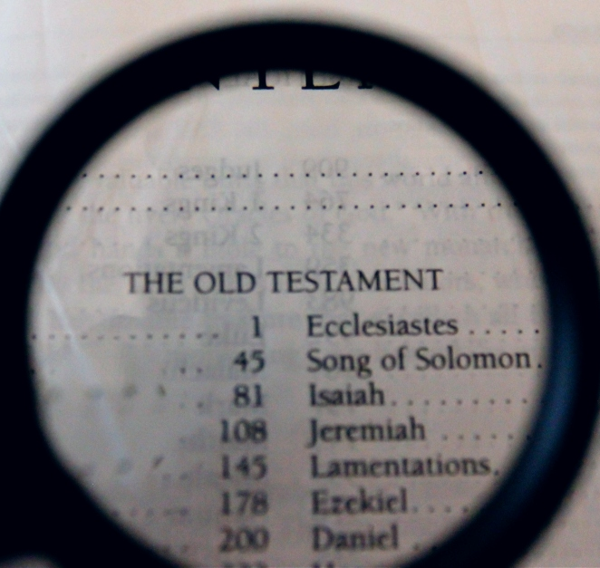
Some Old Testament Teachings…
Keeping all 10 of the Commandments of God (Ex. 20; Deut. 5, Rom. 2,3,6,13, 1 John).
Gift of (Spirit of) Prophecy (Daniel 2; 7; 8; 9; 11; 12, Rev. )
Righteousness is by Faith Alone (Leviticus Sanctuary System; Ps. 5:8; Jer. 23:6, Eph. 2)
Grace and Indwelling of the Holy Spirit (Ps. 51, Heb. 8, Rom. 8)
Repentance (Ez. 18:21-22, Luke 5:32)
The Judgment (Ecc. 12:14, Rev. 14, 18-20)
State of the Dead (death is sleep Ecc. 9:6, John 11)
Day for a year Principle (Ez. 4:6; Num. 14:34, Mark 1, Rev. 11,12,13)

Slide 7
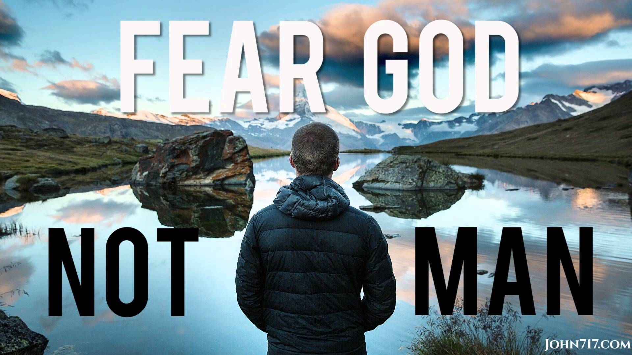
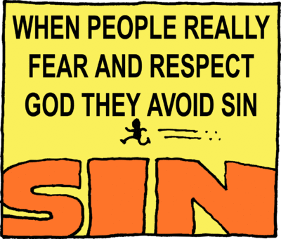
Fear God!?
Strong’s Concordance: phobeo (fob-eh’-o)- fear, be afraid, be afraid of, reverence, 1) to put to flight by terrifying (to scare away), 1a) to put to flight, to flee, 1b) to fear, be afraid, 1) to be struck with fear, to be seized with alarm of those started by strange occurrences, of those struck with amazement, 2) to fear, to be afraid of one, 3) to fear (i.e. hesitate) to do something (for fear of harm), 1c) to reverence, venerate, to treat with deference or reverential obedience

Slide 8
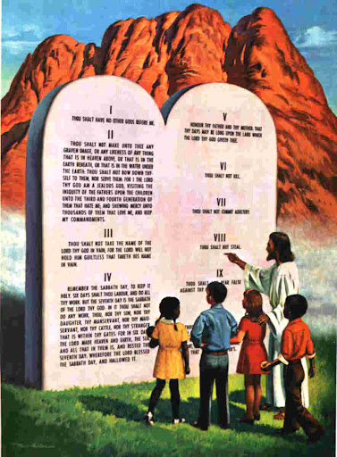
Fear God=Keep the Commandments
Deut. 5:29 “O that there were such an heart in them, that they would fear me, and keep all my commandments always, that it might be well with them, and with their children for ever!”
Prov. 8:13 “The fear of the Lord is to hate evil: pride, and arrogancy, and the evil way, and the froward mouth, do I hate.”
Job 28:28 “And unto man he said, Behold, the fear of the Lord, that is wisdom; and to depart from evil is understanding.”

Slide 9
The Acceptance of the Sabbath
“As we trace the story of the beginning of Sabbathkeeping among the early Adventists, we go to a little church in the township of Washington in the heart of New Hampshire, the state that adjoins Maine on the east and whose western boundary is within sixty miles of the New York state line. Here the members of an independent Christian church in 1843 heard and accepted the preaching of the Advent message. It was an earnest group. Into their midst came a Seventh Day Baptist, Rachel Oakes, who distributed tracts setting forth the binding claims of the fourth commandment. Some in 1844 saw and accepted this Bible truth. One of their number, William Farnsworth, in a Sunday morning service, stood to his feet and declared that he intended to keep God’s Sabbath of the fourth commandment. A dozen others joined him, taking their stand firmly on all of God’s commandments. They were the first Seventh-day Adventists. The minister who cared for this church group, Frederick Wheeler, soon accepted the seventh-day Sabbath and was the first Adventist minister to do so. Another of the Advent preachers, T. M. Preble, who lived in the same state, accepted the Sabbath truth and in February, 1845, published an article in the Hope of Israel, one of the Adventist journals, setting forth the binding claims of the fourth commandment. Joseph Bates, a prominent Adventist minister residing in Fairhaven, Massachusetts, read the Preble article and accepted the Seventh-day Sabbath. Shortly thereafter, Elder Bates journeyed to Washington, New Hampshire, to study this new-found truth with the Sabbathkeeping Adventists residing there. When he returned to his home, he was fully convinced of the Sabbath truth. Bates in time determined to publish a tract setting forth the binding claims of the fourth commandment. His 48-page Sabbath pamphlet was published in August, 1846. A copy of it came to the hands of James and Ellen White at about the time of their marriage in late August. From the scriptural evidence therein presented, they accepted, and began to keep the seventh-day Sabbath. Of this Ellen White later wrote: “In the autumn of 1846 we began to observe the Bible Sabbath, and to teach and defend it” Early Writings, preface, p. xix-xxi

Slide 10
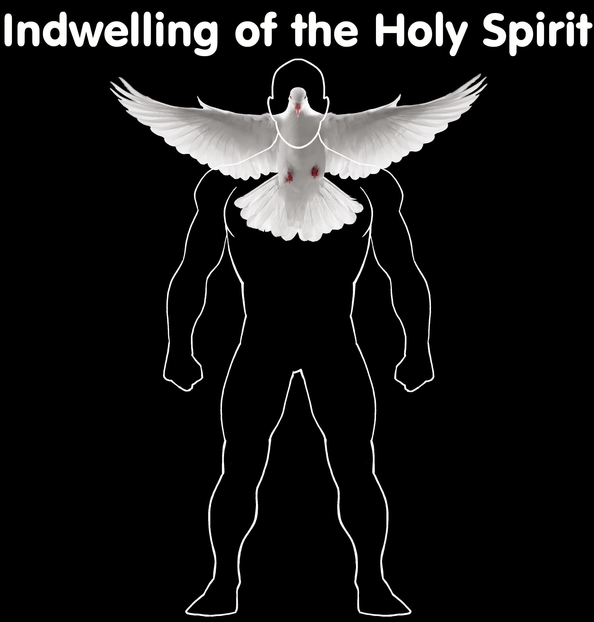
Give Glory to Him…
1 Cor. 10:31 “Whether therefore ye eat, or drink, or whatsoever ye do, do all to the glory of God”
1 Cor. 6:18-20 “Flee fornication. Every sin that a man doeth is without the body; but he that committeth fornication sinneth against his own body. What? know ye not that your body is the temple of the Holy Ghost which is in you, which ye have of God, and ye are not your own? For ye are bought with a price: therefore glorify God in your body, and in your spirit, which are God’s.”

Slide 11
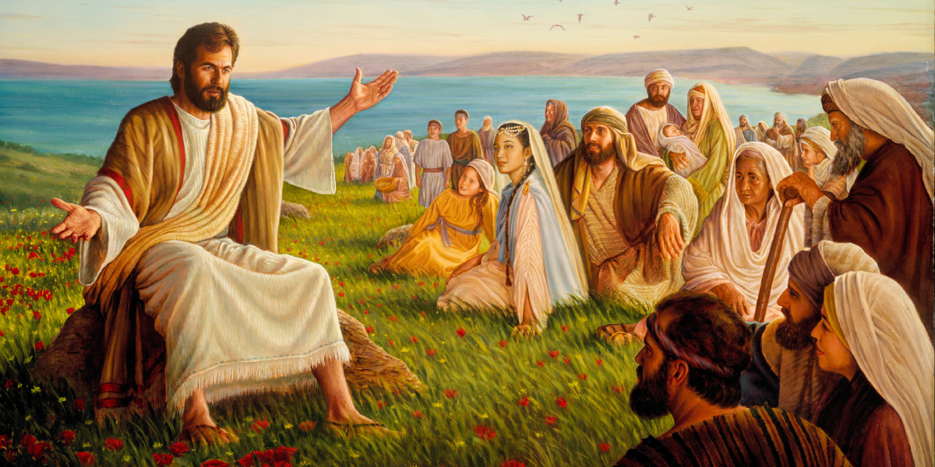
John 15:5-10 “I am the vine, ye are the branches: He that abideth in me, and I in him, the same bringeth forth much fruit: for without me ye can do nothing. If a man abide not in me, he is cast forth as a branch, and is withered; and men gather them, and cast them into the fire, and they are burned. If ye abide in me, and my words abide in you, ye shall ask what ye will, and it shall be done unto you. Herein is my Father glorified, that ye bear much fruit; so shall ye be my disciples. As the Father hath loved me, so have I loved you: continue ye in my love. If ye keep my commandments, ye shall abide in my love; even as I have kept my Father's commandments, and abide in his love.”

Slide 12
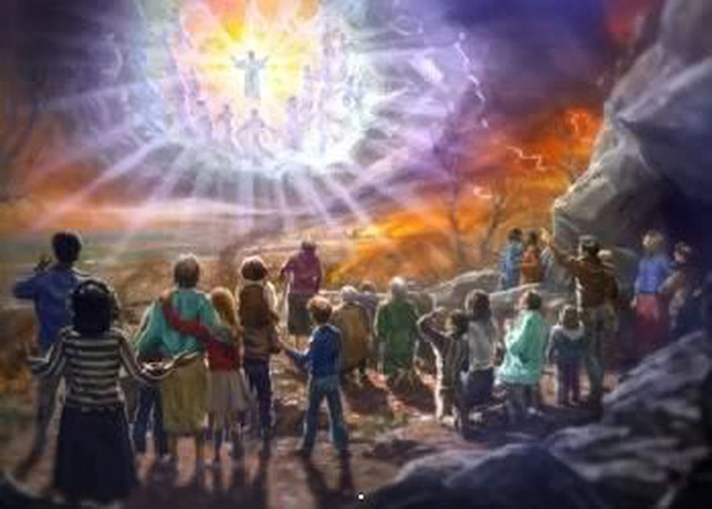
The Hour of His Judgment is Come!
Examples of God’s Judgment:
Ps. 98:9 “Before the Lord; for he cometh to judge the earth: with righteousness shall he judge the world, and the people with equity.”
Jude 1:14-15 “And Enoch also, the seventh from Adam, prophesied of these, saying, Behold, the Lord cometh with ten thousands of his saints, To execute judgment upon all, and to convince all that are ungodly among them of all their ungodly deeds which they have ungodly committed, and of all their hard speeches which ungodly sinners have spoken against him.”

Slide 13
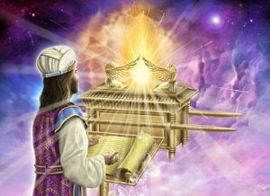
The Hour of His Judgment
Dan. 8:14 “And he said unto me, Unto two thousand and three hundred days; then shall the sanctuary be cleansed.”---ended in 1844
Lev. 16:15-16 “Then shall he kill the goat of the sin offering, that is for the people, and bring his blood within the vail, and do with that blood as he did with the blood of the bullock, and sprinkle it upon the mercy seat, and before the mercy seat: And he shall make an atonement for the holy place, because of the uncleanness of the children of Israel, and because of their transgressions in all their sins: and so shall he do for the tabernacle of the congregation, that remaineth among them in the midst of their uncleanness.”

Slide 14
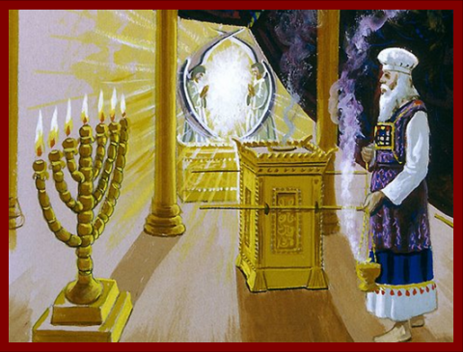
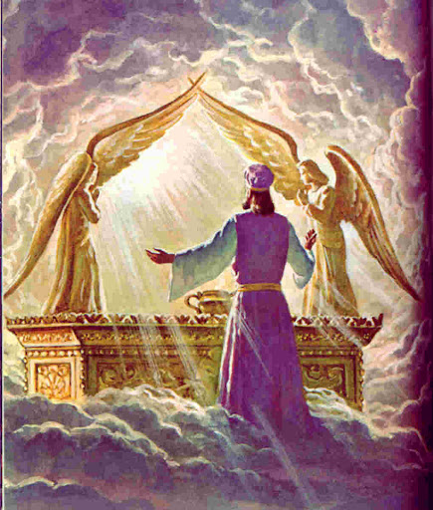
The Sanctuary on earth is a replica
Heb. 8:1-5 “Now of the things which we have spoken this is the sum: We have such an high priest, who is set on the right hand of the throne of the Majesty in the heavens; A minister of the sanctuary, and of the true tabernacle, which the Lord pitched, and not man. For every high priest is ordained to offer gifts and sacrifices: wherefore it is of necessity that this man have somewhat also to offer. For if he were on earth, he should not be a priest, seeing that there are priests that offer gifts according to the law: Who serve unto the example and shadow of heavenly things, as Moses was admonished of God when he was about to make the tabernacle: for, See, saith he, that thou make all things according to the pattern shewed to thee in the mount.”

Slide 15
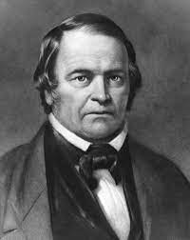
When Was the Hour for the Antitypical Day of Atonement?
Daniel 8:14 “And he said unto me, Unto two thousand and three hundred days; then shall the sanctuary be cleansed.”
Begins with command to restore and build Jerusalem (see Dan. 9:25 and Ezra 7:11-28) in 457 BC, this decree written in Chaldaic and dates are confirmed by the Canon of Ptolemy, the Greek Olympiads which occurred in the 7th Year of the reign of Artaxerxes (see Ezra 7:8).

Slide 16
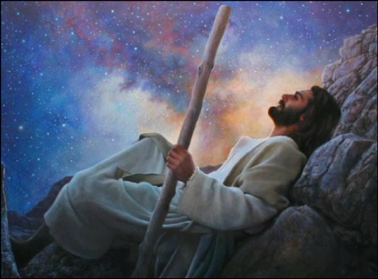
“Worship Him That Made”=Worship the Creator
Rev. 14:7 “and worship him that made heaven, and earth, and the sea, and the fountains of waters”
Gen. 2:1-3 “Thus the heavens and the earth were finished, and all the host of them. And on the seventh day God ended his work which he had made; and he rested on the seventh day from all his work which he had made. And God blessed the seventh day, and sanctified it: because that in it he had rested from all his work which God created and made.”

Slide 17
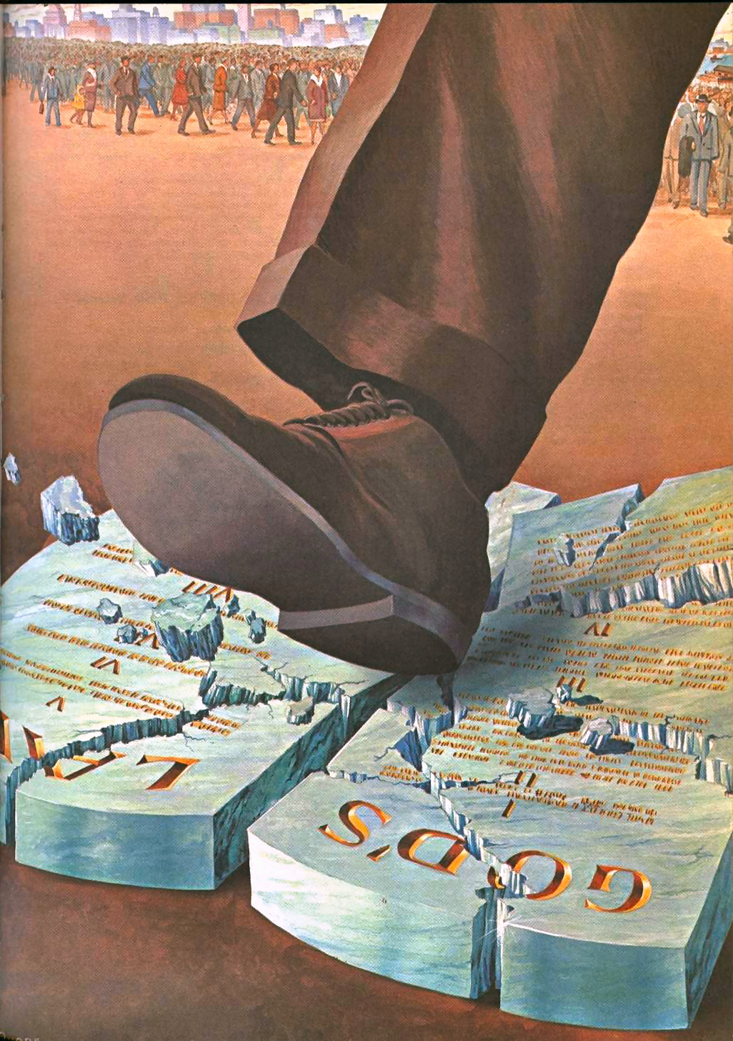
True Worship!
Matt. 15:7-9 “Ye hypocrites, well did Esaias prophesy of you, saying, This people draweth nigh unto me with their mouth, and honoureth me with their lips; but their heart is far from me. But in vain they do worship me, teaching for doctrines the commandments of men.”

Slide 18
Are the Elements There????
In Ezra’s day there was:
A time of rejoicing
Focus on Repentance and Law of God
Preparation for the Day of Atonement/Meeting the LORD
In William Miller’s day there was:
A message that was sweet to those who loved Jesus (Rev. 10)
Focus on Repentance and Law of God
Message was about Second Coming!
In the First Angel’s Message there are:
A message of rejoicing “the everlasting gospel”
Focus on Repentance and Law of God—Fear God!
Prepare to “Meet thy God”

Slide 19
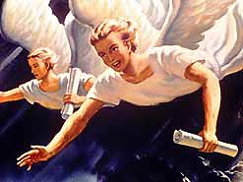
2nd Angel’s Message
And there followed another angel, saying, Babylon is fallen, is fallen, that great city, because she made all nations drink of the wine of the wrath of her fornication

Slide 20
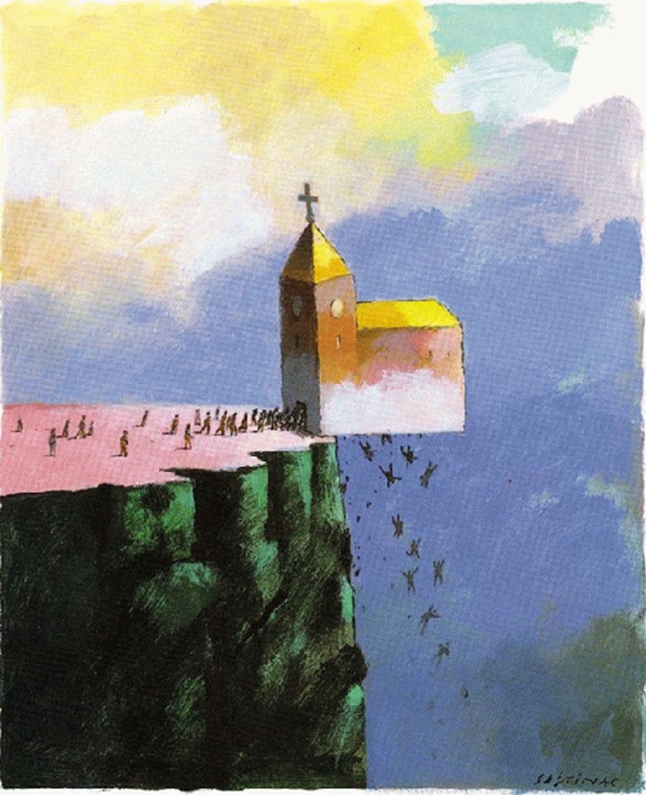
Who is Babylon Fallen?
"It is our individual duty to walk humbly with God. We are not to seek any strange, new message. We are not to think that the chosen ones of God who are trying to walk in the light, compose Babylon. The fallen denominational churches are Babylon. Babylon has been fostering poisonous doctrines, the wine of error. This wine of error is made up of false doctrines, such as the natural immortality of the soul, the eternal torment of the wicked, the denial of the pre-existence of Christ prior to his birth in Bethlehem, and advocating and exalting the first day of the week above God's holy, sanctified day. These and kindred errors are presented to the world by the various, churches, and thus the Scriptures are fulfilled that say, 'For all nations have drunk of the wine of the wrath of her fornication.' It is a wrath which is created by false doctrines, and when kings and presidents drink this wine of the wrath of her fornication, they are stirred with anger against those who will not come into harmony with the false and Satanic heresies which exalt the false Sabbath, and lead men to trample under foot God's memorial.” (R&H, September 12, 1893)

Slide 21
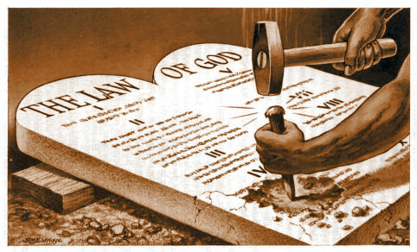
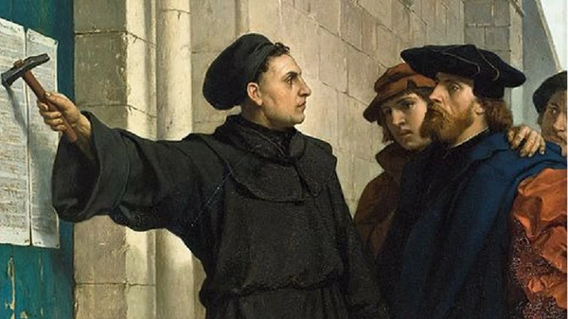
Another Statement
“Babylon is said to be “the mother of harlots.” By her daughters must be symbolized churches that cling to her doctrines and traditions, and follow her example of sacrificing the truth and the approval of God, in order to form an unlawful alliance with the world. The message of Revelation 14 announcing the fall of Babylon, must apply to religious bodies that were once pure and have become corrupt. Since this message follows the warning of the Judgment, it must be given in the last days, therefore it cannot refer to the Romish Church, for that church has been in a fallen condition for many centuries. Furthermore, in the eighteenth chapter of the Revelation, in a message which is yet future, the people of God are called upon to come out of Babylon. According to this scripture, many of God's people must still be in Babylon. And in what religious bodies are the greater part of the followers of Christ now to be found? Without doubt, in the various churches professing the Protestant faith” (GC, p. 382-383)

Slide 22
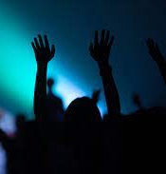
The Last Warning…
“And the third angel followed them, saying with a loud voice, If any man worship the beast and his image, and receive his mark in his forehead, or in his hand, The same shall drink of the wine of the wrath of God, which is poured out without mixture into the cup of his indignation; and he shall be tormented with fire and brimstone in the presence of the holy angels, and in the presence of the Lamb: And the smoke of their torment ascendeth up for ever and ever: and they have no rest day nor night, who worship the beast and his image, and whosoever receiveth the mark of his name”

Slide 23
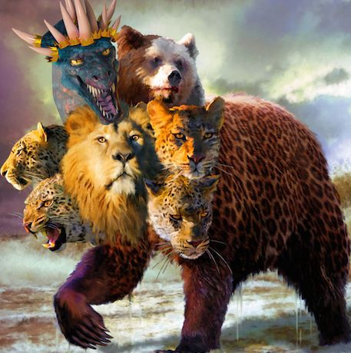
Who’s The Beast? And What is Her Mark?
“Of course the Catholic Church claims that the change was her act. And the act is a mark of her ecclesiastical power and authority in religious matters.” (C.F. Thomas, Chancellor of Cardinal Gibbons, in answer to a letter regarding the change of the Sabbath, November 11, 1895)
“Sunday is our mark of authority . . . The church is above the Bible, and this transference of Sabbath observance is proof of that fact.” (Catholic Record, Sept. 1, 1923, Ontario)

Slide 24
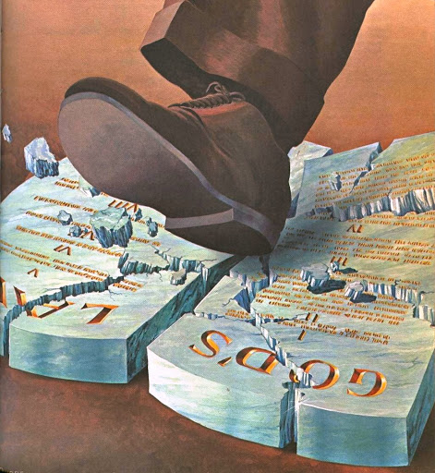
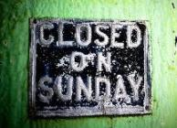
A Couple More Powerful Quotes…
“Perhaps the boldest thing, the most revolutionary change the Church ever did, happened in the first century. The holy day, the Sabbath, was changed from Saturday to Sunday. ‘The day of the Lord’ was chosen, not from any direction noted in the Scriptures, but from the Church’s sense of its power . . . People who think that the Scriptures should be the sole authority, should logically become 7th Day Adventists, and keep Saturday holy” (St. Catherine Church Sentinel, Algonac, Michigan, May 21, 1995)
"It is not yet too late for Protestants to redeem themselves. Will they do it?... will they indeed take the written word only, the Scripture alone, as their sole authority and their sole standard? Or will they still hold the indefensible, self contradictory, and suicidal doctrine and practice of following the authority of the Catholic church and wear the sign of her authority? Will they keep the Sabbath of the Lord, the seventh day, according to Scripture? Or will they keep the Sunday according to the tradition of the Catholic church." (Canon and Tradition, page 31)

Slide 25
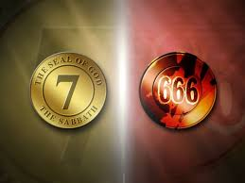

Slide 26
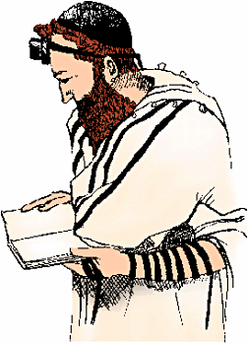
In the Forehead or in the Hand
Deut. 6:1-8 “Now these are the commandments, the statutes, and the judgments, which the Lord your God commanded to teach you, that ye might do them in the land whither ye go to possess it: That thou mightest fear the Lord thy God, to keep all his statutes and his commandments, which I command thee, thou, and thy son, and thy son's son, all the days of thy life; and that thy days may be prolonged. Hear therefore, O Israel, and observe to do it; that it may be well with thee, and that ye may increase mightily, as the Lord God of thy fathers hath promised thee, in the land that floweth with milk and honey. Hear, O Israel: The Lord our God is one Lord: And thou shalt love the Lord thy God with all thine heart, and with all thy soul, and with all thy might. And these words, which I command thee this day, shall be in thine heart: And thou shalt teach them diligently unto thy children, and shalt talk of them when thou sittest in thine house, and when thou walkest by the way, and when thou liest down, and when thou risest up. And thou shalt bind them for a sign upon thine hand, and they shall be as frontlets between thine eyes.”

Slide 27
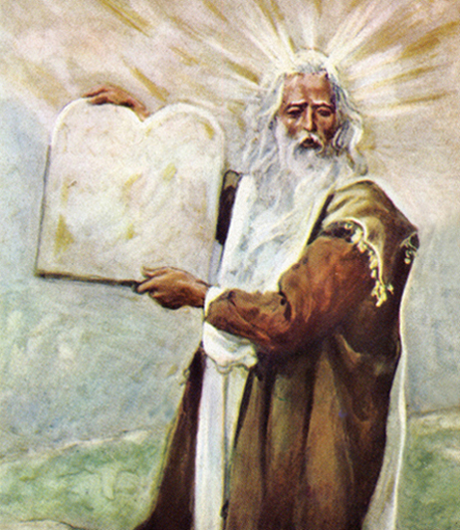
The Patience of the Saints
Rev. 14:12 “Here is the patience of the saints: here are they that keep the commandments of God, and the faith of Jesus”
Is. 58:12 “And they that shall be of thee shall build the old waste places: thou shalt raise up the foundations of many generations; and thou shalt be called, The repairer of the breach, The restorer of paths to dwell in.”
Jer. 6:16 “Thus saith the Lord, Stand ye in the ways, and see, and ask for the old paths, where is the good way, and walk therein, and ye shall find rest for your souls. But they said, We will not walk therein.”

Slide 28
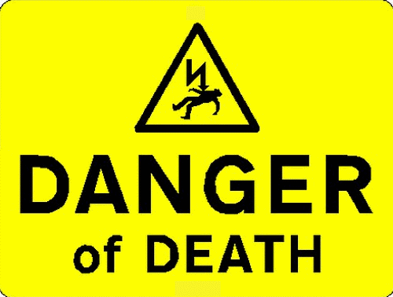
It’s The Final Message of Warning!
“Will the churches heed the Laodicean message? Will they repent, or will they, notwithstanding that the most solemn message of truth--the third angel's message--is being proclaimed to the world, go on in sin? This is the last message of mercy, the last warning to a fallen world. If the church of God becomes lukewarm, it does not stand in favor with God any more than do the churches that are represented as having fallen and become the habitation of devils, and the hold of every foul spirit, and the cage of every unclean and hateful bird.” Manuscript Releases, Vol. 19, p. 176

Slide 29
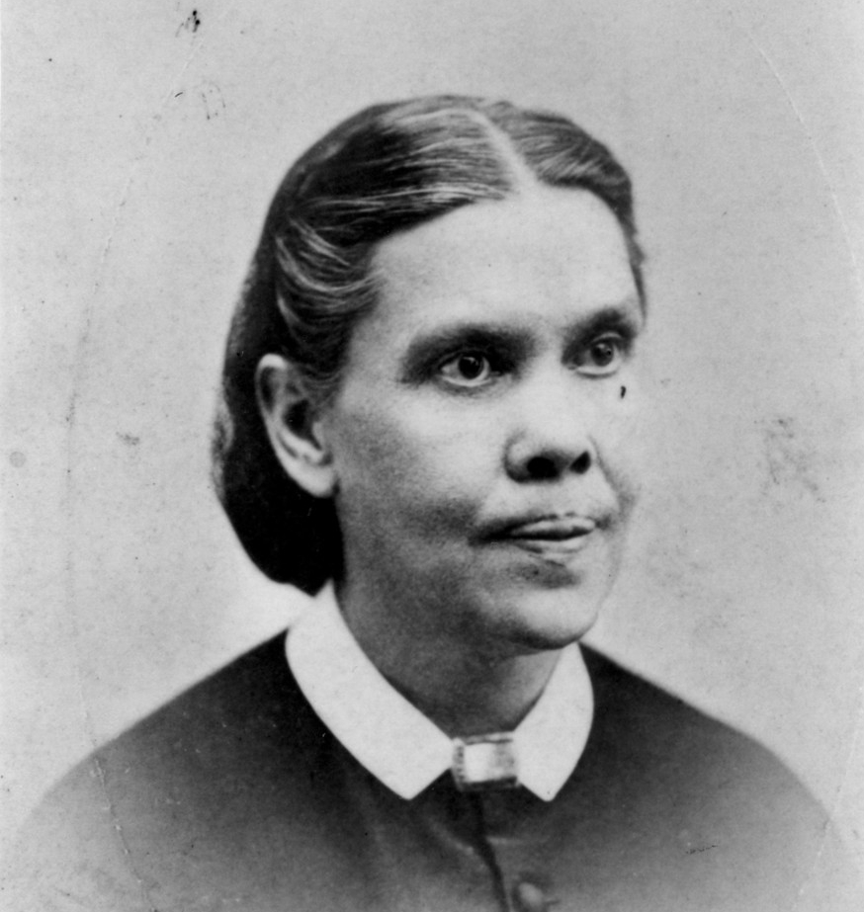
Faith of Jesus=Righteousness By Faith!
“The third angel’s message is the proclamation of the commandments of God and the faith of Jesus Christ. The commandments of God have been proclaimed, but the faith of Jesus Christ has not been proclaimed by Seventh-day Adventists as of equal importance, the law and the gospel going hand in hand. I cannot find language to express this subject in its fullness. ‘The faith of Jesus.’ It is talked of, but not understood. What constitutes the faith of Jesus, that belongs to the third angel’s message? Jesus becoming our sin-bearer that He might become our sin-pardoning Saviour. He was treated as we deserve to be treated. He came to our world and took our sins that we might take His righteousness. And faith in the ability of Christ to save us amply and fully and entirely is the faith of Jesus.” (3 Selected Messages, p. 172)

Slide 30
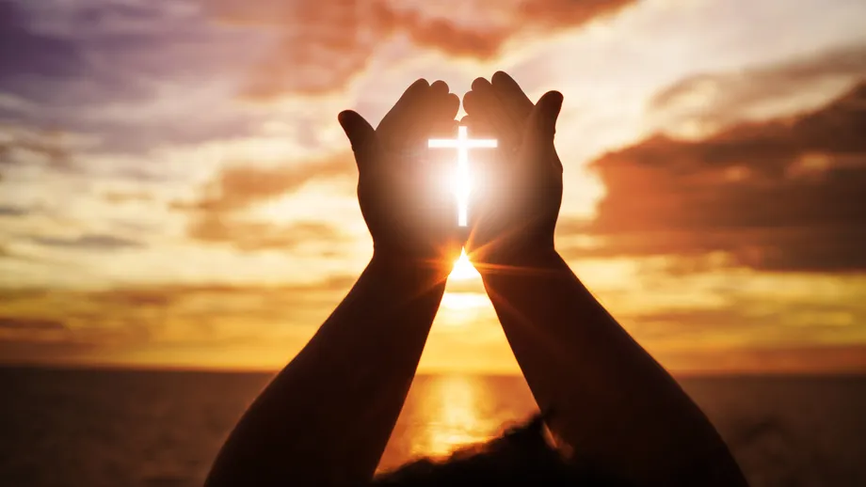
Can’t Be Clearer!
“Several have written to me, inquiring if the message of justification by faith is the third angel’s message, and I have answered, ‘It is the third angel’s message, in verity’”—R&H, Aug. 1, 1890
“The message of Christ’s righteousness is to sound from one end of the earth to the other to prepare the way of the Lord. This is the glory of God, which closes the work of the third angel.”—6T, p. 19

