Slide 1
The Right Arm, pt. 6
Sunshine

Slide 2
Get Some Sunshine!!
Truly the light is sweet, and a pleasant thing it is for the eyes to behold the sun. Eccl. 11:7
“ There are but few who realize that, in order to enjoy health and cheerfulness, they must have an abundance of sunlight, pure air, and physical exercise. We pity little children who are kept confined indoors when the sun is shining gloriously without.
Clothe your boys and girls comfortably and properly. . . . Then let them go out and exercise in the open air, and live to enjoy health and happiness.
The pale and sickly grain-blade that has struggled up out of the cold of early spring puts out the natural and healthy deep green after enjoying for a few days the health-and-life-giving rays of the sun. Go out into the light and warmth of the glorious sun, . . . and share with vegetation its life-giving, healing power.” My Life Today - Page 143

Slide 3
Very Important!
Pure air, sunlight, abstemiousness, rest, exercise, proper diet, the use of water, trust in divine power,—these are the true remedies. Every person should have a knowledge of nature's remedial agencies and how to apply them. It is essential both to understand the principles involved in the treatment of the sick and to have a practical training that will enable one rightly to use this knowledge.” CD, pg. 301
“Physicians often advise invalids to visit foreign countries, to go to some mineral spring, or to traverse the ocean, in order to regain health; when, in nine cases out of ten, if they would eat temperately, and engage in healthful exercise with a cheerful spirit, they would regain health and save time and money. Exercise, and a free, abundant use of the air and sunlight—blessings which heaven has bestowed upon all—would in many cases give life and strength to the emaciated invalid.—Christian Temperance and Bible Hygiene, 160, 1890

Slide 4
Sunshine-One of the 8 Natural Laws
Sunlight and darkness trigger the release of hormones in your brain. Exposure to sunlight is thought to increase the brain’s release of a hormone called serotonin. Serotonin is associated with boosting mood and helping a person feel calm and focused. At night, darker lighting triggers the brain to make another hormone called melatonin. This hormone is responsible for helping you sleep.

Slide 5
Serotonin
“SEROTONIN is one of the most widely recognized (and a frequently searched term on google.com) of all neurotransmitters. It is intricately involved in numerous core physical processes such as the regulation of sleep, appetite and aggression. Serotonin is also a key player in mood, anxiety, fear, and general sense of well-being. Imbalances in serotonin, particularly relative to norepinephrine and dopamine, are common causes of certain types of depression. Antidepressants that block serotonin’s re-uptake back into serotonin neurons are among the most common of all classes of medications prescribed. Serotonin deficiency is a common contributor to mood problems. Some feel it is an epidemic in the United States. Serotonin is key to our feelings of happiness and very important for our emotions because it helps defend against both anxiety and depression.” Integrative Psychiatry

Slide 6
Seattle Depression
“Seattle scores lots of gloomy points for being the northern most major city in the U.S., which means we have the least amount of daylight in the heart of winter. Combine that with it coinciding with the rainy season and you get fall and winter months when it rains on 20-23 of the 30-31 days and, according to the site, only get 28% of possible sunshine.
Seattle is only "out-depressed" by Anchorage, Alaska -- mainly because it's even colder and darker there in the winter.” Komo News. com

Slide 7
Sunshine Makes Happy
“I must become acquainted with myself, I must be a learner always as to how to take care of this building, the body God has given me, that I may preserve it in the very best condition of health. I must eat those things which will be for my very best good physically, and I must take special care to have my clothing such as will conduce to a healthful circulation of the blood. I must not deprive myself of exercise and air. I must get all the sunlight that it is possible for me to obtain. I must have wisdom to be a faithful guardian of my body.” CD, pg. 302

Slide 8
Vitamin D
When natural sunlight hits the skin it triggers the body’s production of vitamin D. Vitamin D is also known as “the sunshine vitamin.” It is a crucial ingredient for overall health; protects against inflammation, lowers high blood pressure, helps muscles, improves brain function and may even protect against cancer. Low levels of vitamin D can cause heart disease, prostate cancer and dementia.

Slide 9
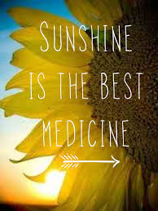
“It’s no secret that vitamin D is a crucial ingredient for overall health, glowing skin, and strong bones, but most people don’t get enough of this fat-soluble vitamin that helps muscles, heart, lungs, and brain function properly. Research has shown that 3/4 of U.S. teens and adults are “D-ficient.” This is a scary number, considering the number of health woes the lack of the vitamin has been linked to: Obesity, cancer, heart disease, diabetes, and certain autoimmune diseases, to name a few.” Active Times

Slide 10
Produces Insulin
According to Larkin Hospital, vitamin D plays a huge roll in the production of insulin and studies have shown a positive association between insulin resistance and vitamin D deficiency. They explain, “many studies supplementing vitamin D to subjects at risk of diabetes have shown significant improvements in fasting glucose levels, insulin production, insulin resistance, and A1c control (a marker of long term blood glucose levels).”
It has been proven that sunshine stimulates your immune systems’ vitamin D and T cells which results in boosted immunity (Ways to Boost Your Immune System Against Cold and Flu). Researchers say, “we rely on solar energy to enable our bodies to stave off infections and fight disease.”
High blood pressure is extremely dangerous, it’s important to educate yourself on ways to lower your blood pressure. One of which include, exposure to sunlight. Research has shown that nitric oxide stored at the top layer of the skin reacts to sunlight which causes blood vessels to widen as the oxide moves into the blood stream. This results in lower blood pressure.

Slide 11
Powerful Antidote!
One of the most beneficial effects of sunshine is that it causes the skin to produce Vitamin D. Human skin when exposed to direct sunlight converts cholesterol into Vitamin D. Vitamin D is then processed by the body which produces a compound called cathelicidin. Cathelicidin is an all natural product of the body and it acts as a powerful antibiotic to destroy germs.
When Vitamin D is formed in the skin as a result of direct exposure to sunshine [transforming cholesterol into Vitamin D] it then stimulates the body to form cathelicidin which is a super strong antibiotic. And its all natural! Cathelicidin is naturally formed in the body as an indirect product of the stimulation of sunlight on the skin! This is the 'antibiotic' that God prescribed in the garden of Eden. It will keep us well and healthy even today! It makes war on cancers, diabetes, and all other diseases!

Slide 12
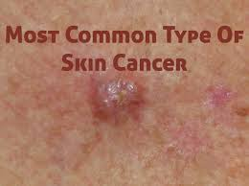
What about Skin Cancer?
We have been inundated for years with the idea that skin cancer is the solely caused by the sunshine. In fact, this is not the case!! Studies have been done to prove beyond a shadow of a doubt that this is not case. The old adage still applies and it applies here, “Garbage in, and garbage out.” When we put garbage into our system, then garbage will result. Notice the following information.

Slide 13
High Fat Diet
“There is little doubt, in the research literature, as to whether or not a high fat diet promotes a higher and earlier incidence of skin cancer due to ultra violet light. Not only skin cancer but breast and colon cancer as well, seem to be increased by a high fat diet. Increasing the calories in the diet of experimental animals "will increase the incidence of cancer; and when the same number of calories are fed to all experimental groups, the animals receiving the most fat, develop the most cancer. Fat seems to have a specific effect in stimulating cancer formation.”
Tannenbaum, A.: The Genesis and Growth of Tumors, Cancer,
Res. 2.468, 1942.
Jacobi, H. P, and Baumann, C. A : The Effect of Fat on Tumor Formation, American Journal On Cancer 39:338, 1940.
(8) Baumann, C. A., and Rusch,H. P: Effect of Diet on Tumors
Induced by Ultraviolet Light, American Journal On Cancer, 35:213,1939

Slide 14
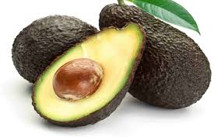
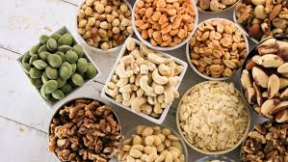
High Fat Diet Main Cause for Skin Cancer- Not These

Slide 15
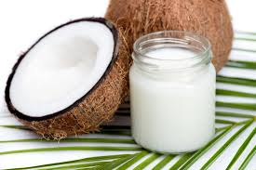
Many foods that are great for us are full of fat. Avocadoes, nuts, virgin olive oil, chia seeds, coconuts, and coconut oil are just a few. However, these foods contain fat that is good for us. The fats that cause skin cancer come from far different foods! It is not the foods the Lord has created that are high in fat that are bad, but rather the processed foods that that have had so many things added to them that cause skin cancer.

Slide 16
Dairy and Processed Foods!
Dairy foods – such as butter, cream, regular-fat milk and cheese.
Meat – such as fatty cuts of beef, pork and lamb, processed meats like salami, sausages and the skin on chicken.
Lard. Hectic days and busy nights: Who has time to cook? That’s why many of us rely on the grab-and-go ease of processed foods.
There’s a downside, though. These meals are often high in fat, salt, and sugar -- and low in nutrients that are good for you such as calcium, omega-3 fatty acids, and fiber.

Slide 17
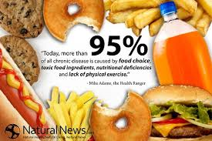
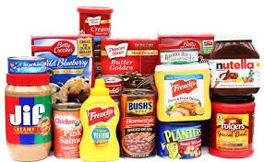
Processed foods full of Saturated Fats

Slide 18
Watch Out!
“Not only does saturated fat stimulate cancer formation but unsaturated or polyunsaturated will do the same. In many cases in scientific literature, the Polyunsaturated fats are shown to stimulate cancer formation more than do the saturated fats . The more unsaturated the fat, the greater seems its ability to stimulate cancer formation caused by sunlight or cancer producing drugs.” Zane Kime, Sunshine, pg. 94

Slide 19
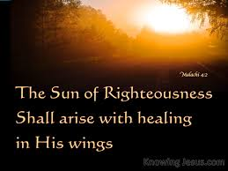
Healer of All Maladies
“But unto you that fear my name shall the Sun of righteousness arise with healing in his wings; and ye shall go forth, and grow up as calves of the stall.” Malachi 4:2
“Bless the LORD, O my soul, and forget not all his benefits: Who forgiveth all thine iniquities; who healeth all thy diseases; Who redeemeth thy life from destruction; who crowneth thee with lovingkindness and tender mercies;” Ps. 103:2-4

