Slide 1
Behind the Door pt 13:
Vietnam, Why Did We Go?

Slide 3
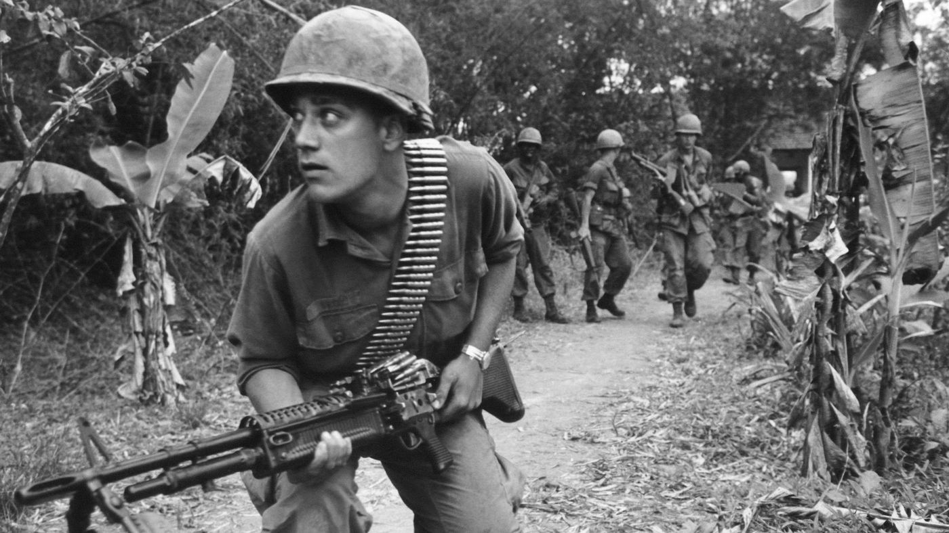
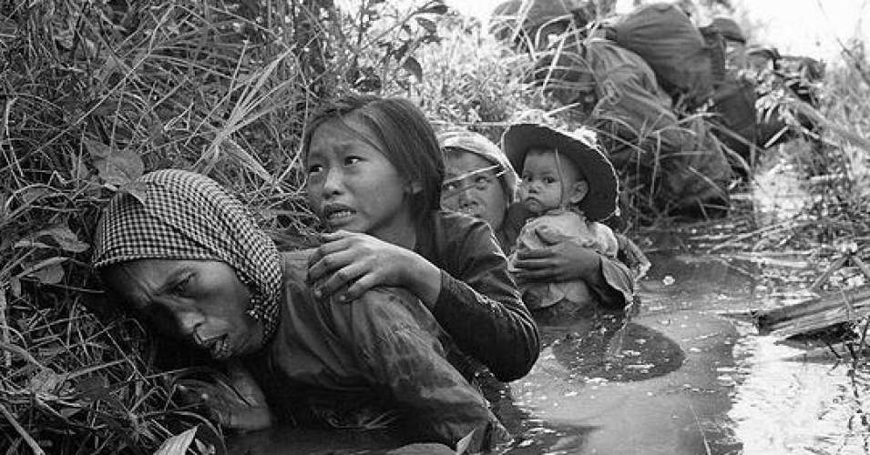
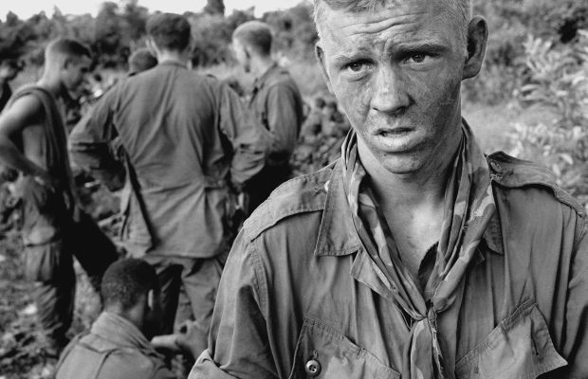
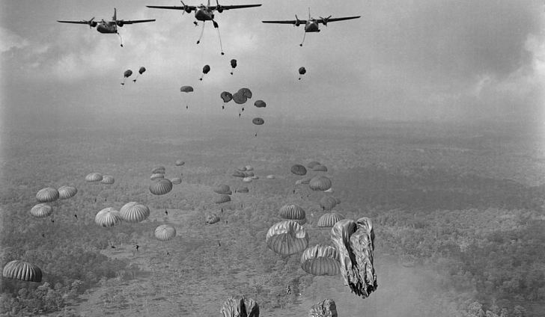

Slide 4
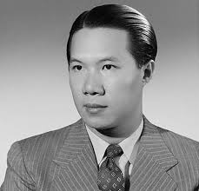
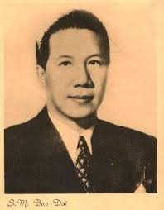
Bao Dai: the 13th and final emperor of the Nguyễn Dynasty, which was the last ruling family of Vietnam. From 1927 to 1945

Slide 5
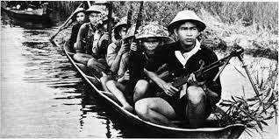
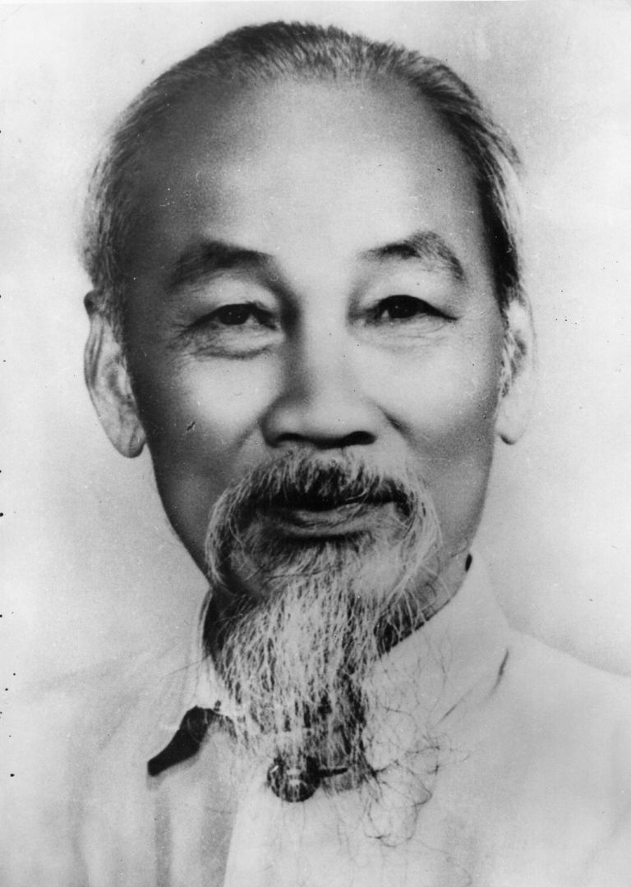
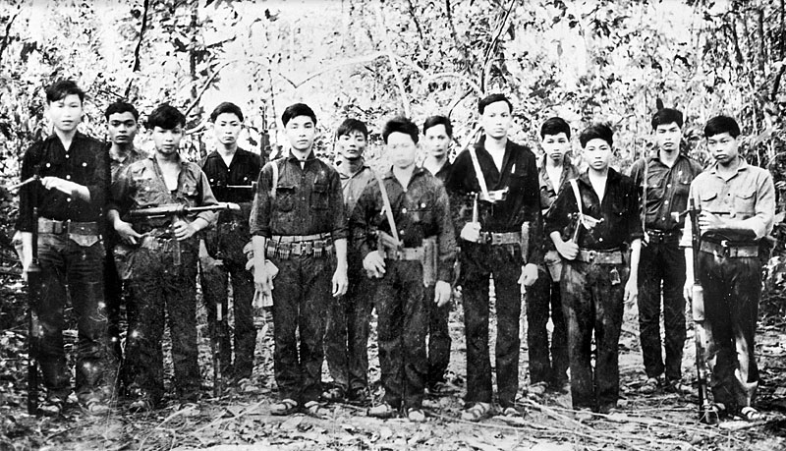
The “Viet Minh” and Ho Chi Minh

Slide 6
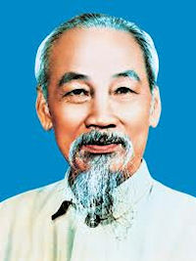
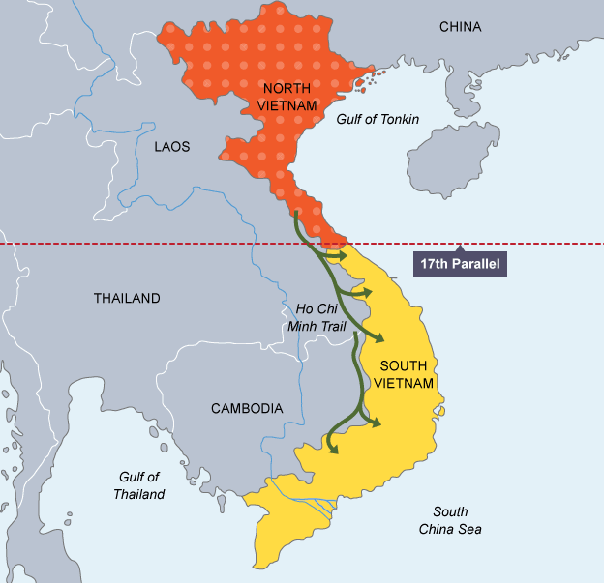
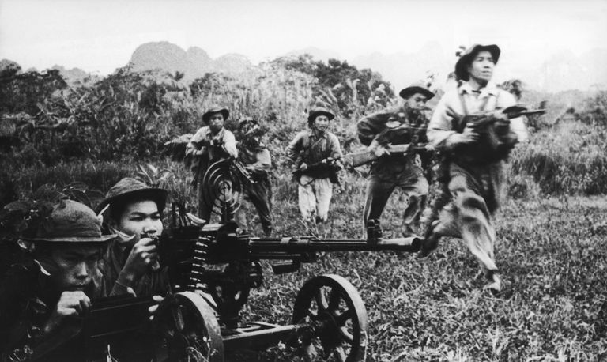
Viet Minh aka Vietcong rule the North with Ho Chi Minh’s Catholic appointees

Slide 7
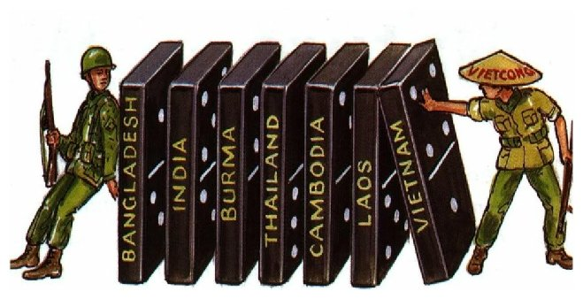
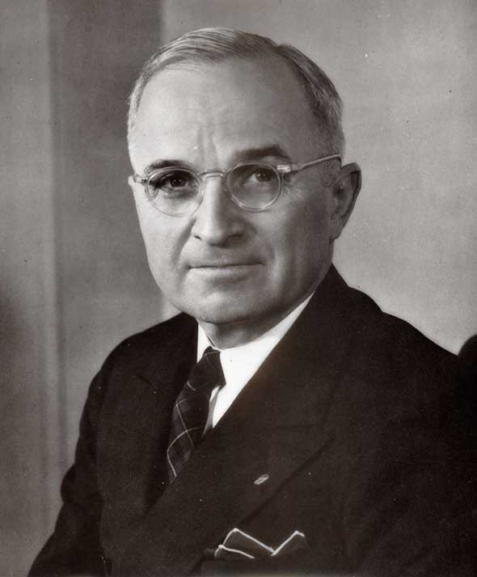
President Harry S. Truman believed in a sort off “domino effect” (domino theory) of Communist expansion. If Vietnam fell to Communism , then perhaps the rest of the South Pacific would as well, eventually reaching and threatening the United States. The pawns play their roles perfectly as Rome controls both sides. The United States began sending aid to French troops in South Vietnam totaling over 1 billion dollars per year, until finally putting assistance increased to U.S. military assistance also
Harry S. Truman: 33rd President of the U.S. from 1945-1953

Slide 8
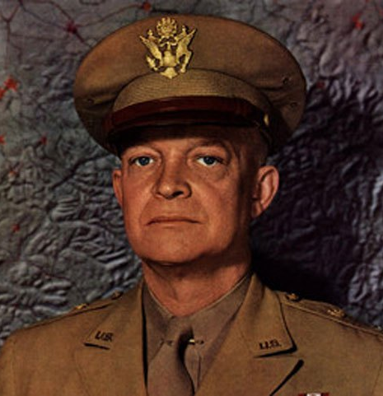
“I am convinced that the French could not win the war because the internal political situation in Vietnam, weak and confused, badly weakened their military position. I have never talked or corresponded with a person knowledgeable in Indochinese affairs who did not agree that had elections been held as of the time of the fighting, possibly 80 per cent of the population would have voted for the Communist Ho Chi Minh as their leader rather than Chief of State Bao Dai.”—Dwight D. Eisenhower, Mandate for Change, 1953-56, p. 372
General Dwight D. Eisenhower and to be 34th President of the United States, 1953-1961

Slide 9
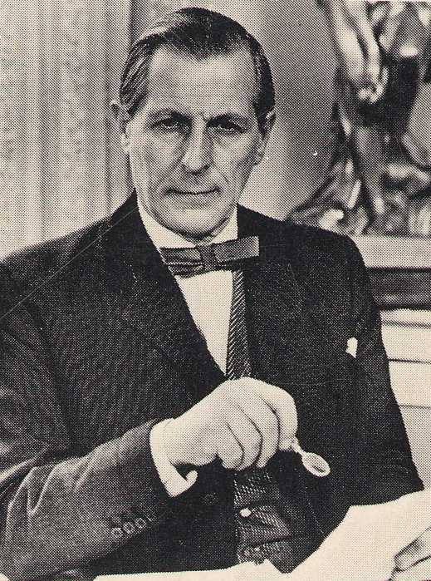
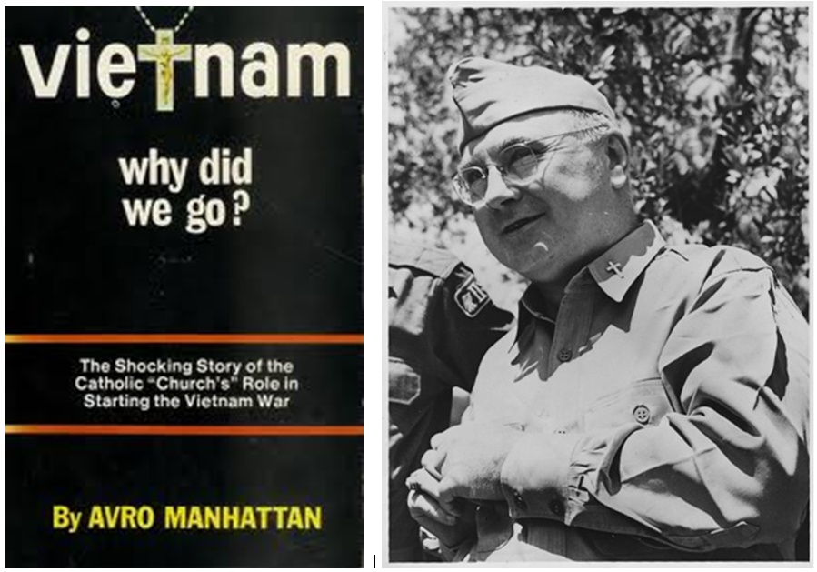
Cardinal Spellman

Slide 10
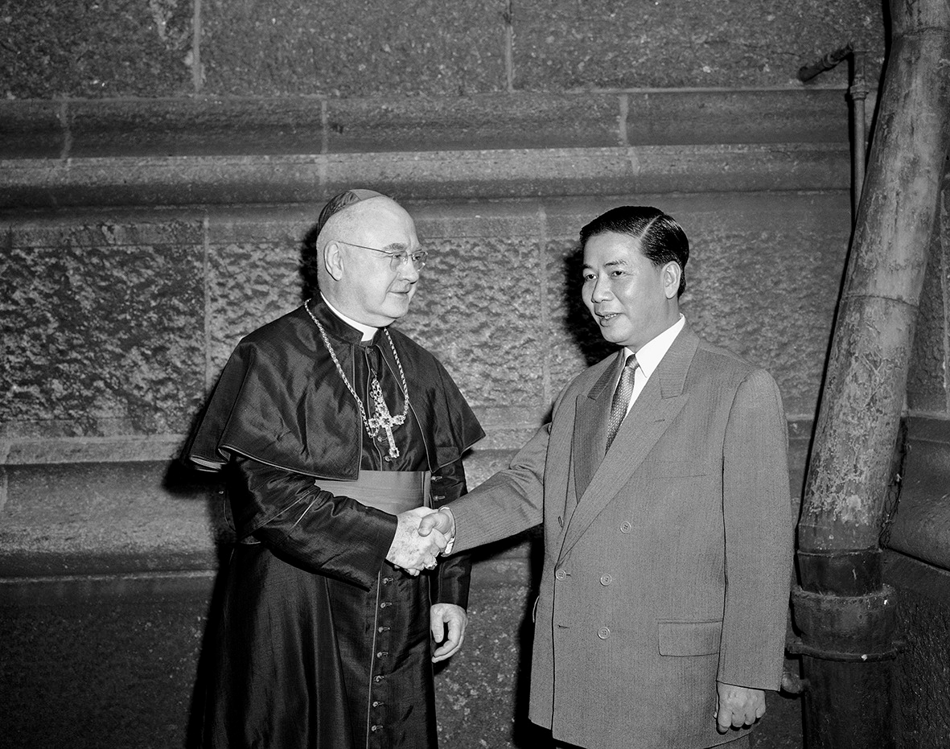
In 1956 America pressures South Vietnam to reject elections which would result in Ho Chi Minh’s victory
The Cause? Cardinal Spellman (left) and Secretary of State (at that time) John Foster Dulles pressures South Vietnam do declare independence from North Vietnam
Instead Rome’s choice to rule the country is Ngo Dinh Diem (right), an anticommunist devout Catholic who enforces Catholic laws on Buddhists (monks burn themselves in protest)
Ngo Dinh Diem and Cardinal Spellman

Slide 11
Rome
Ngo Dinh Diem or No One!!!!
U.S. Officials
Ngo Dinh Diem

Slide 12
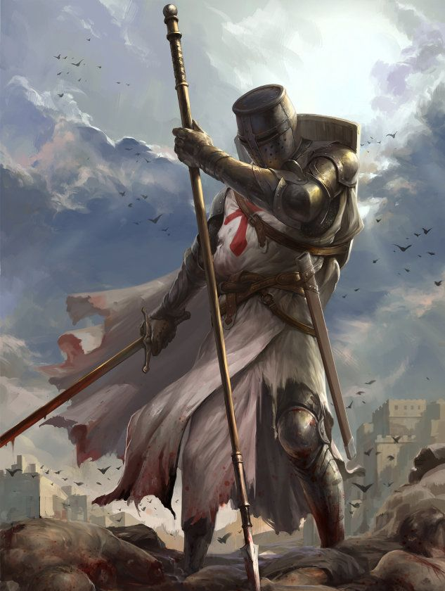
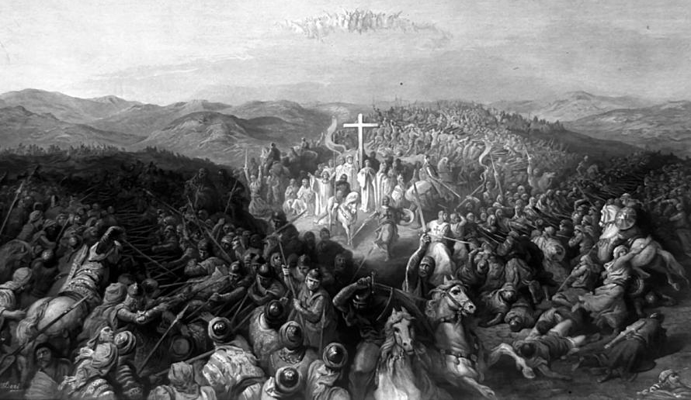
Remember the Crusades??? This is Catholic Policy. And when Rome is able, she exercises this same policy upon friend and foe alike to achieve her ends. The ends justify the means is her favorite maxim.

Slide 13
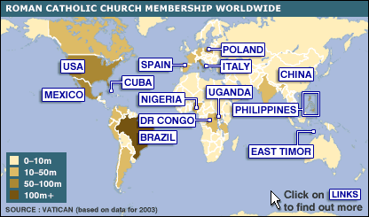
Rome had a desire to establish a Catholic foothold in the mainly Buddhist, Hindu, and ancient Chinese religions which has made up most of the Asia mainland and pacific islands.

Slide 14
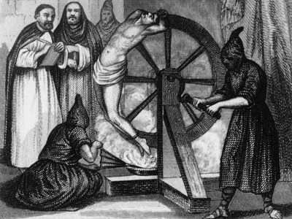
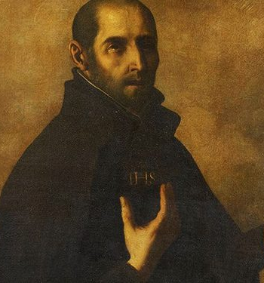
Continuing the Counter Reformation: Convert to Catholicism or Die

Slide 15
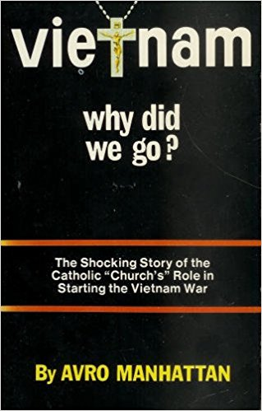
“Vatican agents hatched and plotted the Vietnam war. American soldiers were serving the Vatican in their desperate struggle to survive the jungles, the hell of warfare, pain, death, and destruction. It was all engineered by the whore [of Revelation 17] and her Jesuits.” Publishers Foreward, Vietnam, why did we go? p. 3

Slide 16
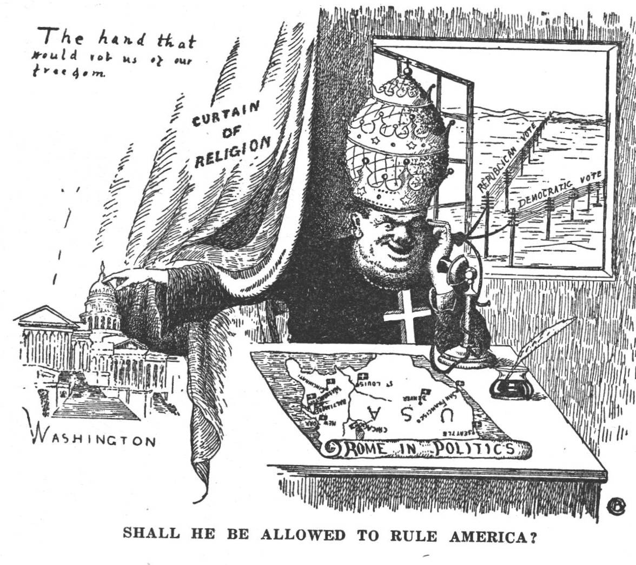

Slide 17
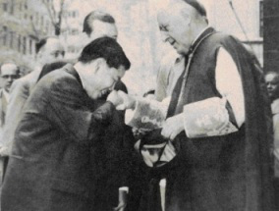
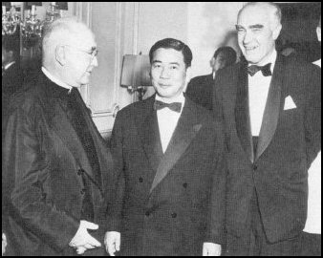

Slide 18
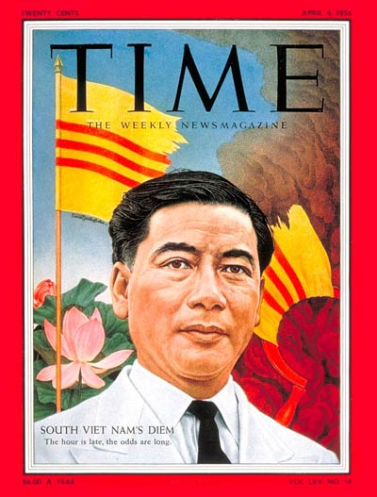
Issue (left): Aug. 4, 1955- (one year before the boycotted elections) “South Viet Nam’s Diem” [subtitled] The hour is late, the odds are long.
They painted this Catholic puppet as a hero for South Vietnam, against Ho Chi Minh’s Northern Vietcong. Buddhism was persecuted and suffered greatly under his oppressive rule. Christians are not supposed to FORCE people to accept their religion. Christians are to win people to Christ, not kill them unless they comply. The Roman power is completely at odds with the teachings of the Bible

Slide 19
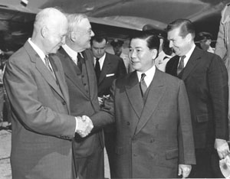
Even JFK played a role among others in Diem’s rise to power. However, as history shows, when Catholic JFK became president and refused to be obedient to Rome’s wishes by trying to destroy the Catholic Federal Reserve, Catholic CIA, and pull troops out of the Catholic Vietnam War, he was slain.

Slide 20
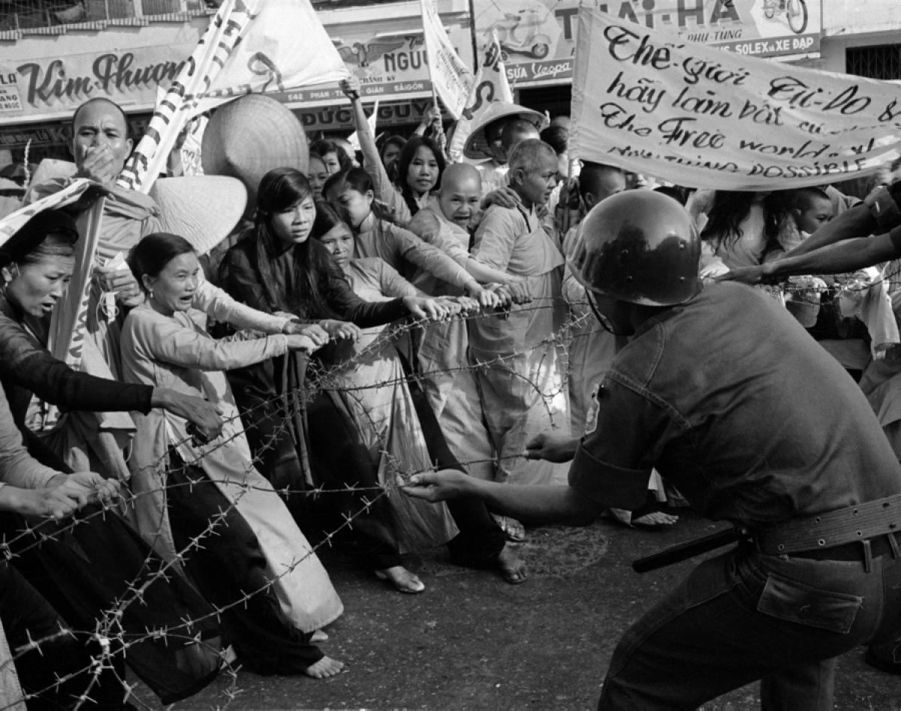
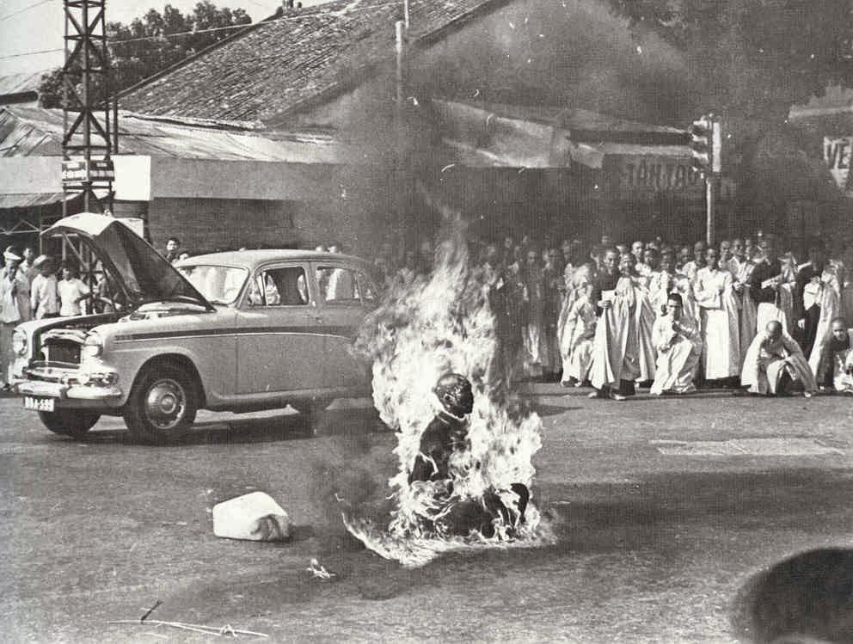
Buddhist’s protesting South Vietnam’s oppressive Roman Catholic President Ngo Dinh Diem (Many monk’s set themselves ablaze to refute the tyranny of Roman laws and enforcement/persecution of all other religions

Slide 21
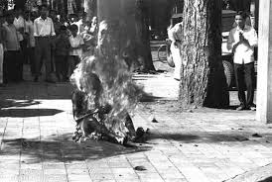
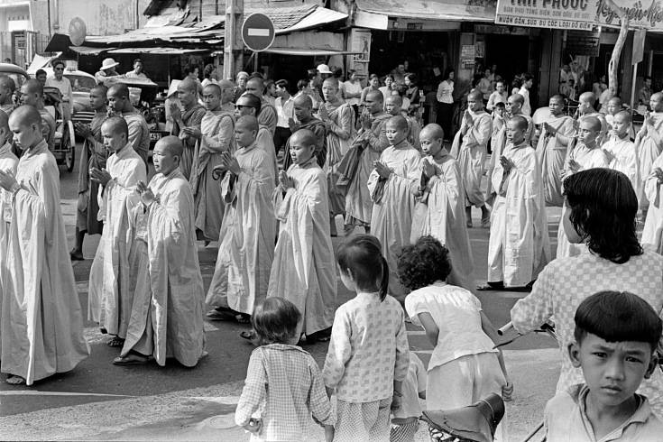
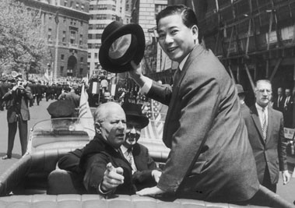
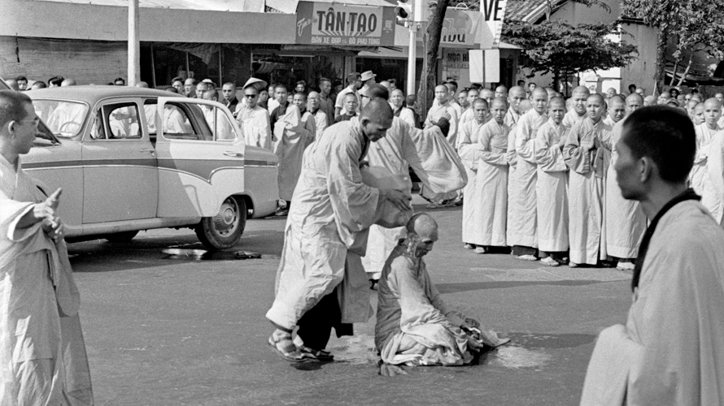

Slide 22
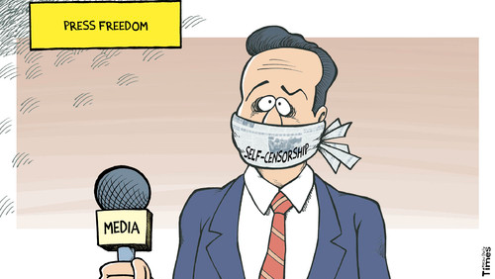

Slide 23
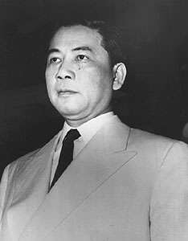
Dictatorial powers of President Diem included:
-May decree a temporary suspension of civil liberties to meet the demands of public security.—this policy was maintained indefinitely.
Sound Familiar???

Slide 24
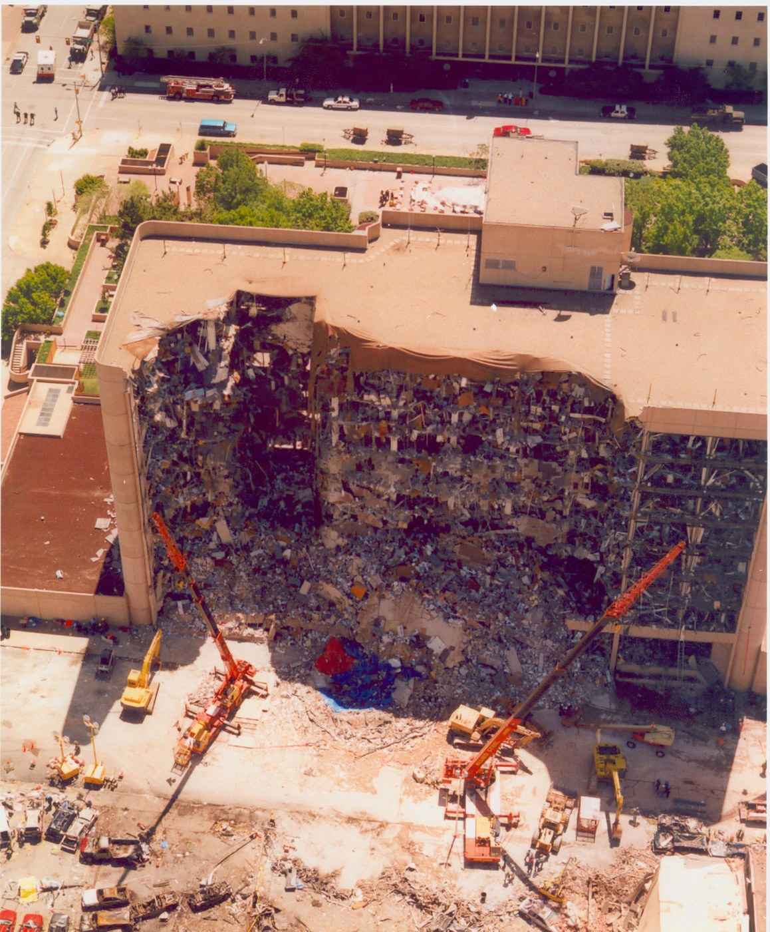
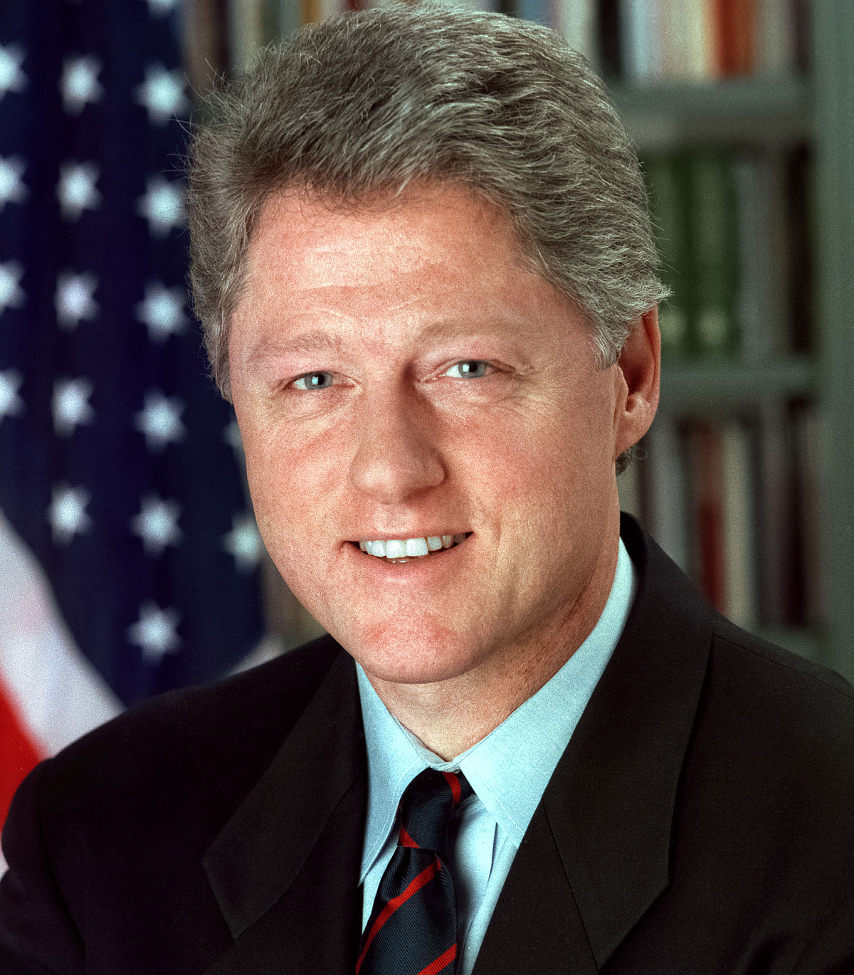
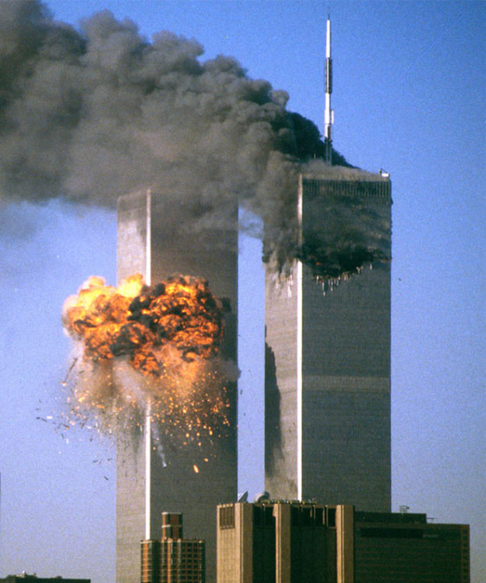
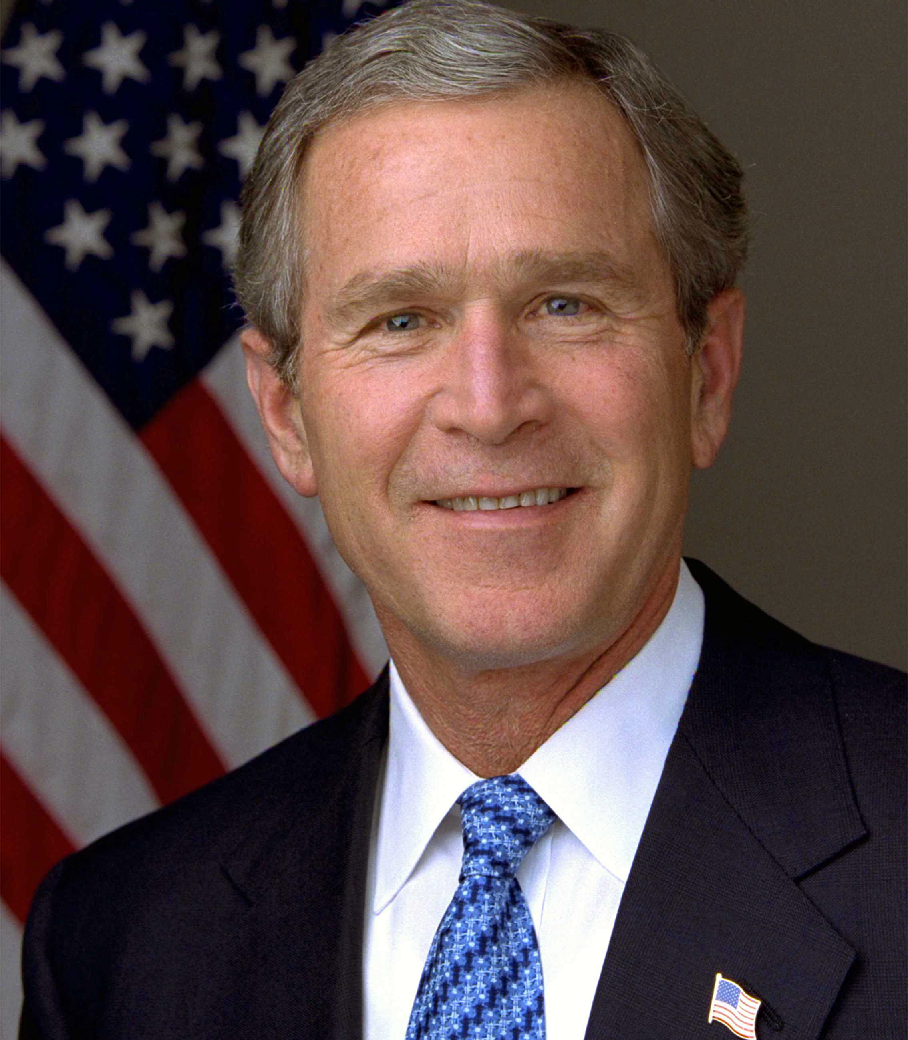
It’s the same playbook
Crisis: Oklahoma City Bombing
Result: Antiterrorism and Effective Death Penalty Act of 1996 gives government the power to suspend civil liberties and rights for the purpose of maintaining security
President: Bill Clinton (Democrat)
Crisis: September 11th Terrorist Attacks
Result: Patriot Act gives government the power to suspend civil liberties and rights in order to maintain security
President: George W. Bush (Republican)

Slide 25
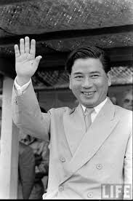
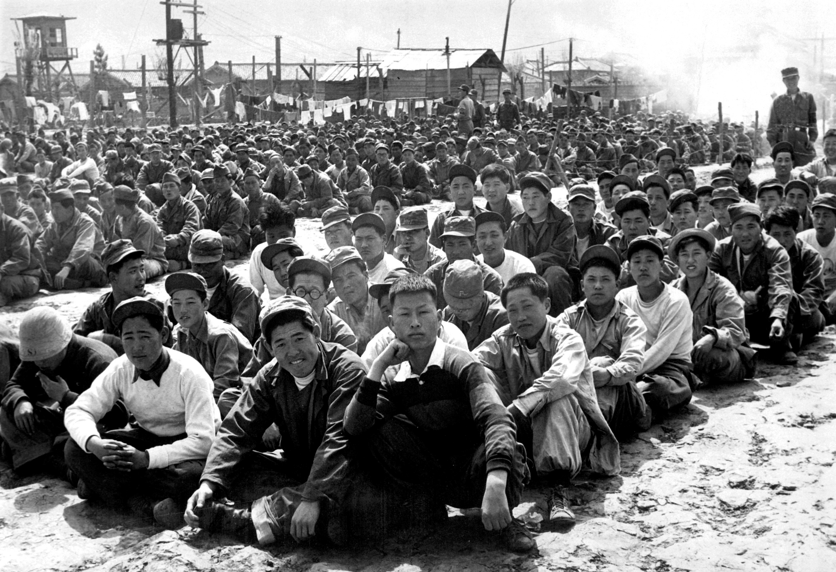
Order 46
“Individuals considered dangerous to the national defense and common security may be confined by executive order to a concentration camp”—Vietnam, why did we go? P. 79

Slide 26
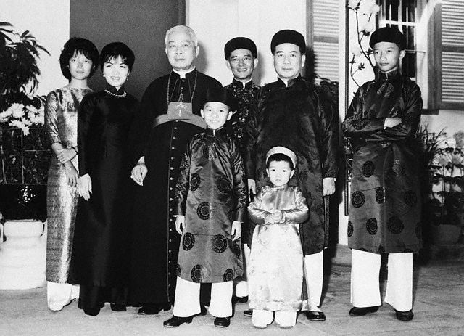
Diem took the teaching of these popes literally. For instance, he firmly held, as Pope Pius IX declared in his Syllabus of Errors, “that it is an error to believe that: the church is not a true and perfect society.” For the Church to be perfect, the state must be integrated with her so that the two become as one, because quoting again Pius IX “it is an error to believe that: the Church ought to be separated from the State and the State from the Church” a principle, which went totally against the Constitution of the U.S., his sponsor.—Vietnam why did we go? P. 82-83

Slide 27
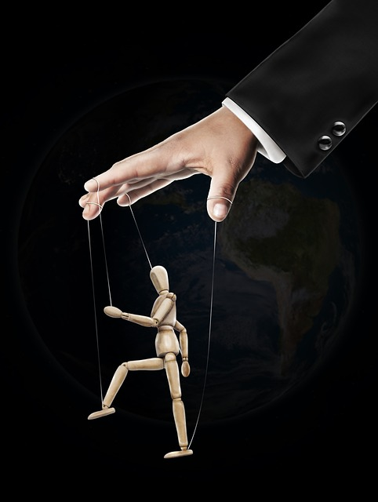
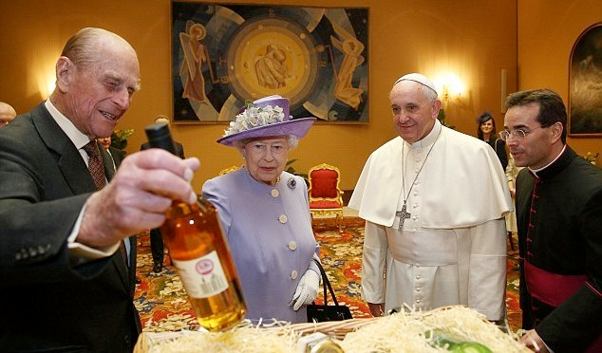
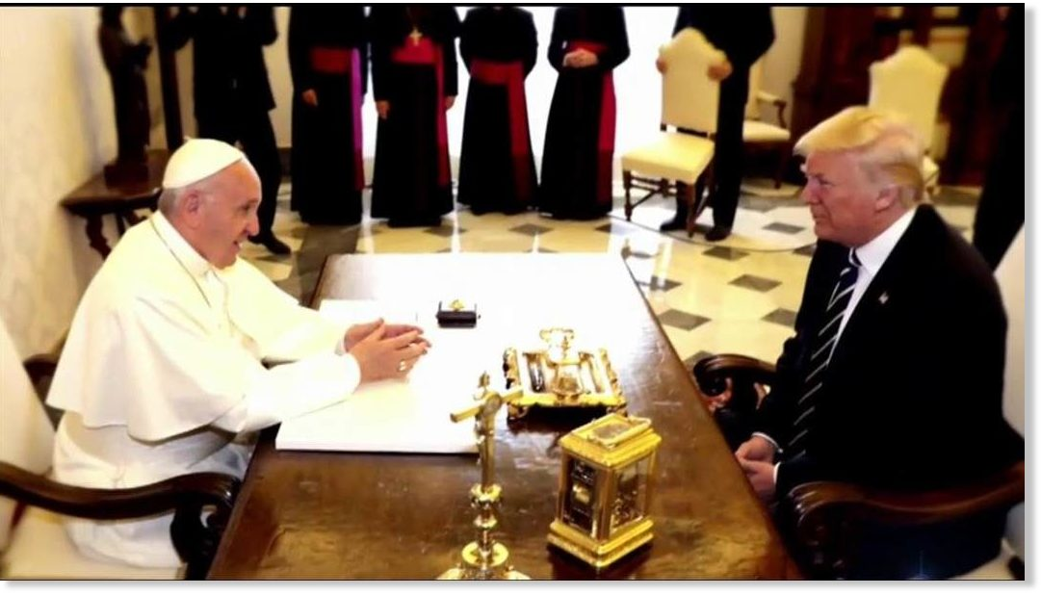

Slide 28
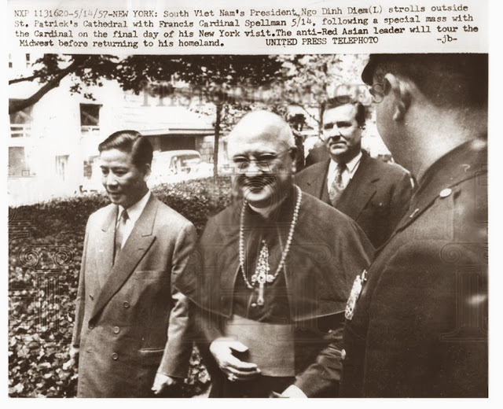
“Elements preventing such union, therefore, had to be eliminated. These meant the Protestants, at that time numbering 50,000, mostly Baptists and Seventh-day Adventists. Diem had planned to eliminate them chiefly via legislation by prohibiting their missions, closing their schools, and refusing licenses to preach, or have religious meetings. This he would have done legally in accordance with the future concordat to be signed with the Vatican, modeled upon that of Franco’s Spain. Such anti-Protestant legislation would have been enforced once the war was over and a Catholic state had been firmly established.”—Vietnam, why did we go? P. 83

Slide 29
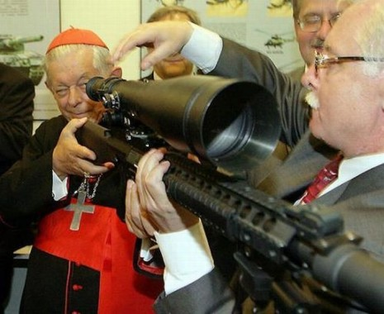
This is Catholic Evangelism
“The jails were soon bursting with prisoners. The mass arrests became so numerous that finally it was necessary to open detention camps. . . Religious sects and racial minorities were persecuted, arrested and whenever possible eliminated. To save themselves from arrest or even death many detainees had to accept the religion, language and customs of the new South Vietnam. . . Minor groups were exterminated or accepted the Catholic Church to save their lives.”—Vietnam, why did we go? P. 81

Slide 30
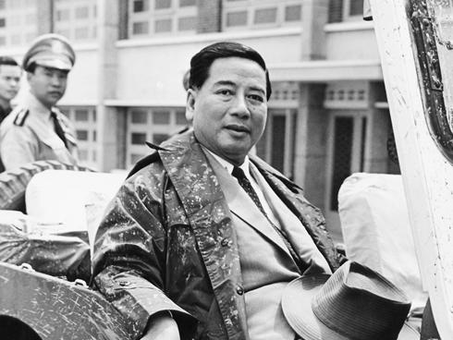
Blodd laid at Rome’s feet

Slide 31
Buddhist’s Practiced “Self-Immolation” by setting themselves on fire to protest the tyranny of Ngo Dinh Diem’s oppressive rule of South Vietnam

Slide 32
Madam Nhu, President Diem’s sister told a news reporter in 1963, in response to Buddhist Self-Immolation protests: “What have the Buddhist leaders done? The only thing they have done, they have barbecued one of their monks—and even that barbecuing was done not even with self-sufficient means because they used imported gasoline”
She was also known to clap as the monks burned themselves alive

