Slide 1
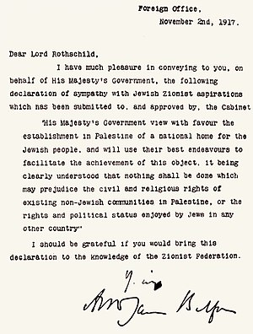

Slide 3
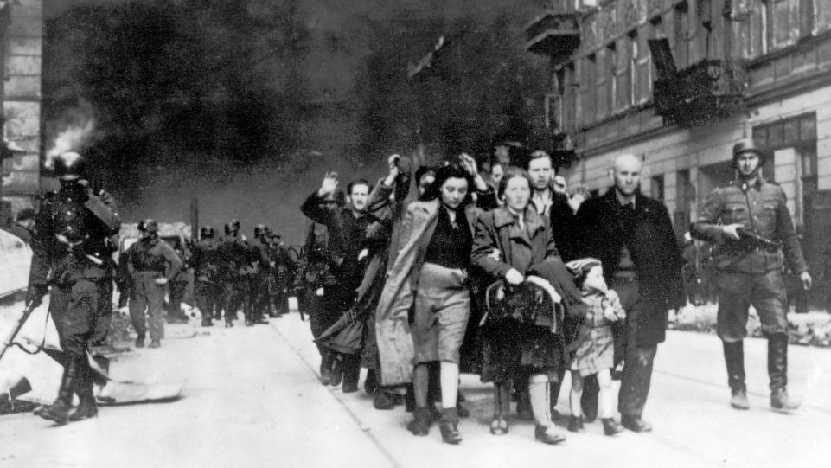
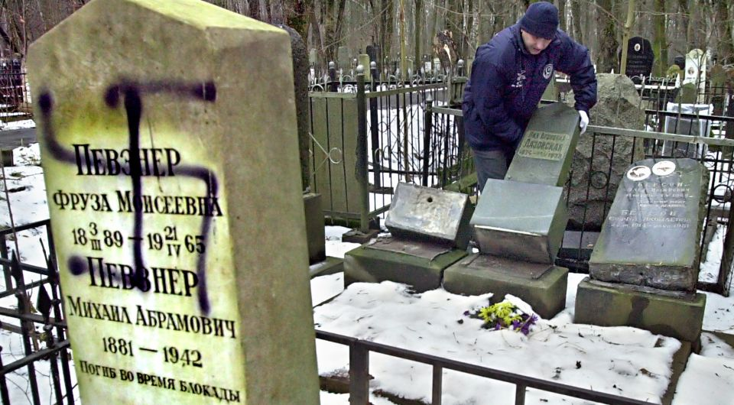
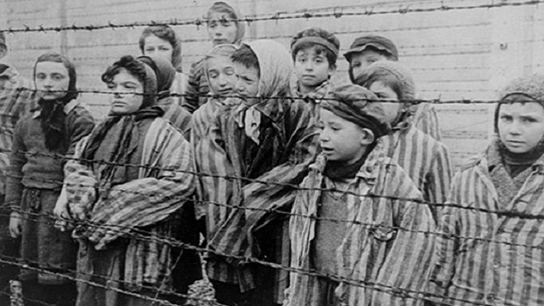

Slide 4
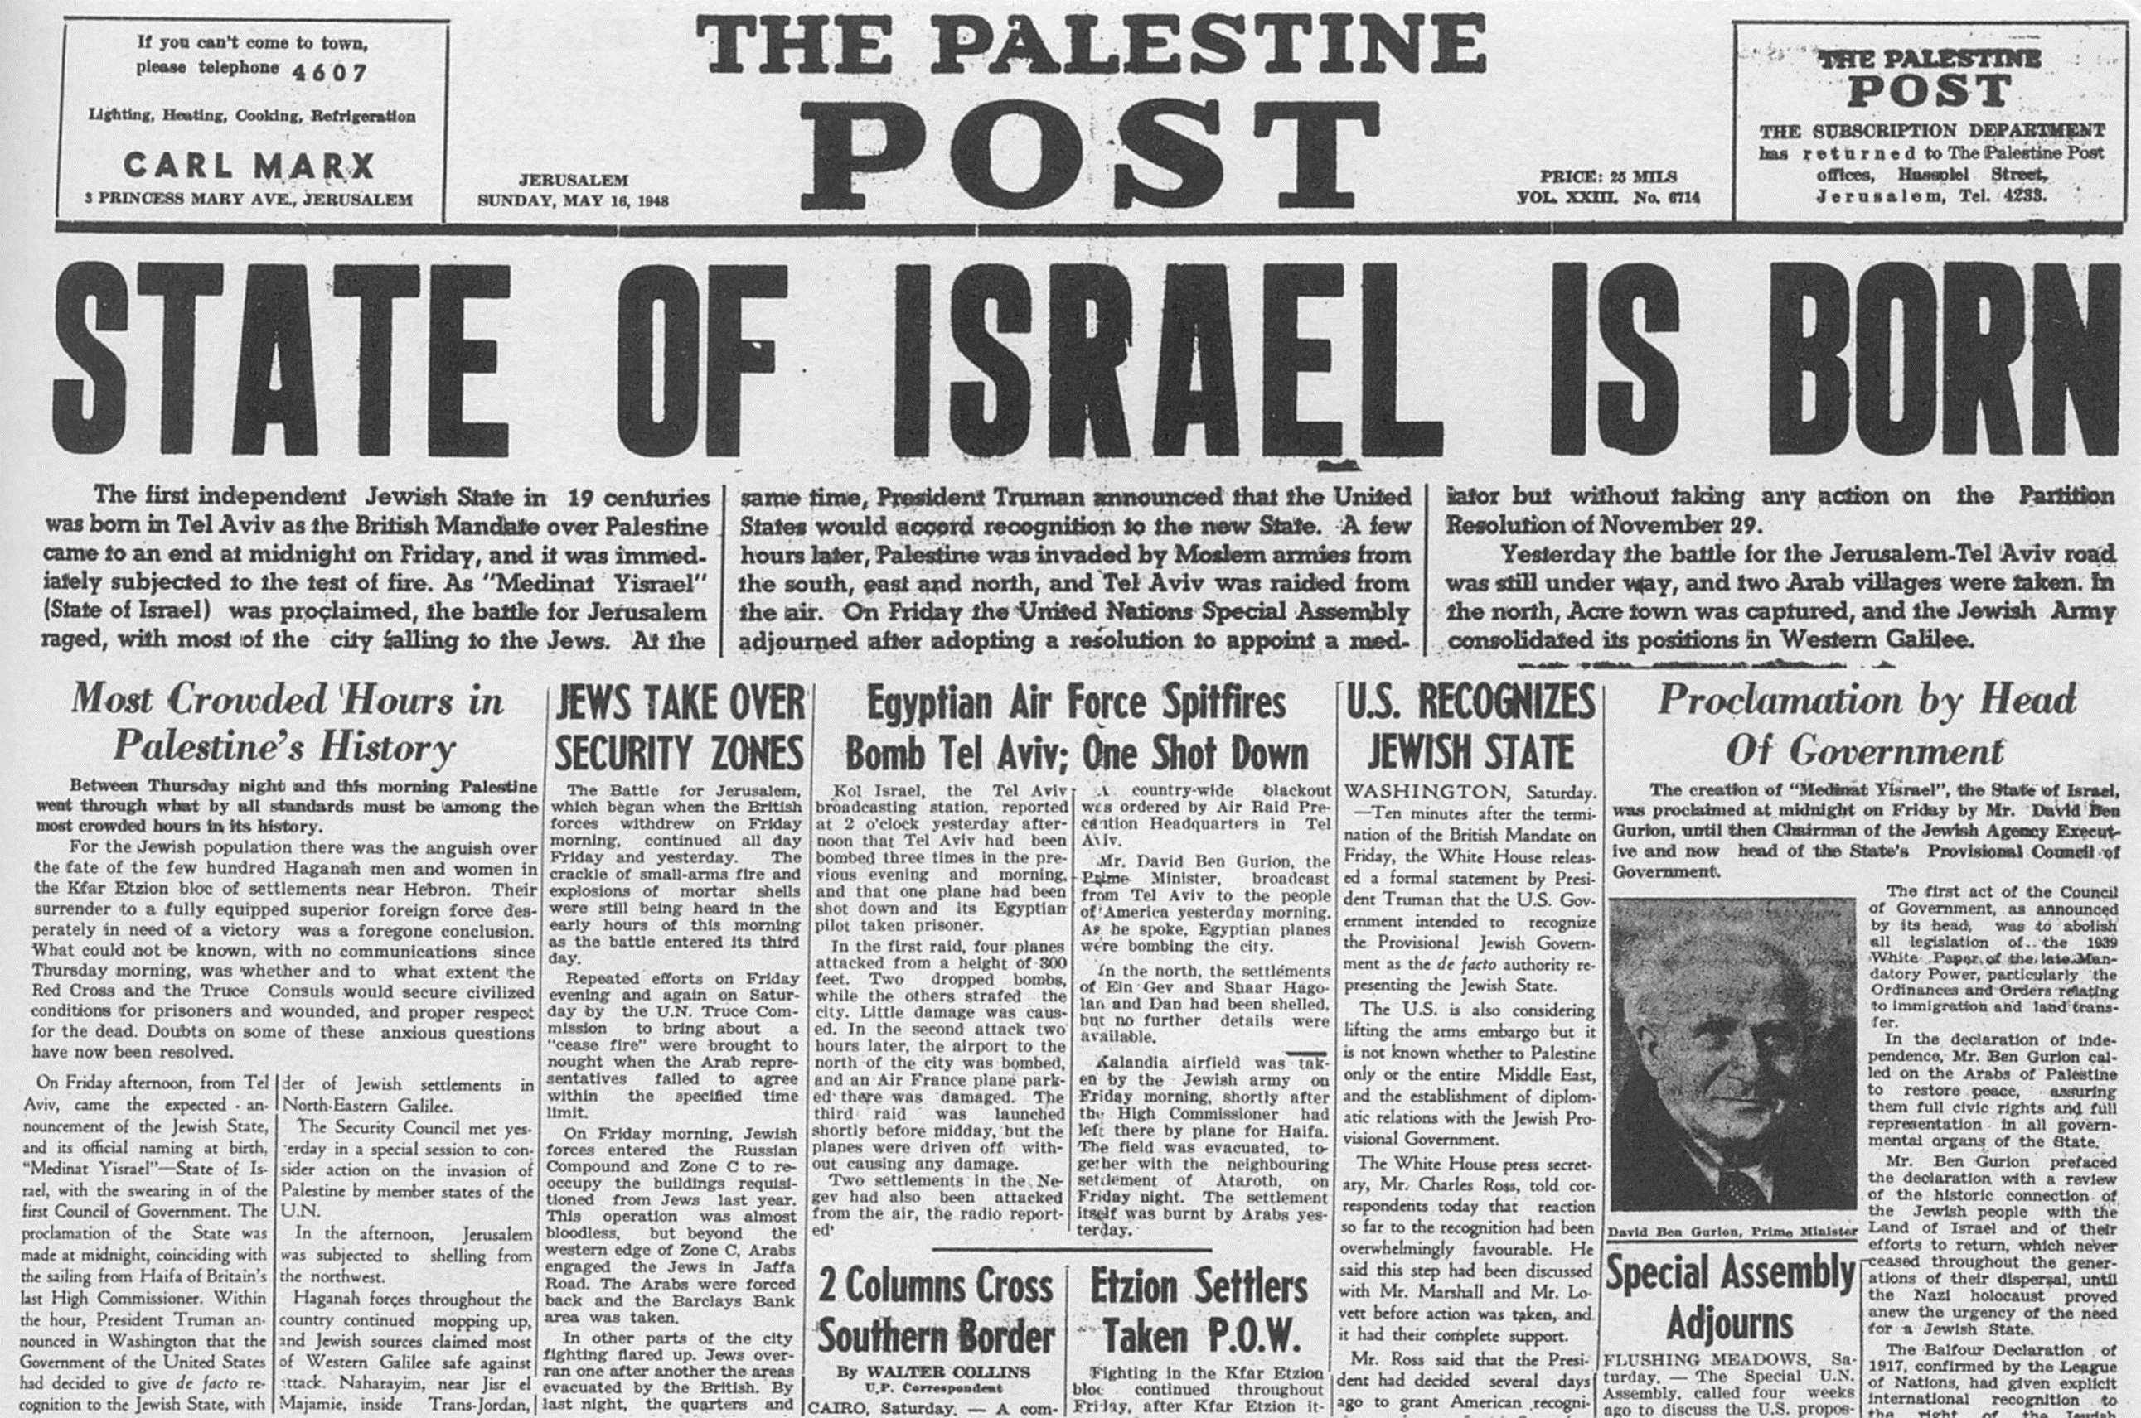
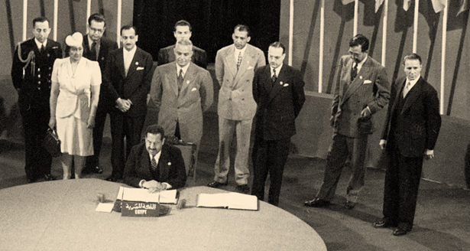
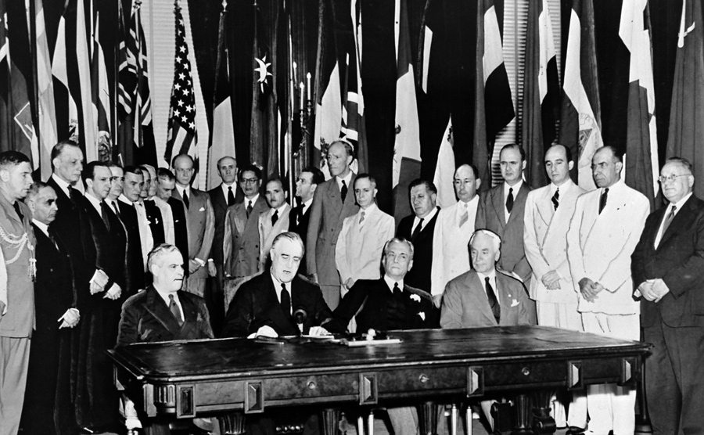
n 1945, representatives of 50 countries met in San Francisco at the United Nations Conference on International Organization to draw up the United Nations Charter

Slide 5
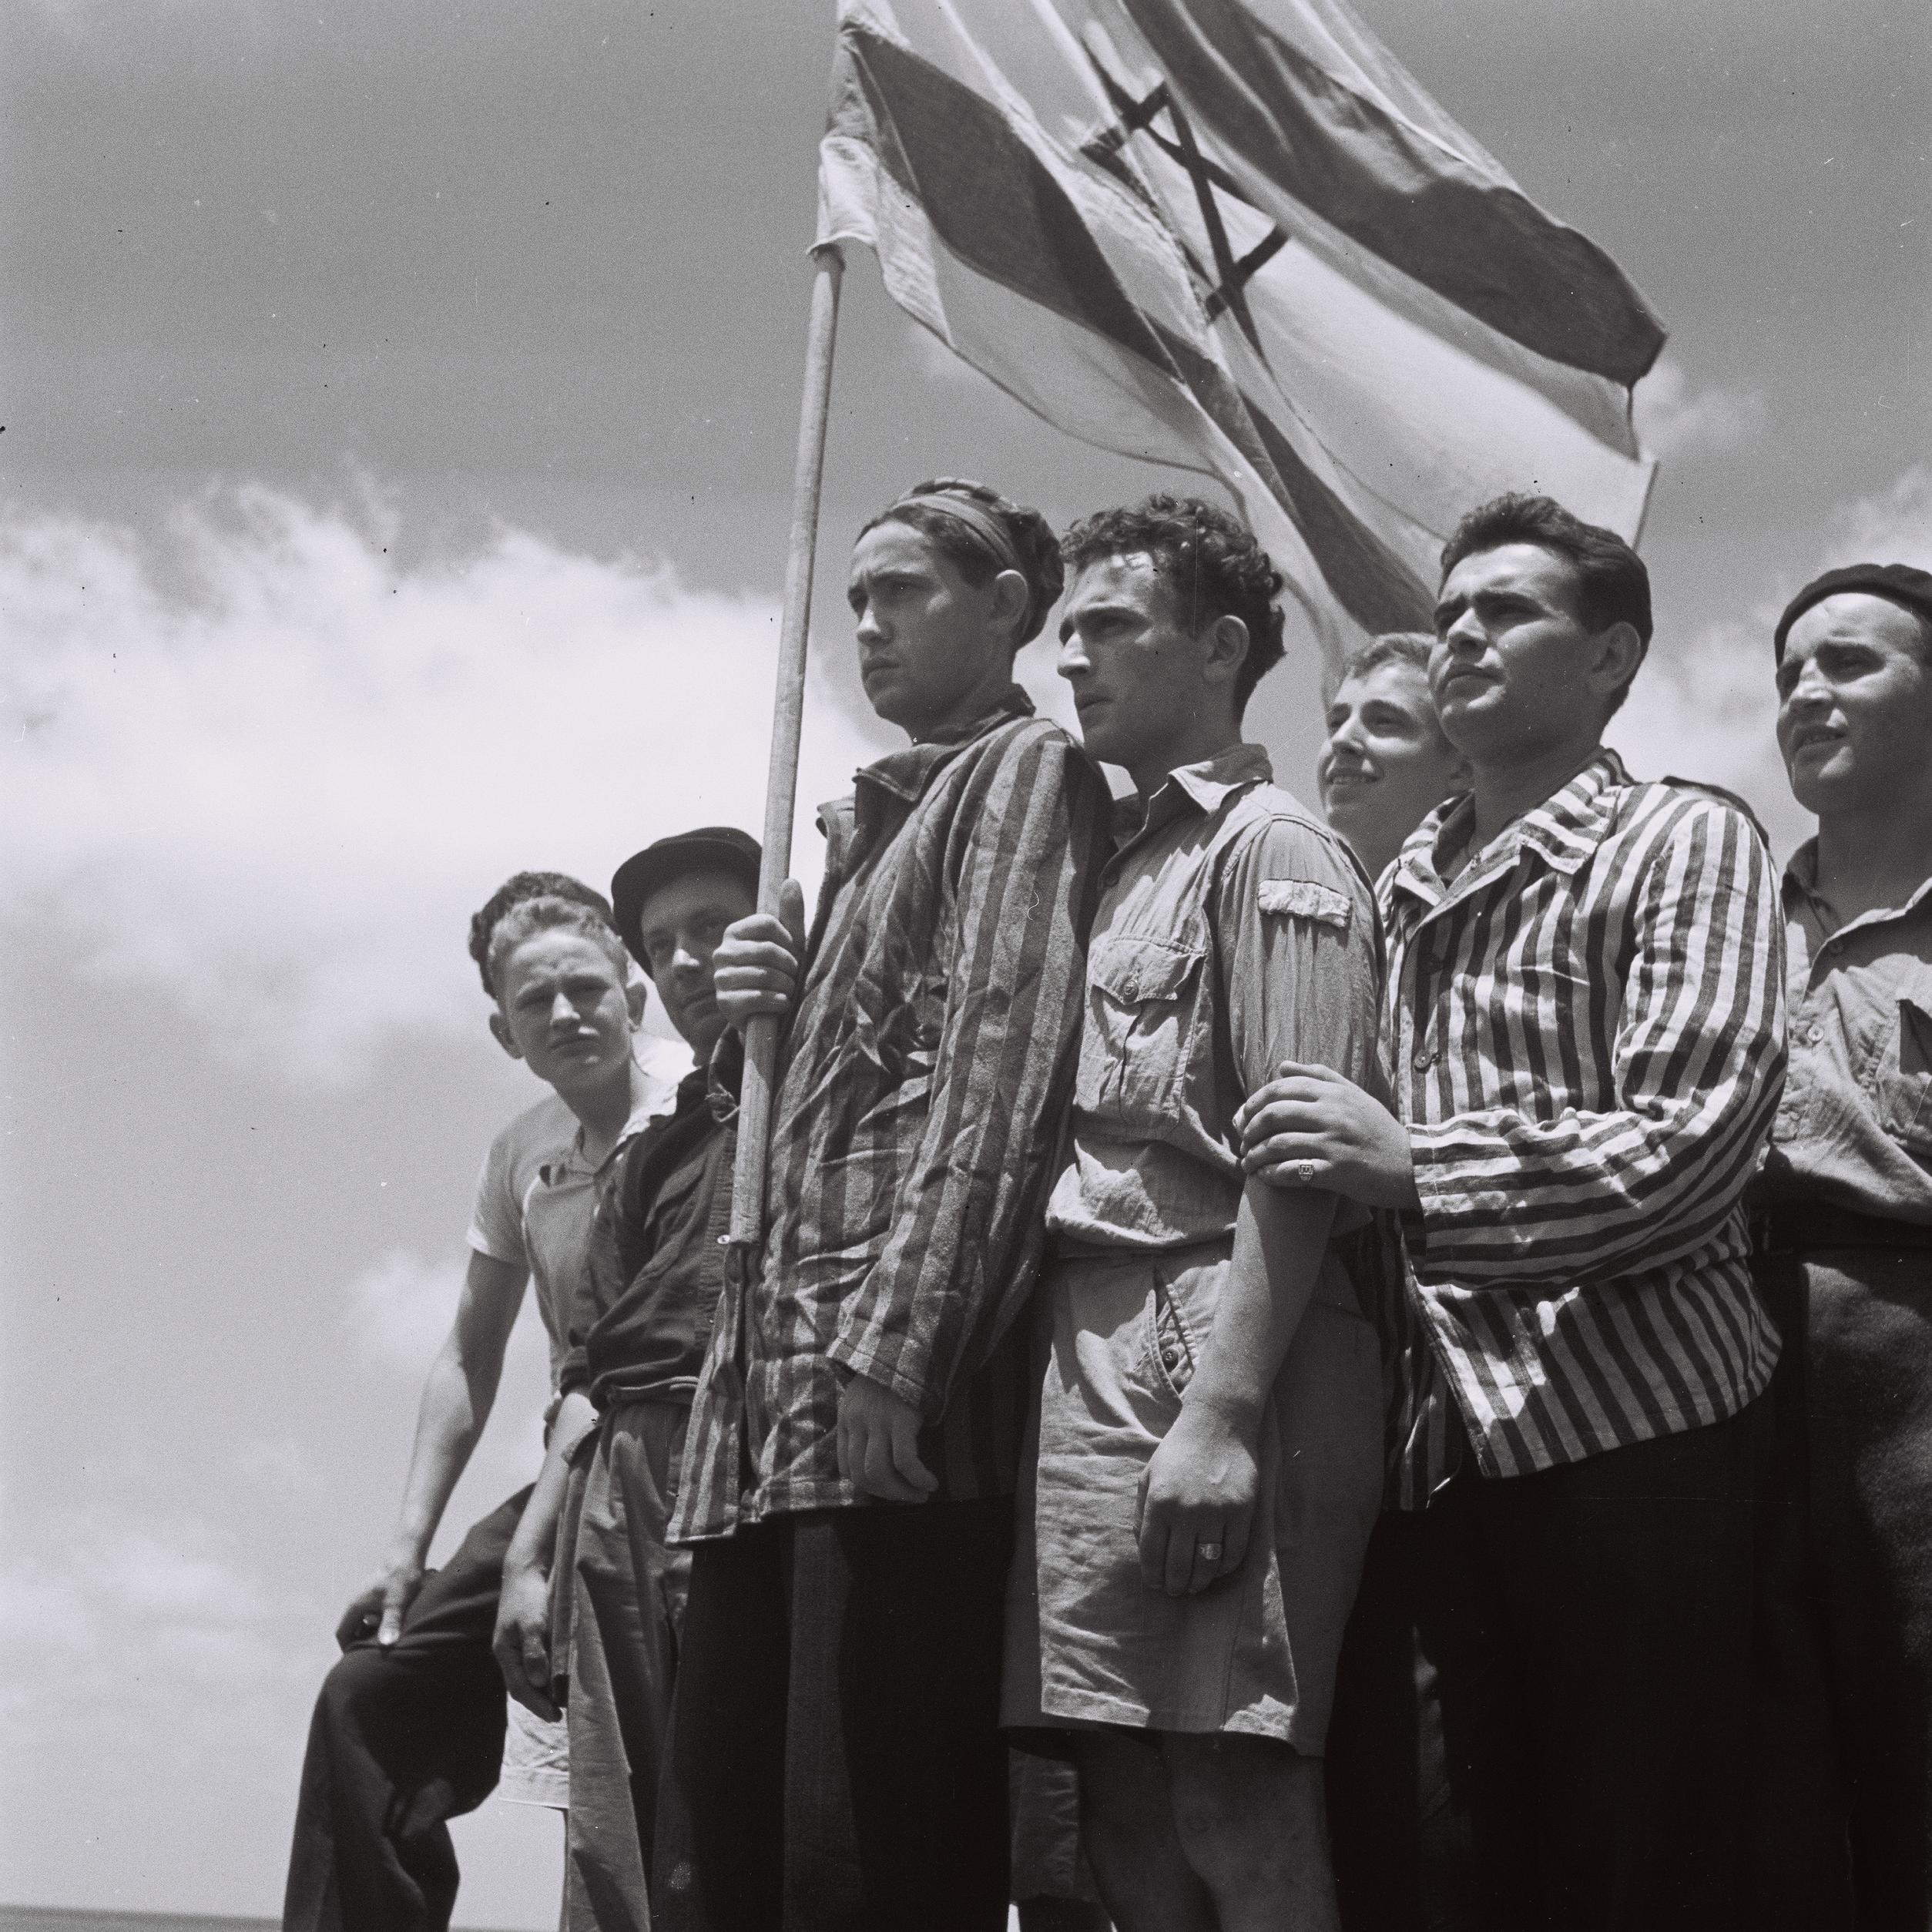
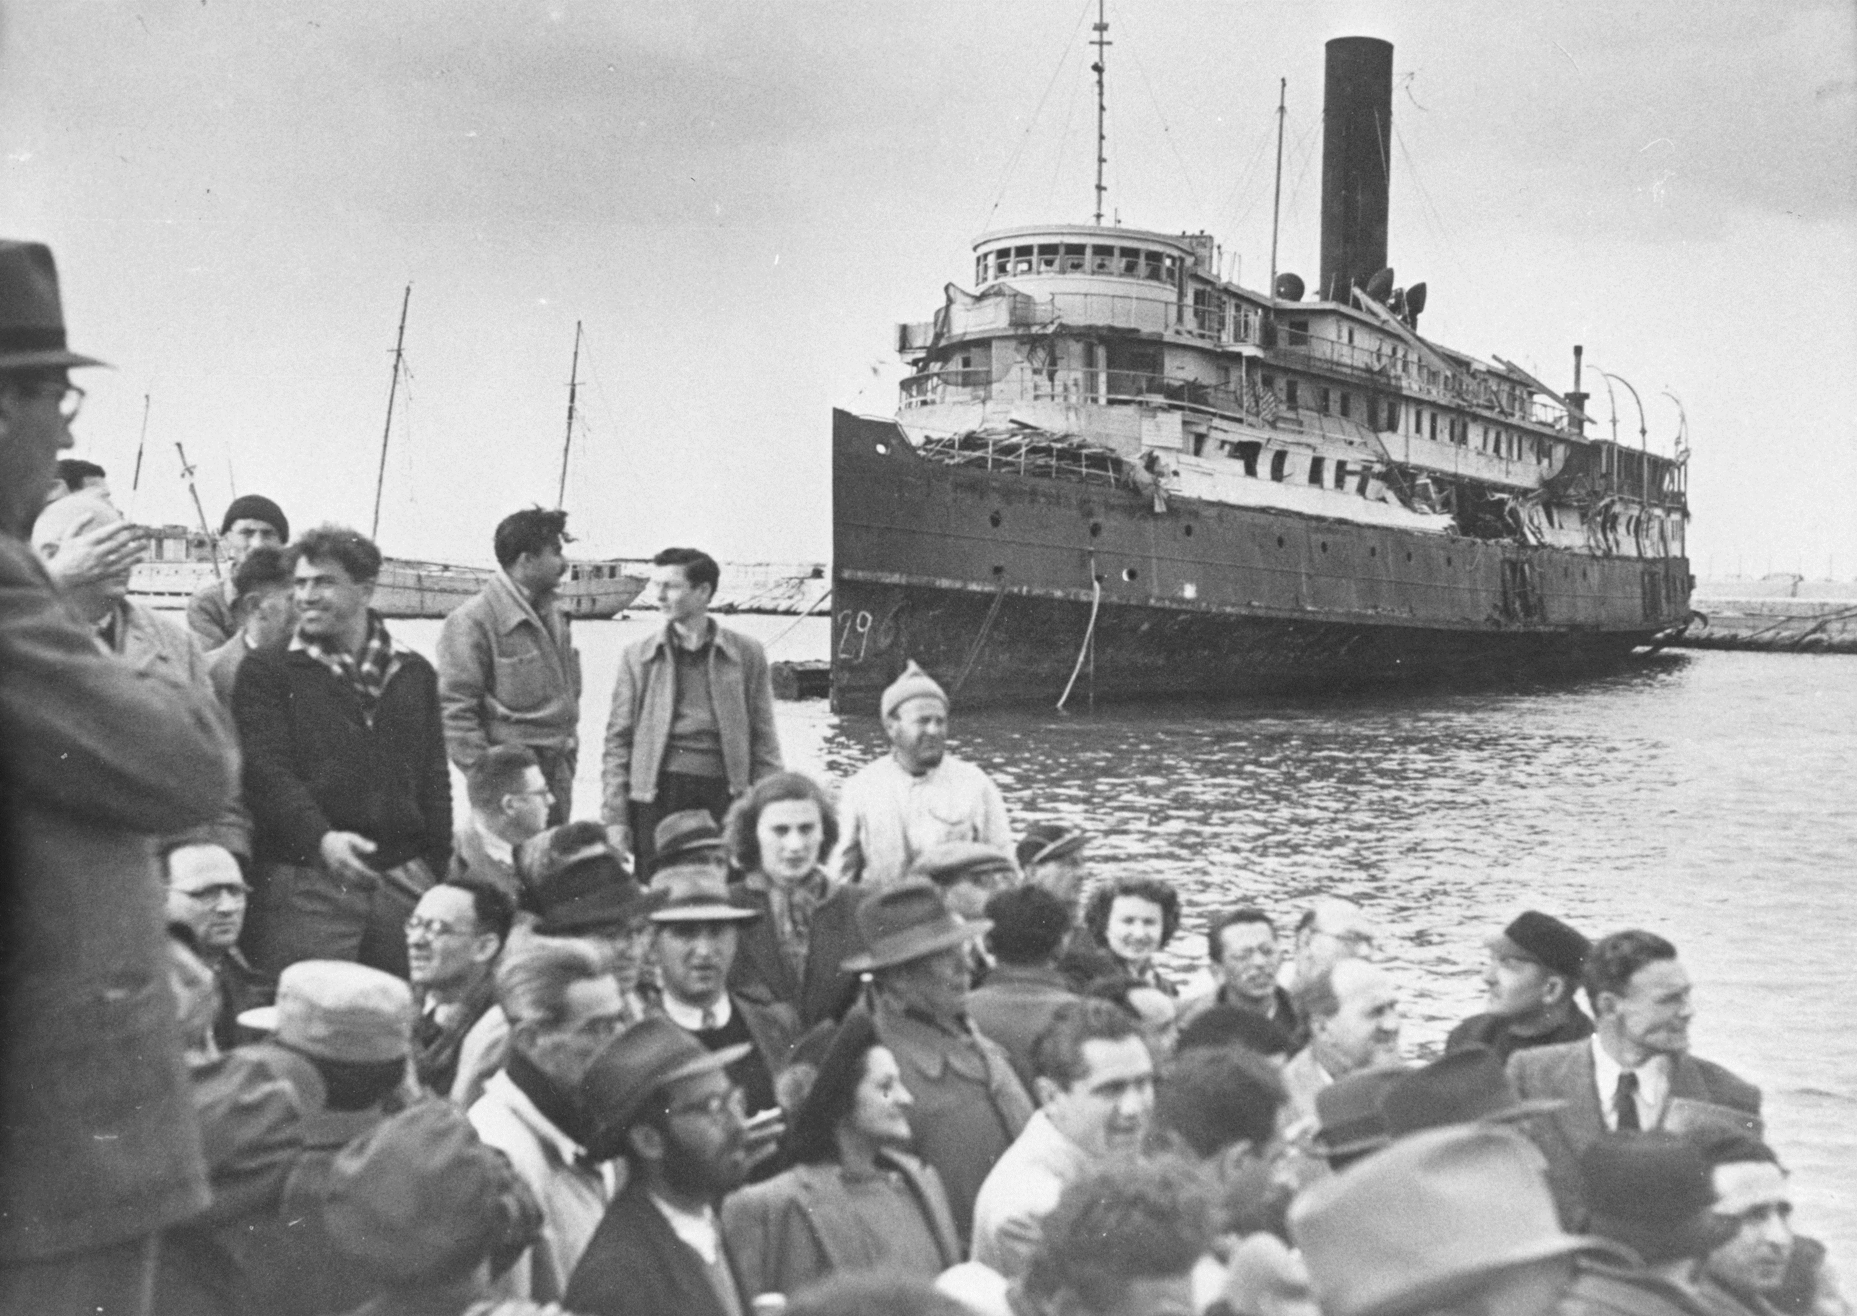
After World War II, and since then, Jews have flocked back to Palestine/Israel in droves, fleeing possible future persecution and antisemitism in the European and western world.

Slide 6
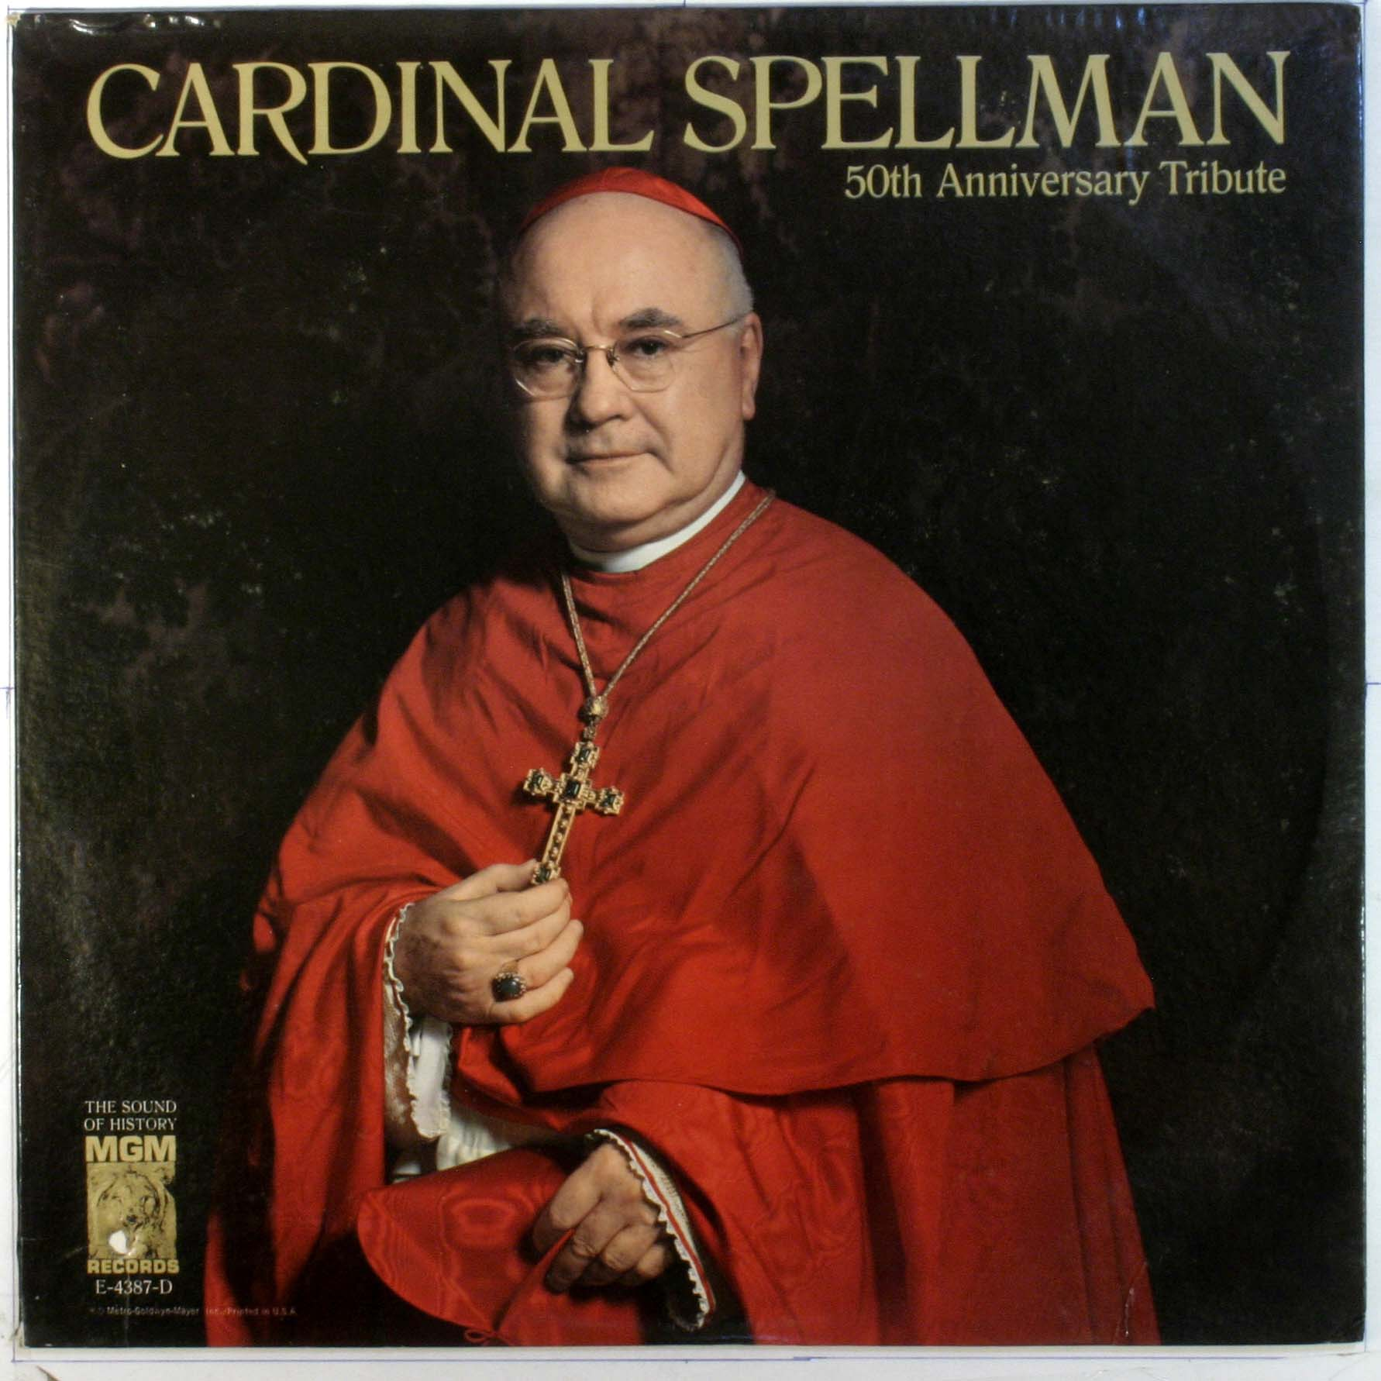
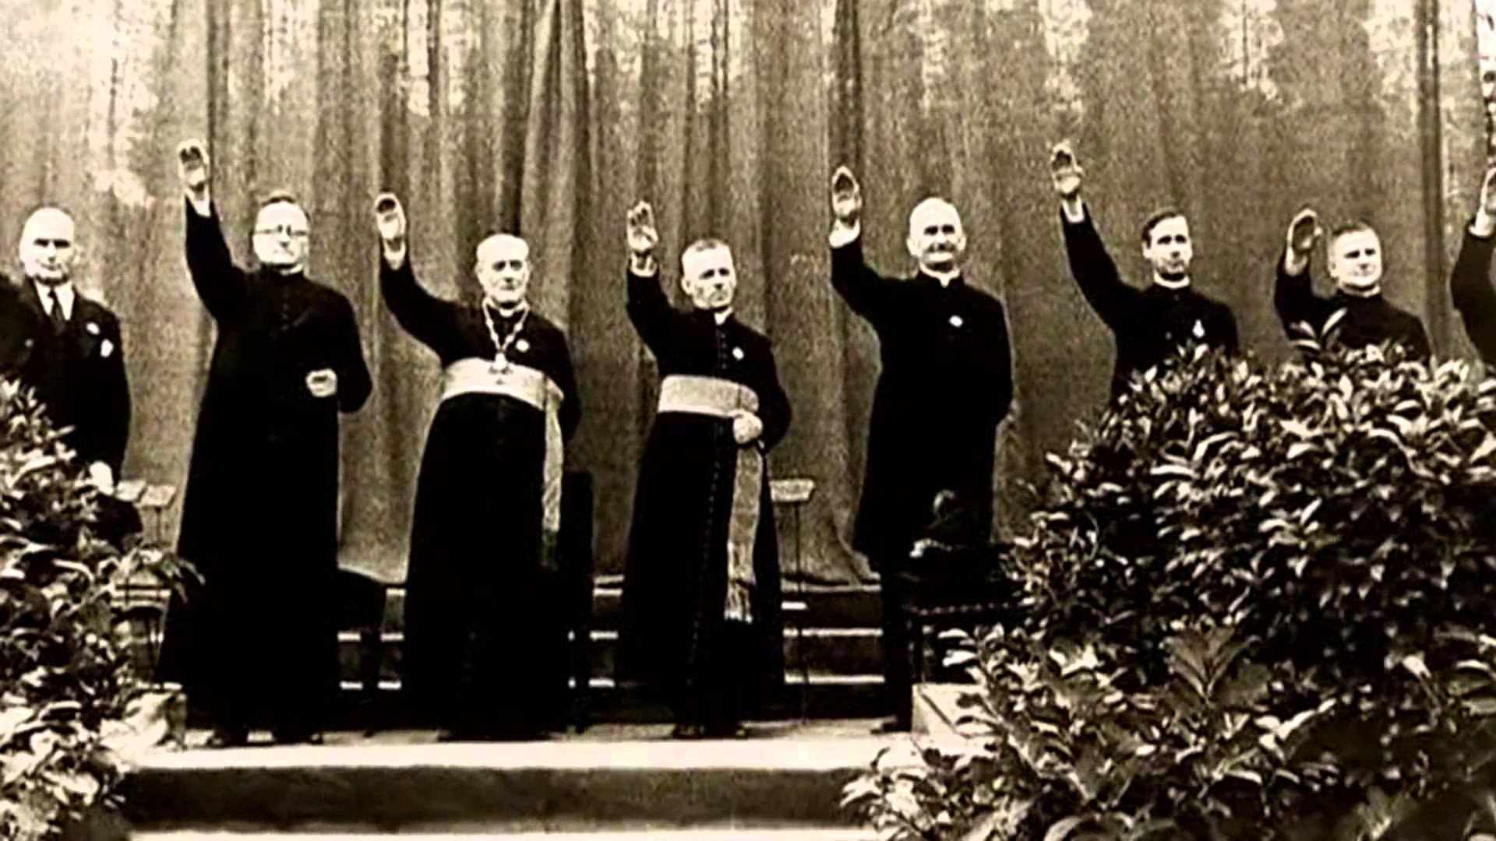
The Catholic Church has everyone duped into believing that the creation of the Israeli nation in 1948 is a part of prophecy.. Instead of a people looking to the Bible prophecies of Daniel and Revelation, marking the movements of the beast power, today most Christian denominations are looking to Middle Eastern land of Israel. Israel is spiritual (God’s people/temple/living stones) not physical. We need to look to our Bibles and Christ. The historical view of the prophetic times of Daniel 7-9 and Revelation 13, 17, and 18 which all unanimously pinpoint the Roman Catholic power as the Antichrist and Sunday worship as his mark.

Slide 7
“It’s important for some to recognize the religious nature of the Communist-Zionist-Catholic configuration. Although deliberately silenced in public pronouncements, behind the Zionist banner there was to be found the ancient messianic hope of the coming global theocracy. It was to be a theocracy in which Jehovah was to be king. The specter of the creation of such a theocracy has haunted the inner chambers of Catholic Church from her earliest inception and still is a dominant fear.”—The Vatican Moscow Washington Alliance, Avro Manhattan, p. 169, 170

Slide 8
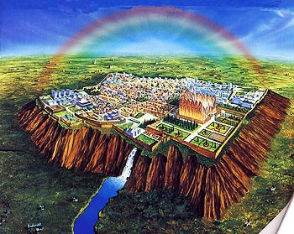
One of the Jewish beliefs is in a temporal reign over all nations for a millennium when the messiah appears, an almost identical belief was already held during the time of Jesus’ ministry; one of the reasons He was rejected…

Slide 9
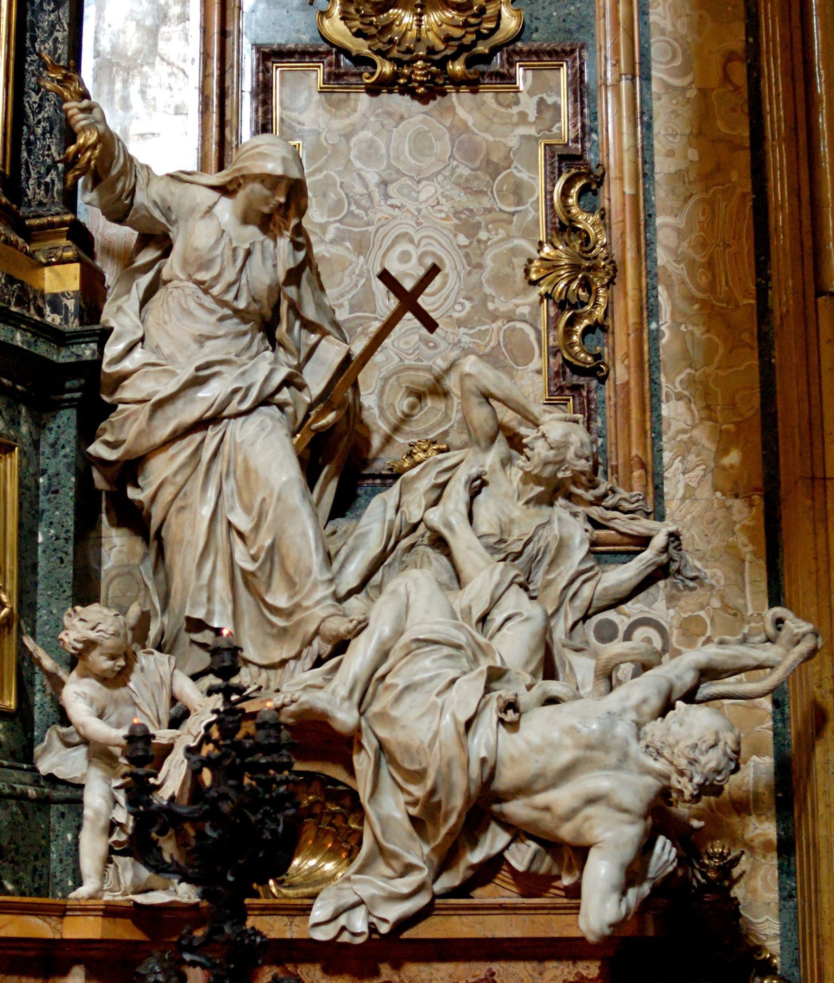
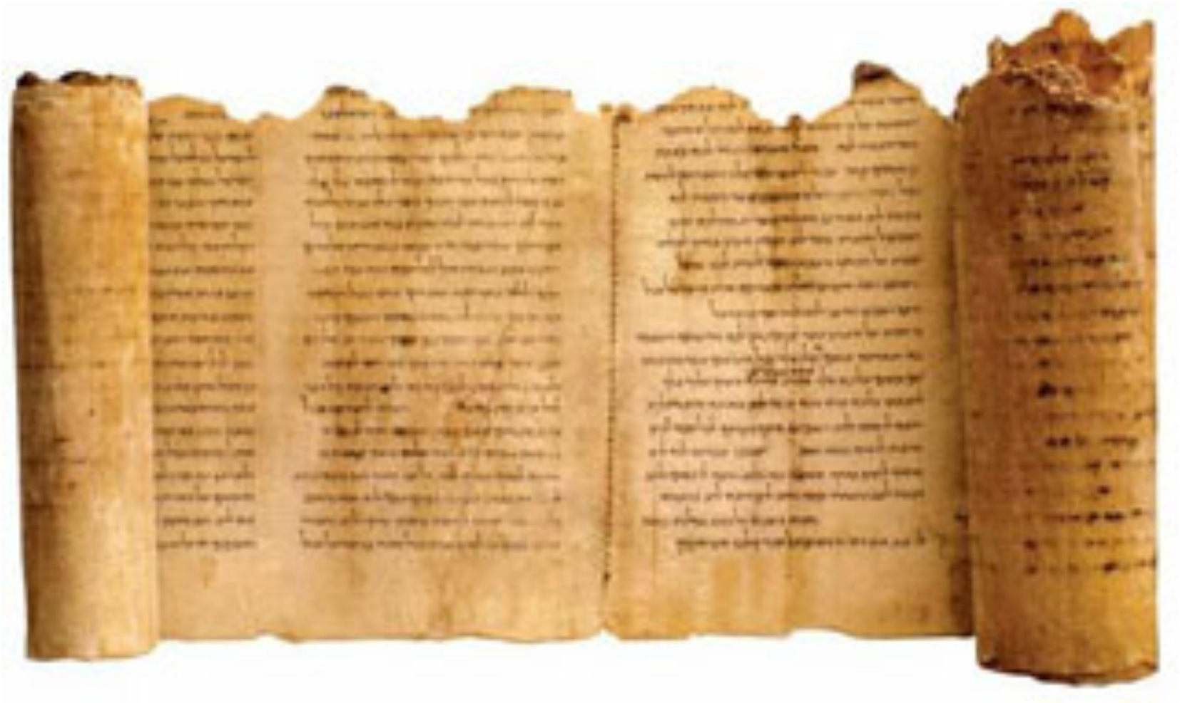
“In Vatican eyes, the millenarian yearning for a global Hebrew theocracy represents a deadly threat to the eschatological teachings of the Catholic church. When translated into political terms, such a view spells not only rivalry, but implacable enmity”—ibid., 170

Slide 12
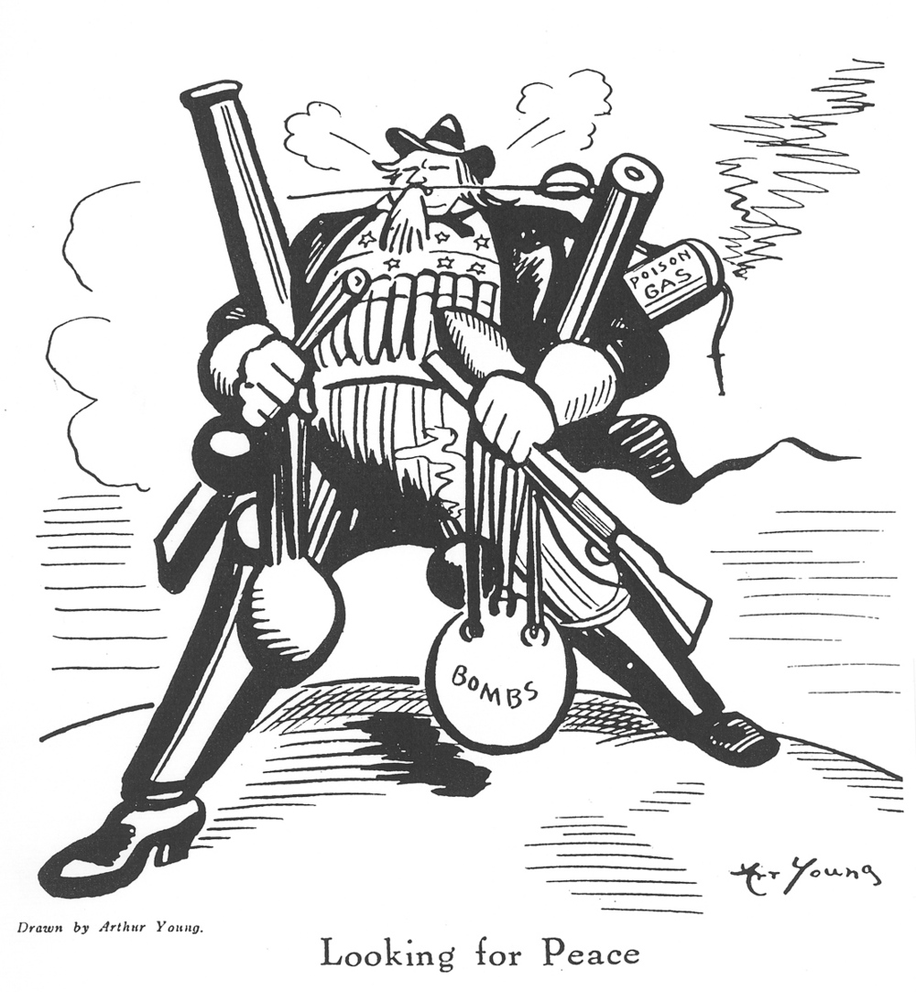
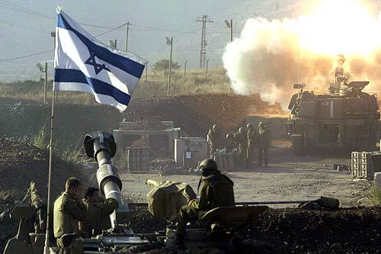
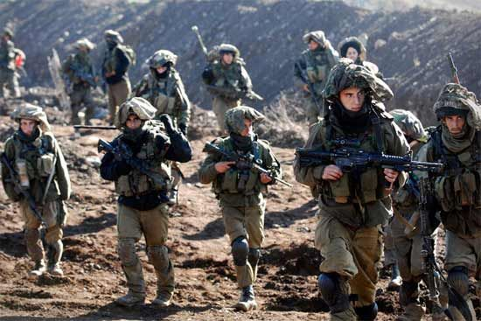

Slide 13
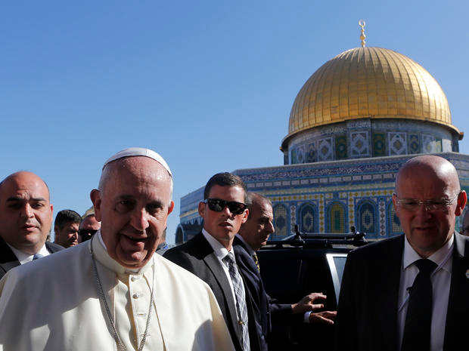
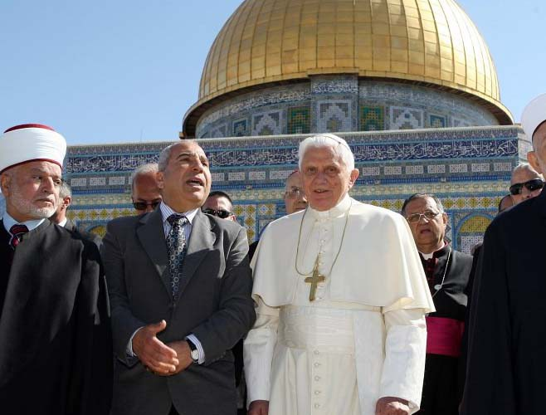
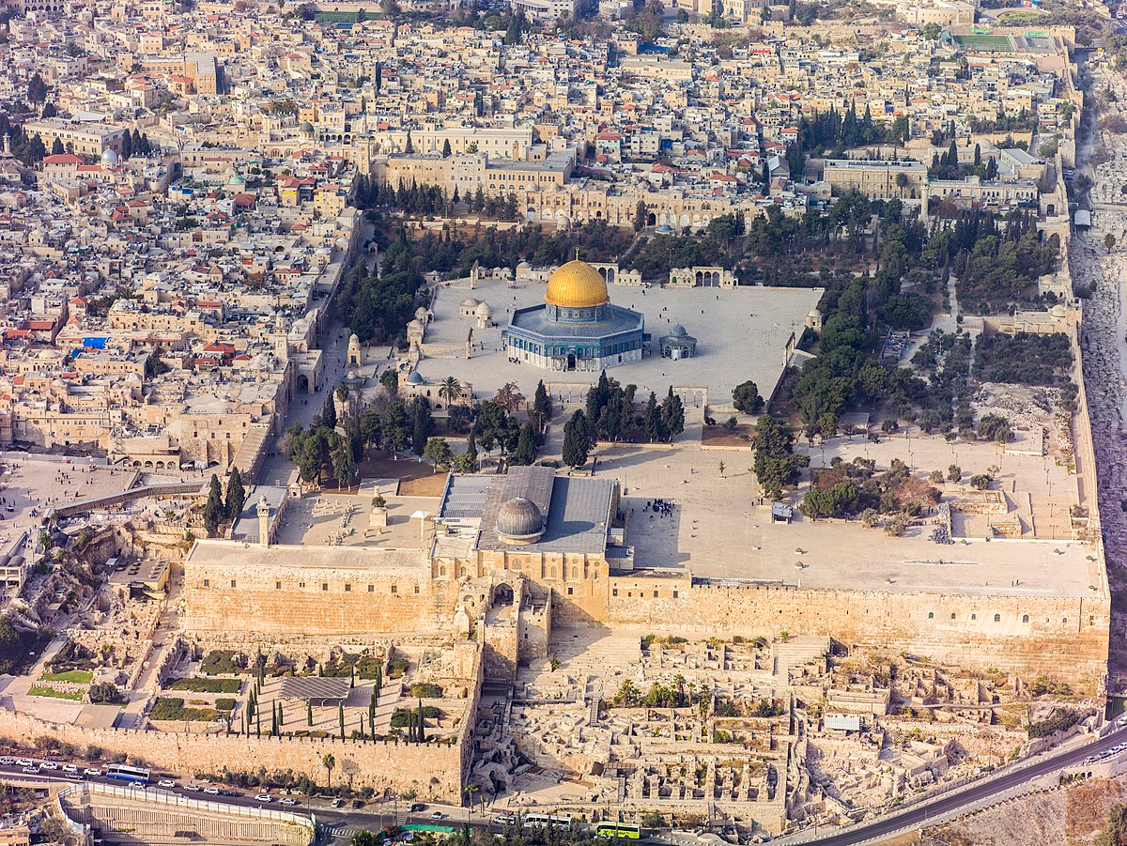
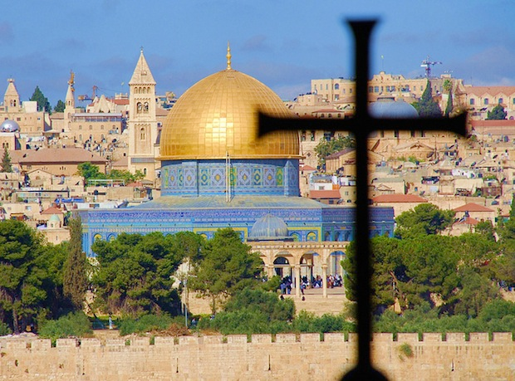

Slide 14
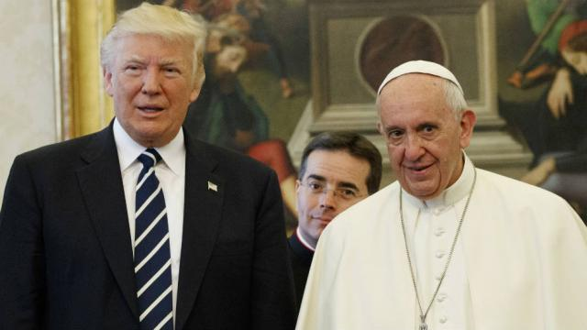
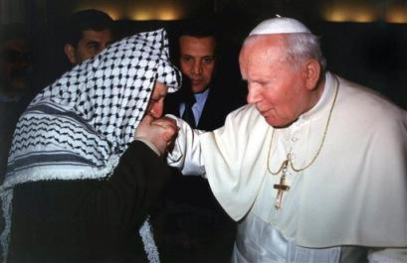
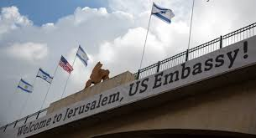
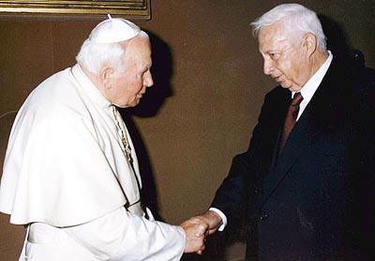
Yasser Arafat kissing Pope John Paul II’s rings
Ariel Sharon with Pope John Paul II

Slide 15
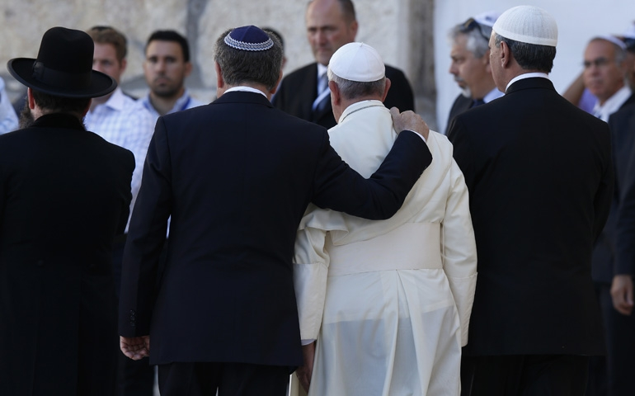

Slide 16
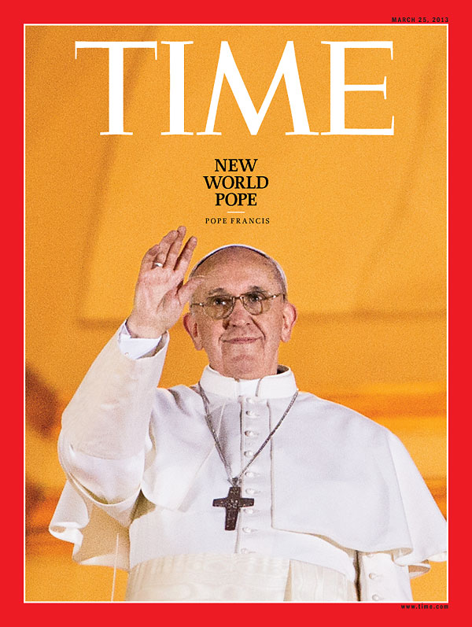
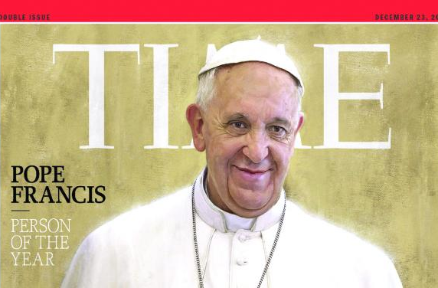

Slide 17
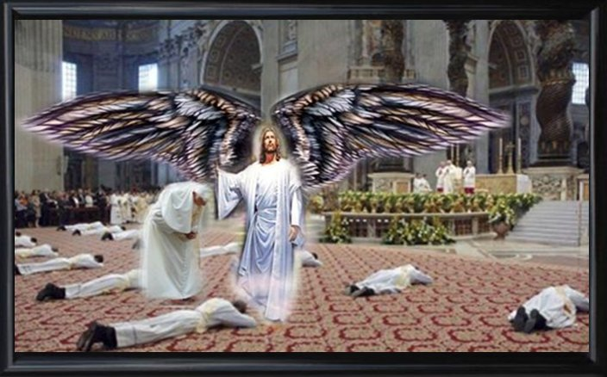
Before Jesus returns, Lucifer will impersonate Christ and counterfeit the Second Coming. The Bible is our only safeguard against this. The real Christ will align perfectly with Scripture:
He will come in the clouds (Rev. 1:7; Mark 13:26)
He will come with ALL the host of heaven, thousands and thousands times ten thousand (Jude 1:14)
It will not be a secret thing, EVERY eye will see Him, and He will descend with the voice of the archangel (Matt. 24: 23-27, 30; 1 Thess. 4:16)
He will never touch the ground, but call His people to Him (1 Thess. 4:17)
He will raise the dead in Christ to Him in the air also (1 Thess. 4:16)

Slide 21
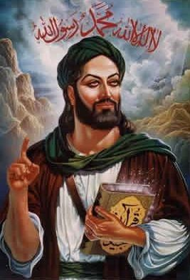
“Somehow the Vatican had to create a weapon to eliminate both the Jews and the true Christian believers who refused to accept Roman Catholicism. Looking to North Africa, they saw the multitudes of Arabs as a source of manpower to tdo their dirty work.”—The Prophet, Jack Chick, p. 18
Muhammad ibn Abdullah (570-632)

Slide 22
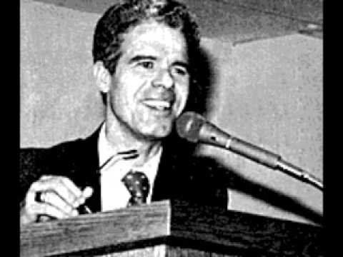
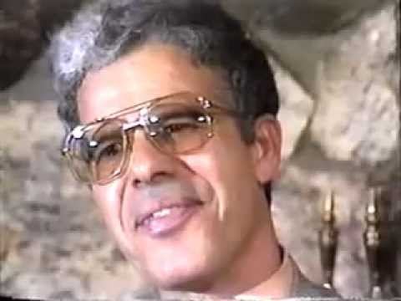
Former Jesuit, Alberto Rivera was a priest in Spain, before leaving Catholicism to embrace Christ. Books about him include: “Is Alberto for Real?-Sidney Hunter, Alberto Rivera series by Jack Chick, and interviewed by Seventh-day Adventist Jim Arabito

