Slide 1
Elijah, pt. 2
“Judgment”

Slide 2
A Voice Would Be Heard
How many thousands of people lived in Israel? How many trained theologians and professed people living for God? Yet, when it came time to fill a need, there was one man! Did you hear that? One man in the midst of thousands would speak for heaven. It was time for that voice to be heard and it would not be silenced! Never forget, if you are walking with the crowd, you aren’t walking with Christ. If it is numbers you seek, then you are seeking outside of God’s will. Be afraid if you find yourself with many; God has never worked with many. Always, it has been the few!!!

Slide 3
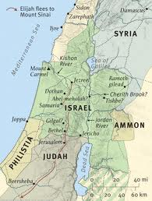
Out of the Way!
East of the Jordan river, in an out of the way place, far from the major thorough fares of the world, God was preparing a man. When God saw that he was ready, the Lord said go and Elijah the Tishbite went to deliver Heaven’s judgments on apostasy!

Slide 4
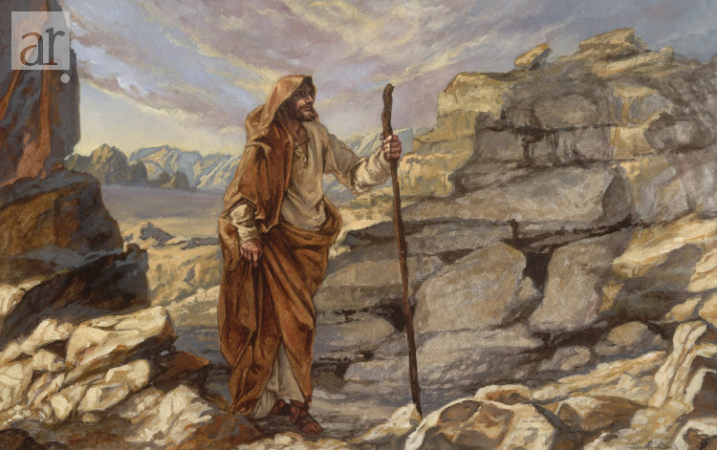
From Beyond Jordan
“To Elijah was entrusted the mission of delivering to Ahab Heaven's message of judgment. He did not seek to be the Lord's messenger; the word of the Lord came to him. And jealous for the honor of God's cause, he did not hesitate to obey the divine summons, though to obey seemed to invite swift destruction at the hand of the wicked king. The prophet set out at once and traveled night and day until he reached Samaria. At the palace he solicited no admission, nor waited to be formally announced. Clad in the coarse garments usually worn by the prophets of that time, he passed the guards, apparently unnoticed, and stood for a moment before the astonished king.” PK, pgs. 120, 121

Slide 5
Great Faith
It was only by the exercise of strong faith in the unfailing power of God's word that Elijah delivered his message. Had he not possessed implicit confidence in the One whom he served, he would never have appeared before Ahab. On his way to Samaria, Elijah had passed by ever-flowing streams, hills covered with verdure, and stately forests that seemed beyond the reach of drought. Everything on which the eye rested was clothed with beauty. The prophet might have wondered how the streams that had never ceased their flow could become dry, or how those hills and valleys could be burned with drought. But he gave no place to unbelief. He fully believed that God would humble apostate Israel, and that through judgments they would be brought to repentance. The fiat of Heaven had gone forth; God's word could not fail; and at the peril of his life Elijah fearlessly fulfilled his commission. Like a thunderbolt from a clear sky, the message of impending judgment fell upon the ears of the wicked king; but before Ahab could recover from his astonishment, or frame a reply, Elijah disappeared as abruptly as he had come, without waiting to witness the effect of his message. It was only by the exercise of strong faith in the unfailing power of God's word that Elijah delivered his message. Had he not possessed implicit confidence in the One whom he served, he would never have appeared before Ahab. On his way to Samaria, Elijah had passed by ever-flowing streams, hills covered with verdure, and stately forests that seemed beyond the reach of drought. Everything on which the eye rested was clothed with beauty. The prophet might have wondered how the streams that had never ceased their flow could become dry, or how those hills and valleys could be burned with drought.” PK ,pgs. 121, 122

Slide 6
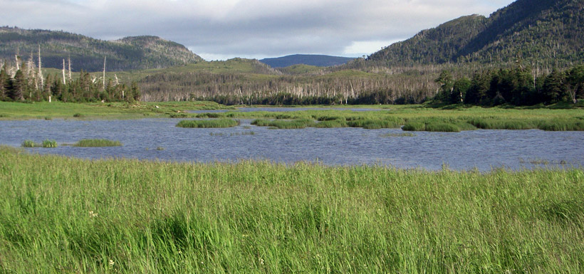
Undaunted by the Human
“He looked upon the King in His beauty, and self was forgotten. He beheld the majesty of holiness, and felt himself to be inefficient and unworthy. He was ready to go forth as Heaven's messenger, un awed by the human, because he had looked upon the Divine. He could stand erect and fearless in the presence of earthly monarchs, because he had bowed low before the King of kings.” DA, pg. 103

Slide 7
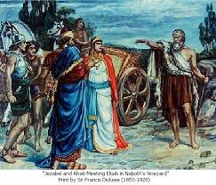
Just Like Us!
“Elias was a man subject to like passions as we are, and he prayed earnestly that it might not rain: and it rained not on the earth by the space of three years and six months.” James 5:17

Slide 8
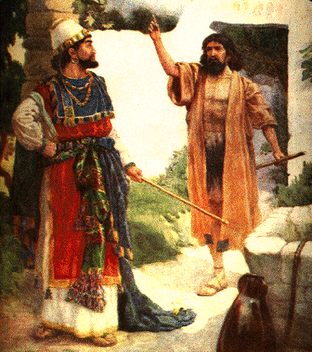
No Rain
“And Elijah the Tishbite, who was of the inhabitants of Gilead, said unto Ahab, As the LORD God of Israel liveth, before whom I stand, there shall not be dew nor rain these years, but according to my word.” 1 Kings 17:1

Slide 9
Judgment!
“At the palace he solicited no admission, nor waited to be formally announced. Clad in the coarse garments usually worn by the prophets of that time, he passed the guards, apparently unnoticed, and stood for a moment before the astonished king. Elijah made no apology for his abrupt appearance. A Greater than the ruler of Israel had commissioned him to speak; and, lifting his hand toward heaven, he solemnly affirmed by the living God that the judgments of the Most High were about to fall upon Israel. "As the Lord God of Israel liveth, before whom I stand," he declared, "there shall not be dew nor rain these years, but according to my word."
It was only by the exercise of strong faith in the unfailing power of God's word that Elijah delivered his message. Had he not possessed implicit confidence in the One whom he served, he would never have appeared before Ahab.” PK, pg. 121

Slide 10
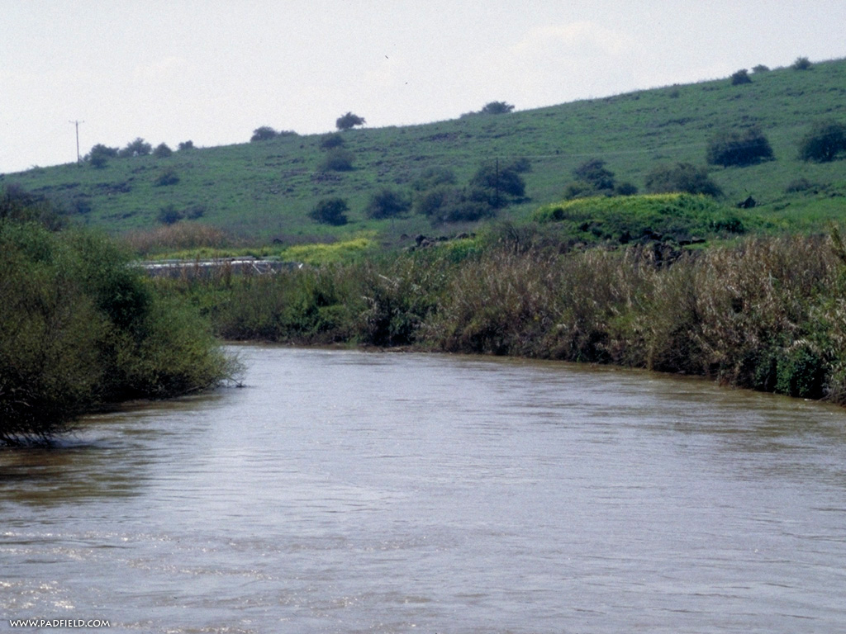
A Place of Refuge!
Do My work and I will show you where to go and hide. Take care of My business first and then I will show you where you are to be and I will take care of you there. “Get thee hence, and turn thee eastward, and hide thyself by the brook Cherith, that is before Jordan. And it shall be, that thou shalt drink of the brook; and I have commanded the ravens to feed thee there.” 1 Kings 17:3,4

Slide 11
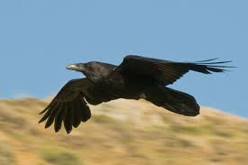
Not Dependent on Man!
With Israel in apostasy and Elijah needing sustenance, the Lord saw fit that His servant lacked for nothing. If man would fail at their post, the Lord was more than able to provide for his needs.
“But my God shall supply all your need according to his riches in glory by Christ Jesus.” Phil. 4:19

Slide 12
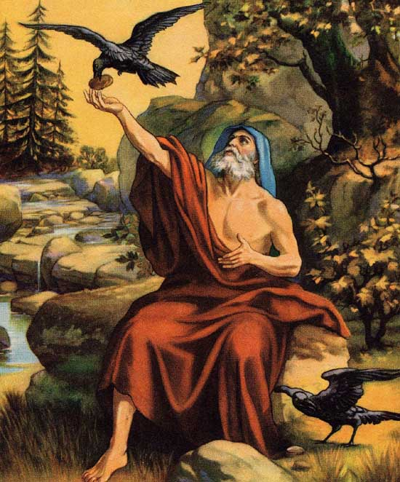
Sustained!
“For a time Elijah remained hidden in the mountains by the brook Cherith. There for many months he was miraculously provided with food. Later on, when, because of the continued drought, the brook became dry, God bade His servant find refuge in a heathen land.”
PK, pg. 129

Slide 13
It will happen again!
“Often the follower of Christ is brought where he cannot serve God and carry forward his worldly enterprises. Perhaps it appears that obedience to some plain requirement of God will cut off his means of support. Satan would make him believe that he must sacrifice his conscientious convictions. But the only thing in our world upon which we can rely is the word of God. "Seek ye first the kingdom of God, and His righteousness; and all these things shall be added unto you." Matt. 6:33. Even in this life it is not for our good to depart from the will of our Father in heaven. When we learn the power of His word, we shall not follow the suggestions of Satan in order to obtain food or to save our lives. Our only questions will be, What is God's command? and what His promise? Knowing these, we shall obey the one, and trust the other.
In the last great conflict of the controversy with Satan those who are loyal to God will see every earthly support cut off. Because they refuse to break His law in obedience to earthly powers, they will be forbidden to buy or sell. It will finally be decreed that they shall be put to death. See Rev. 13:11-17. But to the obedient is given the promise, "He shall dwell on high: his place of defense shall be the munitions of rocks: bread shall be given him; his waters shall be sure." Isa. 33:16. By this promise the children of God will live. When the earth shall be wasted with famine, they shall be fed.” DA, pgs. 121, 122

Slide 14
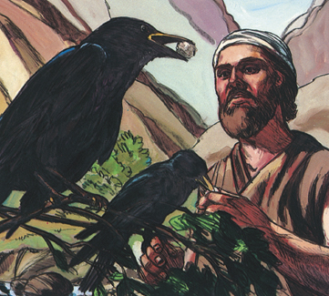
The Lord’s Word is Sure
“ Although the fig tree shall not blossom, neither shall fruit be in the vines; the labour of the olive shall fail, and the fields shall yield no meat; the flock shall be cut off from the fold, and there shall be no herd in the stalls: Yet I will rejoice in the LORD, I will joy in the God of my salvation.” Habb. 3:17, 18

Slide 15
Hunted!
“The king made diligent inquiry, but the prophet was not to be found. Queen Jezebel, angered over the message that had locked up the treasures of heaven, lost no time in conferring with the priests of Baal, who united with her in cursing the prophet and in defying the wrath of Jehovah. But notwithstanding their desire to find him who had uttered the word of woe, they were destined to meet with disappointment. Nor could they conceal from others a knowledge of the judgment pronounced in consequence of the prevailing apostasy. Tidings of Elijah's denunciation of the sins of Israel, and of his prophecy of swift-coming punishment, quickly spread throughout the land. The fears of some were aroused, but in general the heavenly message was received with scorn and ridicule.” PK, pg. 123

Slide 16
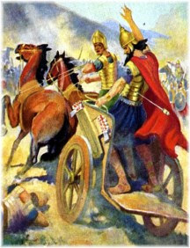
Could Not Be Found!
Elijah had a mission to perform and as long as the Lord saw fit, no amount of searching would bear fruit. Elijah was immortal until his work was done! Ahab looked and looked for his nemesis, but Elijah was nowhere to be found. He was blamed for Israel’s troubles. Apostate Israel would not listen!

Slide 17
Deception and Apostasy
“The prophet's words went into immediate effect. Those who were at first inclined to scoff at the thought of calamity, soon had occasion for serious reflection; for after a few months the earth, unrefreshed by dew or rain, became dry, and vegetation withered. As time passed, streams that had never been known to fail began to decrease, and brooks began to dry up. Yet the people were urged by their leaders to have confidence in the power of Baal and to set aside as idle words the prophecy of Elijah. The priests still insisted that it was through the power of Baal that the showers of rain fell. Fear not the God of Elijah, nor tremble at His word, they urged, it is Baal that brings forth the harvest in its season and provides for man and beast. God's message to Ahab gave Jezebel and her priests and all the followers of Baal and Ashtoreth opportunity to test the power of their gods, and, if possible, to prove the word of Elijah false. Against the assurances of hundreds of idolatrous priests, the prophecy of Elijah stood alone. If, notwithstanding the prophet's declaration, Baal could still give dew and rain, causing the streams to continue to flow and vegetation to flourish, then let the king of Israel worship him and the people say that he is God.” PK, pgs. 123, 124

Slide 18
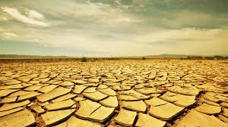
Bad News!
“A year passes, and yet there is no rain. The earth is parched as if with fire. The scorching heat of the sun destroys what little vegetation has survived. Streams dry up, and lowing herds and bleating flocks wander hither and thither in distress. Once-flourishing fields have become like burning desert sands, a desolate waste. The groves dedicated to idol worship are leafless; the forest trees, gaunt skeletons of nature, afford no shade. The air is dry and suffocating;” PK, pgs. 124, 125

Slide 19
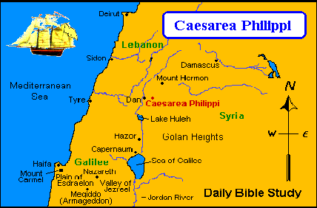
Fugitive-Heaven’s Child!
What a scene! Famine stalks the land! Ahab and Jezebel hunt for Elijah! The Lord miraculously takes care of His child! The brook Cherith begins to dry up. Elijah has nowhere else to go, but the Lord knows of just the right person in just the right place until the famine ends. “Arise, get thee to Zarephath…”

