Slide 1
Elijah, pt.3
‘Miracles’

Slide 2
Review
Apostasy was the order of the day in Israel. The leadership of God’s professed people was totally consumed by Jezebelic Catholicism! Baal and Ashtoreth were worshipped, children were sacrificed, immorality was the center of their religion, and the God of heaven was out of sight. Many voices were raised in protest none were heard. In the midst of this insanity, a man from Gilead, east of the Jordan was called to rebuke apostasy among God’s people! His name was Elijah.

Slide 3
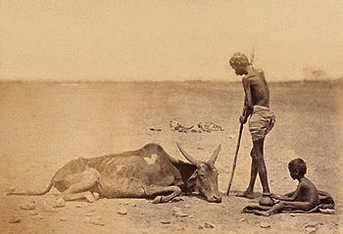
Judgment
Elijah travelled to Samaria and gave the clarion call of judgment. No rain will fall accept at Elijah’s word. Parched earth, no water, and famine will ensue. Death and disease will be reality!

Slide 4
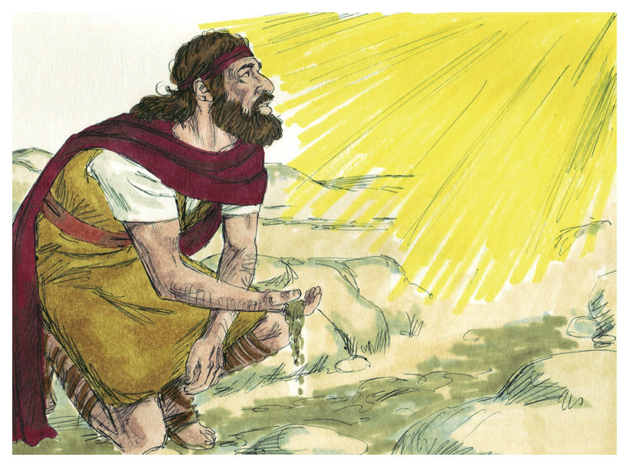
Time for Elijah to Go!
The Book Cherith dried up also. It was time for Elijah to move on. The word of the Lord came to him, “Arise, get thee to Zarephath, which belongeth to Zidon, and dwell there: behold, I have commanded a widow woman there to sustain thee.” 1 Kings 17:9

Slide 5
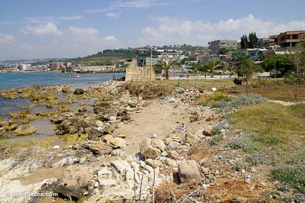
Not a Widow in Israel
“But I tell you of a truth, many widows were in Israel in the days of Elias, when the heaven was shut up three years and six months, when great famine was throughout all the land; But unto none of them was Elias sent, save unto Sarepta, a city of Sidon, unto a woman that was a widow.” Luke 4:25, 26

Slide 6
Woman of Faith
“This woman was not an Israelite. She had never had the privileges and blessings that the chosen people of God had enjoyed; but she was a believer in the true God and had walked in all the light that was shining on her pathway. And now, when there was no safety for Elijah in the land of Israel, God sent him to this woman to find a asylum in her home. So he arose and went to Zarephath. And when he came to the gate of the city, behold, the widow woman was there gathering of sticks: and he called to her, and said, Fetch me, I pray thee, a little water in a vessel, that I may drink. And as she was going to fetch it, he called to her, and said, Bring me, I pray thee, a morsel of bread in thine hand." In this poverty-stricken home the famine pressed sore, and the pitifully meager fare seemed about to fail. The coming of Elijah on the very day when the widow feared that she must give up the struggle to sustain life tested to the utmost her faith in the power of the living God to provide for her necessities. But even in her dire extremity she bore witness to her faith by a compliance with the request of the stranger who was asking her to share her last morsel with him.” PK, pgs. 129, 130

Slide 7
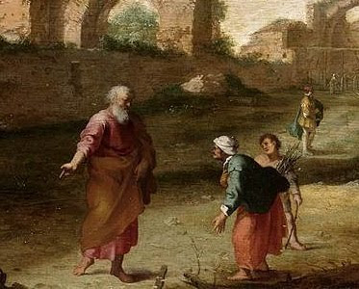
About to Die!
“Let brotherly love continue. Be not forgetful to entertain strangers: for thereby some have entertained angels unawares.” Heb. 13:1,2

Slide 8
What a Faith!
“So he arose and went to Zarephath. And when he came to the gate of the city, behold, the widow woman was there gathering of sticks: and he called to her, and said, Fetch me, I pray thee, a little water in a vessel, that I may drink. And as she was going to fetch it, he called to her, and said, Bring me, I pray thee, a morsel of bread in thine hand. And she said, As the LORD thy God liveth, I have not a cake, but an handful of meal in a barrel, and a little oil in a cruse: and, behold, I am gathering two sticks, that I may go in and dress it for me and my son, that we may eat it, and die. And Elijah said unto her, Fear not; go and do as thou hast said: but make me thereof a little cake first, and bring it unto me, and after make for thee and for thy son.” 1 Kings 17:10-13

Slide 9
“The widow of Zarephath shared her morsel with Elijah, and in return her life and that of her son were preserved. And to all who, in time of trial and want, give sympathy and assistance to others more needy, God has promise great blessing. He has not changed. His power is no less now than in the days of Elijah. No less sure now than when spoken by our Saviour is the promise, "He that receiveth a prophet in the name of a prophet shall receive a prophet's reward." Matthew 10:41. "Be not forgetful to entertain strangers: for thereby some have entertained angels unawares." Hebrews 13:2. These words have lost none of their force through the lapse of time. Our heavenly Father still continues to place in the pathway of His children opportunities that are blessings in disguise; and those who improve these opportunities find great joy. ” PK, pgs. 131,132

Slide 10
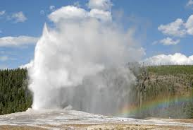
Faithful Widow
The faithful of Scripture were often found among the heathen. The harlot Rahab, Ruth the Moabitess; just a few of those who walked in the faith of Abraham. “When Jesus heard these things, he marvelled at him, and turned him about, and said unto the people that followed him, I say unto you, I have not found so great faith, no, not in Israel.” Luke 7:9

Slide 11
Blessings!!!!
“No greater test of faith than this could have been required. The widow had hitherto treated all strangers with kindness and liberality. Now, regardless of the suffering that might result to herself and child, and trusting in the God of Israel to supply her every need, she met this supreme test of hospitality by doing "according to the saying of Elijah." Wonderful was the hospitality shown to God's prophet by this Phoenician woman, and wonderfully were her faith and generosity rewarded. "She, and he, and her house, did eat many days. And the barrel of meal wasted not, neither did the cruse of oil fail, according to the word of the Lord, which He spake by Elijah.” PK, pgs. Pgs. 130, 131

Slide 12
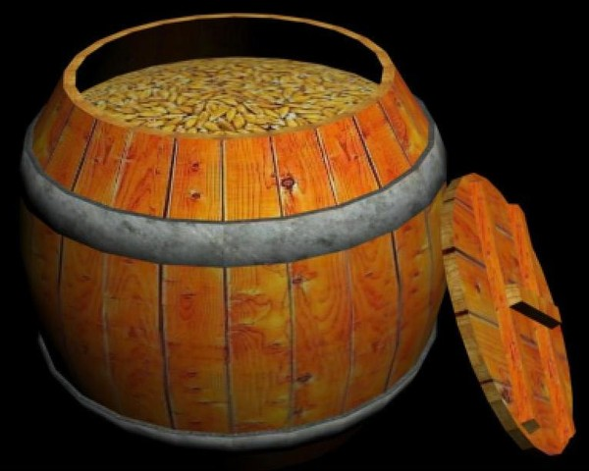
Plenty
“For thus saith the LORD God of Israel, The barrel of meal shall not waste, neither shall the cruse of oil fail, until the day that the LORD sendeth rain upon the earth. And she went and did according to the saying of Elijah: and she, and he, and her house, did eat many days. And the barrel of meal wasted not, neither did the cruse of oil fail, according to the word of the LORD, which he spake by Elijah.” 1 Kings 17:14-16

Slide 13
The Word of the Lord did not fail Elijah or the woman of Zarephath. It did exactly what it said It would do and it did! “For all the promises of God in him are yea, and in him Amen, unto the glory of God by us.” 2 Corinthians 1:20

Slide 14
Word of Power!
“Satan cannot hold the dead in his grasp when the Son of God bids them live. He cannot hold in spiritual death one soul who in faith receives Christ's word of power. God is saying to all who are dead in sin, "Awake thou that sleepest, and arise from the dead." Eph. 5:14. That word is eternal life. As the word of God which bade the first man live, still gives us life; as Christ's word, "Young man, I say unto thee, Arise," gave life to the youth of Nain, so that word, "Arise from the dead," is life to the soul that receives it. God "hath delivered us from the power of darkness, and hath translated us into the kingdom of His dear Son." Col. 1:13. It is all offered us in His word. If we receive the word, we have the deliverance.” DA, pg. 320

Slide 15
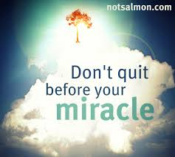
Miracles of God!
The heavens refused to give rain. The barrel of wheat continued to have grain every day. These were awesome miracles of the power of God. These continued on for over 3 years!

Slide 16
“And it came to pass after these things, that the son of the woman, the mistress of the house, fell sick; and his sickness was so sore, that there was no breath left in him. And she said unto Elijah, What have I to do with thee, O thou man of God? art thou come unto me to call my sin to remembrance, and to slay my son? And he said unto her, Give me thy son. And he took him out of her bosom, and carried him up into a loft, where he abode, and laid him upon his own bed. And he cried unto the LORD, and said, O LORD my God, hast thou also brought evil upon the widow with whom I sojourn, by slaying her son? And he stretched himself upon the child three times, and cried unto the LORD, and said, O LORD my God, I pray thee, let this child's soul come into him again. And the LORD heard the voice of Elijah; and the soul of the child came into him again, and he revived.” 1 Kings 17:17-22

Slide 17
Miracle #3
The Resurrection and the Life, Jesus Christ, was in the loft with Elijah, and He brought the child back to life. The widow had exercised faith and the blessings came back to her and her house double!

Slide 18
Elijah’s Eyes on Israel
“Through the long years of drought and famine, Elijah prayed earnestly that the hearts of Israel might be turned from idolatry to allegiance to God. Patiently the prophet waited, while the hand of the Lord rested heavily on the stricken land. As he saw evidences of suffering and want multiplying on every side, his heart was wrung with sorrow, and he longed for power to bring about a reformation quickly. But God Himself was working out His plan, and all that His servant could do was to pray on in faith and await the time for decided action.” PK, pg. 133

