Slide 1
War in the Ukraine

Slide 2
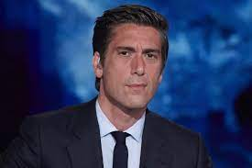
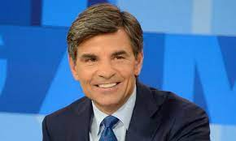
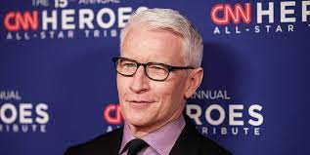
To Whom Are We Listening?
“We have also a more sure word of prophecy; whereunto ye do well that ye take heed, as unto a light that shineth in a dark place, until the day dawn, and the day star arise in your hearts:” 2 Peter 1:19

Slide 3
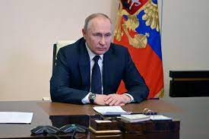
The Russian Badboys???
‘President Vladimir Putin’s growing obsession with Ukraine has developed over many years. In 2005 he referred to the recapture of Crimea as a ridiculous idea – an irresponsible step that would open a Pandora’s box of historical grievances. But, nine years later, he would do exactly that. By summer 2021, he was denying the existence of Ukrainians as a people separate from Russians. Early this week, he declared the Ukrainian state illegitimate.’ Kadri Liik, Senior Policy Fellow.
Obsessed, irresponsible, the bad man!

Slide 4
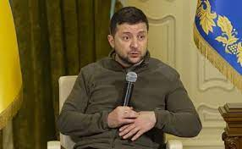
Zelenskiy the Hero
Ukraine’s President Volodymyr Zelenskiy to address US Congress on Wednesday via zoom! Zelenskiy is expected to use the virtual address to urge members of the House of Representatives and Senate to intensify pressure on Joe Biden to allow the transfer of MiG-29 fighter jets from Poland.
The House speaker, Nancy Pelosi, and Senate majority leader, Chuck Schumer, said in a joint letter to members: “The Congress, our country and the world are in awe of the people of Ukraine, who have shown extraordinary courage, resilience and determination in the face of Russia’s unprovoked, vicious and illegal war.”

Slide 5
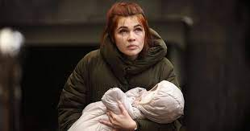
Hogwash
Is Putin really the bad guy and Zelenskiy the good guy? Of course, we feel very bad for the displaced people’s of the Ukraine, and feel deep pain for those who have lost loved ones! What is really going on in the Ukraine? Why is the this conflict taking place, and what are the real reasons behind this conflict?

Slide 6

Behind the Curtain!
“And there came one of the seven angels which had the seven vials, and talked with me, saying unto me, Come hither; I will shew unto thee the judgment of the great whore that sitteth upon many waters: With whom the kings of the earth have committed fornication, and the inhabitants of the earth have been made drunk with the wine of her fornication…And the woman which thou sawest is that great city, which reigneth over the kings of the earth.” Revelation 17:1,2, and 18

Slide 7
Babylon the Great!
“The woman (Babylon) of Revelation 17 is described as “arrayed in purple and scarlet color, and decked with gold and precious stones and pearls, having a golden cup in her hand full of abominations and filthiness:...and upon her forehead was a name written, Mystery, Babylon the Great, the mother of harlots.” Says the prophet: “I saw the woman drunk with the blood of the saints, and with the blood of the martyrs of Jesus.” Babylon is further declared to be “that great city, which reigneth over the kings of the earth.” Revelation 17:4-6, 18. The power that for so many centuries maintained despotic sway over the monarchs of Christendom is Rome. The purple and scarlet color, the gold and precious stones and pearls, vividly picture the magnificence and more than kingly pomp affected by the haughty see of Rome. And no other power could be so truly declared “drunken with the blood of the saints” as that church which has so cruelly persecuted the followers of Christ. Babylon is also charged with the sin of unlawful connection with “the kings of the earth.” It was by departure from the Lord, and alliance with the heathen, that the Jewish church became a harlot; and Rome, corrupting herself in like manner by seeking the support of worldly powers, receives a like condemnation.” GC, pg. 382

Slide 8
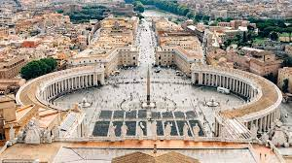
Babylon the Great!
Luther accuses the Roman church and the papacy of keeping the church in captivity, equating Rome with the biblical Babylon that exiled the Israelites from their homeland, holding them captive in Babylon. According to Luther, the pope was holding the church in captivity through the use of the sacramental system and Rome's theology.

Slide 9
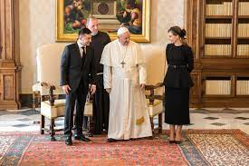
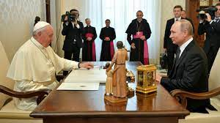
Well, well, well

Slide 10
Is Putin/Zelenskiy Calling the Shots?
In Black Magic Witchcraft, the color white is considered the preeminent color. Since the color, white, is comprised of all colors, and black is a lack of color, white is considered most powerful; black must give way to white. Further, white is considered to be inherently based in the spiritual. The more highly ranked Illuminist will wear white, while the more lowly ranked person will wear black. If an Illuminist meets the Pope, he will almost always wear black, to signify the inferiority, or subordination, of his rank. If you see someone meeting the Pope wearing a different color, you may safely assume he is not Illuminist.
Before we go on, let us restate one critically important spector of this white/black symbolism regarding the Pope's visitors. In Illuminist thinking, when the Pope wears the white dress, he is harkening back to Zarathustra, who wears the white because he is God, the Lucifer Sun-God ! Therefore, the Pope is declaring to all the world that he is God, and is superior to all other men. When Presidents Bush, Clinton, Reagan, along with Queen Elizabeth II and Former Israeli Prime Minister Netanyahu, all wore black as they met with the Pope, they were all acknowledging the Pope's superior position as a religious holy man! They were also acknowledging that the Pope is their God!

Slide 11
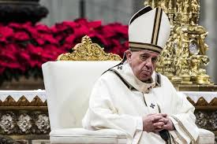
The Pope is Calling the Shots!
!! Listen to the priest speak, “Why, if the government of the United States were at war with the Church, we would say tomorrow, ‘To Hell with the government of the United States;’ and if the church and all the governments of the world were at war, we would say: ‘To Hell with all the governments of the world.’ Why is it the pope has such tremendous power? Why the pope is the ruler of the world. All the emperors, all the kings, all the princes, all the presidents of the world are as these ALTAR BOYS of mine.” Priest Phelan, Western Watchman, June 27, 1912, emphasis supplied. Did you hear what the priest said over 100 years ago? The leaders of the world are as these altar boys of mine!!! Does that include Putin, Volodymyr Zelenskiy, Biden, etc.?? Of course, it does!! Puzzle piece number 1 is in place!!

Slide 12
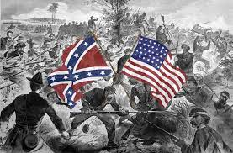
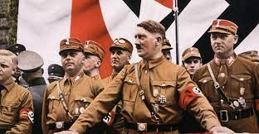
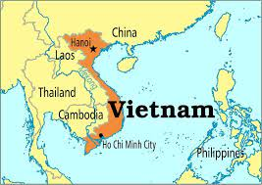
The Vicar of Peace in War???
“And the light of a candle shall shine no more at all in thee; and the voice of the bridegroom and of the bride shall be heard no more at all in thee: for thy merchants were the great men of the earth; for by thy sorceries were all nations deceived. And in her was found the blood of prophets, and of saints, and of all that were slain upon the earth.” Revelation 18:23,24

Slide 13
The Bloodsucker
Edmund Paris’ classic, ‘The Vatican Against Europe, we read, ““The Pope approves of Austria’s harsh treatment of Serbia. He has no great opinion of the armies of Russia and France in the event of a war with Germany. The Cardinal Secretary of State does not see when Austria could make war if she does not decide to do so now….” There, in true colours, is the Vicar of Christ [the pope], the gentle apostle of peace, the Holy Pontiff whom pious authors represent as having died of sorrow at seeing the outbreak of war. — Edmund Paris. The Vatican against Europe, The Wickliffe Press, p. 14. “One may say quite specifically that in 1914, the Roman Catholic Church started the series of hellish wars. It was then that the tribute of blood which she has always taken from the peoples began to swell into a veritable torrent.” —Ibid, p. 48 Paris is discussing WW1, but the principle has application to now!!! Rome creates war for her purposes!!

Slide 14
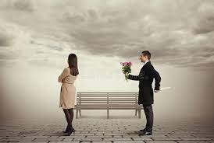
WOW
"I have great pain in my heart because of the worsening of the situation in Ukraine," Francis said, adding that he was anguished and worried like many around the world because peace was threatened by partisan interests. He condemned actions "destabilizing coexistence among nations and discrediting international law".

Slide 15
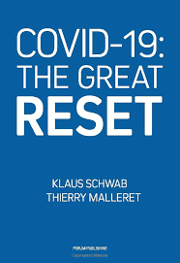
Where CoVid 19 Failed
COVID 19 was very effective in attacking:
1. civil liberties
2. religious liberties
3. the right to work and attend school.
The one thing Rome wanted to set in place was the Great Reset whereby all people’s would be equal, alike enslaved to the papacy.

Slide 16
The Goal of the Monster
“Amid the 2020 global covid lockdowns and economic dislocations it has caused, Klaus Schwab, a previously low-profile founder of a Swiss-based business forum, emerged on the world stage calling for what he called a Great Reset of the entire world economy, using the pandemic as driver. He even published a book in July 2020 outlining his blueprint. It has been rightly called a technocratic society with global top-down central planning. Schwab uses global warming fears and the plight of the world's poor to justify what is in effect a plan for global totalitarianism where, as the Davos website puts it, nobody will own anything. What is not well-known is the fact that the inspiration for Schwab's dystopian plans comes from a Catholic bishop whom he met in Brazil in the 1970's. That bishop links Schwab's vast globalist network with the powerful political influence of the present Pope Francis.” F. William Engdahl New Eastern Outlook, Fri, 24 Dec 2021

Slide 17
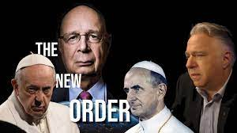
Everyone is equal! Government Dictates
The lockdowns were intended to crush the economy, set it in the direction of nationalizing all industry, and wipe out small business….” In October, 2020 the pope issued an encyclical letter, Fratelli Tutti, in which he went after private property. He wrote, "Business abilities, which are a gift from God, should always be clearly directed to the development of others and to the elimination of poverty..." He declared, "The right to private property is always accompanied by the primary and prior principle of the subordination of all private property to the universal destination of the earth´s goods, and thus the right of all to their use."

Slide 18
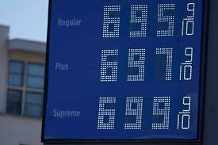
What Better Way than Oil!
What better way to attack world economies than at the pump? Gas rises and so does everything else. What better way than this to control everyone? The war in the Ukraine is making it happen and Rome is behind it! “. The Bible tells us that the papacy controls the buyers and sellers of oil. “And cinnamon, and odors, and ointments, and frankincense, and wine, and oil, and fine flour, and wheat, and beasts, and sheep, and horses, and chariots, and slaves, and souls of men. And the fruits that thy soul lusted after are departed from thee, and all things which were dainty and goodly are departed from thee, and thou shalt find them no more at all. The merchants of these things, which were made rich by her, shall stand afar off for the fear of her torment, weeping and wailing,” Rev. 18: 13-15

Slide 19
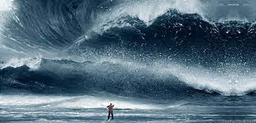
The Lord Will Prevail
“And he had power to give life unto the image of the beast, that the image of the beast should both speak, and cause that as many as would not worship the image of the beast should be killed. And he causeth all, both small and great, rich and poor, free and bond, to receive a mark in their right hand, or in their foreheads: And that no man might buy or sell, save he that had the mark, or the name of the beast, or the number of his name.” Rev. 13:15-17
“And after these things I saw another angel come down from heaven, having great power; and the earth was lightened with his glory.” Rev. 18:1

