Slide 1
Final Scenes, pt. 20
Centurion Called it

Slide 2
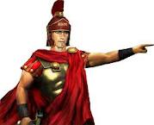
The Centurion
Were it not for the crucifixion of Christ, we would know nothing of the centurion. At the cross, he said something. The gospel writers that report it, Matthew and Luke, declare him saying something different. What can we glean from this man’s life that can help us today?

Slide 3
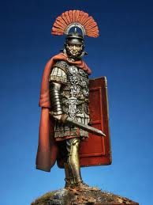
Longinus
Tradition tells us his name was Longinus. A centurion commanded a regiment of men; anywhere between 65-100 men were under his command. Centurions are not born to the position like the children of kings born to royalty. Centurions were made. They rose through the ranks by showing all the necessary characteristics needed to be a centurion.

Slide 4
Characteristics of a Centurion
1. They knew how to command. “For I also am a man set under authority, having under me soldiers, and I say unto one, Go, and he goeth; and to another, Come, and he cometh; and to my servant, Do this, and he doeth it.” Luke 7:8
2. They were brutal. “Then the soldiers of the governor took Jesus into the common hall, and gathered unto him the whole band of soldiers. And they stripped him, and put on him a scarlet robe. And when they had platted a crown of thorns, they put it upon his head, and a reed in his right hand: and they bowed the knee before him, and mocked him, saying, Hail, King of the Jews! And they spit upon him, and took the reed, and smote him on the head.” Matthew 27:27-30

Slide 5
Continue
3. Their duty was to protect Rome any way, shape, or form.
4. They were expert soldiers. They had to be in Judea. Jewish zealots were everywhere. “The apostles differed widely in habits and disposition. There were the publican, Levi-Matthew, and the fiery zealot Simon, the uncompromising hater of the authority of Rome;” DA, pg. 296 “Zealous defenders of the Law and of the national life of the Jewish people; name of a party opposing with relentless rigor any attempt to bring Judea under the dominion of idolatrous Rome, and especially of the aggressive and fanatical war party from the time of Herod until the fall of Jerusalem and Masada. The members of this party bore also the name Sicarii, from their custom of going about with daggers ("sicæ") hidden beneath their cloaks, with which they would stab any one found committing a sacrilegious act or anything provoking anti-Jewish feeling.” Jewish Encyclopedia

Slide 6
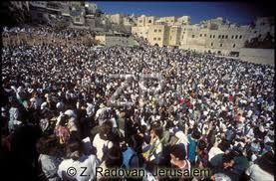
Crowded City for Passover
During the Jewish Passover in 31 AD, it would have been a mob scene. What was already a difficult place to manage would have been terrible to keep under control. 2-3 million crowded their way into the city. The centurion had to do everything possible to maintain control; even kill some people if necessary. Anything to maintain the authority of Rome!

Slide 7
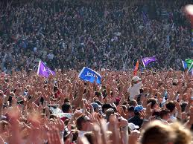
He Had Heard the Stories
Everyone had heard the stories of the Messiah, Jesus of Nazareth. To the centurion, Christ was a challenge that he could ill afford. The Man had mobs flocking about Him; all the more easier for a riot to occur. Longinus knew Jesus was a man of peace, but the Jews were like no other people. Passover season in 31 AD would be a difficult time. For another reason, it became a time Longinus would never forget!

Slide 8
Early Friday Morning
“When the Saviour was brought into the judgment hall, Pilate looked upon Him with no friendly eyes. The Roman governor had been called from his bedchamber in haste, and he determined to do his work as quickly as possible. He was prepared to deal with the prisoner with magisterial severity. Assuming his severest expression, he turned to see what kind of man he had to examine, that he had been called from his repose at so early an hour. He knew that it must be someone whom the Jewish authorities were anxious to have tried and punished with haste.

Slide 9
Amazing!
“Pilate looked at the men who had Jesus in charge, and then his gaze rested searchingly on Jesus. He had had to deal with all kinds of criminals; but never before had a man bearing marks of such goodness and nobility been brought before him. On His face he saw no sign of guilt, no expression of fear, no boldness or defiance. He saw a man of calm and dignified bearing, whose countenance bore not the marks of a criminal, but the signature of heaven.” DA, pgs. 723,724

Slide 10
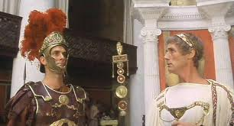
Not a Happy Camper
Pilate nor Longinus were happy campers. Called from sleep at an early hour by the obnoxious Jews, they weren’t happy with this. Longinus had to be fully alert. His master, Pilate, and all Jerusalem had to be under orderly control or problems could erupt very quickly. Longinus hoped this wouldn’t take long; there were so many things pressing on him already that Passover weekend.

Slide 11
He Saw the Messiah
“Jesus was taken, faint with weariness and covered with wounds, and scourged in the sight of the multitude. "And the soldiers led Him away into the hall, called Praetorium, and they call together the whole band. And they clothed Him with purple, and platted a crown of thorns, and put it about His head, and began to salute Him, Hail, King of the Jews! And they . . . did spit upon Him, and bowing their knees worshiped Him." Occasionally some wicked hand snatched the reed that had been placed in His hand, and struck the crown upon His brow, forcing the thorns into His temples, and sending the blood trickling down His face and beard… His lowly birth and humble life are commented upon by the unfeeling mob.

Slide 12
Conflict in his Mind
“…His claim to be the Son of God is ridiculed, and the vulgar jest and insulting sneer are passed from lip to lip. Satan led the cruel mob in its abuse of the Saviour. It was his purpose to provoke Him to retaliation if possible, or to drive Him to perform a miracle to release Himself, and thus break up the plan of salvation. One stain upon His human life, one failure of His humanity to endure the terrible test, and the Lamb of God would have been an imperfect offering, and the redemption of man a failure. But He who by a command could bring the heavenly host to His aid--He who could have driven that mob in terror from His sight by the flashing forth of His divine majesty--submitted with perfect calmness to the coarsest insult and outrage.” DA, pg. 734

Slide 13
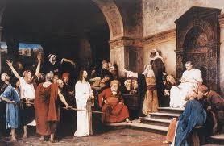
He had seen them All
Longinus was a centurion. He knew all kinds of men; he had seen them all; well, almost all. He had watched men die; he knew all the foul language. He knew the cruelty, cowardice, conniving of men. He had to be able to read men; his life depended on it and Roman power did too!

Slide 14
What he Saw!
“There stood the Son of God, wearing the robe of mockery and the crown of thorns. Stripped to the waist, His back showed the long, cruel stripes, from which the blood flowed freely. His face was stained with blood, and bore the marks of exhaustion and pain; but never had it appeared more beautiful than now. The Saviour's visage was not marred before His enemies. Every feature expressed gentleness and resignation and the tenderest pity for His cruel foes. In His manner there was no cowardly weakness, but the strength and dignity of long-suffering. In striking contrast was the prisoner at His side. Every line of the countenance of Barabbas proclaimed him the hardened ruffian that he was. The contrast spoke to every beholder. Some of the spectators were weeping. As they looked upon Jesus, their hearts were full of sympathy. Even the priests and rulers were convicted that He was all that He claimed to be…

Slide 15
Cont.
“The Roman soldiers that surrounded Christ were not all hardened; some were looking earnestly into His face for one evidence that He was a criminal or dangerous character. From time to time they would turn and cast a look of contempt upon Barabbas. It needed no deep insight to read him through and through. Again they would turn to the One upon trial. They looked at the divine sufferer with feelings of deep pity. The silent submission of Christ stamped upon their minds the scene, never to be effaced until they either acknowledged Him as the Christ, or by rejecting Him decided their own destiny.” DA, pgs. 735, 736

Slide 16
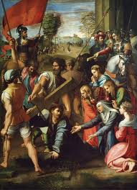
The command was Given

Slide 17
Tense Time
Longinus’ boss gave the command. “ When Pilate saw that he could prevail nothing, but that rather a tumult was made, he took water, and washed his hands before the multitude, saying, I am innocent of the blood of this just person: see ye to it. Then answered all the people, and said, His blood be on us, and on our children. Then released he Barabbas unto them:” Matthew 27:24-26
Longinus had done this many times prior. This would be a difficult task that demanded precision, accuracy, no mistakes.

Slide 18
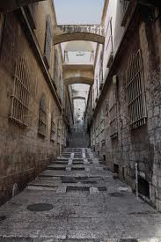
Narrow Streets
Jerusalem’s streets were narrow; an attempt may be made to rescue the criminals. This must not happen at all costs. If heads had to roll, let them roll, but the criminals had to die. Longinus and his men made sure no one got in their way as they took the prisoners to the execution.

Slide 19
Golgotha
Arriving at the place of execution, the prisoners were bound to the instruments of torture. The two thieves wrestled in the hands of those who placed them on the cross; but Jesus made no resistance…The Saviour made no murmur of complaint. His face remained calm and serene, but great drops of sweat stood upon His brow. There was no pitying hand to wipe the death dew from His face, nor words of sympathy and unchanging fidelity to stay His human heart. While the soldiers were doing their fearful work, Jesus prayed for His enemies, "Father, forgive them; for they know not what they do." His mind passed from His own suffering to the sin of His persecutors, and the terrible retribution that would be theirs.” DA, pg. 744

Slide 20
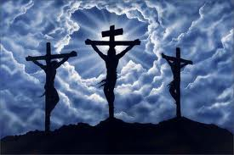
Not One like Him
Jesus didn’t fight with the soldiers; He simply laid down. Longinus saw Him. He heard Jesus say, “Father, forgive them.” He heard Christ’s promise to the thief. He heard the cry of Christ like a victor, “It is finished; into Thy hands I commit My spirit.” Longinus heard and saw it all. He couldn’t take anymore.

Slide 21
Truly, this is the Son of God
“Now when the centurion, and they that were with him, watching Jesus, saw the earthquake, and those things that were done, they feared greatly, saying, Truly this was the Son of God.” Matthew 27:54
“In the closing events of the crucifixion day, fresh evidence was given of the fulfillment of prophecy, and new witness borne to Christ's divinity. When the darkness had lifted from the cross, and the Saviour's dying cry had been uttered, immediately another voice was heard, saying, "Truly this was the Son of God." Matt. 27:54. These words were said in no whispered tones. All eyes were turned to see whence they came. Who had spoken?...

Slide 22
He Believed
…It was the centurion, the Roman soldier. The divine patience of the Saviour, and His sudden death, with the cry of victory upon His lips, had impressed this heathen. In the bruised, broken body hanging upon the cross, the centurion recognized the form of the Son of God. He could not refrain from confessing his faith. Thus again evidence was given that our Redeemer was to see of the travail of His soul. Upon the very day of His death, three men, differing widely from one another, had declared their faith,--he who commanded the Roman guard, he who bore the cross of the Saviour, and he who died upon the cross at His side.” DA, pg. 770

Slide 23
Centurion the Christian
The centurion had been a professional killer, a hired assassin. He killed for Rome! On a Friday, long ago, in Jerusalem, everything changed for him. The patience and power; the compassion and courage; the tenderness and tenacity of Jesus had changed him forever!
“What shall I do then with Jesus, which is called the Christ?” Matthew 26:36

