Slide 1
COP 27

Slide 2
Religions Converge
Between November 6th and 18th, 2022, the UN climate conference COP 27 will take place on the Sinai Peninsula, in Sharm El Sheikh, Egypt. Religious communities and religious leaders have a key role to play in addressing climate change and climate justice, which requires deep transformation within society. The knowledge of what changes are critically needed to diminish long-term harm to the planet is readily available. However, bringing about change in action demands deeper changes in attitude, a change of heart. This has been the domain of religions for millennia. Religions are sources of inspiration for the transformation of heart and the ensuing changes of attitude.

Slide 3
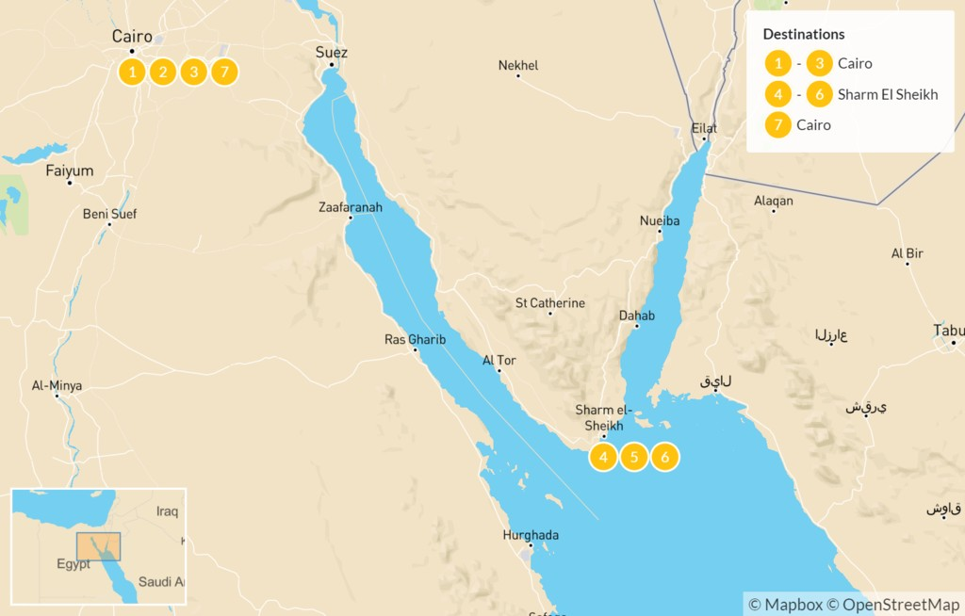
Glorified Vacation
Sharm el Sheikh is a touristy rendezvous in the Sinai peninsula. With a beautiful view of the Red Sea, this place brings many to Egypt every year! This is near where the Queen Helena ‘discovery’ places the Biblical Mt. Sinai. Truly, as the apostle Paul declares, Mt. Sinai is in Arabia. “For this Agar is mount Sinai in Arabia, and answereth to Jerusalem which now is, and is in bondage with her children.” Galatians 4:25

Slide 4
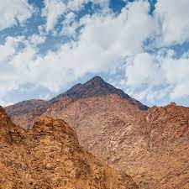
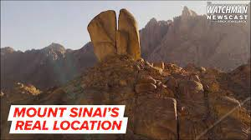

Slide 5

Climate Used to Push Sunday Worship
So, in early to mid November, there will be a gathering of religious leaders from all major religions and they will gather at the pseudo Sinai to discuss Pope Francis’s climate change agenda.
This will be an ecumenical gathering with the climate being the issue on the outside and the real issue being covered up. Francis has made it very clear what the real issue in his climate agenda is….Sunday!!

Slide 6
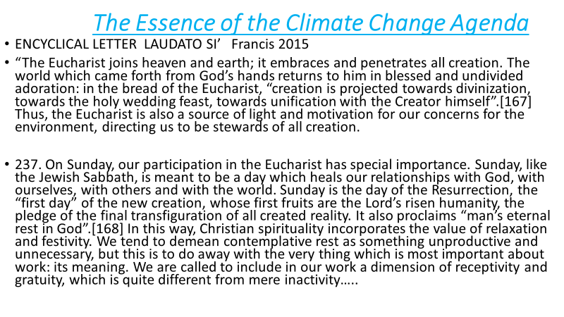

Slide 7

Uniting to Save the Planet!
Francis, the apostate Protestants, and apostate Adventism are building a pseudo unity in order to save the planet with the catch phrase of ‘climate control’! Francis’ behind the scenes meaning of climate control is really SUNDAY!

Slide 8
Climate Out of Whack, Why??
“In accidents and calamities by sea and by land, in great conflagrations, in fierce tornadoes and terrific hailstorms, in tempests, floods, cyclones, tidal waves, and earthquakes, in every place and in a thousand forms, Satan is exercising his power. He sweeps away the ripening harvest, and famine and distress follow. He imparts to the air a deadly taint, and thousands perish by the pestilence. These visitations are to become more and more frequent and disastrous. Destruction will be upon both man and beast. “The earth mourneth and fadeth away,” “the haughty people ... do languish. The earth also is defiled under the inhabitants thereof; because they have transgressed the laws, changed the ordinance, broken the everlasting covenant.” Isaiah 24:4, 5. And then the great deceiver will persuade men that those who serve God are causing these evils. The class that have provoked the displeasure of Heaven will charge all their troubles upon those whose obedience to God's commandments is a perpetual reproof to transgressors. It will be declared that men are offending God by the violation of the Sunday sabbath; that this sin has brought calamities which will not cease until Sunday observance shall be strictly enforced; and that those who present the claims of the fourth commandment, thus destroying reverence for Sunday, are troublers of the people, preventing their restoration to divine favor and temporal prosperity. Thus the accusation urged of old against the servant of God will be repeated and upon grounds equally well established: “And it came to pass, when Ahab saw Elijah, that Ahab said unto him, Art thou he that troubleth Israel? And he answered, I have not troubled Israel; but thou, and thy father's house, in that ye have forsaken the commandments of the Lord, and thou hast followed Baalim.” 1 Kings 18:17, 18. As the wrath of the people shall be excited by false charges, they will pursue a course toward God's ambassadors very similar to that which apostate Israel pursued toward Elijah.” GC, pgs. 589,590

Slide 9
ADRA Speaks for the Denomination
ADRA’s Statement on the Conference of the Parties of the UNFCCC (COP27)
“The Adventist Development and Relief Agency, as humanitarian and development practitioners, has seen first-hand how the global equilibrium is out of order. We aim to do our deed; offices in our network have started to move towards net zero, signed the Climate charter, shared our knowledge at the COP26 and COP27, and published the comprehensive Carbon Reduction Guide in 2021. ADRA calls on policy makers and influential personalities to take necessary decisions in the upcoming UN Climate Conference. The industrialized countries, as the historical perpetrators of the climate crisis, must finally step up to promises made. The COP26 has set some course but more steps are needed, such as stronger consideration of civil society actors; more focus on loss and damage; and meeting the pledge on global adaptation financing. ADRA Europe hopes that these points will find strong consideration in the upcoming policy talks and wishes participants a successful and fruitful COP27.” https://news.eud.adventist.org/en/all-news/news/go/2022-11-08/adras-statement-on-the-conference-of-the-parties-of-the-unfccc-cop27/ https://hopemedia.it/cop27-adra-europa-chiede-unazione-immediata-sul-clima/

Slide 10
Unification of Churches
“The wide diversity of belief in the Protestant churches is regarded by many as decisive proof that no effort to secure a forced uniformity can ever be made. But there has been for years, in churches of the Protestant faith, a strong and growing sentiment in favor of a union based upon common points of doctrine. To secure such a union, the discussion of subjects upon which all were not agreed—however important they might be from a Bible standpoint—must necessarily be waived… When the leading churches of the United States, uniting upon such points of doctrine as are held by them in common, shall influence the state to enforce their decrees and to sustain their institutions, then Protestant America will have formed an image of the Roman hierarchy, and the infliction of civil penalties upon dissenters will inevitably result.” GC, pgs. 444,445

Slide 11
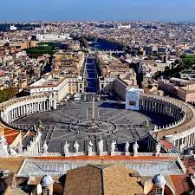
The Warning Remains!
“And the third angel followed them, saying with a loud voice, If any man worship the beast and his image, and receive his mark in his forehead, or in his hand, The same shall drink of the wine of the wrath of God, which is poured out without mixture into the cup of his indignation; and he shall be tormented with fire and brimstone in the presence of the holy angels, and in the presence of the Lamb: And the smoke of their torment ascendeth up for ever and ever: and they have no rest day nor night, who worship the beast and his image, and whosoever receiveth the mark of his name.” Rev. 14:9-11

Slide 12
“In the issue of the contest all Christendom will be divided into two great classes—those who keep the commandments of God and the faith of Jesus, and those who worship the beast and his image and receive his mark. Although church and state will unite their power to compel “all, both small and great, rich and poor, free and bond” (Revelation 13:16), to receive “the mark of the beast,” yet the people of God will not receive it. The prophet of Patmos beholds “them that had gotten the victory over the beast, and over his image, and over his mark, and over the number of his name, stand on the sea of glass, having the harps of God” and singing the song of Moses and the Lamb. Revelation 15:2, 3.” GC, pg. 450

Slide 13
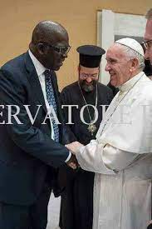
Heading to the Lake!!
What is this fake Adventist doing? Having ecumenical meetings with the beast and his image. The papacy goes to the lake of fire; apostate protestants go there too. What about nominal Adventism that embraces ecumenism? Do they go through to paradise or to the lake of fire? “And the devil that deceived them was cast into the lake of fire and brimstone, where the beast and the false prophet are, and shall be tormented day and night for ever and ever.” Rev. 20:10

Slide 14
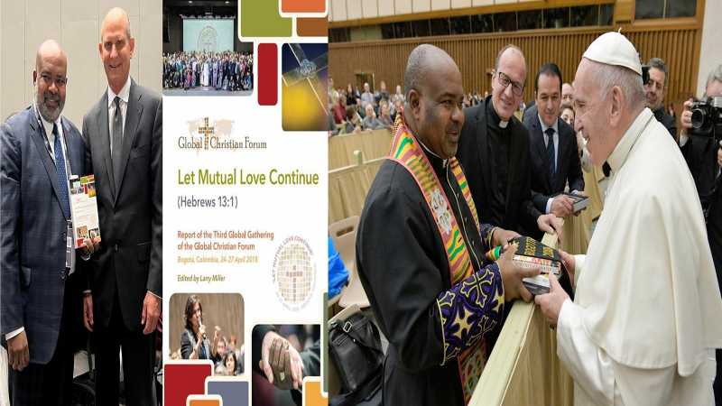

Slide 15
Apostate Adventists-Agents of Satan
“As the storm approaches, a large class who have professed faith in the third angel's message, but have not been sanctified through obedience to the truth, abandon their position and join the ranks of the opposition. By uniting with the world and partaking of its spirit, they have come to view matters in nearly the same light; and when the test is brought, they are prepared to choose the easy, popular side. Men of talent and pleasing address, who once rejoiced in the truth, employ their powers to deceive and mislead souls. They become the most bitter enemies of their former brethren. When Sabbath keepers are brought before the courts to answer for their faith, these apostates are the most efficient agents of Satan to misrepresent and accuse them, and by false reports and insinuations to stir up the rulers against them.” GC, pg. 608

Slide 16
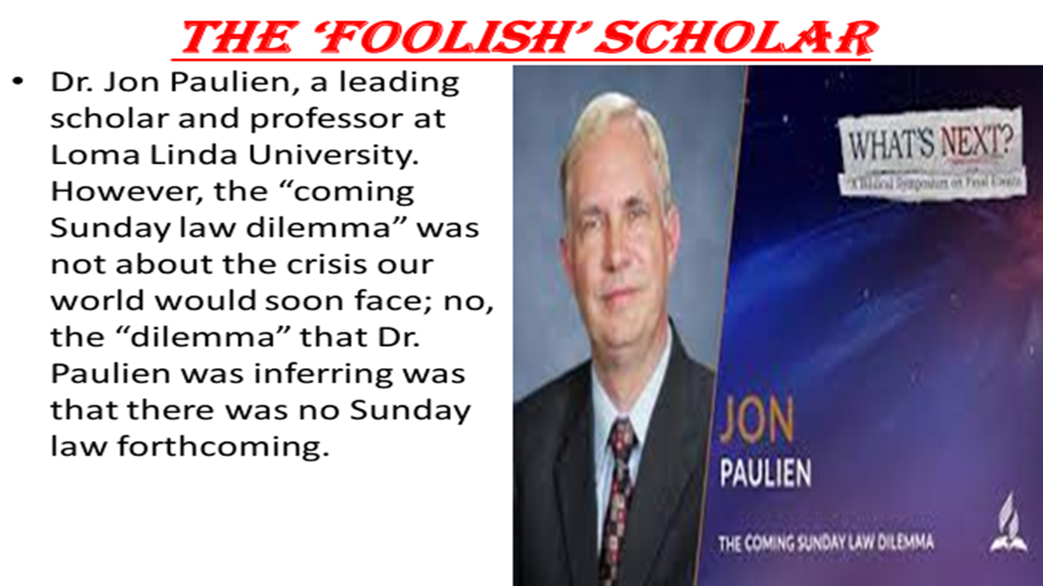

Slide 17
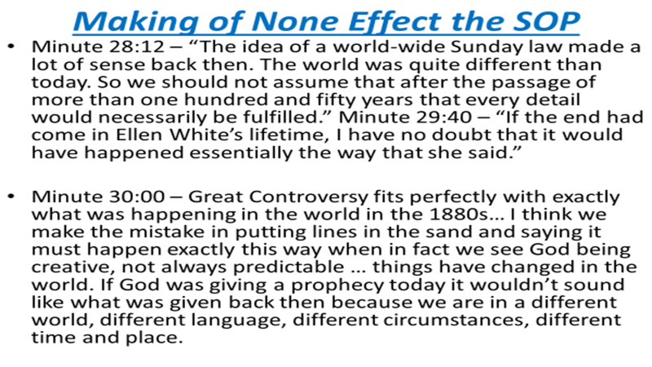

Slide 18
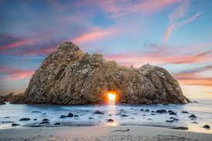
Still Sure!
“We have also a more sure word of prophecy; whereunto ye do well that ye take heed, as unto a light that shineth in a dark place, until the day dawn, and the day star arise in your hearts: Knowing this first, that no prophecy of the scripture is of any private interpretation. For the prophecy came not in old time by the will of man: but holy men of God spake as they were moved by the Holy Ghost.” 2 Peter 1:19-21

