Slide 1
Faces of Grace

Slide 2
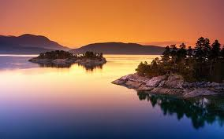
A Man from Canada
He asked me, “We talk so much about God’s love and grace. That is well and good, but what about the starving boy in Africa, or the awful realities of WW II, or the racial prejudices that destroy people? Where is God’s grace in all of that?”

Slide 3
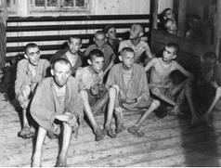
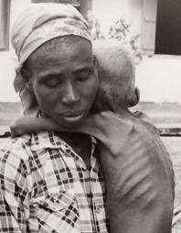
How Would You Answer?

Slide 4
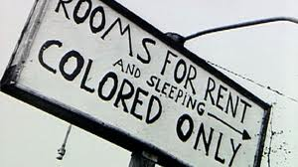
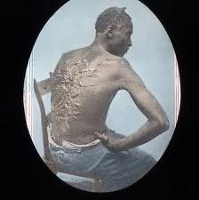
Man at his Worst!

Slide 5
My Response
The previous pictures reveal man at his absolute worst. Allowing fellow human beings to starve, killing people in gas chambers in Auschwitz and Dachau, whipping and enslaving people just because of the color of their skin reveal just how far the perverted human heart will go in abusing one of God’s greatest gifts. In man’s most horrible choices of abuse toward their fellow man, we see God at His very best!!

Slide 6
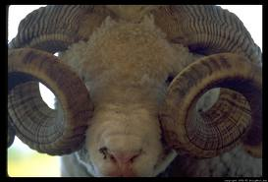
Between two Horns
God had a grave decision to make. How would He create man? Would man be made as a robot to do exactly as programmed? Or would God create man with free choice to be able to do as he choose, even if it meant doing something that could grieve the heart of God and ones fellow human beings? Creating man without choice would have been easy and painless, but there would be no genuine love and appreciation.

Slide 7
God’s Decision
“The government of God is not, as Satan would make it appear, founded upon a blind submission, an unreasoning control. It appeals to the intellect and the conscience. "Come now, and let us reason together" is the Creator's invitation to the beings He has made. Isaiah 1:18. God does not force the will of His creatures. He cannot accept an homage that is not willingly and intelligently given. A mere forced submission would prevent all real development of mind or character; it would make man a mere automaton. Such is not the purpose of the Creator. He desires that man, the crowning work of His creative power, shall reach the highest possible development. He sets before us the height of blessing to which He desires to bring us through His grace. He invites us to give ourselves to Him, that He may work His will in us. It remains for us to choose whether we will be set free from the bondage of sin, to share the glorious liberty of the sons of God.” SC. Pgs. 43,44

Slide 8
Free to Choose
“God desires from all His creatures the service of love--service that springs from an appreciation of His character. He takes no pleasure in a forced obedience; and to all He grants freedom of will, that they may render Him voluntary service…But He who would have the will of all His creatures free, left none unguarded to the bewildering sophistry by which rebellion would seek to justify itself. Before the great contest should open, all were to have a clear presentation of His will, whose wisdom and goodness were the spring of all their joy.” PP, pgs. 34,36

Slide 9
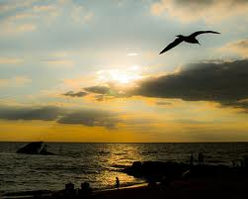
God’s ultimate for Us!
In His omniscience, God saw famine, slavery, concentration camps, war, blood, violence. He saw that that would be the result of giving man choice. God wanted to give us the ultimate gift in creation; the power to choose the very best in life; honor, joy, and peace. Or, to choose the absolute worst man could think of; murder, selfishness, rape, and pain. He would give us no less than absolute free choice—even if it would be abused!

Slide 10
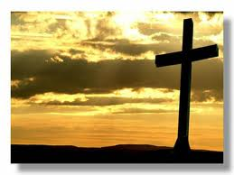
The Other Face
With the abuse of the precious gift of choice, God was faced with a dilemma. Man was now separated from Him by sin, the children He loved and wanted to be with so much. How could He be reunited with them. There was only one way but it would be horribly painful and expensive; Christ would come to this earth and face the worst that HIS creatures could devise and then die!

Slide 11
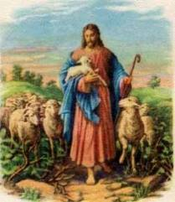
Rich Became Poor
“For ye know the grace of our Lord Jesus Christ, that, though he was rich, yet for your sakes he became poor, that ye through his poverty might be rich.” 2Corinthians 8:9

Slide 12
Grace
“Christ was treated as we deserve, that we might be treated as He deserves. He was condemned for our sins, in which He had no share, that we might be justified by His righteousness, in which we had no share. He suffered the death which was ours, that we might receive the life which was His. "With His stripes we are healed.“ DA, pg. 25

Slide 13
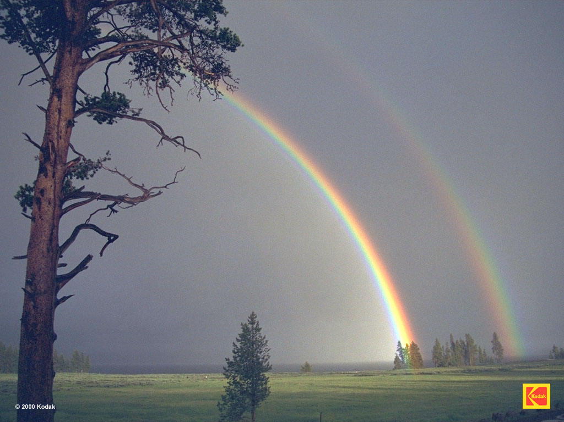
Recreation
“For by grace are ye saved through faith; and that not of yourselves: it is the gift of God: Not of works, lest any man should boast. For we are his workmanship, created in Christ Jesus unto good works, which God hath before ordained that we should walk in them.” Eph. 2:8-10

Slide 14
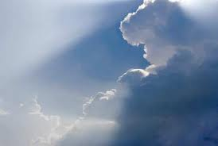
Grace Forgives and Empowers
“But by the grace of God I am what I am: and his grace which was bestowed upon me was not in vain; but I laboured more abundantly than they all: yet not I, but the grace of God which was with me.” 1 Corinthians 15:10

Slide 15
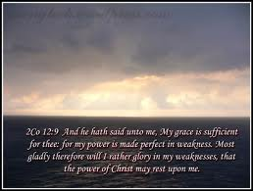

Slide 16
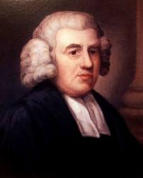
Only One Face!
The two faces of grace have been very painful for heaven, but absolutely necessary if man would ever experience the wonders of God’s love. By the gift of choice and the gift of His Son, God has filled this world with grace. Only man’s abuse of God’s gifts has sought to mar God’s Abundant Grace!

Slide 17
All of Eternity
“The cross of Christ will be the science and the song of the redeemed through all eternity. In Christ glorified they will behold Christ crucified. Never will it be forgotten that He whose power created and upheld the unnumbered worlds through the vast realms of space, the Beloved of God, the Majesty of heaven, He whom cherub and shining seraph delighted to adore--humbled Himself to uplift fallen man; that He bore the guilt and shame of sin, and the hiding of His Father's face, till the woes of a lost world broke His heart and crushed out His life on Calvary's cross. That the Maker of all worlds, the Arbiter of all destinies, should lay aside His glory and humiliate Himself from love to man will ever excite the wonder and adoration of the universe. As the nations of the saved look upon their Redeemer and behold the eternal glory of the Father shining in His countenance; as they behold His throne, which is from everlasting to everlasting, and know that His kingdom is to have no end, they break forth in rapturous song: "Worthy, worthy is the Lamb that was slain, and hath redeemed us to God by His own most precious blood!“ GC, pgs. 651,652

