Slide 1
Charlie Kirk Effect and Bible Prophecy

Slide 2
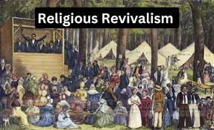
Could This Be the False Revival?
“The enemy of souls desires to hinder this work; and before the time for such a movement shall come, he will endeavor to prevent it by introducing a counterfeit. In those churches which he can bring under his deceptive power he will make it appear that God’s special blessing is poured out; there will be manifest what is thought to be great religious interest. Multitudes will exult that God is working marvelously for them, when the work is that of another spirit. Under a religious guise, Satan will seek to extend his influence over the Christian world.” GC. Pg. 464

Slide 3
The Results of Kirk Being Slain
“Many across the country agree Kirk's tragic assassination in Utah on Sept. 10 — after his years of outreach to young people about faith, family, values and country — has sparked a religious revival, with scores of non-believers picking up a Bible for the first time. It's been dubbed the "Charlie Kirk Effect."
Matt Zerrusen, co-founder of Newman Ministry, a Catholic nonprofit organization that supports over 200 campus ministries nationwide, said he's seen an increase in student faith engagement. "I have not talked to anyone who has not seen an increase in Mass attendance," he recently told Catholic News Agency. "Some schools are reporting increases of 15%.“ Fox News 9-28-2025
“Kirk’s death has ignited an unexpected spiritual awakening, particularly among young people. Known for his bold declaration that he wanted to be remembered for his “courage of faith,” Kirk frequently shared the gospel at his events. Now, in the wake of his passing, churches are reporting unprecedented attendance, and Bible sales are soaring.” Washington Stand, Sept. 29, 2025

Slide 4
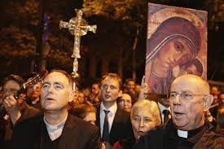
“I’ve never seen politicians speak with this much conviction about their own faith, and be so confident in coming out publicly about their belief system and faith, and that may encourage more people to come to God,” said Morstad, who hosts a podcast, GSD Nation, on Christianity with his sons. “We obviously believe in Christian ethics in this family, and that the deterioration of those over the past several decades is a big reason why America is struggling — and coming back to that is part of what saving America looks like.”

Slide 5
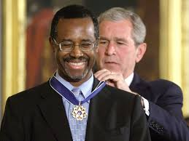
Dr. Ben Carson wow everyone with an unforgettable 4-minute tribute to Charlie Kirk.
“Get on board of the REVIVAL that is coming.”
Carson’s words carried the weight of true wisdom, and the ending was the most powerful moment of all:
“In closing, I want to read a passage from John 12:24, remembering that Charlie was shot at 12:24 pm. ’Verily, verily, I say unto you, this is Christ speaking.
“Except a corn of wheat fall onto the ground and die, it abideth alone. But if it die, it bringeth forth much fruit.’ And I want to thank Charlie for his sacrifice, because much fruit is going to be realized.”

Slide 6
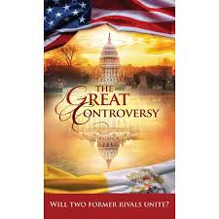
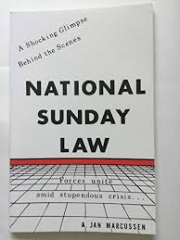
Get the Books Out!
With so many showing interest in spiritual things, let’s get these books out like never before!
With the tragic death of Kirk, we have had many, many requests for the Great Controversy book! If there is such a religious interest, then let’s get the books out!!

Slide 7

“Church members, awake to the importance of the circulation of our literature, and devote more time to this work. Place in the homes of the people papers, tracts, and books that will preach the gospel in its several lines. There is no time to be lost. Let many give themselves willingly and unselfishly to the canvassing work, and thus help to sound a warning that is greatly needed. When the church takes up her appointed work, she will go forth “fair as the moon, clear as the sun, and terrible as an army with banners.”—The Southern Watchman, November 20, 1902 (Pacific Union Recorder, November 20, 1902).

Slide 8
The Rest of the Story
“Notwithstanding the widespread declension of faith and piety, there are true followers of Christ in these churches. Before the final visitation of God’s judgments upon the earth there will be among the people of the Lord such a revival of primitive godliness as has not been witnessed since apostolic times. The Spirit and power of God will be poured out upon His children. At that time many will separate themselves from those churches in which the love of this world has supplanted love for God and His word. Many, both of ministers and people, will gladly accept those great truths which God has caused to be proclaimed at this time to prepare a people for the Lord’s second coming. The enemy of souls desires to hinder this work; and before the time for such a movement shall come, he will endeavor to prevent it by introducing a counterfeit. In those churches which he can bring under his deceptive power he will make it appear that God’s special blessing is poured out; there will be manifest what is thought to be great religious interest. Multitudes will exult that God is working marvelously for them, when the work is that of another spirit. Under a religious guise, Satan will seek to extend his influence over the Christian world.” GC, pg. 464

Slide 9
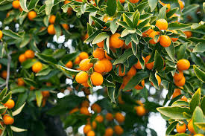
True Revival Primitive Godliness
“For godly sorrow worketh repentance to salvation not to be repented of: but the sorrow of the world worketh death. For behold this selfsame thing, that ye sorrowed after a godly sort, what carefulness it wrought in you, yea, what clearing of yourselves, yea, what indignation, yea, what fear, yea, what vehement desire, yea, what zeal, yea, what revenge! In all things ye have approved yourselves to be clear in this matter.” 2 Corinthians 7:9-11. This is the result of the work of the Spirit of God. There is no evidence of genuine repentance unless it works reformation. If he restore the pledge, give again that he had robbed, confess his sins, and love God and his fellow men, the sinner may be sure that he has found peace with God. Such were the effects that in former years followed seasons of religious awakening. Judged by their fruits, they were known to be blessed of God in the salvation of men and the uplifting of humanity.” GC, pg. 462

Slide 10

Let’s See What Happens!!
“But many of the revivals of modern times have presented a marked contrast to those manifestations of divine grace which in earlier days followed the labors of God’s servants. It is true that a widespread interest is kindled, many profess conversion, and there are large accessions to the churches; nevertheless the results are not such as to warrant the belief that there has been a corresponding increase of real spiritual life. The light which flames up for a time soon dies out, leaving the darkness more dense than before.” GC, pg. 463

Slide 11
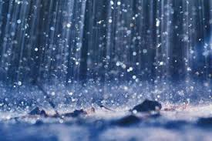
Holy Spirit Will Be Poured Out!
“And after these things I saw another angel come down from heaven, having great power; and the earth was lightened with his glory. And he cried mightily with a strong voice, saying, Babylon the great is fallen, is fallen, and is become the habitation of devils, and the hold of every foul spirit, and a cage of every unclean and hateful bird.” Revelation 18:1,2

Slide 12
How Abundant??
“I saw the latter rain is coming suddenly, as the midnight cry and with ten times the power.” Ellen White letter, Spalding-Megan Collection, pages 3,4
“In the parable of Matthew 25 the time of waiting and slumber is followed by the coming of the bridegroom. This was in accordance with the arguments just presented, both from prophecy and from the types. They carried strong conviction of their truthfulness; and the "midnight cry" was heralded by thousands of believers. Like a tidal wave the movement swept over the land. From city to city, from village to village, and into remote country places it went, until the waiting people of God were fully aroused.” GC, pg. 400

Slide 13
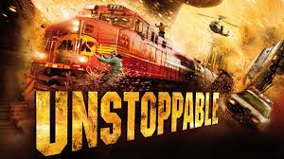
Coming Like a Freight Train
“It is true that in the time of the end, when God's work in the earth is closing, the earnest efforts put forth by consecrated believers under the guidance of the Holy Spirit are to be accompanied by special tokens of divine favor. Under the figure of the early and the latter rain, that falls in Eastern lands at seedtime and harvest, the Hebrew prophets foretold the bestowal of spiritual grace in extraordinary measure upon God's church. The outpouring of the Spirit in the days of the apostles was the beginning of the early, or former, rain, and glorious was the result. To the end of time the presence of the Spirit is to abide with the true church.” Acts of the Apostles, pgs. 54,55

Slide 14
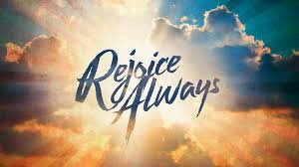
Rejoice!
“Fear not, O land; be glad and rejoice: for the LORD will do great things. Be not afraid, ye beasts of the field: for the pastures of the wilderness do spring, for the tree beareth her fruit, the fig tree and the vine do yield their strength. Be glad then, ye children of Zion, and rejoice in the LORD your God: for he hath given you the former rain moderately, and he will cause to come down for you the rain, the former rain, and the latter rain in the first month.” Joel 2:21,23

