Slide 1
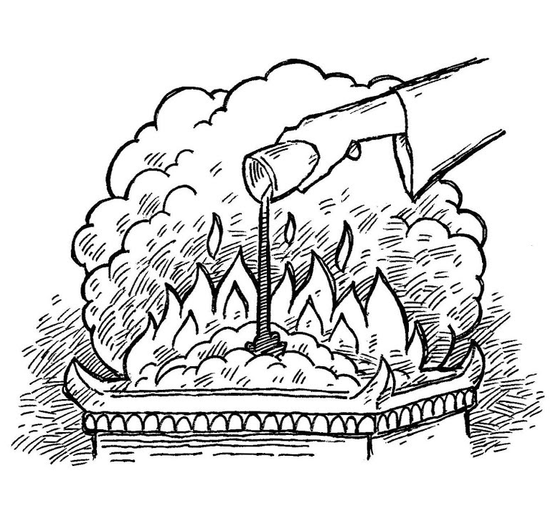
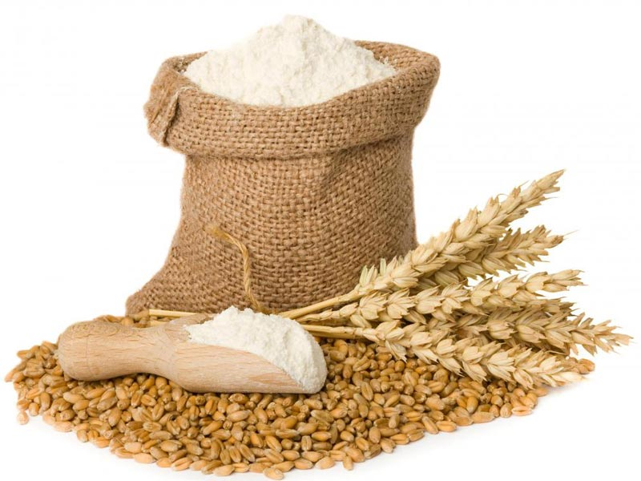
The Meat (Meal) and Drink Offerings

Slide 2
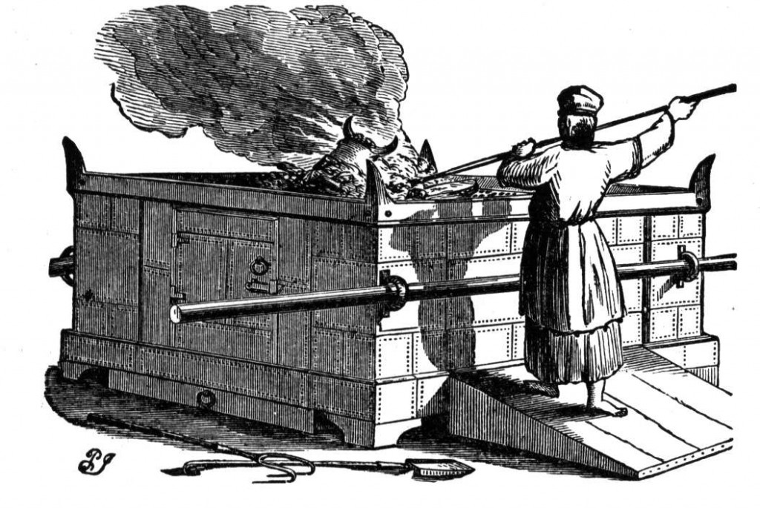
Meat Offerings Accompanied by Drink Offerings and Burnt Offerings
Numbers 15:2-5 “Speak unto the children of Israel, and say unto them, When ye be come into the land of your habitations, which I give unto you, And will make an offering by fire unto the Lord, a burnt offering, or a sacrifice in performing a vow, or in a freewill offering, or in your solemn feasts, to make a sweet savour unto the Lord, of the herd or of the flock: Then shall he that offereth his offering unto the Lord bring a meat offering of a tenth deal of flour mingled with the fourth part of an hin of oil. And the fourth part of an hin of wine for a drink offering shalt thou prepare with the burnt offering or sacrifice, for one lamb.”

Slide 3
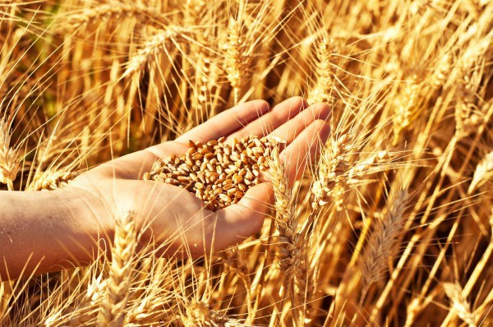
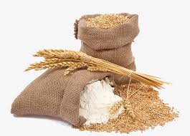
Other Uses
1. Burnt Offerings, morning and evening (Numbers 15)
2. Wave sheaf on the 2nd day of the Feast of Unleavened Bread (Lev. 23:10-13)
3. Pentecost (Lev. 23:16-17)
4. Offering for Jealousy (Numbers 5:15)
6. Cleansing of lepers [no oil or frankincense (Lev. 14:10)
7. Sin-Trespass Offering when sinner cannot provide the minimum turtledoves [no oil or frankincense (Lev. 5:11)
8. Firstfruits is a form of meat offering (Lev. 2:12)

Slide 4
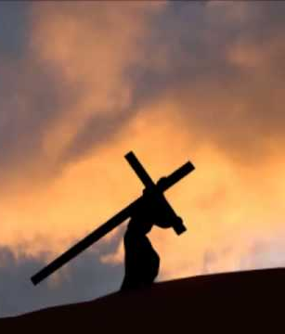
Cause to Effect: The Process of Burnt to Meat Offering
2 Cor. 8:1-5 “Moreover, brethren, we do you to wit of the grace of God bestowed on the churches of Macedonia; How that in a great trial of affliction the abundance of their joy and their deep poverty abounded unto the riches of their liberality. For to their power, I bear record, yea, and beyond their power they were willing of themselves; Praying us with much intreaty that we would receive the gift, and take upon us the fellowship of the ministering to the saints. And this they did, not as we hoped, but first gave their own selves to the Lord, and unto us by the will of God.”

Slide 5
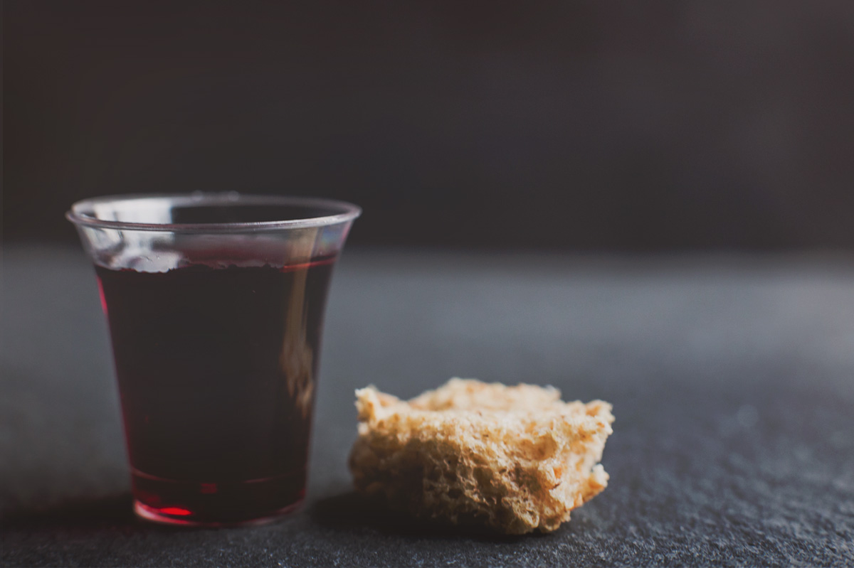
What did it signify?
Like the burnt offerings, the meat offerings were given of the sinners substance as a freewill offering. This offering had a few special purposes. It is a thank offering and was the dedication of material goods or wealth/blessings and works, whereas the burnt offering is dedication of self. The leftovers were for the priest sustainment (Lev. 2:10; 7:9) [except when it was from the priests’ personal meat offering—Lev. 6:23]. It was most importantly a symbol of communion with God, (thus the food and drink) which comes only through the blood sacrifice of Jesus Christ as the Sin Offering (and Burnt Offering) and the entire submission of ourselves as the Burnt Offering—these prerequisites completed, we may now through the Holy Spirit (oil) Christ’s Righteousness, merits, and mediation (frankincense) partake in fellowship with the Creator! In the daily, typologically speaking, it is a symbol of partaking of the word of God every morning and evening, praying that the anointing oil (Holy Spirit) may be upon our reading, and communion time.
Rev. 3:20 “Behold, I stand at the door, and knock: if any man hear my voice, and open the door, I will come in to him, and will sup with him, and he with me.”

Slide 6
“The religious services, the prayers, the praise, the penitent confession of sin ascend from true believers as incense to the heavenly sanctuary; but passing through the corrupt channels of humanity, they are so defiled that unless purified by blood, they can never be of value with God. They ascend not in spotless purity, and unless the Intercessor who is at the God’s right hand presents and purifies all by His righteousness, it is not acceptable to God. All incense from earthly tabernacles must be moist with the cleansing drops of the blood of Christ. He holds before the Father the censer of His own merits, in which there is no taint of earthly corruption. He gathers into this censer the prayers, the praise, and the confessions of His people and with these He puts His own spotless righteousness. Then, perfumed with the merits of Christ’s propitiation, the incense comes up before God wholly and entirely acceptable. O, that all may see that everything in obedience, in penitence, in praise and thanksgiving must be placed upon the glowing fire of the righteousness of Christ. The fragrance of this righteousness ascends like a cloud around the mercy seat”—MS 50, 1900

Slide 7
Meat Offerings…
Lev. 2:1-4 “And when any will offer a meat offering unto the Lord, his offering shall be of fine flour; and he shall pour oil upon it, and put frankincense thereon: And he shall bring it to Aaron's sons the priests: and he shall take thereout his handful of the flour thereof, and of the oil thereof, with all the frankincense thereof; and the priest shall burn the memorial of it upon the altar, to be an offering made by fire, of a sweet savour unto the Lord: And the remnant of the meat offering shall be Aaron's and his sons': it is a thing most holy of the offerings of the Lord made by fire. And if thou bring an oblation of a meat offering baken in the oven, it shall be unleavened cakes of fine flour mingled with oil, or unleavened wafers anointed with oil.

Slide 8
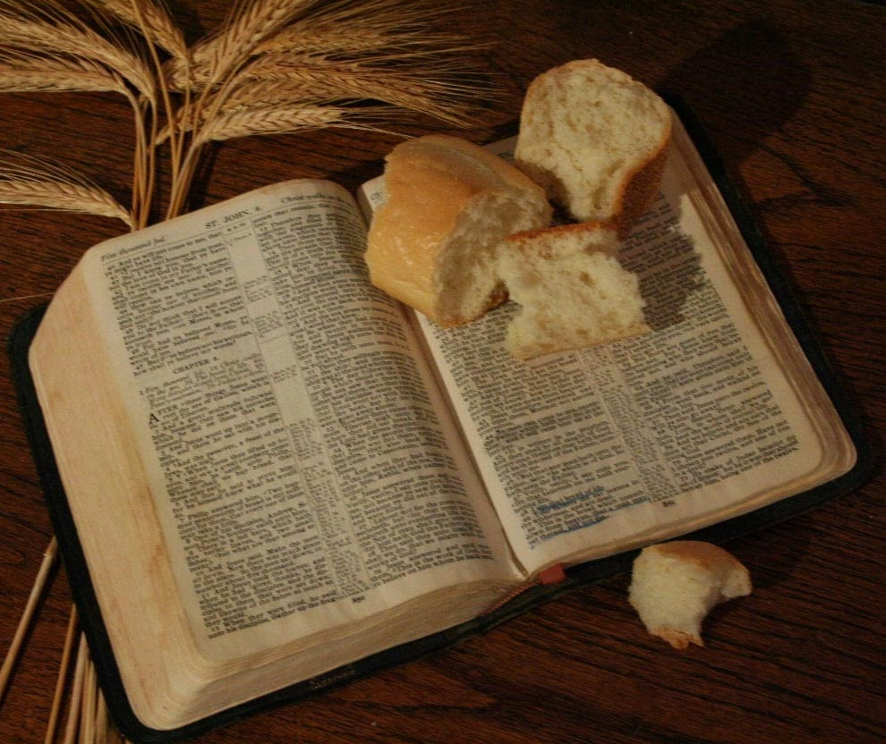
The Symbols Unlocked…
What is the bread?
Like all the offerings, Jesus is the meat offering. He gave His flesh (bread) for the sinner.
John 6:51 “I am the living bread which came down from heaven: if any man eat of this bread, he shall live for ever: and the bread that I will give is my flesh, which I will give for the life of the world.
Matthew 4:4 “But he answered and said, It is written, Man shall not live by bread alone, but by every word that proceedeth out of the mouth of God.”

Slide 9
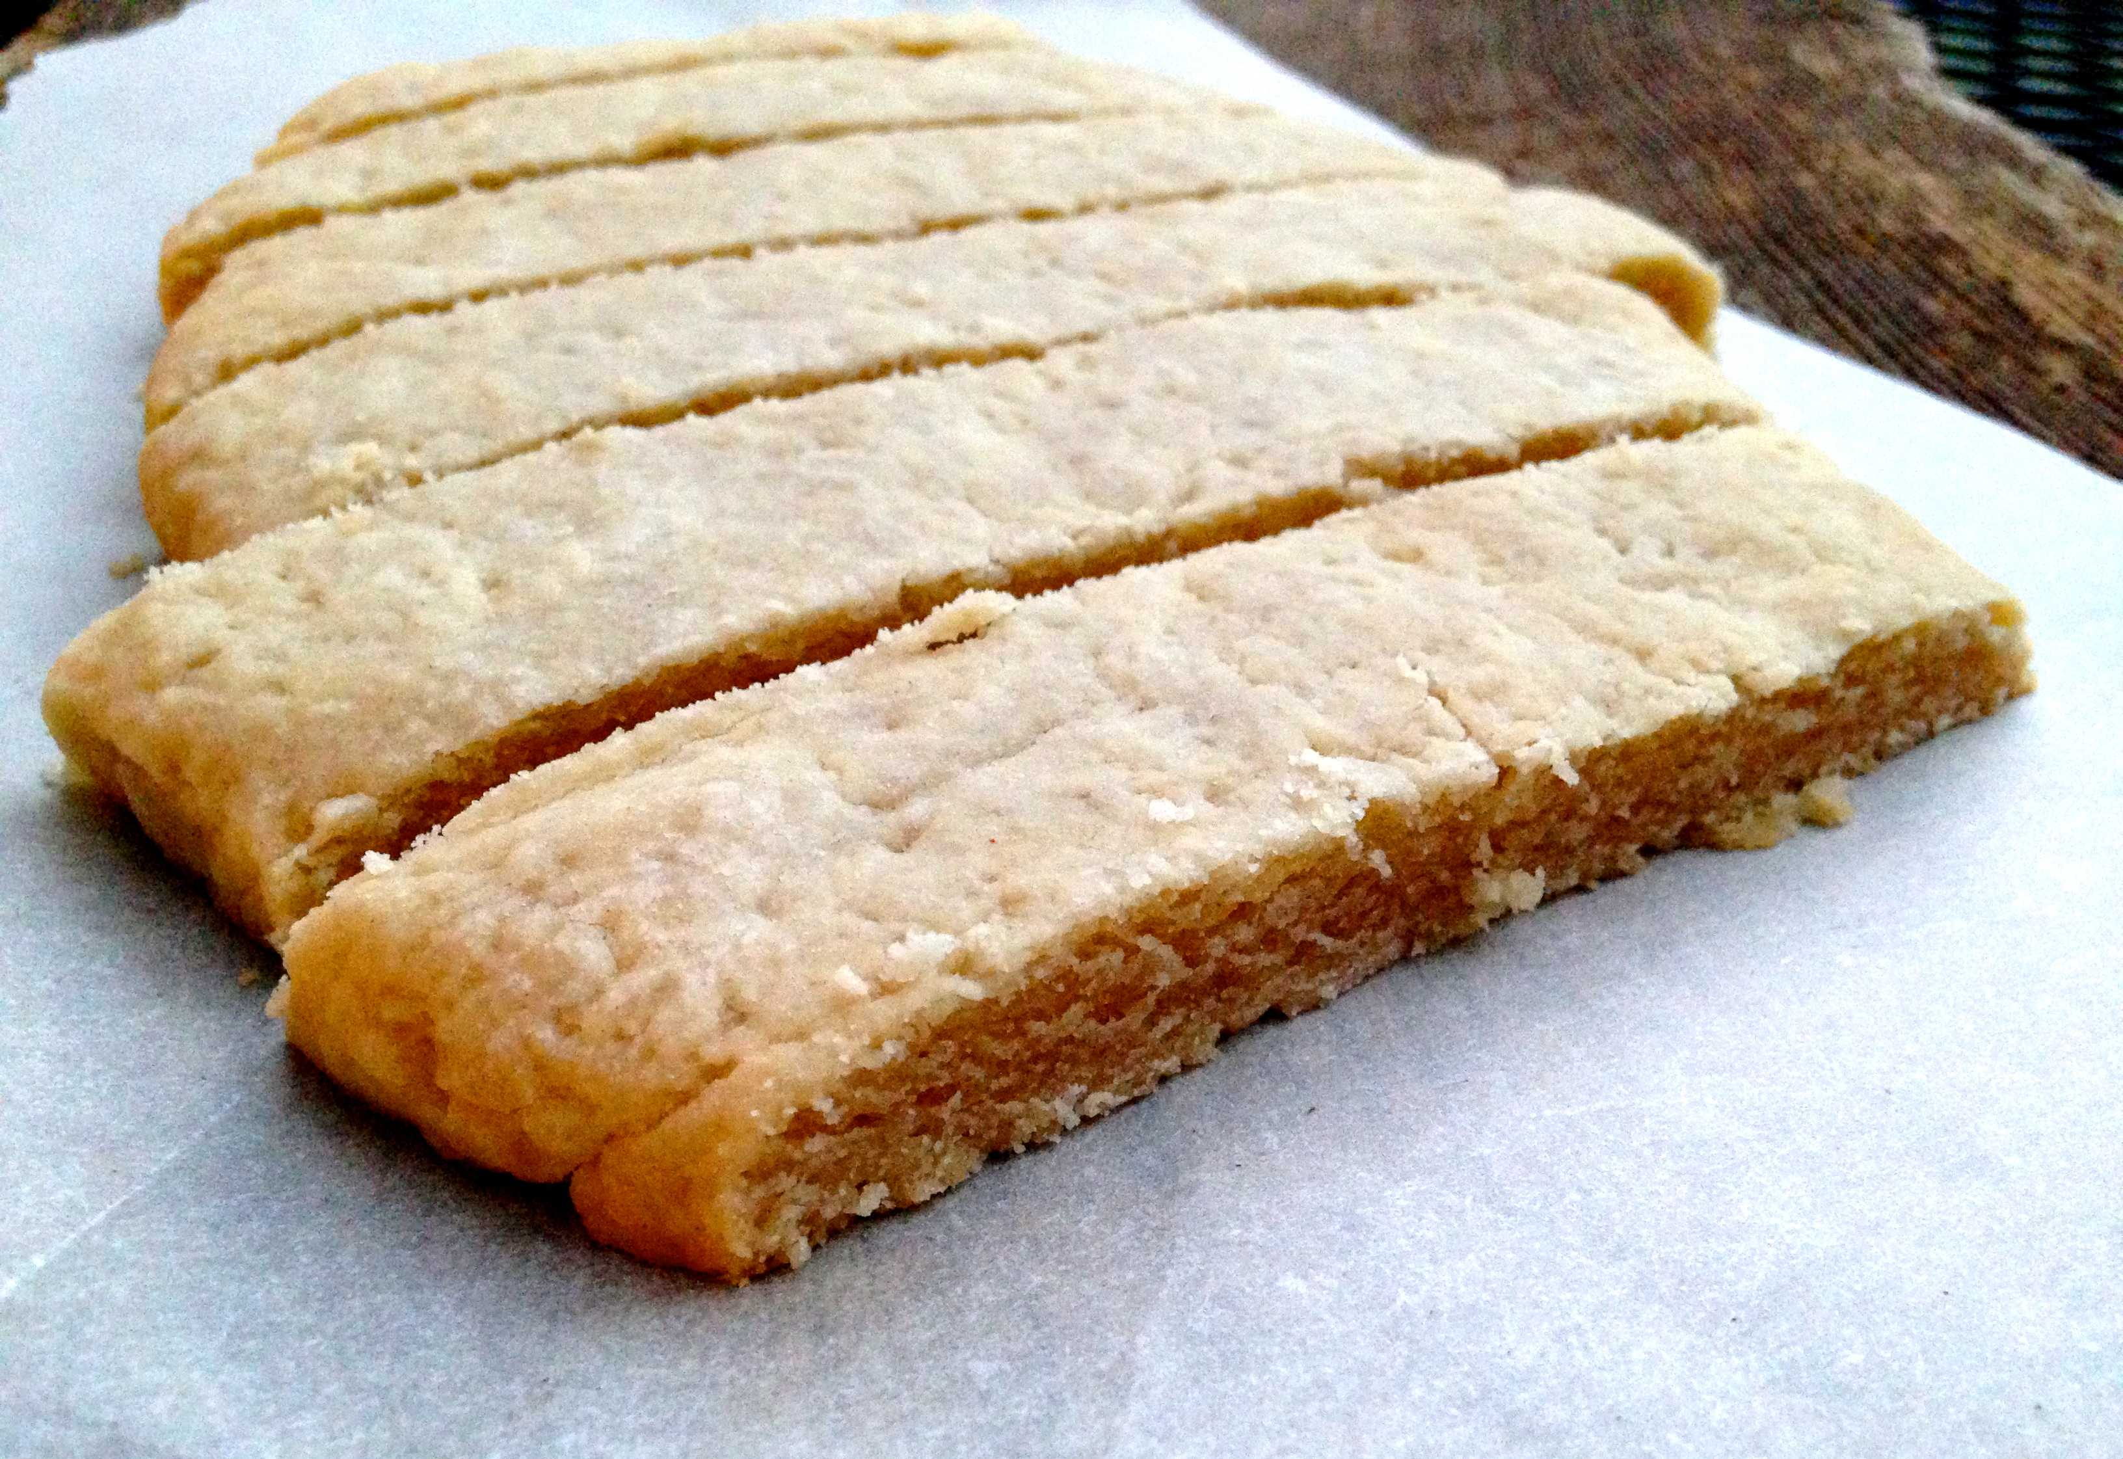
Unleavened, A Requirement!
Lev. 2:5-6, 10-11 “And if thy oblation be a meat offering baken in a pan, it shall be of fine flour unleavened, mingled with oil. Thou shalt part it in pieces, and pour oil thereon: it is a meat offering. . . . And that which is left of the meat offering shall be Aaron's and his sons': it is a thing most holy of the offerings of the Lord made by fire. No meat offering, which ye shall bring unto the Lord, shall be made with leaven: for ye shall burn no leaven, nor any honey, in any offering of the Lord made by fire.
2 Tim. 2:15 “Study to shew thyself approved unto God, a workman that needeth not to be ashamed, rightly dividing the word of truth.”

Slide 10
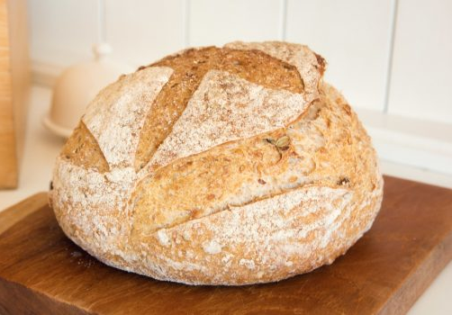
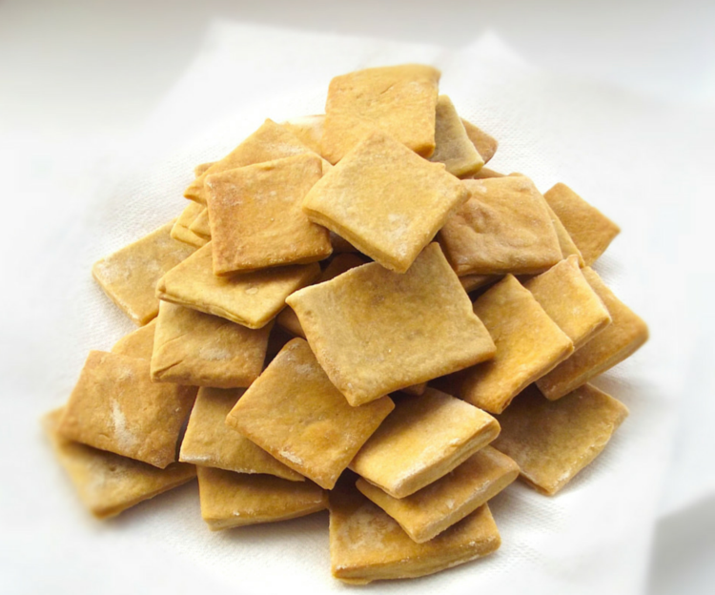
What is Leaven?
Luke 12:1 “In the mean time, when there were gathered together an innumerable multitude of people, insomuch that they trode one upon another, he began to say unto his disciples first of all, Beware ye of the leaven of the Pharisees, which is hypocrisy.”
1 Cor. 5:6-8 “Your glorying is not good. Know ye not that a little leaven leaveneth the whole lump? Purge out therefore the old leaven, that ye may be a new lump, as ye are unleavened. For even Christ our passover is sacrificed for us: Therefore let us keep the feast, not with old leaven, neither with the leaven of malice and wickedness; but with the unleavened bread of sincerity and truth.
VS

Slide 11
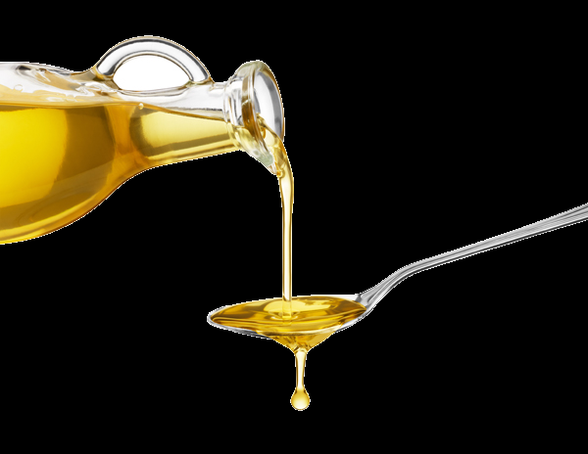
The Oil is the Spirit…
“The golden oil represents the Holy Spirit. With this oil God’s ministers are to be constantly supplied, that they in turn, may impart it to the church.”—Testimonies to Ministers and Gospel Workers, p. 188
What are we to be anointed with?
Acts 10:38 “How God anointed Jesus of Nazareth with the Holy Ghost and with power: who went about doing good, and healing all that were oppressed of the devil; for God was with him.

Slide 12
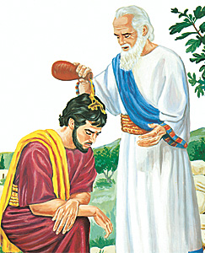
The Anointing of Saul
1 Samuel 10:1, 6 “Then Samuel took a vial of oil, and poured it upon his head, and kissed him, and said, Is it not because the Lord hath anointed thee to be captain over his inheritance? . . . And the Spirit of the Lord will come upon thee, and thou shalt prophesy with them, and shalt be turned into another man.

Slide 13
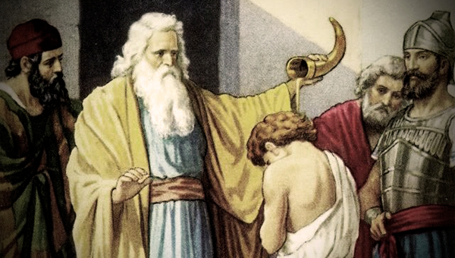
Anointing of David…
1 Sam. 16:13 “Then Samuel took the horn of oil, and anointed him in the midst of his brethren: and the Spirit of the Lord came upon David from that day forward. So Samuel rose up, and went to Ramah.”

Slide 14
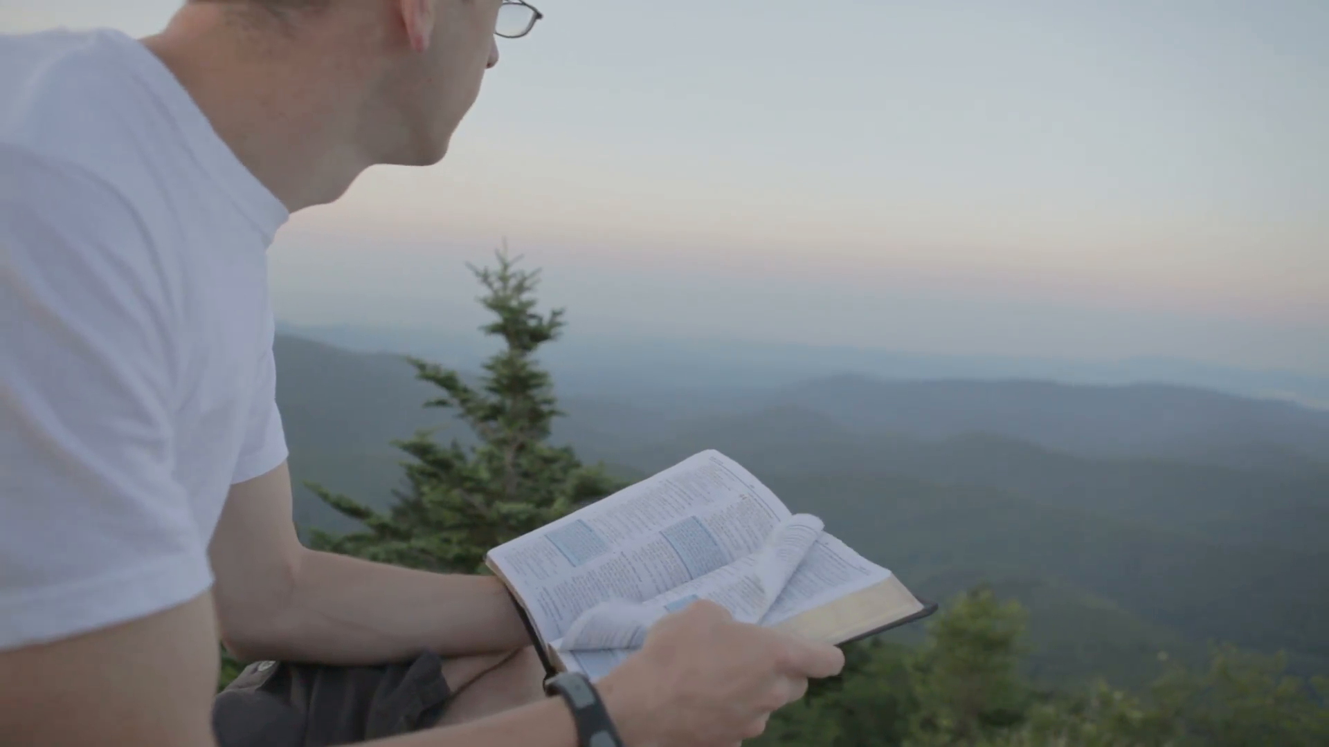
Put the bread and oil together! By Beholding His Word We are changed by the Holy Spirit
2 Cor. 3:18 “But we all, with open face beholding as in a glass the glory of the Lord, are changed into the same image from glory to glory, even as by the Spirit of the Lord.

Slide 15
The Importance of the Spirit
“The mere reading of the Word will not accomplish the result designed of heaven; it must be studied and cherished in the heart. The knowledge of God is not gained without mental effort. We should diligently study the Bible, asking God for the aid of the Holy Spirit, that we may understand His Word. We should take one verse and concentrate the mind on the task of ascertaining the thought which God has put in that verse for us. We should dwell on the thought till it becomes our own, and we know ‘what saith the Lord’”—R&H, June 11. 1908
Heb. 9:14 “How much more shall the blood of Christ, who through the eternal Spirit offered himself without spot to God, purge your conscience from dead works to serve the living God?” (also 2 Pet. 1:4—partaking of the Divine Nature)

Slide 16
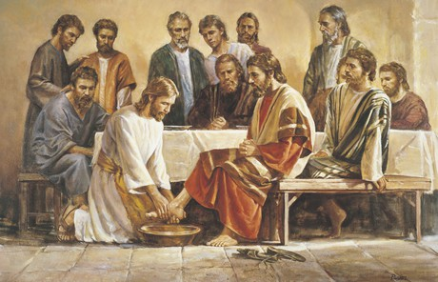
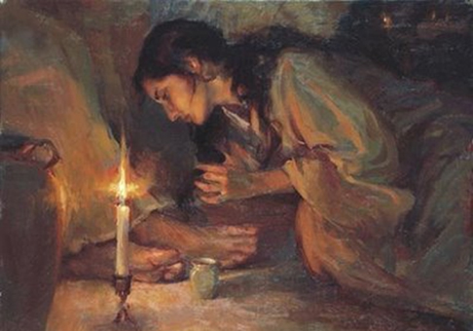
How do we know we have the Spirit?
By their fruits… Gal. 5:22-26 “But the fruit of the Spirit is love, joy, peace, longsuffering, gentleness, goodness, faith, Meekness, temperance: against such there is no law. And they that are Christ's have crucified the flesh with the affections and lusts. If we live in the Spirit, let us also walk in the Spirit. Let us not be desirous of vain glory, provoking one another, envying one another.

Slide 17
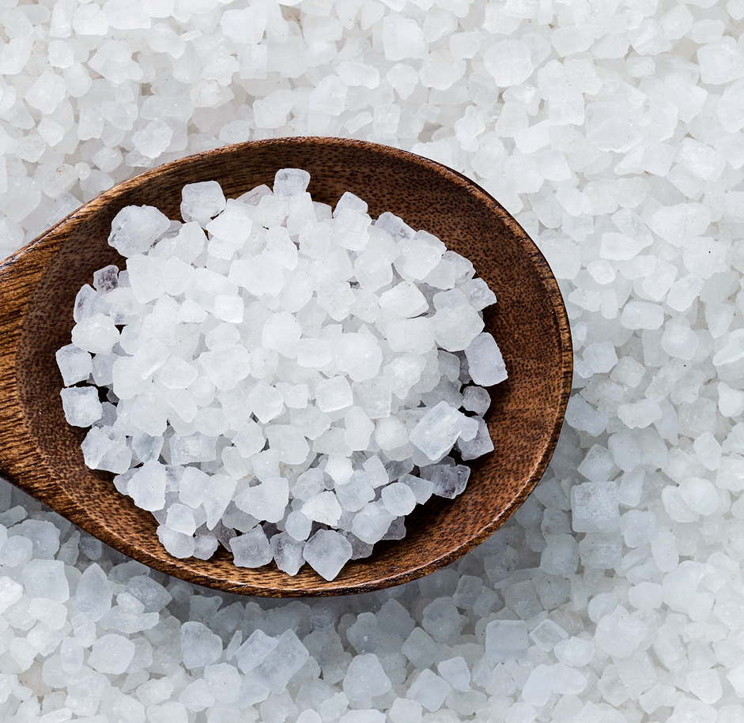
Salt on Everything!!
Lev. 2:13 “And every oblation of thy meat offering shalt thou season with salt; neither shalt thou suffer the salt of the covenant of thy God to be lacking from thy meat offering: with all thine offerings thou shalt offer salt.”
Mark 9:49 “For every one shall be salted with fire, and every sacrifice shall be salted with salt. Salt is good: but if the salt have lost his saltness, wherewith will ye season it? Have salt in yourselves, and have peace one with another.”

Slide 18
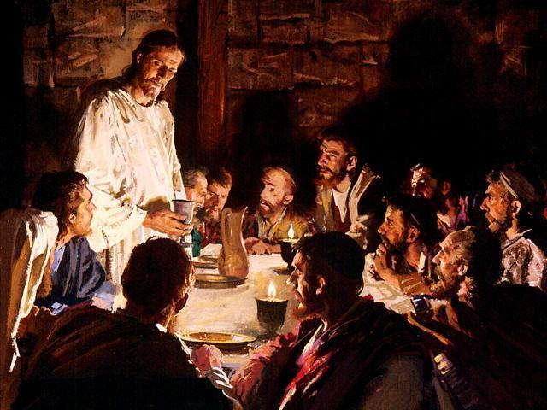
The Drink Offering…
Was to be of wine (Lev. 23:18)
Hebrew word for drink offering (Lev. 23:13, 18) nesek-to pour out
Symbolic of blood (Deut. 32:14—”blood of the grape” & Jesus in the Upper Room Communion)

Slide 19
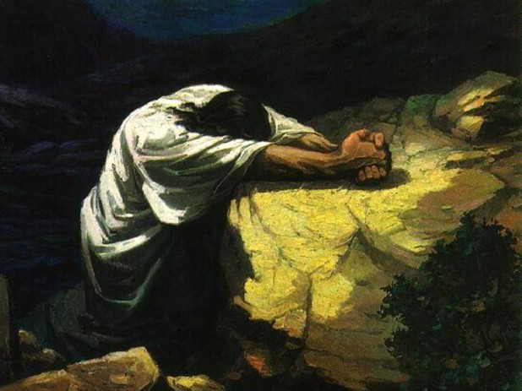
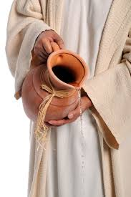
For us? It means the dedication of life unto death
Thine Will be Done O Lord! “Saying, Father, if thou be willing, remove this cup from me: nevertheless not my will, but thine, be done.” Luke 22:42 (the Apostle Paul spoke of being “offered upon the sacrifice” or “poured out” [margin] in Phil. 2:17)
Gen. 35:14 “And Jacob set up a pillar in the place where he talked with him, even a pillar of stone: and he poured a drink offering thereon, and he poured oil thereon.”

