Slide 1
What is the Difference Between Mormons, Jehovah’s Witnesses, and Seventh-day Adventists? pt 25

Slide 2
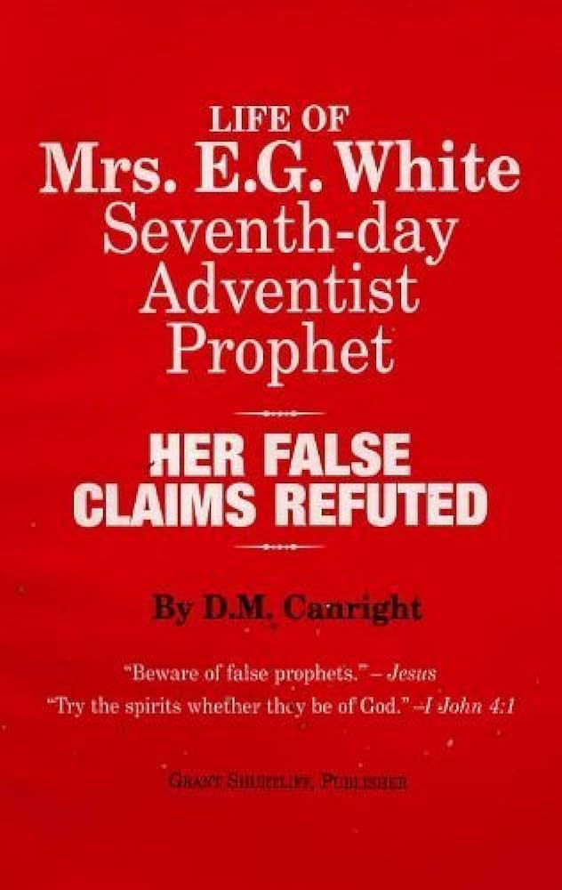
His Final Legacy….
“Canright died on May 12, 1919. Two months later, his final book, The Life of Mrs. E.G. White, was published. In it he criticised White heavily and maintained, among other charges:
that the early doctrines held in 1844 and up to 1851 failed utterly[—SHUT DOOR]
that in some cases her prophecies were wrong, and then suppressed afterwards[—FAILED PROPHECIES]
that she rebuked and controlled peoples' conduct, purportedly by spiritual knowledge, but factually by informings that often attacked an innocent party[—ELLEN WHITE CHARACTER ASSASSINATION]
that she plagiarized many of her purportedly God-inspired texts from other authors, and had to revise one of her books at an expense of $3,000[—PLAGIARISM]” DM Canright, Wikipedia

Slide 3
Word of Caution…
“Light and darkness, truth and error, are before us. We are free to choose. God will never remove all excuse for unbelief. Those who look for hooks to hang their doubts upon, will find them close at hand. It is far easier to suggest doubts than to inspire faith. Because the natural heart is at enmity with God, a greater effort is required to believe than to doubt the word of the Most High. And Satan himself opposes everything that would strengthen faith. There is one course which all must pursue who honestly desire to be freed from doubts. They are cherishing some indulgence forbidden by the word of God, or neglecting some duty enjoined therein. Let those who complain that they walk in darkness, give heed to the light which already shines upon them, and they will receive greater light. Let them do every duty which has been made plain to their understanding, and they will be enabled to understand and perform those of which they are now in doubt. “If any man will do His will, he shall know of the doctrine.” ST, June 8, 1882

Slide 4
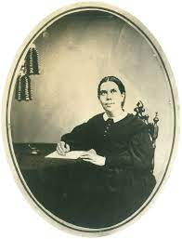
Plagiarism and Ellen White
The most controversial issue by far when questioning the validity of Ellen White as an inspired author is the charge of “plagiarism”—stealing the words or ideas of another with giving proper citation. Many arguments have been made in this line, dating back to the late 1800s [Canright Again] and many books have been published “proving” Ellen White was nothing more than a copy-paste extraordinaire. But is there more to the story?

Slide 5
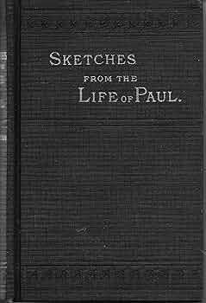

Slide 6
Sketches From the Life of Paul (1883) Life and Epistles of the Apostle Paul (1855)
“The judges sat in the open air, upon seats hewn out in the rock, on a platform which was ascended by a flight of stone steps from the valley below” (p.93)
“Had his oration been a direct attack upon their gods, and the great men of the city who were before him, he would have been in danger of meeting the fate of Socrates” (p.97)
“An extensive and profitable business had grown up at Ephesus from the manufacture and sale of these shrines and images” (p.142)
“Only their reverence for the temple saved the apostle from being torn in pieces on the spot. With violent blows and shouts of vindictive triumph, they dragged him from the sacred enclosure” (p.216)
“The judges sat in the open air, upon seats hewn out in the rock, on a platform which was ascended by a flight of stone steps immediately from the Agora” (p.308)
“Had he begun by attacking the national gods in the midst of their sanctuaries, and with the Areopagites on the seats near him, he would have been in almost as great danger as Socrates before him” (p.310)
“From the expressions used by Luke, it is evident that an extensive and lucrative trade grew up at Ephesus from the manufacture and sale of these shrines (p.432)
“It was only their reverence for the Holy Place which preserved him from being torn to pieces on the spot. They hurried him out of the sacred inclosure and assailed him with violent blows” (p.547)
(Canright, Life of Mrs. E. G. White, p. 195-196)

Slide 7
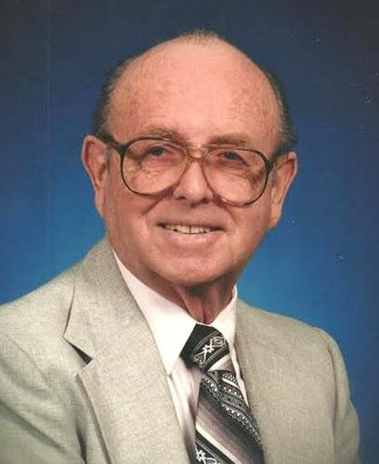
Walter Rea Copy-Pastes Dudley’s Arguments
“While working on my projected volume four (Ellen White’s quotations on Bible doctrines) I happened across something interesting at Orlando, Florida, where I was pastor of the Kress Memorial Church, named for doctors Daniel and Lauretta Kress, noted pioneers in the Adventist medical work. The Kress family gave me an old book by Ellen White, Sketches from the Life of Paul, published in 1883 but never reprinted. When I showed this book to a church member one day, I was told that the problem of the book was that it was too much like another book that had not been written by Ellen White, and that it had never been reprinted because of the close similarities. Being of an inquiring mind, I did a comparison study and discovered that some of the criticism seemed to be true.” Walter Rea, The White Lie, p. 19-20

Slide 8
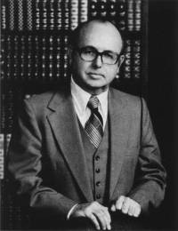
Prophets Borrowing From the Uninspired?
“She used The Great Teacher by John Harris, 1835, which they've admitted. She used The Life of Christ by William Hanna, 1863, which they've admitted. She used The Life of Christ by Farrar, which they have admitted, and others which they have admitted. My book will give a further list of those that she used. The Acts of the Apostles, she used The Life and Epistles of the Apostle Paul by Conybeare and Howson, The Life of Paul by Farrar, The Great Teacher by John Harris, Night Scenes of the Bible by Daniel March, and The Life of Paul by McDuff. And The Great Controversy I've read to you from Willie White, that in the new edition the reader will find more than 400 references to 88 authors and authorities, page 24, Willie White, General Conference, 1911. Patriarchs and Prophets, she used Paradise Lost by Milton Clarks Commentary, Night Scenes of the Bible by March, Edersheim's Old Testament, and even The Aprocrypha which F. D. Nichol talks about in his book published in 1951” Ibid., p. 22-23

Slide 9
Question: Did Ellen White Use/Copy-Paste Uninspired Authors???
Answer: Yes She Did!
Follow Up Questions:
Was it Legally Wrong?
Was it Morally Wrong?
Does this Make Her a False Prophet?

Slide 10
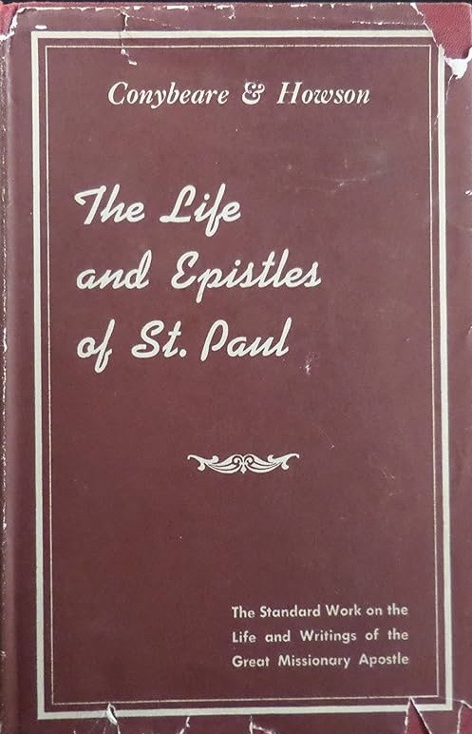
First—The Life and Epistles of Paul
The Conybeare and Howson Book, “Life of Paul” was not a copyrighted work. It could have been, but it wasn’t. It seems that the authors were more concerned with getting the truth out rather than being recognized for the truth they presented. When asked some 30 years later about possible plagiarism, the publishers responded:
“We publish Conybeare's Life and Epistles of the Apostle Paul, but this is not a copyrighted book and we would have no legal grounds for action against your book and we do not think that we have ever raised any objection or made any claim such as you speak of.” (Francis D. Nichol, Ellen G. White and Her Critics (Washington, D.C.: Review and Herald, 1951), pp. 455-457.)

Slide 11
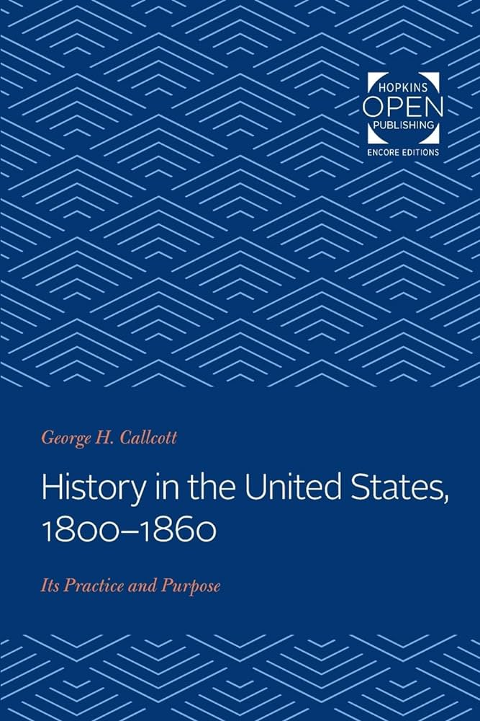
1800s Historians
“Despite their emphasis on honest scholarship, the Romantic historians have suffered grievously at the hands of subsequent scholars, for they have been accused of dishonesty, of altering direct quotations, and of using each other’s material without the scrupulous use of quotation marks. One by one, the early nineteenth-century historians have fallen under attack— Jared Sparks, George Bancroft, John Marshall, David Ramsay, Washington Irving, and Francis Parkman— branded as plagiarists . . . The second major assault by modern scholars on the historians of the early nineteenth century centered about plagiarism, the practice of using in their own works the same phraseology as someone else had used. The early nineteenth-century historian would have been dismayed by the attack, would have pleaded nolo contendere, and would simply have pointed out that he had never pretended to be original when he could find someone else who had satisfactorily said what he had in mind”. George H. Callcott, History of the United States: 1800-1860, p. 128, p. 134

Slide 12
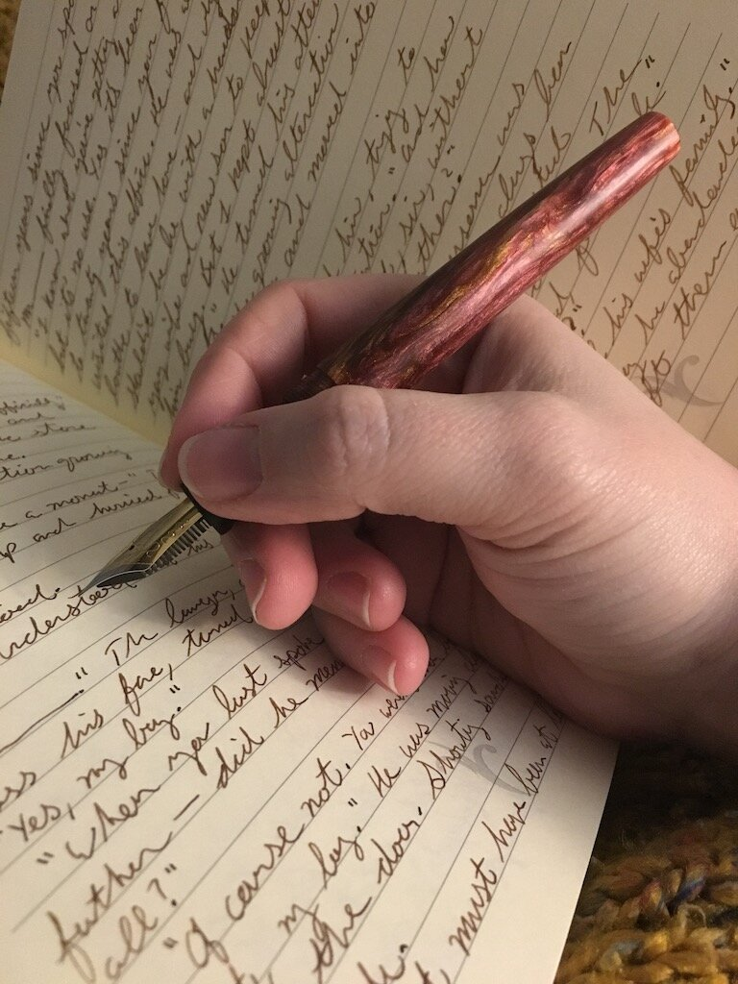
Borrowing a Common Practice!
“Countless lesser historians were as frank. After citing his sources, a typical writer stated that he ‘would here publically [sic] acknowledge that he has often copied their language as well as their facts, and has not been particular to disfigure his page with quotation marks.’ Another glibly explained that his ‘first five chapters . . . are from the admirably written historical sketch in Martin ’s Gazetteer.’ Others openly stated that they ‘had not scrupled” to copy a well-written previous study; that they ‘used substantially an other’s language’; that they utilized the work of others ‘without introducing my authorities’ ; that if a good source was found they had ‘adopted the phraseology of the author entire’; and that they had ‘made use o f them as public property.’” George H. Callcott, History of the United States: 1800-1860, p. 135-136

Slide 13
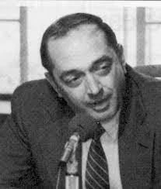
Vincent L Ramik
In 1981, the General Conference contacted a leading copyright expert and authority named Vincent L Ramik. Vincent described himself as a Roman Catholic, but not seriously religious—the perfect person to do this. Vincent was NOT an Adventist, and he had Catholic leanings, but open-minded enough to give a fair critique. The book he was given for review was on of Ellen White’s most criticized works—the Great Controversy. The following is from an interview with Vincent Ramik on September 17, 1981 with Advent Review

Slide 14
Exonerated by a ….. Catholic???
“Ellen White used the writings of others; but in the way she used them, she made them uniquely her own, ethically, as well as legally. And, interestingly, she invariably improved that which she “selected”! Review: Do you have anything you would like to add on this fascinating subject? Ramik: Yes. I believe it was Warren Johns who shared this analogy with me once when we were discussing this case and point. The situation is something like the builder who wishes to build a house. There are certain basic, essential units of building materials that are available to him—windows, doors, bricks, and so on. There are even certain recognizable kinds of textures and styles that have been created by various combinations of these different materials by earlier builders. The builder brings together many of these and uses them. Yet the design of the house, the ultimate appearance, the ultimate shape, the size, the feel, are all unique to the immediate, contemporary builder. He individually puts his own stamp upon the final product—and it is uniquely his. (And he doesn’t say—or need to say—I got this brick here, that door there, this window there, either!) I think it was that way with Ellen White’s use of words, phrases, clauses, sentences, paragraphs, yes, and even pages, from the writings of those who went before her. She stayed well within the legal boundaries of “fair use,” and all the time created something that was substantially greater (and even more beautiful) than the mere sum of the component parts. And I think the ultimate tragedy is that the critics fail to see this. . . . I don’t know whether she was inspired, in the theological sense. I do believe that she was highly motivated. And if it wasn’t God who motivated her, then I don’t know who it could have been.” Was Ellen G. White a Plagiarist?, p. 5, Adventist Review Interview with Vincent L Ramik September 17, 1981

Slide 15
The Reformers Borrowed???
Luther
Tyndale
“This letter is truly the most important piece in the New Testament. It is purest Gospel. It is well worth a Christian's while not only to memorize it word for word but also to occupy himself with it daily, as though it were the daily bread of the soul. It is impossible to read or to meditate on this letter too much or too well. The more one deals with it, the more precious it becomes and the better it tastes. Therefore I want to carry out my service and, with this preface, provide an introduction to the letter, insofar as God gives me the ability, so that every one can gain the fullest possible understanding of it. Up to now it has been darkened by glosses [explanatory notes and comments which accompany a text] and by many a useless comment, but it is in itself a bright light, almost bright enough to illumine the entire Scripture.” Martin Luther, Preface to the Letter of St Paul to the Romans, https://www.ccel.org/l/luther/romans/pref_romans.html
“Forasmuch as this epistle is the principal and most excellent part of the new Testament and most pure evangelion, that is to say glad tidings, and that we call gospel, and also is a light and a way unto the whole scripture; I think it meet that every christian man not only know it, by rote and without the book, but also exercise himself therein evermore continually, as with the daily bread of the soul. No man verily can read it too oft, or study it too well; for the more it is studied, the easier it is; the more it is chewed, the pleasanter it is; and the more groundly it is searched, the preciouser things are found in it, so great treasure of spiritual things lieth hid therein.” William Tyndale, Prologue upon the Epistle of St Paul to the Romans, https://www.bible-researcher.com/romansprologue.html

Slide 16
Plagiarism Questions
Was it Legally Wrong? NO
Was it Morally Wrong?
Does this Make Her a False Prophet?

Slide 17
Ellen White Doesn’t Hide it!
“The great events which have marked the progress of reform in past ages are matters of history, well known and universally acknowledged by the Protestant world; they are facts which none can gainsay. This history I have presented briefly, in accordance with the scope of the book, and the brevity which must necessarily be observed, the facts having been condensed into as little space as seemed consistent with a proper understanding of their application. In some cases where a historian has so grouped together events as to afford, in brief, a comprehensive view of the subject, or has summarized details in a convenient manner, his words have been quoted; but in some instances no specific credit has been given, since the quotations are not given for the purpose of citing that writer as authority, but because his statement affords a ready and forcible presentation of the subject. In narrating the experience and views of those carrying forward the work of reform in our own time, similar use has been made of their published works.” Introduction to the Great Controversy, p. xi, 1888 Edition

Slide 18
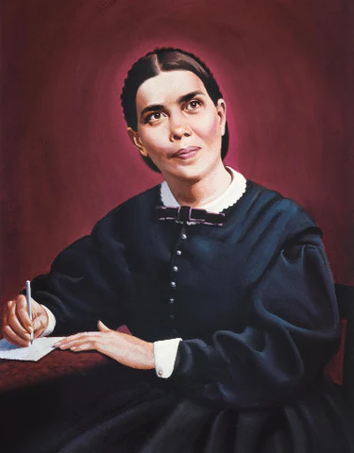
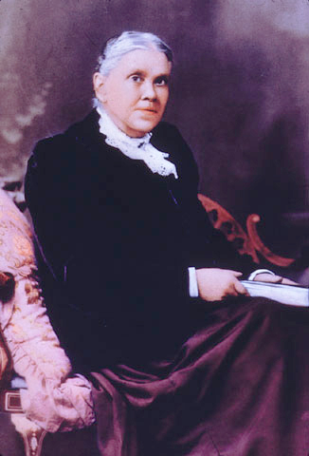
She recommends the books she Borrows from!
Those who wish books will do well to purchase these in preference to the great mass of current literature that will strengthen neither mind nor morals. Many of our people already have the “Life of Christ.” [William Hanna, 1863] The “Life of Paul,” [Conybeare and Howsen, 1855] now offered for sale at this Office, is another useful and deeply interesting work which should be widely circulated . . . . While urging upon all the duty of first bringing their offerings to God, I would not wholly condemn the practice of making Christmas and New Years gifts to our friends. It is right to bestow upon one another tokens of love and remembrance if we do not in this forget God, our best friend. We should make our gifts such as will prove a real benefit to the receiver. I would recommend such books as will be an aid in understanding the word of God, or that will increase our love for its precepts. Provide something to be read during these long winter evenings. For those who can procure it, D'Aubigne's History of the Reformation will be both interesting and profitable. From this work we may gain some knowledge of what has been accomplished in the past in the great work of reform. (R&H, Dec. 26, 1882)

Slide 19
Plagiarism Questions
Was it Legally Wrong? NO
Was it Morally Wrong? NO
Does this Make Her a False Prophet?

Slide 20
Inspired “Selection”?
There are many passages in Scripture, both in the Old and New Testaments which showcase the concept of “inspired selection” or “inspired research”—the biblical prophetic gift of discernment in selecting accurate and authoritative works which were written by uninspired authors and including them into the Holy Scriptures:
OT
1. Parallels to the Flood Story between Genesis and the Epic of Gilgamesh Tablet XI
2. Deut. 19:21 quotes Law of Hammurabi #196 (1810-1750 BC)
3. The books of Kings and Chronicles are inspired research from uninspired sources
4. The Book of Proverbs contains Proverbs from many cultures ranging many centuries
NT
Parable of the Rich Man and Lazarus was a common Jewish parable which ended differently than when Jesus told it: “We have in fact one of the cases where the background to the teaching is more probably found in non-biblical sources.”— I. Howard Marshall, The New International Greek Testament Commentary: The Gospel of Luke, p. 634
Parable of the Workers in the Vineyard (Matt. 20:1-16) was standard Jewish parable which they were still telling at funeral orations in 325 AD (see Jerusalem Talmud Rabbi Ze’era)
Jesus took the parable of the Good Samaritan from 2 Chron. 28:15
The Golden Rule was a common saying during the days of Christ, used by Hilel the Elder from his Shabbat 31a (died 10 AD)
Acts 17:28 quotes Pagan Philosopher Aratus (315-240s BC)
1 Cor. 15:33 quotes Menander’ play Thais (342-292 BC)
Titus 1:12 quotes Stoic Epimenides of Phaestus in his treatise “concerning oracles” (600s-500s BC)

Slide 21
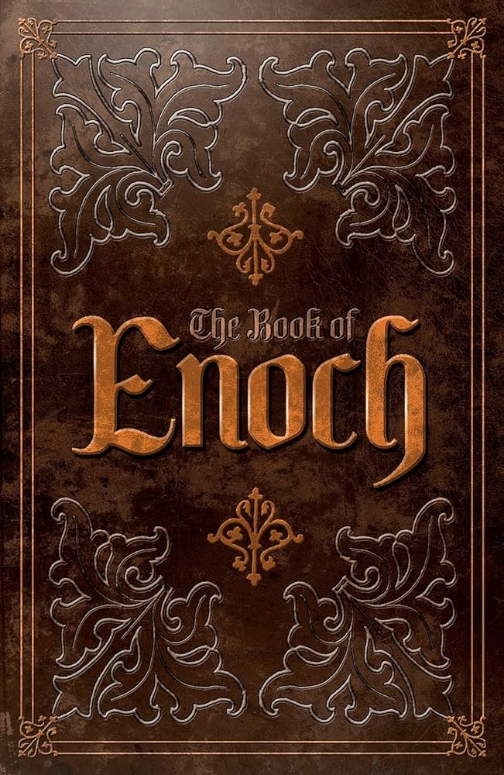
Jude a Plagiarist???…
8. Enoch 1:9 “And behold! He cometh with ten thousands of His holy ones to execute judgement upon all, And to destroy all the ungodly: And to convict all flesh Of all the works of their ungodliness which they have ungodly committed, And of all the hard things which ungodly sinners have spoken against Him.”
Jude 14,15 “And Enoch also, the seventh from Adam, prophesied of these, saying, Behold, the Lord cometh with ten thousands of his saints, To execute judgment upon all, and to convince all that are ungodly among them of all their ungodly deeds which they have ungodly committed, and of all their hard speeches which ungodly sinners have spoken against him.”
9. Luke 1:1-4 “Forasmuch as many have taken in hand to set forth in order a declaration of those things which are most surely believed among us, Even as they delivered them unto us, which from the beginning were eyewitnesses, and ministers of the word; It seemed good to me also, having had perfect understanding of all things from the very first, to write unto thee in order, most excellent Theophilus, That thou mightest know the certainty of those things, wherein thou hast been instructed.”

Slide 22
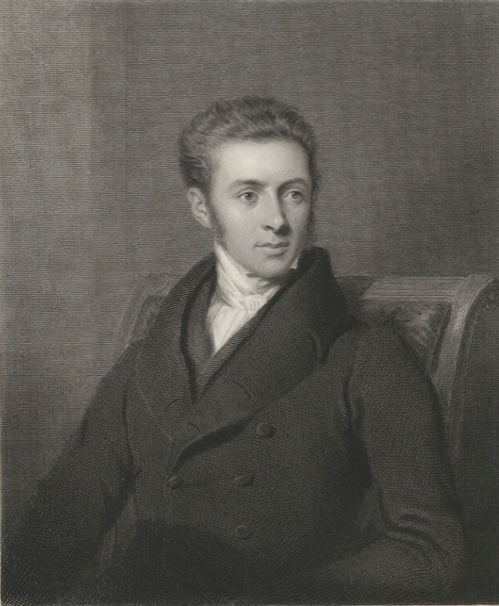
John Harris book, The Great Teacher Author
John Harris (1802-1856): “Suppose, for example, an inspired prophet were now to appear in the church, to add a supplement to the canonical books, – what a babel of opinions would he find existing on almost every theological subject! – and how highly probable is it that his ministry would consist, or seem to consist, in the mere selection and ratification of such of these opinions as accorded with the mind of god. Absolute originality would seem to be impossible. The inventive mind of man has already bodied forth speculative opinions in almost every conceivable form; forestalling and robbing the future of its fair proportion of novelties; and leaving it little more, even to a divine messenger, than the office of taking some of these opinions, and impressing them with the seal of heaven” (The Great Teacher, p. xxxi, 1836).

Slide 23
Plagiarism Questions
Was it Legally Wrong? NO
Was it Morally Wrong? NO
Does this Make Her a False Prophet? NO, If Ellen White is uninspired then so is Moses, Solomon, Kings and Chronicles, Jesus, Paul, Jude, Matthew and Luke! They all borrowed!

Slide 24
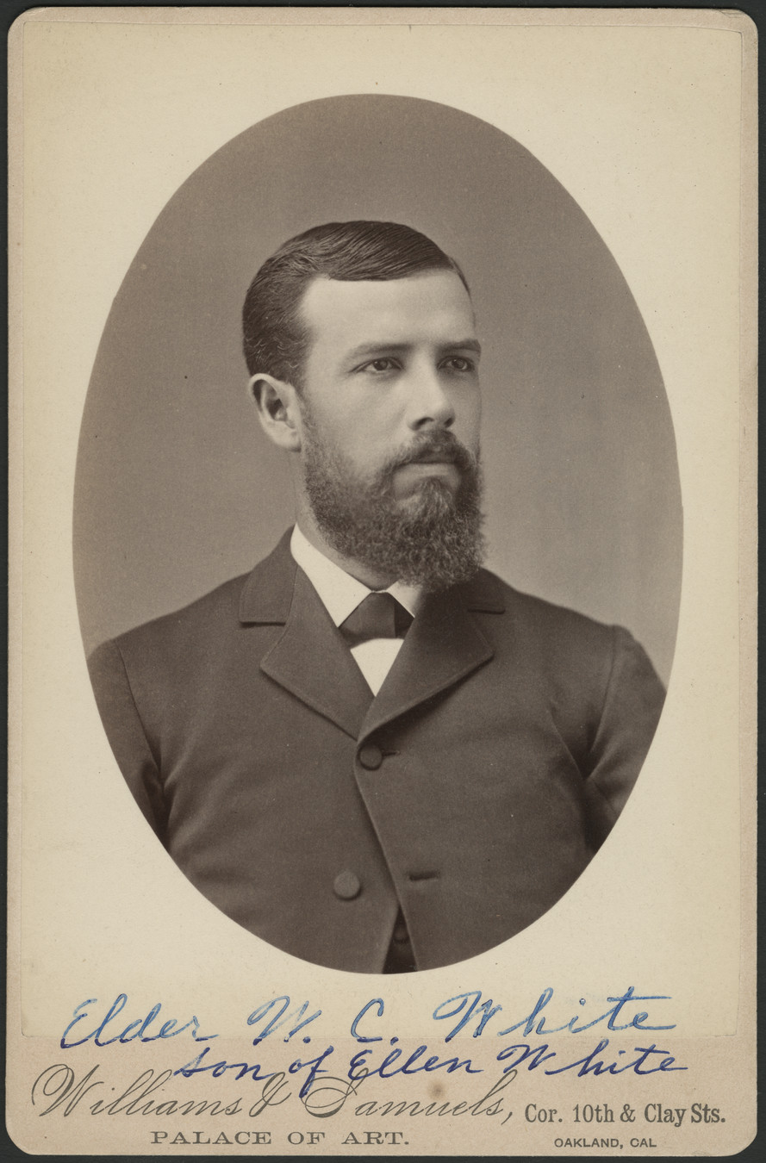
An Interesting View
On the topic of Ellen White and James White borrowing from other pioneers, Ellen White’s son W.C. White stated:
“All felt that the truths to be presented were common property and wherever one could help another or get help from another in the expression of Biblical truths, it was considered right to do so. Consequently there were many excellent statements of present truth copied by one writer from another. And no man said that aught which he wrote was exclusively his own” WC White, Brief Statements, p. 7

Slide 25
Final Word
Ellen White was a prophetess with multiple gifts. She could have visions like Daniel and John, write inspired private letters like Peter, John, and Paul AND do inspired research like Matthew, Luke, Solomon, and the historians of the books of Kings and Chronicles. Ellen White borrowed. Borrowing is not wrong. Countless Bible authors did it. William Tyndale did it. Jesus did it! Obviously, what we view as plagiarism today is not unethical in the eyes of God. Our scholarly standards have changed and added more rules—and we now turn and judge God by the rules we’ve set up—it does not, and should not work like that.

