Slide 1
Prophecy Update! 2-24-24
Hegelian Dialectic at Work

Slide 2
Hegel’s View of World Events
It is disgusting to deal with people who use big words to create confusion rather than explaining something simply! George Hegel, a German philosopher, proposed an analysis of history whereby you pit two ideas or foes against each other, letting them thrash it out. He called these two opposites the thesis and antithesis. Once they have thrashed it out, then you bring forward the secret or hidden goal, which Hegel called the synthesis. The synthesis is what the two foes created by their battle!!
We clearly see this happening today in our world and it is directly heading, as the Bible and Ellen White predicted, to a Sunday Law!! Watch and see!

Slide 3
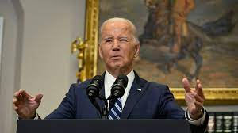
The Liberal Side
President Biden has been told to legislate immorality, and because his masters, the Jesuits, have so much blackmail material on him and his family, he readily obeys their orders! We can call this agenda the thesis!
Under his administration:
1. Community bathrooms for both men and women.
2. Men becoming women and women becoming men.
3. Men becoming women and competing against women in athletics!
4. Biden needs to apologize to Sodom and Gomorrah!!

Slide 4

Legislate Morality!
Using the rule of law to pass his immoral agenda, Biden has deeply divided the country on these issues! While some feel this is just the status quo, others feel that it is totally disgusting! Out of this anger is emerging a plan to legislate morality! Out of this anger is emerging a knight in shining armor who will use government to legislate what good , religious people think is moral and good and we will call his agenda the antithesis!

Slide 5

The Knight to Save America!
He had served briefly in the Louisiana state house, but he was better known as an attorney pursuing conservative causes. “Some people are called to pastoral ministry,” he said, when he first ran for Congress. “I was called to legal ministry, and I’ve been out on the front lines of the ‘culture war.’ ” As an attorney and spokesperson for the Alliance Defending Freedom, a right-wing advocacy organization, he appeared twice before the Louisiana Supreme Court to defend the state’s ban on same-sex marriage.” The New Yorker, October 25, 2023

Slide 6
Who Backs Johnson?
Rep. Mike Johnson of Louisiana won the speakership nomination for the House Republican Conference Tuesday. Heritage Foundation President Dr. Kevin Roberts made the following statement:
“As I have said repeatedly, the speakership is not about any one person, but about who will fight for the everyday American and their interests over the power of the Washington Swamp. I congratulate my good friend Speaker-designate Mike Johnson. As a former Republican Study Committee chairman and current vice chair of the House Republican Conference, Johnson has both a tremendous conservative track record and a willingness to listen to his colleagues and put the will of the conference and the American people first.
“This kind of conservative servant leadership ought to unite House Republicans. All of us at Heritage look forward to working with Speaker Johnson to secure the border, rein in spending, conduct serious oversight of the Biden administration, and provide real leadership on the world stage. It’s time to get to work.” Heritage.org

Slide 7
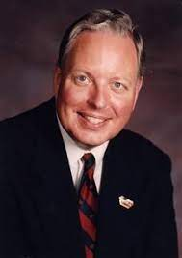
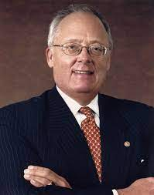
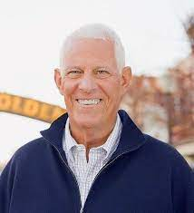
Who is Behind Heritage?
The Heritage Foundation was founded on February 16, 1973 during the Nixon administration by Paul Weyrich, Edwin Feulner, and Joseph Coors. Growing out of the new business activist movement inspired by the Powell Memorandum, discontent with Richard Nixon's embrace of the "liberal consensus" and the nonpolemical, cautious nature of existing think tanks, Weyrich and Feulner sought to create a version of the Brookings Institution that advanced conservative activism. Weyrich and Feulner were educated and devout Catholics while Coors was a strong evangelical!!

Slide 8

Heritage Foundation Goals
It will be on these seven fronts that The Heritage Foundation will make our stand, to:
Empower parents to make education choices,
Secure America’s borders and reduce crime,
Ensure free and fair elections,
Reverse the growth of regulations, spending, and inflation,
Counter the threat of Communist China,
Hold Big Tech accountable, and
Protect unborn life and family formation.

Slide 9

Great Goals!!
In the light of our modern, Bidenesque presidency, who would not be interested in these goals.
Education alternatives, securing our borders, fighting and curbing crime, honest elections, holding off inflation, keeping China subdued, holding Big Tech accountable, and protecting the unborn!! Who can’t accept these awesome ideals??

Slide 10
A Hidden Agenda
Meanwhile in his chapter on the U.S. Department of Labor, Jonathan Berry frames his proposals as part of divine history. “The Judeo-Christian tradition, stretching back to Genesis, has always recognized fruitful work as integral to human dignity, as service to God, neighbor, and family,” he writes, while claiming the Biden administration “has been hostile to people of faith.”
Berry worries that “God ordained the Sabbath as a day of rest, and until very recently the Judeo-Christian tradition sought to honor that mandate by moral and legal regulation of work on that day” and blames consumerism and secularism for the decline in Sabbath observance.
But he’s not content to reminisce about the good ol’ days when Americans went to church. He wants the federal government to push people back to church, and calls on Congress to “encourage communal rest by amending the Fair Labor Standards Act (FLSA) to require that workers be paid time and a half for hours worked on the Sabbath.” Berry argues this would lead to higher costs that would reduce work on the Sabbath.

Slide 11

Johnson, Heritage Found., and Project 2025
“Project 2025” is saying the quiet part out loud: Right-wing groups do not want to ensure all Americans have religious freedom, but want to impose conservative Christian views on our religiously-diverse country.
The federal government does not need to worry about saving souls.
Instituting “biblically based” policies, saving souls and inducing Sabbath observance constitute a direct attack on religious freedom, a freedom guaranteed by the First Amendment, which keeps the government out of religion.”

Slide 12
She Knew What She was Saying
“Yet this very class put forth the claim that the fast-spreading corruption is largely attributable to the desecration of the so-called “Christian sabbath,” and that the enforcement of Sunday observance would greatly improve the morals of society. This claim is especially urged in America, where the doctrine of the true Sabbath has been most widely preached….But the fact that a movement to establish error is connected with a work which is in itself good, is not an argument in favor of the error. We may disguise poison by mingling it with wholesome food, but we do not change its nature. On the contrary, it is rendered more dangerous, as it is more likely to be taken unawares. It is one of Satan's devices to combine with falsehood just enough truth to give it plausibility. The leaders of the Sunday movement may advocate reforms which the people need, principles which are in harmony with the Bible; yet while there is with these a requirement which is contrary to God's law, His servants cannot unite with them. Nothing can justify them in setting aside the commandments of God for the precepts of men.” GC, pg. 587

Slide 13
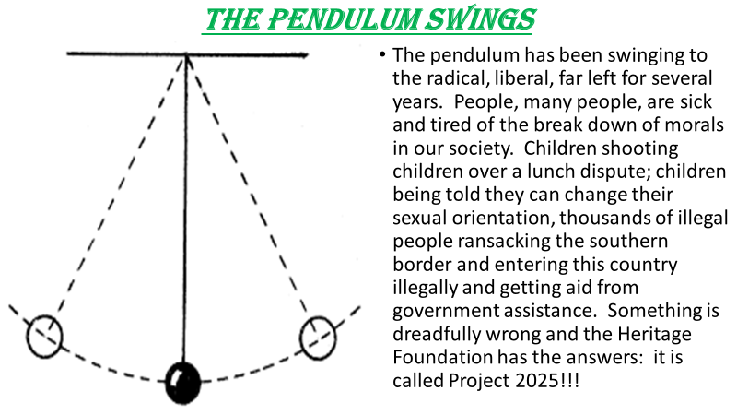
Do We Now See?

Slide 14

The Evangelical, papal knight
The pendulum that has gone hard left for many years could very well swing back far to the right in the next few years. Heaven decides the time!!! Mike Johnson and the Heritage Foundation are ready to do just that!! And prophecy has foretold what the ultimate goal will be!! “The leaders of the Sunday movement may advocate reforms which the people need, principles which are in harmony with the Bible; yet while there is with these a requirement which is contrary to God's law, His servants cannot unite with them. Nothing can justify them in setting aside the commandments of God for the precepts of men.” GC, pg. 587

