Slide 1
Revelation 2
A Look at the First 4 Churches

Slide 2
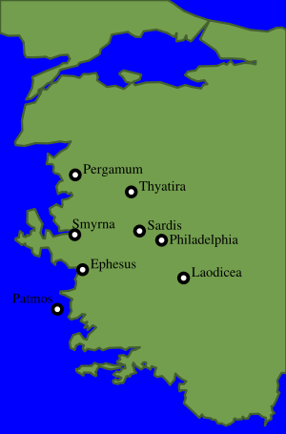
Churches in John’s Day

Slide 3
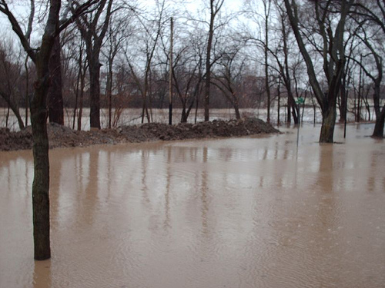
Ephesus
The churches in Revelation 2 and 3 have application in 3 different ways.
1. They apply to literal churches in John’s day.
2. They apply to individual Christians who manifest such characteristics.
3. They apply historically to the Christian Church from John’s day till the end of time. This will be the focus of our study.

Slide 4
Confirmed
“The names of the seven churches are symbolic of the church in different periods of the Christian Era. The number 7 indicates completeness, and is symbolic of the fact that the messages extend to the end of time, while the symbols used reveal the condition of the church at different periods in the history of the word.
Christ is spoken of as walking in the midst of the golden candlesticks. Thus is symbolized His relation to the churches. He is in constant communication with His people. He knows their true state. He observes their order, their piety, their devotion.” AA, pgs. 585,586

Slide 5
Ephesus 31-100 AD
“Unto the angel of the church of Ephesus write; These things saith he that holdeth the seven stars in his right hand, who walketh in the midst of the seven golden candlesticks; I know thy works, and thy labour, and thy patience, and how thou canst not bear them which are evil: and thou hast tried them which say they are apostles, and are not, and hast found them liars: And hast borne, and hast patience, and for my name's sake hast laboured, and hast not fainted. Nevertheless I have somewhat against thee, because thou hast left thy first love. Remember therefore from whence thou art fallen, and repent, and do the first works; or else I will come unto thee quickly, and will remove thy candlestick out of his place, except thou repent. But this thou hast, that thou hatest the deeds of the Nicolaitans, which I also hate. He that hath an ear, let him hear what the Spirit saith unto the churches; To him that overcometh will I give to eat of the tree of life, which is in the midst of the paradise of God.” Revelation 2:1-7

Slide 6
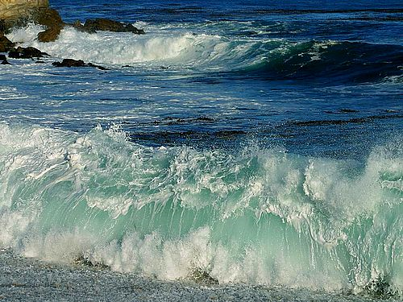
Left their first love
The early church was known for its evangelistic fervor. (Colossians 1:23 declares “which ye have heard, [and] which was preached to every creature…”) However, after a time, they lost their focus on evangelism and started going after new theories and ideas and were rebuked for this!

Slide 7
The Nicolaitines
To every church, a promise is given to the over comer. To the church of Ephesus is given the promise of the tree of life. Adam and Eve lost access to this tree by their disobedience and those who will partake of its fruit will be those, who through faith in Jesus Christ, have learned the lesson of sin and have gained victory over sin.
“Now unto him that is able to keep you from falling, and to present you faultless before the presence of his glory with exceeding joy,” Jude 24
“Whereby are given unto us exceeding great and precious promises: that by these ye might be partakers of the divine nature, having escaped the corruption that is in the world through lust.” 2Peter 1:4
“But the doctrine is now largely taught that the gospel of Christ has made the law of God of none effect; that by "believing" we are released from the necessity of being doers of the word. But this is the doctrine of the Nicolaitans, which Christ so unsparingly condemned…They declare that we have only to believe on Jesus Christ, and that faith is all-sufficient: that the righteousness of Christ is to be the sinner's credentials; that this imputed righteousness fulfills the law for us, and that we are under no obligation to obey the law of God.” Bible Echo, February 8, 1897

Slide 8
Smyrna 100-313 AD
“And unto the angel of the church in Smyrna write; These things saith the first and the last, which was dead, and is alive; I know thy works, and tribulation, and poverty, (but thou art rich) and I know the blasphemy of them which say they are Jews, and are not, but are the synagogue of Satan. Fear none of those things which thou shalt suffer: behold, the devil shall cast some of you into prison, that ye may be tried; and ye shall have tribulation ten days: be thou faithful unto death, and I will give thee a crown of life. He that hath an ear, let him hear what the Spirit saith unto the churches; He that overcometh shall not be hurt of the second death.” Revelation 2:8-11

Slide 9

Persecution from Pagan Rome
During this time of Smyrna, there were many who claimed to be following Christ, but they were actually following the devil.
“The same principle that actuated Satan in the courts of heaven to war against God is now working in the children of disobedience, and actuates them to manufacture spurious commandments that contradict the statutes of Jehovah.” ST, 6-11-1894
It was also a time of great persecution for the followers of Christ. Nearly all the Roman Emperors during that time persecuted the followers of Christ. The persecution culminated in the 10 year period of 303-313 when Diocletian started killing Christians!

Slide 10
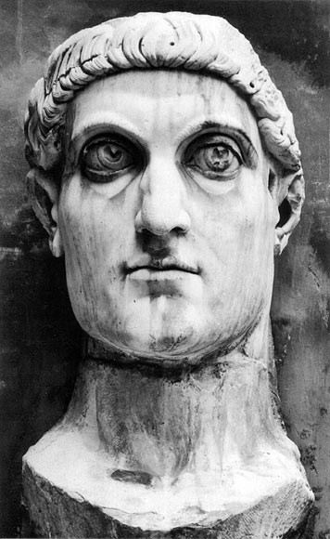
10 Years of Persecution
Diocletian started the 10 year period of persecution. The year-day principle applies here; 10 days=10 years. This period of 10 years ended with the Edict of Milan that was passed by Constantine in 313 AD. This Edict stopped the persecution, but paved the way for the paganism that now walked into the church. This time of church history, along with Philadelphia, were the only times the church remained pure! Not even Ephesus was pure!

Slide 11
Pergamos 313-538
“And to the angel of the church in Pergamos write; These things saith he which hath the sharp sword with two edges; I know thy works, and where thou dwellest, even where Satan's seat is: and thou holdest fast my name, and hast not denied my faith, even in those days wherein Antipas [was] my faithful martyr, who was slain among you, where Satan dwelleth. But I have a few things against thee, because thou hast there them that hold the doctrine of Balaam, who taught Balac to cast a stumblingblock before the children of Israel, to eat things sacrificed unto idols, and to commit fornication. So hast thou also them that hold the doctrine of the Nicolaitans, which thing I hate. Repent; or else I will come unto thee quickly, and will fight against them with the sword of my mouth. He that hath an ear, let him hear what the Spirit saith unto the churches; To him that overcometh will I give to eat of the hidden manna, and will give him a white stone, and in the stone a new name written, which no man knoweth saving he that receiveth [it].” Revelation 2:12-17

Slide 12
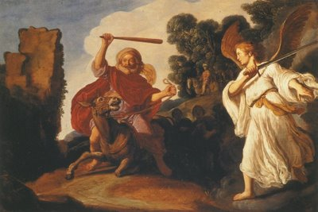
The Donkey Spoke
No more fitting character could fit the church of this time period; it was a time of great compromise. With the conversion of Constantine in the early part of the 4th century, the world walked into the church and the horrors of paganism took over.
“The spirit of compromise and conformity was restrained for a time by the fierce persecutions which the church endured under paganism. But as persecution ceased, and Christianity entered the courts and palaces of kings, she laid aside the humble simplicity of Christ and His apostles for the pomp and pride of pagan priests and rulers; and in place of the requirements of God, she substituted human theories and traditions. The nominal conversion of Constantine,… caused great rejoicing; and the world, cloaked with a form of righteousness, walked into the church. Now the work of corruption rapidly progressed. Paganism, while appearing to be vanquished, became the conqueror.” GC, pg. 49,50

Slide 13
Compromise
From Numbers 22-24, we find Balaam was the great compromiser. He would do anything for money, even go against God and His people. He perverted the worship of God in order to curse God’s people. Balaam used enchantments and wizardry to try to bring a curse upon God’s people. When everything failed, it was Balaam that told the Midianite women to steal into the camp and seduce the Israelites away from God. “Behold, these caused the children of Israel, through the counsel of Balaam, to commit trespass against the LORD in the matter of Peor, and there was a plague among the congregation of the LORD.” Numbers 31:16

Slide 14
Pagans and Christians Unite
This compromise between paganism and Christianity resulted in the development of "the man of sin" foretold in prophecy as opposing and exalting himself above God. That gigantic system of false religion is a masterpiece of Satan's power--a monument of his efforts to seat himself upon the throne to rule the earth according to his will. Satan once endeavored to form a compromise with Christ. He came to the Son of God in the wilderness of temptation, and showing Him all the kingdoms of the world and the glory of them, offered to give all into His hands if He would but acknowledge the supremacy of the prince of darkness. Christ rebuked the presumptuous tempter and forced him to depart. But Satan meets with greater success in presenting the same temptations to man. To secure worldly gains and honors, the church was led to seek the favor and support of the great men of earth; and having thus rejected Christ, she was induced to yield allegiance to the representative of Satan--the bishop of Rome.” GC, pg. 50

Slide 15
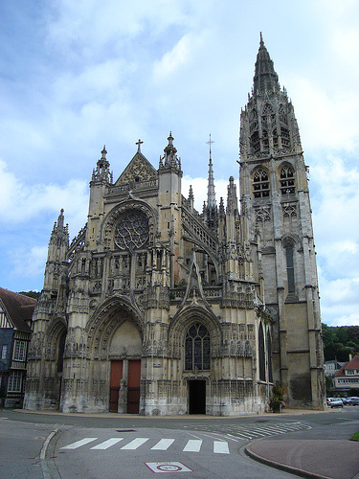
Even the Nicolaitines Come in!
During this time of horrible apostasy, the doctrine came into the church that a man could be saved in his sins. This was the doctrine of the Nicolaitines. There were those in this time, called antipas, or anti church fathers, who were commended for their faithfulness. They refused the inroads of paganism into the church.

Slide 16
Thyatira- 538-1517
“And unto the angel of the church in Thyatira write; These things saith the Son of God, who hath his eyes like unto a flame of fire, and his feet [are] like fine brass; I know thy works, and charity, and service, and faith, and thy patience, and thy works; and the last [to be] more than the first. Notwithstanding I have a few things against thee, because thou sufferest that woman Jezebel, which calleth herself a prophetess, to teach and to seduce my servants to commit fornication, and to eat things sacrificed unto idols. And I gave her space to repent of her fornication; and she repented not. Behold, I will cast her into a bed, and them that commit adultery with her into great tribulation, except they repent of their deeds. And I will kill her children with death; and all the churches shall know that I am he which searcheth the reins and hearts: and I will give unto every one of you according to your works. But unto you I say, and unto the rest in Thyatira, as many as have not this doctrine, and which have not known the depths of Satan, as they speak; I will put upon you none other burden. But that which ye have [already] hold fast till I come. And he that overcometh, and keepeth my works unto the end, to him will I give power over the nations: And he shall rule them with a rod of iron; as the vessels of a potter shall they be broken to shivers: even as I received of my Father. And I will give him the morning star. He that hath an ear, let him hear what the Spirit saith unto the churches.” Revelation 2:18-29

Slide 17
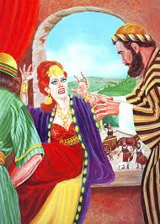
Jezebel
No one represented the church of the Dark Ages, the papacy, better than Jezebel. Her characteristics include:
1. set up a false sanctuary system.
2. set up traditions above the 10 commandments.
3. persecuted the followers of Christ.
4. used the court system to get what she wanted.
All of these characteristics can be found in 1 Kings, chapters 16-21.

Slide 18
Papacy
“This compromise between paganism and Christianity resulted in the development of "the man of sin" foretold in prophecy as opposing and exalting himself above God. That gigantic system of false religion is a masterpiece of Satan's power--a monument of his efforts to seat himself upon the throne to rule the earth according to his will.”… To secure worldly gains and honors, the church was led to seek the favor and support of the great men of earth; and having thus rejected Christ, she was induced to yield allegiance to the representative of Satan--the bishop of Rome.
It is one of the leading doctrines of Romanism that the pope is the visible head of the universal church of Christ, invested with supreme authority over bishops and pastors in all parts of the world.” GC, pg. 50

Slide 19
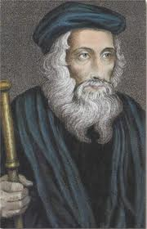
The Faithful-John Wycliffe
No matter how bad it got during the Dark Ages of Rome, God has always had His faithful ones. During this time of darkness, the Walden sees, the Hussites, and Albigences of France were alive and sharing Christ with others. Never has there been a time when God did not have His faithful witnesses for the truth.

Slide 20
Summary of Revelation 2
Revelation 2 looks at the church from the time of the Apostolic Era down through the Dark Ages. Again, the time frame for these churches is:
Ephesus 31-100 AD- the Apostolic Age
Smyrna 100-313 AD- the church under persecution.
Pergamos 313-538 AD- the church of compromise.
Thyatira 538-1517 AD church of Dark Ages.

