Slide 1
Touching the Lord’s Anointed

Slide 2
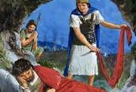
David’s golden opportunity had come. Saul, his enemy, was in his grasp. David’s men encouraged him to take Saul’s head off. He deserved it, even anyone does! What would David do? His time had arrived!

Slide 3
The Decision
“And he came to the sheepcotes by the way, where was a cave; and Saul went in to cover his feet: and David and his men remained in the sides of the cave. And the men of David said unto him, Behold the day of which the LORD said unto thee, Behold, I will deliver thine enemy into thine hand, that thou mayest do to him as it shall seem good unto thee. Then David arose, and cut off the skirt of Saul's robe privily. And it came to pass afterward, that David's heart smote him, because he had cut off Saul's skirt. And he said unto his men, The LORD forbid that I should do this thing unto my master, the LORD'S anointed, to stretch forth mine hand against him, seeing he is the anointed of the LORD.” 1 Sam.24:3-6

Slide 4
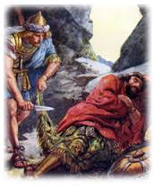
David Didn’t Kill Him!
David did not kill the king. David surely warned people of Saul’s wickedness. The news of Saul’s wicked deeds spread over the land. Everyone knew of the troubles at the head of the work! David was so concerned about the leadership that he took his parents out of the country!

Slide 5
People on the Move!
“David therefore departed thence, and escaped to the cave Adullam: and when his brethren and all his father's house heard it, they went down thither to him. And every one that was in distress, and every one that was in debt, and every one that was discontented, gathered themselves unto him; and he became a captain over them: and there were with him about four hundred men. And David went thence to Mizpeh of Moab: and he said unto the king of Moab, Let my father and my mother, I pray thee, come forth, and be with you, till I know what God will do for me. And he brought them before the king of Moab: and they dwelt with him all the while that David was in the hold.” 1 Sam. 22:1-4

Slide 6
David’s story teaches that we do not kill someone put in a position by God! It does not teach that we do not warn others of the apostate teachings of a wicked ruler who is bent on teaching false doctrine and leading people astray!

Slide 7
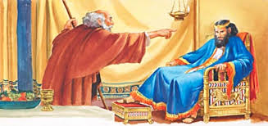
Nathan and David

Slide 8
Rebukes the Anointed of the Lord!
“And there came a traveller unto the rich man, and he spared to take of his own flock and of his own herd, to dress for the wayfaring man that was come unto him; but took the poor man's lamb, and dressed it for the man that was come to him…. And he shall restore the lamb fourfold, because he did this thing, and because he had no pity. And Nathan said to David, Thou art the man. Thus saith the LORD God of Israel, I anointed thee king over Israel, and I delivered thee out of the hand of Saul; And I gave thee thy master's house, and thy master's wives into thy bosom, and gave thee the house of Israel and of Judah; and if that had been too little, I would moreover have given unto thee such and such things. Wherefore hast thou despised the commandment of the LORD, to do evil in his sight? thou hast killed Uriah the Hittite with the sword, and hast taken his wife to be thy wife, and hast slain him with the sword of the children of Ammon. Now therefore the sword shall never depart from thine house; because thou hast despised me, and hast taken the wife of Uriah the Hittite to be thy wife.” 2 Samuel 12:4-10

Slide 9
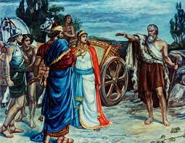
Elijah Blasts the Leader!
“And it came to pass, when Ahab saw Elijah, that Ahab said unto him, Art thou he that troubleth Israel? And he answered, I have not troubled Israel; but thou, and thy father's house, in that ye have forsaken the commandments of the LORD, and thou hast followed Baalim.” 1 Kings 18:17,18

Slide 10
Rebukes the Lord’s Anointed!
“It is natural for the wrongdoer to hold the messengers of God responsible for the calamities that come as the sure result of a departure from the way of righteousness. Those who place themselves in Satan's power are unable to see things as God sees them. When the mirror of truth is held up before them, they become indignant at the thought of receiving reproof. Blinded by sin, they refuse to repent; they feel that God's servants have turned against them and are worthy of severest censure. Standing in conscious innocence before Ahab, Elijah makes no attempt to excuse himself or to flatter the king. Nor does he seek to evade the king's wrath by the good news that the drought is almost over. He has no apology to offer. Indignant, and jealous for the honor of God, he casts back the imputation of Ahab, fearlessly declaring to the king that it is his sins, and the sins of his fathers, that have brought upon Israel this terrible calamity.” PK, pgs. 139, 140

Slide 11
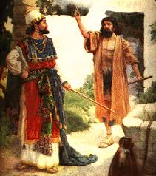
Were Nathan and Elijah Wrong?
Were these two men wrong for rebuking the wicked and evil teachings/deeds of these apostate leaders? The Lord’s anointed were dead in the wrong and they, along with those who were being led astray by them, needed a warning blast and the Lord’s anointed were rebuked!

Slide 12
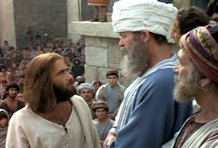
Yeah, but I follow Jesus…..
How did Jesus, the most loving, kind, and gracious man who ever lived deal with the Lord’s anointed? How did He speak to the leaders of His day who were leading the people astray by false teachings?

Slide 13
Hypocrites!!
“Woe unto you, scribes and Pharisees, hypocrites! for ye make clean the outside of the cup and of the platter, but within they are full of extortion and excess. Thou blind Pharisee, cleanse first that which is within the cup and platter, that the outside of them may be clean also. Woe unto you, scribes and Pharisees, hypocrites! for ye are like unto whited sepulchres, which indeed appear beautiful outward, but are within full of dead men's bones, and of all uncleanness. Even so ye also outwardly appear righteous unto men, but within ye are full of hypocrisy and iniquity.” Matthew 23:25-28

Slide 14
It Got Better!
“Jesus said unto them, If God were your Father, ye would love me: for I proceeded forth and came from God; neither came I of myself, but he sent me. Why do ye not understand my speech? even because ye cannot hear my word. Ye are of your father the devil, and the lusts of your father ye will do. He was a murderer from the beginning, and abode not in the truth, because there is no truth in him. When he speaketh a lie, he speaketh of his own: for he is a liar, and the father of it. And because I tell you the truth, ye believe me not. Which of you convinceth me of sin? And if I say the truth, why do ye not believe me? He that is of God heareth God's words: ye therefore hear them not, because ye are not of God.” John 8:42-47

Slide 15
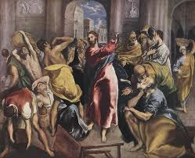
Jesus let them have it. The Lord’s Anointed let the ‘lord’s anointed have it’. He told the leaders they were of the devil, leading people astray, and would suffer the wrath of God! He told them they were devilish hypocrites!!!

Slide 16
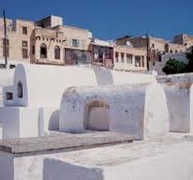
“Christ's indignation was directed against the hypocrisy, the gross sins, by which men were destroying their own souls, deceiving the people and dishonoring God. In the specious deceptive reasoning of the priests and rulers He discerned the working of satanic agencies. Keen and searching had been His denunciation of sin; but He spoke no words of retaliation. He had a holy wrath against the prince of darkness;” DA, pg. 619

Slide 17
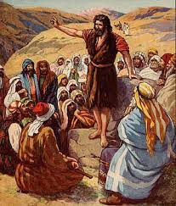
How About John the Baptist?
“ And were baptized of him in Jordan, confessing their sins. But when he saw many of the Pharisees and Sadducees come to his baptism, he said unto them, O generation of vipers, who hath warned you to flee from the wrath to come? Bring forth therefore fruits meet for repentance: And think not to say within yourselves, We have Abraham to our father: for I say unto you, that God is able of these stones to raise up children unto Abraham.” Matthew 3:6-9

Slide 18
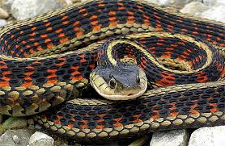
If speaking out against apostate leaders and calling sin by its right name was touching the Lord’s anointed, then John the Baptist was guilty. How ridiculous!!
John, Jesus, Elijah, and Nathan loved people too much to allow them to remain in their sins and not warn them; especially the leaders!!

Slide 19
What About Us?
“The forerunner of Christ's first advent was a very plain-spoken man. He rebuked sin, and called things by their right names. He laid the ax at the root of the tree. He thus addressed one class of professed converts who came to be baptized of him in Jordan: "O generation of vipers, who hath warned you to flee from the wrath to come? Bring forth therefore fruits meet for repentance. . . . And now also the ax is laid unto the root of the trees: therefore every tree which bringeth not forth good fruit is hewn down, and cast into the fire."
In this fearful time, just before Christ is to come the second time, God's faithful preachers will have to bear a still more pointed testimony than was borne by John the Baptist. A responsible, important work is before them; and those who speak smooth things, God will not acknowledge as His shepherds. A fearful woe is upon them.” Volume 1 Testimonies, pg. 321

Slide 20
