Slide 1
THE BOOK OF ROMANS
Turning the world upside down

Slide 2
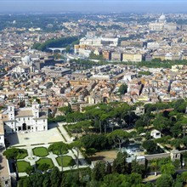
The Place

Slide 3
Turned the World Upside Down Twice
“By a recent decretal an indulgence had been promised by the pope to all who should ascend upon their knees "Pilate's staircase," said to have been descended by our Saviour on leaving the Roman judgment hall and to have been miraculously conveyed from Jerusalem to Rome. Luther was one day devoutly climbing these steps, when suddenly a voice like thunder seemed to say to him: "The just shall live by faith." Romans 1:17. He sprang to his feet and hastened from the place in shame and horror. That text never lost its power upon his soul. From that time he saw more clearly than ever before the fallacy of trusting to human works for salvation, and the necessity of constant faith in the merits of Christ. His eyes had been opened, and were never again to be closed, to the delusions of the papacy.” GC, pg. 125
“On his return to England, Wesley, under the instruction of a Moravian preacher, arrived at a clearer understanding of Bible faith. He was convinced that he must renounce all dependence upon his own works for salvation and must trust wholly to "the Lamb of God, which taketh away the sin of the world." At a meeting of the Moravian society in London a statement was read from Luther, describing the change which the Spirit of God works in the heart of the believer. As Wesley listened, faith was kindled in his soul. "I felt my heart strangely warmed," he says. "I felt I did trust in Christ, Christ alone, for salvation: and an assurance was given me, that He had taken away my sins, even mine, and saved me from the law of sin and death."- GC, pg. 255,256

Slide 4
Paul’s Opening Statement
“Paul, a servant of Jesus Christ, called to be an apostle, separated unto the gospel of God, (Which he had promised afore by his prophets in the holy scriptures,) Concerning his Son Jesus Christ our Lord, which was made of the seed of David according to the flesh; And declared to be the Son of God with power, according to the spirit of holiness, by the resurrection from the dead: By whom we have received grace and apostleship, for obedience to the faith among all nations, for his name: Among whom are ye also the called of Jesus Christ:” Romans 1:1-6

Slide 5
Breaking it Down
“separated unto the gospel of God, (Which he had promised afore by his prophets in the holy scriptures,) Concerning his Son Jesus Christ our Lord,…” Romans 1:1-3
“And I will put enmity between thee and the woman, and between thy seed and her seed; it shall bruise thy head, and thou shalt bruise his heel.” Gen, 3:15
“The LORD thy God will raise up unto thee a Prophet from the midst of thee, of thy brethren, like unto me; unto him ye shall hearken;” Deut. 18:15
“He is despised and rejected of men; a man of sorrows, and acquainted with grief: and we hid as it were our faces from him; he was despised, and we esteemed him not. Surely he hath borne our griefs, and carried our sorrows: yet we did esteem him stricken, smitten of God, and afflicted. But he was wounded for our transgressions, he was bruised for our iniquities: the chastisement of our peace was upon him; and with his stripes we are healed.” Isaiah 53:3-5

Slide 6
The Old Testament
“Then he said unto them, O fools, and slow of heart to believe all that the prophets have spoken: Ought not Christ to have suffered these things, and to enter into his glory? And beginning at Moses and all the prophets, he expounded unto them in all the scriptures the things concerning himself.” Luke 24:25-27
“For had ye believed Moses, ye would have believed me: for he wrote of me. But if ye believe not his writings, how shall ye believe my words?” Jn. 5:46,47
“And he said unto him, If they hear not Moses and the prophets, neither will they be persuaded, though one rose from the dead.” Luke 16:31

Slide 7
Christ in the Flesh
“Concerning his Son Jesus Christ our Lord, which was made of the seed of David according to the flesh;” Roman 1:3
“For what the law could not do, in that it was weak through the flesh, God sending his own Son in the likeness of sinful flesh, and for sin, condemned sin in the flesh:” Romans 8:3
“Forasmuch then as the children are partakers of flesh and blood, he also himself likewise took part of the same; that through death he might destroy him that had the power of death, that is, the devil; And deliver them who through fear of death were all their lifetime subject to bondage. For verily he took not on him the nature of angels; but he took on him the seed of Abraham. Wherefore in all things it behoved him to be made like unto his brethren, that he might be a merciful and faithful high priest in things pertaining to God, to make reconciliation for the sins of the people. For in that he himself hath suffered being tempted, he is able to succour them that are tempted.” Hebrews 2:14-18

Slide 8
Christ’s Power
“And declared to be the Son of God with power, according to the spirit of holiness, by the resurrection from the dead:” Romans 1:4
The crowning evidence of Christ’s power was His power to resurrect. This same power can resurrect us from sin.
“But if the Spirit of him that raised up Jesus from the dead dwell in you, he that raised up Christ from the dead shall also quicken your mortal bodies by his Spirit that dwelleth in you. Therefore, brethren, we are debtors, not to the flesh, to live after the flesh. For if ye live after the flesh, ye shall die: but if ye through the Spirit do mortify the deeds of the body, ye shall live.“ Rom. 8:11-13
“Bethany was so near Jerusalem that the news of the raising of Lazarus was soon carried to the city. Through spies who had witnessed the miracle the Jewish rulers were speedily in possession of the facts. A meeting of the Sanhedrin was at once called to decide as to what should be done. Christ had now fully made manifest His control of death and the grave. That mighty miracle was the crowning evidence offered by God to men that He had sent His Son into the world for their salvation.” DA 537

Slide 9
For the Humble
“By whom we have received grace and apostleship, for obedience to the faith among all nations, for his name:
Among whom are ye also the called of Jesus Christ: “ Romans 1:5,6
“Behold, his soul which is lifted up is not upright in him: but the just shall live by his faith.” Habakkuk 2:4
The proud and arrogant, the self sufficient, are not justified before God. The obedient are humble and justified because they are trusting Christ.

Slide 10
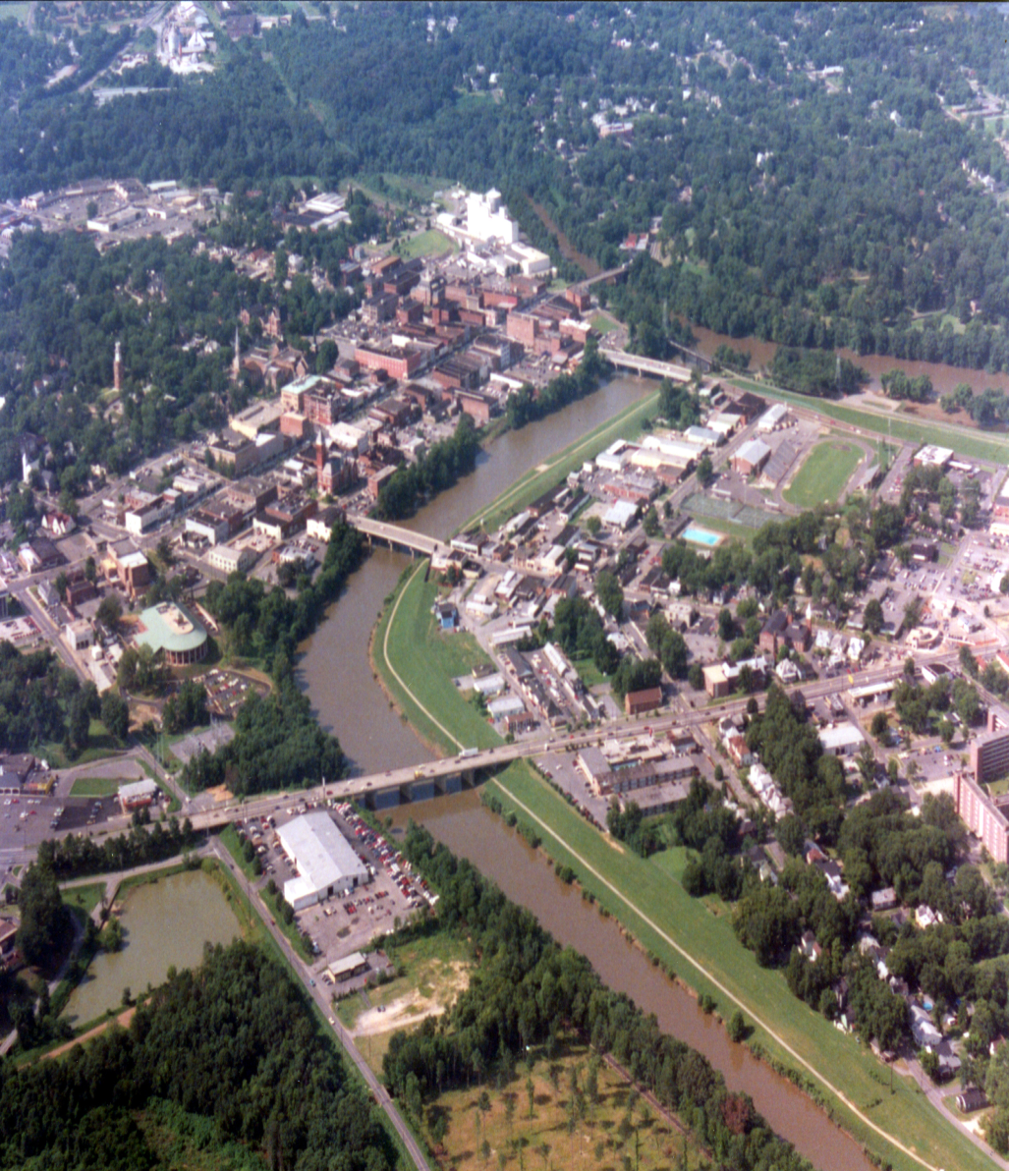
Rome
“To all that be in Rome, beloved of God, called to be saints: Grace to you and peace from God our Father, and the Lord Jesus Christ. First, I thank my God through Jesus Christ for you all, that your faith is spoken of throughout the whole world.” Romans 1:7,8

Slide 11
Beloved of God
“Behold, what manner of love the Father hath bestowed upon us, that we should be called the sons of God: therefore the world knoweth us not, because it knew him not.” 1John 3:1
“The LORD hath appeared of old unto me, saying, Yea, I have loved thee with an everlasting love: therefore with loving kindness have I drawn thee.” Jer. 31:3
“Called saints”
All of those who follow Christ are considered saints. It is not for one to be exalted as a saint and others classed as ordinary Christians; there is only one class of people. The papacy has distinguished between saints ‘sainthood’ and regular Christians; this should not be.

Slide 12
Praying Without Ceasing
“First, I thank my God through Jesus Christ for you all, that your faith is spoken of throughout the whole world. For God is my witness, whom I serve with my spirit in the gospel of his Son, that without ceasing I make mention of you always in my prayers;” Rom. 1:8,9
“Rejoice evermore. Pray without ceasing.” 1Thess 5:16,17
“Always in every prayer of mine for you all making request with joy,” Phil. 1:4
“Cease not to give thanks for you, making mention of you in my prayers;” Eph. 1:16
This does not mean that Paul always was praying all the time, but that he did not become weary in consistent prayer.

Slide 13
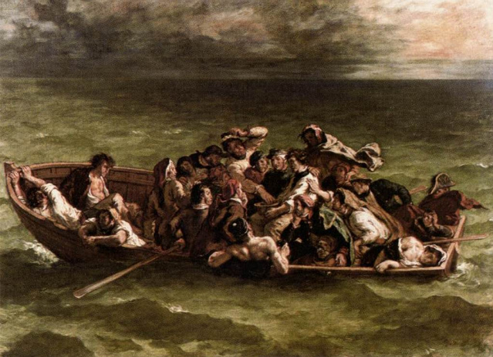
A Prosperous Journey
“Making request, if by any means now at length I might have a prosperous journey by the will of God to come unto you.” Romans 1:10 On Paul’s trip to Rome, he was shipwrecked; Paul saw it differently.

Slide 14
Victory and Conversions
“And falling into a place where two seas met, they ran the ship aground; and the forepart stuck fast, and remained unmovable, but the hinder part was broken with the violence of the waves. And the soldiers' counsel was to kill the prisoners, lest any of them should swim out, and escape.” Acts 27:41,42 All things work together for good for them that love God
“In the same quarters were possessions of the chief man of the island, whose name was Publius; who received us, and lodged us three days courteously. And it came to pass, that the father of Publius lay sick of a fever and of a bloody flux: to whom Paul entered in, and prayed, and laid his hands on him, and healed him. So when this was done, others also, which had diseases in the island, came, and were healed:” Acts 28:7-9
“ During the three months that the ship's company remained at Melita, Paul and his fellow laborers improved many opportunities to preach the gospel. In a remarkable manner the Lord wrought through them. For Paul's sake the entire shipwrecked company were treated with great kindness; all their wants were supplied, and upon leaving Melita they were liberally provided with everything needful for their voyage.” AA, pg 446

Slide 15
Some Spiritual Gift
“For I long to see you, that I may impart unto you some spiritual gift, to the end ye may be established; That is, that I may be comforted together with you by the mutual faith both of you and me. Now I would not have you ignorant, brethren, that oftentimes I purposed to come unto you, (but was let hitherto,) that I might have some fruit among you also, even as among other Gentiles.” Rom. 1:11-13
“Wherefore he saith, When he ascended up on high, he led captivity captive, and gave gifts unto men.” Eph 4:8
“Now there are diversities of gifts, but the same Spirit. And there are differences of administrations, but the same Lord. And there are diversities of operations, but it is the same God which worketh all in all. But the manifestation of the Spirit is given to every man to profit withal. For to one is given by the Spirit the word of wisdom; to another the word of knowledge by the same Spirit; To another faith by the same Spirit; to another the gifts of healing by the same Spirit; To another the working of miracles; to another prophecy; to another discerning of spirits; to another divers kinds of tongues; to another the interpretation of tongues:” 1 Corinthians 12:4-10

Slide 16
I’m in Debt
Romans 1:14 “I am debtor both to the Greeks, and to the Barbarians; both to the wise, and to the unwise.”
Because of what Christ had done for him, Paul realized he owed the world his all because Christ gave His all. Most today think everyone else owes them a living; not with Paul!
“And whosoever will be chief among you, let him be your servant: Even as the Son of man came not to be ministered unto, but to minister, and to give his life a ransom for many.”
Matthew 20:28 This was Paul’s life and his gospel. Christ all in all

Slide 17
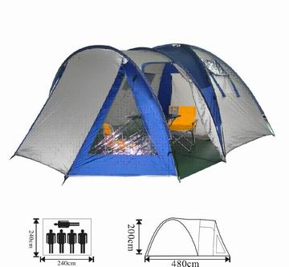
Paul, the Tentmaker

Slide 18
Christ Emptied Himself
“Let this mind be in you, which was also in Christ Jesus: Who, being in the form of God, thought it not robbery to be equal with God: But made himself of no reputation, and took upon him the form of a servant, and was made in the likeness of men: And being found in fashion as a man, he humbled himself, and became obedient unto death, even the death of the cross.” Philippians 2:5-8

Slide 19
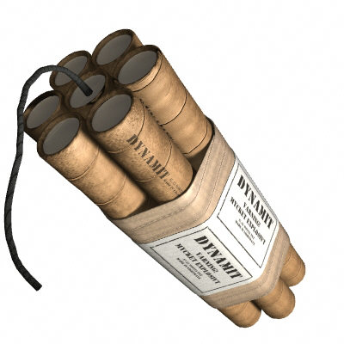
Paul’s Gospel
“So, as much as in me is, I am ready to preach the gospel to you that are at Rome also. For I am not ashamed of the gospel of Christ: for it is the power of God unto salvation to every one that believeth; to the Jew first, and also to the Greek. For therein is the righteousness of God revealed from faith to faith: as it is written, The just shall live by faith.” Romans 1:15-17

Slide 20
The Centerpiece
The gospel of Christ contains the righteousness of God within it. The righteousness of God is found in the law of God. To truly preach the gospel of Christ one must exalt the ten commandments. Without the law of God lifted up, there is no gospel.
“My tongue shall speak of thy word: for all thy commandments are righteousness.” Psalm 119:172
The gospel of Christ and the law of God go hand in hand. One cannot be excluded from the other. If either of these two elements are negated, then you don’t have the gospel.

Slide 21
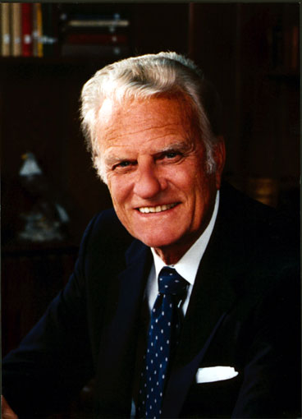
Preacher of the Gospel?
The gospel, in exalting Christ and the law, does not exalt man. Wherever men are exalted and lifted up, then you can be sure that the gospel is not being preached. The exalting of man negates the gospel of Christ.

Slide 22
Christ Alone
In the gospel, only Christ is exalted. The just live by faith in Christ. Because they realize that they have no righteousness of their own, they must live by faith in Christ because they can’t find righteousness anywhere else.
“Not by works of righteousness which we have done, but according to his mercy he saved us, by the washing of regeneration, and renewing of the Holy Ghost; Which he shed on us abundantly through Jesus Christ our Saviour; That being justified by his grace, we should be made heirs according to the hope of eternal life.” Titus 3:5-7

