Slide 1
Melchisedec
Who Are You?

Slide 2
Not the First Time
Hebrews 7 states more about Melchisedec than any other passage in Scripture. However, Paul builds to this chapter, having mentioned him in previous chapters as well. This is not the 1st time Paul mentions him.
Notice:
“As he saith also in another place, Thou art a priest for ever after the order of Melchisedec.” Heb. 5:6
“Whither the forerunner is for us entered, even Jesus, made an high priest for ever after the order of Melchisedec.” Heb. 6:20

Slide 3
A Heavenly Being
In both instances, Paul makes it very clear that the Melchisedec priesthood is eternal and it is in contrast with the Levitical priesthood which is earthly, and temporal. Jesus came thru the Melchisedec order. Before Hebrews 7, Paul makes it clear that there is something heavenly about Melchisedec and his priesthood. Then, in Hebrews 7, Paul declares that he ‘Without father, without mother, without descent, having neither beginning of days, nor end of life; but made like unto the Son of God; abideth a priest continually.” Heb. 7:3 Everything says that Melchisedec is more than human!

Slide 4
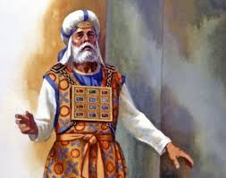
The Broken Record!!!
“For he testifieth, Thou art a priest for ever after the order of Melchisedec.” Heb. 7:17
“The Lord sware and will not repent, Thou art a priest for ever after the order of Melchisedec:)” verse 21

Slide 5
A Wonderful Priest!
“And thou shalt take two onyx stones, and grave on them the names of the children of Israel: Six of their names on one stone, and the other six names of the rest on the other stone, according to their birth. With the work of an engraver in stone, like the engravings of a signet, shalt thou engrave the two stones with the names of the children of Israel: thou shalt make them to be set in ouches of gold. And thou shalt put the two stones upon the shoulders of the ephod for stones of memorial unto the children of Israel: and Aaron shall bear their names before the LORD upon his two shoulders for a memorial.” Ex. 28:9-12
“And Aaron shall bear the names of the children of Israel in the breastplate of judgment upon his heart, when he goeth in unto the holy place, for a memorial before the LORD continually.” Ex. 28:29

Slide 6
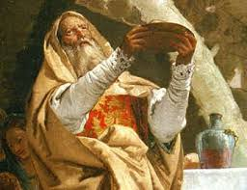
Mysterious Man!
Who was he? Mystery and wonder has surrounded this man for a long time. There is not a huge supply of material on him, but there is enough to make a case for who he was. Let us dig in and find out who he is!!

Slide 7
The Bible Says
“And the king of Sodom went out to meet him after his return from the slaughter of Chedorlaomer, and of the kings that were with him, at the valley of Shaveh, which is the king's dale. And Melchizedek king of Salem brought forth bread and wine: and he was the priest of the most high God. And he blessed him, and said, Blessed be Abram of the most high God, possessor of heaven and earth: And blessed be the most high God, which hath delivered thine enemies into thy hand. And he gave him tithes of all.” Genesis 14:17-20

Slide 8
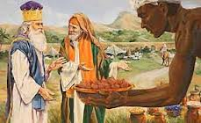
Building a Resume
1. King of Salem.
2. Priest of the Most High God.
3. Abraham paid tithes to him.

Slide 9
Let the explosion Begin!
“For this Melchisedec, king of Salem, priest of the most high God, who met Abraham returning from the slaughter of the kings, and blessed him; To whom also Abraham gave a tenth part of all; first being by interpretation King of righteousness, and after that also King of Salem, which is, King of peace; Without father, without mother, without descent, having neither beginning of days, nor end of life; but made like unto the Son of God; abideth a priest continually. Now consider how great this man was, unto whom even the patriarch Abraham gave the tenth of the spoils. And verily they that are of the sons of Levi, who receive the office of the priesthood, have a commandment to take tithes of the people according to the law, that is, of their brethren, though they come out of the loins of Abraham: But he whose descent is not counted from them received tithes of Abraham, and blessed him that had the promises. And without all contradiction the less is blessed of the better. And here men that die receive tithes; but there he receiveth them, of whom it is witnessed that he liveth.” Hebrews 7:1-8

Slide 10
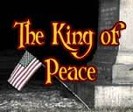
Wow and Wow!!!
1. King of Righteousness.
2. King of Peace.
3. Without father.
4. Without mother.
5. having neither beginning of days or end of life!!!
6. Paul said, in the 1st century, that Melchisedec is alive!
Melchisedec is an Eternal Being! We can dance, we can spin, we can him and hah; we must deal with what the passage says!

Slide 11
Without father or mother!
I know of NO beings on this earth who have ever lived that can declare this of him or herself. We must have parents or we do not live. This man Melchisedec had no parents. He is an eternal being! How many people do we know who were considered the King of Righteousness/King of Peace? Only the Lord Jesus Christ has been referred to as such!

Slide 12
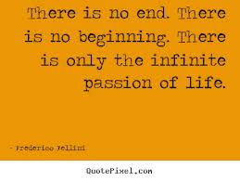
No beginning and no end!
Someone who has no beginning and has no ending is an Eternal Being!
Revelation 1 declares, “I am Alpha and Omega, the beginning and the ending, saith the Lord, which is, and which was, and which is to come, the Almighty.” Revelation 1:8

Slide 13
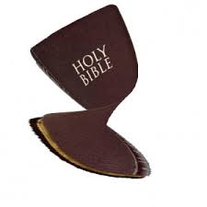
You are Misinterpreting those Verses!
If there is a question about interpretation, what do we do? Do we consult the scholars or the wise men or the theologians? Are we at the mercy of worldly wise men or religiously wise men for answers? No, 100 times no.
We go to the Spirit of Prophecy! Only to the Spirit of Prophecy!!

Slide 14
Desire of Ages, pgs. 578,579
“ Yet again the Spirit of God speaks to Jerusalem. Before the day is done, another testimony is borne to Christ. The voice of witness is lifted up, responding to the call from a prophetic past. If Jerusalem will hear the call, if she will receive the Saviour who is entering her gates, she may yet be saved. Reports have reached the rulers in Jerusalem that Jesus is approaching the city with a great concourse of people. But they have no welcome for the Son of God. In fear they go out to meet Him, hoping to disperse the throng. As the procession is about to descend the Mount of Olives, it is intercepted by the rulers. They inquire the cause of the tumultuous rejoicing. As they question, "Who is this?" the disciples, filled with the spirit of inspiration, answer this question. In eloquent strains they repeat the prophecies concerning Christ: Adam will tell you, It is the seed of the woman that shall bruise the serpent's head. Ask Abraham, he will tell you, It is "Melchizedek King of Salem," King of Peace. Gen. 14:18. Jacob will tell you, He is Shiloh of the tribe of Judah. Isaiah will tell you, "Immanuel," "Wonderful, Counselor, The mighty God, The everlasting Father, The Prince of Peace." Isa. 7:14; 9:6.

Slide 15
Cont.
“Jeremiah will tell you, The Branch of David, "the Lord our Righteousness." Jer. 23:6. Daniel will tell you, He is the Messiah. Hosea will tell you, He is "the Lord God of hosts; the Lord is His memorial." Hosea 12:5. John the Baptist will tell you, He is "the Lamb of God, which taketh away the sin of the world." John 1:29. The great Jehovah has proclaimed from His throne, "This is My beloved Son." Matt. 3:17. We, His disciples, declare, This is Jesus, the Messiah, the Prince of life, the Redeemer of the world. And the prince of the powers of darkness acknowledges Him, saying, "I know Thee who Thou art, the Holy One of God." Mark 1:24” Desire of Ages pgs. 578, 579

Slide 16
Ellen White/Holy Spirit Declare
All of those Old Testament statements pointed forward to Christ. The seed that would bruise the serpents head, Immanuel, Shiloh from the tribe of Judah, the Lord our Righteousness, the Messiah, the Lamb of God. All of these pointed to Christ. And in this statement, Ellen white says that Melchizedek was Christ. Now, let us see what else she says about this mysterious man! She declares that Melchizedek was deity!!! This confirms Scripture!

Slide 17
Further Comments
“…A morning talk, given at Battle Creek by Mrs. E.G. White, Jan. 20, 1890, printed in the R & H of 2-18-1890, contains the following statement: ‘It was Christ that spoke through Melchisedec, the priest of the Most High God. Melchisedec was not Christ, but the voice of God in the world, the representative of the Father.‘ John 14:17,26 and 16:13-15, tell us who represents the Father in the earth. At the baptism of Christ the Holy Spirit appeared as a dove; on the day of Pentecost, as Cloven tongues of fire. It is not unreasonable (therefore) to conclude that the SAME SPIRIT could appear to Abraham in the person of the King of Salem. (“Priest of the most High God.”)
“It was Christ who spoke through Melchizedek, the priest of the most high God. Melchizedek was NOT Christ, but he was the VOICE of God in the world, the REPRESENTATIVE of the Father.” – Selected Messages, Book 1, p. 409.

Slide 18
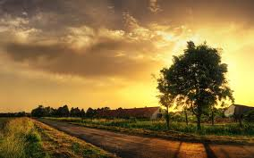
The Bible/SOP Agree!
Hebrews 7 declares Melchisedec to be an eternal being. The SOP declares the same thing. Since he was eternal and not the Father or the Son, then it becomes very obvious that Melchisedec was the Holy Spirit in humanity!

Slide 19
Confirmed Again!
At a council meeting at Avondale School, about the year 1893, there were present Elders Haskell, F.L.H. Baker, G.B. Starr, and their wives, and Sister E.G. White, also W.A. Colcord, who was the editor of the Australian Signs of the Times. Elder Colcord requested the privilege of reading some articles regarding the personality of Melchisedec. We all listened as he read and were surprised that Sister White listened also, with seeming interest, as she was not accustomed to listening to any argumentative writings. “As Elder Colcord was reading, Sister White interrupted him, saying: “Elder Colcord, I would not publish these articles, if I were you.” “Why not?” He inquired. “Because they are not correct.” She answered. He then asked, “Who then was Melchisedec?” She replied, “I will tell you who Melchisedec was. He was the Holy Spirit of God assuming human form. He represented Christ to the people of that generation.” That ended the council.

Slide 20
Cont.
Elder Colcord offered no argument to refute her position, and we all seemed perfectly satisfied with the statement; in fact, I had never heard an explanation that was satisfactory before. After the meeting, Elder S.N. Haskell said to me, “Elder Starr, when the Spirit of Prophecy speaks so plainly as that about a matter, it can be proved by the Bible, so let’s look it up.” We found that description of Melchisedec in Hebrews 7:3 was fully met by the Holy Spirit. “Without father, without mother, without descent, having neither beginning of days, nor end of life; but made like unto the Son of God; abideth a high priest continually.” We found that in Hebrews 9:14 that statement, “The Eternal Spirit.” That would meet, also, “Without beginning of days, nor end of life.” Then in Romans 8:26, “likewise the Spirit also helpeth our infirmities: for we know not what we should pray for as we ought: but the Spirit itself maketh intercession for us with groanings which cannot be uttered.” (By man). Thus – These statements make the Holy Spirit a high priest forever. Every specification was met by the Holy Spirit, A HIGH PRIEST FOREVER, but cannot be met by any angel or human being.

Slide 21
Holy Spirit as Mediator
Genesis 14:18 “And Melchizedek king of Salem brought forth bread and wine: and he was the priest of the most high God.”
Hebrews 7:3 “Without father, without mother, without descent, having neither beginning of days, nor end of life; but made like unto the Son of God; abideth a priest continually.”
Romans 8:26,27 “Likewise the Spirit also helpeth our infirmities: for we know not what we should pray for as we ought: but the Spirit itself maketh intercession for us with groanings which cannot be uttered. And he that searcheth the hearts knoweth what is the mind of the Spirit, because he maketh intercession for the saints according to the will of God.”

Slide 22
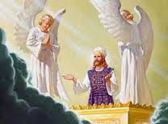
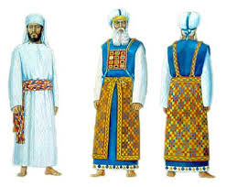
Under one of two Priesthoods

Slide 23
Which are We Under?
Melchesidec Priesthood/Christ
Levitical Priesthood/Papacy
The Melchesidec priesthood, as outlined by Paul in Hebrews 7, is representative of our dependence upon Christ and His righteousness. This is the priesthood that the Lord called the Israelites to follow and to understand. Tragically, they never saw it!
The Levitical priesthood, as Paul outlines in Hebrews 7, is built on the premise that we are depending on ourselves or someone else as our spiritual leader. This is usurping the authority that belongs to Christ alone! May we ever look to Jesus and to NO man!

