Slide 1
Ezekiel, pt. 2
‘The Call’

Slide 2
Review
Ezekiel was a captive slave in the foreign land of Babylon. Because of the apostasy of His people, he beheld the dismantling of his goals, his church, and his nation. Ezekiel was given a vision of the glory of God, seated high upon His throne. He beheld the workings of Christ as He guides the affairs of earth, the overruling providence for good. He saw the work of cherubim as they look after God’s children, guiding them to safe paths. After seeing this, being given the assurance of God’s plan and purpose, Ezekiel was asked to do something!

Slide 3
The Vision
“This vision was given to Ezekiel at a time when his mind
was filled with gloomy forebodings. He saw the land of his
fathers lying desolate. The city that was once full of
people was no longer inhabited. The voice of mirth and the
song of praise were no more heard within her walls. The
prophet himself was a stranger in a strange land, where
boundless ambition and savage cruelty reigned supreme. That
which he saw and heard of human tyranny and wrong
distressed his soul, and he mourned bitterly day and night.
But the wonderful symbols presented before him beside the
river Chebar revealed an overruling power mightier than
that of earthly rulers. Above the proud and cruel monarchs
of Assyria and Babylon the God of mercy and truth was
enthroned.” 5 Testimonies, pg. 752

Slide 4
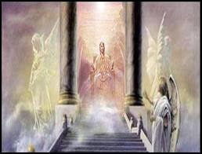
Wheels in Wheels
The wheel like complications that appeared to the prophet
to be involved in such confusion were under the guidance of
an infinite hand. The Spirit of God, revealed to him as
moving and directing these wheels, brought harmony out of confusion; so the whole world was under His control.
Myriads of glorified beings were ready at His word to
overrule the power and policy of evil men, and bring good
to His faithful ones.” 5 Test., pg. 752

Slide 5
Ezekiel 2:1-8
”And he said unto me, Son of man, stand upon thy feet, and I will speak unto thee. And the spirit entered into me when he spake unto me, and set me upon my feet, that I heard him that spake unto me. And he said unto me, Son of man, I send thee to the children of Israel, to a rebellious nation that hath rebelled against me: they and their fathers have transgressed against me, even unto this very day. For they are impudent children and stiff hearted. I do send thee unto them; and thou shalt say unto them, Thus saith the Lord GOD. And they, whether they will hear, or whether they will forbear, (for they are a rebellious house,) yet shall know that there hath been a prophet among them. And thou, son of man, be not afraid of them, neither be afraid of their words, though briers and thorns be with thee, and thou dost dwell among scorpions: be not afraid of their words, nor be dismayed at their looks, though they be a rebellious house. And thou shalt speak my words unto them, whether they will hear, or whether they will forbear: for they are most rebellious. But thou, son of man, hear what I say unto thee; Be not thou rebellious like that rebellious house: open thy mouth, and eat that I give thee.”

Slide 6
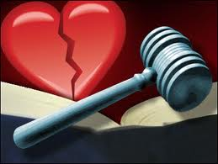
Repetition of Statements
In these passages are statements that are repeated throughout Ezekiel, chapters 2 and 3.
1. God’s professed people are rebellious and stiff hearted.
2. Ezekiel is to speak God’s Word to them.
3. He is to give the message regardless of consequences ‘whether they will hear or whether they will forbear’.

Slide 7
The Only Solution
The only solution to our carnal minds; the only source that can change and empower us to do right is the Word of God, Jesus Christ. Apart from Him, we are sunk in hopeless despair. With Him, we can do all things.
“As they feed upon His word, they find that it is spirit and life. The word destroys the natural, earthly nature, and imparts a new life in Christ Jesus. The Holy Spirit comes to the soul as a Comforter. By the transforming agency of His grace, the image of God is reproduced in the disciple; he becomes a new creature. Love takes the place of hatred, and the heart receives the divine similitude. This is what it means to live "by every word that proceedeth out of the mouth of God." This is eating the Bread that comes down from heaven.” DA, pg. 391

Slide 8
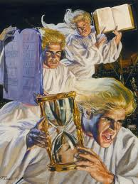
Our Commission
“And I saw another angel fly in the midst of heaven, having the everlasting gospel to preach unto them that dwell on the earth, and to every nation, and kindred, and tongue, and people,…” Rev. 14:6
“And this gospel of the kingdom shall be preached in all the world for a witness unto all nations; and then shall the end come.” Matthew 24:14

Slide 9
Give the Warning!
But we see that the God of heaven sometimes commissions men to teach that which is regarded as contrary to the established doctrines. Because those who were once the depositaries of truth became unfaithful to their sacred trust, the Lord chose others who would receive the bright beams of the Sun of Righteousness, and would advocate truths that were not in accordance with the ideas of the religious leaders. ” Gospel Workers, pgs. 69, 70

Slide 10
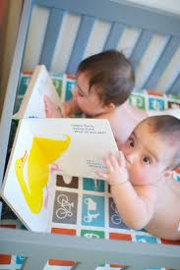
Advent Experience
“Moreover he said unto me, Son of man, eat that thou findest; eat this roll, and go speak unto the house of Israel. So I opened my mouth, and he caused me to eat that roll. And he said unto me, Son of man, cause thy belly to eat, and fill thy bowels with this roll that I give thee. Then did I eat it; and it was in my mouth as honey for sweetness.” Ezekiel 3:1-3

Slide 11
1844
“And the voice which I heard from heaven spake unto me again, and said, Go and take the little book which is open in the hand of the angel which standeth upon the sea and upon the earth. And I went unto the angel, and said unto him, Give me the little book. And he said unto me, Take it, and eat it up; and it shall make thy belly bitter, but it shall be in thy mouth sweet as honey. And I took the little book out of the angel's hand, and ate it up; and it was in my mouth sweet as honey: and as soon as I had eaten it, my belly was bitter. And he said unto me, Thou must prophesy again before many peoples, and nations, and tongues, and kings.” Rev. 10:8-11
The experience of Ezekiel was just like that of the early Advent people. They ate the book of Daniel, were delighted with what it said, but were saddened when Christ didn’t return in 1844. This is Revelation 10 ‘s theme.

Slide 12
God is being Rejected
”But the house of Israel will not hearken unto thee; for they will not hearken unto me: for all the house of Israel are impudent and hardhearted. Behold, I have made thy face strong against their faces, and thy forehead strong against their foreheads. As an adamant harder than flint have I made thy forehead: fear them not, neither be dismayed at their looks, though they be a rebellious house. Moreover he said unto me, Son of man, all my words that I shall speak unto thee receive in thine heart, and hear with thine ears. And go, get thee to them of the captivity, unto the children of thy people, and speak unto them, and tell them, Thus saith the Lord GOD; whether they will hear, or whether they will forbear.” Ezekiel 3:7-11

Slide 13
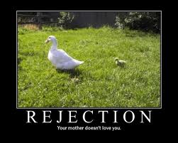
Just Like Samuel
”And said unto him, Behold, thou art old, and thy sons walk not in thy ways: now make us a king to judge us like all the nations. But the thing displeased Samuel, when they said, Give us a king to judge us. And Samuel prayed unto the LORD. And the LORD said unto Samuel, Hearken unto the voice of the people in all that they say unto thee: for they have not rejected thee, but they have rejected me, that I should not reign over them.” 1 Samuel 8:5-7

Slide 14
Watchman on the Wall
“ Son of man, I have made thee a watchman unto the house of Israel: therefore hear the word at my mouth, and give them warning from me. When I say unto the wicked, Thou shalt surely die; and thou givest him not warning, nor speakest to warn the wicked from his wicked way, to save his life; the same wicked man shall die in his iniquity; but his blood will I require at thine hand. Yet if thou warn the wicked, and he turn not from his wickedness, nor from his wicked way, he shall die in his iniquity; but thou hast delivered thy soul. Again, When a righteous man doth turn from his righteousness, and commit iniquity, and I lay a stumbling block before him, he shall die: because thou hast not given him warning, he shall die in his sin, and his righteousness which he hath done shall not be remembered; but his blood will I require at thine hand. Nevertheless if thou warn the righteous man, that the righteous sin not, and he doth not sin, he shall surely live, because he is warned; also thou hast delivered thy soul.” Ezekiel 3:17-21

Slide 15
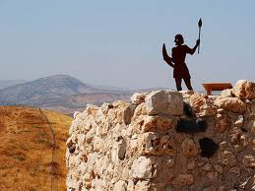
Protector, Warning Blaster
The watchman stood guard over the city. He watched with vigilance for the enemies approach. When he saw the first sign of approach, he would sound the warning blast. Those who heeded the blast made preparation; those who didn’t were in trouble!

Slide 16
The Glory Remains
”Then the spirit took me up, and I heard behind me a voice of a great rushing, saying, Blessed be the glory of the LORD from his place. I heard also the noise of the wings of the living creatures that touched one another, and the noise of the wheels over against them, and a noise of a great rushing…Then I arose, and went forth into the plain: and, behold, the glory of the LORD stood there, as the glory which I saw by the river of Chebar: and I fell on my face.” Ezekiel 3:12,13,23

Slide 17
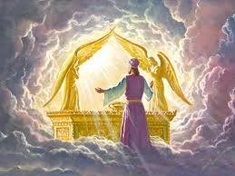
Presence of Christ
Ezekiel would face continual opposition. He would face the ire and hate of ancient Adventism and the heathen. He was to share the truth, regardless of the consequences. What kept him going was the repeated vision of God’s continual presence on His throne!

Slide 18
Guards His Children Still!
“In the vision of the prophet Ezekiel there was the appearance of a hand beneath the wings of the cherubim. This is to teach God's servants that it is divine power that gives success. Those whom God employs as His messengers are not to feel that His work is dependent on them. Finite beings are not left to carry this burden of responsibility. He who slumbers not, who is continually at work for the accomplishment of His designs, will carry forward His work. He will thwart the purposes of wicked men and will bring to confusion the counsels of those who plot mischief against His people. He who is the King, the Lord of hosts, sitteth between the cherubim, and amidst the strife and tumult of nations. He guards His children still. When the strongholds of kings shall be overthrown, when the arrows of wrath shall strike through the hearts of His enemies, His people will be safe in His hands.” PK., pg. 176

