Slide 1
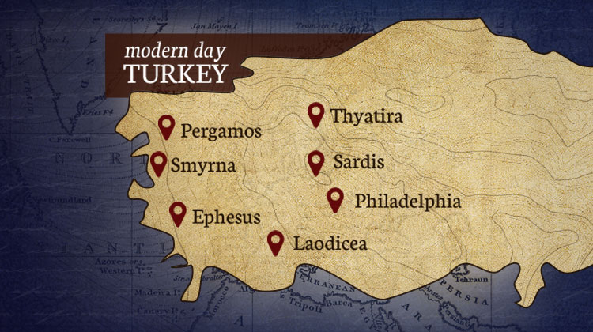
The Seven Churches pt 1: The Backdrop!

Slide 2
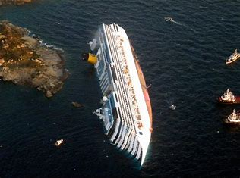
What Can We Do???
“The author cannot send forth this little volume without reiterating once more, most humbly, yet most earnestly, his immovable conviction that the Government of Britain [U.S.] and the Government of God are, at this hour, proceeding on lines directly antagonistic, and that either we must change our course or the Most High must change His if a great catastrophe is to be avoided. . . God raised up Britain [America] and gave her greatness beyond the measure of all former empires. For what end? That she might subserve the interests of the Gospel, as embodied in Protestantism. This is our first duty as a nation. The neglect of it is our first sin, no matter what other duties we make ourselves busy about. The laws of God’s providence being what they are, we cannot retain our supremacy, or , it may be, our existence, and neglect our great mission. But let be what may, the fate of our empire, whether it part in twain or dissolve in ruin, one thing is certain, Protestantism shall survive and triumph.”—JA Wylie, The Jesuits: Their Moral Maxims and Plots, 1881, p. vi

Slide 3
John the Beloved Disciple on Patmos… And Troubler of Israel!!!
“The rulers of the Jews were filled with bitter hatred against John for his unwavering fidelity to the cause of Christ. They declared that their efforts against the Christians would avail nothing so long as John's testimony kept ringing in the ears of the people. In order that the miracles and teachings of Jesus might be forgotten, the voice of the bold witness must be silenced. John was accordingly summoned to Rome to be tried for his faith. Here before the authorities the apostle's doctrines were misstated. False witnesses accused him of teaching seditious heresies. By these accusations his enemies hoped to bring about the disciple's death. John answered for himself in a clear and convincing manner, and with such simplicity and candor that his words had a powerful effect. His hearers were astonished at his wisdom and eloquence. But the more convincing his testimony, the deeper was the hatred of his opposers. The emperor Domitian was filled with rage. He could neither dispute the reasoning of Christ's faithful advocate, nor match the power that attended his utterance of truth; yet he determined that he would silence his voice.” AA, 569-570

Slide 4
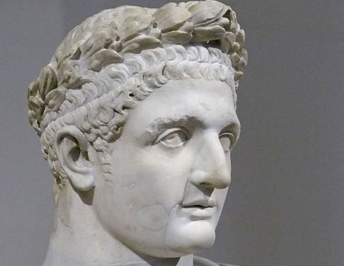
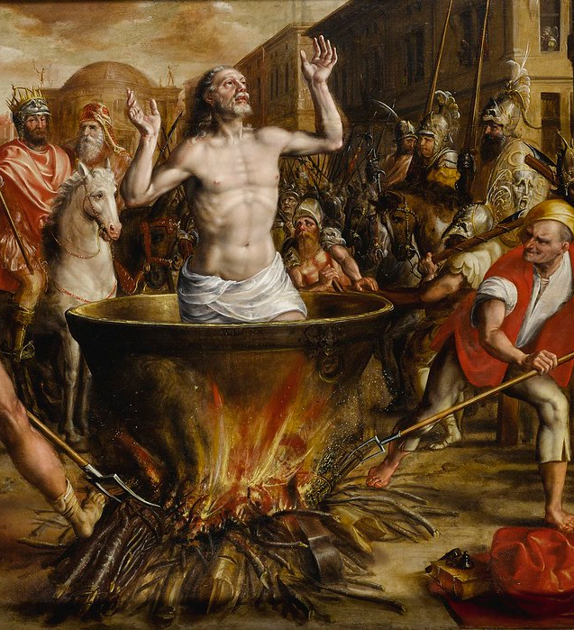
The Boiling Oil
“John was cast into a caldron of boiling oil; but the Lord preserved the life of His faithful servant, even as He preserved the three Hebrews in the fiery furnace. As the words were spoken, Thus perish all who believe in that deceiver, Jesus Christ of Nazareth, John declared, My Master patiently submitted to all that Satan and his angels could devise to humiliate and torture Him. He gave His life to save the world. I am honored in being permitted to suffer for His sake. I am a weak, sinful man. Christ was holy, harmless, undefiled. He did no sin, neither was guile found in His mouth. These words had their influence, and John was removed from the caldron by the very men who had cast him in. Again the hand of persecution fell heavily upon the apostle. By the emperor's decree John was banished to the Isle of Patmos, condemned "for the word of God, and for the testimony of Jesus Christ." Revelation 1:9. Here, his enemies thought, his influence would no longer be felt, and he must finally die of hardship and distress.” AA, 570

Slide 5
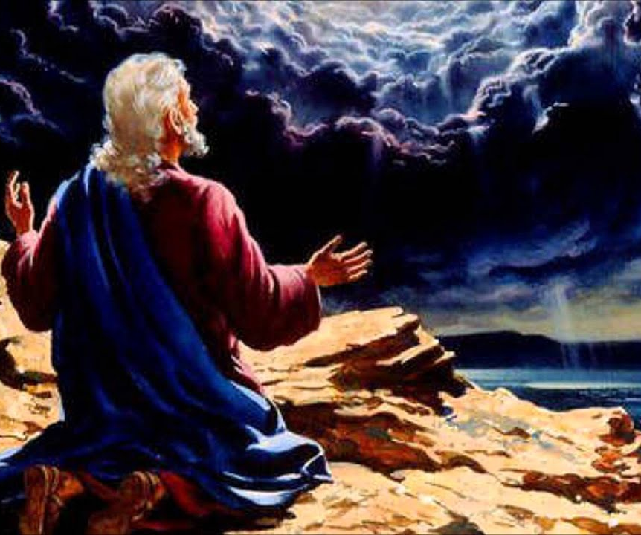
Ellen White Sets Up the Meaning/Purpose of Revelation
“The whole Bible is a revelation; for all revelation to men comes through Christ, and all centers in Him. God has spoken unto us by His Son, whose we are by creation and by redemption. Christ came to John exiled on the Isle of Patmos to give him the truth for these last days, to show him that which must shortly come to pass. Jesus Christ is the great trustee of divine revelation. It is through Him that we have a knowledge of what we are to look for in the closing scenes of this earth’s history. God gave this revelation to Christ, and Christ communicated the same to John. John, the beloved disciple, was the one chosen to receive this revelation. He was the last survivor of the first chosen disciples. Under the New Testament dispensation he was honored as the prophet Daniel was honored under the Old Testament dispensation.” Ms 129, 1905

Slide 6
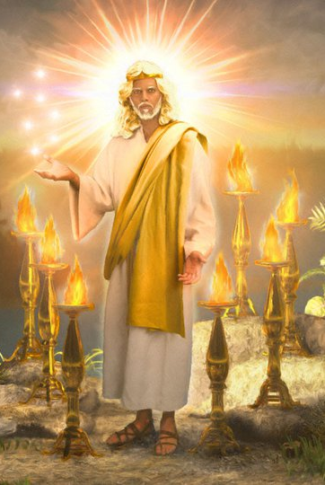
Jesus Came in Person to Deliver this Message!
“The instruction to be communicated to John was so important that Christ came from heaven to give it to His servant, telling him to send it to the churches. This instruction is to be the object of our careful and prayerful study; for we are living in a time when men who are not under the teaching of the Holy Spirit will bring in false theories. These men have been standing in high places, and they have ambitious projects to carry out. They seek to exalt themselves and to revolutionize the whole showing of things. God has given us special instruction to guard us against such ones. He bade John write in a book that which should take place in the closing scenes of this earth’s history.” Ms 29, 1905

Slide 7
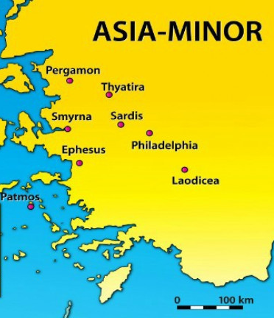
What We Will Study and How….
The Seven Churches in the Context of the Literal Seven Churches—How the messages relate to that specific Church
The Seven Churches in the Context of a time Prophecy—How the messages relate prophetically to chronological periods of Church history
The Seven Churches in the Context of Personal counsel—How the messages relate to all Christians in all periods of earth’s history

Slide 8
But First… We Must Study Ch. 1!
Rev. 1:1-3 “The Revelation of Jesus Christ, which God gave unto him, to shew unto his servants things which must shortly come to pass; and he sent and signified it by his angel unto his servant John: Who bare record of the word of God, and of the testimony of Jesus Christ, and of all things that he saw. Blessed is he that readeth, and they that hear the words of this prophecy, and keep those things which are written therein: for the time is at hand.”
?

Slide 9
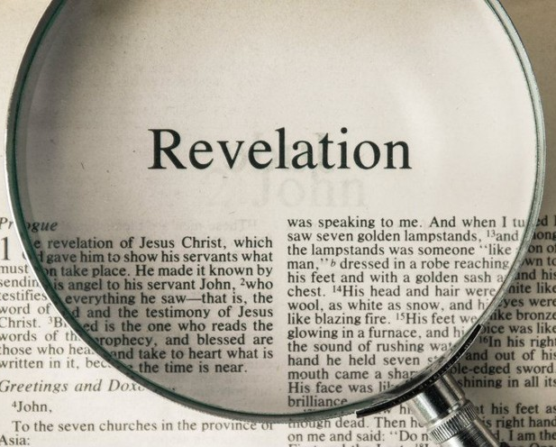
Isaiah On “Sealed” Books
Is. 29:11-13 “And the vision of all is become unto you as the words of a book that is sealed, which men deliver to one that is learned, saying, Read this, I pray thee: and he saith, I cannot; for it is sealed: And the book is delivered to him that is not learned, saying, Read this, I pray thee: and he saith, I am not learned. Wherefore the Lord said, Forasmuch as this people draw near me with their mouth, and with their lips do honour me, but have removed their heart far from me, and their fear toward me is taught by the precept of men:”

Slide 10
Revelation NOT a Sealed Book!
“Many have entertained the idea that the book of Revelation is a sealed book, and they will not devote time and study to its mysteries. They say that they are to keep looking to the glories of salvation, and that the mysteries revealed to John on the Isle of Patmos are worthy of less consideration than these. But God does not so regard this book. He declares: “I testify unto every man that heareth the words of the prophecy of this book, If any man shall add unto these things, God shall add unto him the plagues that are written in this book: and if any man shall take away from the words of the book of this prophecy, God shall take away his part out of the book of life, and out of the holy city, and from the things which are written in this book. He which testifieth these things saith, Surely I come quickly.” [Rev. 22:18-20] The book of Revelation opens to the world what has been, what is, and what is to come; it is for our instruction upon whom the ends of the world are come. It should be studied with reverential awe. We are privileged in knowing what is for our learning. But do we treat the word of God with the reverence which is his due, and with the gratitude which God would be pleased to see? “All Scripture is given by inspiration of God, and is profitable for doctrine, for reproof, for correction, for instruction in righteousness: that the man of God may be perfect, thoroughly furnished unto all good works.” [2 Tim. 3:16-17] The Lord himself revealed to his servant John the mysteries of the book of Revelation, and he designs that they shall be open to the study of all. In this book are depicted scenes that are now in the past, and some of eternal interest that are taking place around us; other of its prophecies will not receive their complete fulfilment until the close of time, when the last great conflict between the powers of darkness and the Prince of heaven will take place.” R&H Aug. 31, 1897

Slide 11
Continuing in Revelation 1
Rev. 1:4-7 “John to the seven churches which are in Asia: Grace be unto you, and peace, from him which is, and which was, and which is to come [repeated in verse 1:8, 4:8; 11:17; 16:5]; and from the seven Spirits which are before his throne; And from Jesus Christ, who is the faithful witness, and the first begotten of the dead, and the prince of the kings of the earth. Unto him that loved us, and washed us from our sins in his own blood, And hath made us kings and priests unto God and his Father; to him be glory and dominion for ever and ever. Amen. Behold, he cometh with clouds; and every eye shall see him, and they also which pierced him: and all kindreds of the earth shall wail because of him. Even so, Amen.

Slide 12
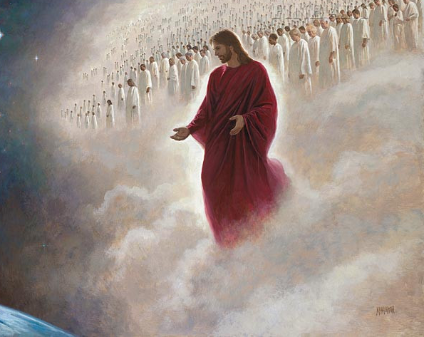
Jesus’ Second Coming Will NOT be a Secret!
1 Thess. 3:13 “To the end he may stablish your hearts unblameable in holiness before God, even our Father, at the coming of our Lord Jesus Christ with all his saints.”
2 Thess. 1:7-9 “And to you who are troubled rest with us, when the Lord Jesus shall be revealed from heaven with his mighty angels, In flaming fire taking vengeance on them that know not God, and that obey not the gospel of our Lord Jesus Christ: Who shall be punished with everlasting destruction from the presence of the Lord, and from the glory of his power”
Matt. 24:30-31 “And then shall appear the sign of the Son of man in heaven: and then shall all the tribes of the earth mourn, and they shall see the Son of man coming in the clouds of heaven with power and great glory. And he shall send his angels with a great sound of a trumpet, and they shall gather together his elect from the four winds, from one end of heaven to the other.”

Slide 13
Special Resurrection…
Dan. 12:1-2 “And at that time shall Michael stand up, the great prince which standeth for the children of thy people: and there shall be a time of trouble, such as never was since there was a nation even to that same time: and at that time thy people shall be delivered, every one that shall be found written in the book. And many of them that sleep in the dust of the earth shall awake, some to everlasting life, and some to shame and everlasting contempt.”

Slide 14
They Who Pierced Him…
“Looking upon the smitten Lamb of God, the Jews had cried, "His blood be on us, and on our children." That awful cry ascended to the throne of God. That sentence, pronounced upon themselves, was written in heaven. That prayer was heard. The blood of the Son of God was upon their children and their children's children, a perpetual curse. Terribly was it realized in the destruction of Jerusalem. Terribly has it been manifested in the condition of the Jewish nation for eighteen hundred years,—a branch severed from the vine, a dead, fruitless branch, to be gathered up and burned. From land to land throughout the world, from century to century, dead, dead in trespasses and sins! Terribly will that prayer be fulfilled in the great judgment day. When Christ shall come to the earth again, not as a prisoner surrounded by a rabble will men see Him. They will see Him then as heaven's King. Christ will come in His own glory, in the glory of His Father, and the glory of the holy angels. Ten thousand times ten thousand, and thousands of thousands of angels, the beautiful and triumphant sons of God, possessing surpassing loveliness and glory, will escort Him on His way. Then shall He sit upon the throne of His glory, and before Him shall be gathered all nations. Then every eye shall see Him, and they also that pierced Him. In the place of a crown of thorns, He will wear a crown of glory,—a crown within a crown. In place of that old purple kingly robe, He will be clothed in raiment of whitest white, "so as no fuller on earth can white them." Mark 9:3. And on His vesture and on His thigh a name will be written, "King of kings, and Lord of lords." Revelation 19:16. Those who mocked and smote Him will be there. The priests and rulers will behold again the scene in the judgment hall. Every circumstance will appear before them, as if written in letters of fire. Then those who prayed, "His blood be on us, and on our children," will receive the answer to their prayer. Then the whole world will know and understand. They will realize who and what they, poor, feeble, finite beings, have been warring against. In awful agony and horror they will cry to the mountains and rocks, "Fall on us, and hide us from the face of Him that sitteth on the throne, and from the wrath of the Lamb: for the great day of His wrath is come; and who shall be able to stand?" Revelation 6:16, 17.” DA, 739-740

Slide 15
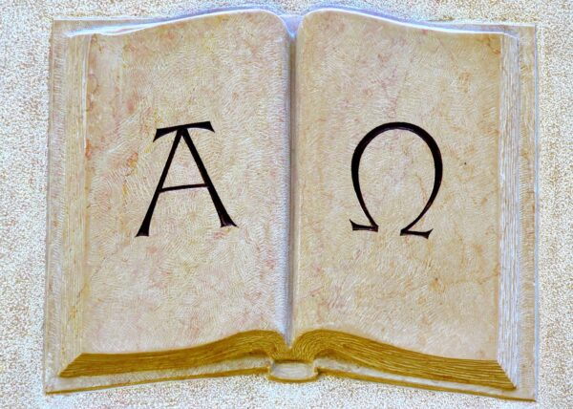
Rev. 1:8-11 “I am Alpha and Omega, the beginning and the ending, saith the Lord, which is, and which was, and which is to come, the Almighty. I John, who also am your brother, and companion in tribulation, and in the kingdom and patience of Jesus Christ, was in the isle that is called Patmos, for the word of God, and for the testimony of Jesus Christ. I was in the Spirit on the Lord's day, and heard behind me a great voice, as of a trumpet, Saying, I am Alpha and Omega, the first and the last: and, What thou seest, write in a book, and send it unto the seven churches which are in Asia; unto Ephesus, and unto Smyrna, and unto Pergamos, and unto Thyatira, and unto Sardis, and unto Philadelphia, and unto Laodicea.”
Is. 2:12 “For the day of the Lord of hosts shall be upon every one that is proud and lofty, and upon every one that is lifted up; and he shall be brought low”
Mark 2:28 “Therefore the Son of man is Lord also of the sabbath.”

Slide 16
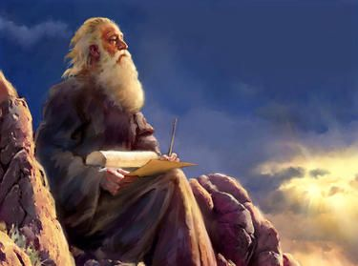
Lord’s Day = Sabbath!
“The Sabbath, which God had instituted in Eden, was as precious to John on the lonely isle as when he was with his companions in the cities and towns. The precious promises that Christ had given regarding this day he repeated and claimed as his own. It was the sign to him that God was his; for God had declared: “Verily my Sabbaths ye shall keep: for it is a sign between me and you throughout your generations; that ye may know that I am the Lord that doth sanctify you.... Wherefore the children of Israel shall keep the Sabbath, to observe the Sabbath throughout their generations, for a perpetual covenant. It is a sign between me and the children of Israel forever.” [Ex. 31:16-17] On the Sabbath day the risen Saviour made his presence known to John. “I was in the Spirit on the Lord's day,” he writes” Youth’s Instructor April 5, 1900

Slide 18
Rev. 1:12-19 The Sanctuary Foundation
Rev. 1:12-19 “And I turned to see the voice that spake with me. And being turned, I saw seven golden candlesticks; And in the midst of the seven candlesticks one like unto the Son of man, clothed with a garment down to the foot, and girt about the paps with a golden girdle. His head and his hairs were white like wool, as white as snow; and his eyes were as a flame of fire; And his feet like unto fine brass, as if they burned in a furnace; and his voice as the sound of many waters. And he had in his right hand seven stars: and out of his mouth went a sharp twoedged sword: and his countenance was as the sun shineth in his strength. And when I saw him, I fell at his feet as dead. And he laid his right hand upon me, saying unto me, Fear not; I am the first and the last: I am he that liveth, and was dead; and, behold, I am alive for evermore, Amen; and have the keys of hell and of death. Write the things which thou hast seen, and the things which are, and the things which shall be hereafter; The mystery of the seven stars which thou sawest in my right hand, and the seven golden candlesticks. The seven stars are the angels of the seven churches: and the seven candlesticks which thou sawest are the seven churches.”

Slide 19
What We Will Study and How….
The Seven Churches in the Context of the Literal Seven Churches—How the messages relate to that specific Church
The Seven Churches in the Context of a time Prophecy—How the messages relate prophetically to chronological periods of Church history
The Seven Churches in the Context of Personal counsel—How the messages relate to all Christians in all periods of earth’s history

