Slide 1
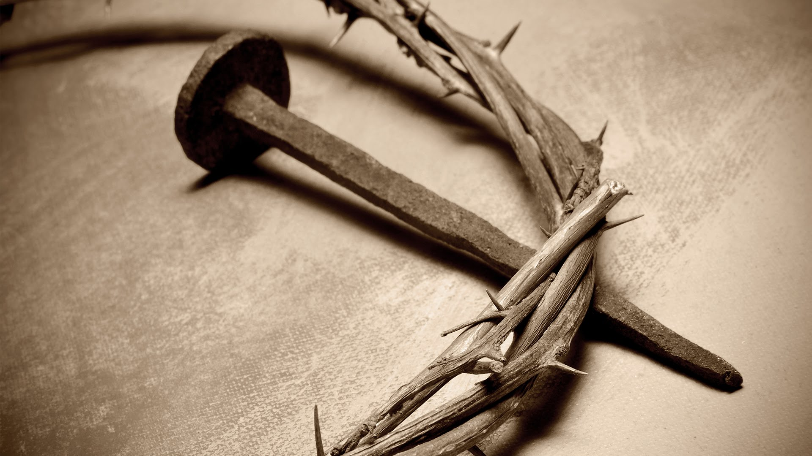
The “New” Covenant of Jesus Christ

Slide 2
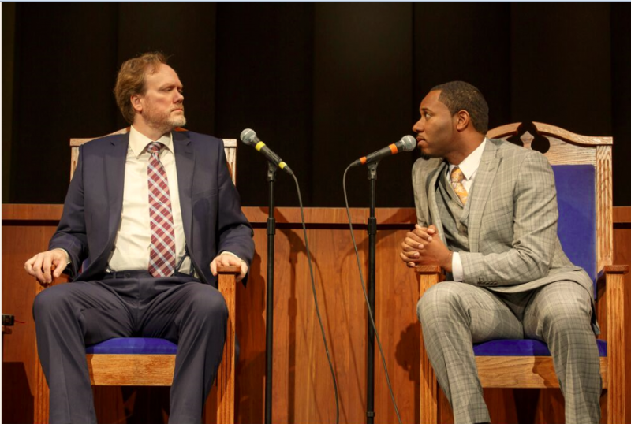
Theological Issues with the New Covenant
The Left Extreme of
the Pendulum:
Law nailed to the cross
Saved in Sin
No Sanctuary
No Food Restrictions
No Tithe

Slide 3
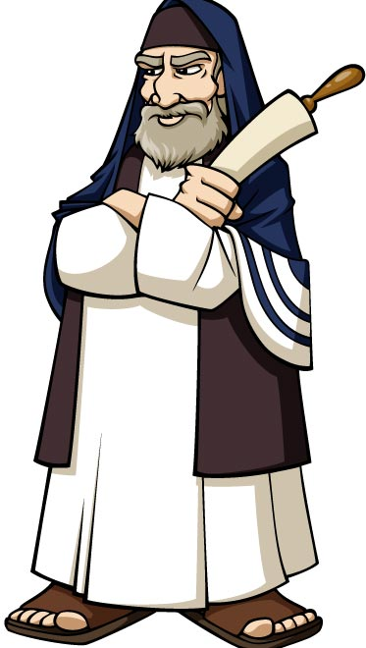
Theological Issues with the New Covenant Continued. . .
The Right Extreme of
the Pendulum:
Keep Feast Days
Works Based Religion (Do this! Don’t Do That!)
The Church Will Save You!
Ordinance Seekers

Slide 4
What is a Covenant?
Covenant-(From American Dictionary of the English Language, 1828)
1. A mutual consent or agreement of two or more persons, to do or to forbear some act or thing; a contract; stipulation. A covenant is created by deed in writing, sealed and executed; or it may be implied in the contract.
3. In theology, the covenant of works, is that implied in the commands, prohibitions, and promises of God; the promise of God to man, that mans perfect obedience should entitle him to happiness. This do, and live; that do, and die.
Covenant Hebrew-(Strong’s Concordance) briyth (ber-eeth’)
League, confederacy, alliance, pledge, constitution, ordinance, agreement, divine ordinance with signs or pledges
Covenant Greek-(Stong’s) diatheke (dee-ath-ay’-kay)
Testament, disposition, arrangement of any sort, a compact, God’s covenant with Noah, Abraham, Moses, Israel, David, etc.

Slide 5
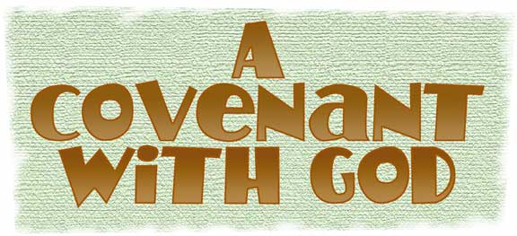
3 KEY POINTS
Throughout human history, God has ever sought to covenant with man to ensure our and His happiness, harmony, protection, and perpetuation of life. Though the covenants have been reaffirmed, blessed with more spiritual light, and “modified” in an earthly sense; it has not changed—The deal God makes with us is the same: For the subjection and obedience of man, God promises to remember His covenant and save us from our sins and bring us into everlasting life. In each covenant God made there are the Terms or Arrangement/Agreement/Promises and the outward sign of the covenant, and How the Covenant is broken. Our failings has caused God to constantly reestablish His same covenant with various parties throughout time. The covenant is the same; but it has 2 final forms; shadow and fulfillment of Figure.

Slide 6
The First Covenant:
Gen. 3:15, 21 “And I will put enmity between thee and the woman, and between thy seed and her seed; it shall bruise thy head, and thou shalt bruise his heel . . . Unto Adam also and to his wife did the LORD God make coats of skins, and clothed them”
The sacrificial offerings were ordained by God to be to man a perpetual reminder and a penitential acknowledgment of his sin and a confession of his faith in the promised Redeemer. They were intended to impress upon the fallen race the solemn truth it was sin that caused death. To Adam, the offering of the first sacrifice was a most painful ceremony. His hand must be raised to take life, which only God could give. It was the first time he had ever witnessed death, and he knew that had he been obedient to God, there would have been no death of man or beast. As he slew the innocent victim, he trembled at the thought that his sin must shed the blood of the spotless Lamb of God. This scene gave him a deeper and more vivid sense of the greatness of his transgression, which nothing but the death of God’s dear Son could expiate. (PP, 69)
--What are the terms? The sign? How it’s broken?

Slide 7
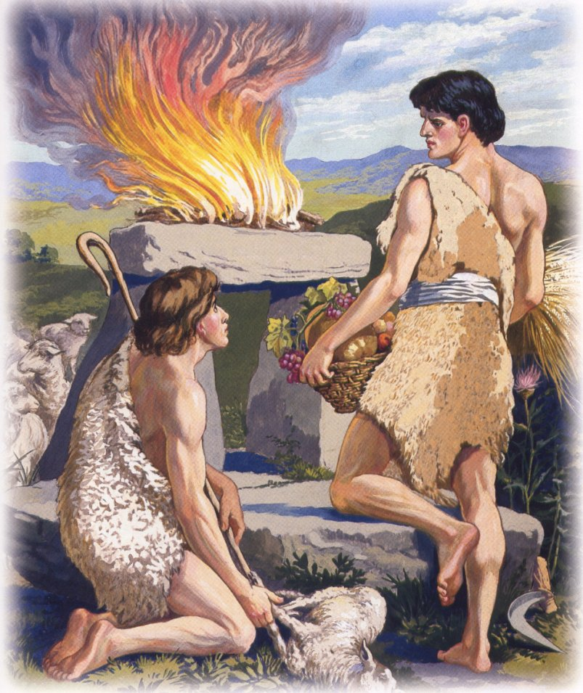
Cain Broke the Covenant: Left Himself Open to Satan
Gen. 4:3-5, 8 “And in process of time it came to pass, that Cain brought of the fruit of the ground an offering unto the LORD. And Abel, he also brought of the firstlings of his flock and the fat thereof. And the LORD had respect unto Abel and to his offering: But unto Cain and to his offering he had not respect. And Cain was very wroth, and his countenance fell. . . Cain rose up against Abel his brother, and slew him”

Slide 8
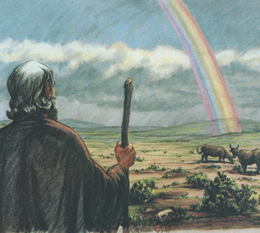
Antediluvians Broke the Covenant made with Adam
Gen. 6:2-5, 8 “the Sons of God saw the daughters of men that they were fair’ and they took them wives of all which they chose. . . and they bare children to them . . . And God saw that the wickedness of man was great in the earth, and that every imagination of the thoughts of his heart was only evil continually. . . But Noah found grace in the eyes of the LORD.”
Covenant Established with Noah
Gen. 9:15-17 “And I will remember my covenant. . . And the bow shall be in the cloud; and I will look upon it, that I remember the everlasting covenant between God and every living creature of all flesh that is upon the earth. . . This is the token of the covenant”

Slide 9
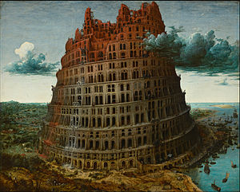
Babel Did Not Believe the Covenant
Gen. 11:2-4 “And it came to pass, as they journeyed from the east, that they found a plain in Shinar; and they dwelt there. And they said one to another, Go to, let us make brick, and burn them thoroughly. And they had brick for stone, and slime for morter. And they said, Go to, let us build us a city and a tower, whose tope may reach unto heaven; and let us make a name”
The dwellers on the plain of Shinar disbelieved God’s covenant that He would not again bring a flood upon the earth. Many of them denied the existence of God and attributed the Flood to the operation of natural causes. Others believed in a Supreme Being, and that it was He who had destroyed the antediluvian world; and their hearts, like that of Cain, rose up in rebellion against Him. (PP, 122)

Slide 10
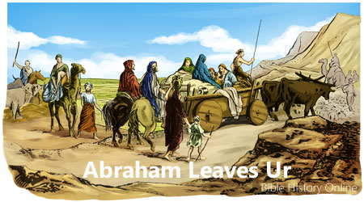
Renewed Covenant with Abraham: Same Terms, Different Sign
Gen. 12:1- “Now the LORD had said unto Abram, Get thee out of thy country, and from thy kindred, and from thy father’s house, unto a land that I will shew thee: And I will make of thee a great nation, and I will bless thee, and make thy name great; and thou shalt be a blessing: And I will bless them that bless thee and curse them that curseth thee: and in thee shall all the families of the earth be blessed. So Abram departed, as the LORD had spoken unto him.
Obedience, trust, and Faith
Gen. 17:9, 10 “And God said unto Abraham, Thou shalt keep my covenant therefore, thou, and thy seed after thee in their generations. This is my covenant which ye shall keep, between me and you and thy seed after thee; Every man child among you shall be circumcised.”
No change in terms, just in “sign”

Slide 11
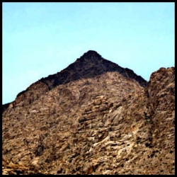
Covenant Reestablished at Sinai
Ex. 19:5 “Ye have seen what I did unto the Egyptians, and how I bare you on eagles’ wings, and brought you unto myself. Now therefore, if ye will obey my voice indeed, and keep my covenant, then ye shall be a peculiar treasure unto me above all people: for all the earth is mine.
Terms?
Obedience to God’s Law and will
Sign?
Law, Sabbath and Tabernacle
Services/feasts, circumcision,
rainbow still in effect

Slide 12
The Signs
Exodus 20 established the eternal Law as conditions for His covenant, obedience, again, are the terms.
Ex. 31:16, 17 “Wherefore the children of Israel shall keep the sabbath, to observe the sabbath throughout their generations, for a perpetual covenant. It is a sign between me and the children of Israel for ever: for in six days the LORD made heaven and earth, and on the seventh day he rested, and was refreshed.”
Ezekiel 20:19 “I am the LORD your God; walk in my statutes, and keep my judgments, and do them.”
Lev. 12:3 “And in the eighth day the flesh of his foreskin be circumcised.”

Slide 13
The “New” Covenant
Jer. 31:31-35 “Behold, the days come, saith the LORD, that I will make a new covenant with the house of Israel, and with the house of Judah: Not according to the covenant that I made with their fathers in the day that I took them by the hand to bring them out of the land of Egypt; which my covenant they brake, although I was an husband unto them, said the LORD: But this shall be the covenant that I will make with the house of Israel; After those days, saith the LORD, I will put my law in their inward parts, and write it in their hearts; and I will be their God, and they shall be my people. And they shall teach no more every man his neighbor, and every man his brother, saying, Know the LORD: for they shall all know me, from the least of them unto the greatest of them, saith the LORD: for I will forgive their iniquity, and I will remember their sin no more. Thus saith the LORD which giveth the sun for a light by day, and the ordinances of the moon and of the stars for a light by night”

Slide 14
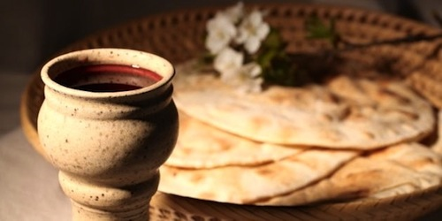
Jesus Defines the New Covenant
Matt. 26:27-28 “And he took the cup, and gave thanks, and gave it to them, saying, Drunk ye all of it; For this is my blood of the new testament, which is shed for many for the remission of sins.”

Slide 15
New Testament Reaffirms
Heb. 8:4-7, 10, 12 & 13 “For if he were on earth, he should not be a priest, seeing that there are priests that offer gifts according to the law: Who serve unto the example and shadow of heavenly things, as Moses was admonished of God when he was about to make the tabernacle: for, See, saith he, that thou make all things according to the pattern shewed to thee in the mount. But now hath he obtained a more excellent ministry, by how much also he is the mediator of a better covenant, which was established upon better promises. For if that first covenant had been faultless, then should no place have been sought for the second. . . For this is the covenant I will make with the house of Israel after those days, saith the LORD; I will put my laws into their mind, and write them in their hearts: and I will be to them a God, and they shall be my people: . . . their sins and their iniquities will I remember no more. . . A new covenant, he hath made the first old. Now that which is old is ready to vanish away.”
Heb. 9:1, 9 “Then verily the first covenant had also ordinances of divine service, and a worldly sanctuary. . . Which was a figure for the time then present, in which were offered both gifts and sacrifices, that could not make him that did the service perfect, as pertaining to the conscience; Which stood only in meats and drinks, and divers washings, and carnal ordinances, imposed on them until the time of reformation.

Slide 16
Colossians 2 spells it out
Col.2:8-12, 14 & 16 “Beware lest any man spoil you through philosophy and vain deceit, after the tradition of men, after the rudiments of the world, and not after Christ. For in him dwelleth all the fulness of the Godhead bodily. And ye are complete in him, which is the head of all principality and power: In whom also ye are circumcised with the circumcision made without hands, in putting off the body of the sins of the flesh by the circumcision of Christ: Buried with him in baptism, wherein also ye are risen with him through the faith of the operation of God, who hath raised him from the dead. . . Blotting out the handwriting of ordinances that was against us, which was contrary to us, and took it out of the way, nailing it to the cross; . . . Let no man therefore judge you in meat, or in drink, or in respect of an holyday, or of the new moon, or of the sabbath days: Which are a shadow of things to come; but the body is of Christ.”

Slide 17
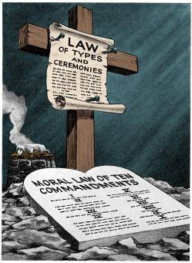
The Greater Covenant
All ordinances of service (shadows) have now met the Antitype. The entire earthly sanctuary system has been vindicated by Christ in Heaven. We look to a heavenly sanctuary by faith, to a spiritual circumcision, to spiritual feast days fulfilled in prophecy. The new signs of the covenant are all these things and the Law of God, in which contains the seal of God in the Sabbath Commandment
Ex. 34:38 “And he was there with the Lord forty days and forty nights; he did neither eat bread, nor drink water. And he wrote upon the tables the words of the covenant, the ten commandments.”

Slide 18
Old Meets New in Christ
Deut. 7:9 “Know therefore that the LORD thy God, he is God, the faithful God, which keepeth covenant mercy with them that love him and keep his commandments”
John 14:15 “If ye love me, keep my commandments”
Rev. 22:14 “Blessed are they that do his commandments, that they may have right to the tree of life”
Ps. 103:17, 18 “But the mercy of the LORD is from everlasting to everlasting upon them that fear him, and his righteousness unto children’s children. To such as keep his covenant, and to those that remember his commandments”
Perfect Harmony! The Terms are the Same-Obedience, Faith, Trust, Love. The Sign? The Commandments and spiritual fulfillment of every aspect of the Old Covenant.

Slide 19
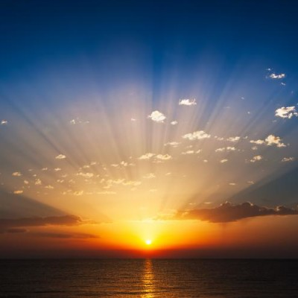
Let the Son Shine!
Christ’s death and resurrection completed His covenant. Before this time, it was revealed through types and shadows, which pointed to the great offering to be made by the world’s Redeemer, offered in promise for the sins of the world. Anciently believers were saved by the same Savior as now, but it was a God veiled. They saw God’s mercy in figures. The promise given to Adam and Eve in Eden was the gospel to a fallen race. The promise was made that the seed of the woman should bruise the serpent’s head, and it should bruise His heel. Christ’s sacrifice is the glorious fulfillment of the whole Jewish economy. The Sun of Righteousness has risen. Christ our righteousness is shining in brightness upon us. (MS 148, 1897)

