Slide 1
Ezekiel, pt. 19
COMING Home!

Slide 2
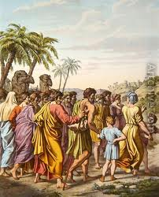
Captivity and Return
We noticed in Ezekiel 33:21 that Jerusalem was burned to the ground in 586 BC by Nebuchadnezzar's forces. Not wanting to leave His people sorrowing and hopeless, the Lord graciously encourages them that they will return to Israel again!! This is the focus of Ezekiel 36!

Slide 3
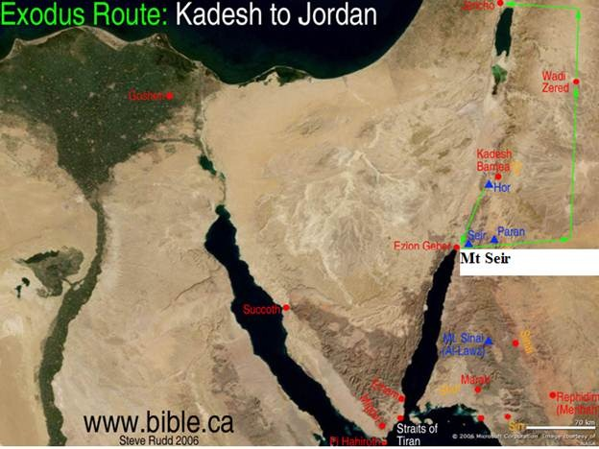
In the Interim-MT seir
“Moreover the word of the LORD came unto me, saying, Son of man, set thy face against mount Seir, and prophesy against it, And say unto it, Thus saith the Lord GOD; Behold, O mount Seir, I am against thee, and I will stretch out mine hand against thee, and I will make thee most desolate. I will lay thy cities waste, and thou shalt be desolate, and thou shalt know that I am the LORD.” Ezek 35:1-4

Slide 4
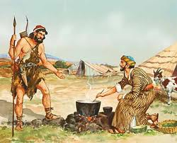
Repeated-profane oine!
“Thus dwelt Esau in mount Seir: Esau is Edom.” Gen. 36:8
“Thus saith the Lord GOD; Because that Edom hath dealt against the house of Judah by taking vengeance, and hath greatly offended, and revenged himself upon them; Therefore thus saith the Lord GOD; I will also stretch out mine hand upon Edom, and will cut off man and beast from it; and I will make it desolate from Teman; and they of Dedan shall fall by the sword. And I will lay my vengeance upon Edom by the hand of my people Israel: and they shall do in Edom according to mine anger and according to my fury; and they shall know my vengeance, saith the Lord GOD.” Ezek. 25:12-14

Slide 5
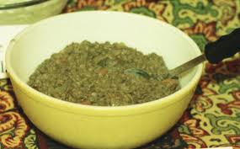
Hatred Amidst Rare Privileges!
“Because thou hast had a perpetual hatred, and hast shed the blood of the children of Israel by the force of the sword in the time of their calamity, in the time that their iniquity had an end: Therefore, as I live, saith the Lord GOD, I will prepare thee unto blood, and blood shall pursue thee: sith thou hast not hated blood, even blood shall pursue thee.” Ezekiel 35:5,6

Slide 6
Esau/Mt. Seir/Edom
“The birthright which he had so carelessly bartered he could not now regain. "For one morsel of meat," for a momentary gratification of appetite that had never been restrained, Esau sold his inheritance; but when he saw his folly, it was too late to recover the blessing. "He found no place of repentance, though he sought it carefully with tears." Hebrews 12:16, 17. Esau was not shut out from the privilege of seeking God's favor by repentance, but he could find no means of recovering the birthright. His grief did not spring from conviction of sin; he did not desire to be reconciled to God. He sorrowed because of the results of his sin, but not for the sin itself.
Because of his indifference to the divine blessings and requirements, Esau is called in Scripture "a profane person." Verse 16. He represents those who lightly value the redemption purchased for them by Christ, and are ready to sacrifice their heir ship to heaven for the perishable things of earth. Multitudes live for the present, with no thought or care for the future.” PP, pg. 181

Slide 7
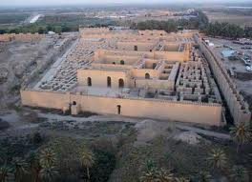
Ezekiel 36-Homeward Bound
“But ye, O mountains of Israel, ye shall shoot forth your branches, and yield your fruit to my people of Israel; for they are at hand to come. For, behold, I am for you, and I will turn unto you, and ye shall be tilled and sown: And I will multiply men upon you, all the house of Israel, even all of it: and the cities shall be inhabited, and the wastes shall be builded: And I will multiply upon you man and beast; and they shall increase and bring fruit: and I will settle you after your old estates, and will do better unto you than at your beginnings: and ye shall know that I am the LORD.” Ezekiel 36:8-11

Slide 8
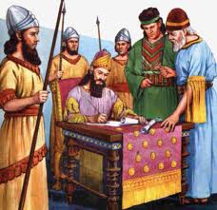
After the Babylonian Captivity
“Moreover I will take from them the voice of mirth, and the voice of gladness, the voice of the bridegroom, and the voice of the bride, the sound of the millstones, and the light of the candle. And this whole land shall be a desolation, and an astonishment; and these nations shall serve the king of Babylon seventy years. And it shall come to pass, when seventy years are accomplished, that I will punish the king of Babylon, and that nation, saith the LORD, for their iniquity, and the land of the Chaldeans, and will make it perpetual desolations.” Jeremiah 25:10-12

Slide 9
3 Decrees
“And the elders of the Jews builded, and they prospered through the prophesying of Haggai the prophet and Zechariah the son of Iddo. And they builded, and finished it, according to the commandment of the God of Israel, and according to the commandment of Cyrus, and Darius, and Artaxerxes king of Persia.” Ezra 6:14 Through these 3 decrees, the restoration of the Jews to Israel, the rebuilding of the temple, and the restoration of the city were made possible. The climactic decree was in 457 BC!

Slide 10
Do They Apply Again?
“For I will take you from among the heathen, and gather you out of all countries, and will bring you into your own land.” Ezekiel 36:24
“And ye shall dwell in the land that I gave to your fathers; and ye shall be my people, and I will be your God. I will also save you from all your uncleannesses: and I will call for the corn, and will increase it, and lay no famine upon you. And I will multiply the fruit of the tree, and the increase of the field, that ye shall receive no more reproach of famine among the heathen.” Ezekiel 36:28-30
“And the desolate land shall be tilled, whereas it lay desolate in the sight of all that passed by. And they shall say, This land that was desolate is become like the garden of Eden; and the waste and desolate and ruined cities are become fenced, and are inhabited.” Ezek. 36:34,35

Slide 11
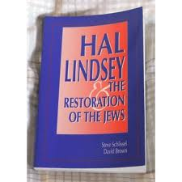
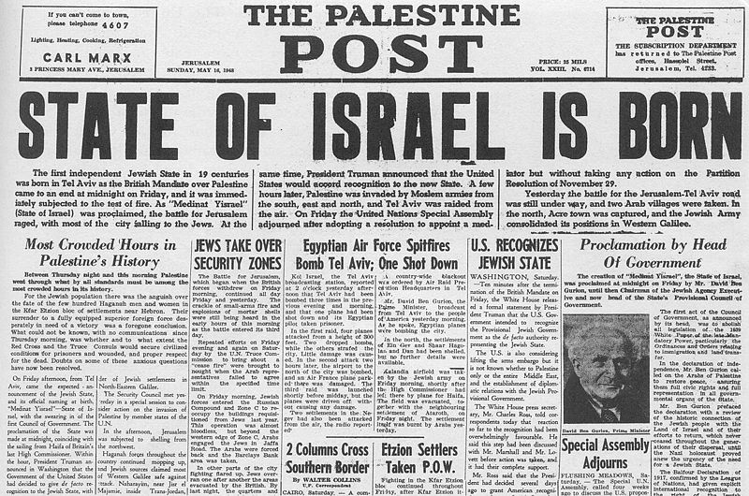
1948-Fulfillment?

Slide 12
No! A Thousand Times No!!
The time prophecy of Daniel 9:24-27 had designated “Seventy weeks are determined upon thy people and upon thy holy city, to finish the transgression, and to make an end of sins, and to make reconciliation for iniquity,…”. When that time period ended in 34 AD, at the stoning of Stephen, the Jewish nation ceased to be the people of God forever. Individual Jews could accept Christ. The nation divorced itself from Christ and God chose out the church to be the depositors of divine truth.

Slide 13
1948 God had Nothing to do with it!
In 1918, the Jesuits would cause their Zionists in England to issue the Balfour Declaration, declaring Palestine to be the new homeland for the wandering Jew. Could it be that after 1900 years of Rome’s crusades, inquisitions, and pogroms, the Jewish race would now have a place to call it’s own? Or was Zionism a set up for the greatest betrayal the Jewish race has ever known? World War I prepared the land for the people, WWII prepared the people for the land. “Instead of taking a public stand, he, Cardinal Spellman would operate behind the scenes by personally calling on ever South American country to cast their votes for Israel…There was little doubt that Spellman knew the UN delegates…After a bitter struggle, Israel was admitted to the UN by a vote of 37-12. The Israelis had turned to a number of men of prominence including John Foster Dulles to promote their cause. Many were convinced that Spellman had been the deciding factor.” John Cooney, The American Pope, pages 186-187.

Slide 14
Rome’s Plan to Destroy Them
“World War II was to be fomented through manipulation of the differences that existed between the German Nationalists and the Political Zionists. This was to result in an expansion of Russian influence and the establishment of a state of Israel in Palestine.” Albert Pike’s letter to Mazzini, 1871
“In Vatican eyes, therefore, the millenarian yearning for a global Hebrew theocracy, represents a deadly threat to the eschatological teachings of the Catholic church. When translated into concrete political terms, such a view spells not only rivalry, but implacable enmity. -- Avro Manhattan, The Vatican Moscow Washington Alliance, chick Publications, pp. 169, 170.

Slide 15
Explaining Scripture
“And when ye shall see Jerusalem compassed with armies, then know that the desolation thereof is nigh. Then let them which are in Judaea flee to the mountains; and let them which are in the midst of it depart out; and let not them that are in the countries enter there into. For these be the days of vengeance, that all things which are written may be fulfilled. But woe unto them that are with child, and to them that give suck, in those days! for there shall be great distress in the land, and wrath upon this people. And they shall fall by the edge of the sword, and shall be led away captive into all nations: and Jerusalem shall be trodden down of the Gentiles, until the times of the Gentiles be fulfilled.” Luke 21:20-24
1. 70 AD
2. led captive as slaves
3. Jerusalem trodden down by the Gentiles until the time of the Gentiles be fulfilled.
4. What is Jerusalem here, who are the Gentiles and what are the Gentiles times?
Revelation 11:2 “But the court which is without the temple leave out, and measure it not; for it is given unto the Gentiles: and the holy city shall they tread under foot forty and two months.”

Slide 16
Explanation
3. Jerusalem trodden down by the Gentiles until the time of the Gentiles be fulfilled.
4. What is Jerusalem here, who are the Gentiles and what are the Gentiles times? Revelation 11:2 “But the court which is without the temple leave out, and measure it not; for it is given unto the Gentiles: and the holy city shall they tread under foot forty and two months.”
Jerusalem is the holy city. The Gentiles are the papacy. The times of the Gentiles is 1260 years. What was the holy city tread down by Rome for 1260 years? Was it the city of Jerusalem or was it the church? THE CHURCH!!

Slide 17
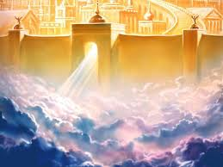
Heavenly Home!
1. Israel had their day in the sunshine.
2. By 34 AD, they ceased to be God’s people.
3. God’s blessing rested on the church.
4. Any attempts to restore Israel came from Rome with the desire to destroy the Jews.
5. The promises in Ezekiel 36 are for God’s children today to take us to the Heavenly promised land.

Slide 18
Given to the Children of God!
“Then will I sprinkle clean water upon you, and ye shall be clean: from all your filthiness, and from all your idols, will I cleanse you. A new heart also will I give you, and a new spirit will I put within you: and I will take away the stony heart out of your flesh, and I will give you an heart of flesh. And I will put my spirit within you, and cause you to walk in my statutes, and ye shall keep my judgments, and do them.” Ezekiel 36:25-27

