Slide 1
The Judgment of the Living

Slide 2
When?
“The Lord has shown me clearly that the image of the beast will be formed before probation closes; for it is to be the great test for the people of God, by which their eternal destiny will be decided…(Rev. 13:11-17 quoted)
“This is the test that the people of God must have before they are sealed. All who prove their loyalty to God by observing His law, and refusing to accept a spurious sabbath, will rank under the banner of the Lord God Jehovah, and will receive the seal of the living God. Those who yield the truth of heavenly origin and accept the Sunday sabbath, will receive the mark of the beast.” (Letter 11, 1890) quoted in 7A Bible Commentary, pg. 976

Slide 3
The Last Beast
“ And I beheld another beast coming up out of the earth; and he had two horns like a lamb, and he spake as a dragon. And he exerciseth all the power of the first beast before him, and causeth the earth and them which dwell therein to worship the first beast, whose deadly wound was healed. And he doeth great wonders, so that he maketh fire come down from heaven on the earth in the sight of men, And deceiveth them that dwell on the earth by the means of those miracles which he had power to do in the sight of the beast; saying to them that dwell on the earth, that they should make an image to the beast, which had the wound by a sword, and did live…

Slide 4
”And he had power to give life unto the image of the beast, that the image of the beast should both speak, and cause that as many as would not worship the image of the beast should be killed. And he causeth all, both small and great, rich and poor, free and bond, to receive a mark in their right hand, or in their foreheads: And that no man might buy or sell, save he that had the mark, or the name of the beast, or the number of his name. Here is wisdom. Let him that hath understanding count the number of the beast: for it is the number of a man; and his number [is] Six hundred threescore [and] six.” Rev. 13:11-17

Slide 5
Summary
Ellen White is very clear that the image of the beast is formed before probation closes and that this will be the test before God’s people are sealed. Judgment of the living can not take place until the image of the beast is formed. This will be the final test for God’s people. Well, what then is the image of the beast that plays so vital a role in the final work of God and the sealing of His people?

Slide 6
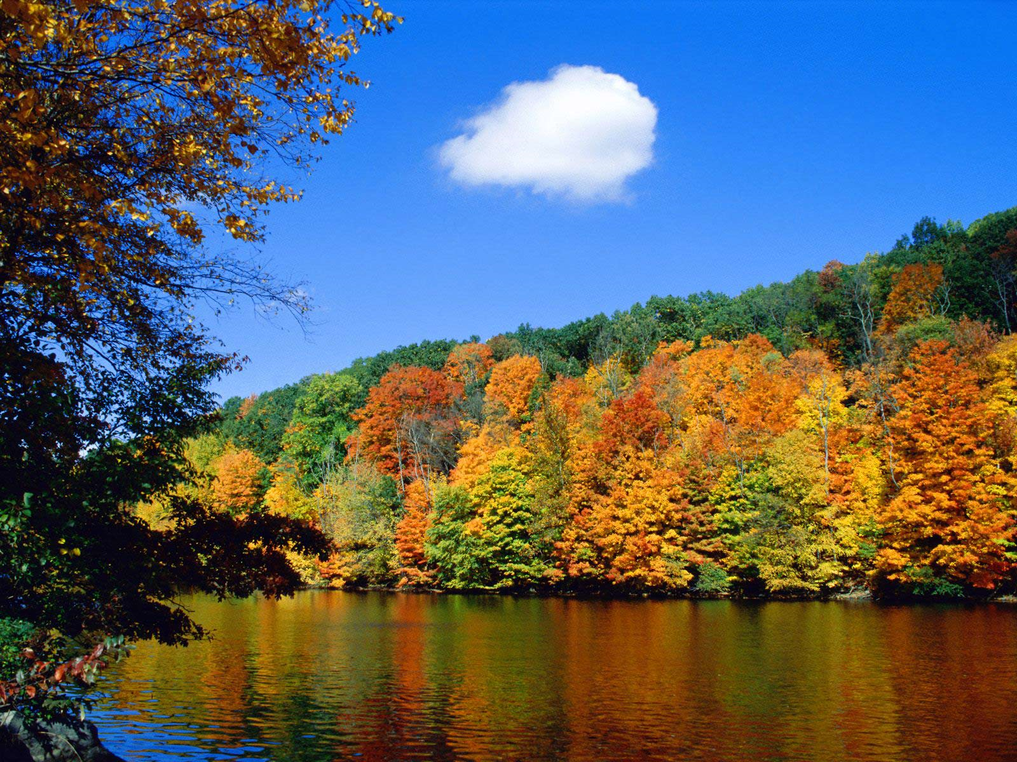
The image of the beast
“And deceiveth them that dwell on the earth by the means of those miracles which he had power to do in the sight of the beast; saying to them that dwell on the earth, that they should make an image to the beast, which had the wound by a sword, and did live. And he had power to give life unto the image of the beast, that the image of the beast should both speak, and cause that as many as would not worship the image of the beast should be killed.” Revelation 13:14,15

Slide 7
What is the Image?
“But what is the "image to the beast"? and how is it to be formed? The image is made by the two-horned beast, and is an image to the first beast. It is also called an image of the beast. Then to learn what the image is like, and how it is to be formed, we must study the characteristics of the beast itself, --the papacy. When the early church became corrupted by departing from the simplicity of the gospel, and accepting heathen rites and customs, she lost the Spirit and power of God; and in order to control the consciences of the people she sought the support of the secular power. The result was the papacy, a church that controlled the power of the State, and employed it to further her own ends, especially for the punishment of "heresy." In order for the United States to form an image of the beast, the religious power must so control the civil government that the authority of the State will also be employed by the church to accomplish her own ends. “ GC. 1888 version, pg. 443

Slide 8
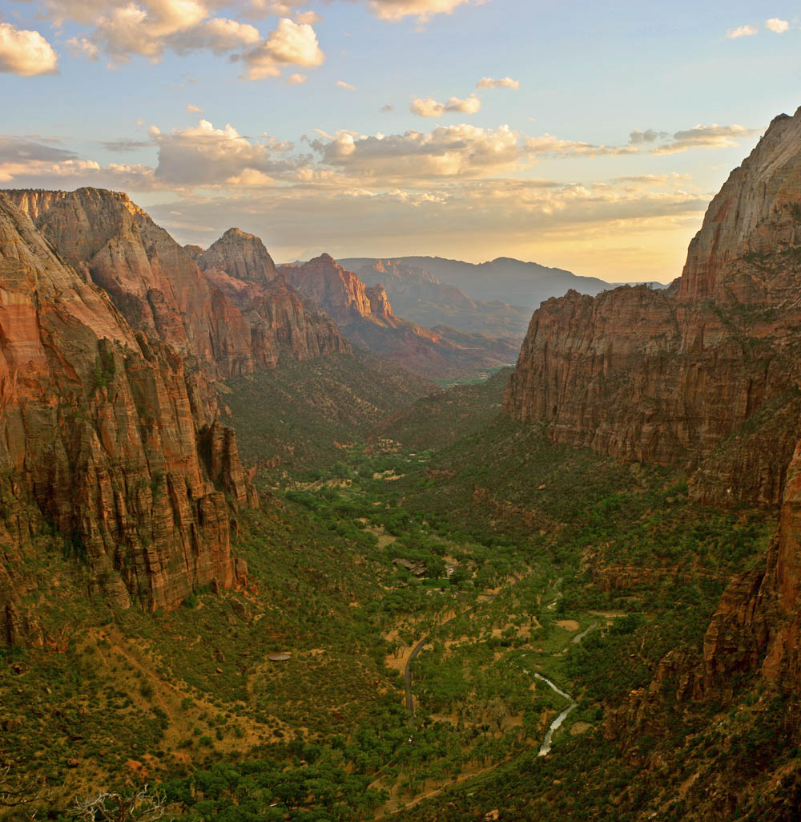
How the image works!
The United States forms an image of the beast when the religious power controls the state and tells the state what to do and the state responds by enforcing her decrees. Anyone who doesn’t go along with the church/state union is punished. The church/state union will be in place when America passes a Sunday law and enforces it against dissenters.

Slide 9
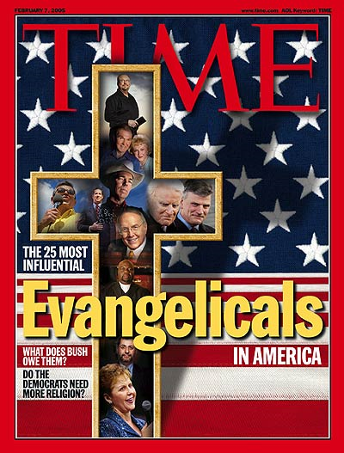
Near the Time

Slide 10
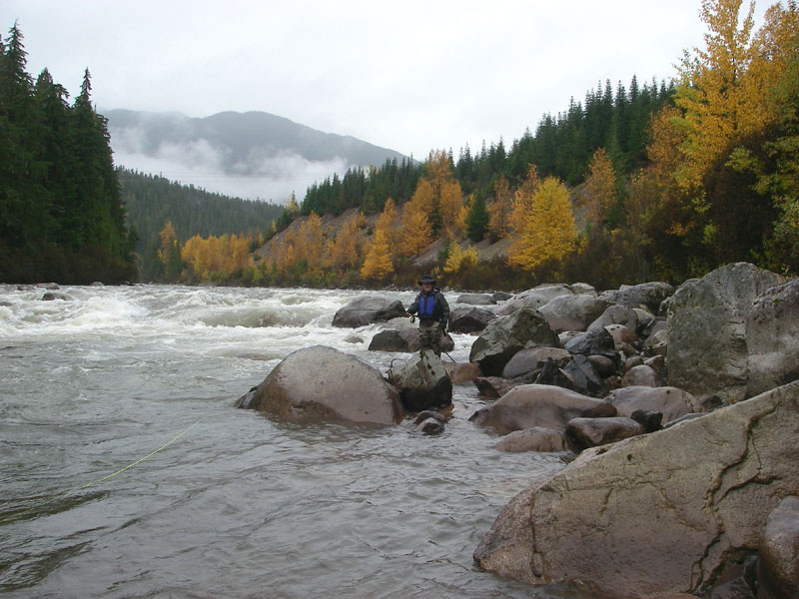
Summary Thus Far
1. The image of the beast will be formed before probation closes.
2. This will be the final test for the people of God.
3. The image will be formed when America passes the National Sunday Law and enforces it.
4. Those who pass this test will receive the seal of God. Those who don’t will receive the mark of the beast.

Slide 11
When SDA’s become apart of Babylon!
At this point in history, when a Sunday law is passed, and SDA’s embrace Sunday, thereby accepting the mark of the beast, then SDA’s will have become a part of Babylon.
“The Lord has a controversy with his professed people in these last days. In this controversy men in responsible positions will take a course directly opposite to that pursued by Nehemiah. They will not only ignore and despise the Sabbath themselves, but they will try to keep it from others by burying it beneath the rubbish of custom and tradition. In churches and in large gatherings in the open air, ministers will urge upon the people the necessity of keeping the first day of the week. ” RH, March 18, 1884

Slide 12
Measuring Time
“Not one of us should be discouraged. You should desire to know Jesus. He stands at the door of your hearts. "Behold, I stand at the door, and knock: if any man hear My voice, and open the door, I will come in to him, and sup with him, and he with Me." Well, what is the matter? There is something that you must do. You must clear the way and open the doors of your hearts. Perhaps you have a sin of self-indulgence to remove; perhaps some member should be removed, and it is better to enter into life maimed than to perish with all your members. The grand judgment is taking place, and has been going on for some time. Now the Lord says, Measure the temple and the worshipers thereof. Remember, when you are walking the streets about your business, God is measuring you; when you are attending your household duties, when you engage in conversation, that God is measuring you. Remember that your words and actions are being daguerreotyped [photographed] in the books of heaven, as the face is reproduced by the artist on the polished plate.” 2 Sermons and Talks, pg. 53

Slide 13
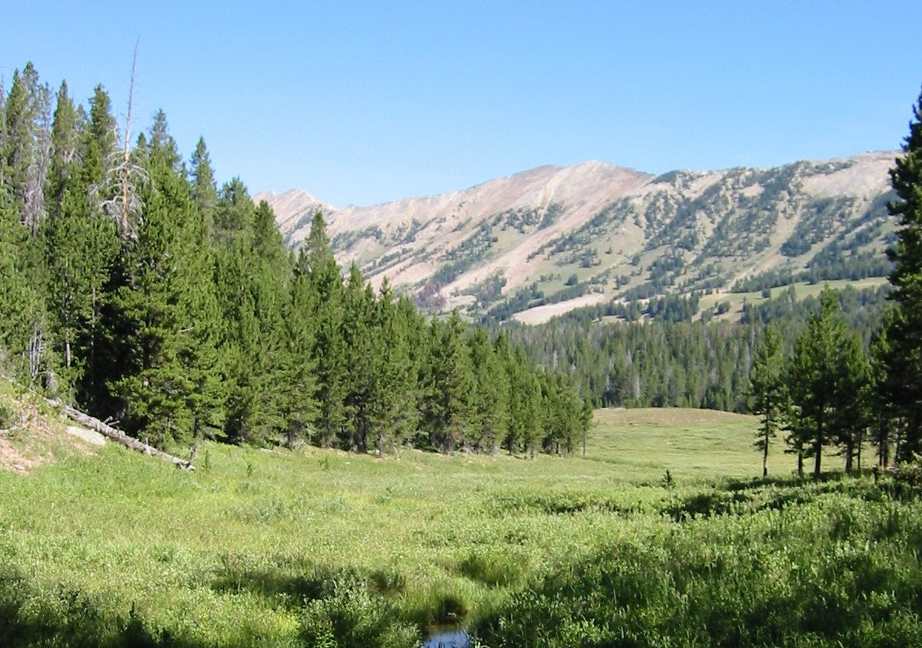
What Next?
At the time of the National Sunday Law, the judgment of the living will commence. Those who have been living in rebellion to God, even though keeping the Sabbath, will be cut off from God’s people and will receive the mark of the beast! Those who have been trusting Christ and having victory will be sealed with the seal of God! “He that overcometh, the same shall be clothed in white raiment; and I will not blot out his name out of the book of life, but I will confess his name before my Father, and before his angels.” Rev. 3:5

Slide 14

Sealed, Saved, and Sanctified
At this time, those SDA’s who are sealed with the seal of God, will receive the latter rain, and will give the Loud Cry of the Third and Fourth angel’s messages. These messages have been given for years, but never under the power of the Latter Rain. This will come at the time of the National Sunday Law.

Slide 15
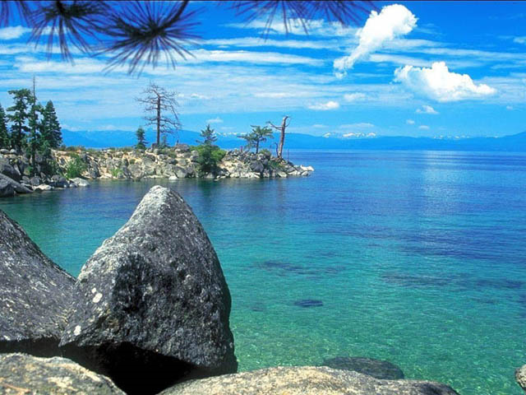
Marked and Out!
SDA’s who do not receive the seal of God will be marked with the mark of rebellion. They will have become a part of Babylon; they will have been weighed in the balances and found wanting. They will use all their energy to war against the truth. They will call the latter rain a false spirit and will stir the world to oppose, persecute, and destroy the true and faithful!

Slide 16
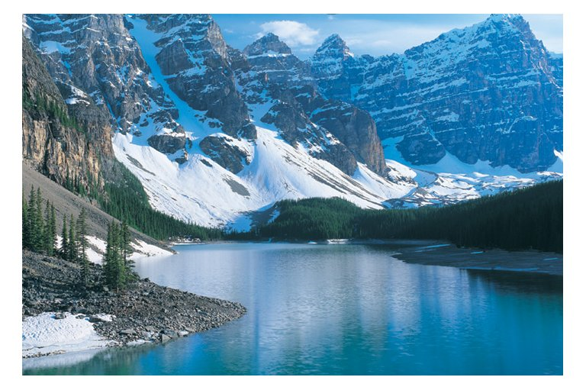
They are Drunk!
“And they were all amazed, and were in doubt, saying one to another, What meaneth this? Others mocking said, These men are full of new wine.
But Peter, standing up with the eleven, lifted up his voice, and said unto them, Ye men of Judea, and all ye that dwell at Jerusalem, be this known unto you, and hearken to my words: for these are not drunken, as ye suppose, seeing it is but the third hour of the day. But this is that which was spoken by the prophet Joel; And it shall come to pass in the last days, saith God , I will pour out of my Spirit upon all flesh: and your sons and your daughters shall prophesy,” Acts 2:12-17

Slide 17
There it is!
“As the storm approaches, a large class who have professed faith in the third angel's message, but have not been sanctified through obedience to the truth, abandon their position and join the ranks of the opposition. By uniting with the world and partaking of its spirit, they have come to view matters in nearly the same light; and when the test is brought, they are prepared to choose the easy, popular side. Men of talent and pleasing address, who once rejoiced in the truth, employ their powers to deceive and mislead souls. They become the most bitter enemies of their former brethren. When Sabbath keepers are brought before the courts to answer for their faith, these apostates are the most efficient agents of Satan to misrepresent and accuse them, and by false reports and insinuations to stir up the rulers against them. “ GC, pg. 608

Slide 18
Judgment First Hits the People of God
“For the time is come that judgment must begin at the house of God: and if it first begin at us, what shall the end be of them that obey not the gospel of God?” 1Peter 4:17
SDA’s have been judged. Now, as the message goes in the power of the Latter Rain, all the world will hear the truth for the final time. Most will oppose and reject the message, but many will embrace Christ and His truth!
“The seed has been sown, and now it will spring up and bear fruit. The publications distributed by missionary workers have exerted their influence, yet many whose minds were impressed have been prevented from fully comprehending the truth or from yielding obedience. Now the rays of light penetrate everywhere, the truth is seen in its clearness, and the honest children of God sever the bands which have held them. Family connections, church relations, are powerless to stay them now. Truth is more precious than all besides. Notwithstanding the agencies combined against the truth, a large number take their stand upon the Lord's side. “ GC. Pg. 612

Slide 19
Leading Men
“While many of our rulers are active agents of Satan, God also has His agents among the leading men of the nation. The enemy moves upon his servants to propose measures that would greatly impede the work of God; but statesmen who fear the Lord are influenced by holy angels to oppose such propositions with unanswerable arguments. Thus a few men will hold in check a powerful current of evil… When the final warning shall be given, it will arrest the attention of these leading men through whom the Lord is now working, and some of them will accept it, and will stand with the people of God through the time of trouble. “
GC, pgs. 610,611

Slide 20
The 144,000
During the time of the Loud Cry, some of God’s people will be martyred. Those who have the seal of God and live on: plus those who accept the message and come out from the world and worldly churches, will comprise the 144,000. At that time, they will all have a true and pure faith. At that time, they will all be SDA’s. Apostate SDA’s and everyone else will make up the lost of humanity and will suffer the 7 last plagues. May we chose Christ as our Lord everyday that His gracious and lovely character will be ours!

